Slide 1
TEXAS RECORDS EXCHANGE (TREx) UPDATE

Slide 2
AGENDA
Texas Records Exchange (TREx) Updates
2022-2023 Review (Spring)
Data Element Updates
Code Table Updates
2022-2023 Changes (Summer)
New Data Elements

Slide 3
2022-2023: DATA ELEMENT REVIEW – SPRING
Updated Data Elements
PK-ELIGIBLE-PREVIOUS-YEAR-INDICATOR-CODE (TE138)
POST-SECONDARY-CERTIFICATION-LICENSURE-EARNED (TE133)
PERSONAL-GRADUATION-PLAN (TE063)
Added New Element
POST-SECONDARY-CERTIFICATION-LICENSURE-RESULT (TE142)

Slide 4
PK-ELIGIBLE-PREVIOUS-YEAR-INDICATOR-CODE
PK-ELIGIBLE-PREVIOUS-YEAR-INDICATOR-CODE (TE138).
The definition for the data element, PK-ELIGIBLE-PREVIOUS-YEAR-INDICATOR-CODE (TE138), indicated it was to be used only for four-year-old students. TREx updated the data element definition to include five-year-old students as eligible for prekindergarten if a parent chooses to retain the student.
Updated Data Element

Slide 5
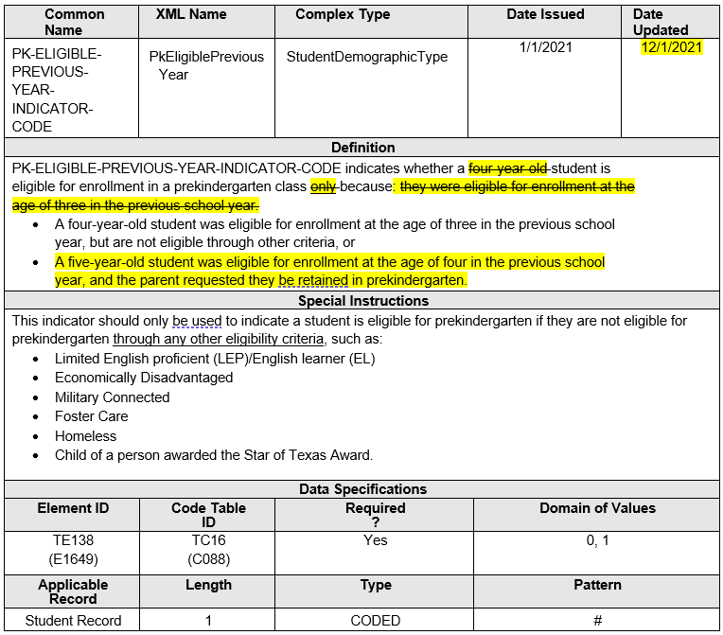
PK-ELIGIBLE-PREVIOUS-YEAR-INDICATOR-CODE Continued
Updated data element PK-ELIGIBLE-PREVIOUS-YEAR-INDICATOR-CODE (TE138) definition.

Slide 6
IBC UPDATES AND EXAM RESULTS
TEA must collect and report information for those students who fail to pass an IBC exam. To align with PEIMS, TREx added one new data element, POST-SECONDARY-LICENSURE-RESULT (TE142), with a corresponding code table, POST-SECONDARY-LICENSURE-RESULT-CODE (TC47). The data element definition for POST-SECONDARY-LICENSURE-CERTIFICATION-CODE (TE133) was updated from indicating an exam earned by a student to an exam taken by a student.
Changed the data element name POST-SECONDARY-CERTIFICATION-LICENSURE-EARNED (TE133) to POST-SECONDARY-CERTIFICATION-LICENSURE-CODE.
Added new data element POST-SECONDARY-CERTIFICATION-LICENSURE-RESULT (TE142).
Added new code table POST-SECONDARY-CERTIFICATION-LICENSURE-RESULT-CODE (TC47).

Slide 7
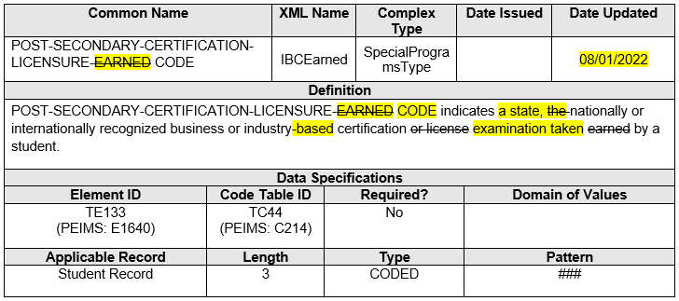
POST-SECONDARY-CERTIFICATION-LICENSURE-CODE
Changed the data element name POST-SECONDARY-CERTIFICATION-LICENSURE-EARNED (TE133) to POST-SECONDARY-CERTIFICATION-LICENSURE-CODE.

Slide 8
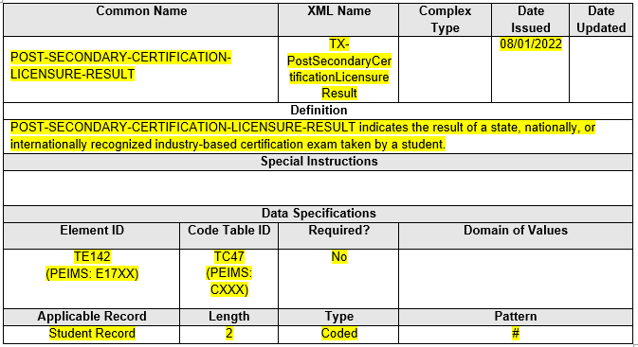
POST-SECONDARY-CERTIFICATION-LICENSURE-RESULT
Added new data element POST-SECONDARY-CERTIFICATION-LICENSURE-RESULT (TE142).

Slide 9
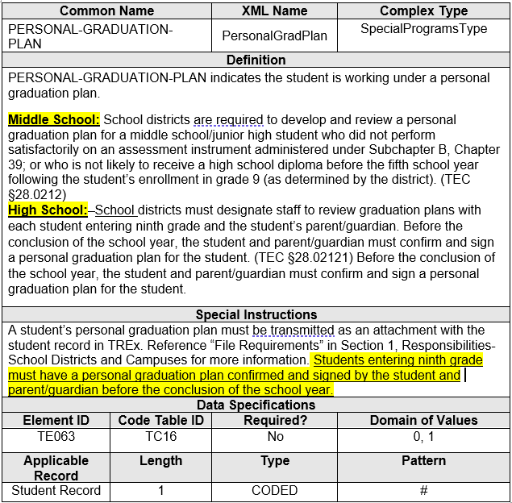
PERSONAL-GRADUATION-PLAN
Updated data element Definition and Special Instructions for PERSONAL-GRADUATION-PLAN (TE063)

Slide 10
2022-2023: CODE TABLE CHANGES
Updated Code Tables
POST-SECONDARY-CERTIFICATION-LICENSURE-RESULT-CODE (TC47)
FINANCIAL-AID- APPLICATION-CODE (TC46)

Slide 11
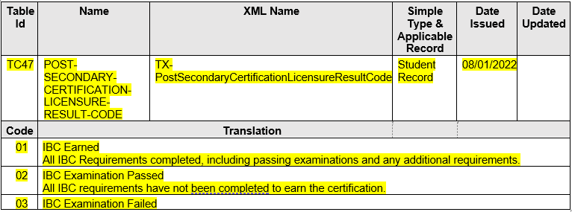
POST-SECONDARY-CERTIFICATION-LICENSURE-RESULT-CODE
Added new code table POST-SECONDARY-CERTIFICATION-LICENSURE-RESULT-CODE (TC47).

Slide 12
FINANCIAL-AID- APPLICATION-CODE
FINANCIAL-AID- APPLICATION-CODE (TC46)
The Curriculum Standards and Student Support division determined that the code “02” translation needed further clarification.
Updated Code Table

Slide 13
FINANCIAL-AID- APPLICATION-CODE Continued
Updated code “02” to “Exception submitted/Opt-Out” for the 2022-2023 school year.

Slide 14
2022-2023: DATA ELEMENT CHANGES – SUMMER
TEA will add four new data elements to allow the transfer of prior-year attendance data. The inclusion of prior-year attendance data enables LEAs to determine if a new virtual student is eligible for ADA funding under SB 15:
PRIOR-YEAR-TOTAL-DAYS-ABSENT (TE144)
PRIOR-YEAR-TOTAL-DAYS-PRESENT (TE145)
PRIOR-YEAR-RS-TOTAL-DAYS-PRESENT (TE146)
PRIOR-YEAR-RA-TOTAL-DAYS-PRESENT (TE147)

Slide 15
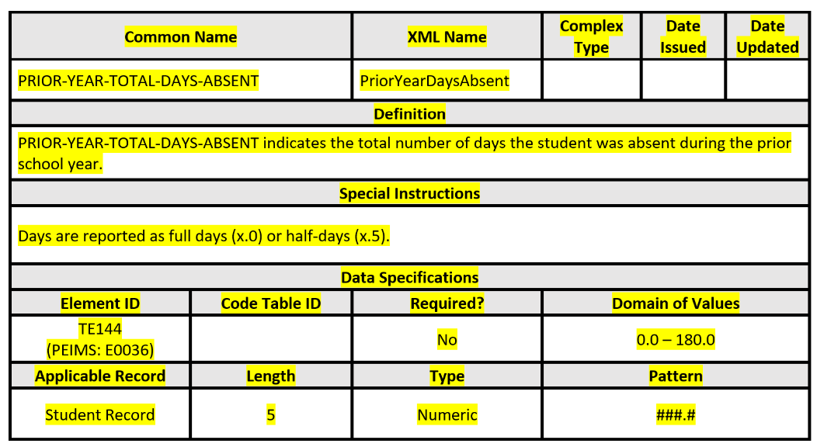
PRIOR-YEAR-TOTAL-DAYS-ABSENT
PRIOR-YEAR-TOTAL-DAYS-ABSENT (TE144)

Slide 16
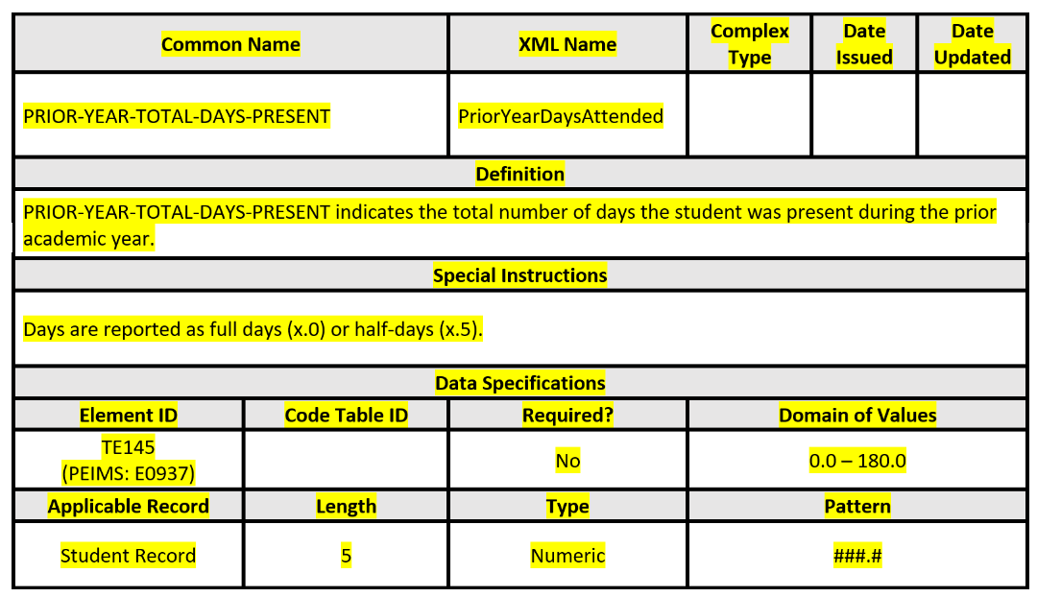
PRIOR-YEAR-TOTAL-DAYS-PRESENT
PRIOR-YEAR-TOTAL-DAYS-PRESENT (TE145)

Slide 17
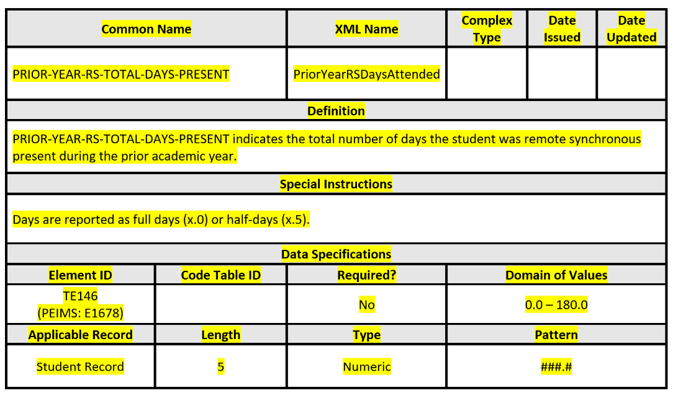
PRIOR-YEAR-RS-TOTAL-DAYS-PRESENT
PRIOR-YEAR-RS-TOTAL-DAYS-PRESENT (TE146)

Slide 18
PRIOR-YEAR-RA-TOTAL-DAYS-PRESENT
PRIOR-YEAR-RA-TOTAL-DAYS-PRESENT (TE147)

Slide 19
Questions

