Slide 1
Texas Education Data Standards

Slide 2
Agenda 2023-2024
Ed-Fi Handbook
Staff Responsibilities
Payroll
Frequently Asked Questions
New Resource

Slide 3
Ed-Fi Handbook

Slide 4
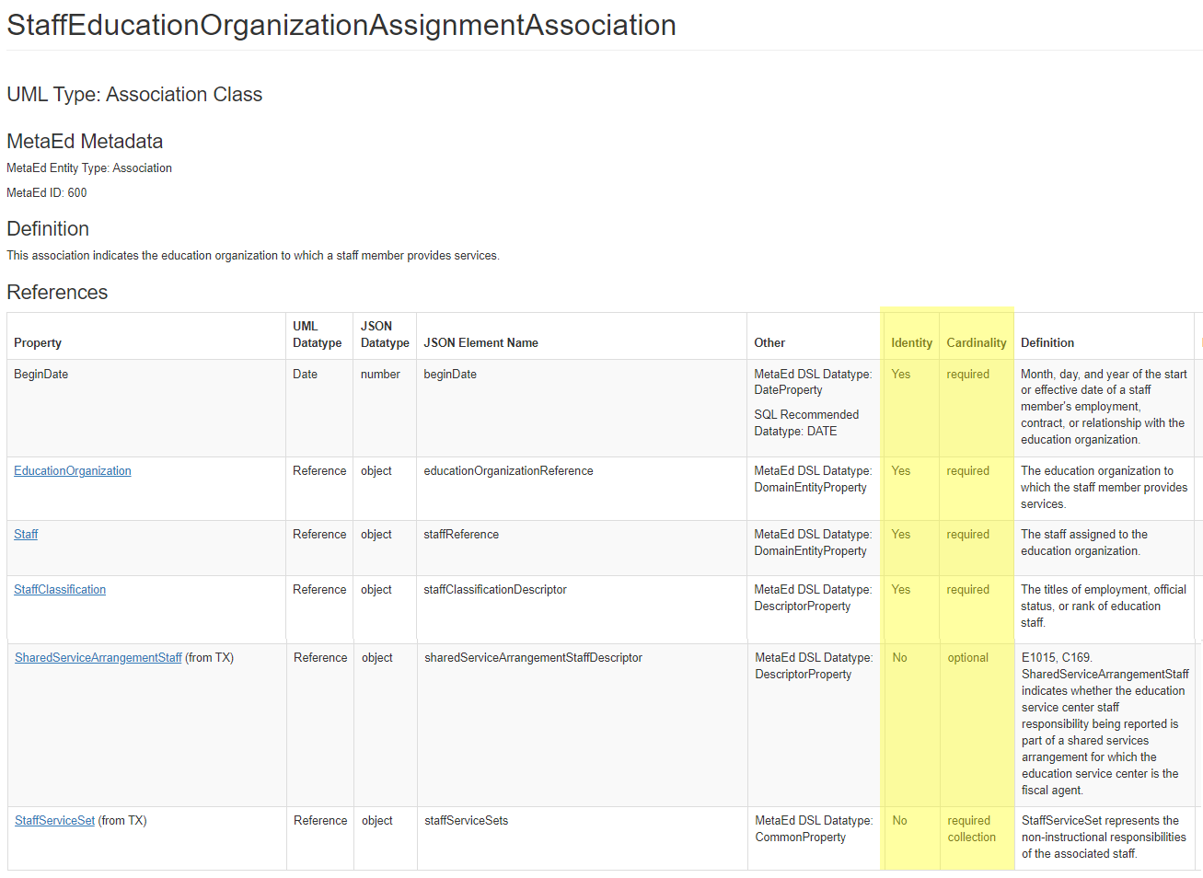
Ed-Fi Handbook First Slide
TEA will publish a Handbook for each version of the data standards.

Slide 5
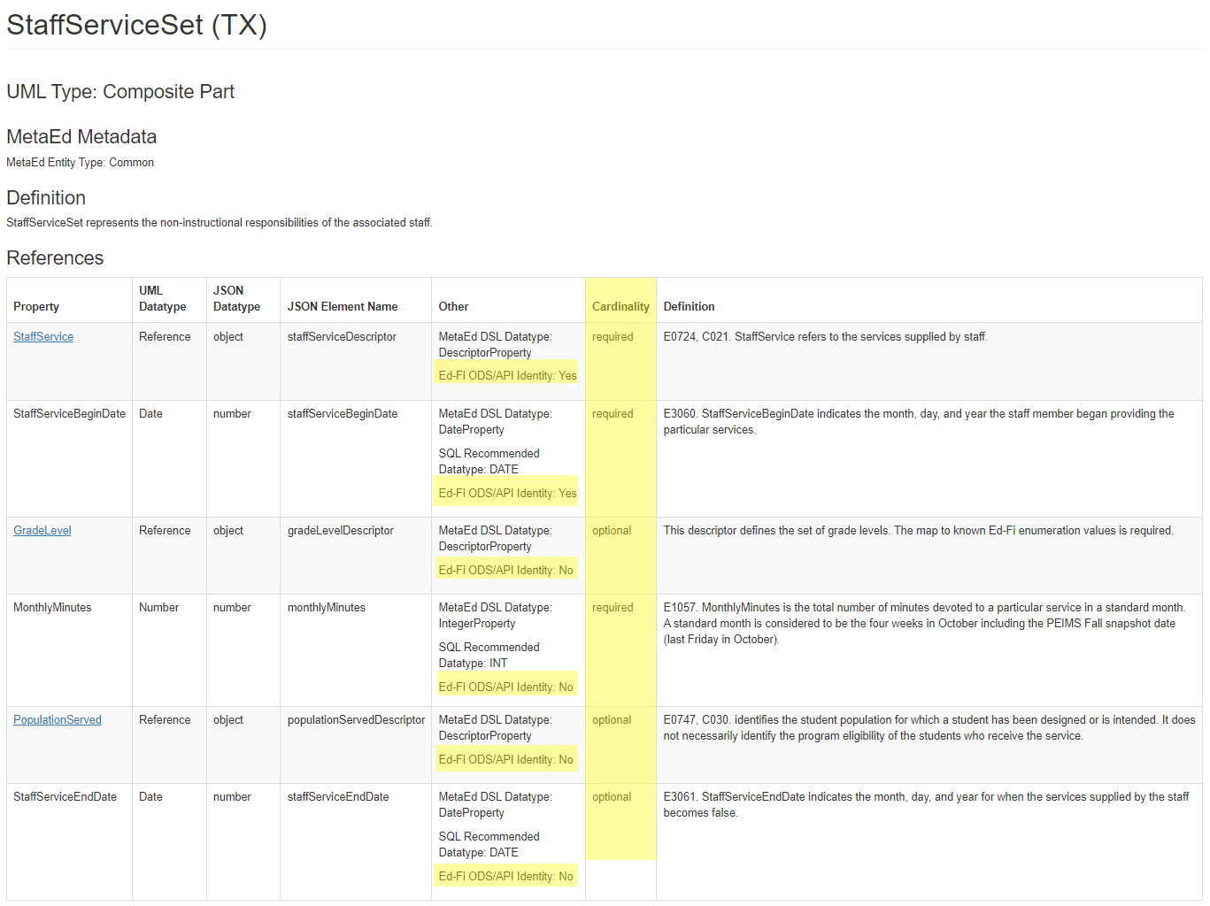
Ed-Fi Handbook Continued

Slide 6
Staff Responsibilities and Payroll

Slide 7
Staff Responsibilities General Slide
Reported for the four weeks in October, which includes the PEIMS Fall snapshot date (last Friday in October).
Current:
Currently reported using the StaffResponsibilitiesExtension complex type.
Upgrade:
Depending on the StaffClassification, reported using the StaffEducationOrganizationAssignmentAssociation and the StaffSectionAssociation.

Slide 8
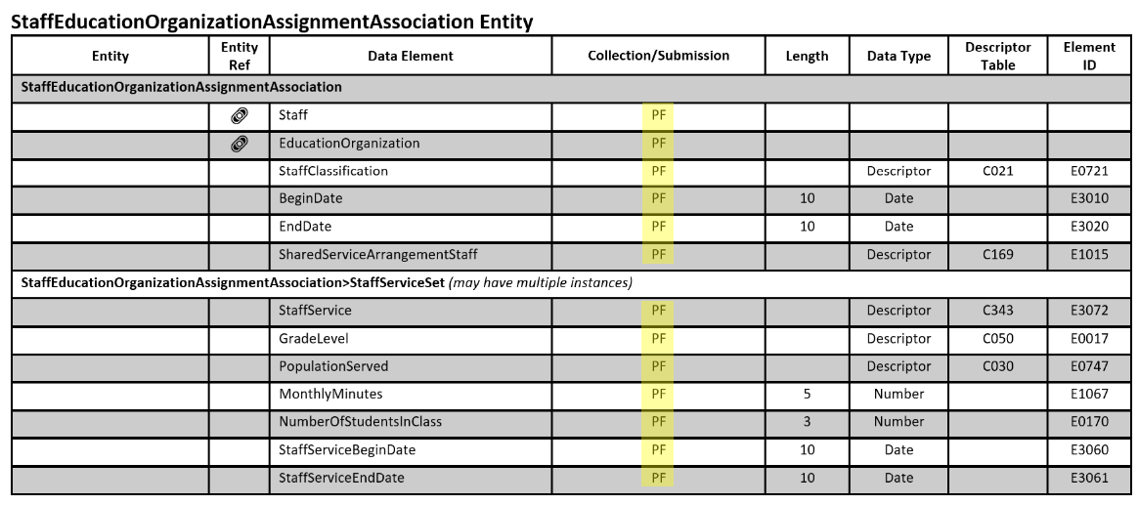
StaffEducationOrganizationAssignmentAssociation Entity

Slide 9
StaffClassification
Staff Classification | Short Description | Staff Classification | Short Description
003 | Assistant Principal | 004 | Assistant/Associate/Deputy Superintendent
005 | Psychological Associate | 006 | Audiologist
008 | Counselor | 011 | Educational Diagnostician
012 | District Instructional Program Director or Executive Director | 013 | Librarian
019 | Physician | 020 | Principal
022 | School Nurse | 023 | LSSP/Psychologist
024 | Social Worker | 027 | Superintendent/Chief Admin Officer/Chief Executive Officer/President

Slide 10
StaffClassification Continued
Staff Classification | Short Description | Staff Classification | Short Description
028 | Teacher Supervisor | 030 | Truant Officer/Visiting Teacher
040 | Athletic Director | 041 | Teacher Facilitator
042 | Teacher Appraiser | 043 | Business Manager
044 | Tax Assessor and/or Collector | 045 | Director of Personnel/Human Resources
054 | Department Head | 055 | Registrar
056 | Athletic Trainer | 100 | Instructional Materials Coordinator
101 | Legal Services | 102 | Communications Professional
103 | Research/Evaluation Professional | 104 | Internal Auditor

Slide 11
StaffClassification Continue
Staff Classification | Short Description | Staff Classification | Short Description
105 | Security | 106 | District/Campus Information Technology Professional
107 | Food Service Professional (including but no limited to Dietician) | 108 | Transportation
109 | Athletics (Other than Athletic Director) | 110 | Custodial
111 | Maintenance | 112 | Business Services Professional
113 | Other District Exempt Professional Auxiliary | 114 | Other Campus Exempt Professional Auxiliary
115 | Psychiatric Nurse | 116 | Licensed Clinical Social Worker
117 | Licensed Professional Counselor | 118 | Licensed Marriage and Family Therapist
119 | Family and Community Liaison | 120 | Instructional Coach
Sometimes 087 Teacher

Slide 12
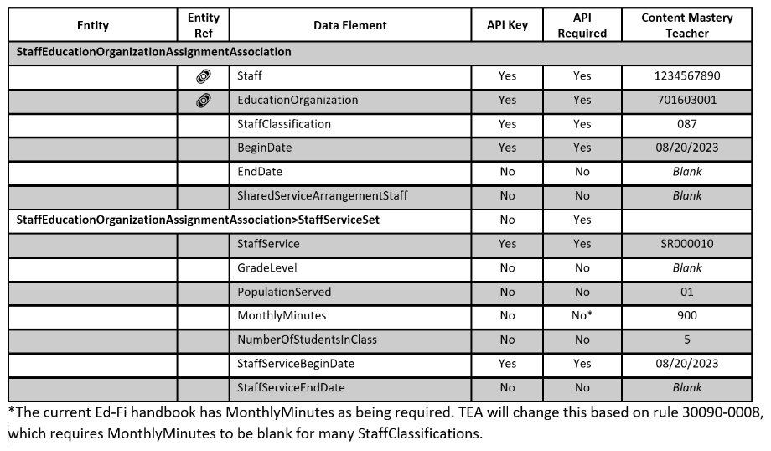
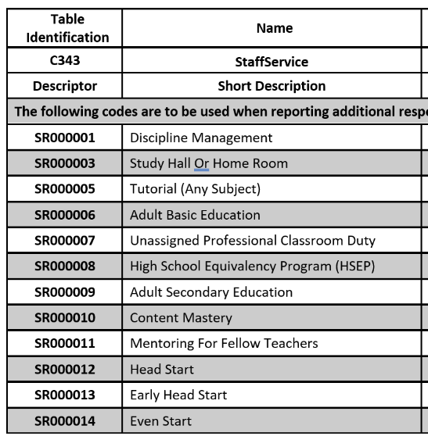
StaffEducationOrganizationAssignmentAssociation for Teacher (087)

Slide 13
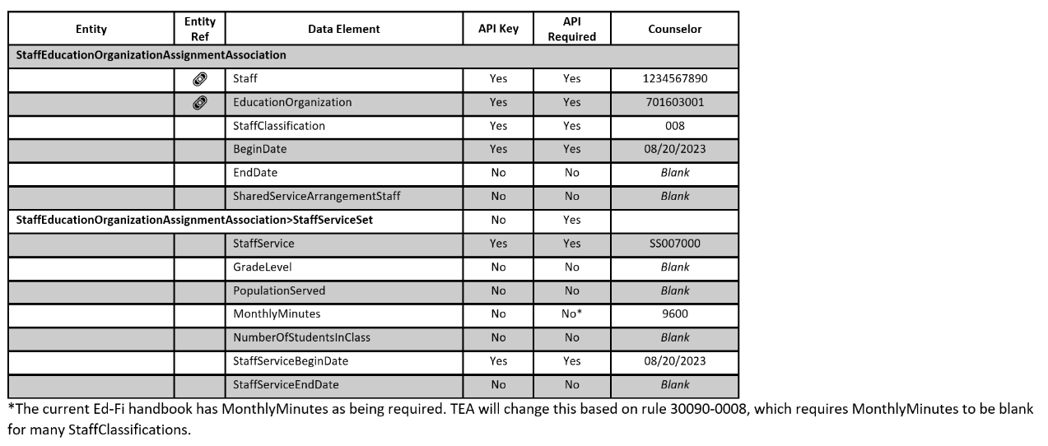
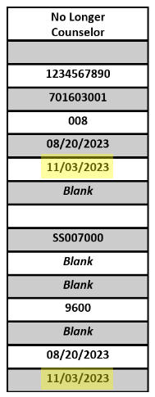
Counselor to Assistant Principal
All of the data above will move from the LEA to the Individual Operational Data Store (IODS) and then the Transition Zone. TEA will use the BeginDate and EndDate to determine what will promote to the PEIMS Data Mart.

Slide 14
Assistant Principal to Athletic Director
All of the data above will move from the LEA to the Individual Operational Data Store (IODS) and then the Transition Zone. TEA will use the BeginDate and EndDate to determine what will promote to the PEIMS Data Mart.

Slide 15
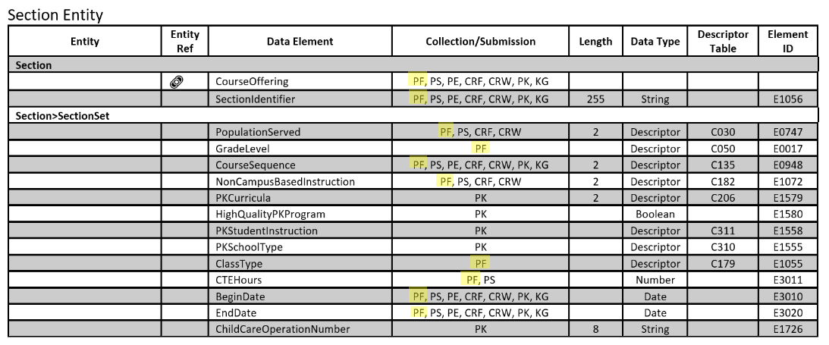
Section Entity – Teacher (087)
All of the data above will move from the LEA to the IODS and then the Transition Zone. TEA will use the BeginDate and EndDate to determine what will promote to the PEIMS Data Mart.

Slide 16
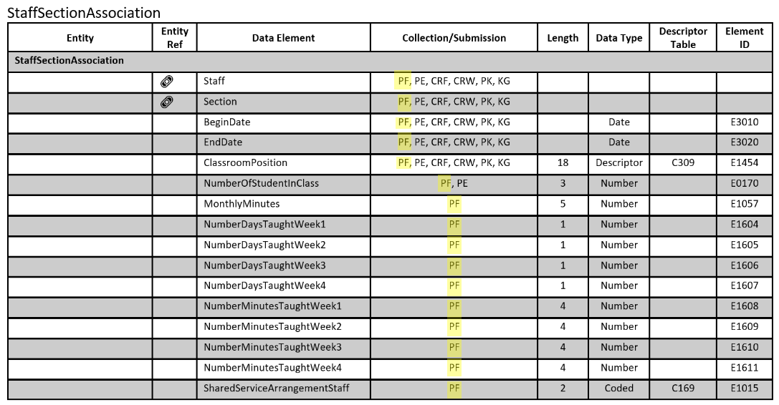
StaffSectionAssociation Entity
All of the data above will move from the LEA to the IODS and then the Transition Zone. TEA will use the BeginDate and EndDate to determine what will promote to the PEIMS Data Mart.

Slide 17
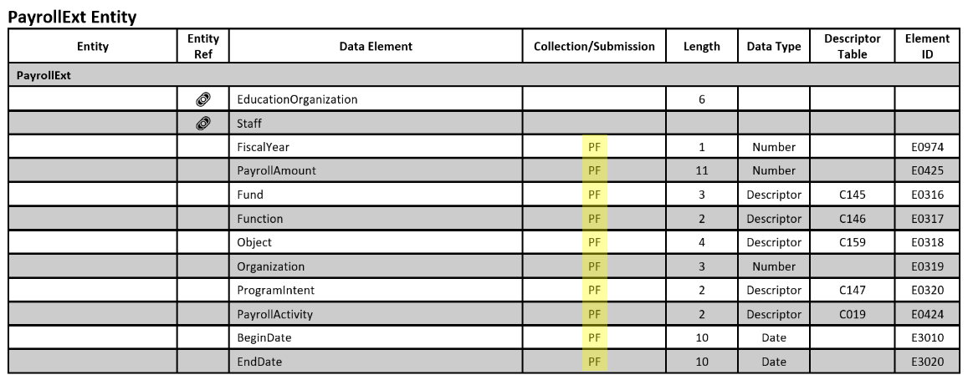
Staff Payroll
All of the data above will move from the LEA to the IODS and then the Transition Zone. TEA will use the BeginDate and EndDate to determine what will promote to the PEIMS Data Mart.

Slide 18
What happens after PEIMS Fall Snapshot? duplicate
TEA will only promote data as of the last Friday in October.
LEAs will work with their vendor to determine if the API for Budget and Staff Payroll will continue sending data to the IODS. The LEA does NOT need to change its existing processes except to ensure that the BeginDate and EndDate reflect when the change occurs.

Slide 19
Frequently Asked Questions

Slide 20
Frequently Asked Questions 1
What happens when staff changes positions and salaries after the start of the school year? Will there be more than one payroll and staff responsibilities record for the staff?
The staff and payroll information would be changed in the human resources and finance systems using the corresponding BeginDate and EndDate based on when the change occurred. The API would then transfer the data to the IODS. TEA will automatically retrieve the data and move the state reportable data into the Transition Zone. The LEA will promote the data to the PEIMS Data Mart. TEA will use the BeginDate and EndDate to determine which records are promoted. The LEA process in their human resources and finance systems should remain the same.

Slide 21
Frequently Asked Questions 2
Will there still be a snapshot date? If so, what happens to the changes made to staff and payroll data after the snapshot date?
Yes, there will still be a snapshot date. TEA will promote the data for the PEIMS Fall Submission as of the last Friday in October. The BeginDate and EndDate will be used when the data is promoted to the PEIMS Data Mart. The LEA would continue to make changes as needed in their human resources and finance systems.

Slide 22
New Resource

Slide 23
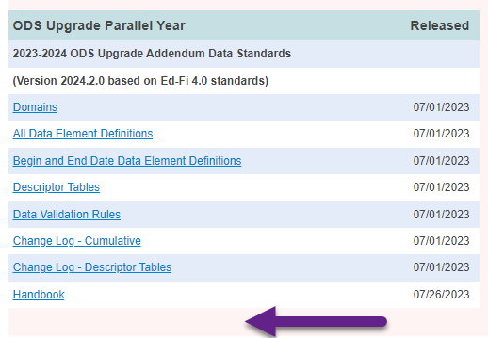
Texas Education Data Standards where to find
Combined Data Standard

Slide 24
Texas Education Data Standards demo

Slide 25
Questions?

