Slide 1
Additional Days School Year Overview August 1, 2023

Slide 2
Key TEA Personnel
Additional Days School Year (ADSY) Team
Brian Doran
Director of Expanded Learning Models
Ruchamah Belizor
Summer Learning Project Manager!
Erik Torres
Manager of Additional Days School Year
Key TEA
Personnel
ADSY Inbox: ADSY@tea.texas.gov

Slide 3
Agenda
Additional Days School Year Overview
Design Considerations
Option 1: Volunteer Summer Learning
Option 2: Intersessional Calendar
Option 3: Full Year Redesign
2023-2024 Updates
ADSY Planning and Execution Program
Budgeting Considerations
Observed and Anticipated Implementation
Q&A

Slide 4
Declining Achievement During Summer Breaks
Student achievement levels drop during the summer months, commonly referred to as the “summer slide”.
Years of learning
The impact of summer slide may create a gap of up to three grade levels for low income students by fifth grade
Student Type:
6
Middle-class student
Middle-class student
Middle-class student
Summer
Summer
Summer
Summer
Summer
Low-income student
Low-income student
Low-income student
School Year Growth:
4
Students progress at same rate during school year
Students progress at same rate during school year
Students progress at same rate during school year
Summer Growth:
2
Advanced by one month
Fall behind by 2-3 months
Fall behind by 2-3 months
Fall behind by 2-3 months
Note: No variance in amount of summer slide by grade
0
Grade
K
1st
2nd
3rd
4th
5th
Graph completed by Boston Consulting Group. Source: Cooper, H., Borman, G., and Fairchild, R. (2010). “School Calendars and Academic Achievement” In. J. Meece and J.Eccles (Eds.), Handbook of research on schools, schooling and human development (pp. 342-355). Mahwah, NJ: Eribaum

Slide 5
Economically disadvantaged students experienced greater learning loss in both reading and math
Reading¹
Change in % Met Grade Level or Above from 2019 to 2021
Math²
Change in % Met Grade Level or Above from 2019 to 2021
Economically Disadvantaged
Not Economically Disadvantaged
Economically Disadvantaged
Not Economically Disadvantaged
-5%
-4%
-13%
The percentage of economically disadvantaged students who Met or Mastered Grade Level in Math decreased by 5 percentage points more than non-economically disadvantaged students
-18%
1. Includes STAAR 3-8 Reading, English I and English II EOC Assessments; 2.7M tested students in 2019 with 2M eco. dis. and 2.4M in 2021 with 1.7M eco. dis. 2. Includes STAAR 3-8 Mathematics, Algebra I EOC Assessment; 3.3M tested students in 2019 with 1.7M eco. dis. and 2.9M in 2021 with 1.4M eco. dis. Note: Results for grades 3-5 combine assessments given in Spanish and English. Participation in STAAR math and reading assessments in 2021 was 86%. Spring 2021 STAAR results are for learning and recovery planning only – no SSI grade promotion requirements or ratings for districts or campuses. There is no 2020 STAAR data because of cancellation of STAAR in spring 2020. | Source: Spring 2019 and Spring 2021 STAAR Data

Slide 6
In 2022, ADSY campuses outpaced the state in percent of students who scores approaches or better on STAAR
Percent STAAR eligible scoring Approaches or Better - Grades 3-5 SY20-21 to SY21-22
ADSY Campuses
Math
Reading
non ADSY
78%
73%
74%
69%
55%
59%
47%
42%
2021
2022
2021
2022
Campuses using ADSY days outpaced non-ADSY campuses in change in students scoring approaches or better on STAAR by 9 percentage points in math and 8 percentage points in RLA.
Sources: PEIMS ADSY attendance data, Student STAAR data. Only students in grades 3-5 in SY21-22 with STAAR records in both SY20-21 and SY21-22 are included (non-ADSY campuses N=569,823; ADSY campuses N=41,479 students in 352 campuses.

Slide 7
Additional Days School Year (ADSY)
HB 3 added half-day formula funding for school systems that want to
add instructional days (beyond a minimum 180 days, up to 210 days)
to any of their elementary schools (grades PK-5).
Minimum 180 Instructional Days
Up to 30 Additional Days
Half-day formula funding

Slide 8
ADSY Eligibility
Serve at least one grade level within grades PreK-5
Ensure the campus academic calendar will have at least 180 instructional days, not including staff development waivers; ideal calendars also have two bad-weather make-up days identified
Have a campus academic calendar with at least 75,600 operational minutes
Be willing to add up to 30 additional half days of instruction (ADSY days) to the 180 instructional days in a campus’s academic calendar
Have a teacher meeting the LEA’s certification requirements deliver at least two hours of instruction on dedicated ADSY days
Host ADSY days on separate days from regular instructional calendar days

Slide 9
ADSY Design Considerations
Option 1: Voluntary Summer Learning
Purpose: Summer Enrichment
Think: 180-day traditional calendar, and up to 30 days for something additional
Option 2: Intersessional Calendar
Purpose: Targeted Remediation
Think: 180 days spaced out over the full year, with intermittent breaks for targeted remediation with a subset of students
Option 3: Full Year Redesign
Purpose: Rethinking the School Day
Think: A revamped 7x6-weeks calendar, daily schedule changes to increase teacher planning time and student play

Slide 10
Summer Program Example
Snyder ISD – 2021-2022 Calendar
30 Additional Days through Summer Program
Last Day of Academic Year: June 11, 2021
Summer Dates: June 14 – July 30, 2021
Program follows evidence-based practices from RAND Getting to Work on Summer Learning (minimum of 25 six-hour days)
Start of Following Year: August 11, 2021
Length of Summer Break: 1.5 weeks for students in Summer Intersession, 8.5 weeks for others
bit.ly/snyder-summer-schedule
Notes:
Typical length of summer – 12 weeks

Slide 11
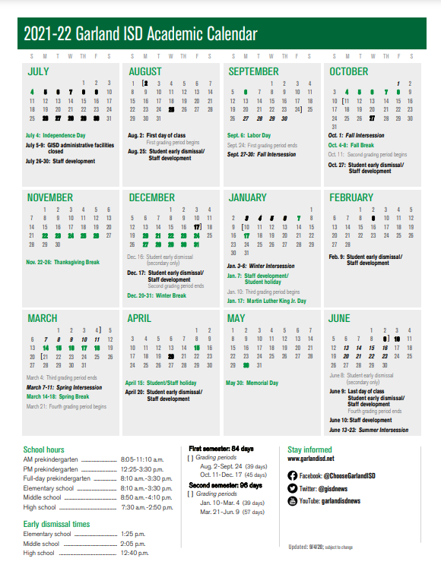
Intersessional Calendar Example
Garland ISD – 2021-2022 Calendar
22 Additional Days through Intersessions
Start Date: August 2, 2021
Intersessions:
9/27 – 10/1 – Fall Intersession
1/3 – 1/6 – Winter Intersession
3/7 – 3/11 – Spring Intersession
6/13 – 6/23 – Summer Intersession
End Date: 6/9/22 for all students, 6/23/22 for students in Summer Intersession
Length of Summer Break: 7 weeks for students in Summer Intersession, 9 weeks for others
bit.ly/garland-isd-calendar
Notes:
Typical length of summer – 12 weeks

Slide 12
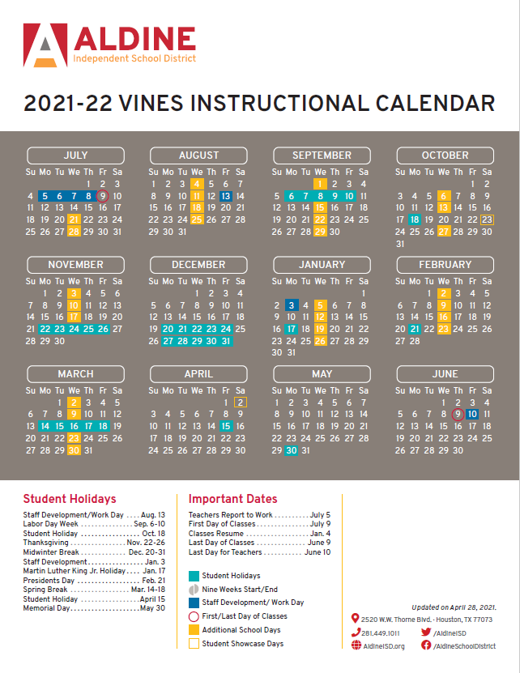
Full Year Redesign Calendar Example
Aldine ISD – 2021-2022 Calendar
30 Additional Days through Full Year Redesign
Start Date: July 9, 2021
Additional Days: Wednesdays throughout the school year (minimizes attendance risks for non-compulsory ADSY funding)
End Date: 6/9/22
Length of Summer Break: 4 weeks for all students
bit.ly/aldine-isd-calendar
Notes:
Typical length of summer – 12 weeks

Slide 13
PEIMS and Fiscal Considerations
There are fiscal considerations around timing of funds (ADSY) or extending use of ESSER funds. It is critical to bring your finance team along as a core member of the planning committee.
ADSY Attendance Projections – Attendance is projected on a biennial basis. If you did not project ADSY attendance for 2023-2024 or 2024-2025 in the winter of 2022, you can still receive ADSY funds, however it would be in the settle-up process after the year is over.
Attaching to Associated School Year – Summer ADSY days can be associated with either the previous school year or the following school year. This impacts the grade levels a campus/LEA would invite to the summer program. This may also impact SIS rollover and require attendance to be collected manually.
Reporting with 180 days – LEAs will receive a warning in the 3rd PEIMS submission starting in 22-23 for any instructional calendars fewer than 180. This warning does not account for Missed Day Waivers or future waiver opportunities. PEIMS coordinators need to be aware of the ADSY program!

Slide 14
2023-2024 Updates

Slide 15
ADSY Survey
TEA is launching the 2023-2024 ADSY Implementation Survey from August 3rd through August 25th, 2023. The goal is to gather implementation trends to inform support, as well as to verify academic calendar eligibility. This will launch via TAA on Thursday, August 3rd. Please encourage participating LEAs to complete this survey!

Slide 16
ADSY Waiver Updates
Beginning in the 2023–2024 school year, participating campuses are eligible for up to five days of ADSY waivers for missed instructional days throughout the year due to weather, health, or safety reasons. These waiver days are for the purpose of ensuring compliance with the 180 days of instruction requirement and are distinct from the Missed School Day waiver.
LEAs needing an ADSY Waiver will need to submit documentation through the TEAL waivers system.

Slide 17
ADSY Waiver Components
LEA Contact (First Name, Last Name, Phone, Email)
Date of Board Approval
Campus(es) impacted (select “All Campuses” if applying for the entire district)
Reason for Missed School Day(s) (Weather, Health, Safety, or Other)
Date of Missed School Day(s)
Certification of Board-adopted 180 instructional day calendar for the current school year
Explanation of Reason for Missed School Day(s)
Supporting Documentation (submitted with waiver application):
Documentation for the reason for missed school day(s). Supporting documentation may be news articles, letter to parents, info shared with Board or district, etc.
Board agenda from meeting at which the waiver application request was approved.
Submission of evidence of a board-approved 180-day calendar via the ADSY 2023-2024 survey to verify ADSY eligibility. (Must be submitted prior to applying for the waiver.

Slide 18
ADSY Planning and Execution Program

Slide 19
ADSY vs. ADSY PEP
ADSY PEP is a grant program – distinct from ADSY -- that includes an initial planning year followed by annual program refinement and implementation. Participating LEAs implement either an evidence based summer program or a full year redesign.
ADSY PEP requirements are above and beyond the requirements to access ADSY formula funds. Only LEAs going through the grant program need to meet these requirements (some examples below).
Summer
Full Year Redesign
25+ summer days with 6+ hours
3 hours of academics + 2 hours enrichment + 1 flex hour each day
Strategic plan development focused on academic, enrichment, operations, and culture
30 ADSY days added as a streamlined 210-day calendar for all students
Daily master schedule changes to reflect more student brain breaks and teacher planning time
Strategic plan development focused on all facets of model design and implementation

Slide 20
ADSY Planning and Execution Program
The ADSY Planning and Execution Program (PEP) is a four-year process for school systems to design, implement, and continuously improve Summer Learning and Full Year Redesign options of the ADSY Initiative. This program is not required to access ADSY funding.
Planning Year
June
Jul
Aug
Sep
Oct
Nov
Dec
Jan
Feb
Mar
Apr
May
Programming
SP Pt. 1 Development
SP Pt. 2 Development
SP Pt. 3 Development
Supports
Orientation Webinar
Workshop #1
Workshop #4
Contract with TA
Workshop #2
Workshop #3
Summer Program
Milestones
Plan Pt. 1 Approval
HQIM Selection
Plan Pt. 2 Approval
Board Approval
Plan Pt. 3 Approval
Execution Years (annually starting in 2022-2023)
June
Jul
Aug
Sep
Oct
Nov
Dec
Jan
Feb
Mar
Apr
May
Programming
Summer Program
Annual Reflection
Supports/ Milestones
Pre-Program Assessment
Post-Program Assessment
Workshop #1 (Revisit Program)
Annual Reflection Submitted
Workshop #2 (Plan for Year 2)
Select Artifacts Updated for Year 2
HQIM Re-Selection

Slide 21
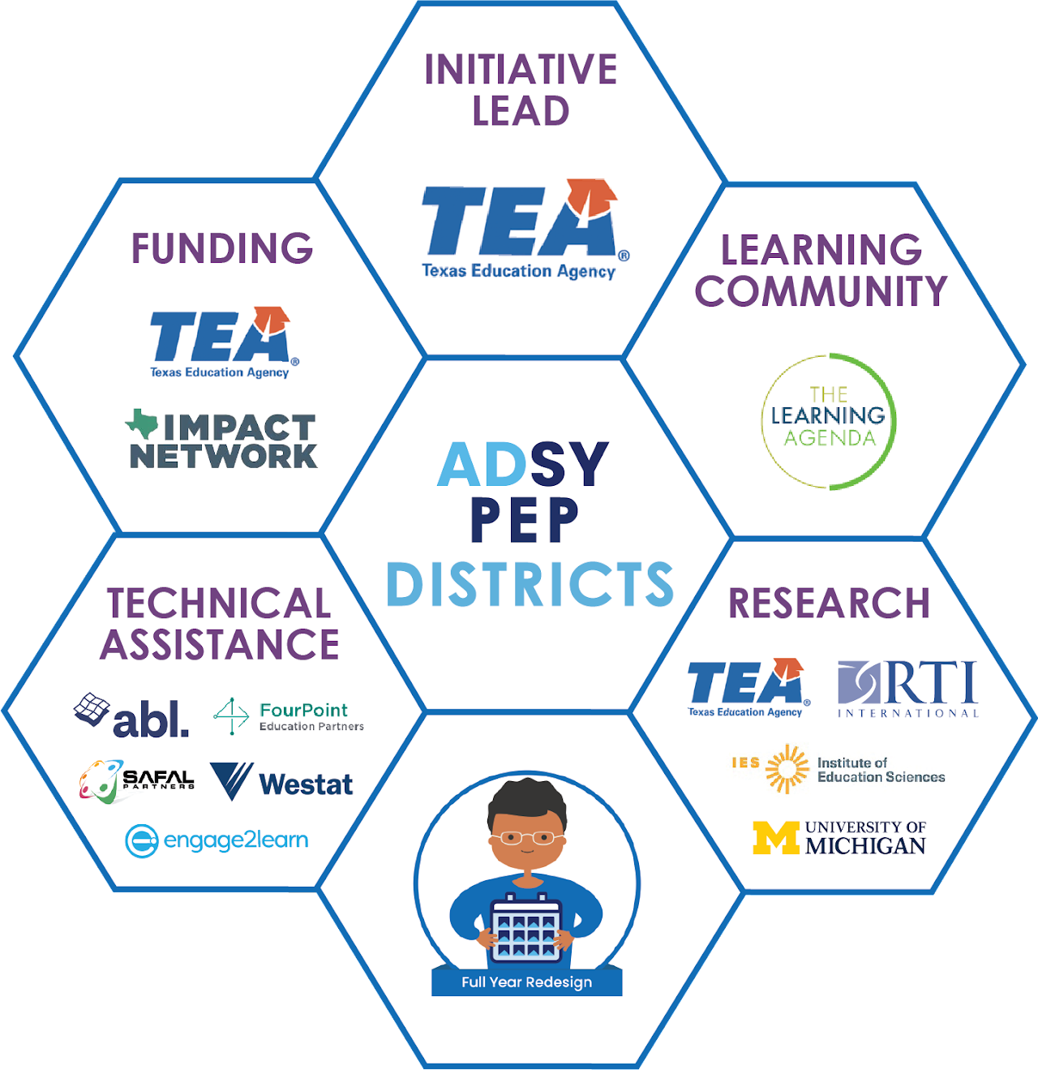
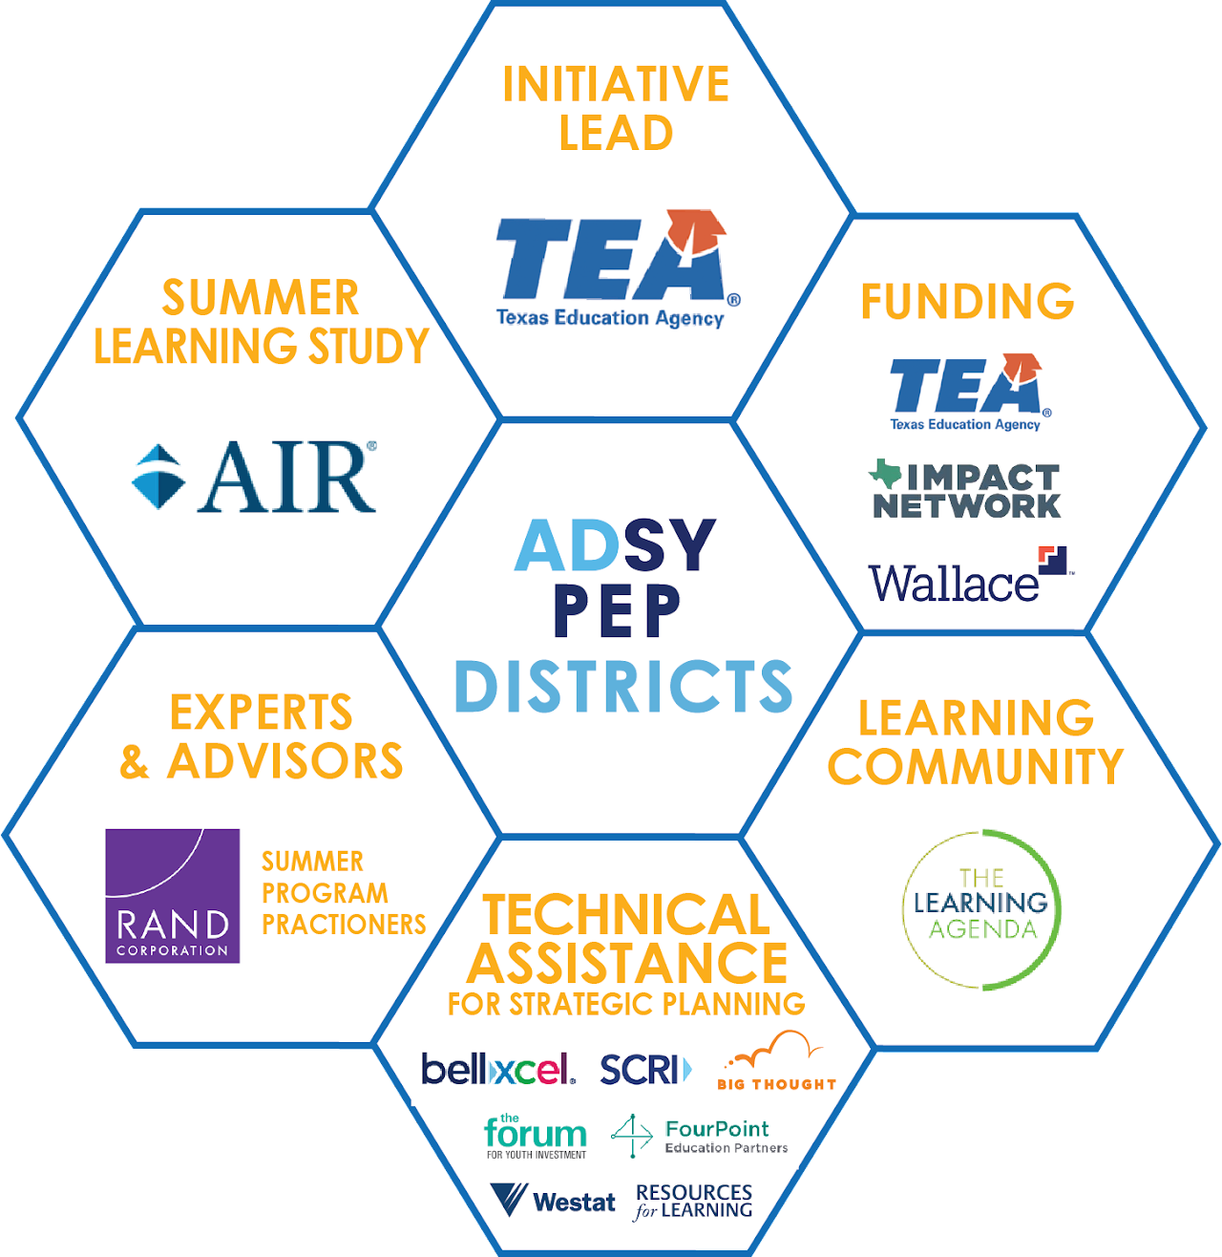
ADSY PEP Stakeholders
Decision 7 / Full Year Redesign
Decision 8 / ADSY Summer

Slide 22
Decision 7: ADSY PEP Full Year Redesign Current State
Cycle # | # of Active LEAs | Implementation Year | ADSY Student Enrollment | ADSY Day Att. Rate | Non-ADSY Day Att. Rate
1 | 5 | 21-22 | 4,136 | 86.8% | 91.3%
2 | 6 | 22-23 | 848 (estimated) | Pending
3 | 3 | 23-24 | TBD
Decision 7 / Full Year Redesign remains a small grant program that is difficult to implement, but is seeing very promising student outcomes.

Slide 23
ADSY PEP Full Year Redesign Accountability Growth
Initial accountability data for Cycle 1 Full Year Redesign grantees shows participating campuses outperforming their LEA’s accountability growth by an average of 11 points.
+26
+3
+21
+11
+0
+10
*One-campus LEA
A-F Designation
B-to-B
Low C-to-High B
D-to-A
B-to-B
D-to-High C

Slide 24
Decision 8: ADSY PEP Summer Current State
Cycle # | # of Active LEAs | Implementation Summer | Student Enrollment
1 | 5 | 2021 | 2,600
2 | 38 | 2022 | 41,000+
3 | 22 | 2023 | 62,000+
4 | 9+ | 2024 | TBD
Decision 8 / Strong Summer has supported over 5% of districts in the state implement an evidence-based summer program.

Slide 25
ADSY PEP LEAs Across the State
Voluntary Summer Learning
Full-Year Redesign or Intersessional Models
LEAs implementing both Models
ADSY PEP has LEA representation across the state:
60+ LEAs implementing Voluntary Summer Learning in summer 2023
12 LEAs implemented Full-Year Redesign or Intercessional Models in 2022-23

Slide 26
Budgeting for Summer Learning

Slide 27
Budgeting Tools - Most Common Sources of Summer Funding
Funding Source | Federal vs. State | Type of Funding | Funding Delivery Method | Timing for Receiving Funds | Fund Flexibility Level
21st CCLC | Federal | Competitive Grant | New grants are awarded in grant cycles every 2-3 years | One grant cycle is five years long | HIGH: Funds can be used for academics or enrichment
Additional Days School Year | State | Formula Funding | Foundation School Program | State funding cycle (including settle-up) | HIGH: Funds are dispersed as general revenue
Early Education Allotment | State | Formula Funding | Foundation School Program | State funding cycle | HIGH: Funds must go toward improving student performance
English Learner Summer Program | Federal | Formula Funding | EL units are reimbursed on a prorated basis | Annually | LOW: Funds must be used on instruction
State Compensatory Education | State | Formula Funding | Foundation School Program | State funding cycle | HIGH: Funds must go toward increasing academic achievement and reducing dropout rates
Teacher Incentive Allotment | State | Formula Funding | Foundation School Program | Annually | LOW: Only TIA districts are eligible for this funding. Funds must go toward teacher compensation
Title Funds | Federal | Formula Funding | Drawdowns determined by districts | Drawdowns determined by districts | VARIES: Fund use is determined by Title Fund

Slide 28
Example: Stacking ADSY with 21st CCLC Funds
ADSY funds can be ‘stacked’ with 21st Century/ACE funds in the same day if they are used as a supplemental aspect to the program.
ADSY has a minimum instruction requirement of two hours per day
21st CCLC requires a four-hour summer day

Slide 29
Implementation Trends

Slide 30
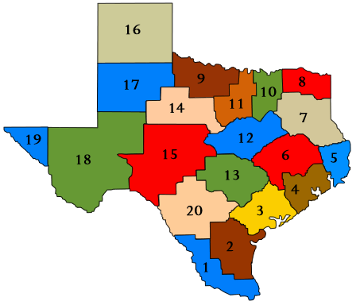
ADSY District Participation and ESC Region
77 LEAs utilized ADSY funding in 21-22 across 363 total campuses
 | SY21-22
Districts Implementing ADSY | 77
ESC Regions with zero districts | 6, 7, 8, 16
ESC Regions Overrepresented* | 4, 10, 20
Regions that include major urban centers (Houston, Dallas, San Antonio) tend to have higher district representation. Rural east Texas and the panhandle areas tend to be underrepresented.
Sources: PEIMS. *An ESC region is considered “overrepresented” if more than 10% of districts in the cohort come from that region – 8 or more districts.

Slide 31
Q&A
For additional questions please visit https://tea.texas.gov/adsy or e-mail adsy@tea.texas.gov

