Slide 1
Serving Emergent Bilingual Students August 1, 2023 Division of Emergent Bilingual Support
Notes:
9:00-9:05 (Amy)

Slide 2
Our Goal Is…
At the blueprint level, we will lead the state by developing guidance, tools and resources that bring intentionality and focus to emergent bilingual students and ensure their access to high quality programs and instruction which lead to positive academic success.​
2
Notes:
Dr. Lara

Slide 3
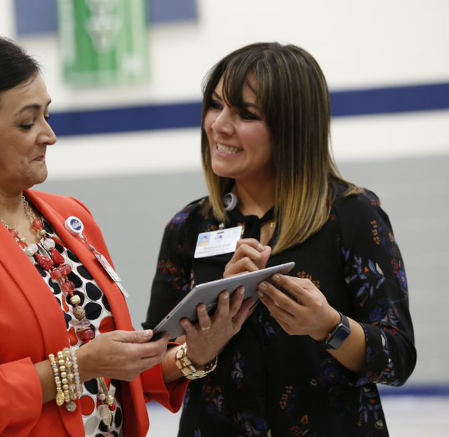
Objectives
Welcome
Senate Bill 560
Updates on TAC Ch. 89
LPAC: TEA Developed Forms
Home Language Survey (HLS)
Reflections and Closing

Slide 4
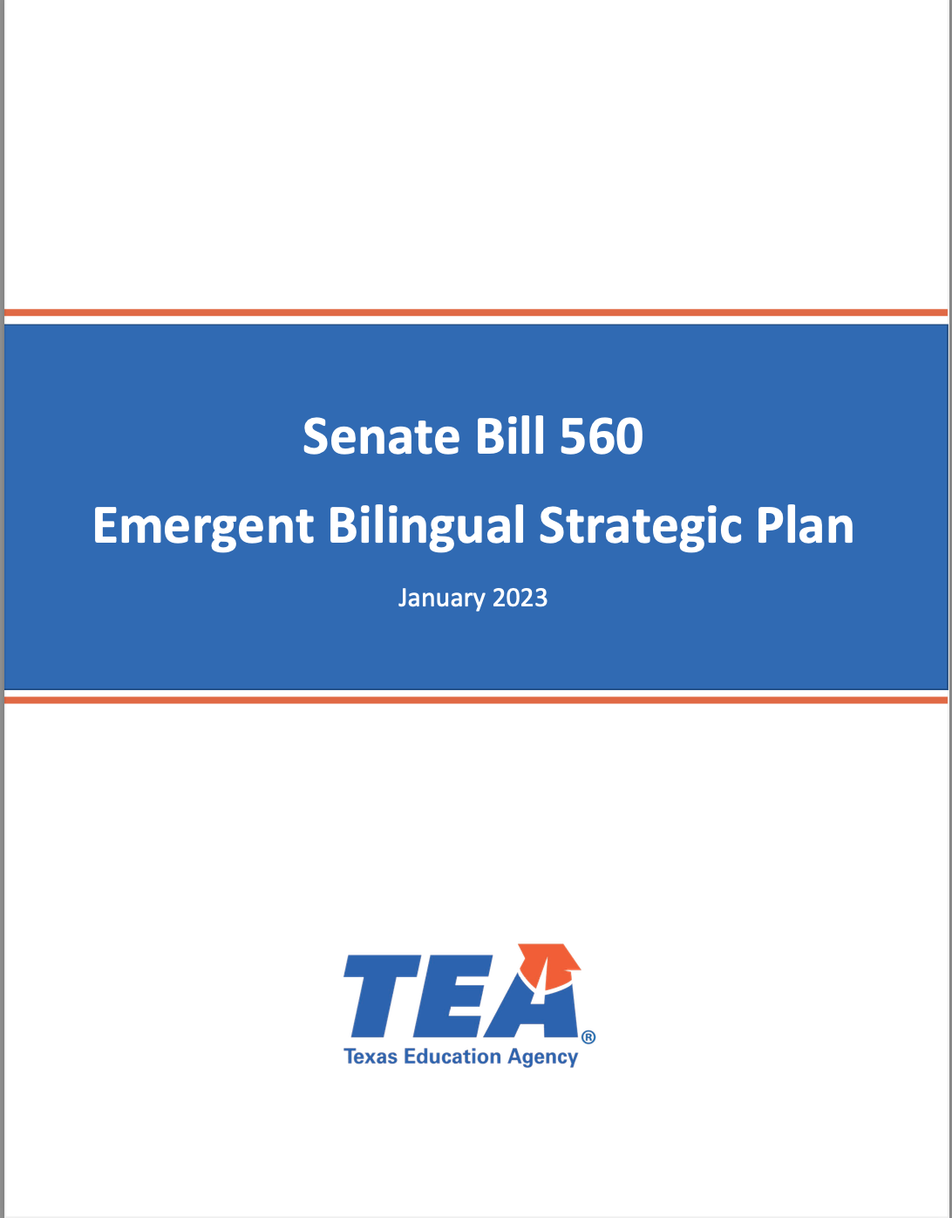
Improving Bilingual Education
Increase the number of bilingual certified teachers
Increase the number of dual language one-way and two-way programs
Educate families and educators on the benefits of bilingualism
Adopt a uniform process for identifying emergent bilingual students and monitoring their bilingual learning with meaningful data sources
Increase the number of bilingual and multilingual graduates
Notes:
Dr. Lara

Slide 5
Chapter 89 Revision Updates
Notes:
3:00-3:20

Slide 6
Proposed Chapter 89 Revisions Tentative approval by August 8, 2023
August 8th
Home Language Survey
TEA state-developed form
Reclassification
Composite Score
3rd question
End of Year for 23-24 SY
Terminology
Emergent Bilingual Student
Content-Based Language Instruction (CBLI)
Primary/ Partner Language
Program Models
Dual Language Immersion minimum requirements for two-way and clarification on partner teaching
*ESCs & LEAs are to continue to use the current LPAC guidance and training materials posted on txel.org/LPAC.

Slide 7
TEA Developed Forms
Home Language Survey
Program Placement
Parental Denials
Reclassification
Change of Program Placement
Standardized forms for uniformity & alignment
All forms will be translated into top 24 languages, and others as needed by LEAs.
Notes:
https://nces.ed.gov/programs/digest/d21/tables/dt21_204.20.asp

Slide 8
NEW Home Language Survey – August 8, 2023

Slide 9
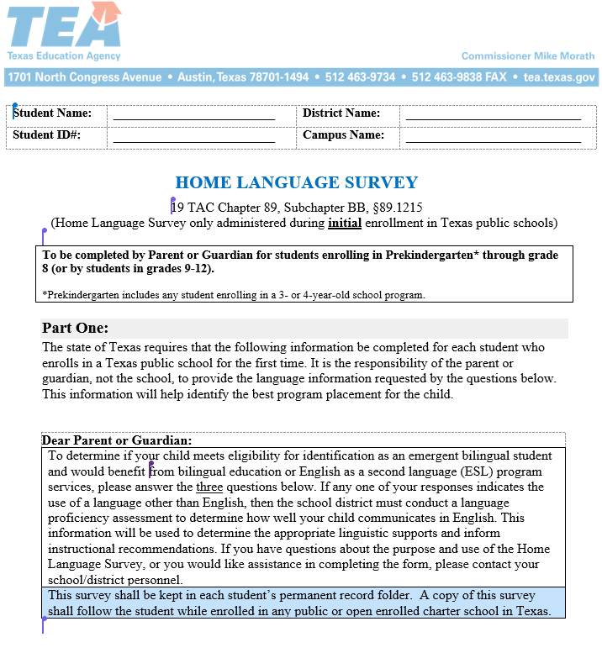
Home Language Survey (HLS) Hard and Soft Copy
Coding the (2) languages collected from the HLS remains the same (Question 1 and 2)
1st Language spoken mainly at home
2nd Language spoken mainly by child
3rd Language spoken by child from previous home setting
HLS questions will solicit more than one language to capture home language(s) every time
Example parent/child that comes from a bilingual speaking households
Digital HLS completed online should provide the same access of writing in text
Original HLS will be the one signed on a TEA developed form in the language spoken by parent/guardian

Slide 10
Program Services and PEIMS Coding Increasing Awareness Campaign
Program Participation Code
Represents program model parents' consent
Code when EB students are served by a teacher on a bilingual exception or ESL waiver
Change of program models
Date will reflect the date parents acknowledged the change in program
Reclassification for EB Students
Monitoring for the first 2 years
3rd and 4th year after reclassification
Former EB student
DLI, TBE, ESL

Slide 11
Next Steps
Inform ESCs and LEAs in our upcoming EB Support Division meetings
ESC Meeting August 11th
LEA Webinar September 1st
Update LPAC Modules to align with new terminology and guidance on HLS, identification, placement, progress monitoring, and reclassification/exit
Include all TEA Developed Forms in Multiple Languages
Align guidance in Student Attendance Accounting Handbook (SAAH’s next version)

Slide 12
Thank you for your time!
Contact Information
Emergent Bilingual Support Division
EmergentBilingualSupport@tea.texas.gov
Dr. Julie Lara
Director of Emergent Bilingual Support Division
Julie.lara@tea.texas.gov
Dr. Xóchitl Anabel Rocha
Bilingual Programs, Policy, and Technical Assistance Manager
Xochitl.rocha@tea.texas.gov

