Slide 1
TITLE SLIDE: TSDS ODS 3.x Project
Updates
TSDS Upgrade Project
Texas Education Agency
August 2023

Slide 2
SESSION AGENDA
PILOT PROGRAM
2022-2023
PARALLEL SUBMISSION
2023-2024
NEXT STEPS
Recommended Actions
OPEN DISCUSSION
Questions and Comments

Slide 3
PILOT PROGRAM

Slide 4
Pilot Program
A small-scale, short-term evaluation that helps an organization learn how a large-scale project might work in practice.
Clear Goals
Test Group
Time Length
Capture Feedback
Action Response

Slide 5
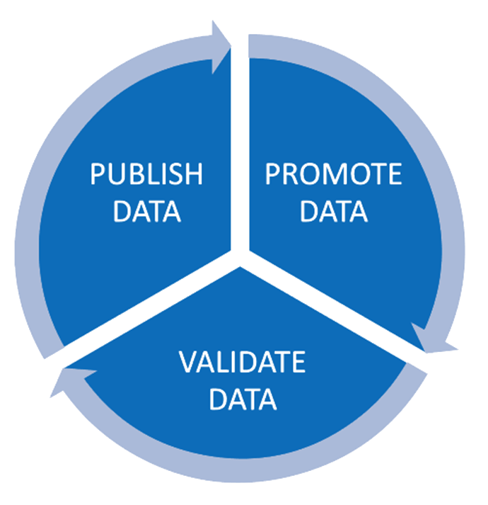
PILOT PROGRAM GOALS
LEA Custom Solutions
Initial Testing of 25+ LEAs
Active Vendor Involvement
Various Product Integrations
Regional ESC Support
ECDS KG Collaboration
Vetting of TEA Resources

Slide 6
PREPARING FOR DEPARTURE
PURPOSE: Provide vendors the ability to develop their product solutions and conduct initial testing with their LEAs.
Integration
Data Output
End-to-End
PEIMS Fall
Child Find
Class Roster Fall
Class Roster Winter
9
34
17
VENDORS
LEAs
00
REGIONS

Slide 7
FLIGHT MANIFEST
PILOT VENDORS
FRONTLINE EDUCATION
AERIES
POWERSCHOOL
ASCENDER
HARRIS SCHOOL SOLUTIONS
SKYWARD
FOCUS SCHOOL SOFTWARE
INFINITE CAMPUS
TYLER TECHNOLOGIES

Slide 8
FLIGHT MANIFEST
PILOT LEAS
Arlington
Bryan
Coppell
Cedars Int’l Academy
Fort Worth
Eagle Pass
Edna
Avery
Basis Texas
Gainesville
Gladewater
Hurst-Euless-Bedford
Lake Worth
Keller
Lorena
Leon
Little Elm
Gold-Burg
Magnolia
Moody
Perryton
Richardson
Princeton
San Benito
Royse City
San Angelo
Sharyland
Sivells Bend
Sweetwater
Tomball
Texas Tech University K-12
Ysleta
Uplift Education
Woodville

Slide 9
PILOT FLIGHT PLAN
SEPTEMBER 2022
2022-2023 SDK Released
Pilot Vendor Commitments
JANUARY 2023
TEAL, Parallel Portal, &
DMC Configuration for Pilot LEAs
APRIL - JULY 2023
Complete End-to-End
Testing with LEAs
OCTOBER 2022
Pilot Nominations
COHORT 1
VENDOR SUPPORT
PILOT LEAs
END-TO-END
PILOT TRAINING
FEEDBACK
FEBRUARY 2023
Data Promotion
L1.5 Filters
COHORT 2
AUGUST 2022
TEDS Post-Addendum
DECEMBER 2022
TEA Testing, SDK Update,
Pilot LEA Selections (Initial)
MARCH 2023
Cohort 1: Advanced Testing
Cohort 2: Initial Kickoff & Setup
AUGUST 2023
Vendor & LEA Feedback
Lessons Learned

Slide 10
FLIGHT TRACKER
9
VENDOR INTEGRATION & SUPPORT
SDK & Staging Environment
DATA PUBLICATION
LEA Coordination
Level 1 Errors & Incremental Data
TESTING
Data Counts
TEA Use Cases
TEDS, Webinars, Vendor Coordination Meetings
MONTHS
5
MONTHS
3
MONTHS

Slide 11
IN-FLIGHT ANNOUNCEMENTS
9
VENDOR WEBINARS
6
REGIONAL PRESENTATIONS
5
CONFERENCES

Slide 12
THIS IS YOUR CAPTAIN SPEAKING
STATEWIDE VENDOR WEBINARS
Aug. 2022: Kickoff
Sep. 2022: SDK
Oct. 2022: Exchange
Dec. 2022: SDK Update
Jan. 2023: Cohort 1
Feb. 2023: Cohort 2
Mar. 2023: Status
May 2023: Namespace
Jun. 2023: SDK Update
FCN WEBINARS
September 27, 2022
October 18, 2022
December 13, 2022
January 17, 2023
February 21, 2023
March 22, 2023
April 18, 2023
May 23, 2023
June 20, 2023

Slide 13
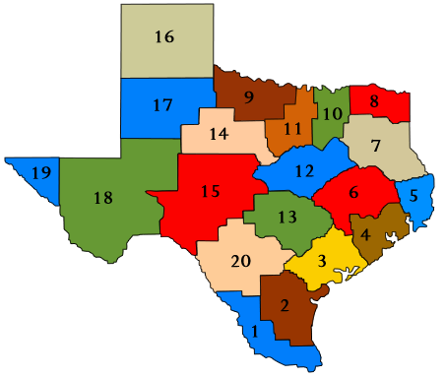
ARRIVED AT YOUR DESTINATION
ESC REGIONS
CONFERENCES
April 2023 | ESC-7
May 2023 | ESC-10
May 2023 | ESC-6
May 2023 | ESC-11
June 2023 | ESC-1
June 2023 | ESC-17
August 2023 | ESC-15
August 2023 | ESC-10
September 2023 | ESC-7
Feb. 2023 |  | TASBO Engage SLDS Best Practices
Apr. 2023 |  | TSUN
Jun. 2023 |  | TASBO Summer ASCENDER

Slide 14
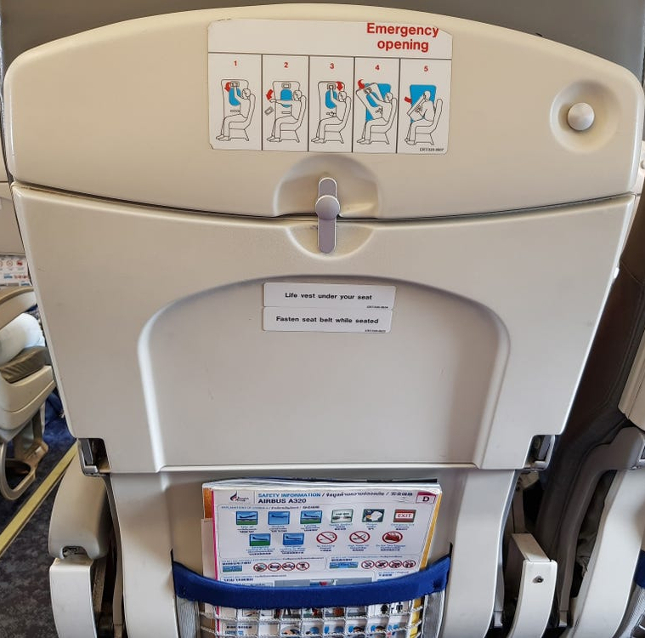
SELF-SERVE INSTRUCTIONS (LEAs)
5
CLICK SHEETS & VIDEOS
Requesting Access to Parallel Portal
Generating Key and Secrets
Requesting Access for Promotions
Verify PEIMS Record Counts
Verify CORE Record Counts

Slide 15
MAINTAINING ALTITUDE (VENDORS)
Software Development Kit
Staging Environment
Ed-Fi Handbook
Domain Dependency
MetaEd Files

Slide 16
SUPPORTING THE PILOT
394
Tickets Submitted
336
Tickets Resolved
TIMS (LEAs): 137
Vendor Portal: 257

Slide 17
ON CALL SERVICE
VENDOR COORDINATION:
Scheduled meetings with each pilot vendor to assist with their specific issues.
PILOT LEA WEBINARS:
Three webinars with all 34 Pilot LEAs to provide specific guidance and use case testing for pilot data submissions.
Class Roster
Child Find
PEIMS Fall

Slide 18
FEEDBACK CAPTURED
Regular meetings with TEA!
Reviewing the changes that we will see in the future.
Weekly meetings to discuss discoveries of missing data, validation triggers, and processes.
Being able to get a look at the screens and processes before going live.
Providing the vendors dedicated time to do discovery and programming.

Slide 19
CHALLENGES ENCOUNTERED
Integrating with vendor products and connection
Learning the new titles for the Ed-Fi components
Figuring out what the errors meant
Lack of formal training for LEAs
Unable to test against live data
Unable to get all data published

Slide 20
CHANGES RECOMMENDED
Provide videos or webinars to walk users all way through the process
Provide technical resources to assist users with parallel comparison testing
Provide better identification and explanation of errors for troubleshooting
Provide more transparency on when data is loaded to Transition Zone within the DMC
Provide meetings with TEA, LEAs and vendors to resolve issues and share best practices

Slide 21
PARALLEL YEAR

Slide 22
Parallel Submission
Running multiple versions of an application concurrently and testing of the same input on different systems.
Clear Goals
Test Group
Time Length
Capture Feedback
Action Response

Slide 23
PARALLEL SUBMISSION GOALS
Testing of All Custom Solutions
Testing of 300+ LEAs
Complete Vendor Readiness
Regional ESC Support
Various Product Integrations
Vetting of TEA Resources
Testing of All TSDS Submissions

Slide 24
WHO IS REQUIRED?
ALL
Source System Vendors
ALL
Custom Solutions
ALL
Education Service Centers
TRAINING
SUPPORT

Slide 25
WHO IS PARTICIPATING?
342
Local Education Agencies
3 Million
Student Enrollment

Slide 26
PARALLEL LEA ACCEPTANCE
BY
AUGUST 14
TEA will inform any LEA accepted to the 2023-2024 Parallel Submission via email.
Download:
2023-2024 Parallel LEAs

Slide 27
VENDOR EXPECTATIONS
PARTICIPATION & DATA SUBMISSIONS
All vendors are required to participate in the 2023-2024 Parallel Submission.
TRAINING & SUPPORT
All vendors are responsible for providing any appliable training for their product(s).
VENDOR READINESS
All vendors are required obtain a TSDS Compatible Designation by the 2024-2025 Go-Live year.
All vendors are responsible for resolving Level 1 errors in a timely manner.
All vendors should provide “live” data, whenever possible, for parallel testing.
All vendors should obtain access to the TSDS Vendor Support Portal to submit issues to TEA.
All vendors should ensure data is available prior to published due dates.
All vendors are required to test and support each of their TSDS data submissions.
All SIS and HR/Finance vendors will need to obtain the necessary Ed-Fi certification.

Slide 28
ESC EXPECTATIONS
PARTICIPATION & DATA SUBMISSIONS
All ESCs are required to participate in the 2023-2024 Parallel Submission.
TRAINING & SUPPORT
All ESCs are responsible for providing TSDS training to their participating LEAs.
FEEDBACK & RESPONSE
All ESCs are responsible for ensuring active LEA participation throughout the Parallel Submission.
All ESCs are responsible for Level 2 support for their participating LEAs.
All ESCs should attend webinars and continuous trainings throughout the Parallel Submission.
All ESCs should coordinate with their vendor for onboarding and support.
All ESCs should develop effective strategies to solicit feedback from their participating LEAs.
All ESCs should share best practices and be actively involved in vetting TEA resources.
All ESCs should test and verify their required TSDS PEIMS submissions.

Slide 29
LEA EXPECTATIONS
PARTICIPATION & DATA SUBMISSIONS
All LEAs accepted by TEA are required to participate in at least one TSDS data submission.
ACCESS & TESTING
All LEAs are required to obtain the appropriate access to the parallel environment.
FEEDBACK & RESPONSE
All LEAs should implement effective strategies to ensure continuous progress.
All LEAs should compare data, validations, and reports to complete their testing.
All LEAs should coordinate with their vendor(s) for onboarding and support.
All LEAs should collaborate with their ESC and vendor(s) on identified issues.
All LEAs should attend the TSDS training provided by their ESC prior to testing.
All LEAs should coordinate with their ESC and vendor(s) to develop best practices.
All LEAs should submit enhancement requests through TIMS tickets.

Slide 30
ONBOARDING GUIDANCE
The onboarding strategy may vary from vendor to vendor and product to product.
A vendor may choose to onboard their LEAs in stages to ensure a high level of support.
A vendor may choose to establish testing cohorts based upon TSDS data submissions.
A vendor should have all their participating LEAs onboarded successfully by January 2024.
A vendor must have their LEAs certify their data submissions for TSDS Compatible Designation.

Slide 31
LEVERAGING FROM PILOT
STATEWIDE
WEBINARS
VENDOR COORDINATION
Includes Field Coordination Network and vendor webinars, as well as submission-based webinars for participating LEAs.
Includes vendor meetings with TEA to provide guidance, resolve roadblocks, and ensure effective progress.
TESTING GUIDANCE
TECHNICAL RESOURCES
Includes resources, guidance, and specific use cases to assist in testing for each TSDS data submission.
Includes Software Development Kit, Staging environment, Swagger, Ed-Fi Handbook, and technical guidance documents.

Slide 32
PARALLEL SUBMISSION
SEPTEMBER 2023
DMC Configuration
Data Publication
Resolve L1 & L1.5
JANUARY 2024
ECDS KG
PEIMS Mid-Year
PEIMS Fall (resub)
JUNE 2024
PEIMS Summer
ECDS PK
SELA
OCTOBER 2023
Class Roster Fall
Charter School Waitlist
MARCH 2024
Class Roster Winter
KICKOFF
SUBMISSION-BASED WEBINARS & RESOURCES
PARALLEL START
INITIAL TESTING
CHECKPOINT
ADVANCED TESTING
PARALLEL END
TSDS COMPATIBLE DESIGNATION
FEBRUARY 2024
SPPI-14
PEIMS Mid-Year (resub)
BEST PRACTICES
AUGUST 2023
ESC Training
LEA Acceptance
Vendor Integration
JULY 2024
Child Find
RF Tracker
PEIMS Summer (resub)
DECEMBER 2023
PEIMS Fall
RF Tracker
MAY 2024
Advanced DMC Functions
Training & Support Feedback
AUGUST 2023
Vendor & LEA Feedback
Lessons Learned

Slide 33
UPCOMING IMPORTANT DATES
AUG.
7
Parallel Submission Open
2024 IODS
TEDS 2024.1.0 (March 2023)
OCT.
19
Class Roster Fall
Submission Due
Comparison Testing
Class Roster Fall
Submission Due
Comparison Testing
AUG.
14
LEA Acceptance
TEA Notification
Vendor Coordination
OCT.
27
Charter School Waitlist
Submission Due
Comparison Testing
Charter School Waitlist
Submission Due
Comparison Testing
Late August/Early September: SDK Update / Staging Environment TEDS 2024.2.0 (July 2023)

Slide 34
NEXT STEPS

Slide 35
PARALLEL SUBMISSION
2023-2024
1
2
Communicate
Obtain Access
Prior to Onboarding
Prior to Training
Reach out to each accepted LEA to establish or identify the onboarding plan to set expectations on training and support.
Provide guidance and support for each accepted LEA to obtain the necessary access for the parallel environment.
3
4
Provide Training
Support
Prior to Testing
Throughout
Ensure proper product training (vendor) and TSDS training (ESC) has been completed prior to the start of testing.
Effectively monitor progress and actively support the participating LEAs throughout the Parallel Submission year.

Slide 36
KEY TAKEAWAYS
TEA has concluded the Pilot Program and will continue to solicit feedback form those that participated.
All vendors are required to participate in the 2023-2024 Parallel Submission with their accepted LEAs.
TEA will notify all LEAs accepted the 2023-2024 Parallel Submission by August 14, 2023.
Vendors and ESCs should coordinate with participating LEAs regarding their onboarding and support plans.
AVAILABLE RESOURCES
List of Parallel LEAs
Subject to change
TSDS Upgrade Project
More updates coming soon
TSDS Training Materials
Resources for ESCs
SDK - Installation Guide
Resource for vendors

Slide 37
OPEN DISCUSSION

Slide 38
TITLE SLIDE: TSDS ODS 3.x Project
Updates
QUESTIONS

