Slide 1

TSDS UPGRADE PROJECT - ESC

Slide 2

AGENDA
DATA STANDARDS
Submission Requirements and Technical Resources
PROJECT UPDATES
Pilot Program, Demonstration, Training Strategy
NEXT STEPS
How to Prepare for Parallel Submission

Slide 3

DATA STANDARDS

Slide 4


TEXAS EDUCATION DATA STANDARDS
Texas Student Data System

Slide 5
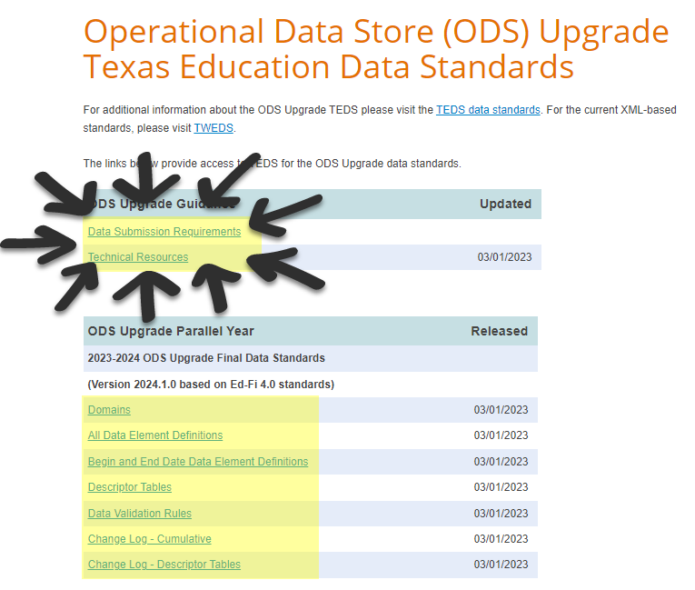

NEW RESOURCES
ODS Upgrade Data Standards

Slide 6
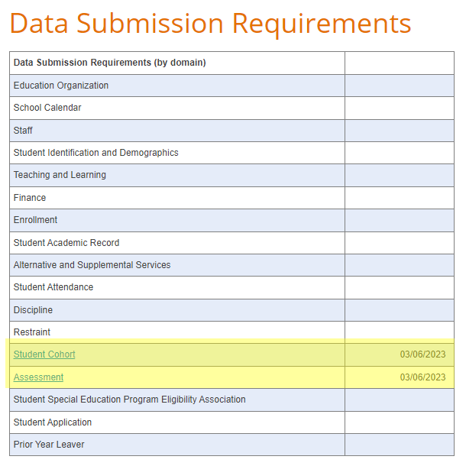
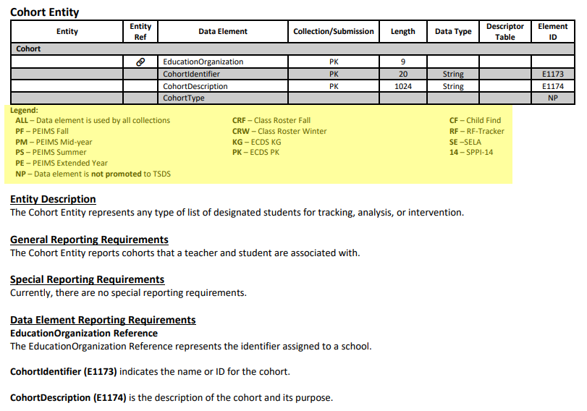
DATA SUBMISSION REQUIREMENTS

Slide 7
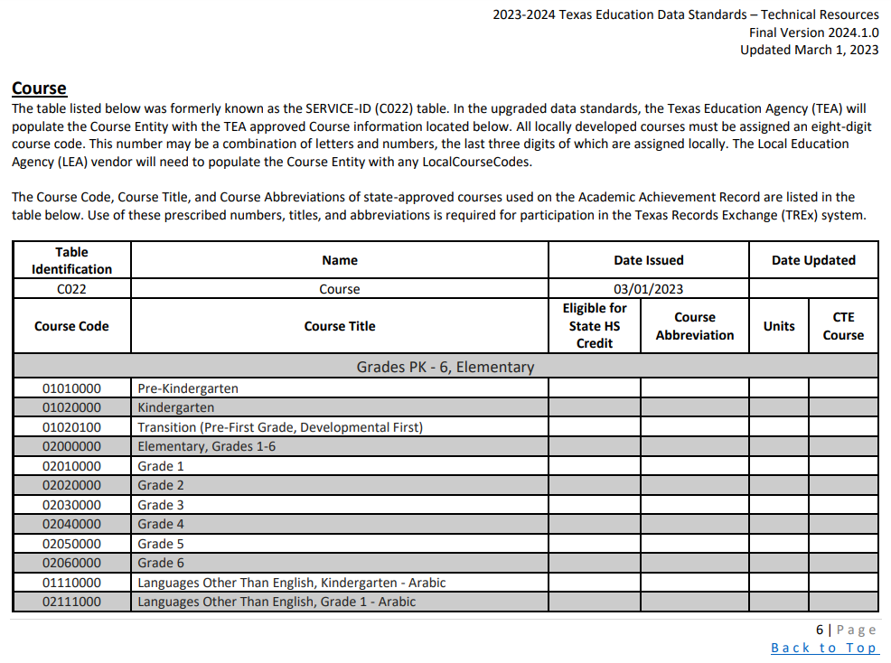
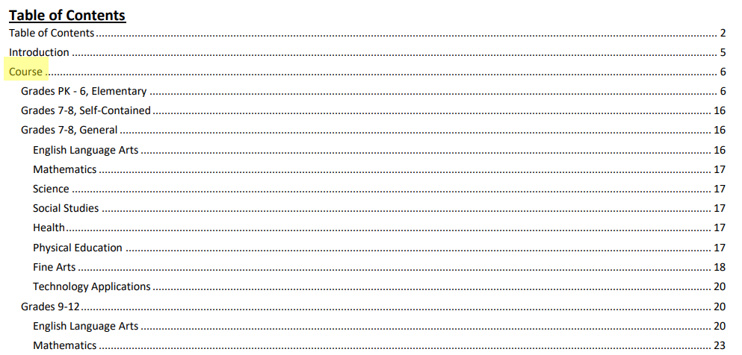

TECHNICAL RESOURCES: COURSE

Slide 8
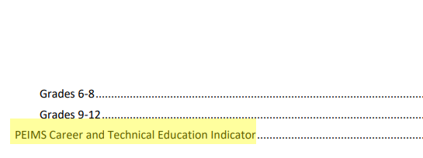
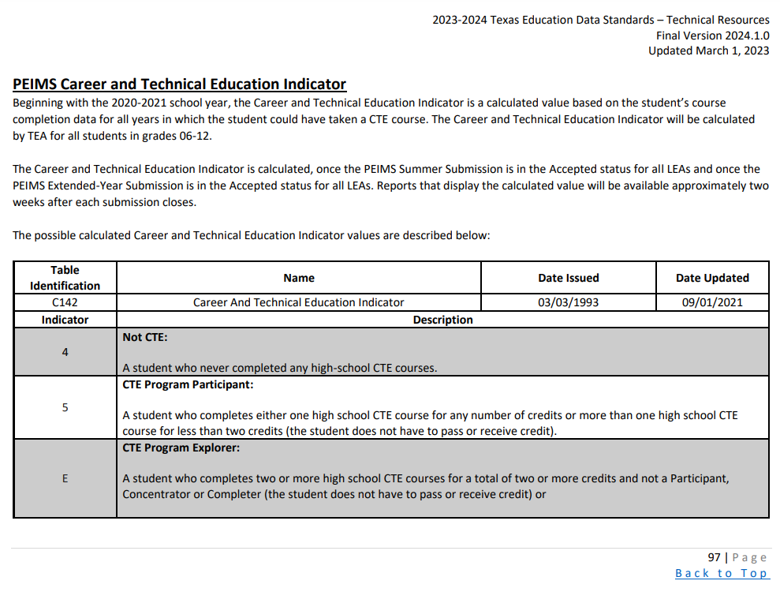

TECHNICAL RESOURCES: CTE INDICATOR

Slide 9

PROJECT UPDATES

Slide 10
PROJECT TIMELINE
Pilot
Parallel
Go Live
September 2021 – August 2023
  Optional: TSDS vendors can participate in pilot program to develop and test their product solutions.
  Optional: LEAs can partner with their vendors to conduct end-to-end testing in preparation to parallel submission.
August 2023 – August 2024
  Required: All TSDS vendors test their product solutions.
  Optional: LEAs will submit both API transactions and XML submissions and compare results to ensure vendor readiness.
August 2024 – August 2025
  Required: All LEAs will submit their TSDS official data through API transactions.
  XML submissions no longer accepted for TSDS.
EXTENDED

Slide 11

PILOT PROGRAM

Slide 12
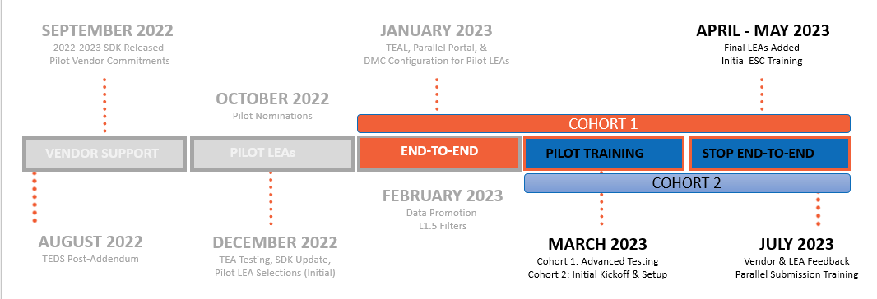
TIMELINE OF EVENTS

Slide 13
PILOT PROGRAM FUNCTIONALITY
  TEA-defined claim sets:
      HR Vendor
      Finance Vendor
      HR/Finance Vendor
      SIS/HR/Finance Vendor
    Data Management Center (DMC)
      Level 1.5 Filter Details
  TEA-defined claim sets:
      Assessment Vendor
      Read Only All Resources
    Data Management Center (DMC)
      Manage Claim Set Functionality
      Level 2 Validations
    Software Development Kit (SDK)
      Update Coming End of March
RECENTLY RELEASED
IN PROGRESS

Slide 14

PILOT PROGRAM ACCOMPLISHMENTS
  Data Published:
      4 vendors have published for 7 LEAs
      620,000 resources published to 30 entities
    Data Promoted
      6 LEAs have promoted to PEIMS or CORE
      90,200 records for PEIMS Fall
      69,900 records for Class Roster Fall
    Support Tickets
      146 support tickets submitted
PROGRESS REPORT

Slide 15









PILOT PROGRAM VENDORS
COHORT 1 VENDORS
Aeries
SIS
PowerSchool
SIS (2), HR/Finance (2)
Infinite Campus
SIS
Frontline
SIS, HR/Finance
Skyward
SIS (2), HR/Finance (2)
COHORT 2 VENDORS
Ascender
Harris School
Solutions
Focus School Software
Tyler Technologies

Slide 16
COHORT 1: PILOT LEAS
Edna ISD
Lake Worth ISD
Lorena ISD
Princeton ISD
Magnolia ISD
Royse City ISD
San Angelo ISD
San Benito CISD
Sharyland ISD

Slide 17
COHORT 2: PILOT LEAS
Cedars International Academy
Coppell ISD
Eagle Pass ISD
Leon ISD
Little Elm ISD
Perryton ISD
Sweetwater ISD

Slide 18
SCALING THE PILOT PROGRAM
Arlington ISD
Basis Texas
Bryan ISD
Gainesville ISD
Fort Worth ISD
Hurst-Euless-Bedford ISD
Gladewater ISD
Gold-Burg ISD
Keller ISD
Moody ISD
Richardson ISD
Tomball ISD
Texas Tech University K-12
Uplift Education
Woodville ISD
Yselta ISD

Slide 19
BREAKDOWN OF LEAS BY VENDOR
Edna ISD, Keller ISD, Moody ISD
Eagle Pass ISD, Gainesville ISD, Gladewater ISD, Gold-Burg ISD, Leon ISD, Perryton ISD , Sweetwater ISD, Woodville ISD
Arlington ISD,
Magnolia ISD
Cedars International Academy
Fort Worth ISD, Little Elm ISD, Richardson ISD, Texas Tech University K-12
Princeton ISD
Basis Texas, Bryan ISD, Hurst-Euless-Bedford ISD, Lorena ISD, San Angelo ISD, Tomball ISD, Uplift Education
Lake Worth ISD, Royse City ISD, San Benito CISD, Sharyland ISD
Coppell ISD, Ysleta ISD

Slide 20



ACHIEVING PILOT PROGRAM GOALS
GOAL
ACTUAL
At least one LEA from each ESC
At least one Charter School
LEA with in-house solution
LEA with multiple vendors
Early testing of ECDS KG
Wide range of data diversity
25+ LEAs by the end of July
17 ESC regions with a pilot LEA
3 Charter Schools accepted
*Several LEAs in consideration
9 LEAs with multiple vendors
*LEAs with CLI in consideration
LEA and vendor hosted systems
32 LEAs accepted
* TEA may add LEA(s) to fulfill this goal later in Pilot

Slide 21
FREQUENTLY ASKED QUESTIONS
Will additional LEAs be added to the Pilot Program?
TEA is not expecting to accept any additional LEAs to the 2022-2023 Pilot Program after April 2023. All accepted LEAs were informed on or before March 20, 2023. LEAs were accepted based upon discussion and coordination with their pilot vendor(s) and the goals of the pilot program.
Any LEA that has previously expressed interest through the LEA Nomination Form and was not included in the 2022-2023 Pilot Program will be accepted for the 2023-2024 Parallel Submission.

Slide 22
FREQUENTLY ASKED QUESTIONS1
Will LEAs currently participating in the Pilot Program be automatically included for the 2023-2024 Parallel Submission?
Yes. All LEAs currently participating in the Pilot Program will be included in the list of accepted LEAs for the 2023-2024 Parallel Submission. They will be informed of their acceptance prior to the start of school year.

Slide 23
FREQUENTLY ASKED QUESTIONS2
When will ESCs be able to start testing their own PEIMS data submissions?
An ESC may start testing their PEIMS Fall data submission in the 2022-2023 Pilot Program based upon their vendor’s readiness and capacity. Please coordinate with your vendor and contact TSDSDeployment@tea.texas.gov if interested.
All ESCs will be expected to participate in the 2023-2024 Parallel Submission and test their data submissions for PEIMS Fall and PEIMS Mid-year.

Slide 24
FREQUENTLY ASKED QUESTIONS3
How and when will LEAs be accepted for the 2023-2024 Parallel Submission?
TEA will be sending additional correspondence in May 2023 to all LEAs to solicit participation for the 2023-2024 Parallel Submission. Any LEA that has previously submitted their interest through the LEA Nomination Form will not need to apply again. TEA will coordinate with their vendor(s) and ESC prior to LEA acceptance. LEAs will be informed of their acceptance prior to the start of the 2023-2024 school year.
More information will be shared in the upcoming FCN webinars as it becomes available.

Slide 25

VALIDATIONS

Slide 26
LEVELS OF VALIDATIONS
LEVEL 1
Includes basic data integrity checks that occur during the process of loading data via API transactions into the Individual Operational Data Store (IODS) in the Landing Zone. Data that fails Level 1 validations does not enter the IODS.
LEVEL 1.5
Includes filters that prevent invalid or non-TSDS data from being loaded into TSDS. These filters include Unique ID checks, descriptor value checks, Do Not Report flag checks, and Course ID checks.
LEVEL 3
Business rules that are executed in TSDS. Level 3 validations contain all Level 2 validations, plus any additional validations required for the TSDS submissions. Fatal errors prevent TSDS submissions from being completed or finalized.
LEVEL 2
Business rules that are executed on the data destined for TSDS. Fatal, Special Warning, and Warning validation errors do not prevent data from being loaded to TSDS.

Slide 27
HIGH-LEVEL ARCHITECTURE
Data
Level 1
These occur during the API transactions and prevent data from being loaded to the IODS in the Landing Zone.
These must be resolved by the source system vendor.

Slide 28
HIGH-LEVEL ARCHITECTURE1
Data
LEVEL 1.5
These filter checks occur in the IODS in the Landing Zone and prevent data from being loaded to TSDS.
Checks the values of Course IDs, descriptor values, Unique IDs, and data flagged as “Do Not Report”.

Slide 29
HIGH-LEVEL ARCHITECTURE2
Data
LEVEL 2
These business rule validation checks are run against the data prior to promoting to PEIMS or CORE data mart.
These include Fatals, Special Warnings, and Warnings and do not prevent the data from being loaded to TSDS.
LEAs will need to resolve the Fatal errors prior to completing their TSDS data submissions.

Slide 30
HIGH-LEVEL ARCHITECTURE3
Data
VIEW IN DMC
Level 1.5 and Level 2 results are displayed in the DMC application.

Slide 31
HIGH-LEVEL ARCHITECTURE4
Data
Data
LEVEL 3
These business rule validation checks are run against the data after promoting to the PEIMS or CORE data marts. These will include some validations that could not be run at Level 2.
These include Fatals, Special Warnings, and Warnings.
LEAs will need to resolve the Fatal errors prior to completing their TSDS data submissions.

Slide 32
FREQUENTLY ASKED QUESTIONS5
How will LEAs be informed of Level 1 validation errors?
Level 1 validations occur during the API transactions from the LEA’s source system(s) to the IODS in the Landing Zone. The LEA’s source system vendor(s) would be responsible for informing the LEA of any Level 1 validation errors through their products or reporting.
Any data that results in a Level 1 validation error will not be loaded into the IODS in the Landing Zone.

Slide 33
FREQUENTLY ASKED QUESTIONS6
Does the LEA need to resolve Level 1.5 filter results?
It would depend on whether the data was intended and expected to be used for TSDS data submissions. Any data identified in the Level 1.5 filter results will not be loaded to the Transition Zone and will not be made available to promote to the PEIMS and CORE data marts. These results would need to be resolved to be loaded for TSDS reporting.
An LEA may have data loaded to their IODS that is intended for local use. This data may be displayed as a Level 1.5 filter result and would not need to be resolved, as it would not be reported to TEA.

Slide 34
FREQUENTLY ASKED QUESTIONS7
How do Level 2 and Level 3 validation differ?
Level 2 validations are the business rules that are run against the data prior to promoting to the PEIMS and CORE data marts. These validations do not prevent the data from being loaded to TEA’s Transition Zone and do not need to be resolved. An LEA would be able to view the Fatals, Special Warnings, and Warnings in the DMC application.
Level 3 validations include all Level 2 validations, plus any additional business rule validations required for the TSDS submissions. These validations are executed when promoting the data to the PEIMS and CORE data marts. Fatal errors would need to be resolved prior to completing any TSDS data submission.

Slide 35
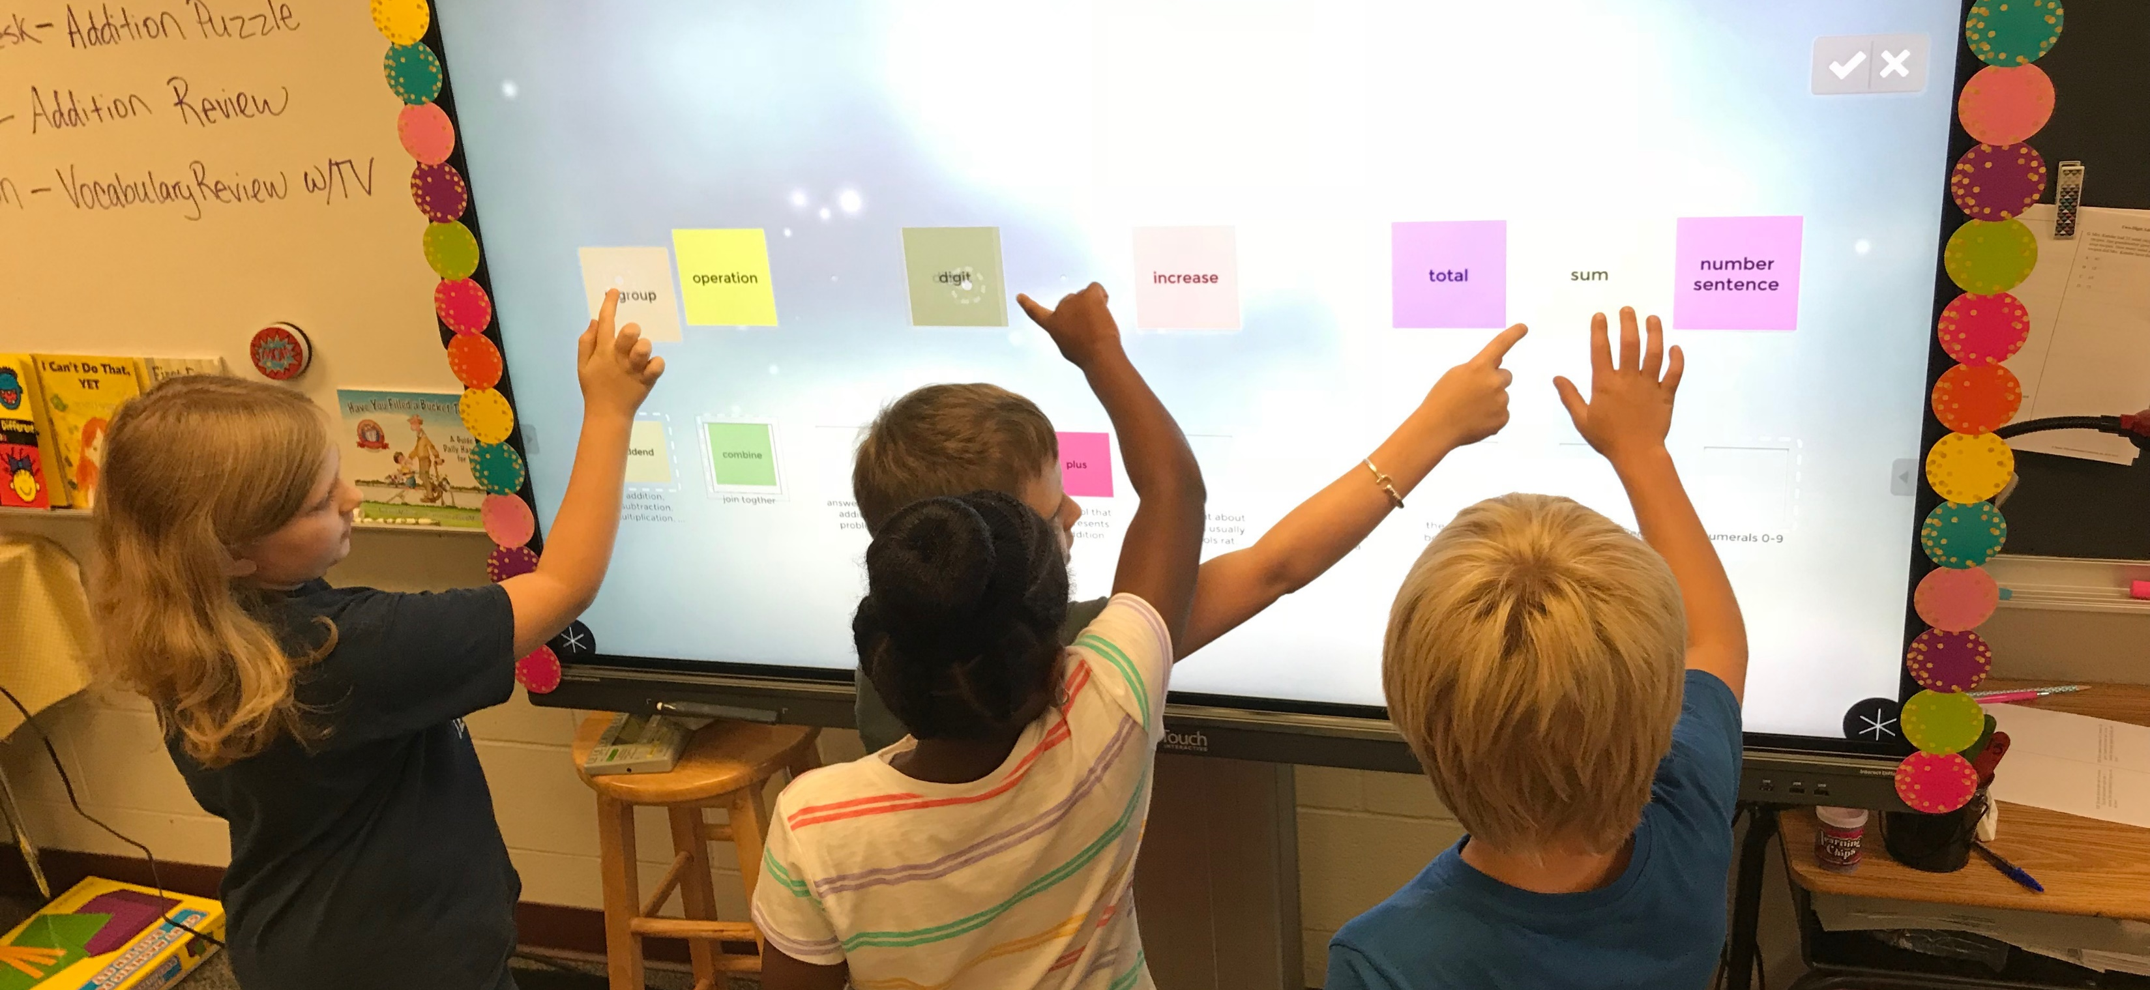
DEMONSTRATION

Slide 36
DATA MANAGEMENT CENTER
What the demo will be covering:
  LEA Technical Administrator:
      DMC LEA Technical
      DMC LEA Admin Configurator
  LEA Data Steward:
      DMC LEA Data Monitor
      DMC LEA L2 Validations
  Administrator Functionality:
      Manage Claim Sets
      Manage Keys and Secrets
      Map Descriptors
  Monitor Validations Functionality:
      View L1.5 Filter Details
TEAL ROLES
DMC

Slide 37
FREQUENTLY ASKED QUESTIONS8
Can an LEA add multiple applications configured with claim sets in the DMC application?
Yes. The LEA can add multiple applications in the DMC application and generate different key and secret credentials based upon the claim set assigned. For instance, an LEA could have one application configured for their SIS vendor, one for their HR/Finance vendor, and one for their ECDS assessment vendor.

Slide 38
FREQUENTLY ASKED QUESTIONS9
Does the key and secret need to be generated every school year?
No. An LEA will not need to generate a new key and secret every school year. The LEA would only need to generate a key and secret when a new application is added or if they switch source system vendors.

Slide 39
FREQUENTLY ASKED QUESTIONS1110
If the Level 1.5 filter result is marked as “verified”, is it stored at the user level or at the LEA-level?
Any Level 1.5 filter result marked as “verified” will be stored the same for all DMC users at the LEA. This indication allows the LEA to easily identify results that have been previously reviewed in the DMC application.

Slide 40
FREQUENTLY ASKED QUESTIONS12
When does the LEA need to perform descriptor mapping?
The LEA would need to perform the necessary descriptor mapping for any descriptor value that is loaded into the IODS that does not match a TEDS defined code value and is intended to be used for TSDS reporting.
Example: “High School Diploma” is loaded to the IODS, but the LEA wants to report “No Degree” for TSDS purposes. The LEA would map “High School Diploma” to “0 (No Degree)” in the DMC application.

Slide 41
FREQUENTLY ASKED QUESTIONS13
If the source system vendor loads the TEDS defined code values to the IODS, does the LEA need to perform descriptor mapping in the DMC application?
The LEA would not need to perform descriptor mapping in the DMC application for data loaded into the IODS with TEDS defined code values. Additionally, if the LEA and/or vendor performs cross-walks or mapping of the data prior to sending to the IODS, then descriptor mapping in the DMC application may not be needed. LEAs should verify and confirm any descriptor values marked as “unmapped” in the DMC application.

Slide 42
FREQUENTLY ASKED QUESTIONS14
Will ESC users be able to access their LEA's data in the DMC?
TEA is still in the process of defining the DMC application access requirements for ESCs as it pertains to their LEAs. The expected access being considered is view-only access to LEA claim sets, Level 2 validations, and summary tables displaying IODS data and validation information.
Because of potential local use, the current design is not expecting to give ESC users access to an LEA's L1.5 filter details. ESCs who need to access these filters to support their LEAs would need to request TEAL access at the LEA level.

Slide 43
FREQUENTLY ASKED QUESTIONS15
Will ESC users be able switch between their LEAs within the DMC application?
Yes. ESC users will be able to switch between their organization and their LEAs by using the dropdown header in the DMC application.

Slide 44
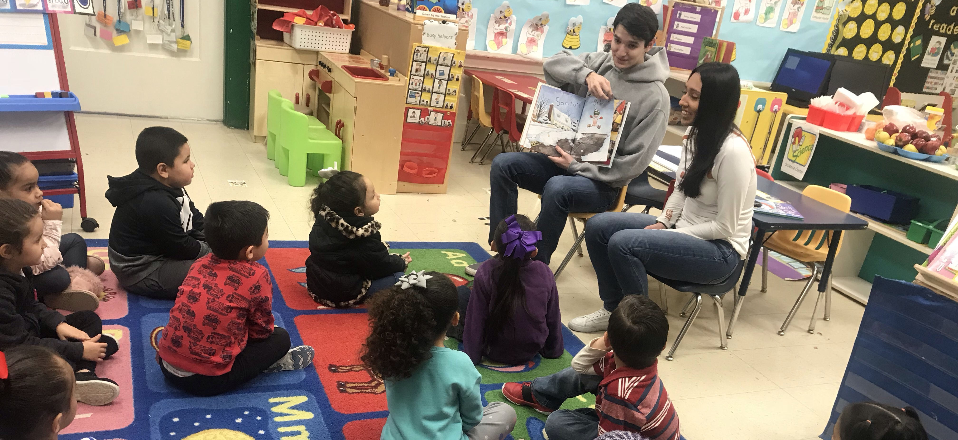
TRAINING STRATEGY

Slide 45

COHORT 1: TRAINING STRATEGY & PLAN
STRATEGY: SUPPORT & OBSERVATION
Ensure testing progress of frequent and incremental releases of TSDS functionality. TEA proactively supports LEAs with resources that promote self-learning and limit the need for instructor-led trainings. ESCs observe training and guidance.
Self-Guiding Resources:
TEA promoted self-learning through click sheets and how-to-videos for more intuitive features and then conducted a Level 1.5 Filter Details training course with interaction and demonstration.
Weekly Assignments:
TEA provided week-by-week assignments for LEAs to ensure progress and limit time commitments. LEAs received support from TEA and provided feedback through weekly meetings.
PLAN

Slide 46

COHORT 2: TRAINING STRATEGY & PLAN
STRATEGY: TRAINING WHEELS
Determine the effectiveness of the training resources previously developed with Cohort 1. TEA reactively supports LEAs by offering assistance and guidance only when requested. TEA begins to rely upon ESCs to monitor progress and support.
Launch Meeting:
TEA provided all self-guiding resources to LEAs and ESCs during the kickoff launch meeting of Cohort 2 through an online site. LEAs completed click sheets and resources at their own pace.
TIMS Support:
LEAs expected to submit issues through TIMS for any support needed. ESCs begin to get involved in supporting the LEAs. TEA expected to conduct monthly webinars for support and guidance.
PLAN

Slide 47
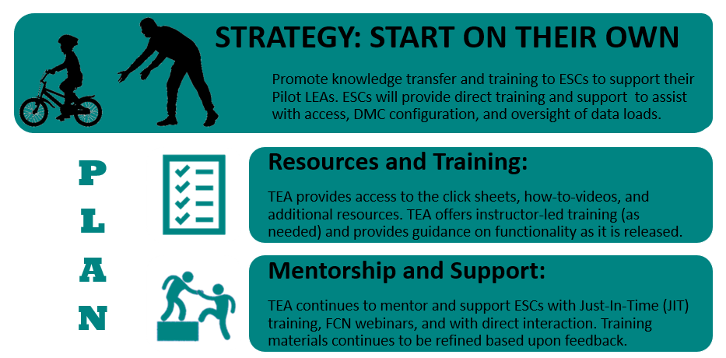
FINAL PILOT: TRAINING STRATEGY & PLAN

Slide 48
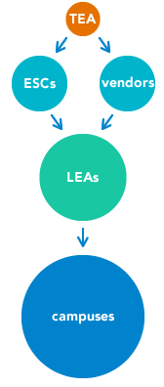
PARALLEL YEAR: TRAINING STRATEGY & PLAN
  TEA will follow the same train-the-trainer model for the TSDS Upgrade Project as it is for TSDS currently:
      Just-In-Time (JIT) Training
      New User Training (offered in October and February)
      Continuing Education Training (CET)
      Field Coordination Network (FCN)
  TEA will provide certification to ESCs and vendors so they can offer training and support to their LEAs.
TRAIN-THE-TRAINER

Slide 49

TRAINING COURSES: TO BE REMOVED
Technical Champion Curriculum
Data Transfer Utility
(DTU)
Validation Tool
(VT)
Delete Utility
eData Manager
(eDM) Data Loading

Slide 50


TRAINING COURSES: TO BE ADDED
  COURSES
  DMC LEA/ESC Technical
  DMC LEA/ESC Data Monitor
  DMC LEA/ESC L2 Validations
  DMC LEA/ESC Admin Configurator
  CERTIFICATIONS
TSDS DMC Technical Champion | TSDS DMC Administration & Security Champion

Slide 51
TRAINING COURSES: NOT CHANGING
TEDS/TWEDS
PEIMS
Unique ID
ECDS
RF Tracker
Charter School Waitlist
SPPI-14
SELA
Class Roster
Child Find
TIMS
Common Steps for Core
*These courses will be updated to reflect the TSDS Upgrade Project.

Slide 52

TSDS TRAINING ADVISORY GROUP (TTAG)
TEA is in the process of establishing TSDS Training Advisory Groups to assist in the vetting and refinement of TSDS materials.
The TSDS training team will begin soliciting volunteers in April 2023.
Additional information and estimated time commitments will be provided during that outreach.
Welcome Back!

Slide 53
FREQUENTLY ASKED QUESTIONS16
Will ESCs and vendors need to get recertified for all TSDS?
All current TSDS Technical Champions will need to complete all new DMC courses and certification testing to be certified as a TSDS DMC Technical Champion.
All current TSDS PEIMS Champions and TSDS Core Champions will not need to be recertified but will be required to attend all continuing education training (CET) for the TSDS Upgrade Project.

Slide 54
FREQUENTLY ASKED QUESTIONS17
When will the ESCs and certified vendors begin receiving training on the TSDS Upgrade Project?
TEA will offer training to ESCs and certified vendors beginning in July 2023.
Just-in-time (JIT) and continuing education training (CET) offerings will be offered throughout the 2023-2024 school year on the TSDS Upgrade Project.

Slide 55

NEXT STEPS

Slide 56
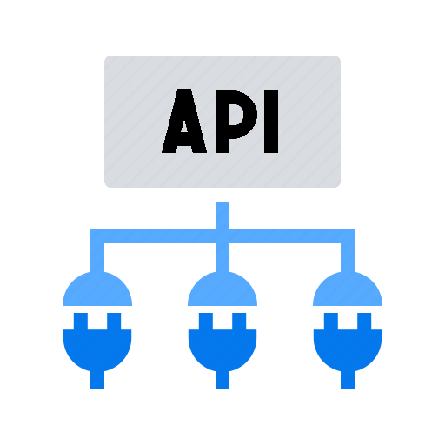


2023-2024: PARALLEL SUBMISSION
REQUIRED For All Vendors
OPTIONAL For LEAs & ESCs
LEAs will compare XML data against API transactions through TSDS reports and validations.
All TSDS submissions are expected to be compared by the submission due dates.
XML will be used for official TSDS reporting.
LEAs will be nominated, selected, and approved to participate
in the parallel submission. Recommending 250+ LEAs.

Slide 57
HOW TO PREPARE FOR PARALLEL SUBMISSION
1
2
Communicate
Identify
By May 2023
By June 2023
ESCs should inform their LEAs in their region of the TSDS Upgrade Project and the opportunity to participate in the 2023-2024 Parallel Submission.
ESCs should identify any LEA that may have an in-house or custom solution for generating XML files. A migration plan will be necessary.
3
4
Coordinate
Schedule
By July 2023
By October 2023
ESCs should coordinate with their own vendor(s) to ensure product readiness for submitting their own PEIMS data. Determine timeline for implementation.
ESCs should schedule the training for their LEAs participating in the 2023-2024 Parallel Submission. TEA will begin training ESCs this Summer.

Slide 58

HOW CAN TEA SUPPORT YOU?
FCN Webinars
Let us know what additional information, topics, and guidance TEA can provide in upcoming FCN webinars.
Technical Resources
Let us know what additional technical resources TEA should consider and prioritize to assist your ability to support LEAs.
LEA Guidance
Let us know what additional communications and guidance TEA can provide directly to LEAs or statewide through webinars.
Training Materials
Let us know what feedback you have on training resources and materials to ensure the most effective knowledge transfer.

Slide 59
KEY TAKE-AWAYS
New resources have been published on the Texas Education Data Standards website.
Additional LEAs were added to the Pilot Program. Identify the LEA(s) added for your region.
TEA will begin training ESCs to onboard the remaining Pilot LEAs. TEA will offer additional mentorship and support.
Start preparing for the 2023-2024 Parallel Submission and reach out to TEA for specific needs and considerations.
DMC DEMO
  TEAL Roles for LEAs:
  DMC LEA Technical
  DMC LEA Data Monitor
  Generating Key and Secret:
  Add Application
  Specify Claim Set
  Provide to Vendor
  Level 1.5 Filter Details:
  Unique ID Checks
  Descriptor Mapping
  Resolution Needed for TSDS

Slide 60

QUESTIONS

