Slide 1
PEIMS

Slide 2
Note
The focus of this presentation is on the changes for the official XML data submissions during the 2023-2024 school year.

Slide 3
Agenda
PEIMS
Program Area Contacts
2022-2023 Extended Year
Submission Updates
Timeline
Frequently Asked Questions
2023-2024
Application Updates
Data Element Updates
Code Table Updates
Report Updates
Business Rule Updates
Reporting Requirement Updates
Timeline
Technical Resources
Questions
* Updated since Spring 2023 training

Slide 4
Program Area Contacts
Expanded Learning Models
Brian Doran, Director – brian.doran@tea.texas.gov
Department of Standards & Support
Monica Martinez, Associate Commissioner – monica.martinez@tea.texas.gov
Federal Program Compliance Division
Idalia Ibanez, Program Director – idalia.ibanez@tea.texas.gov

Slide 5
2022-2023

Slide 6
ADSY-Extended Year Submission Updates
Overview of updates to the Additional Days School Program:
Removed data elements
Updates to reporting requirements
Updates to reports
Updates to business rules
New business rule to verify campus calendar days for ADSY

Slide 7
ADSY-Extended Year Submission Updates - 2
TEA removed the following data elements from the PEIMS Extended Year Submission:
TOTAL-DAYS-ABSENT (E0036)
ESC-SSA-STAFF-INDICATOR-CODE (E1015)
EXCESS-HOURS-IN-INSTRUCTIONAL-SETTING (E0945)

Slide 8
ADSY-Extended Year Submission Updates - 3
Updated Data Element Reporting Requirements in the BasicReportingPeriodAttendanceExtension:

Slide 9
ADSY-Extended Year Submission Updates - 4
Updated Data Element Reporting Requirements:

Slide 10
ADSY-Extended Year Submission Updates - 5
Report PDM4-130-003 Superintendent’s Report of ADSY Attendance has been updated with the following changes:
Remove Total Days Absent row C
Update Days Membership row B to not include Total Days Absent in calculation
* Updated since Spring 2023 training

Slide 11
ADSY-Extended Year Submission Updates - 6
Updated Special Education FTE row K to not include Excess Hours in Instructional Setting in calculation:

Slide 12
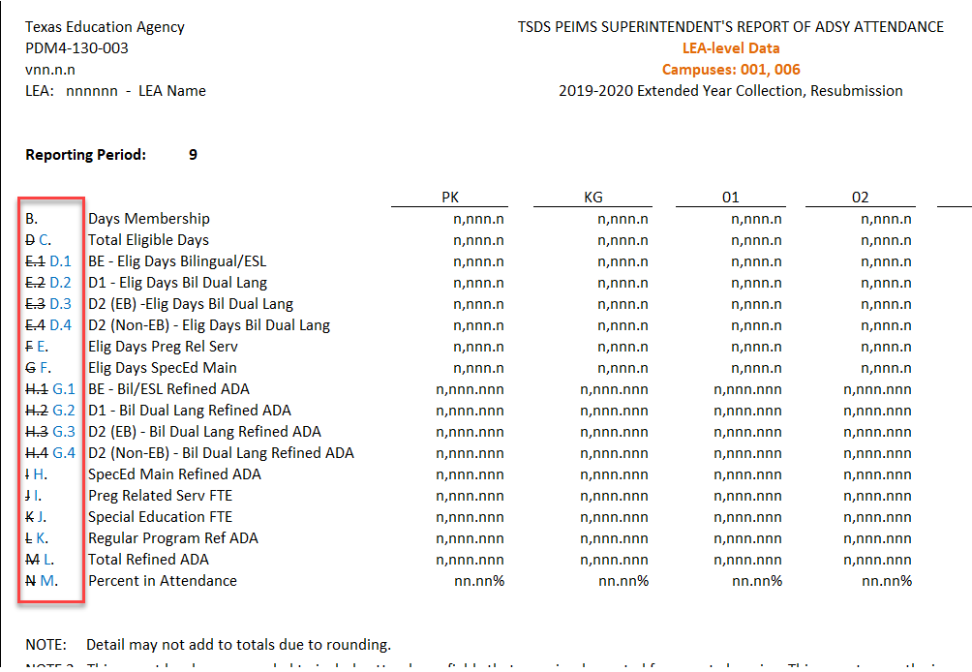
ADSY-Extended Year Submission Updates - 7
Rows reassigned letters after removing row for Total Days Absent:

Slide 13
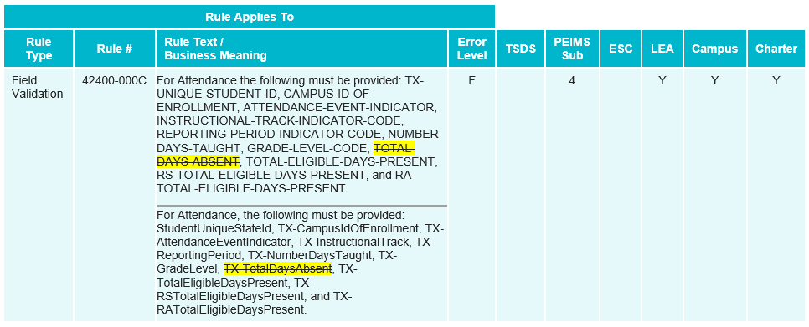
ADSY-Extended Year Submission Updates - 8
Updated Field Validation Rule to remove TOTAL-DAYS-ABSENT:

Slide 14
ADSY-Extended Year Submission Updates - 9
Updated Business Rule to remove TOTAL-DAYS-ABSENT:

Slide 15
ADSY-Extended Year Submission Updates - 10
Updated Business Rule to remove TOTAL-DAYS-ABSENT:

Slide 16
ADSY-Extended Year Submission Updates - 11
Removed Business Rule from PEIMS Extended Year Submission:

Slide 17
ADSY-Extended Year Submission Updates - 12
Added Business Rule :

Slide 18
EB-Extended Year Submission Updates
Senate Bill (SB) 2066 passed in the 87th legislative session amends TEC §29.060(a) and (d) and §29.066(a) and (b), to replace the term, “limited English proficient (LEP)” with “emergent bilingual (EB)”.

Slide 19
EB-Extended Year Submission Updates - 2
The following PEIMS Extended Year reports have been updated:
PDM4-120-003 Student Indicator Report by Grade
PDM4-120-004 Bilingual/ESL Summer School Roster
PDM4-130-001 Flex Attendance – Superintendent’s Report of Student Attendance
PDM4-130-003 Superintendent’s/Principal’s Report of ADSY Attendance
* Updated since Spring 2023 training

Slide 20
Timeline PEIMS Extended Year Submission 2023
PEIMS Extended Year Submission | Date
PEIMS Extended Year Submission ready for users to promote data | March 27, 2023
TSDS PEIMS Extended Year ready for users to complete, approve, and accept submissions | July 31, 2023
Requests to retire Unique IDs due at TEA for PEIMS Extended Year First Submission | August 18, 2023
PEIMS Extended Year First Submission due date for LEAs | August 31, 2023
Requests to retire Unique IDs due at TEA for PEIMS Extended Year Resubmission | September 8, 2023
PEIMS Extended Year Resubmission due date for LEAs | September 21, 2023

Slide 21
Frequently Asked Questions
How should ADSY attendance be reported when an LEA has ADSY days scheduled during the school year?
Regardless of when the ADSY days are offered, ADSY attendance is reported in the PEIMS Extended Year Submission for the associated academic year.

Slide 22
Frequently Asked Questions - 4
Why are TOTAL-DAYS-ABSENT (E0036) being removed from the PEIMS Extended Year Submission?
TEA removed TOTAL-DAYS-ABSENT (E0036) as the ADSY program is funded on the days the student participates in the program.

Slide 23
Frequently Asked Questions - 5
Why are EXCESS-HOURS-IN-INSTRUCTIONAL-SETTING (E0945) being removed from the PEIMS Extended Year Submission?
TEA removed EXCESS-HOURS-IN-INSTRUCTIONAL-SETTING (E0945) because the ADSY program only reports data for students in grades PK-5. This grade range of students is not eligible to participate in CTE and therefore would not earn excess contact hours in their instructional setting.

Slide 24
Frequently Asked Questions - 6
When does TEA calculate the CTE indicator code?
The CTE Indicator Code is calculated after each submission is completed. The CTE auto-calculation process is run after the close of the PEIMS Summer First Submission, Resubmission and year-round schools' submission. It is then calculated again after the close of PEIMS Extended Year First Submission and Resubmission.

Slide 25
2023-2024

Slide 26
Application Updates
The following PEIMS application functionality will be updated to include new data elements:
Data Search
Data Retrieval
Data Element Summary

Slide 27
TX First Early HS Completion Pgm Data Element Updates
Overview
During the 87th legislative session, Senate Bill (SB) 1888 was passed, which amends TEC§ 28.0253. As a result, the Texas Education Agency (TEA), in coordination with the Texas Higher Education Coordinating Board (THECB), shall establish the Texas First Early High School Completion Program. This program allows public high school students who demonstrate early readiness for college to graduate early from high school.

Slide 28
TX First Early HS Completion Pgm Data Element Updates - 2
Overview cont.
To be eligible for an award under the program, a student must:
Be a resident of this state as determined by THECB rules;
Have graduated early from high school under the Texas First Early High School Completion Program; and
Completed the Financial Aid Application Requirement for High School Graduation (TEC§ 28.0256).

Slide 29
TX First Early HS Completion Pgm Data Element Updates - 3
Overview cont.
THECB shall award a grant (state credit) to pay for tuition, mandatory fees, and other costs of attendance at an institution to each eligible student based on if the student graduates two or more semesters or less than two semesters or the equivalent earlier than the student's high school cohort.
TEA will increase a district’s average daily attendance for students who graduated early under the Texas First High School Completion Program and are enrolled at an eligible institution.
TEA will also reduce each district’s FSP entitlement by the amount granted (state credit) to each eligible student.

Slide 30
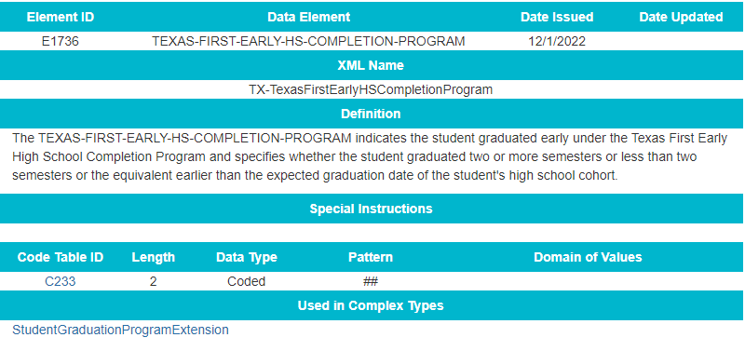
TX First Early HS Completion Pgm Data Element Updates - 4
Added new data element TEXAS-FIRST-EARLY-HS-COMPLETION-PROGRAM (E1736) to the StudentGraduationProgramExtension complex type to be reported as optional in the PEIMS Fall Submission.

Slide 31
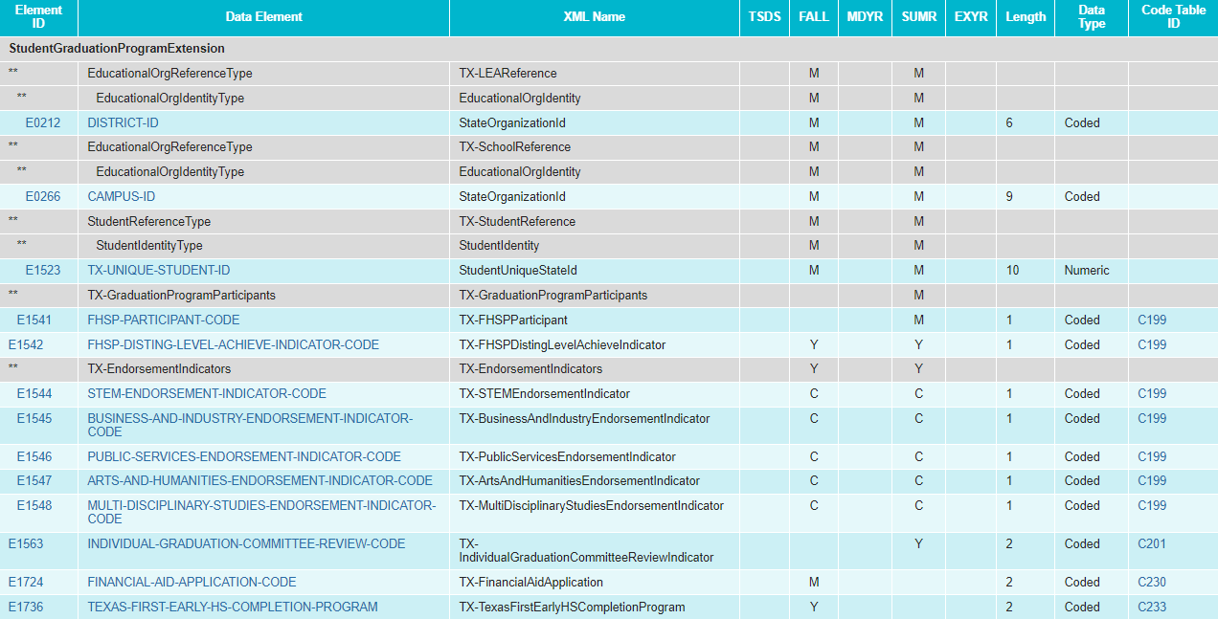
TX First Early HS Completion Pgm Data Element Updates -5
Modified the StudentGraduationProgramExtension complex type for the PEIMS Fall Submission:
Added TEXAS-FIRST-EARLY-HS-COMPLETION-PROGRAM (E1736) as optional

Slide 32
TX First Early HS Completion Pgm Code Table Updates
Added new code table TEXAS-FIRST-EARLY-HS-COMPLETION-PROGRAM (C233):

Slide 33
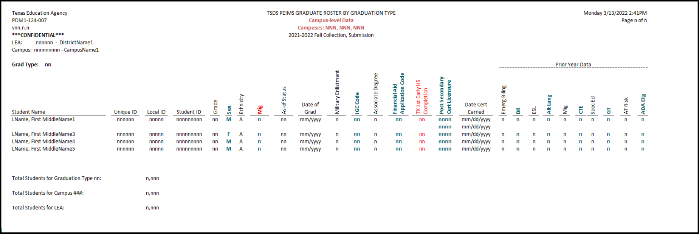
TX First Early HS Completion Pgm Report Updates
Revised the following PEIMS Fall Submission report to reflect these changes:
PDM1-124-007 Graduate Roster by Graduation Type

Slide 34
TX First Early HS Completion Pgm Business Rule Updates
No New Business Rules
No Updated Business Rules
No Deleted Business Rules

Slide 35
Adult HS Charter School Pgm - Data Element Updates
Overview
During the 87th legislative session, Senate Bill (SB) 1615 was passed, which amended Chapter 12 of the TEC by adding Subchapter G, “Adult High School Charter School Program.” Additionally, SB 1615 transferred existing TEC sections 29.259(j) and (k) to Subchapter G, Chapter 12, TEC§ 12.263, Adult Education Program Funding. Under Section 12.263, any student attending an adult high school charter school program may be eligible for funding under the state compensatory education (SCE) allotment. The Excel Center (For Adults) is the only charter currently operating under TEC§ 29.259.

Slide 36
Adult HS Charter School Pgm - Data Element Updates -2
Overview cont.
Currently, TEA collects a STUDENT-CENSUS-BLOCK-GROUP (E1648) for all economically disadvantaged students enrolled as of the PEIMS Fall snapshot date (last Friday in October) and is reported in the PEIMS Fall Submission to calculate the SCE allotment funding. However, the changes in SB 1615 allow any economically disadvantaged student attending an adult high school charter school program to be included in the calculations for SCE allotment funding regardless of enrollment date. Therefore, for TEA to calculate the appropriate SCE allotment funding, the STUDENT-CENSUS-BLOCK-GROUP (E1648) must be collected for any economically disadvantaged student who attended a charter operating under TEC §29.259 at any time during the school year.

Slide 37
Adult HS Charter School Pgm - Data Element Updates - 3
Added the existing data element STUDENT-CENSUS-BLOCK-GROUP (E1648) to the StudentExtension complex type as optional for the PEIMS Summer Submission:

Slide 38
Adult HS Charter School Pgm - Data Element Updates - 4
Updated Data Element Reporting Requirements:
StudentExtension complex type

Slide 39
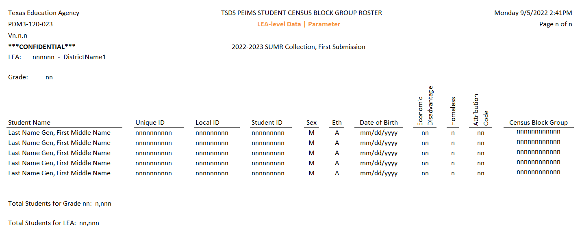
Adult HS Charter School Pgm Report Updates
A new report will be developed for the student census block group data.
PDM3-120-023 Student Census Block Group Roster
* Updated since Spring 2023 training

Slide 40
Adult HS Charter School Pgm Rule Updates
Added New Business Rules:

Slide 41
Adult HS Charter School Pgm Rule Updates - 5
Added New Business Rules (cont.):

Slide 42
Migrant Indicator Data Element Updates
Overview
The Elementary and Secondary Education Act of 1965 (ESEA), as amended by the Every Student Succeeds Act of 2015 (ESSA) in December 2015, updated the definition of a migrant child and the terminology used in Title 1, Chapter 3 from Education of Migrant Children to Education of Migratory Children.

Slide 43
Migrant Indicator Data Element Updates - 2
Overview cont.
LEAs currently report the data element, MIGRANT-INDICATOR-CODE (E0984), to indicate whether a student should be coded as a participant in the migrant education program. The current data element definition needs to be updated in addition to guidance updates to the terminology from “migrant” to “migratory” to align terminology with federal legislation.

Slide 44
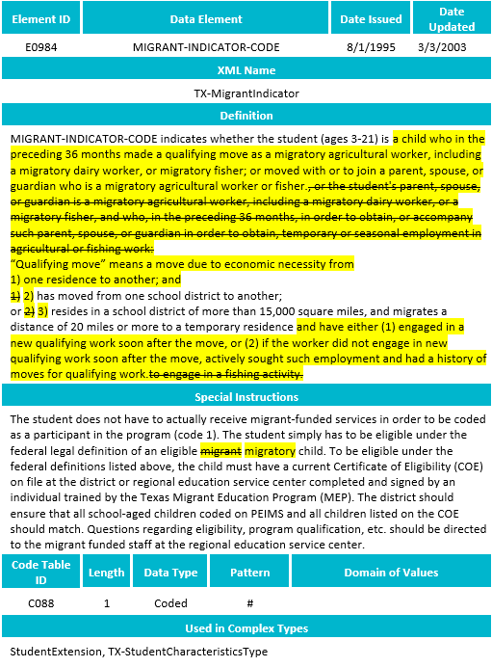
Migrant Indicator Data Element Updates - 3
Updated Data Element:

Slide 45
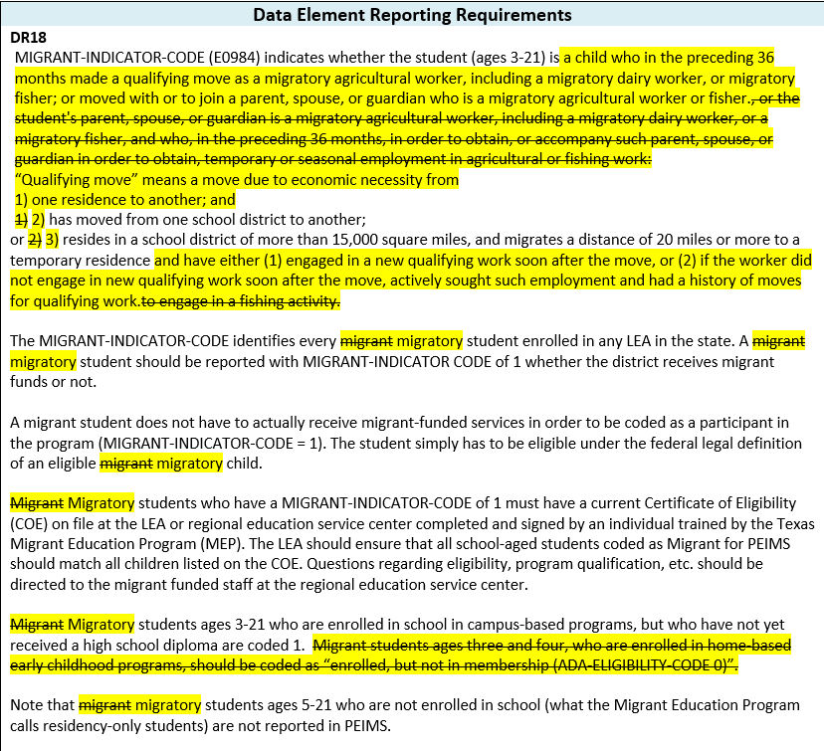
Migrant Indicator Data Element Updates - 4
Updated Data Element Reporting Requirements:

Slide 46
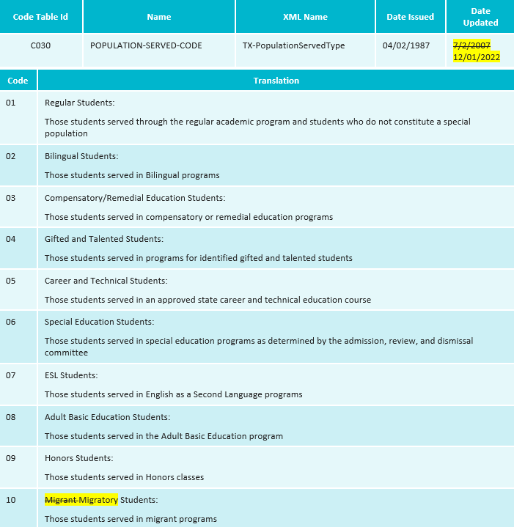
Migrant Indicator Code Table Updates
Revised the code translation for POPULATION-SERVED-CODE (C030) code 10:

Slide 47
Migrant Indicator Report Updates
Revised the following PEIMS reports to reflect these changes:
Fall Submission reports
PDM1-124-007 Graduate Roster by Graduation Type
PDM1-120-005 Student Data Review
PDM1-120-012 Student Indicator Report by Grade
PDM1-120-003 Student Program Roster
PDM1-120-009 Disaggregation of PEIMS Student Data
PDM1-124-004 School Leaver Roster
PDM3-120-002 Migrant Students by Grade

Slide 48
Migrant Indicator Report Updates - 5
Revised the following PEIMS reports to reflect these changes:
Fall Submission reports (cont.)
PDM1-120-004 Students by ADA Eligibility and Grade
PDM1-124-007 Graduate Roster by Graduation Type
PDM1-120-001 Student Type by Grade, Ethnicity, and Sex
PDM1-470-001 Disaggregation of PEIMS Student Data

Slide 49
Migrant Indicator Report Updates - 6
Revised the following PEIMS reports to reflect these changes:
Summer Submission reports
PDM3-120-015 Previous Year Average Daily Attendance
PDM3-130-010 Attendance Rates Comparison by Ethnicity, Gender, and Special Population
PDM3-820-001 Special Education FTEs By District of Residence and Instructional Setting
PDM3-120-004 Disaggregation of PEIMS Summer Attendance Data
PDM3-120-007 Student Indicator Report by Grade
PDM3-130-005 Comparison of Current and Prior Year Attendance

Slide 50
Migrant Indicator Report Updates - 7
Revised the following PEIMS reports to reflect these changes:
Summer Submission reports (cont.)
PDM3-130-009 Attendance by District of Residence
PDM3-130-020 Special Education FTEs By District of Residence and Instructional Setting
PDM3-454-002 Migrant and Attendance Count Data
PDM3-470-001 Disaggregation of PEIMS Summer Attendance Data

Slide 51
Migrant Indicator Business Rule Updates
No New Business Rules
No Updated Business Rules
No Deleted Business Rules

Slide 52
FASRG Updates
Overview
On September 7, 2022, the Financial Compliance Division released the Financial Accountability System Resource Guide (FASRG) version 18.0. The change included removing three program intent codes, Pre-Kindergarten (32), Pre-Kindergarten – Compensatory Education (34), and Pre-Kindergarten – Bilingual Education (35), from being used for budget, payroll, and contracted instructional (CI) staff for the 2022-2023 school year.

Slide 53
Code Table Updates
Modified the PROGRAM-INTENT-CODE (C147) code table to remove 32, 34, and 35 from being used for budget, payroll, and contracted instructional staff.

Slide 54
CTE Code Table Updates
Overview
Beginning in the 2020-2021 school year, TEA began auto-calculating the Career and Technology (CTE) indicator to assign to all students in grades 6-12. The calculation is based on the student's course completion data submitted by an LEA in the PEIMS Summer and Extended Year Submissions. The College, Career, and Military Preparation Division maintains the translations in the CAREER-AND-TECHNICAL-ED-IND-CD (C142) and has requested changes to help clarify the codes.

Slide 55
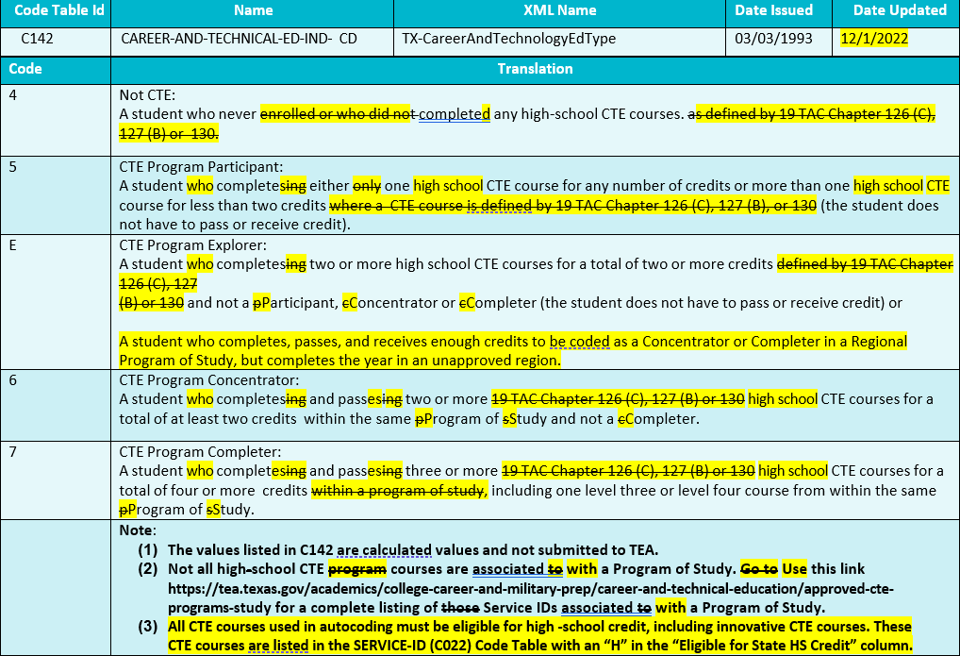
CTE Code Table Updates - 2
Modified the CAREER-AND-TECHNICAL-ED-IND-CD (C142) translations.

Slide 56
Code Table Updates - 2
C022 SERVICE-ID
The following Service IDs have been added:
12700110 Career and College Exploration (First Time Taken)
12700120 Career and College Exploration (Second Time Taken)
N1110035 Elements of Data Science
N1130030 Ethnic Studies: American Indian/Native Studies
N1290062 Multilingual Acculturation Studies for Newcomers
* New slide since Spring 2023 training

Slide 57
Code Table Updates - 2
C022 SERVICE-ID
Code ’13036300’ changed as follows:
Description changed from ‘Principles of Biosciences’ to ‘Principles of Bioscience’
* New slide since Spring 2023 training

Slide 58
Code Table Updates - 2
C022 SERVICE-ID
The following Service IDs have been removed:
12700300 College and Career Readiness
12700400 Investigating Careers (First Time Taken)
12700410 Investigating Careers (Second Time Taken)
12700420 Investigating Careers (Third Time Taken)
12700430 Investigating Careers (Fourth Time Taken)
N1160011 Functional Fitness
* New slide since Spring 2023 training
Notes:
TEDS Addendum update 2024.2.0 7/1/2023

Slide 59
Code Table Updates - 2
C022 SERVICE-ID
The following Service IDs have been removed (cont.):
N1260001 Cyber Citizenship
N1303756 Gateway To Technology (PLTW) (First Time Taken)
N1303757 Gateway To Technology (PLTW) (Second Time Taken)
N1303758 Gateway To Technology (PLTW) (Third Time Taken)
N1303759 Gateway To Technology (PLTW) (Fourth Time Taken)
N1303752 Texas Pre-Freshman Engineering Program I
* New slide since Spring 2023 training

Slide 60
Code Table Updates - 2
C215 INSTRUCTIONAL-PROGRAM-TYPE
Code ’05’ changed as follows:
‘05’ Dropout Recovery Program/Campus TEC 12.1141(c) or TEC 39.0548
* New slide since Spring 2023 training

Slide 61
Business Rule Updates - 2
Revised Rules
20032-0107-20032-0111,
20032-0113-20032-0118
20032-0120
20032-0153
42401-0005
44425-0048
* New slide since Spring 2023 training

Slide 62
Business Rule Updates
Revised Rules
* New slide since Spring 2023 training

Slide 63
Business Rule Updates
Revised Rules
* New slide since Spring 2023 training

Slide 64
Business Rule Updates
Revised Rules
* New slide since Spring 2023 training

Slide 65
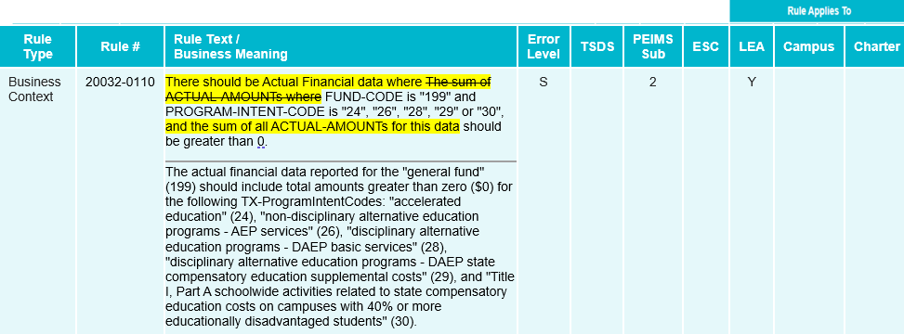
Business Rules Updates
Revised Rules
* New slide since Spring 2023 training

Slide 66
Business Rules Updates
Revised Rules
* New slide since Spring 2023 training

Slide 67
Business Rules Updates
Revised Rules
* New slide since Spring 2023 training

Slide 68
Business Rules Updates
Revised Rules
* New slide since Spring 2023 training

Slide 69
Business Rules Updates
Revised Rules
* New slide since Spring 2023 training

Slide 70
Business Rules Updates
Revised Rules
* New slide since Spring 2023 training

Slide 71
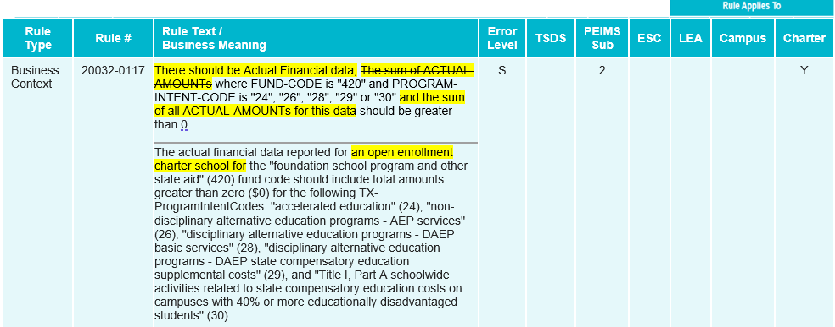
Business Rule Updates
Revised Rules
* New slide since Spring 2023 training

Slide 72
Business Rule Updates
Revised Rules
* New slide since Spring 2023 training

Slide 73
Business Rule Updates
Revised Rules
* New slide since Spring 2023 training

Slide 74
Business Rule Updates
Revised Rules
* New slide since Spring 2023 training

Slide 75
Business Rule Updates
Revised Rules
* New slide since Spring 2023 training

Slide 76
Business Rule Updates - 2
Deleted Rules from PEIMS Summer Submission
* New slide since Spring 2023 training

Slide 77
Reporting Requirement Updates
E1079 PRIMARY-PK-FUNDING-SOURCE
E1080 SECONDARY-PK-FUNDING-SOURCE
BasicReportingPeriodAttendanceExtension DR3
The Primary and Secondary PK Funding Source Codes are only reported for prekindergarten students when a student is funded for half-day but attends full-day, or the PK student is ineligible for funding. See PEIMS code table C186. These students must have a Primary PK Funding Source Code and may have a Secondary PK Funding Source Code reported.
An eligible five-year-old student in a Prekindergarten class must also be reported with a PARENT-REQUEST-RETENTION-INDICATOR (E1729) in the PEIMS Fall Submission.
* New slide since Spring 2023 training

Slide 78
Reporting Requirement Updates
E1079 PRIMARY-PK-FUNDING-SOURCE
E1080 SECONDARY-PK-FUNDING-SOURCE
StudentSchoolAssociationExtension DR11
The Primary and Secondary PK Funding Source Codes are only reported for prekindergarten students when a student is funded for half-day but attends full-day, or the PK student is ineligible for funding. See PEIMS code table C186. These students must have a Primary PK Funding Source Code and may have a Secondary PK Funding Source Code reported.
An eligible five-year-old student in a Prekindergarten class must also be reported with a PARENT-REQUEST-RETENTION-INDICATOR (E1729).
* New slide since Spring 2023 training

Slide 79
Reporting Requirement Updates
** TX-DyslexiaServices Complex Type ** DR 12
The TX-DyslexiaService Complex Type represents which type of dyslexia or related services, if any, a student identified with dyslexia or a related disorder under TEC 48.009 has received at any time during the school year.
The sub-complex type is only reported for students identified with dyslexia or a related disorder under TEC 48.009 (student with DYSLEXIA-INDICATOR-CODE of ‘1’ on the StudentExtension complex type).
If a student identified with dyslexia or a related disorder under TEC 48.009 does not receive services, DYSLEXIA-SERVICES-CODE of ‘00’ should be reported for that student.
* New slide since Spring 2023 training

Slide 80
Reporting Requirement Updates
**TX-IndustryCertifications Complex Type ** DR 50
The TX-IndustryCertifications Complex Type provides information on the examinations by a student during a school year. The TX-IndustryCertifications Complex Type includes the following:
Type of Certification
Results of the examination, and
If requesting, the cost of examination to the Local Education Agency (LEA).
More than one IBC may be reported for each student. For each unique IBC or license examination taken by a student during a school year, the complex type TX-IndustryCertifications will be reported. In the XML reporting, this is known as “unbounded” and allows an XML item or set of items to be repeated as many times as needed.
Effective dating is a method of tracking data changes over time. A new instance of the TX-IndustryCertifications Complex Type will be reported each time a student takes an IBC or license examination during the school year. With each new instance of the complex type, a new date should be reported in the EFFECTIVE-DATE (TX-DateCertEarned).
*New slide since Spring 2023 training

Slide 81
Timeline PEIMS Fall Submission
PEIMS Fall Submission | Date
TSDS PEIMS ready to load data to eDM | August 7, 2023
PEIMS Fall Submission ready for users to promote data | September 11, 2023
Close of school-start window - Last Friday in September | September 29, 2023
PEIMS Fall snapshot date | October 27, 2023
TSDS PEIMS Fall ready for users to complete, approve, and accept submissions | October 30, 2023
Requests to retire Unique IDs due at TEA for PEIMS Fall First Submission | December 1, 2023
PEIMS Fall First Submission due date for LEAs and ESCs | December 7, 2023
Requests to retire Unique IDs due at TEA for PEIMS Fall Resubmission | January 12, 2024
PEIMS Fall Resubmission due date for LEAs and ESCs | January 18, 2024

Slide 82
Timeline PEIMS Mid-Year Submission
PEIMS Mid-Year Submission | Date
PEIMS Mid-Year Submission ready for users to promote data | November 13, 2023
PEIMS Mid-Year ready for users to complete, approve, and accept submissions | December 18, 2023
PEIMS Mid-Year First Submission due date for LEAs and ESCs | January 25, 2024
PEIMS Mid-Year Resubmission due date for LEAs and ESCs | February 8, 2024

Slide 83
Timeline PEIMS Summer Submission 2024
PEIMS Summer Submission | Date
PEIMS Summer Submission ready for users to promote data | February 26, 2024
TSDS PEIMS Summer ready for users to complete, approve, and accept submissions | May 20, 2024
Requests to retire Unique IDs due at TEA for PEIMS Summer First Submission | June 14, 2024
PEIMS Summer First Submission due date for LEAs | June 20, 2024
Requests to retire Unique IDs due at TEA for PEIMS Summer Resubmission | July 12, 2024
PEIMS Summer Resubmission due date for LEAs LEAs registered with TEA with year-round tracks ending later than June 20, 2024 may delay PEIMS Summer Resubmission until two weeks following completion of the latest year-round track or August 15, 2024, whichever comes first. However, the initial data delivery for submission 3 must still be made by June 20, 2024, for all LEAs. In no case will any resubmission be processed after August 15, 2024. Data corrections made after August 15, 2024 will be processed by State Funding. | July 18, 2024

Slide 84
Timeline PEIMS Extended Year Submission 2024
PEIMS Extended Year Submission | Date
PEIMS Extended Year Submission ready for users to promote data | March 25, 2024
TSDS PEIMS Extended Year ready for users to complete, approve, and accept submissions | July 29, 2024
Requests to retire Unique IDs due at TEA for PEIMS Extended Year First Submission | August 23, 2024
PEIMS Extended Year First Submission due date for LEAs | August 29, 2024
Requests to retire Unique IDs due at TEA for PEIMS Extended Year Resubmission | September 13, 2024
PEIMS Extended Year Resubmission due date for LEAs | September 19, 2024

Slide 85
Technical Resources
Technical Support
TSDSCustomerSupport@tea.texas.gov
Technical Specifications
TSDS Web-Enabled Data Standards (TWEDS)​
TSDS Incident Management System (TIMS)
TIMS Support System Application
TIMS Knowledge Base Article Repository

Slide 86
Questions?
Thank you for attending.

