Slide 1
Census Block Group Tools

Slide 2
Note
The focus of this presentation is on the changes for the official XML data submissions during the 2023-2024 school year.

Slide 3
Agenda
Census Block Group Tools
Program Area Contacts
2022-2023
Reminders
Current Known Issues
2023-2024
Application Updates
Updates
Timeline
Frequently Asked Questions
Technical Resources
Questions

Slide 4
Program Area Contacts
Forecasting & Fiscal Analysis Analysis
Sara Kohn, Director of Forecasting & Fiscal Analysis - Sara.Kohn@tea.texas.gov

Slide 5
2022-2023

Slide 6
Reminders
The ‘Census Block Group Tool (CBGT)’ privilege is listed under the following TEAL Roles:
PEIMS Data Completer
ODS Data Loader
ODS Campus Data Loader

Slide 7
Current Known Issues
Record Threshold
The system should allow up to 10,000 records for processing. This is currently not working as expected.
TEA recommends sending a maximum of 5,000 records per file at this time.
Once the issue is resolved, TEA will inform users the record threshold can be increased.

Slide 8
Current Process Review
The current CBGT Tool and API solution allow users to input a student's street address information which is used to calculate the census block group number based on (X) Latitude (Y)Longitude coordinates obtained from the ESRI Geocoder snapshot data. In conjunction with the X/Y coordinate data the 2020 U.S. census data is also used to provide the census block group number.
Currently the ESRI Geocoder data uses a snapshot taken at the beginning of the current school year.

Slide 9
Future Process Review
The logic remains the same in using the x/y coordinates from the ESRI data snapshot before going to the 2020 U.S. Census data to obtain the census block group number.
TEA is working to update the ESRI Geocoder data throughout the year and will communicate the progress on this work during the FCN webinars.

Slide 10
2023-2024

Slide 11
Application Updates
No application updates are currently scheduled for the 2023-2024 school year.

Slide 12
Updates
No New Data Elements, Code Tables, Reports, or Business Rules
No Updated Data Elements, Code Tables, or Reports
No Deleted Data Elements, Code Tables, Reports, or Business Rules

Slide 13
Business Rule Update
Updated business rule 40100-0224 for the 2023-2024 school year to ensure only valid census block groups are reported. The Error Level was changed to “Fatal.”

Slide 14
Reminders
Reassign the Census Block Group number each year for those students who are reported with a Census Block Group number to PEIMS.

Slide 15
Data Element Updates
Added the existing STUDENT-CENSUS-BLOCK-GROUP (E1648) to the StudentExtension complex type to be reported as “optional” in the PEIMS Summer Submission. The STUDENT-CENSUS-BLOCK-GROUP is only reported by the Excel Center For Adults (227-827).UDENT-CENSUS-BLOCK-GROUPSTUDENT-CENSUS-BLOCK-GROUP

Slide 16
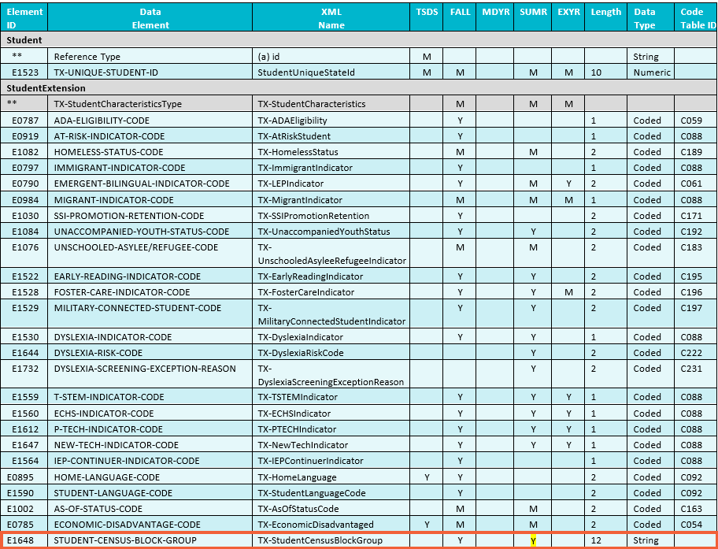
Data Element Updates

Slide 17
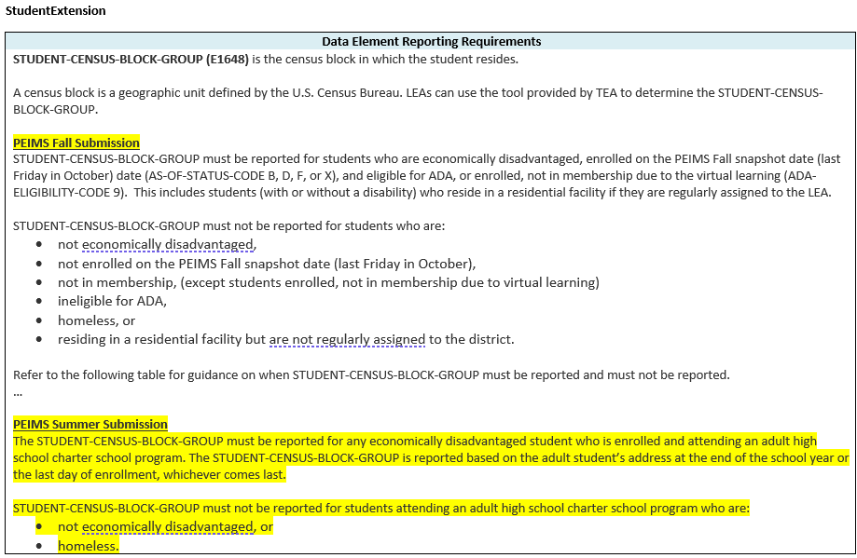
Data Element Updates

Slide 18
Timeline – PEIMS Fall Submission
Name of Collection | Date
TSDS PEIMS ready to load data to the eDM | August 7, 2023
PEIMS Fall Submission ready for users to promote data | September 11, 2023
Close of school start window – Last Friday in September | September 29, 2023
PEIMS Fall snapshot date – Last Friday in October | October 27, 2023
TSDS PEIMS Fall ready for users to complete, approve and accept submissions | October 30, 2023
PEIMS Fall First Submission due date for LEAs and ESCs | December 07, 2023
PEIMS Fall Resubmission due date for LEAs and ESCs | January 18, 2024

Slide 19
Timeline – PEIMS Summer Submission
Name of Collection | Date
PEIMS Summer submission ready for users to promote data | February 26, 2024
TSDS PEIMS Summer ready for users to complete, approve and accept submissions | May 20, 2024
Requests to retire Unique IDs due at TEA for PEIMS Summer first submission | June 14, 2024
PEIMS Summer first submission due date for LEAs | June 20, 2024
Requests to retire Unique IDs due at TEA for PEIMS Summer resubmission | July 12, 2024
PEIMS Summer resubmission due date for LEAs | July 18, 2024

Slide 20
Frequently Asked Questions
What do I do if the Census Block Group Tool does not give me a 100% confidence score?
TEA guidance is to use the Map if the CBGT does not return a 100% confidence score.

Slide 21
Technical Resources
Technical Support and Resources
TSDSCustomerSupport@tea.texas.gov
Census Block Group Map Instructions
Census Block Group API Instructions
Census Block Tier Mapping for 2023
State Funding Division:
State Funding Webpage
Knowledge Base Articles:
TSDSKB-595: Census Block Group Number Information / FAQs

Slide 22
Questions?
Thank you for attending.

