Slide 1
PEIMS

Slide 2
Note
The focus of this presentation is on the changes for the official XML data submissions during the 2023-2024 school year.

Slide 3
Agenda
PEIMS
Program Area Contacts
2022-2023
Submission Updates
Reminders
Current Known Issues
Timeline
Frequently Asked Questions
2023-2024
Application Updates
Data Element Updates
Code Table Updates
Report Updates
Business Rule Updates
Timeline
Technical Resources
Questions

Slide 4
Program Area Contacts
Expanded Learning Models
Brian Doran, Director – brian.doran@tea.texas.gov
Safe and Supportive Schools
Hank Weikert, Director – hank.weikert@tea.texas.gov
Department of Standards & Support
Monica Martinez, Associate Commissioner – monica.martinez@tea.texas.gov
Federal Program Compliance Division
Idalia Ibanez, Program Director – idalia.ibanez@tea.texas.gov

Slide 5
2022-2023

Slide 6
ADSY-Summer Submission Updates
Overview
Updated the definition and data element reporting requirements for the ADDITIONAL-DAYS-PROGRAM-INDICATOR-CODE (E1671) data element.
Updated the SchoolExtension complex type to include the ADDITIONAL-DAYS-PROGRAM-INDICATOR-CODE (E1671) data element, to be reported as Optional in the PEIMS Summer Submission.
The Learning Support and Programs Division can determine the calendars that fall short of the required 180 days or 75,600 minutes, including approved waiver minutes/days.

Slide 7
ADSY-Summer Submission Updates - 1
Overview cont.
The Learning Support and Programs Division can provide outreach to campuses between the PEIMS Summer First Submission and Resubmission to allow for any needed data corrections.
TEA will create a new report at the statewide level and a new report at the LEA level, both reports will be available the first week in May. New rules will be added, in the March 31, 2023, release, to reflect the collection of the indicator during the PEIMS Summer Submission.

Slide 8
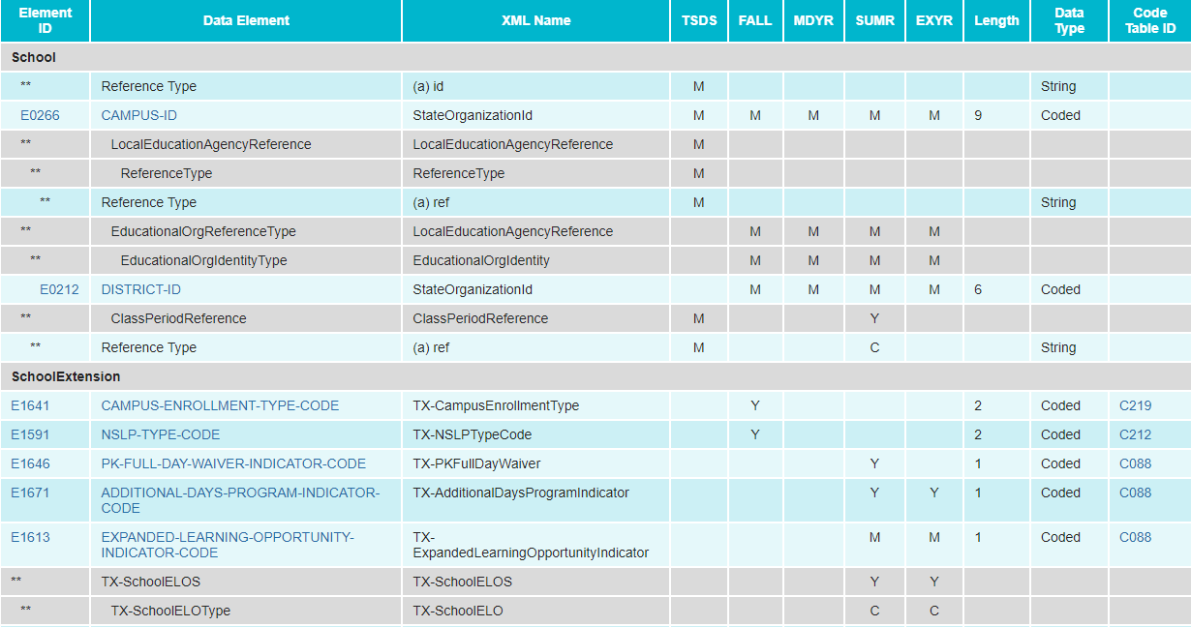
ADSY-Summer Submission Updates - 2
Added ADDITIONAL-DAYS-PROGRAM-INDICATOR-CODE to the SchoolExtension complex type:

Slide 9
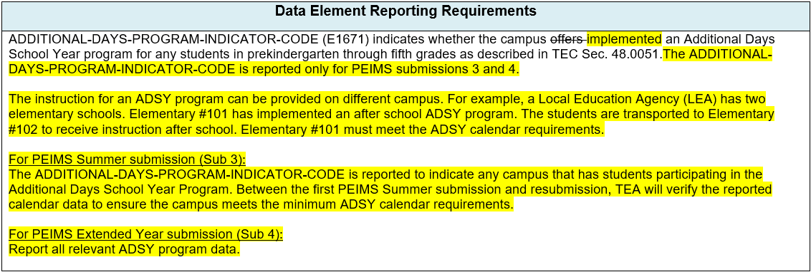
ADSY-Summer Submission Updates - 3
Updated Data Element Reporting Requirements:

Slide 10
ADSY-Summer Submission Updates - 4
The following new report is tentatively scheduled to be released on March 31, 2023:
PDM3-116-010 ADSY Campus List

Slide 11
ADSY-Summer Submission Updates - 5
Added New Business Rules:

Slide 12
Dyslexia-Summer Submission Updates
Overview
TEA currently collects dyslexia related services information during the PEIMS Summer Submission. During the PEIMS Fall Submission, TEA collects data indicating if a student is identified as dyslexic under TEC 48.009.
During the PEIMS Summer Submission, TEA collects the type of dyslexia or related services, if any, a student identified with dyslexia or related disorder under TEC §48.009 has received at any time during the school year. However, TEA does not collect an indicator to validate that each student identified as dyslexic has been reported with the services received.

Slide 13
Dyslexia-Summer Submission Updates - 2
Overview cont.
Additionally, local education agencies (LEAs) are required to screen students in kindergarten and first grade for dyslexia or related disorders. Currently, when an LEA does not screen a student, TEA cannot identify why the screening did not take place.
The division of special education has requested changes to what is collected for dyslexic students.

Slide 14
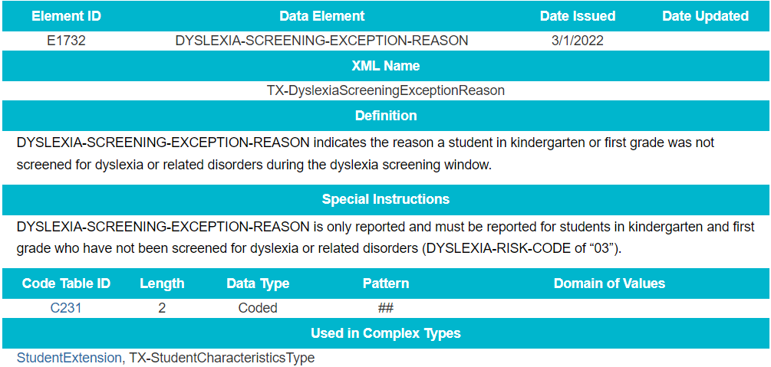
Dyslexia-Summer Submission Updates - 3
Updates to the complex type StudentExtension:
Added new data element DYSLEXIA-SCREENING-EXCEPTION-REASON (E1732) as optional:

Slide 15
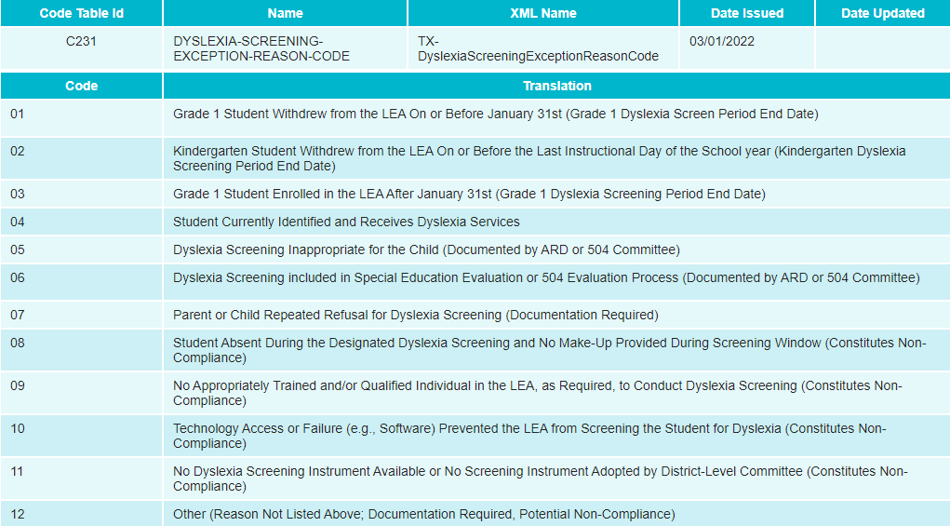
Dyslexia-Summer Submission Updates - 4
Added new code table DYSLEXIA-SCREENING-EXCEPTION-REASON-CODE (C231) with 12 codes:

Slide 16
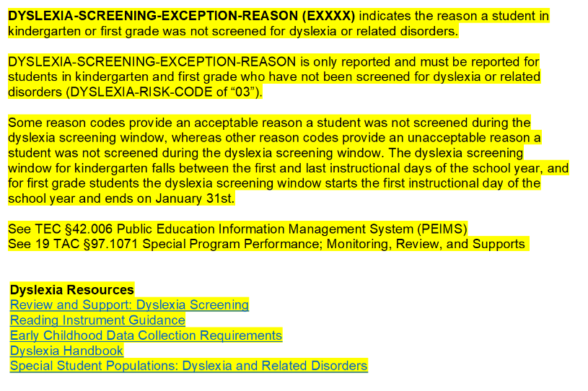
Dyslexia-Summer Submission Updates - 5
Added Data Element Reporting Requirements:

Slide 17
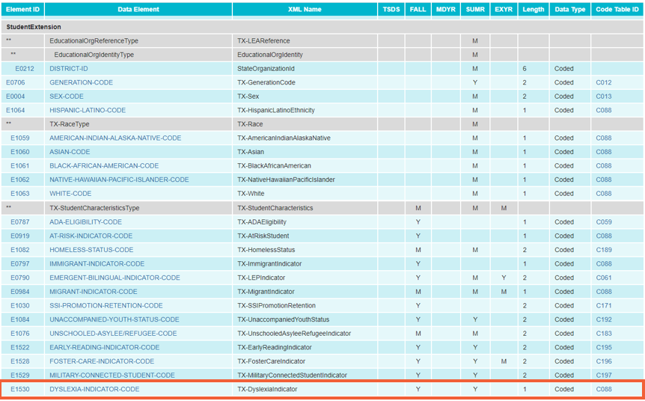
Dyslexia-Summer Submission Updates - 6
Added DYSLEXIA-INDICATOR-CODE (E1530) to PEIMS Summer Submission in the StudentExtension complex type as optional:

Slide 18
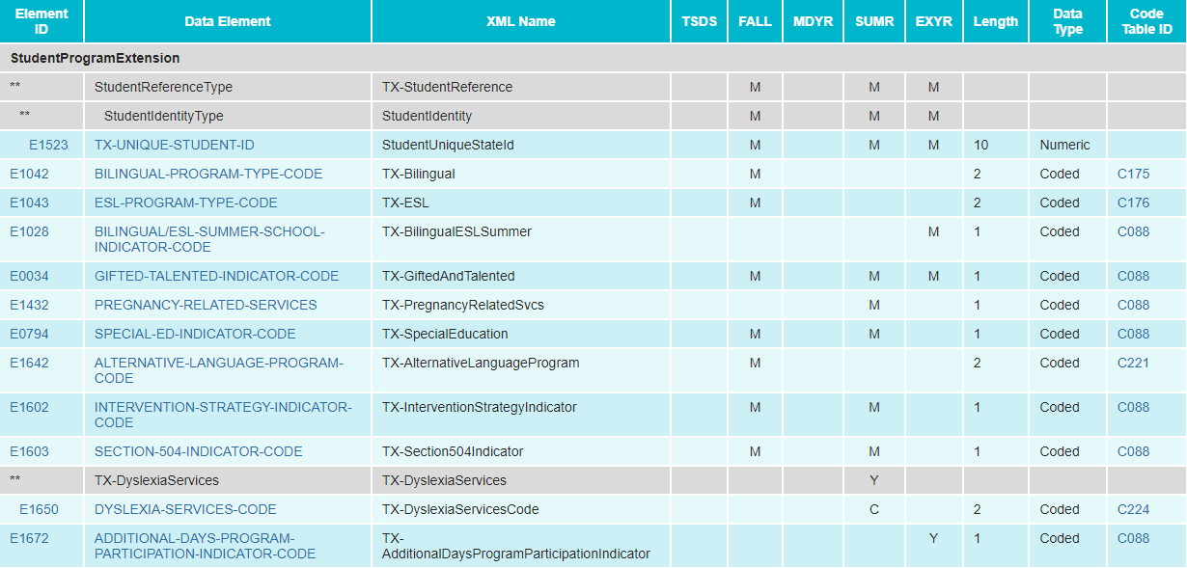
Dyslexia-Summer Submission Updates - 7
Updated the data element DYSLEXIA-SERVICES-CODE (E1650) in the StudentProgramExtension complex type from mandatory to conditionally mandatory:

Slide 19
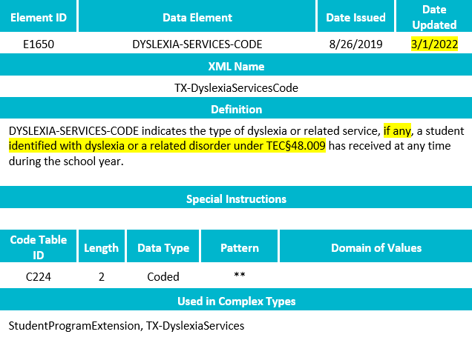
Dyslexia-Summer Submission Updates - 8
Revised the data element definition for DYSLEXIA-SERVICES-CODE (E1650):

Slide 20
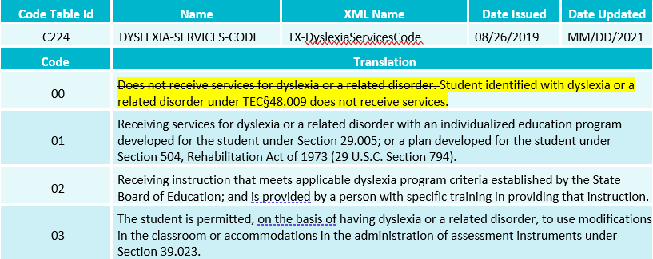
Dyslexia-Summer Submission Updates - 9
Revised the translation for Code 00 for DYSLEXIA-SERVICES-CODE (C224) code table:

Slide 21
Dyslexia-Summer Submission Updates - 10
Updated Data Element Reporting Requirements:

Slide 22
Dyslexia-Summer Submission Updates - 11
The following reports are tentatively scheduled to be updated in the software release on March 31, 2023:
PDM3-120-007 Student Indicator Report by Grade
Add DYSLEXIA-INDICATOR-CODE (E1530)
PDM3-120-018 Student Dyslexia and/or Related Services Roster
Add DYSLEXIA-INDICATOR-CODE (E1530)
Add DYSLEXIA-SCREENING-EXCEPTION-REASON (E1732)

Slide 23
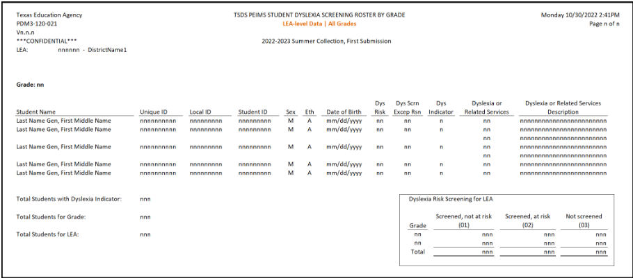
Dyslexia-Summer Submission Updates - 12
The following new report is tentatively scheduled to be released in the software release on March 31, 2023:
PDM3-120-021 Student Dyslexia Screening Roster by Grade

Slide 24
Dyslexia-Summer Submission Updates - 13
Added New Business Rules:

Slide 25
Dyslexia-Summer Submission Updates - 14
Added New Business Rules (cont.):

Slide 26
Dyslexia-Summer Submission Updates - 15
Added New Business Rules (cont.):

Slide 27
EB-Summer Submission Updates
Senate Bill (SB) 2066 passed in the 87th legislative session amends Texas Education Code (TEC) §29.060(a) and (d) and §29.066(a) and (b), to replace the term, “limited English proficient (LEP)” with “emergent bilingual (EB)”.
The following PEIMS Summer reports have been updated to reflect these changes:
PDM3-120-004 Disaggregation of PEIMS Summer Attendance Data
PDM3-120-015 Prior Year Average Daily Attendance Data

Slide 28
EB-Summer Submission Updates - 2
The following PEIMS Summer reports have been updated to reflect these changes:
PDM3-125-002 Student Disciplinary Action Detail Report for Students with Restraint Events
PDM3-130-001 Superintendent’s/Principal’s Report of Student Attendance
PDM3-130-003 Superintendent’s/Principal’s Report of Selected Students
PDM3-130-005 Comparison of Current and Prior Year Attendance

Slide 29
EB-Summer Submission Updates - 3
The following PEIMS Summer reports have been updated to reflect these changes:
PDM3-130-008 Superintendent’s/Principal’s Summary Report of Student Attendance
PDM3-130-009 Attendance by District of Residence
PDM3-130-010 Attendance Rates Comparison by Ethnicity, Gender, and Special Population
PDM3-130-011 Flex Attendance - Superintendent’s Report of Student Attendance

Slide 30
EB-Summer Submission Updates - 4
The following PEIMS Summer reports have been updated to reflect these changes:
PDM3-130-013 Flex Attendance - Superintendent’s Report by Special Program
PDM3-130-014 Flex Attendance - Superintendent’s Summary Report of Student Attendance
PDM3-131-011 Students with a Mandatory Expulsion to a JJAEP with Attendance in that Reporting Period

Slide 31
IBC-Summer Submission Updates
Overview
House Bill 22 (HB 22), passed during the 85th legislative session, established the A-F accountability system. Per TEC §39.053, students can earn College, Career, and Military Readiness (CCMR) credit for earning an approved industry-based certification (IBC). Additionally, House Bill 3 (HB 3), passed during the 86th legislative session, entitles LEAs to one IBC reimbursement per student to help defray the cost of the exams passed.

Slide 32
IBC-Summer Submission Updates - 2
Overview cont.
Currently, LEAs use the data element, POST-SECONDARY-LICENSURE-CERTIFICATION-CODE (E1640) to report IBCs earned for CCMR credit (students have earned the certification) and IBCs passed (students have passed all or a portion of a multileveled certification). TEA uses this data element to determine whether a student has met the threshold to earn the CCMR indicator, and data element IBC-EXAM-FEE-AMOUNT (E1654) to determine if the LEA is requesting reimbursement. LEAs may request reimbursement for a portion of an IBC exam a student passed, even if the student has not completed all the requirements to earn the certification.

Slide 33
IBC-Summer Submission Updates - 3
Overview cont.
Additionally, the 2018-2019 school year was the last year TEA collected when a student failed an IBC exam. While the LEA cannot request reimbursement for those students who fail to pass an IBC exam, TEA must collect this information for reporting purposes.

Slide 34
IBC-Summer Submission Updates - 4
Updates to the complex type StudentExtension:
Increased the length from three to four digits for POST-SECONDARY-CERTIFICATION-LICENSURE-CODE (E1640).
Increased the length from three to four digits for IBC-VENDOR-CODE (E1655).

Slide 35
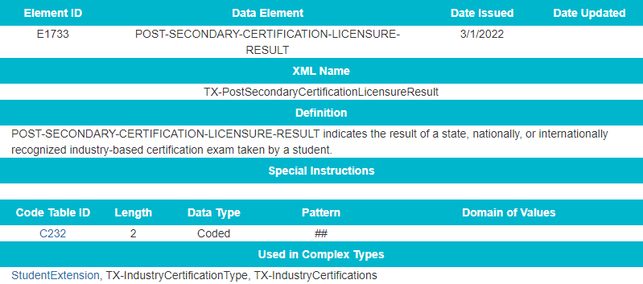
IBC-Summer Submission Updates - 5
Updates to the sub-complex type TX-IndustryCertifications:
Added a new data element POST-SECONDARY-CERTIFICATION-LICENSURE-RESULT (E1733).

Slide 36
IBC-Summer Submission Updates - 6
Added a new code table POST-SECONDARY-CERTIFICATION-LICENSURE-RESULT-CODE (C232).

Slide 37
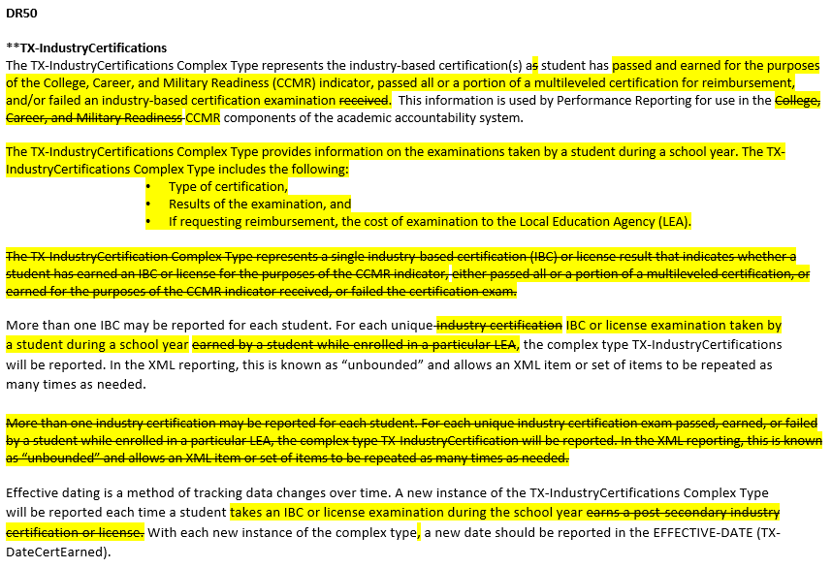
IBC-Summer Submission Updates - 7
Added and Updated Data Element Reporting Requirements:

Slide 38
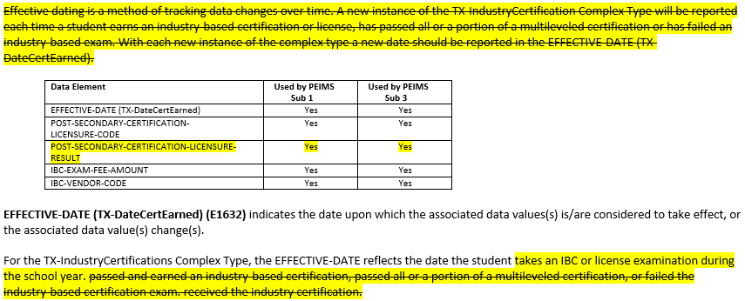
IBC-Summer Submission Updates - 8

Slide 39
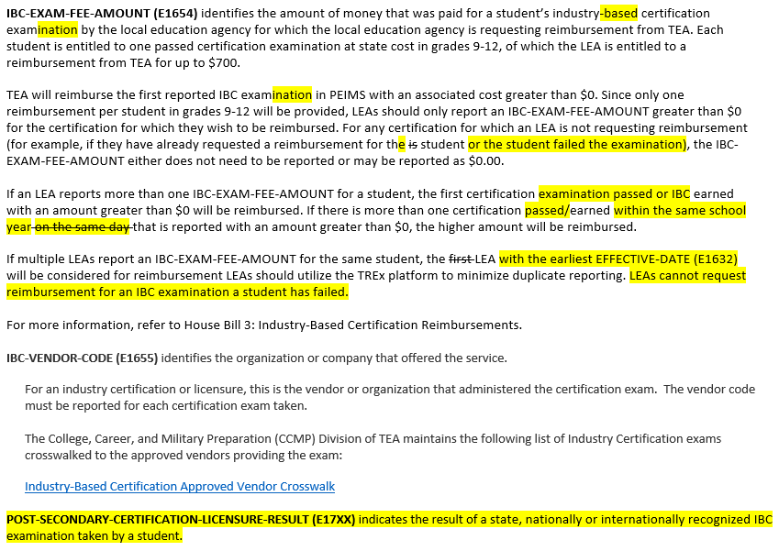
IBC-Summer Submission Updates - 9

Slide 40
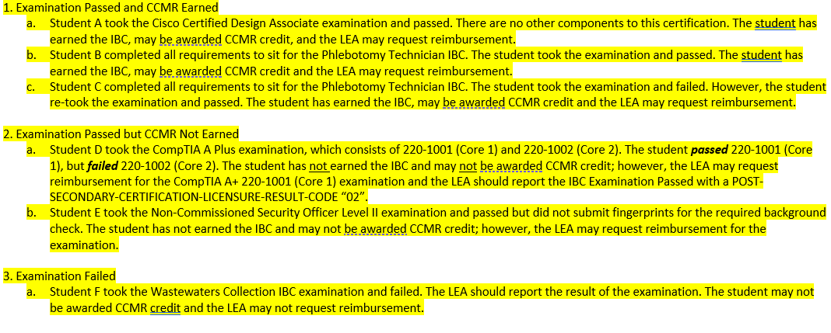
IBC-Summer Submission Updates - 10
Added Examples:

Slide 41
IBC-Summer Submission Updates - 11
The following PEIMS Summer reports have been updated to reflect these changes:
PDM3-120-010 Student Advanced Academic Roster by Grade
PDM3-120-019 Industry Based Certification Roster

Slide 42
IBC-Summer Submission Updates - 12
Added New Business Rule:

Slide 43
IBC-Summer Submission Updates - 13
2022-2023 PEIMS Fall Submission
IBCs earned from June 1, 2022 - August 31, 2022, are classified as prior year IBCs and are validated against the 2021-2022 TEDS code tables.
2022-2023 PEIMS Summer Submission
IBCs earned from September 1, 2022 – May 31, 2023, are classified as current school year IBCs and are validated against the 2022-2023 code tables.
Code tables: C214 Industry Certification Licensure Code and C226 Vendor Code.

Slide 44
SSSP-Summer Submission Updates
Overview
During the 86th legislative session, Senate Bill (SB) 11 was passed, which amended Subchapter D, Chapter 37, TEC by adding §37.115. This new section requires the board of trustees for each LEA to establish a safe and supportive school program (SSSP) team to serve at each campus to conduct threat assessments. The SSSP team must report to the agency, through guidelines developed by the agency, the following information regarding the team's activities and other information for each LEA campus the team serves, the outcome of each assessment made by the team, including:
any disciplinary action taken, including a change in school placement (§37.115(k)(3)(A));
changes in school placement, including placement in a juvenile justice alternative education program or disciplinary alternative education program (§37.115(k)(4)(D));

Slide 45
SSSP-Summer Submission Updates - 2
Overview cont.
placements in in-school suspension or out-of-school suspension and incidents of expulsion (§37.115(k)(3)(F));
In prior years, LEAs reported the total number of discipline incidents that included a Safe and Supportive Schools Program (SSP) team review and the resulting total number of changes in school placement that occurred after the SSP review was conducted through an annual data collection/survey.

Slide 46
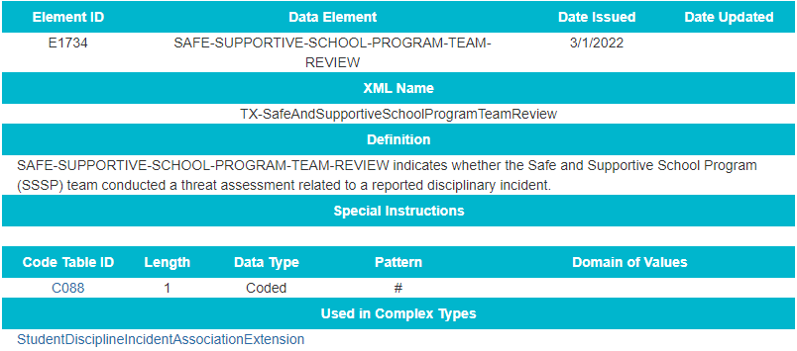
SSSP-Summer Submission Updates - 3
Updates to the StudentDisciplineIncidentAssociationExtension complex type:
Added a new data element SAFE-SUPPORTIVE-SCHOOL-PROGRAM-TEAM-REVIEW (E1734).

Slide 47
SSSP-Summer Submission Updates - 4
Added Data Element Reporting Requirements:

Slide 48
SSSP-Summer Submission Updates - 5
The following reports are tentatively scheduled to be updated in the software release on March 31, 2023:
PDM3-132-001 Student Disciplinary Action Roster
PDM3-132-002 Student Disciplinary Action Detail by Reason
PDM3-132-004 Student Disciplinary Action Detail by Incident Number

Slide 49
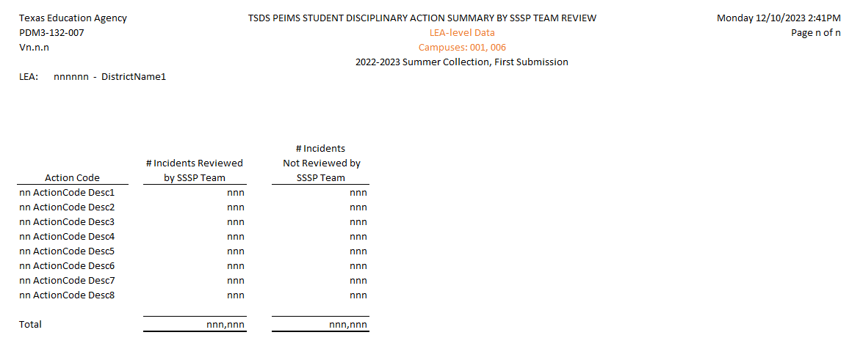
SSSP-Summer Submission Updates - 6
The following new report is tentatively scheduled to be released in the software release on March 31, 2023:
PDM3-132-007 Student Disciplinary Action Summary by SSSP Team Review

Slide 50
Virtual Students-Summer Submission Updates
Overview
TEA added a new indicator, VIRTUAL-STUDENT-NOT-IN-MEMBERSHIP (E1735) to the PEIMS Summer Submission for use by an LEA when a student spends at least half of their instructional time enrolled in virtual courses without the benefit of funding under ADA.
During 2021-2022, these students may have been identified with crisis codes 10A and 10B

Slide 51
Virtual Students-Summer Submission Updates - 2
Overview cont.
These students may be reported with attendance in the PEIMS Summer Submission if some of their time was spent outside of the virtual program and they are eligible for ADA.
Additional information regarding Remote Learning can be found here: https://tea.texas.gov/academics/learning-support-and-programs/remote-learning

Slide 52
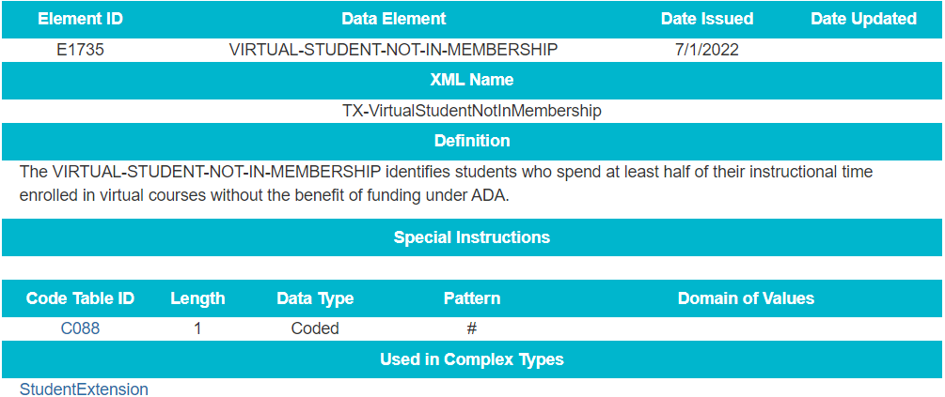
Virtual Students-Summer Submission Updates - 3
Added new indicator VIRTUAL-STUDENT-NOT-IN-MEMBERSHIP (E1735) to the StudentExtension complex type:

Slide 53
Virtual Students-Summer Submission Updates - 4
Added new indicator VIRTUAL-STUDENT-NOT-IN-MEMBERSHIP (E1735) to the StudentExtension complex type as optional:

Slide 54
Virtual Students-Summer Submission Updates - 5
Scenario #1
A student enrolled in virtual learning from the first day of school until the student withdrew February 15, 2022.
During the 2021-2022 school year, the student would have been reported with a CRISIS-CODE 10A and an ADA-ELIGIBILITY-CODE 9.
No attendance would be reported for this student.
During the 2022-2023 school year, the same scenario, the student would be reported with a VIRTUAL-STUDENT-NOT-IN-MEMBERSHIP 1 and an ADA-ELIGIBILITY-CODE 9.

Slide 55
Virtual Students-Summer Submission Updates - 6
Scenario #2
A student enrolled in virtual learning from the first day of school until November 15, 2021, at which time the student returned to school and then was eligible for ADA funding.
During the 2021-2022 school year, the student would have been reported with no CRISIS-CODE and an ADA-ELIGIBILITY-CODE 9 since the eligibility was changed after the PEIMS Fall Snapshot date.
Attendance would be reported for this student.
During the 2022-2023 school year, the same scenario, the student would be reported with a VIRTUAL-STUDENT-NOT-IN-MEMBERSHIP 0 and an ADA-ELIGIBILITY-CODE 9.

Slide 56
Virtual Students-Summer Submission Updates - 7
The following report is tentatively scheduled to be updated in the software release on March 31, 2023:
PDM3-120-007 Student Indicator Report by Grade

Slide 57
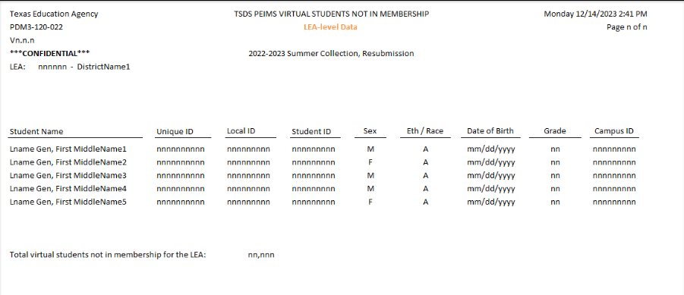
Virtual Students-Summer Submission Updates - 8
The following new report is tentatively scheduled to be released in the software release on March 31, 2023:
PDM3-120-022 Virtual Students Not in Membership

Slide 58
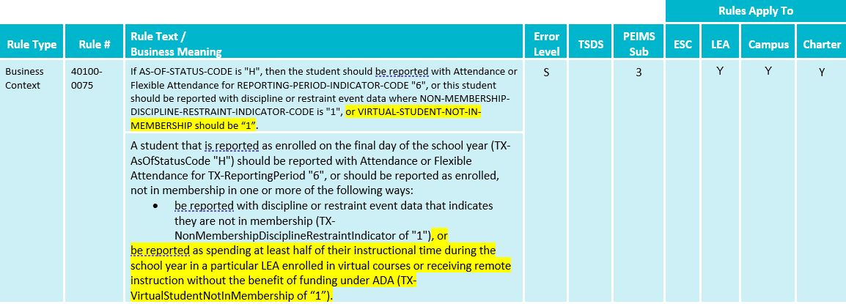
Virtual Students-Summer Submission Updates - 9
Updated Business Rules:

Slide 59
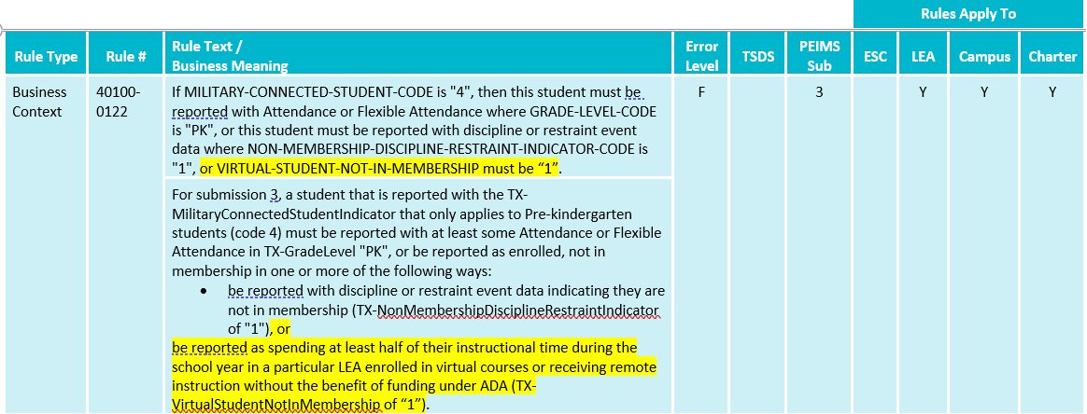
Virtual Students-Summer Submission Updates - 10
Updated Business Rules (cont.):

Slide 60
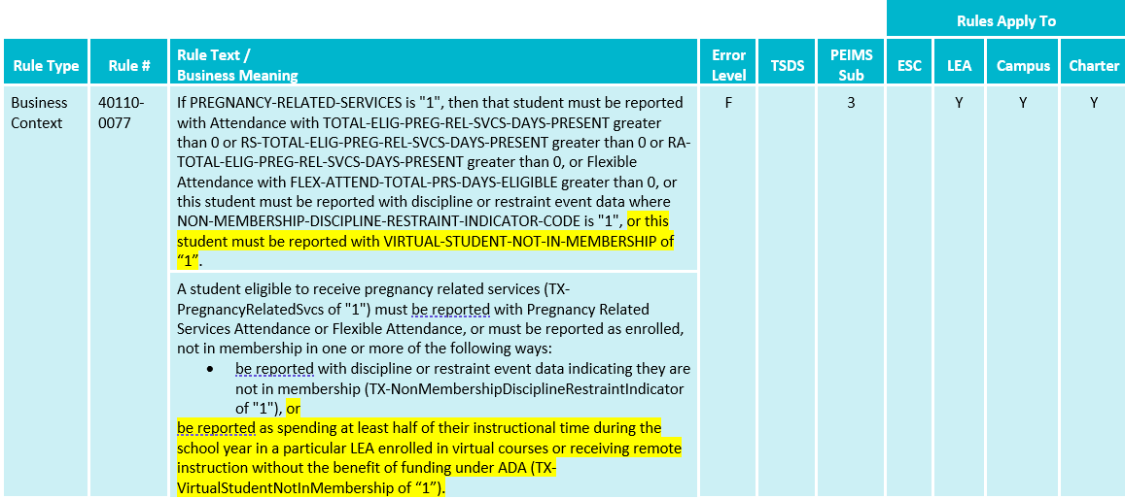
Virtual Students-Summer Submission Updates - 11
Updated Business Rules (cont.):

Slide 61
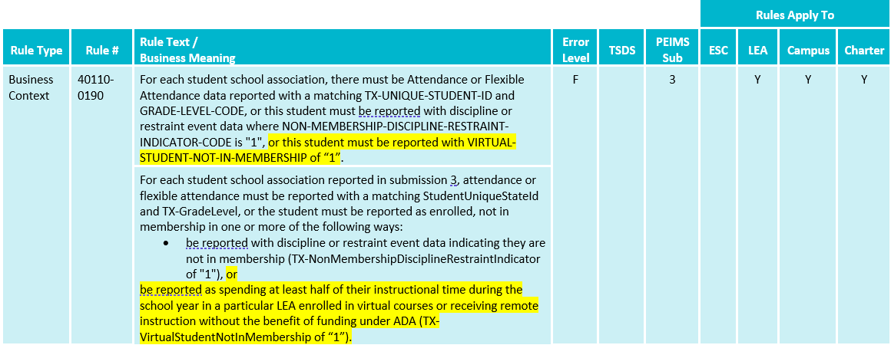
Virtual Students-Summer Submission Updates - 12
Updated Business Rules (cont.):

Slide 62
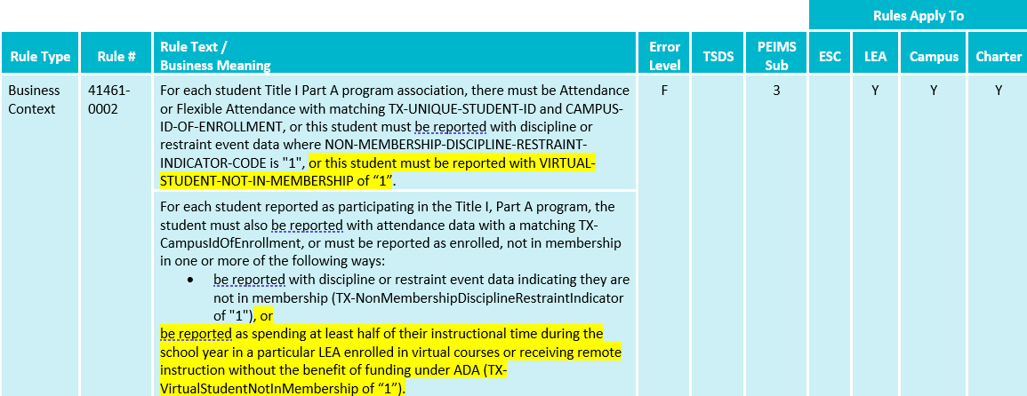
Virtual Students-Summer Submission Updates - 13
Updated Business Rules (cont.):

Slide 63
Virtual Students-Summer Submission Updates - 14
Updated Business Rules (cont.):

Slide 64
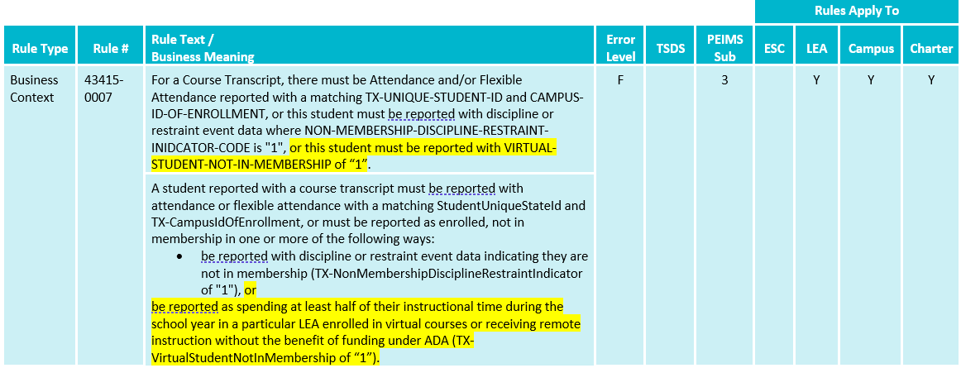
Virtual Students-Summer Submission Updates - 15
Updated Business Rules (cont.):

Slide 65
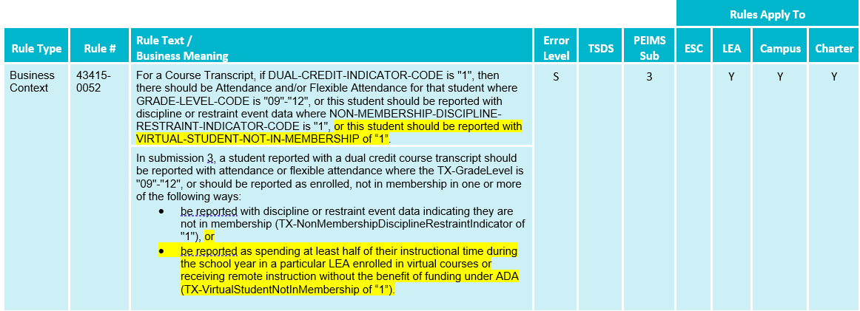
Virtual Students-Summer Submission Updates - 16
Updated Business Rules (cont.):

Slide 66
No Attendance-Summer Submission Updates
Students can be reported without attendance in the PEIMS Summer Submission only if they have one of the following indicators:
NON-MEMBERSHIP-DISCIPLINE-RESTRAINT-INDICATOR-CODE (E1725) = ‘1’
2022-2023 VIRTUAL-STUDENT-NOT-IN-MEMBERSHIP (E1735) = ‘1’

Slide 67
No Attendance-Summer Submission Updates - 2
For the Student Basic Information, Student Enrollment (Program), and Student Special Education Program subcategories, PEIMS Summer promotion logic updates:
Promote all students with attendance (including Basic and/or Flex attendance) OR
Promote any students with a DisciplineActionExtension where NON-MEMBERSHIP-DISCIPLINE-RESTRAINT-INDICATOR-CODE (E1725) equals a ‘1’ OR
Promote any students with a RestraintEventExtension where NON-MEMBERSHIP-DISCIPLINE-RESTRAINT-INDICATOR-CODE (E1725) equals a ‘1’ OR
Promote any students with a StudentExtension where CRISIS-CODE (E054) equals a ’10A’ or ‘10B’ VIRTUAL-STUDENT-NOT-IN-MEMBERSHIP (E1735) equals a ‘1’

Slide 68
No Attendance-Summer Submission Updates - 3
The following PEIMS report was updated to use the campus ID and/or grade level from the CourseTranscript complex type:
PDM3-113-001 Student Class Schedule

Slide 69
No Attendance-Summer Submission Updates - 4
The following PEIMS reports will be updated to use the campus ID and/or grade level from the StudentSchoolAssociation complex type and are tentatively scheduled for the software release on March 31, 2023:
PDM3-120-005 Student Crisis Code
PDM3-120-007 Student Indicator Report by Grade
PDM3-120-010 Student Advanced Academic Roster by Grade
PDM3-120-017 Prekindergarten Student Roster

Slide 70
No Attendance-Summer Submission Updates - 5
Currently the student restraint reports use the following grade level and campus ID:
The campus ID comes from the RestraintEventExtension, CAMPUS-ID-OF-RESTRAINT-EVENT (E1032) – this will not change.
For the grade level, the reports use the reporting period in the RestraintEventExtension to match to the reporting period in the attendance complex types (basic or flex attendance).

Slide 71
No Attendance-Summer Submission Updates - 6
Changes to how the grade level will be sourced for the Student Restraint reports:
Regular Attendance:
If a student has regular attendance where the reporting period indicator from the RestraintEventExtension complex type matches the reporting period indicator from the BasicReportingPeriodAttendanceExtension complex type, then the report will display the grade level from the BasicReportingPeriodAttendanceExtension complex type.
If there are multiple matches, then the report will use the maximum grade level logic to select the grade level to display on the report.

Slide 72
No Attendance-Summer Submission Updates - 7
Flex Attendance:
If there is no regular attendance for the reporting period and a student is reported with flexible attendance, then check flexible attendance.
If a student has flexible attendance where the reporting period indicator from the RestraintEventExtension complex type matches the reporting period indicator from the SpecialProgramsReportingPeriodAttendanceExtension complex type, then the report will display the grade level from the SpecialProgramsReportingPeriodAttendanceExtension complex type.
If there are multiple matches, then the report will use the maximum grade level logic to select the grade level to display on the report.

Slide 73
No Attendance-Summer Submission Updates - 8
If no regular or flexible attendance is reported for the student for the reporting period when the restraint event occurred, then the report shall display a blank for the grade level in the report.
No Attendance (Student with a restraint record but not in membership):
If there is no attendance for the student, then no grade level shall display in the report.

Slide 74
No Attendance-Summer Submission Updates - 9
The following Student Restraint reports are tentatively scheduled to be updated in the software release on May 5, 2023:
PDM3-125-001 Student Restraint Roster by Campus ID of Restraint Event
PDM3-125-003 Student Restraint Events by Grade
PDM3-125-004 Law Enforcement Student Restraint Roster by Campus ID of Restraint Event

Slide 75
No Attendance-Summer Submission Updates - 10
Currently the Student Discipline reports use the following grade level and campus ID:
The campus ID comes from the DisciplineIncidentExtension, CAMPUS-ID-OF-ENROLLMENT (E0782). This will not change.
For the grade level, the reports use the reporting period in the DisciplineActionExtension to match to the reporting period in the attendance complex types (basic or flex attendance).

Slide 76
No Attendance-Summer Submission Updates - 11
Changes to how the grade level will be sourced for the Student Discipline reports:
Regular Attendance:
If a student has regular attendance where the reporting period indicator from the DisciplineActionExtension complex type matches the reporting period indicator from the BasicReportingPeriodAttendanceExtension complex type, then the report will display the grade level from the BasicReportingPeriodAttendanceExtension complex type.
If there are multiple matches, then the report will use the maximum grade level logic to select the grade level to display on the report.

Slide 77
No Attendance-Summer Submission Updates - 12
Flex Attendance:
If there is no regular attendance for the reporting period and a student is reported with flexible attendance, then check flexible attendance.
If a student has flexible attendance where the reporting period indicator from the DisciplineActionExtension complex type matches the reporting period indicator from the SpecialProgramsReportingPeriodAttendanceExtension complex type, then the report will display the grade level from the SpecialProgramsReportingPeriodAttendanceExtension complex type.
If there are multiple matches, then the report will use the maximum grade level logic to select the grade level to display on the report.

Slide 78
No Attendance-Summer Submission Updates - 13
If no regular or flexible attendance is reported for the student for the reporting period when the discipline incident occurred, then the report shall display a blank for the grade level in the report.
No Attendance (Students with a discipline record but not in membership):
If there is no attendance for the student, then no grade level shall display in the report.

Slide 79
No Attendance-Summer Submission Updates - 14
The following Student Discipline reports are tentatively scheduled to be updated in the software release on May 5, 2023:
PDM3-132-001 Student Disciplinary Action Roster
PDM3-132-002 Student Disciplinary Action Detail by Reason
PDM3-132-004 Student Disciplinary Action Detail by Incident Number

Slide 80
ADSY-Extended Year Submission Updates
Overview of updates to the Additional Days School Program:
Removed data elements
Updates to reporting requirements
Updates to reports
Updates to business rules
New business rule to verify campus calendar days for ADSY

Slide 81
ADSY-Extended Year Submission Updates - 2
TEA removed the following data elements from the PEIMS Extended Year Submission:
TOTAL-DAYS-ABSENT (E0036)
ESC-SSA-STAFF-INDICATOR-CODE (E1015)
EXCESS-HOURS-IN-INSTRUCTIONAL-SETTING (E0945)

Slide 82
ADSY-Extended Year Submission Updates - 3
Updated Data Element Reporting Requirements in the BasicReportingPeriodAttendanceExtension:

Slide 83
ADSY-Extended Year Submission Updates - 4
Updated Data Element Reporting Requirements:

Slide 84
ADSY-Extended Year Submission Updates - 5
Report PDM4-130-003 Superintendent’s Report of ADSY Attendance is tentatively scheduled to be updated in the software release on May 5, 2023 with the following changes:
Remove Total Days Absent row C
Update Days Membership row B to not include Total Days Absent in calculation

Slide 85
ADSY-Extended Year Submission Updates - 6
Updated Special Education FTE row K to not include Excess Hours in Instructional Setting in calculation:

Slide 86
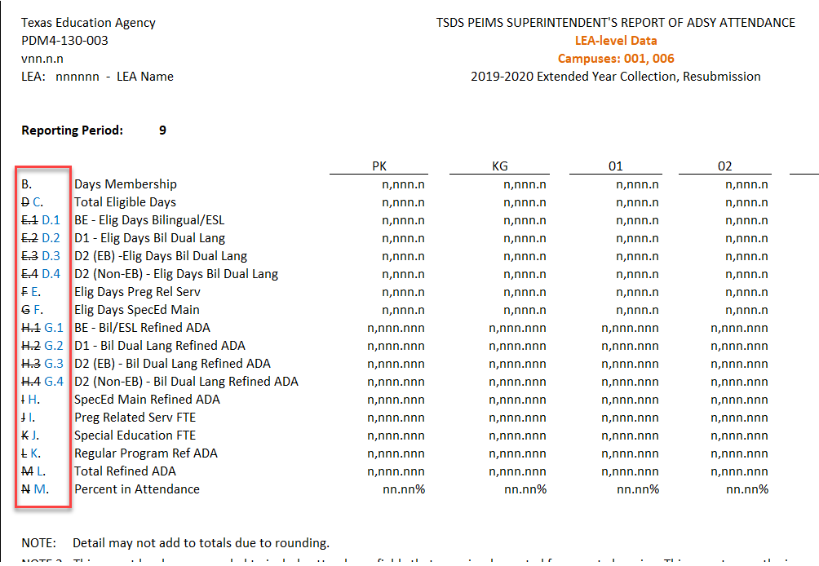
ADSY-Extended Year Submission Updates - 7
Rows reassigned letters after removing row for Total Days Absent:

Slide 87
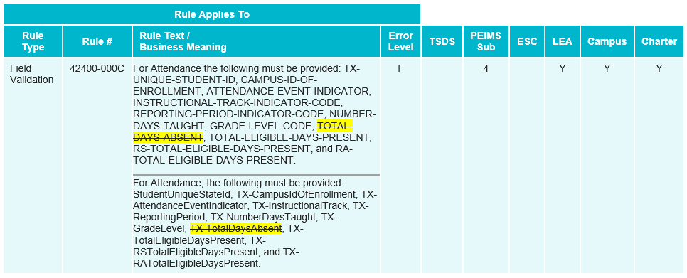
ADSY-Extended Year Submission Updates - 8
Updated Field Validation Rule to remove TOTAL-DAYS-ABSENT:

Slide 88
ADSY-Extended Year Submission Updates - 9
Updated Business Rule to remove TOTAL-DAYS-ABSENT:

Slide 89
ADSY-Extended Year Submission Updates - 10
Updated Business Rule to remove TOTAL-DAYS-ABSENT:

Slide 90
ADSY-Extended Year Submission Updates - 11
Removed Business Rule from PEIMS Extended Year Submission:

Slide 91
ADSY-Extended Year Submission Updates - 12
Added Business Rule :

Slide 92
EB-Extended Year Submission Updates
Senate Bill (SB) 2066 passed in the 87th legislative session amends TEC §29.060(a) and (d) and §29.066(a) and (b), to replace the term, “limited English proficient (LEP)” with “emergent bilingual (EB)”.

Slide 93
EB-Extended Year Submission Updates - 2
The following PEIMS Extended Year reports are tentatively scheduled to be updated in the software release on June 23, 2023:
PDM4-120-003 Student Indicator Report by Grade
PDM4-120-004 Bilingual/ESL Summer School Roster
PDM4-130-001 Flex Attendance – Superintendent’s Report of Student Attendance
PDM4-130-003 Superintendent’s/Principal’s Report of ADSY Attendance

Slide 94
Reminders
2022-2023 Year-round schools
LEAs registered with TEA with year-round tracks ending later than June 15, 2023, may delay PEIMS Summer Resubmission until two weeks following completion of the latest year-round track or August 17, 2023, whichever comes first.
The initial data delivery for the PEIMS Summer Submission must still be made by June 15, 2023, for all LEAs.
TEA will send a communication to ESCs at the beginning of May requesting information regarding year-round school extensions needed for the 2022-2023 PEIMS Summer Resubmission.

Slide 95
Current Known Issues
43415-0027 EXYR Fatal-For the campus reported in CAMPUS-ID-OF-ENROLLMENT, the grade range registered with the TEA must include at least one of grades "06"-"12".
This rule is firing for campuses that contain grades 06-08 and should be applicable to grades 06-12.
Workaround: If an LEA receives this fatal rule validation for grade levels 06-08, please advise them to enter a TIMS ticket so TEA can assist with their Extended Year Resubmission.
A correction for this known issue is tentatively scheduled for the software release on May 5, 2023.

Slide 96
Current Known Issues - 2
PDM3-132-003 TSDS PEIMS Student Disciplinary Action Summary
The parameters selected section, at the bottom, of the report is missing disciplinary action reason codes and disciplinary action codes.
This update is tentatively scheduled for the software release on March 31, 2023.

Slide 97
Current Known Issues - 3
PDM3-404-002 Career and Technical Education Student Roster
The PDF version of this report is failing when generated.
The CSV version of this report generates appropriately when initiated.
A correction for this known issue is tentatively scheduled for the software release on May 5, 2023.

Slide 98
Timeline PEIMS Summer Submission 2023
PEIMS Summer Submission | Date
PEIMS Summer Submission ready for users to promote data | February 27, 2023
TSDS PEIMS Summer ready for users to complete, approve, and accept submission | May 15, 2023
Requests to retire Unique due at TEA for PEIMS Summer First Submission | June 9, 2023
PEIMS Summer First Submission due date for LEAs | June 15, 2023
Request to retire Unique IDs due at TEA for PEIMS Summer Resubmission | July 14, 2023
PEIMS Summer Resubmission due date for LEAs LEAs registered with TEA with year-round tracks ending later than June 15, 2023, may delay PEIMS Summer Resubmission until two weeks following completion of the latest year-round track or August 17, 2023, whichever comes first. However, the initial data delivery for submission 3 must still be made by June 15, 2023, for all LEAs. In no case will any resubmission be processed after August 17, 2023. Data corrections made after August 17, 2023, will be processed by State Funding. | July 20, 2023

Slide 99
Timeline PEIMS Extended Year Submission 2023
PEIMS Extended Year Submission | Date
PEIMS Extended Year Submission ready for users to promote data | March 27, 2023
TSDS PEIMS Extended Year ready for users to complete, approve, and accept submissions | July 31, 2023
Requests to retire Unique IDs due at TEA for PEIMS Extended Year First Submission | August 18, 2023
PEIMS Extended Year First Submission due date for LEAs | August 31, 2023
Requests to retire Unique IDs due at TEA for PEIMS Extended Year Resubmission | September 8, 2023
PEIMS Extended Year Resubmission due date for LEAs | September 21, 2023

Slide 100
Frequently Asked Questions
How would an LEA report the PEIMS Summer Submission if the school year ends after the due date?
If an LEA closes after the PEIMS Summer First Submission, they will need to complete the first submission and then do a resubmission to correct (add) any data. If they close after the PEIMS Summer Resubmission or are a year-round school, they will receive an extension.

Slide 101
Frequently Asked Questions - 2
How should ADSY attendance be reported when an LEA has ADSY days scheduled during the school year?
Regardless of when the ADSY days are offered, ADSY attendance is reported in the PEIMS Extended Year Submission for the associated academic year.

Slide 102
Frequently Asked Questions - 3
Can an LEA add eight ADSY days to the start of their regular calendar to meet the 180-day calendar requirement?
No. The LEA cannot add ADSY days to the start of their regular calendar to meet the 180-day calendar requirement. The regular board-approved calendar must demonstrate 180-days of instruction and 75,600 minutes, distinct from the ADSY days.

Slide 103
Frequently Asked Questions - 4
Why are TOTAL-DAYS-ABSENT (E0036) being removed from the PEIMS Extended Year Submission?
TEA removed TOTAL-DAYS-ABSENT (E0036) as the ADSY program is funded on the days the student participates in the program.

Slide 104
Frequently Asked Questions - 5
Why are EXCESS-HOURS-IN-INSTRUCTIONAL-SETTING (E0945) being removed from the PEIMS Extended Year Submission?
TEA removed EXCESS-HOURS-IN-INSTRUCTIONAL-SETTING (E0945) because the ADSY program only reports data for students in grades PK-5. This grade range of students is not eligible to participate in CTE and therefore would not earn excess contact hours in their instructional setting.

Slide 105
Frequently Asked Questions - 6
When does TEA calculate the CTE indicator code?
The CTE Indicator Code is calculated after each submission is completed. The CTE auto-calculation process is run after the close of the PEIMS Summer First Submission, Resubmission and year-round schools' submission. It is then calculated again after the close of PEIMS Extended Year First Submission and Resubmission.

Slide 106
Frequently Asked Questions - 7
When will the 2022-2023 CTE weighted tiers table be available for the new CTE service IDs?
The CTE department will publish an updated weighted tiers table for the 2022-2023 school year in April/May 2023.

Slide 107
Frequently Asked Questions - 8
When will the 2022-2023 CTE crosswalk be available?
The CTE auto-calculation look-up tables are updated for the current school year at the beginning of April. For example, TEA will update the 2022-2023 CTE auto-calculation look-up tables in April 2023.

Slide 108
Frequently Asked Questions - 9
Would the VIRTUAL-STUDENT-NOT-IN-MEMBERSHIP(E1735) indicator be reported in the PEIMS Summer Submission for a student that was reported as ADA-ELIGIBILITY-CODE (E0787) “9” in the PEIMS Fall Submission but changed to ADA “1” during the second semester?
The VIRTUAL-STUDENT-NOT-IN-MEMBERSHIP (E1735) should be reported for a student who spends at least half of their instructional time enrolled in virtual courses without the benefit of funding under ADA (ADA-ELIGIBILITY-CODE “9”). Depending on the LEA calendar, a student reported under this scenario may not need the indicator. If the student was enrolled in virtual courses without the benefit of funding under ADA for less than half their instruction time, the indicator would not be reported.

Slide 109
2023-2024

Slide 110
Application Updates
The following PEIMS application functionality will be updated to include new data elements:
Data Search
Data Retrieval
Data Element Summary

Slide 111
TX First Early HS Completion Pgm Data Element Updates
Overview
During the 87th legislative session, Senate Bill (SB) 1888 was passed, which amends TEC§ 28.0253. As a result, the Texas Education Agency (TEA), in coordination with the Texas Higher Education Coordinating Board (THECB), shall establish the Texas First Early High School Completion Program. This program allows public high school students who demonstrate early readiness for college to graduate early from high school.

Slide 112
TX First Early HS Completion Pgm Data Element Updates - 2
Overview cont.
To be eligible for an award under the program, a student must:
Be a resident of this state as determined by THECB rules;
Have graduated early from high school under the Texas First Early High School Completion Program; and
Completed the Financial Aid Application Requirement for High School Graduation (TEC§ 28.0256).

Slide 113
TX First Early HS Completion Pgm Data Element Updates - 3
Overview cont.
THECB shall award a grant (state credit) to pay for tuition, mandatory fees, and other costs of attendance at an institution to each eligible student based on if the student graduates two or more semesters or less than two semesters or the equivalent earlier than the student's high school cohort.
TEA will increase a district’s average daily attendance for students who graduated early under the Texas First High School Completion Program and are enrolled at an eligible institution.
TEA will also reduce each district’s FSP entitlement by the amount granted (state credit) to each eligible student.

Slide 114
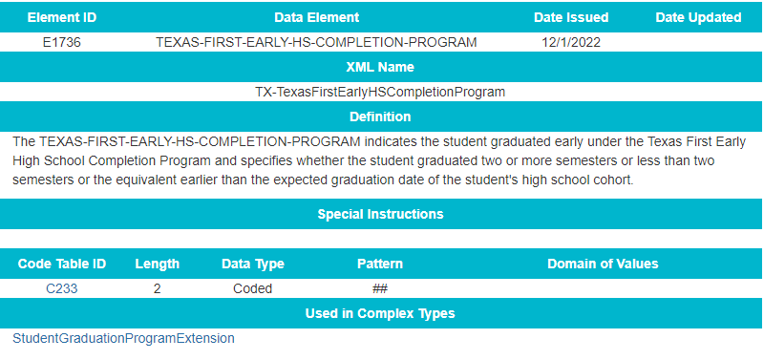
TX First Early HS Completion Pgm Data Element Updates - 4
Added new data element TEXAS-FIRST-EARLY-HS-COMPLETION-PROGRAM (E1736) to the StudentGraduationProgramExtension complex type to be reported as optional in the PEIMS Fall Submission.

Slide 115
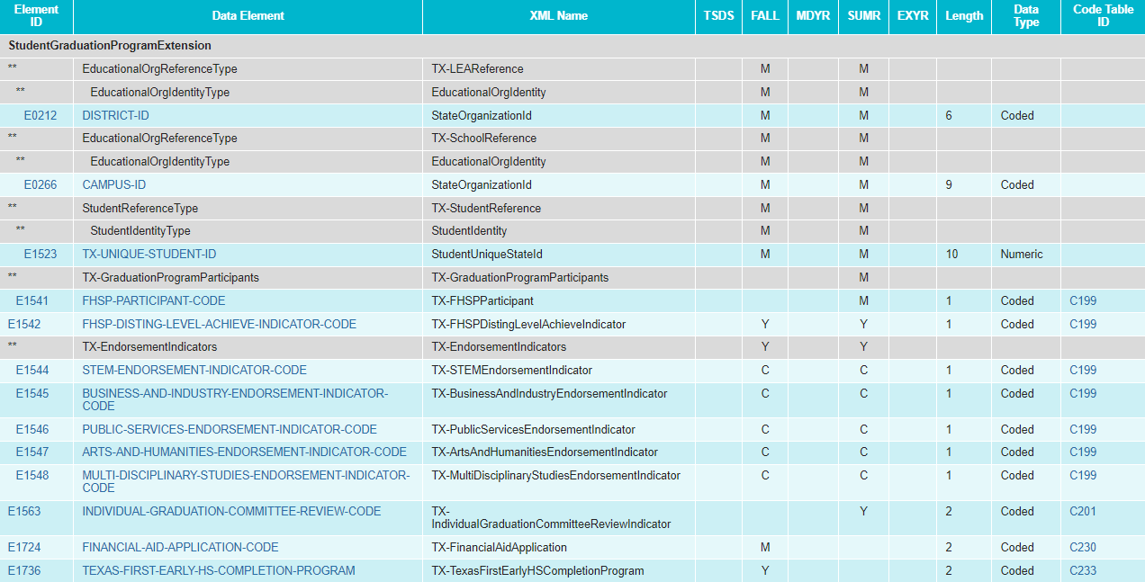
TX First Early HS Completion Pgm Data Element Updates -5
Modified the StudentGraduationProgramExtension complex type for the PEIMS Fall Submission:
Added TEXAS-FIRST-EARLY-HS-COMPLETION-PROGRAM (E1736) as optional

Slide 116
TX First Early HS Completion Pgm Code Table Updates
Added new code table TEXAS-FIRST-EARLY-HS-COMPLETION-PROGRAM (C233):

Slide 117
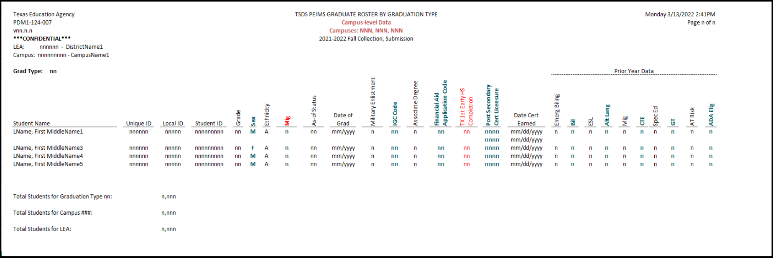
TX First Early HS Completion Pgm Report Updates
Revised the following PEIMS Fall Submission report to reflect these changes:
PDM1-124-007 Graduate Roster by Graduation Type

Slide 118
TX First Early HS Completion Pgm Business Rule Updates
No New Business Rules
No Updated Business Rules
No Deleted Business Rules

Slide 119
Adult HS Charter School Pgm - Data Element Updates
Overview
During the 87th legislative session, Senate Bill (SB) 1615 was passed, which amended Chapter 12 of the TEC by adding Subchapter G, “Adult High School Charter School Program.” Additionally, SB 1615 transferred existing TEC sections 29.259(j) and (k) to Subchapter G, Chapter 12, TEC§ 12.263, Adult Education Program Funding. Under Section 12.263, any student attending an adult high school charter school program may be eligible for funding under the state compensatory education (SCE) allotment. The Excel Center (For Adults) is the only charter currently operating under TEC§ 29.259.

Slide 120
Adult HS Charter School Pgm - Data Element Updates -2
Overview cont.
Currently, TEA collects a STUDENT-CENSUS-BLOCK-GROUP (E1648) for all economically disadvantaged students enrolled as of the PEIMS Fall snapshot date (last Friday in October) and is reported in the PEIMS Fall Submission to calculate the SCE allotment funding. However, the changes in SB 1615 allow any economically disadvantaged student attending an adult high school charter school program to be included in the calculations for SCE allotment funding regardless of enrollment date. Therefore, for TEA to calculate the appropriate SCE allotment funding, the STUDENT-CENSUS-BLOCK-GROUP (E1648) must be collected for any economically disadvantaged student who attended a charter operating under TEC §29.259 at any time during the school year.

Slide 121
Adult HS Charter School Pgm - Data Element Updates - 3
Added the existing data element STUDENT-CENSUS-BLOCK-GROUP (E1648) to the StudentExtension complex type as optional for the PEIMS Summer Submission:

Slide 122
Adult HS Charter School Pgm - Data Element Updates - 4
Updated Data Element Reporting Requirements:
StudentExtension complex type

Slide 123
Adult HS Charter School Pgm Report Updates
A new report will be developed for the student census block group data.

Slide 124
Adult HS Charter School Pgm Rule Updates
Added New Business Rules:

Slide 125
Adult HS Charter School Pgm Rule Updates - 5
Added New Business Rules (cont.):

Slide 126
Migrant Indicator Data Element Updates
Overview
The Elementary and Secondary Education Act of 1965 (ESEA), as amended by the Every Student Succeeds Act of 2015 (ESSA) in December 2015, updated the definition of a migrant child and the terminology used in Title 1, Chapter 3 from Education of Migrant Children to Education of Migratory Children.

Slide 127
Migrant Indicator Data Element Updates - 2
Overview cont.
LEAs currently report the data element, MIGRANT-INDICATOR-CODE (E0984), to indicate whether a student should be coded as a participant in the migrant education program. The current data element definition needs to be updated in addition to guidance updates to the terminology from “migrant” to “migratory” to align terminology with federal legislation.

Slide 128
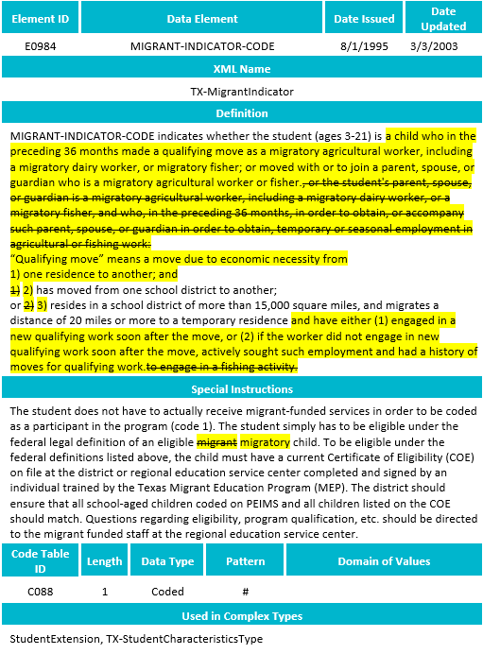
Migrant Indicator Data Element Updates - 3
Updated Data Element:

Slide 129
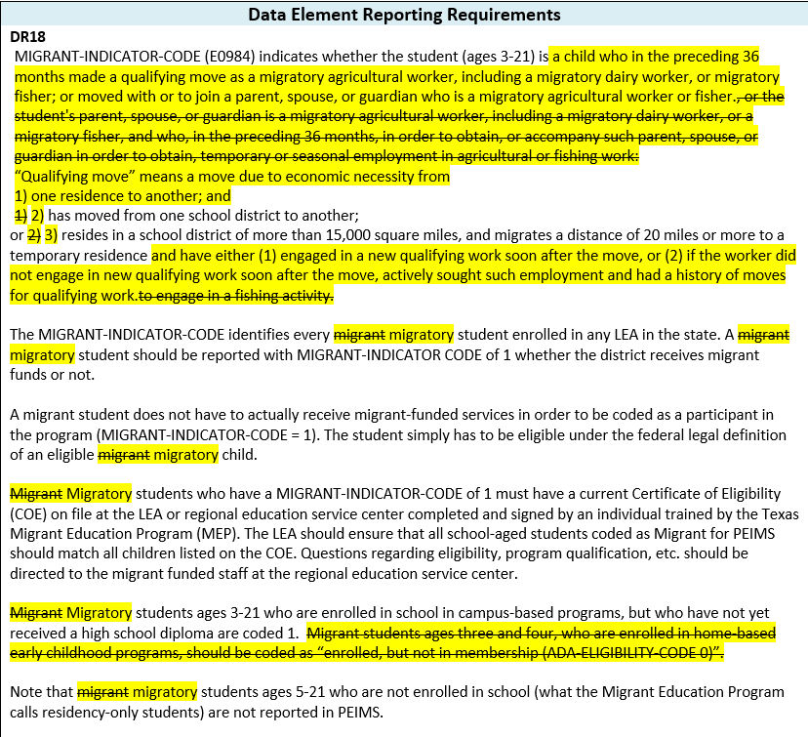
Migrant Indicator Data Element Updates - 4
Updated Data Element Reporting Requirements:

Slide 130
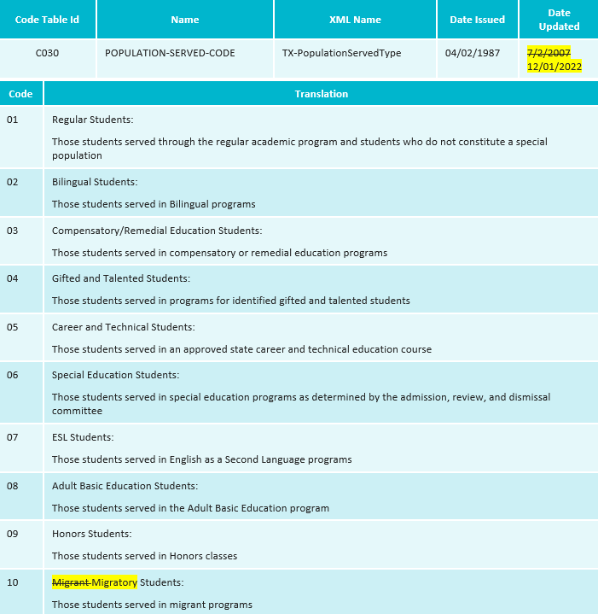
Migrant Indicator Code Table Updates
Revised the code translation for POPULATION-SERVED-CODE (C030) code 10:

Slide 131
Migrant Indicator Report Updates
Revised the following PEIMS reports to reflect these changes:
Fall Submission reports
PDM1-124-007 Graduate Roster by Graduation Type
PDM1-120-005 Student Data Review
PDM1-120-012 Student Indicator Report by Grade
PDM1-120-003 Student Program Roster
PDM1-120-009 Disaggregation of PEIMS Student Data
PDM1-124-004 School Leaver Roster
PDM3-120-002 Migrant Students by Grade

Slide 132
Migrant Indicator Report Updates - 5
Revised the following PEIMS reports to reflect these changes:
Fall Submission reports (cont.)
PDM1-120-004 Students by ADA Eligibility and Grade
PDM1-124-007 Graduate Roster by Graduation Type
PDM1-120-001 Student Type by Grade, Ethnicity, and Sex
PDM1-470-001 Disaggregation of PEIMS Student Data

Slide 133
Migrant Indicator Report Updates - 6
Revised the following PEIMS reports to reflect these changes:
Summer Submission reports
PDM3-120-015 Previous Year Average Daily Attendance
PDM3-130-010 Attendance Rates Comparison by Ethnicity, Gender, and Special Population
PDM3-820-001 Special Education FTEs By District of Residence and Instructional Setting
PDM3-120-004 Disaggregation of PEIMS Summer Attendance Data
PDM3-120-007 Student Indicator Report by Grade
PDM3-130-005 Comparison of Current and Prior Year Attendance

Slide 134
Migrant Indicator Report Updates - 7
Revised the following PEIMS reports to reflect these changes:
Summer Submission reports (cont.)
PDM3-130-009 Attendance by District of Residence
PDM3-130-020 Special Education FTEs By District of Residence and Instructional Setting
PDM3-454-002 Migrant and Attendance Count Data
PDM3-470-001 Disaggregation of PEIMS Summer Attendance Data

Slide 135
Migrant Indicator Business Rule Updates
No New Business Rules
No Updated Business Rules
No Deleted Business Rules

Slide 136
FASRG Updates
Overview
On September 7, 2022, the Financial Compliance Division released the Financial Accountability System Resource Guide (FASRG) version 18.0. The change included removing three program intent codes, Pre-Kindergarten (32), Pre-Kindergarten – Compensatory Education (34), and Pre-Kindergarten – Bilingual Education (35), from being used for budget, payroll, and contracted instructional (CI) staff for the 2022-2023 school year.

Slide 137
Code Table Updates
Modified the PROGRAM-INTENT-CODE (C147) code table to remove 32, 34, and 35 from being used for budget, payroll, and contracted instructional staff.

Slide 138
CTE Code Table Updates
Overview
Beginning in the 2020-2021 school year, TEA began auto-calculating the Career and Technology (CTE) indicator to assign to all students in grades 6-12. The calculation is based on the student's course completion data submitted by an LEA in the PEIMS Summer and Extended Year Submissions. The College, Career, and Military Preparation Division maintains the translations in the CAREER-AND-TECHNICAL-ED-IND-CD (C142) and has requested changes to help clarify the codes.

Slide 139
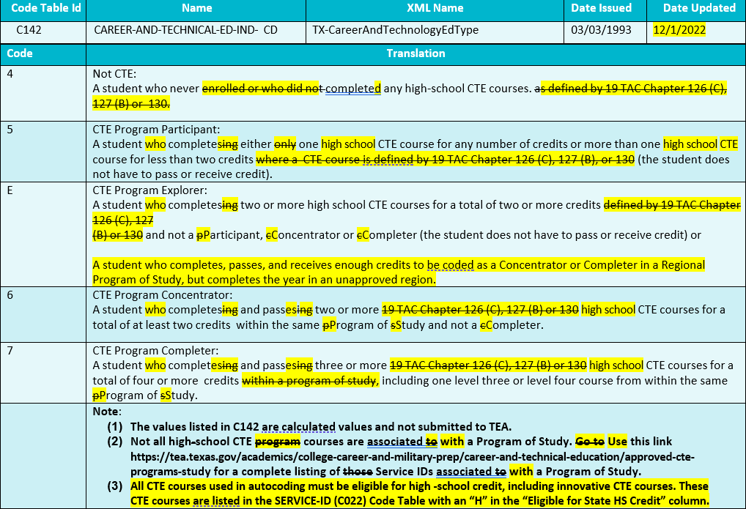
CTE Code Table Updates - 2
Modified the CAREER-AND-TECHNICAL-ED-IND-CD (C142) translations.

Slide 140
Timeline PEIMS Fall Submission
PEIMS Fall Submission | Date
TSDS PEIMS ready to load data to eDM | August 7, 2023
PEIMS Fall Submission ready for users to promote data | September 11, 2023
Close of school-start window - Last Friday in September | September 29, 2023
PEIMS Fall snapshot date | October 27, 2023
TSDS PEIMS Fall ready for users to complete, approve, and accept submissions | October 30, 2023
Requests to retire Unique IDs due at TEA for PEIMS Fall First Submission | December 1, 2023
PEIMS Fall First Submission due date for LEAs and ESCs | December 7, 2023
Requests to retire Unique IDs due at TEA for PEIMS Fall Resubmission | January 12, 2024
PEIMS Fall Resubmission due date for LEAs and ESCs | January 18, 2024

Slide 141
Timeline PEIMS Mid-Year Submission
PEIMS Mid-Year Submission | Date
PEIMS Mid-Year Submission ready for users to promote data | November 13, 2023
PEIMS Mid-Year ready for users to complete, approve, and accept submissions | December 18, 2023
PEIMS Mid-Year First Submission due date for LEAs and ESCs | January 25, 2024
PEIMS Mid-Year Resubmission due date for LEAs and ESCs | February 8, 2024

Slide 142
Timeline PEIMS Summer Submission 2024
PEIMS Summer Submission | Date
PEIMS Summer Submission ready for users to promote data | February 26, 2024
TSDS PEIMS Summer ready for users to complete, approve, and accept submissions | May 20, 2024
Requests to retire Unique IDs due at TEA for PEIMS Summer First Submission | June 14, 2024
PEIMS Summer First Submission due date for LEAs | June 20, 2024
Requests to retire Unique IDs due at TEA for PEIMS Summer Resubmission | July 12, 2024
PEIMS Summer Resubmission due date for LEAs LEAs registered with TEA with year-round tracks ending later than June 20, 2024 may delay PEIMS Summer Resubmission until two weeks following completion of the latest year-round track or August 15, 2024, whichever comes first. However, the initial data delivery for submission 3 must still be made by June 20, 2024, for all LEAs. In no case will any resubmission be processed after August 15, 2024. Data corrections made after August 15, 2024 will be processed by State Funding. | July 18, 2024

Slide 143
Timeline PEIMS Extended Year Submission 2024
PEIMS Extended Year Submission | Date
PEIMS Extended Year Submission ready for users to promote data | March 25, 2024
TSDS PEIMS Extended Year ready for users to complete, approve, and accept submissions | July 29, 2024
Requests to retire Unique IDs due at TEA for PEIMS Extended Year First Submission | August 23, 2024
PEIMS Extended Year First Submission due date for LEAs | August 29, 2024
Requests to retire Unique IDs due at TEA for PEIMS Extended Year Resubmission | September 13, 2024
PEIMS Extended Year Resubmission due date for LEAs | September 19, 2024

Slide 144
Technical Resources
Technical Support
TSDSCustomerSupport@tea.texas.gov
Technical Specifications
TSDS Web-Enabled Data Standards (TWEDS)​
TSDS Incident Management System (TIMS)
TIMS Support System Application
TIMS Knowledge Base Article Repository

Slide 145
Collection Closing Remarks
Importance of ensuring data quality before submission closes
High Number of Extension Requests
High Number of Working Submissions
What can TEA and the ESC teams do to assist LEAs with ensuring data quality and still meet the due dates?

Slide 146
Extension Requests
Submission | Number of Requests | Latest Date Requested to Complete | Actual Due Date
2021 SUMR FIRST | 1 | 7/3/2021 | 6/17/2021
2021 SUMR RESUB | 15 | 8/13/2021 | 7/16/2021
2022 FALL FIRST | 6 | 12/17/2021 | 12/2/2021
2022 FALL RESUB | 45 | 2/4/2022 | 1/20/2022
2022 MDYR FIRST | 0
2022 MDYR RESUB | 11 | 3/9/2022 | 2/10/2022
2022 SUMR FIRST | 6 | 6/30/2022 | 6/16/2022
2022 SUMR RESUB | 20 | 8/18/2022 | 7/21/2022
2023 FALL FIRST | 12 | 1/6/2023 | 12/8/2023
2023 FALL RESUB | 11 | 1/25/2023 | 1/19/2023
2023 MDYR FIRST | 0
2023 MDYR RESUB | 1 | 2/10/2023 | 2/9/2023

Slide 147
Working Submissions – How Many
August 1, 2022 – today
41
August 1, 2021 – July 31, 2022
37
August 1, 2020 – July 31, 2021
35

Slide 148
Working Submissions – Example Answer Email
This email is to acknowledge your submission of information related to the PEIMS Summer submission for the 2021-2022 school year for XXXXX ISD. As you mentioned in the information provided, course completion records were underreported.
The revised Texas Student Data System reports that were submitted to TEA for the PEIMS Summer Working collection reflect an increase in the number course completion records for English Language Arts (CPELA) from 0 to 393.
While it is the policy of TEA that the official PEIMS data cannot be corrected once a collection is finalized and released for use by the TEA program areas, the PEIMS staff is distributing your letter and the before and after data reports to Performance Reporting and Research and Analysis for their review.
cc: Program Area Directors

Slide 149
Working Submissions – Department Actions
State Funding
Updates that would impact ADA/FTE calculations
State Funding informs the LEA via email that they must hire an independent auditor to perform an audit of the PEIMS attendance data and confirm that amendments are needed before the TEA will make the amendments.
The auditor should be familiar with LEA attendance reporting procedures and conduct a comprehensive review/audit of all the district’s attendance data, including the data for which a revision is sought.

Slide 150
Working Submissions – Department Actions (cont.)
Federal Fiscal Compliance and Reporting Division
Updates that impact Enrollment, Title I, and Economic Disadvantaged Counts
Federal Fiscal Compliance uses this data to supersede the data found in the final certified tables for reporting (before the federal reporting deadlines).
Research and Analysis
Updates that impact Graduate, Leaver, Course Completion, and IBC counts
Research and Analysis does not use the actual working submission data to update datasets or public reporting.
May assist in explaining data flagged as potentially erroneous by USED during EDFacts submission.

Slide 151
Working Submissions – Department Actions (cont.)
Performance Reporting
Updates that impact Course Completion and IBC Counts
Performance Reporting does not use the Working Submission data for accountability or reporting purposes.
Please see the PR FAQ:
Question: Do accountability calculations include data from the PEIMS working collection?
Answer: No, Performance Reporting only uses data submitted during the official PEIMS submission and resubmission windows. Data submitted in the working collection is not used for accountability calculations.

Slide 152
Working Submissions – Self-Reported Data Unit
The Self-Reported Data Unit (SRDU) directed by Brittany Wright aims to improve the quality of the self-reported data the agency receives from LEAs. The unit:
Collaborates with TEA divisions who have identified data anomalies and helps investigate those anomalies further, addresses data-related complaints submitted by external stakeholders, and conducts independent research to identify potential data concerns.
SRDU may issue compliance review letters to LEAs when potential data concerns are identified. Compliance reviews are a collaborative review process with LEAs to ensure they are acting in accordance with state law and other regulatory requirements. TEA requests documentation and other information by a particular deadline to review and determine whether there has been a violation and commonly works with the LEAs to bring them into compliance and/or to establish better local practices.

Slide 153
Working Submissions – SRDU (cont.)
At the conclusion of any reviews, SRDU works with relevant agency staff to improve the internal processes with the goal of ensuring LEAs have the information and tools necessary to accurately report data to the agency.
SRDU and Working Submissions:
As part of the process of identifying LEAs with anomalous data, SRDU uses the Working Submission information to identify whether an LEA has already self-identified and corrected an issue with their data submission(s).
SRDU may use the Working Submission information to issue “informational” letters to LEAs that explain importance of submitting accurate and timely data to the agency and provide resources to improve future data submissions.
SRDU may also use the Working Submission information to issue compliance review letters to LEAs that seem to have systemic issues with reporting accurate, complete, and timely information to the agency.

Slide 154
Questions?
Thank you for attending.

