Slide 1
Additional Days School Year
Overview
March 21, 2023

Slide 2

Key TEA Personnel
Additional Days School Year (ADSY) Team
Brian Doran
Director of Expanded Learning Models
Ruchamah Belizor
Summer Learning Project Manager!
Currently Hiring
Manager of Additional Days School Year
Key TEA
Personnel
ADSY Inbox: ADSY@tea.texas.gov

Slide 3

Agenda
  Additional Days School Year Overview
  Design Considerations
    Option 1: Volunteer Summer Learning
    Option 2: Intersessional Calendar
    Option 3: Full Year Redesign
  ADSY Planning and Execution Program
  Budgeting Considerations
  Observed and Anticipated Implementation
  Q&A

Slide 4
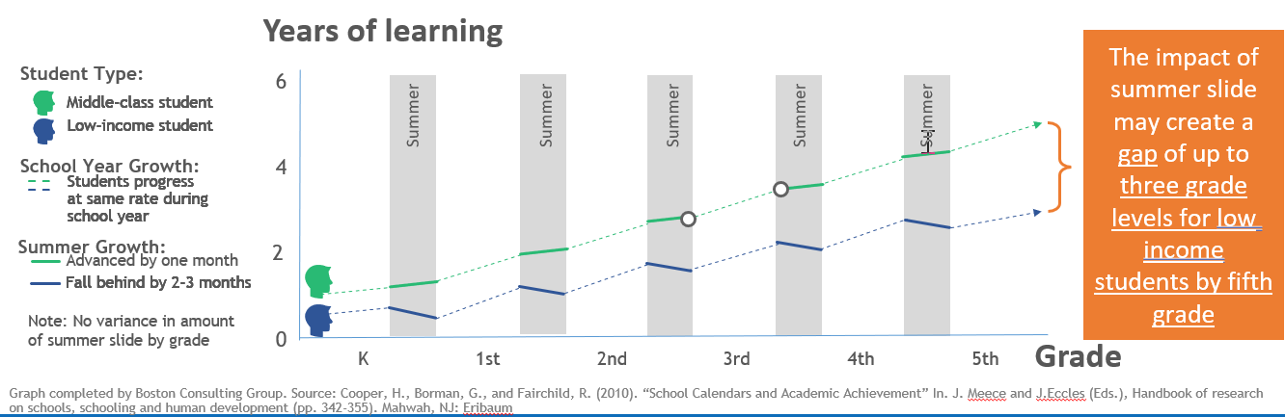
Declining Achievement During Summer Breaks
Student achievement levels drop during the summer months, commonly referred to as the “summer slide”.

Slide 5
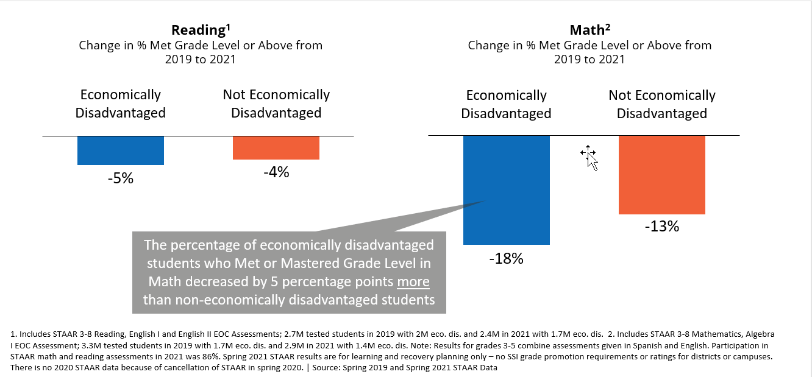
Economically disadvantaged students experienced greater learning loss in both reading and math

Slide 6
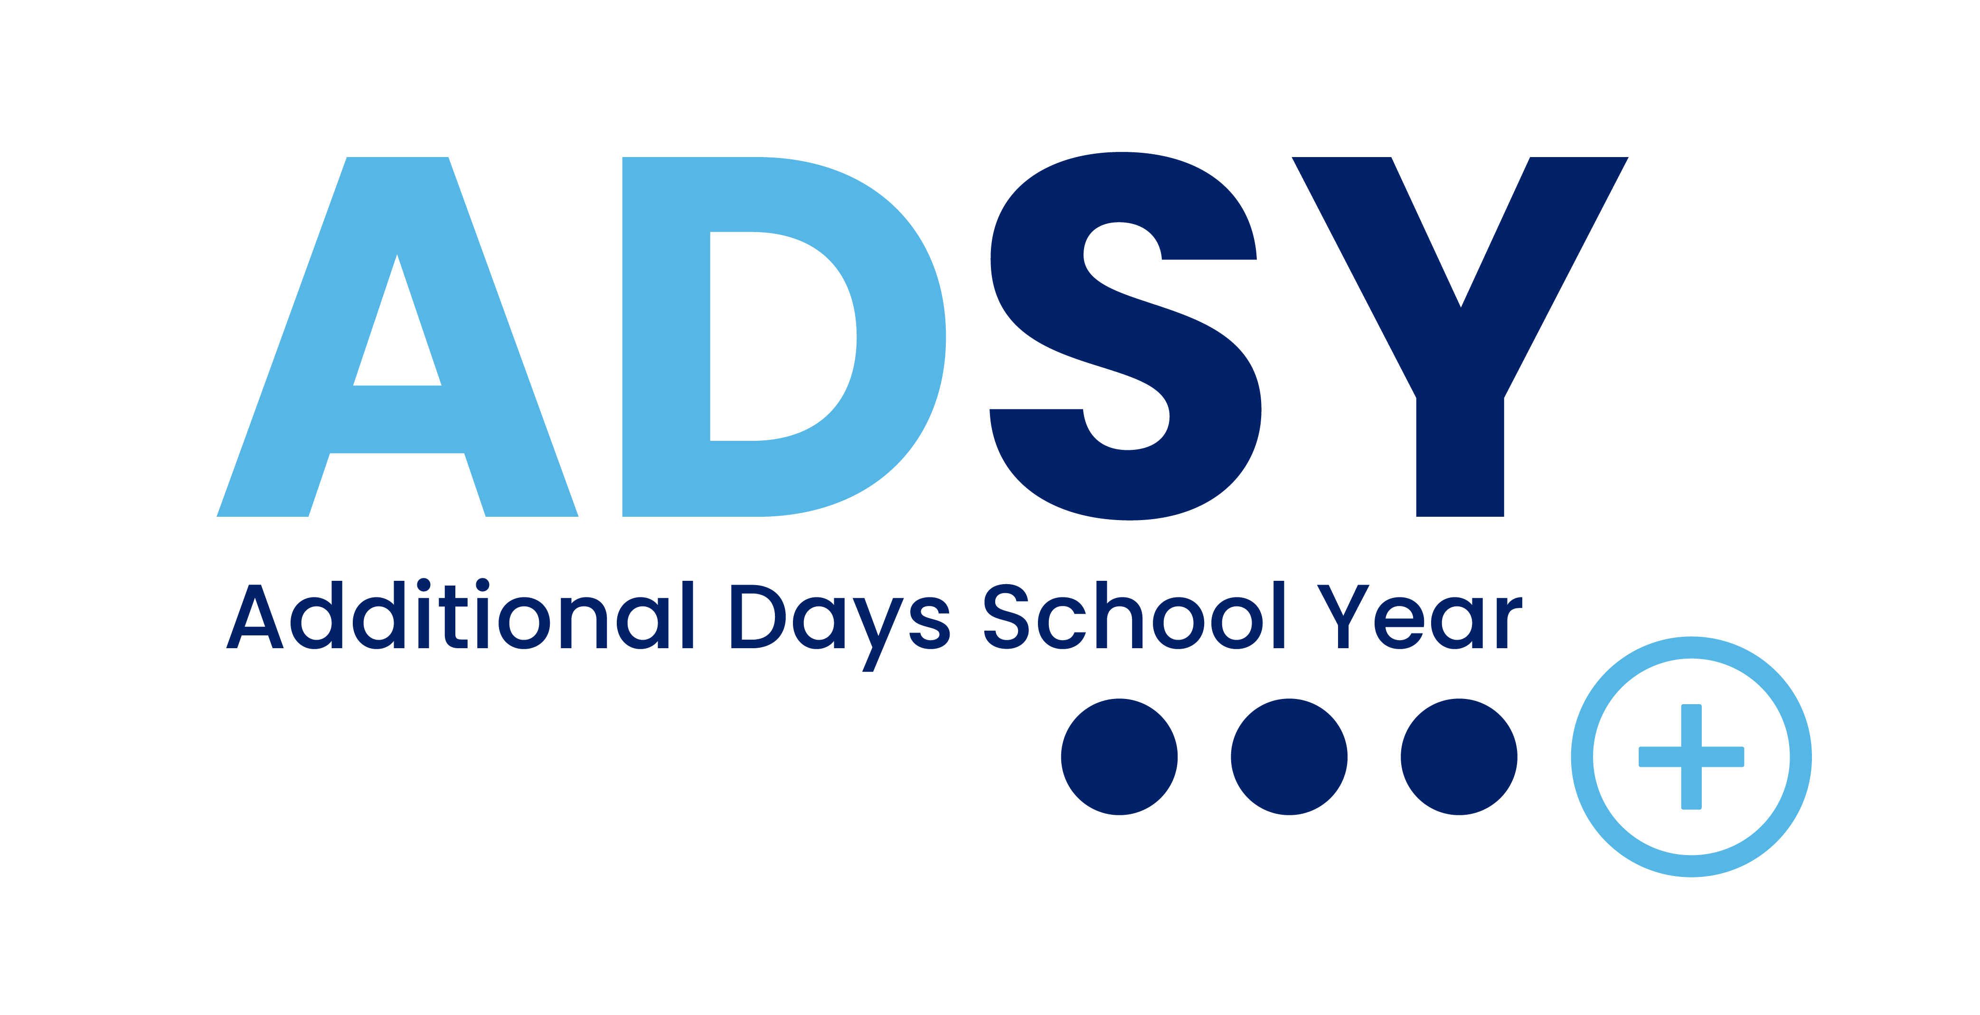
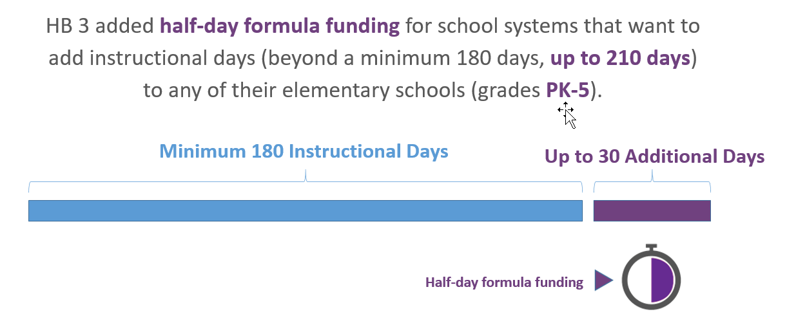
Additional Days School Year (ADSY)

Slide 7






ADSY Eligibility
Serve at least one grade level within grades PreK-5
Ensure the campus academic calendar will have at least 180 instructional days, not including staff development waivers; ideal calendars also have two bad-weather make-up days identified
Have a campus academic calendar with at least 75,600 operational minutes
Be willing to add up to 30 additional half days of instruction (ADSY days) to the 180 instructional days in a campus’s academic calendar
Have a certified teacher deliver at least two hours of instruction on dedicated ADSY days
Host ADSY days on separate days from regular instructional calendar days

Slide 8

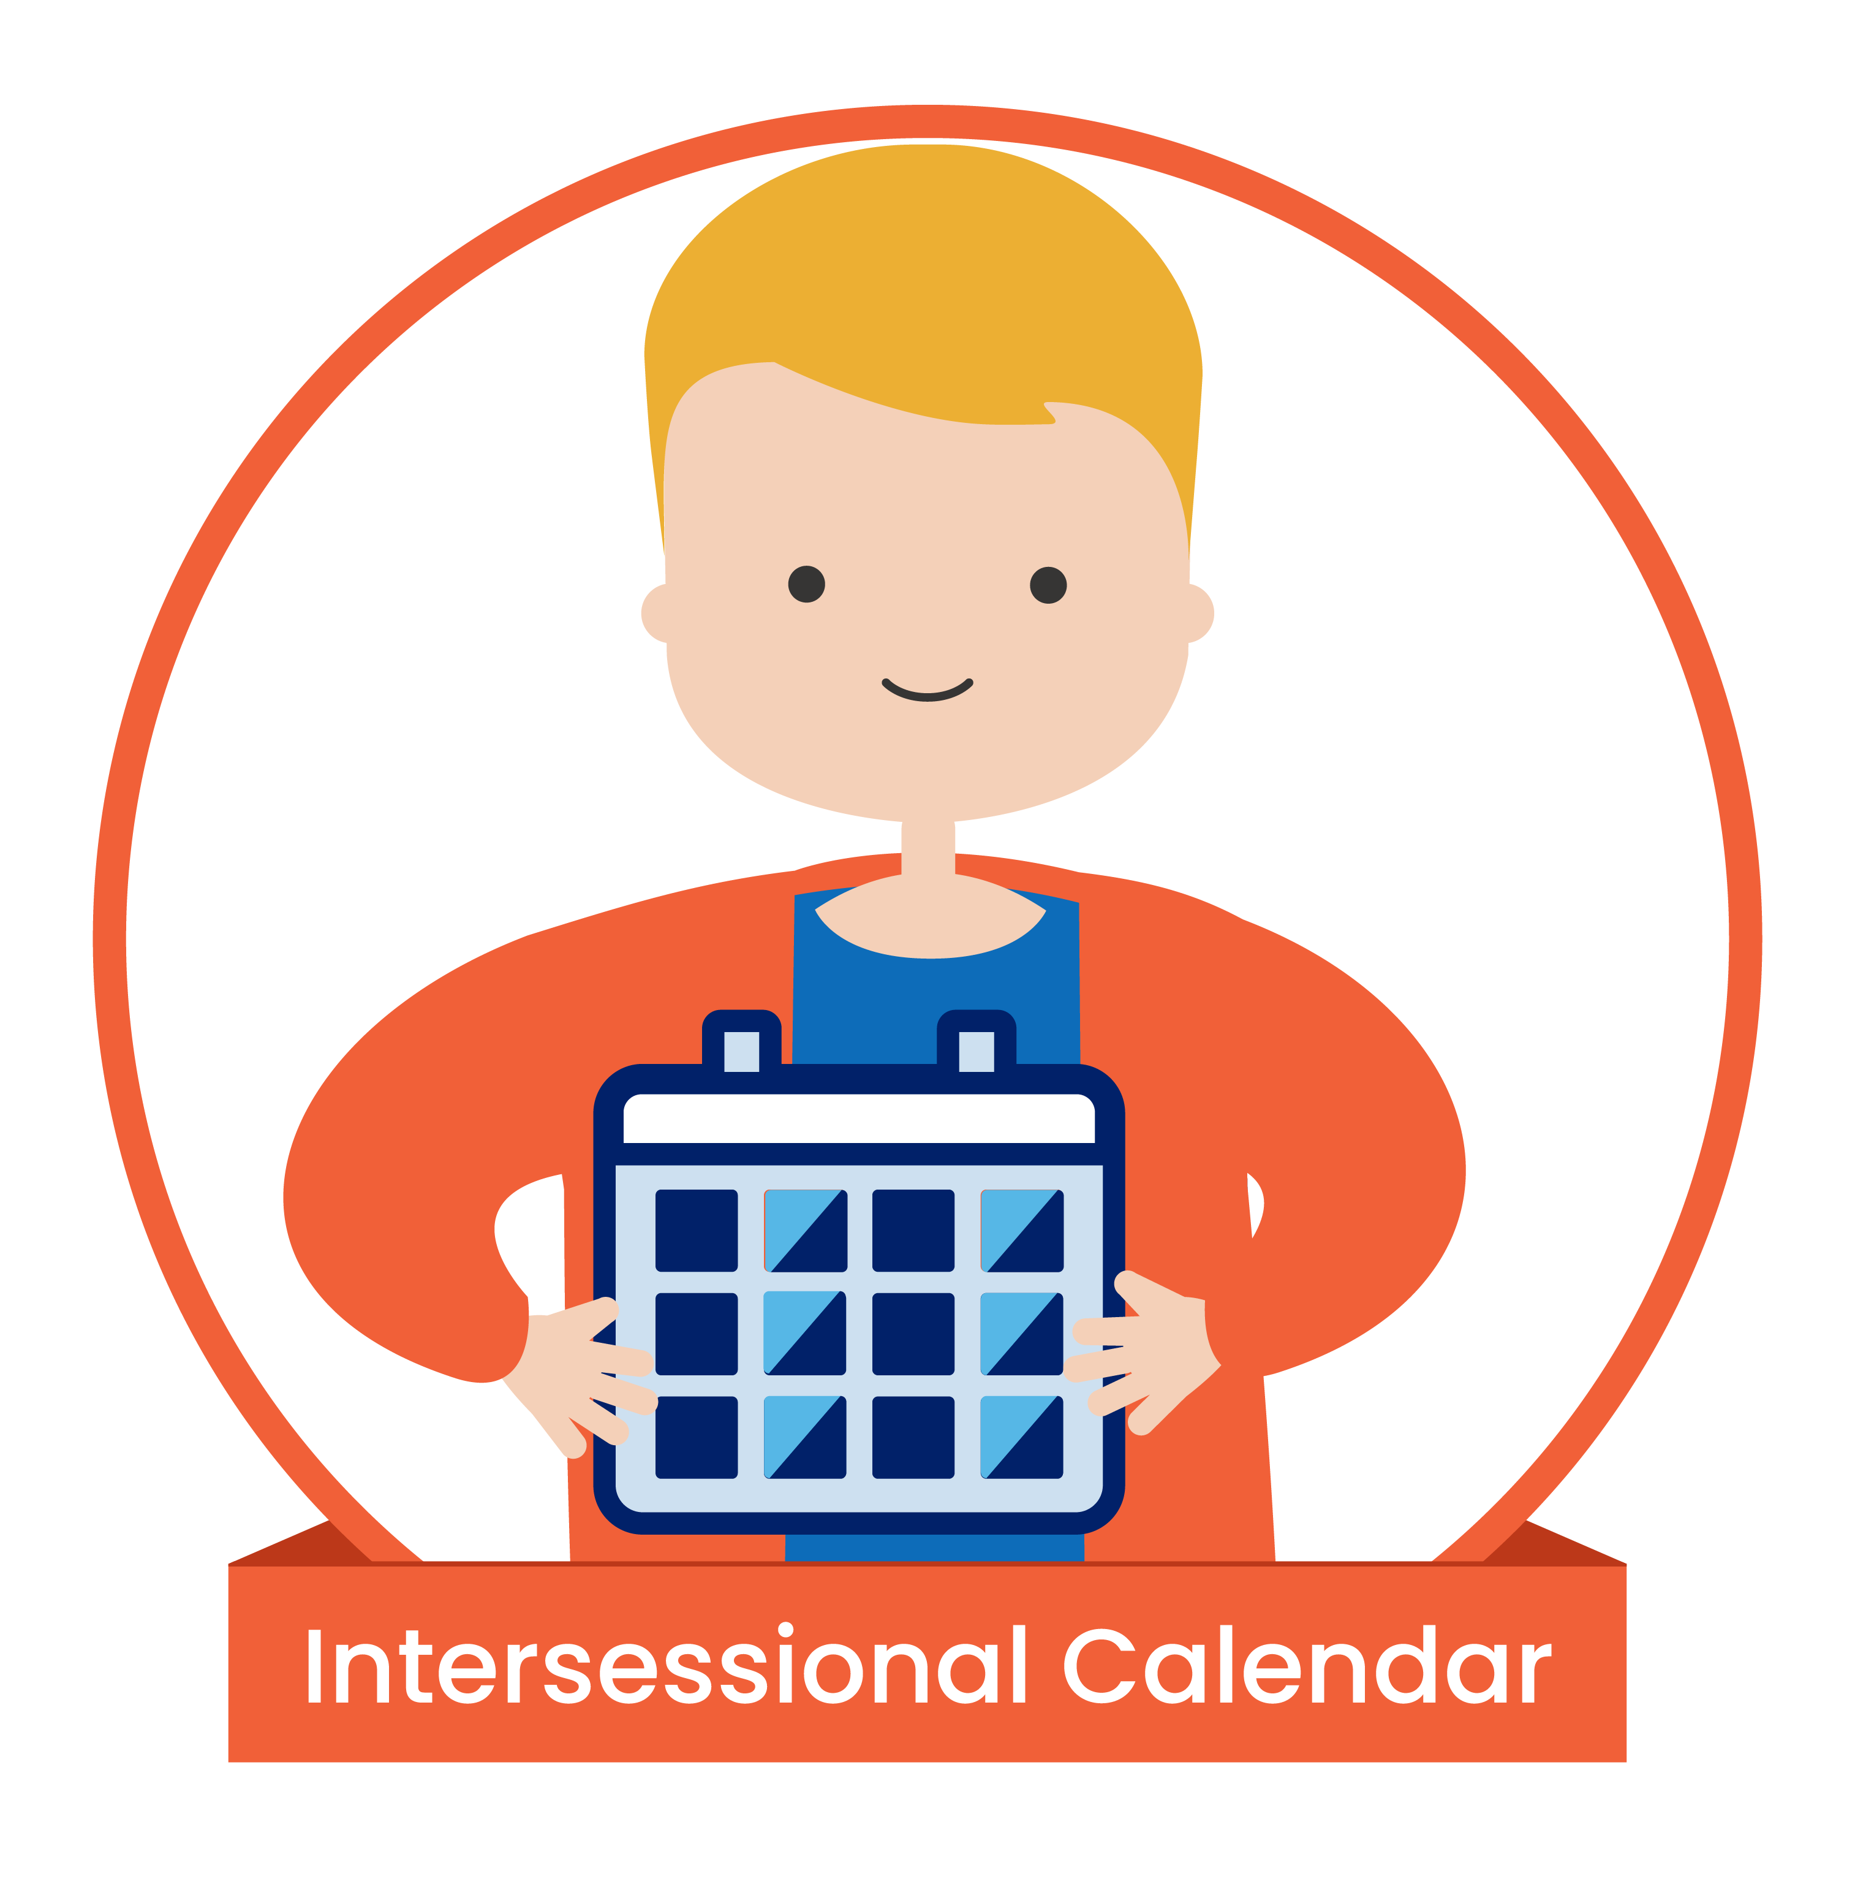

ADSY Design Considerations
Option 1: Voluntary Summer Learning
  Purpose: Summer Enrichment
  Think: 180-day traditional calendar, and up to 30 days for something additional
Option 2: Intersessional Calendar
  Purpose: Targeted Remediation
  Think: 180 days spaced out over the full year, with intermittent breaks for targeted remediation with a subset of students
Option 3: Full Year Redesign
  Purpose: Rethinking the School Day
  Think: A revamped 7x6-weeks calendar, daily schedule changes to increase teacher planning time and student play

Slide 9

Summer Program Example
Snyder ISD – 2021-2022 Calendar
30 Additional Days through Summer Program
Last Day of Academic Year: June 11, 2021
Summer Dates: June 14 – July 30, 2021
Program follows evidence-based practices from RAND Getting to Work on Summer Learning (minimum of 25 six-hour days)
Start of Following Year: August 11, 2021
Length of Summer Break: 1.5 weeks for students in Summer Intersession, 8.5 weeks for others
bit.ly/snyder-summer-schedule
Notes:
Typical length of summer – 12 weeks

Slide 10
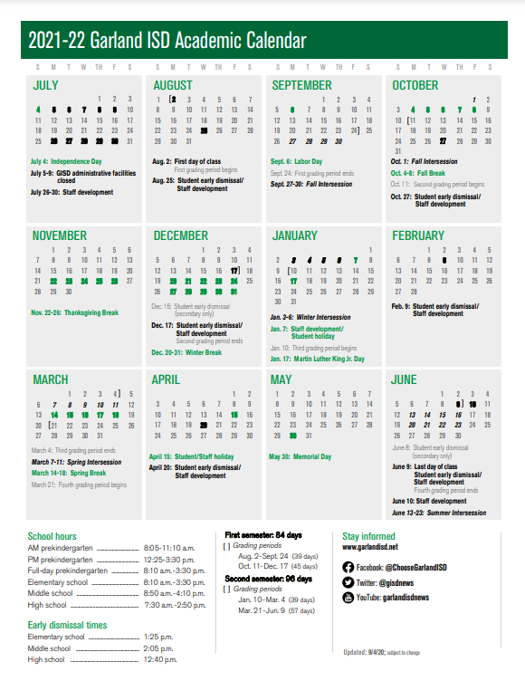
Intersessional Calendar Example
Garland ISD – 2021-2022 Calendar
22 Additional Days through Intersessions
Start Date: August 2, 2021
Intersessions:
9/27 – 10/1 – Fall Intersession
1/3 – 1/6 – Winter Intersession
3/7 – 3/11 – Spring Intersession
6/13 – 6/23 – Summer Intersession
End Date: 6/9/22 for all students, 6/23/22 for students in Summer Intersession
Length of Summer Break: 7 weeks for students in Summer Intersession, 9 weeks for others
bit.ly/garland-isd-calendar
Notes:
Typical length of summer – 12 weeks

Slide 11
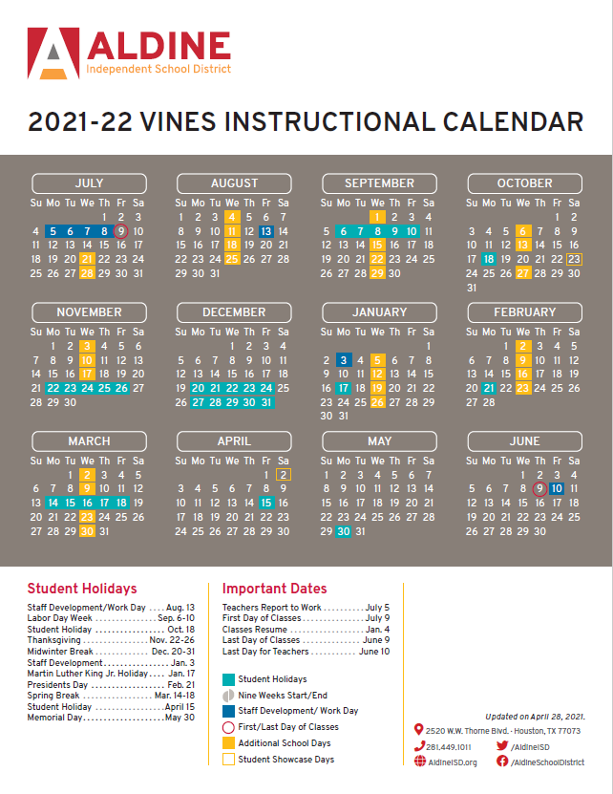
Full Year Redesign Calendar Example
Aldine ISD – 2021-2022 Calendar
30 Additional Days through Full Year Redesign
Start Date: July 9, 2021
Additional Days: Wednesdays throughout the school year (minimizes attendance risks for non-compulsory ADSY funding)
End Date: 6/9/22
Length of Summer Break: 4 weeks for all students
bit.ly/aldine-isd-calendar
Notes:
Typical length of summer – 12 weeks

Slide 12



PEIMS and Fiscal Considerations
There are fiscal considerations around timing of funds (ADSY) or extending use of ESSER funds. It is critical to bring your finance team along as a core member of the planning committee.
ADSY Attendance Projections – Attendance is projected on a biennial basis. If you did not project ADSY attendance for 2023-2024 or 2024-2025 in the winter of 2022, you can still receive ADSY funds, however it would be in the settle-up process after the year is over.
Attaching to Associated School Year – Summer ADSY days can be associated with either the previous school year or the following school year. This impacts the grade levels a campus/LEA would invite to the summer program. This may also impact SIS rollover and require attendance to be collected manually.
Reporting with 180 days – LEAs will receive a warning in the 3rd PEIMS submission starting in 22-23 for any instructional calendars fewer than 180. PEIMS coordinators need to be aware of the ADSY program!

Slide 13


Legislation to Watch and 23-24 Updates
There are a couple of bills and waiver updates that we are monitoring as we get ready for the 23-24 school year. Guidance will be sent out if any of the following are enacted.
HB 4317 – Updates the minimum day requirement to 175 instead of 180.
SB 2319 – Updates the minimum day requirement to just minutes, and changes up-to 30 days to 12,600 minutes.
SAAH/Waiver Updates – Adds up to 5 days of flexibility to the 180 day requirement for weather/health/safety reasons.

Slide 14
ADSY Planning and Execution Program

Slide 15
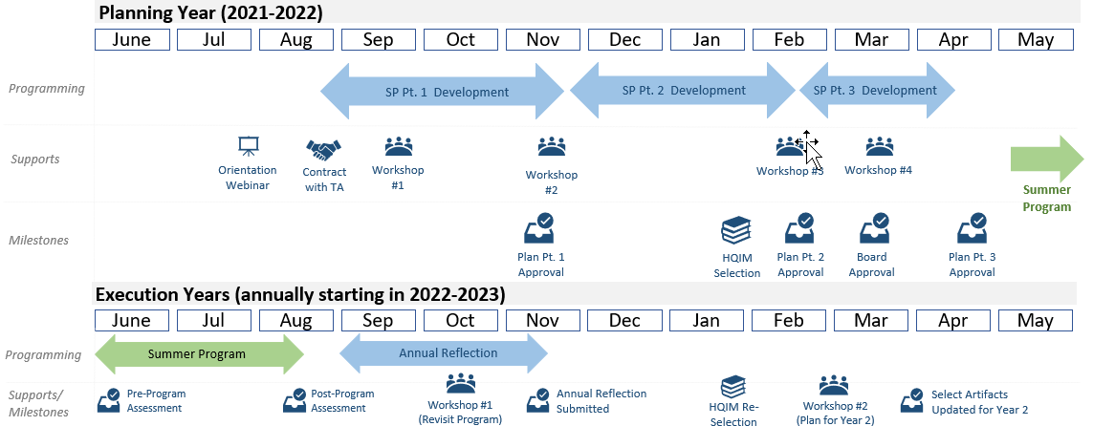
ADSY Planning and Execution Program 1
The ADSY Planning and Execution Program (PEP) is a four-year process for school systems to design, implement, and continuously improve Summer Learning and Full Year Redesign options of the ADSY Initiative. This program is not required to access ADSY funding.

Slide 16
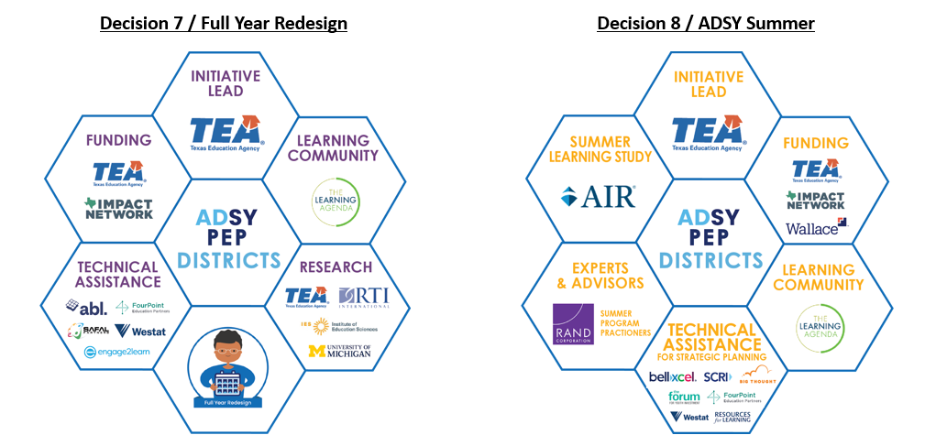
ADSY PEP Stakeholders

Slide 17
Decision 7: ADSY PEP Full Year Redesign Current State
Cycle # | # of Active LEAs | Implementation Year | ADSY Student Enrollment | ADSY Day Att. Rate | Non-ADSY Day Att. Rate
1 | 5 | 21-22 | 4,136 | 86.8% | 91.3%
2 | 6 | 22-23 | 848 (estimated) | Pending | Pending
3 | 3 | 23-24 | TBD | Pending | Pending
Decision 7 / Full Year Redesign remains a small grant program that is difficult to implement, but is seeing very promising student outcomes.

Slide 18
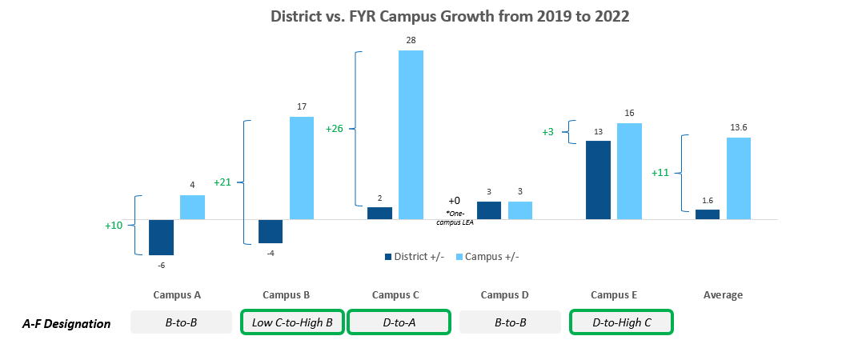
ADSY PEP Full Year Redesign Accountability Growth
Initial accountability data for Cycle 1 Full Year Redesign grantees shows participating campuses outperforming their LEA’s accountability growth by an average of 11 points.

Slide 19
Decision 8: ADSY PEP Summer Current State
Cycle # | # of Active LEAs | Implementation Summer | Student Enrollment
1 | 5 | 2021 | 2,600
2 | 38 | 2022 | 41,000+
3 | 22 | 2023 | 62,000+
4 | 9+ | 2024 | TBD
Decision 8 / Strong Summer has supported over 5% of districts in the state implement an evidence-based summer program.

Slide 20
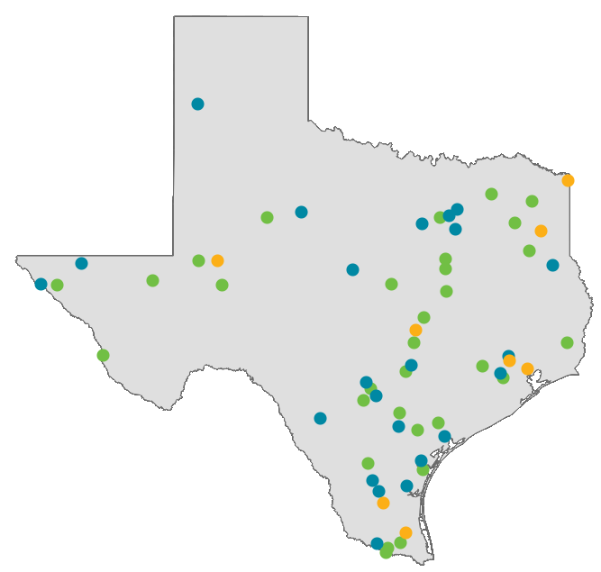
ADSY PEP LEAs Across the State
Voluntary Summer Learning
Full-Year Redesign or Intersessional Models
LEAs implementing both Models
ADSY PEP has LEA representation across the state:
  45+ LEAs implementing Voluntary Summer Learning
  12 LEAs implementing Full-Year Redesign or Intercessional Models in 2022-23

Slide 21
Budgeting for Summer Learning

Slide 22
Budgeting Tools - Most Common Sources of Summer Funding
Funding Source | Federal vs. State | Type of Funding | Funding Delivery Method | Timing for Receiving Funds | Fund Flexibility Level
21st CCLC | Federal | Competitive Grant | New grants are awarded in grant cycles every 2-3 years | One grant cycle is five years long | HIGH: Funds can be used for academics or enrichment
Additional Days School Year | State | Formula Funding | Foundation School Program | State funding cycle (including settle-up) | HIGH: Funds are dispersed as general revenue
Early Education Allotment | State | Formula Funding | Foundation School Program | State funding cycle | HIGH: Funds must go toward improving student performance
English Learner Summer Program | Federal | Formula Funding | EL units are reimbursed on a prorated basis | Annually | LOW: Funds must be used on instruction
State Compensatory Education | State | Formula Funding | Foundation School Program | State funding cycle | HIGH: Funds must go toward increasing academic achievement and reducing dropout rates
Teacher Incentive Allotment | State | Formula Funding | Foundation School Program | Annually | LOW: Only TIA districts are eligible for this funding. Funds must go toward teacher compensation
Title Funds | Federal | Formula Funding | Drawdowns determined by districts | Drawdowns determined by districts | VARIES: Fund use is determined by Title Fund

Slide 23
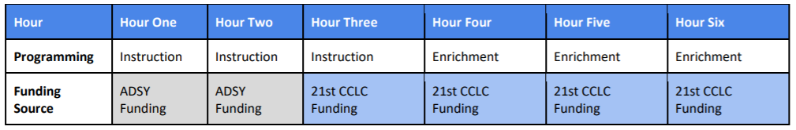
Example: Stacking ADSY with 21st CCLC Funds
ADSY funds can be ‘stacked’ with 21st Century/ACE funds in the same day if they are used as a supplemental aspect to the program.
ADSY has a minimum instruction requirement of two hours per day
21st CCLC requires a four-hour summer day

Slide 24
Implementation Trends

Slide 25
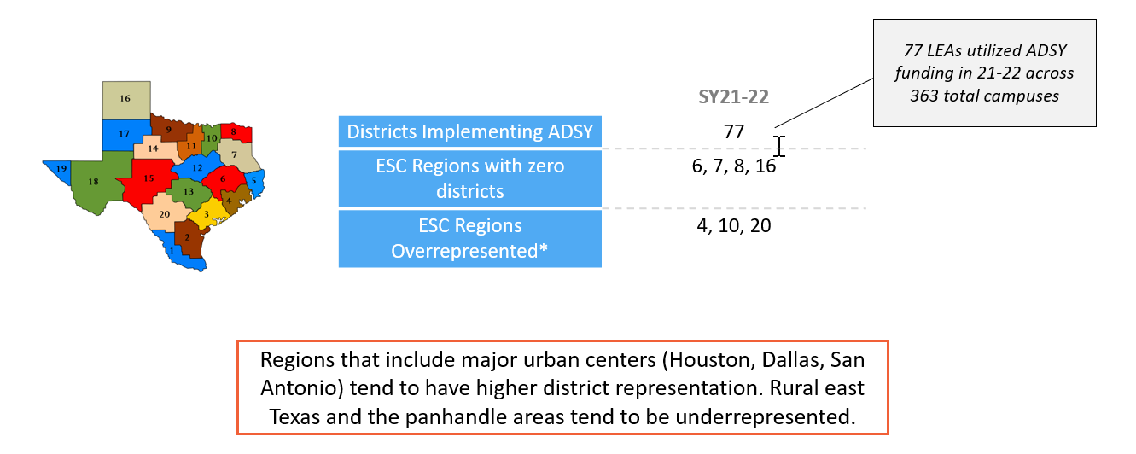
ADSY District Participation and ESC Region
Sources: PEIMS. *An ESC region is considered “overrepresented” if more than 10% of districts in the cohort come from that region – 8 or more districts.

Slide 26
Q&A
For additional questions please visit https://tea.texas.gov/adsy
or e-mail adsy@tea.texas.gov

