Slide 1
Child Find

Slide 2
Note
The focus of this presentation is on the changes for the official XML data submissions during the 2023-2024 school year.

Slide 3
Agenda
Child Find
Program Area Contacts
Program Area Updates and Guidance
2022-2023
Submission Updates
Reminders
Timeline
Frequently Asked Questions
2023-2024
Application Updates
Data Element Updates
Code Table Updates
Report Updates
Business Rule Updates
Timeline
Technical Resources
Questions

Slide 4
Program Area Contacts
Department of Special Populations Policy and Programs
Zane Wubbena, Ph.D., State Performance SPED Data Manager
Donna Holmes, State Performance Plan and Website Coordinator
spp@tea.texas.gov

Slide 5
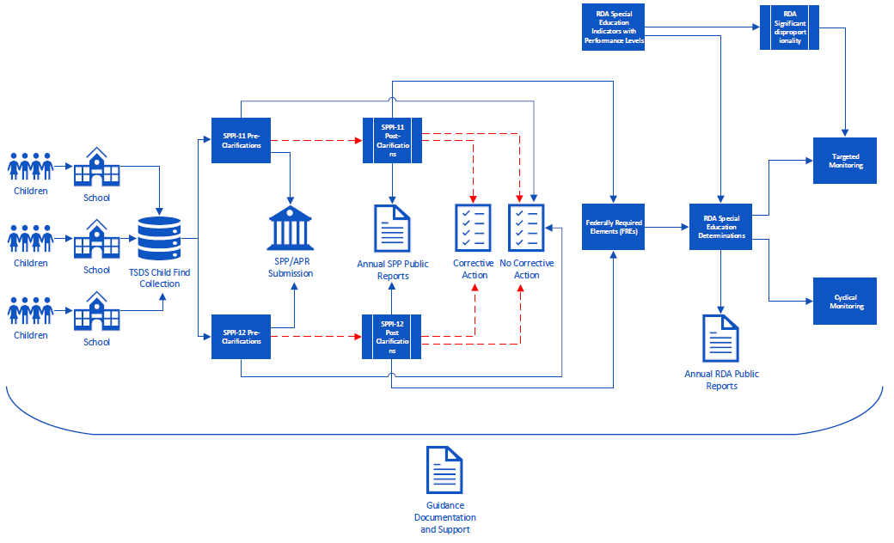
Program Area Updates & Guidance

Slide 6
2022-2023

Slide 7
Submission Updates
CHF0-100-002: SPPI-12 Student Compliance Report
New column ‘Calc Days Til 3rd Bday Count’ has been added.
Calculation of the number of calendar days between EFFECTIVE-DATE (E1632) and the child’s third birthday
LEAs should review any child showing a count of less than 90 days in this column.
Children showing a count of less than 90 days will have their compliance calculated through the SPPI-11 timeline.
Children showing a negative count do not need to have the EFFECTIVE-DATE data element reported for them (or the date was entered incorrectly).
The CSV version of the report is now available to users.

Slide 8
Submission Updates 1
CHF0-100-005: SPPI-11 Calculations Report
New report available to LEA users.
It is only available in CSV format.
Displays all the intermediate calculations performed by the Core application that go into determining the SPPI-11 compliance.
Users can utilize the report in conjunction with the SPPI-11 compliance flowchart for troubleshooting student non-compliance issues.

Slide 9
Submission Updates 2
CHF0-100-005: SPPI-11 Calculations Report (cont’d)
Important columns to pay attention to:
Calc Days After Consent Count: indicates the number of instructional days remaining in the school year starting on the parental consent date. This is the first step in determining the compliance timeframe.
Calc Init Eval Cutoff Date: indicates the calculated compliance cutoff date (i.e., due date) for the initial evaluation. An evaluation reported after this date results in non-compliance.
Calc Day 30 After Init Eval Date: indicates the 30th calendar date after the initial evaluation. Under most scenarios, this acts as the cutoff date for the eligibility determination (unless it falls during the summer).

Slide 10
Reminders
EFFECTIVE-DATE (E1632)
Only reported for SPPI-12 children to indicate the date that they began receiving early childhood intervention (ECI) services.
Date must come before the child’s 3rd birthday.
Children reported with an effective date less than 90 calendar days before their 3rd birthday will have their compliance calculated through the SPPI-11 timeline.
Review the ‘Calc Days Til 3rd Bday Count’ column on report CHF0-100-002 to see the calculated count for each child.
These children will show up on both the CHF0-100-001 and CHF0-100-002 reports and will also be counted in both the CHF0-100-003 and CHF0-100-004 reports.

Slide 11
Reminders 1
ECI-TRANSITION-CONFERENCE-DATE (E1713)
Only reported for SPPI-12 children
If there is no transition conference held between the agency providing ECI services, the family, and the LEA, then the LEA should report ECI-TRANSITION-CONFERENCE-DATE (E1713) with the same date reported for ECI-NOTIFICATION-DATE (E1712).
If there was a transition conference held, the LEA should report the date the conference was held for the ECI-TRANSITION-CONFERENCE-DATE (E1713).

Slide 12
Timeline
Child Find | Date
TSDS ready to load data to eDM | August 1, 2022
Child Find ready for users to promote data | September 12, 2022
Child Find ready for users to complete | May 15, 2023
Child Find submission due date for LEAs | July 27, 2023
Child Find data available to customers | August 10, 2023

Slide 13
Frequently Asked Questions
Validation rule 41163-0086 is firing for one of my SPPI-11 students, indicating non-compliance. We obtained the parent’s permission to evaluate over the summer and completed the student’s FIIE before the new school year started. What should I check to ensure my student is reported accurately?
Check that the PARENTAL-CONSENT-DATE (E1714) has been reported as per the TEDS guidance. When the parental consent is obtained during the summer and the FIIE (initial evaluation) is completed prior to the new school year beginning, the parental consent date should be backdated to the last day of school in the prior year. This is to ensure that it is being reported on an instructional day so the timeline count can begin.

Slide 14
Frequently Asked Questions 1
I have a child being reported for SPPI-12. I do not know the exact date that this child began receiving ECI services. What should be entered for the EFFECTIVE-DATE (E1632) data element for this child?
LEAs should make every effort to determine the accurate start date to the report for the EFFECTIVE-DATE. If the exact date cannot be determined, a “proxy” date can be used. For example, LEAs could report the same date being reported for the ECI-NOTIFICATION-DATE (E1712). As always, LEAs should maintain local documentation in this scenario.

Slide 15
Frequently Asked Questions 2
I have a child being reported for SPPI-12. I ran the CHF0-100-002 report and noticed the compliance-related columns are blank. I separately ran the CHF0-100-001 report for SPPI-11 and noticed this child was on that report as well. Why is the child on both reports?
A child appearing on both the CHF0-100-001 and CHF0-100-002 reports indicates an SPPI-12 child reported with an EFFECTIVE-DATE less than 90 days before their 3rd birthday. This can be seen in the ‘Calc Days Til 3rd Bday Count’ column on the CHF0-100-002 report. If this count is incorrect, review that the child’s DATE-OF-BIRTH and EFFECTIVE-DATE are being reported accurately.

Slide 16
2023-2024

Slide 17
Application Updates
No application updates are currently scheduled for the 2023-2024 school year.

Slide 18
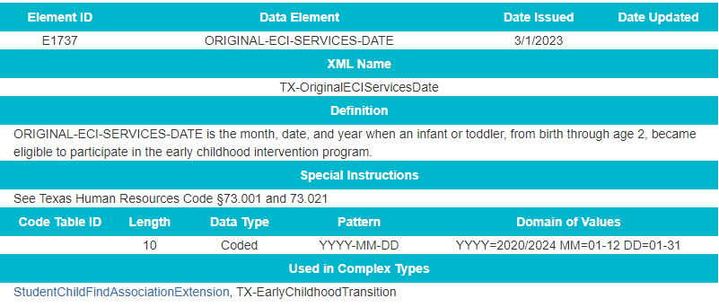
Data Element Updates
Added ORIGINAL-ECI-SERVICES-DATE (E1737) as conditionally mandatory

Slide 19
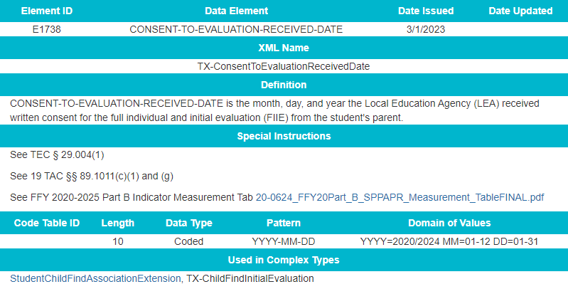
Data Element Updates 3
Added CONSENT-TO-EVALUATION-RECEIVED-DATE (E1738) as mandatory

Slide 20
Data Element Updates 4
Removed PARENTAL-CONSENT-DATE (E1714)
Updated ECI-TRANSITION-CONFERENCE-DATE (E1713) from conditionally mandatory to optional

Slide 21
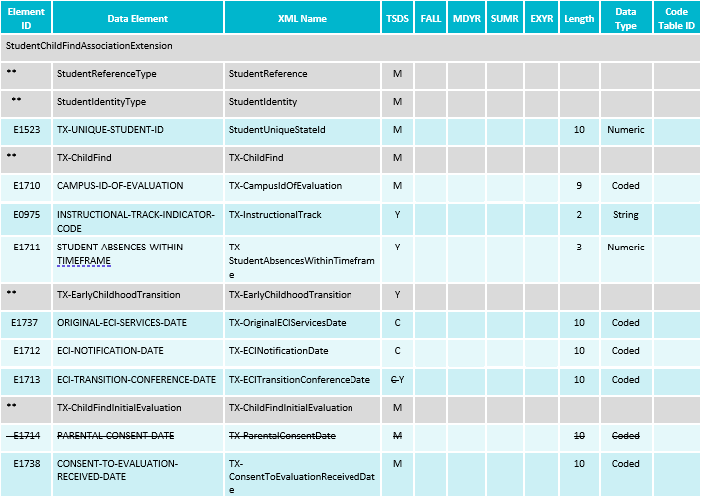
Data Element Updates 5

Slide 22
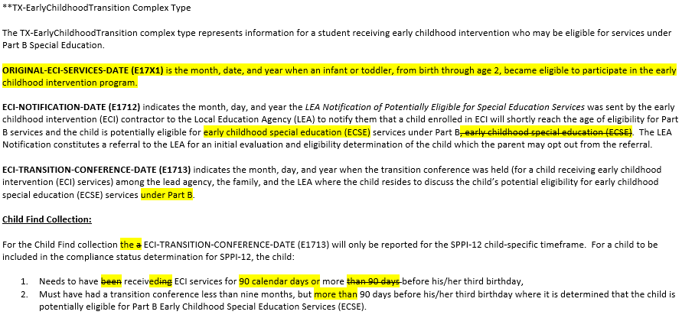
Data Element Updates 6
Updated Data Element Reporting Requirements for the added and deleted data elements in the StudentChildFindAssociationExtension complex type

Slide 23
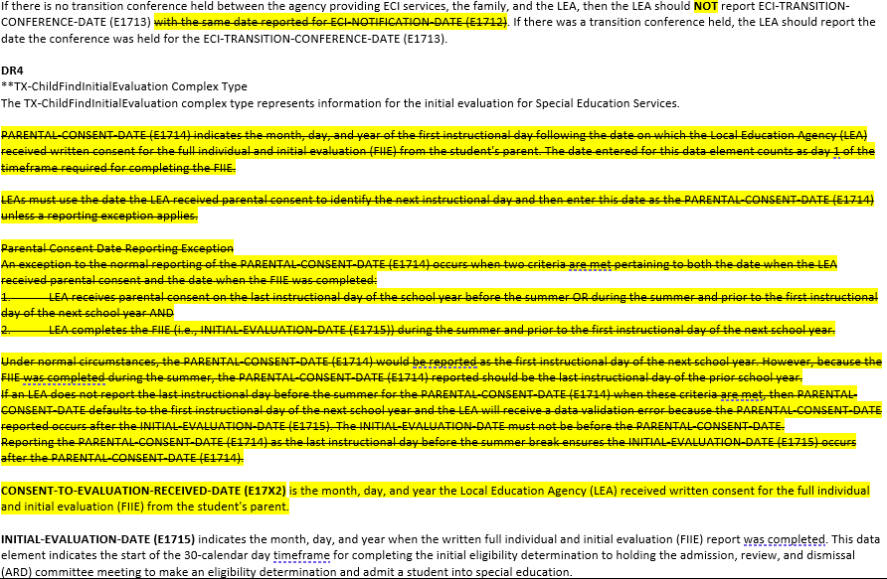
Data Element Updates 7

Slide 24
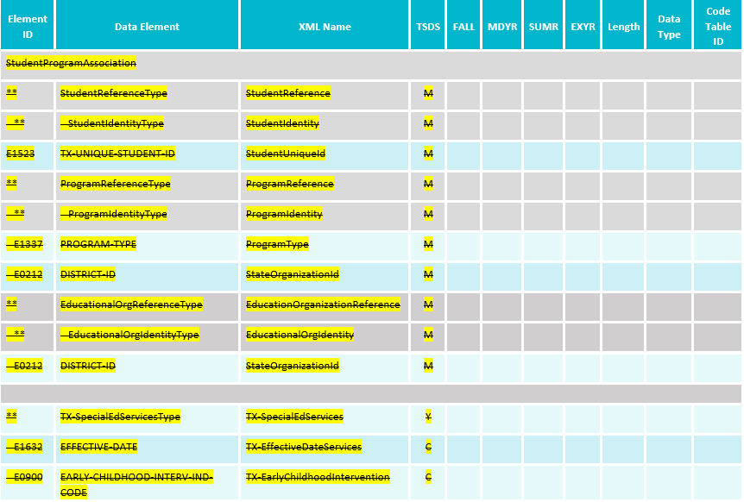
Data Element Updates 8
Removed StudentSpecialEdProgramAssociationExtension complex type:

Slide 25
Code Table Updates
No New Code Tables
No Updated Code Tables
No Deleted Code Tables

Slide 26
Report Updates
The following reports will be updated to add/remove columns for the previously mentioned data element updates.
CHF0-100-001: SPPI-11 Student Compliance Report
CHF0-100-002: SPPI-12 Student Compliance Report
CHF0-100-005: SPPI-11 Calculations Report
More information, including updated report mockups, will be shared prior to the start of the 2023-2024 school year.

Slide 27
Business Rule Updates
Deleted the following business rules from the Child Find Collection:
41163-0075
41163-0076
41163-0077
41163-0079
41163-0081
41163-0084

Slide 28
Business Rule Updates 9
Added the following business rules for the Child Find Collection:

Slide 29
Business Rule Updates 1
Added the following business rules for the Child Find Collection:

Slide 30
Timeline 1
Child Find | Date
TSDS ready to load data to eDM | August 7, 2023
Child Find ready for users to promote data | September 11, 2023
Child Find ready for users to complete | May 20, 2024
Child Find Submission due date for LEAs | July 25, 2024
Child Find data available to customers | August 8, 2024

Slide 31
Technical Resources
Technical Support
TSDSCustomerSupport@tea.texas.gov
Child Find Program Area
SPPI-11 Guidance Documents SPPI-12 Guidance Documents
TIMS Knowledge Base Articles
TSDSKB-620: SPPI-11 Compliance Flow Chart | TSDSKB-645: SPPI-12 Frequently Asked Questions
TSDSKB-621: SPPI-12 Compliance Flow Chart | TSDKSB-646: SPPI-11 Frequently Asked Questions
TSDSKB-622: Child Find Frequently Asked Questions | TSDSKB-648: SPPI-11 and SPPI-12 Interactive Flow Chart
TSDSKB-642: Child Find Program Guidance

Slide 32
Questions?
Thank you for attending.

