Slide 1
Class Roster

Slide 2
Note
The focus of this presentation is on the changes for the official XML data submissions during the 2023-2024 school year.

Slide 3
Agenda
Class Roster
Program Area Contacts
Program Area Updates and Guidance
2022-2023
Reminders
Timeline
Frequently Asked Questions
2023-2024
Application Updates
Data Element Updates
Code Table Updates
Report Updates
Business Rule Updates
Timeline
Frequently Asked Questions
Technical Resources
Questions

Slide 4
Program Area Contacts
Teacher Incentive Allotment (TIA)
Lyra Swinney, Project Coordinator - tia@tea.texas.gov

Slide 5
Program Area Updates & Guidance
Teacher Incentive Allotment (TIA)
Districts Employing Designated Teachers
Class Roster Winter Submission and TIA Guidance and Resources
TIA Q&A

Slide 6
2022-2023

Slide 7
Reminders
LEAs should run all Class Roster Winter reports to verify their staff and student data and counts before completing their submission.
TIA Teacher Incentive Allotment:
CLS2-100-007 Teacher Incentive Allotment Designated Staff Report:
Teacher data for all teachers with a TIA designation code(s)
Campuses at which the teachers provide instruction, for LEAs to verify the designated campuses for funding

Slide 8
Timeline
Class Roster Collection – Winter Submission | Date
TSDS ready to load data to eDM | August 1, 2022
Class Roster Winter ready for users to promote data | January 30, 2023
Class Roster Winter ready for users to complete | February 24, 2023
Class Roster Winter snapshot date – Last Friday in February | February 24, 2023
Class Roster Winter Submission due date for LEAs | March 30, 2023
Class Roster Winter data available to customers | April 13, 2023

Slide 9
Frequently Asked Questions
How does an LEA maintain the begin/expiration dates of Teacher Incentive Allotment (TIA) designations?
LEAs can access the Begin and Expiration dates of the TIA designations for the TIA teachers they employ publicly through the Teacher Incentive Allotment Designated Teacher Search. Begin and end dates of designations are not collected in TSDS, and only active designations should be reported in the Class Roster Winter Collection.

Slide 10
2023-2024

Slide 11
Application Updates
No application updates are currently scheduled for the 2023-2024 school year.

Slide 12
Data Element Updates
No New Data Elements
No Updated Data Elements
No Deleted Data Elements

Slide 13
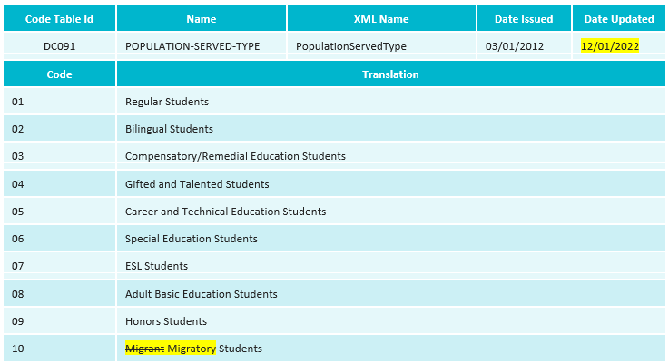
Code Table Updates
Updated POPULATION-SERVED-TYPE (DC091) code 10 value translation from ‘Migrant Students’ to ‘Migratory Students’

Slide 14
Report Updates
No New Reports
No Updated Reports
No Deleted Reports

Slide 15
Business Rule Updates
Removed rule 10020-0003 from the Class Roster Fall Submission:

Slide 16
Business Rule Updates
Added rule 10020-0070 for the Class Roster Fall Submission:

Slide 17
Timeline
Class Roster Collection – Fall Submission | Date
TSDS ready to load data to eDM | August 7, 2023
Class Roster Fall ready for users to promote data | September 11, 2023
Class Roster Fall snapshot date – Last Friday in September | September 29, 2023
Class Roster Fall ready for users to complete | September 29, 2023
Class Roster Fall Submission due date for LEAs | October 19, 2023
Class Roster Fall data available to customers | November 2, 2023

Slide 18
Timeline
Class Roster Collection – Winter Submission | Date
TSDS ready to load data to eDM | August 7, 2023
Class Roster Winter ready for users to promote data | January 29, 2024
Class Roster Winter ready for users to complete | February 23, 2024
Class Roster Winter snapshot date – Last Friday in February | February 23, 2024
Class Roster Winter Submission due date for LEAs | March 28, 2024
Class Roster Winter data available to customers | April 11, 2024

Slide 19
Frequently Asked Questions
Since an SSN is needed to obtain a Unique Id for the Class Roster Fall Submission, how do we report a visiting teacher from abroad who is in the process of getting an SSN?
If the LEA changes the NON-CAMPUS-BASED-INSTRUCTION-CODE (E1072) code in the SectionExtension to “03- Non-District Teacher Providing Classroom Instruction Services”, then the teacher data (StaffExtension and TeacherSectionAssociationExtension) would not be required and just the students would be reported.

Slide 20
Frequently Asked Questions
If a staff member has a ROLE-ID of Teacher (087) with a non-campus-based code of something other than "00 – Not Applicable", will that section get promoted, but not show up on staff and student roster reports?
The section will get promoted when there is a non-campus-based code of something other than "00 – Not Applicable" and display on the CLS1-100-005 Staff Roster report as well as the CLS1-100-1001 Student Class Roster report.

Slide 21
Technical Resources
Technical Support:​
TSDSCustomerSupport@tea.texas.gov
TIA Program Area:​
tia@tea.texas.gov
Knowledge Base Articles:​
TSDSKB-587 General FAQs for Class Roster Collection
​

Slide 22
Questions?
Thank you for attending.

