Slide 1

EARLY CHILDHOOD DATA SYSTEM (ECDS)

Slide 2
Note
The focus of this presentation is on the changes for the official XML data submissions during the 2023-2024 school year.

Slide 3
Agenda
ECDS
  Program Area Contacts
  Program Area Updates and Guidance
  2023-2024
    Application Updates
    Data Element Updates
    Code Table Updates
    Report Updates
    Business Rule Updates
    Timeline
    Frequently Asked Questions
  Technical Resources
  Questions

Slide 4
Program Area Contacts
Early Childhood Education (ECE) Division
  Sylina Valdez, Program Director
  Rebecca Matz, Program, Enrollment, and Partnership Specialist
  Magali Farooqi, Assessment Specialist
  ECE Support Portal
* Updated since Spring 2023 training

Slide 5
Program Area Updates & Guidance
ECDS Kindergarten Assessment Guidance
  Ensure student information is loaded timely
ECDS Prekindergarten Assessment Update
  Current Commissioner's list has been extended through SY 23-24
High-Quality Prekindergarten Update
  Update on the changes made in the ECDS reporting
    FAMILY-ENGAGEMENT-PLAN-LINK (E1583) definition and data element reporting requirements
    PROGRAM-EVALUATION-TYPE (E1626) definition and moved from Section level to LEA level
    PK-SCHOOL-TYPE (E1555) definition
    CHILD-CARE-OPERATION-NUMBER (E1726) definition and moved from LEA level to Course Section level
* Updated since Spring 2023 training

Slide 6
PK School Type Code Table
Code | Description
01 Non-Public Pre-K Head Start ​ | would be reported for a standalone Head Start not associated with a school district.​
02 Public Pre-K ​ | would be reported for public school programs implementing prekindergarten programs (excluding partnerships).​
05 Non-Public Pre-K Licensed Child Care ​ | would be reported for standalone childcare providers not associated with a school district.​
07 Public Pre-K Head Start ​ (LEA Grantee) | would be reported for public prekindergarten Head Start classrooms where the LEA is the Head Start grantee. (This school type code will NOT require the LEA to submit a Child Care Operation Number.)
08 Public Pre-K Licensed Child Care ​ | would be reported for public prekindergarten programs that partner directly with a licensed childcare provider to dually enroll students (includes partnership classrooms where children are dually enrolled in both the LEA and childcare provider site). (This school type code WILL require the LEA to submit a Child Care Operation Number.)​
10 Non-Public Pre-K ​ | would be reported for private prekindergarten providers not associated with a school district.​
11 In-District Charter Partnership ​ | would be reported for prekindergarten programs that are operated through an in-district charter partnership. The board of the LEA has authorized a non-profit organization, government entity, institute of higher education, and/or an existing charter as an in-district charter.​ (This school type code WILL require the LEA to submit a Child Care Operation Number.)​
12 Public Pre-K Head Start (Non-LEA Grantee) | would be reported for public prekindergarten programs that partner with a Head Start program and the Head Start grantee is not an LEA. (This school type code WILL require the LEA to submit a Child Care Operation Number.)​
99 Other ​ | would be reported when any of the codes do not describe the program.​
* New slide since Spring 2023 training

Slide 7
2023-2024

Slide 8
Application Updates
No application updates are currently scheduled for the 2023-2024 school year.

Slide 9
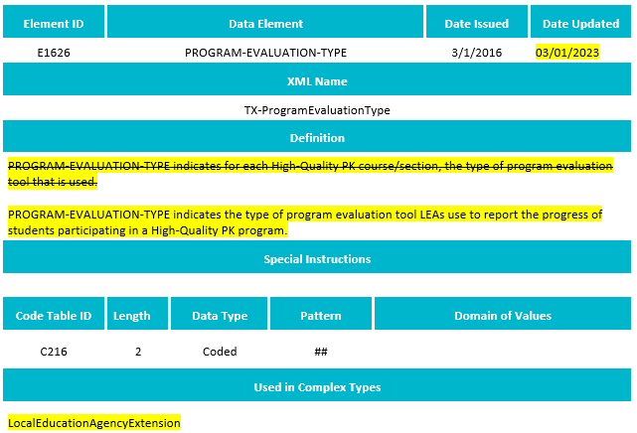
Data Element Updates
Updated the definition for PROGRAM-EVALUATION-TYPE (E1626).

Slide 10
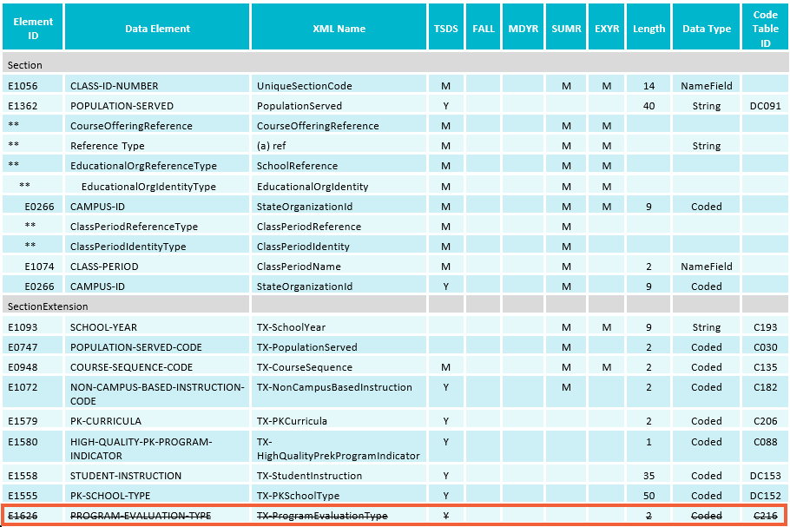
Data Element Updates - 1
Deleted PROGRAM-EVALUATION-TYPE (E1626) from the SectionExtension complex type.

Slide 11
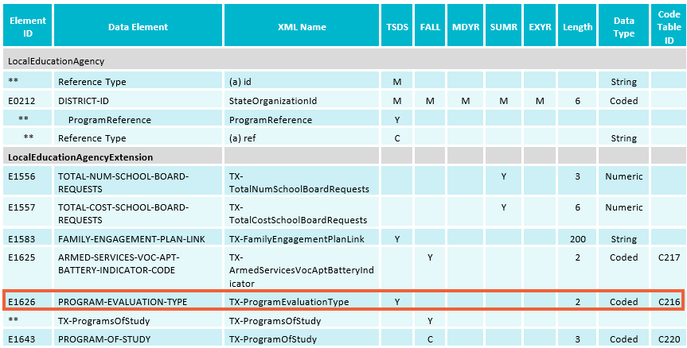
Data Element Updates - 2
Added the existing PROGRAM-EVALUATION-TYPE (E1626) to the LocalEducationAgencyExtension complex type.

Slide 12
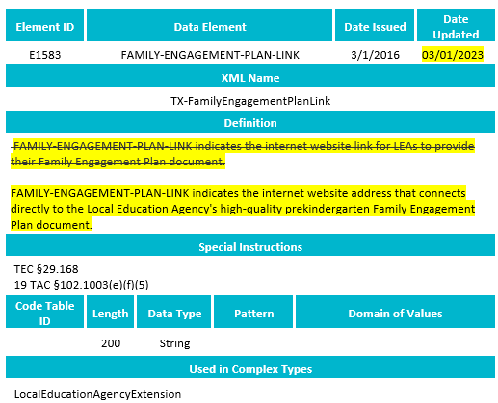
Data Element Updates - 3
Updated the definition for FAMILY-ENGAGEMENT-PLAN-LINK (E1583).

Slide 13
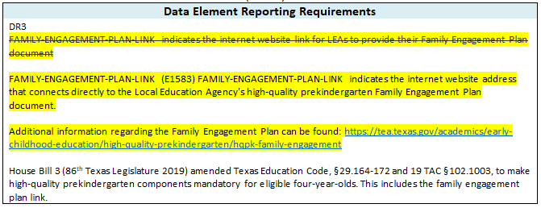
Data Element Updates - 4
Updated the data element reporting requirements in the LocalEducationAgencyExtension for the FAMILY-ENGAGEMENT-PLAN-LINK (E1583).

Slide 14
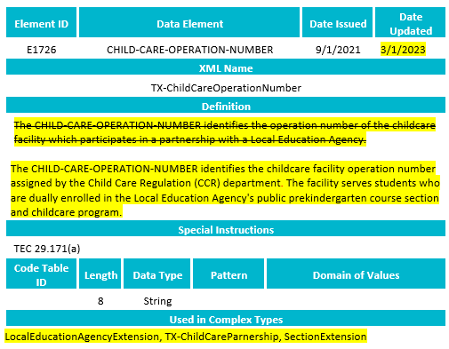
Data Element Updates - 5
Updated the definition for CHILD-CARE-OPERATION-NUMBER (E1726).

Slide 15
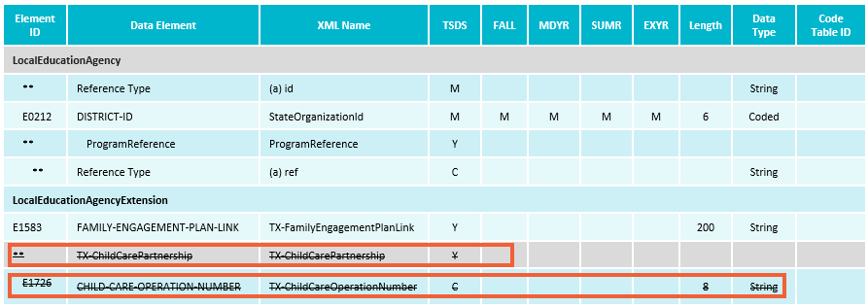
Data Element Updates - 6
Deleted the sub-complex, TX-ChildCarePartnership, and the included CHILD-CARE-OPERATION-NUMBER (E1726) from the LocalEducationAgencyExtension complex type.

Slide 16
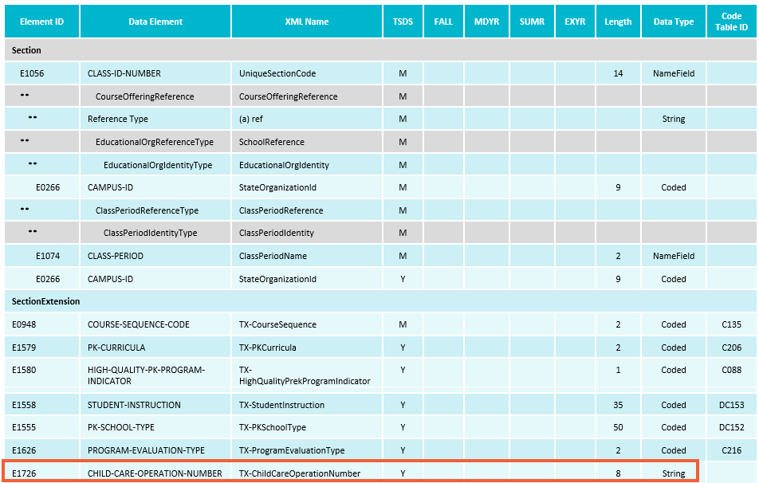
Data Element Updates - 7
Added the CHILD-CARE-OPERATION-NUMBER (E1726) to the SectionExtension complex type to be reported as optional.

Slide 17
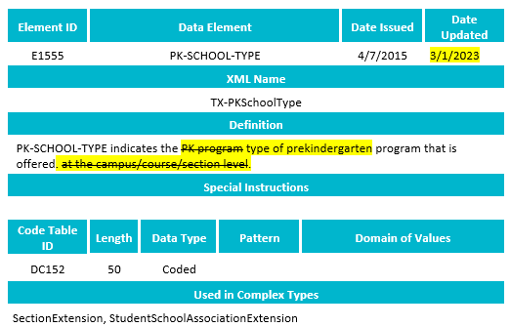
Data Element Updates - 8
Updated the definition for the PK-SCHOOL-TYPE (E1555).

Slide 18
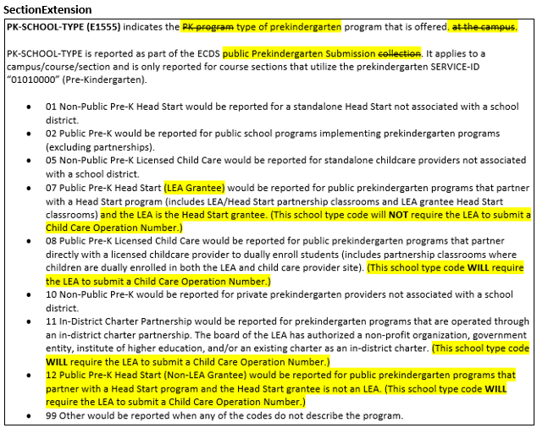
Data Element Updates - 9
Updated the data element reporting requirements for the PK-SCHOOL-TYPE (E1555) in the SectionExtension complex type.

Slide 19
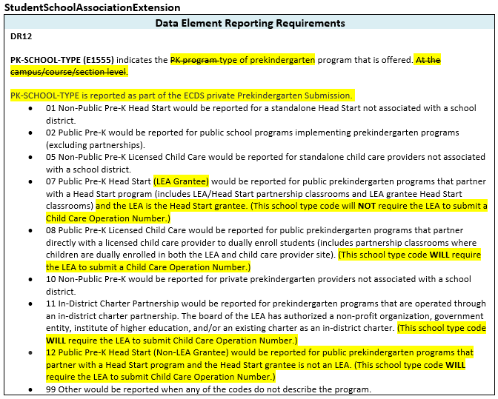
Data Element Updates - 10
Updated the data element reporting requirements for the PK-SCHOOL-TYPE (E1555) in the StudentSchoolAssociationExtension complex type.

Slide 20
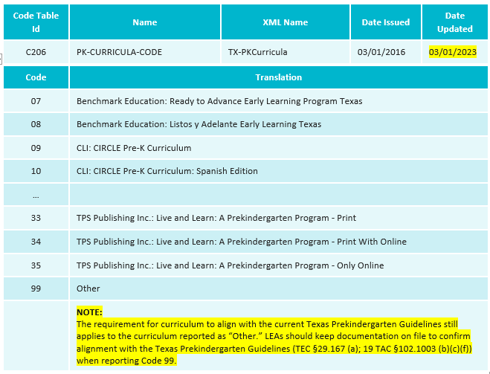
Code Table Updates
Added additional guidance to the PK-CURRICULA-CODE (C206) code table when an LEA reports "99-Other."

Slide 21
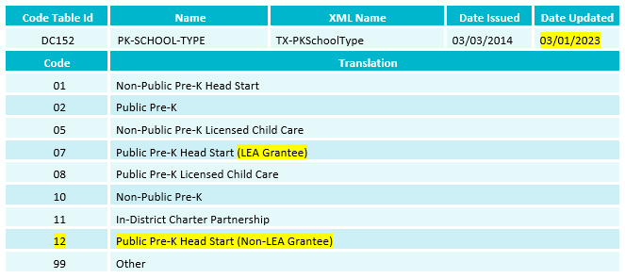
Code Table Updates - 1
Updated the code translation for “07 - Public Pre-K Head Start” to “Public Pre-K Head Start (LEA Grantee)” in the PK-SCHOOL-TYPE (DC152) code table.
Added new code and translation “12 - Public Pre-K Head Start (Non-LEA Grantee)” to PK-SCHOOL-TYPE (DC152) code table.

Slide 22
Report Updates
The following reports will be updated to add/remove rows/columns for the previously mentioned data element updates:
  ECD0-000-006 TSDS Early Childhood PK Data Submission
  ECD0-000-007 TSDS Early Childhood PK Completion
  ECD0-000-010 TSDS Early Childhood High Quality PK Component Completion
* Updated slide since Spring 2023 training

Slide 23
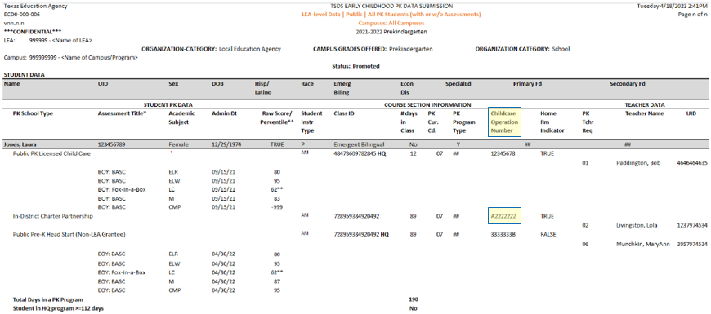
Report Updates
ECD0-000-006 TSDS Early Childhood PK Data Submission report updates:
  E1726 CHILD-CARE-OPERATION-NUMBER
* New slide since Spring 2023 training

Slide 24
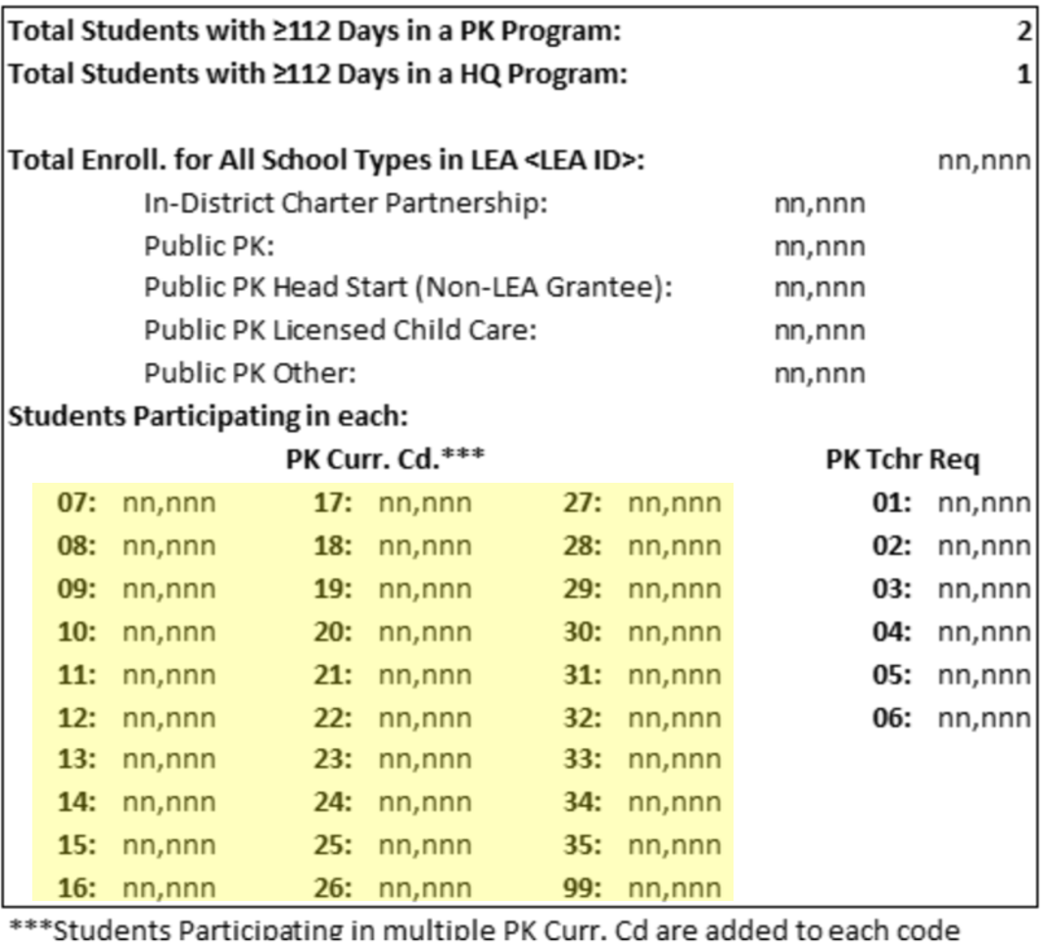
Report Updates
ECD0-000-006 TSDS Early Childhood PK Data Submission report updates:
  C206 PK-CURRICULA-CODE
* New slide since Spring 2023 training

Slide 25
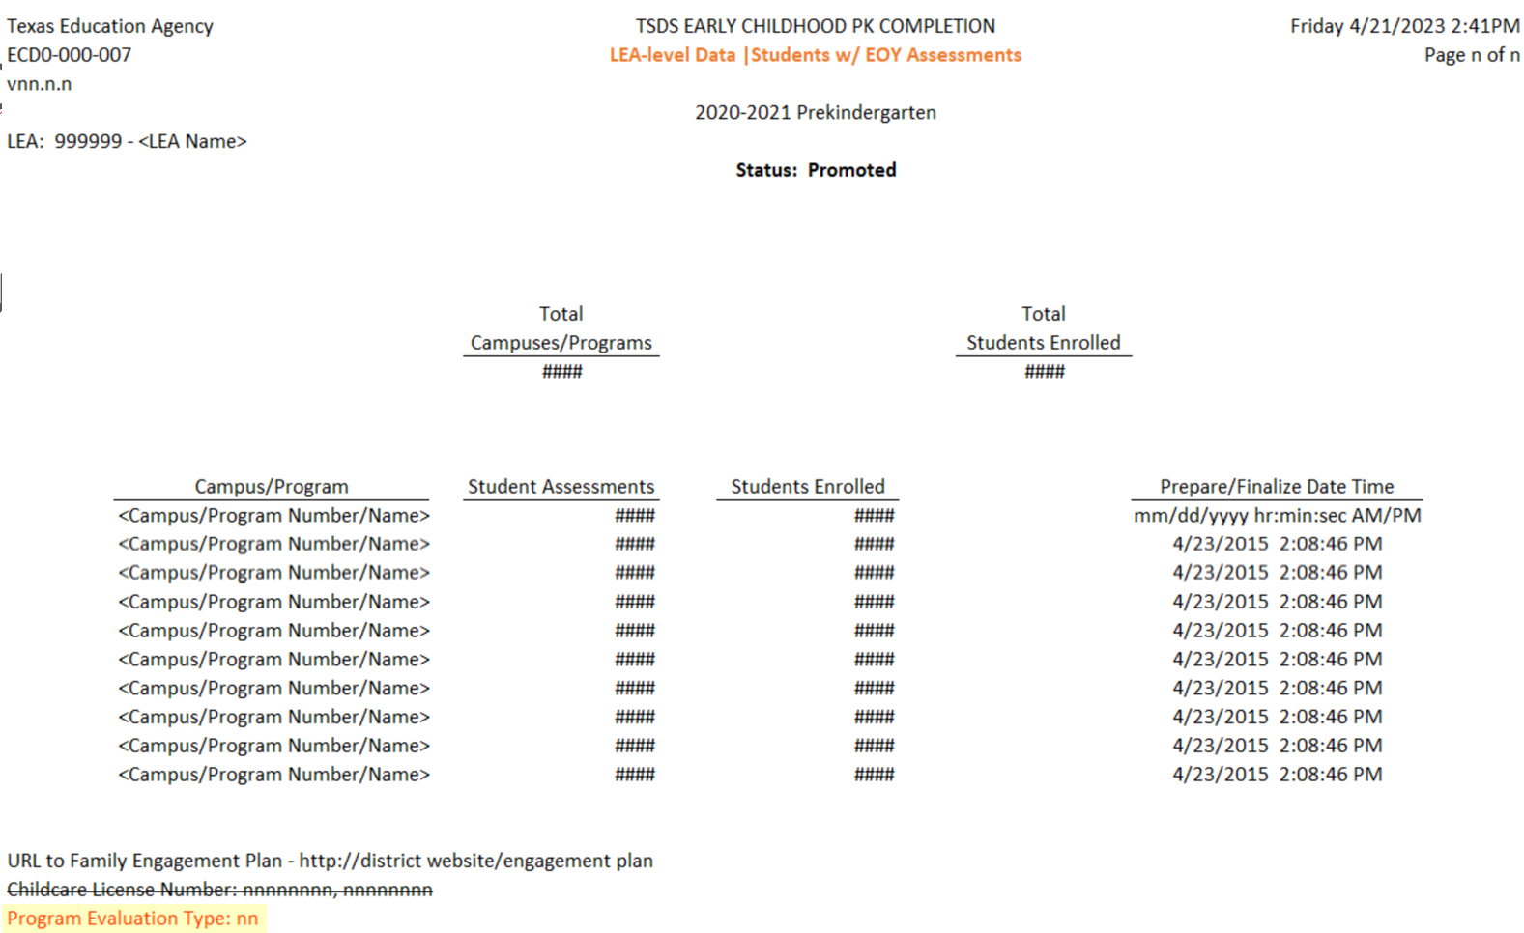
Report Updates
ECD0-000-007 TSDS Early Childhood PK Completion updates:
  C216 PROGRAM-EVALUATION-TYPE-CODE
* New slide since Spring 2023 training

Slide 26
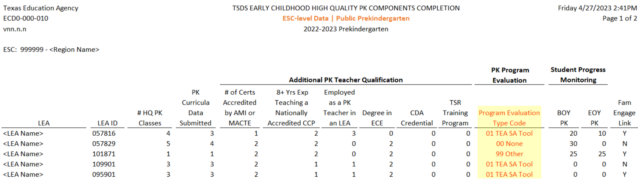
Report Updates
ECD0-000-010 TSDS Early Childhood High Quality PK Component Completion updates:
  C216 PROGRAM-EVALUATION-TYPE-CODE
* New slide since Spring 2023 training

Slide 27
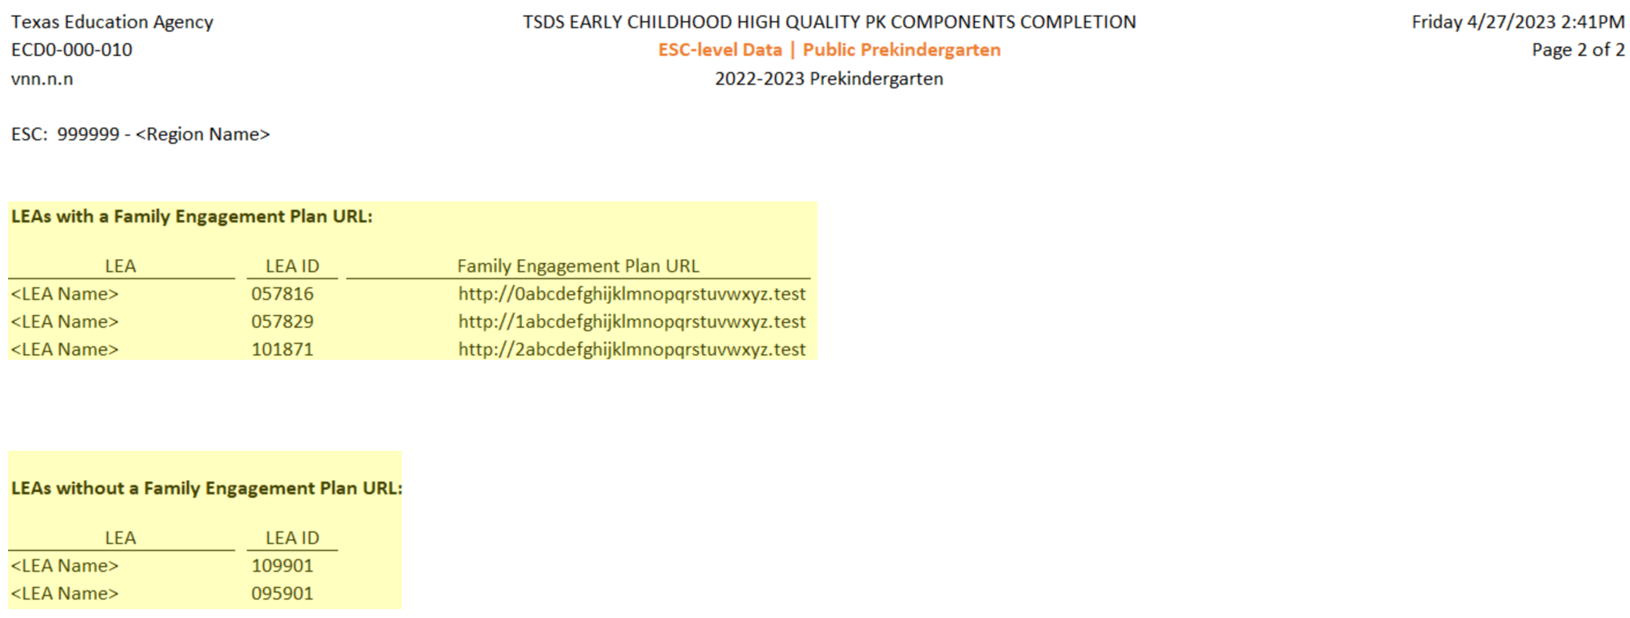
Report Updates
ECD0-000-010 TSDS Early Childhood High Quality PK Component Completion updates:
  E1583 FAMILY-ENGAGEMENT-PLAN-LINK
* New slide since Spring 2023 training

Slide 28
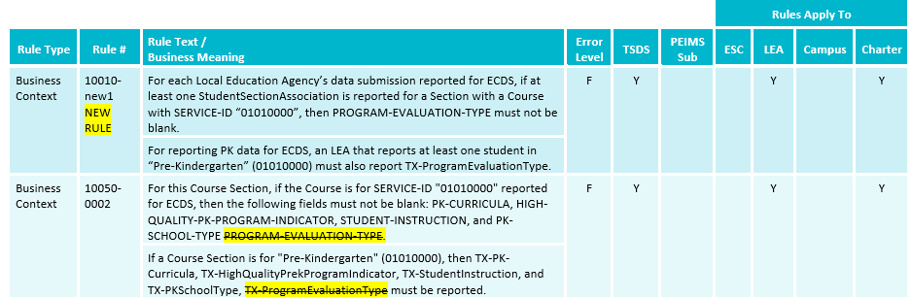
Business Rule Updates
New business rule for E1626 PROGRAM-EVALUATION-TYPE
Updated business rule 10050-0002 to remove reference to PROGRAM-EVALUATION-TYPE.

Slide 29
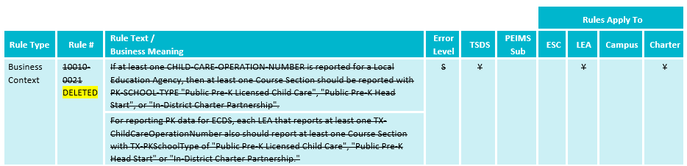
Business Rule Updates - 1
Deleted business rule 10010-0021.

Slide 30
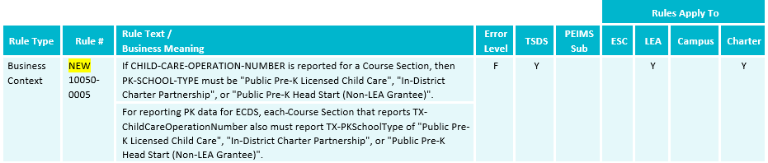
Business Rule Updates - 2
New business rule 10050-0005 for reference to PK-SCHOOL-TYPE (DC152) and CHILD-CARE-OPERATION-NUMBER (E1726)

Slide 31
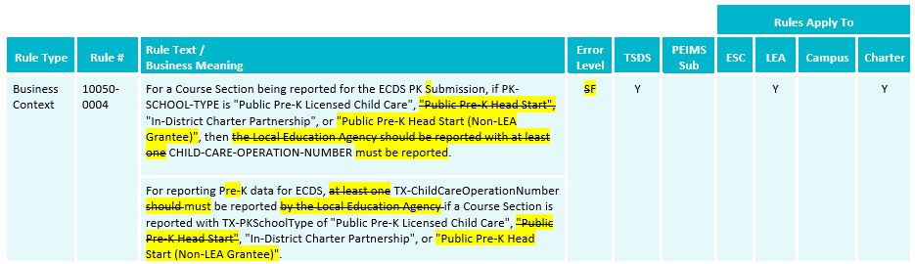
Business Rule Updates - 3
Updated business rule 10050-0004 for reference to PK-SCHOOL-TYPE (DC152) and CHILD-CARE-OPERATION-NUMBER (E1726).

Slide 32
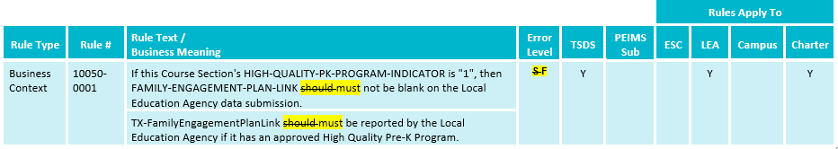
Business Rule Updates - 4
Updated business rule 10050-0001 for reference to FAMILY-ENGAGEMENT-PLAN-LINK (E1583).

Slide 33
Timeline
Early Childhood Data System Collection (ECDS) - KG | Date
TSDS ready to load data to eDM | August 7, 2023
ECDS Kindergarten ready for users to promote data | November 13, 2023
ECDS Kindergarten Submission due date for LEAs | January 25, 2024
ECDS Kindergarten data available to customers | February 8, 2024

Slide 34
Timeline - 1
Early Childhood Data System Collection (ECDS) - PK | Date
TSDS ready to load data to eDM | August 7, 2023
ECDS Prekindergarten ready for users to promote data | November 13, 2023
Private Prekindergarten application deadline for BPD (Business Partner Directory) Org number | May 30, 2024
ECDS Prekindergarten Submission due date for LEAs and Private Prekindergarten Organizations | June 27, 2024
ECDS Prekindergarten data available to customers | July 11, 2024

Slide 35
Frequently Asked Questions
When loading KG assessments from the ECDS application it shows that it loaded in the ODS, but when I go into the ODS batch uploads why do I not see the Student Assessment file?
LEAs should check the File Manager in the ODS to see if the StudentAssessment or AssessmentMetadata xml files are showing an error that prevented them from being batched into the ODS uploads.

Slide 36
Frequently Asked Questions - 1
Should Local Education Agencies (LEAs) report all prekindergarten (PK) and kindergarten (KG) students enrolled at any time before the Early Childhood Data System (ECDS) Collections, even if they are not assessed?
LEAs should report all KG and PK students in their respective ECDS Collections that were enrolled at any time before the collection due date, regardless if the student was assessed. In addition, LEAs should be verifying through their business validations and reports if a KG or PK student that is reported should have a TEA Commissioner approved assessment. For the ECDS KG and PK submissions all students that are promoted will show on the ECD0-000- 004 KG Data Submission Report or ECD0-000-006 PK Data Submission Report. Those KG students that are submitted without an assessment will display demographics, course/section, special programs information and show as ‘Not Assessed’ for their assessment information on the report. Those PK students that are submitted without an assessment will display demographics, course/section, special programs information and show as ‘Null’ for their assessment information. In addition, a special warning business validation should also be triggered indicating the ECDS KG or PK student should have assessment data information reported.

Slide 37
Technical Resources
Technical Specifications:
  Texas Education Data Standards (TEDS)
Technical Support:
  TSDSCustomerSupport@tea.texas.gov
ECDS Program Area:
  Early Childhood Education Website
  Early Childhood Education Division Support Portal
Knowledge Base Articles:
  TSDSKB-249 ECDS: General FAQs
  TSDSKB-508 ECDS: Assessment Specifications

Slide 38

Questions?
Thank you for attending.

