Slide 1
ESC PEIMS Coordinator Meeting
McKinney-Vento Student Identification
Wednesday, March 20, 2023
1:00pm-1:30pm
Notes:
KK Intro (Welcome – allow 1-2 min for folks to come on) (get green light from JB)
Discuss each section’s takeaway.
Good afternoon. Thank you for joining us today for our 2nd quarterly webinar. As we allow a few minutes for others to join, we just want to let you know that we appreciate you all for being with us today and our hope is that the information we share with you today can assist you in the work you do daily with our parents, teachers, campus and district leadership, support staff, other stakeholders, but most importantly we hope that the work we do together serves as a great benefit to our students. So, let’s get started!

Slide 2
Highly Mobile and At-Risk Student Programs Division
Kelly Kravitz, MPSA
Director
Highly Mobile and At-Risk Student Programs
Phone: 512-463-9235
Email: Kelly.Kravitz@tea.texas.gov
Jordan Brown
Program Specialist
Texas Education for Homeless Children and Youth (TEHCY) Program
Phone: 512-463-9467
Email: Jordan.Brown@tea.texas.gov
Notes:
Team Introductions/Each team member introduce themselves:
Before we get started with our presentation today, let’s take a moment for our Team members to introduce themselves. Again, we are the Highly Mobile and At-Risk Student Programs Division under the leadership of our Director, Ms. Kelly Kravitz. Ms. Kravitz was unable to be here with us today, but many of you know her. She has been here at the agency for 10 years and done tremendous work in these areas that are part of the HMAR division. With that, I’ll turn it over to Cal Lopez > Jordan Brown > Dr. LaTrenda Watson > Dr. Jimmy Bowser.

Slide 3
Texas Education for Homeless Children and Youth

Slide 4


2019-2022 Statewide Data
Homeless Student Identification
Notes:
JB
Here is a look at the statewide identification of students experiencing homelessness, with recent 21-22 identification.
(Review color legend)
Typically, identification can increase during events like natural disasters (which can displace families). Recently, we have seen a decrease in identification due to COVID-19, and in the next year. But we also know that overall enrollment has dropped, so it’s important to look at the percentage of students as part of the whole state population.
19-20 – About 2%​
20-21 – 1.75%​
21-22 – 1.79%

Slide 5
Who is covered by the
McKinney-Vento Homeless Assistance Act?
  Children and youth who lack a fixed, regular, and adequate nighttime residence, including children and youth:
    Sharing the housing of other persons due to the loss of housing, economic hardship, or similar reason
    Living in motels, hotels, trailer parks, or camping grounds, due to the lack of alternative adequate accommodations
    Living in emergency or transitional shelters, or are abandoned in hospitals
    Living in a public or private place not designated for or ordinarily used as a regular sleeping accommodation for human beings
Notes:
Children and youth who lack a fixed, regular, and adequate nighttime residence, including children and youth:
Sharing the housing of other persons due to the loss of housing, economic hardship, or similar reason
Living in motels, hotels, trailer parks, or camping grounds, due to the lack of alternative adequate accommodations
Living in emergency or transitional shelters, or are abandoned in hospitals
Living in a public or private place not designated for or ordinarily used as a regular sleeping accommodation for human beings

Slide 6
Who is covered by the
McKinney-Vento Homeless Assistance Act?
1
  Children and youth who lack a fixed, regular, and adequate nighttime residence, including children and youth:
    Living in cars, parks, public spaces, abandoned buildings, substandard housing, bus or train stations, or similar settings
    Migratory children living in the above circumstances [42 U.S.C. § 11434a(2)]
    Unaccompanied youth includes a homeless child or youth not in the physical custody of a parent or guardian
    [42 U.S.C § 11434a(6)]
Notes:
Children and youth who lack a fixed, regular, and adequate nighttime residence, including children and youth:
Living in cars, parks, public spaces, abandoned buildings, substandard housing, bus or train stations, or similar settings
Migratory children living in the above circumstances
Unaccompanied youth includes a homeless child or youth not in the physical custody of a parent or guardian

Slide 7
2019-2022 Statewide Homeless Data by Living Situation
Notes:
Identification data up until 21-22.
(Review color legend)
Doubled up students are the most common situation, but also the most difficult to identify.

Slide 8
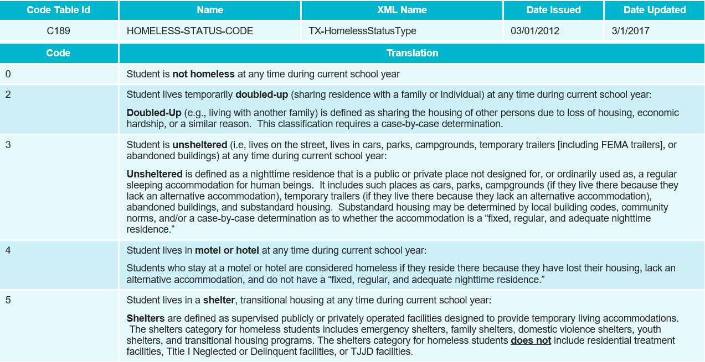
TSDS PEIMS Homeless Status Codes
Notes:
JB
We discussed what qualifies a student as homeless under the McKinney-Vento Act. Let’s look at how that translates into the PEIMS status codes.
The Homeless Status code is located in code table C189. You can see there are 5 codes in total and each row has a quick description to give you a better idea of what the term means.
Note: ALL identified students must be coded in the PEIMS system.
Evaluate this every year.
0 – Not homeless
2 – Doubled up – the most common living situation
3 – Unsheltered
4 – Motel/hotel
5 - Shelter

Slide 9
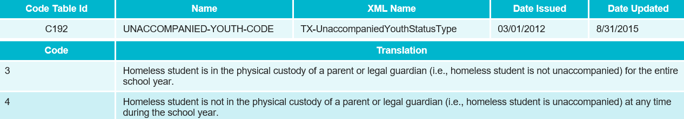
TSDS PEIMS Unaccompanied Youth Code
Notes:
JB
Here is the code table for unaccompanied youth, C192. These codes only apply to homeless students.
Every homeless student must be coded as either 3 or 4. The McKinney-Vento liaison typically assess and determines which coding is appropriate during the intake process.
3 – The homeless student is in the physical custody (not unaccompanied) of a parent or guardian
4 – The homeless student is not in the physical custody (unaccompanied) of a parent or guardian
Historically there was an unaccompanied youth code.

Slide 10
McKinney-Vento Student Coding
Student eligibility for McKinney-Vento services should be assessed annually
McKinney-Vento eligible students should be coded at the time of identification
McKinney-Vento coding does not carry over from year-to-year
Identification and coding is for the current school year
Notes:
Student coding timeframe specifics.
Annually – means every school year. This includes students who were identified during the previous school year.
As soon as the student is identified, they need to be coded in PEIMS.
Identification and coding lasts for the school year during which the students have been identified.
Coding does not carry over, this reiterates that housing status need to be assess annually.

Slide 11








McKinney-Vento Liaisons Facilitate Identification of Students Experiencing Homelessness by Providing:
Identification Processes
Training of
LEA Staff
Awareness Materials
Community Collaboration
Notes:
Who ensures this process is completed?
LEA McKinney-Vento liaisons facilitate identification of students experiencing homelessness by providing:
Identification procedures
Training of LEA staff
Awareness materials and
Collaborate with the community.
Reach out to your McKinney-Vento liaison with any questions on this process. You can find their contact information on your LEA McKinney-Vento webpage, or the Regional ESC McKinney-Vento webpage.

Slide 12

McKinney-Vento Student Identification
LEAs should have processes and strategies in place to identify students experiencing homelessness:
Upon enrollment
Anytime during the school year
In the event of a natural disaster
Notes:
Timeframes for identification
LEAs should have processes and strategies in place to identify students experiencing homelessness:
Upon enrollment
Anytime during the school year
In the event of a natural disaster

Slide 13

Identification of Unaccompanied Homeless Youth
Review each situation on a case-by-case basis
Review their living situation and nighttime residency
Student must be BOTH unaccompanied AND experiencing homelessness
Notes:
Unaccompanied youth includes a homeless child or youth not in the physical custody of a parent or guardian.
Often secondary students, but elementary and middle school students can also be considered UY
Have a conversation with your students.

Slide 14
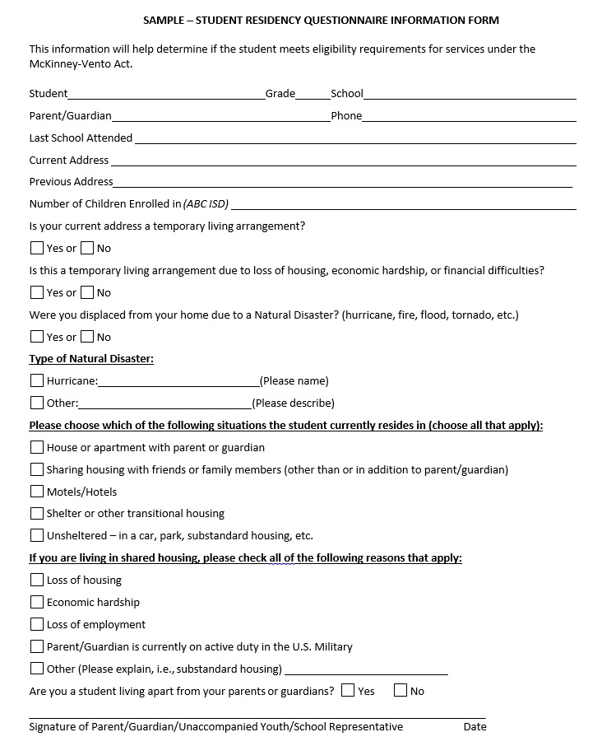
Sample: Student Residency Questionnaire (SRQ)
Best practice to determine McKinney-Vento eligibility
Available in a digital format
SRQ’s completed throughout the school year
Notes:
The SRQ is a recommended best practice to assist with the identification of students experiencing homelessness. Utilization of the SRQ provides an audible and systematic process to determine McKinney-Vento eligibility for housing determination each year.
McKinney-Vento Eligibility should be made on a case-be case basis
Helps consider the unique circumstances of each student.

Slide 15
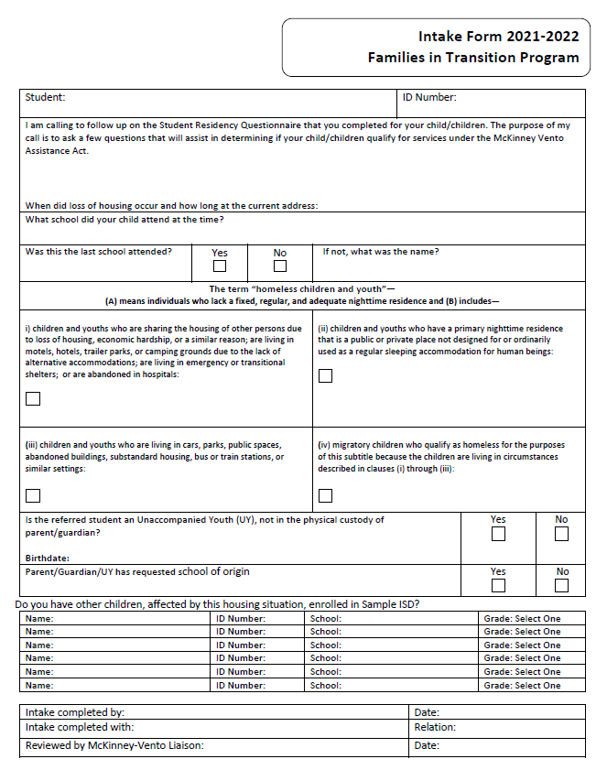
Sample Intake Form – Page 1
Clarify responses on the SRQ
Document School of Origin
Identify all eligible students in the family
Notes:
Another identification strategy to compliment the SRQ form.
Use the intake form to clarify responses on the SRQ to determine identification and program services. The intake form is a great tool to ensure that all eligible students in a family are identified.

Slide 16
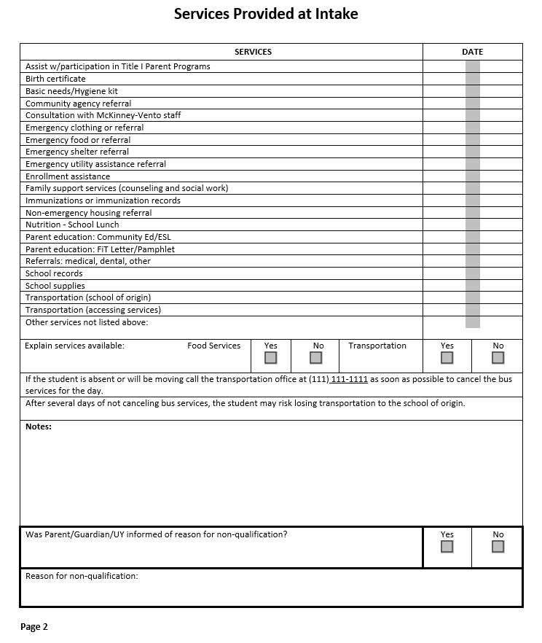
Sample Intake Form – Page 2
Review program services
Document referrals and services provided
Document non-qualification criteria and intake notes
Notes:
The second page of the intake form assists with reviewing and documenting the services provided to the student such as school of origin transportation, free lunch program, etc.
SRQs along with intake forms are auditable documentation of identification or disqualification of MV program services. This sample form can be adapted to fit your LEA needs.

Slide 17
Next Steps
Review processes and procedures for McKinney-Vento student identification with registrars and front office staff.
Foster links between LEA McKinney-Vento Liaisons, Registrars, and PEIMS support staff.
Encourage staff to review McKinney-Vento program reports to monitor student enrollment, coding, and services on a regular basis.
Develop processes and procedures to address and correct any coding errors throughout the school year.
Foster cross-collaboration and training.

Slide 18
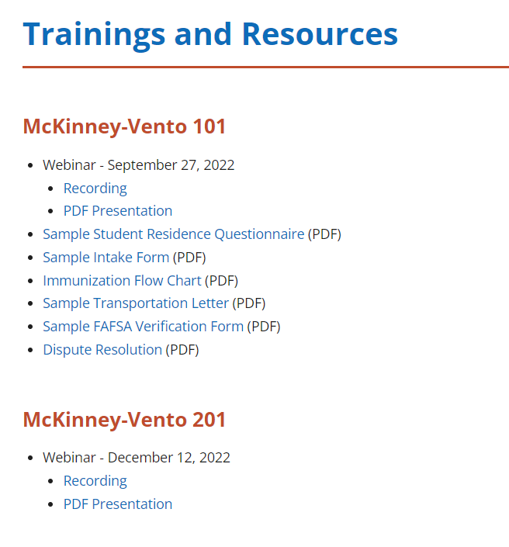
McKinney-Vento 101/Identification Resources
McKinney-Vento 101 webinar recording and slide deck
Sample Student Residency Questionnaire
Sample Intake Form
Immunization Flow Chart
Sample Transportation Letter
Dispute Resolution Resources
McKinney-Vento 201 Training
Copyright ©Texas Education Agency, 2022. All rights reserved

Slide 19
ESSER Special Populations Brief – NEW!
Provides reminder of ESSER funding and how these resources can be used to address the unique academic, social, emotional, mental health, and related needs of Special Populations due to COVID-19.
TEA HMAR Webpage Tools and Resources: https://tea.texas.gov/academics/special-student-populations/tools-and-resources

Slide 20
General Updates

Slide 21
TEHCY Upcoming Trainings and Events
Training | Date & Time
TEHCY / ARP Homeless I Grant Coffee Chat | March 7th, 2023 Tuesday, March 21st, 2023 10:30 – 11:30 am
ARP Homeless II Grant Coffee Chat | Wednesday, March 29th, 2023 10:00 – 11:00 am
Foster Youth Conference | April 6-7, 2023
ACET – San Marcos | April 26-28, 2023
Notes:
TEHCY/ARP Homeless I Grant Coffee Chat has been rescheduled from March 7th to March 21st, 2023, during the same time of day.

Slide 22
HMAR Webinars 2022-23 | Save the date!
Transition Assistance (Part II)
Wednesday, April 5, 2023
10:00 am – 11:30 am
Register
HMAR 4th Webinar
Thursday, May 4, 2023
1:00 pm – 2:30 pm
Register
Notes:
Upcoming HMAR webinars- save the date

Slide 23





HM&AR Division Emails
Military Connected Students
Pregnancy Related Services
Texas Education for Homeless Children and Youth (TEHCY) Program
Child Abuse and Neglect Awareness
Foster Care and Student Success
PregnancyRelatedServices@tea.texas.gov
FosterCareLiaison@tea.texas.gov
HomelessEducation@tea.texas.gov
PreventingHumanTrafficking@tea.texas.gov
MilitaryConnectedStudents@tea.texas.gov
Copyright ©Texas Education Agency, 2023. All rights reserved.
Notes:
TA emails for each program area

Slide 24
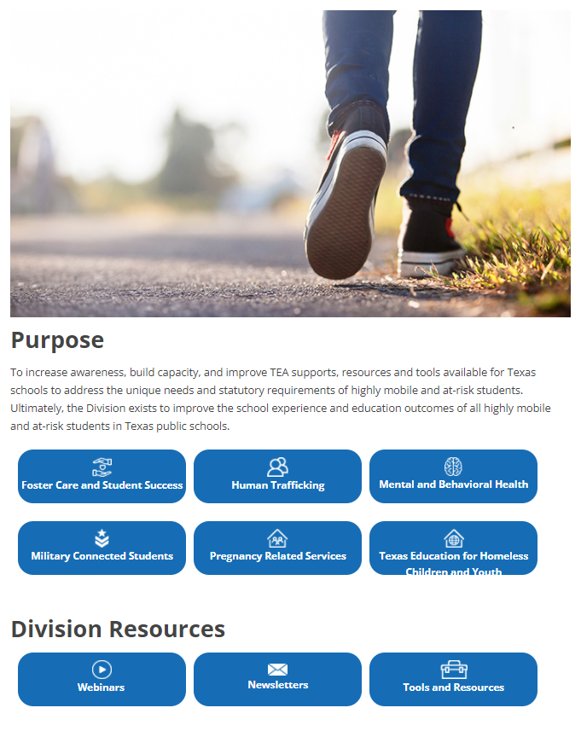
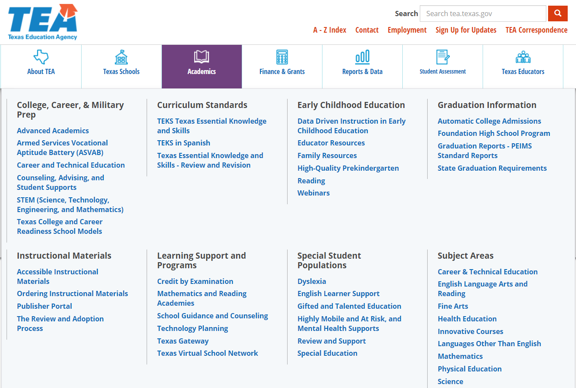

TEA HMAR Webpage
Notes:
Mouse on the slide moves to HM&AR Link → Student Programs Webinars → Program Newsletters (talk through each of them)
KK – Remind audience about our webpage and where to go for previous zooms and newsletters

Slide 25
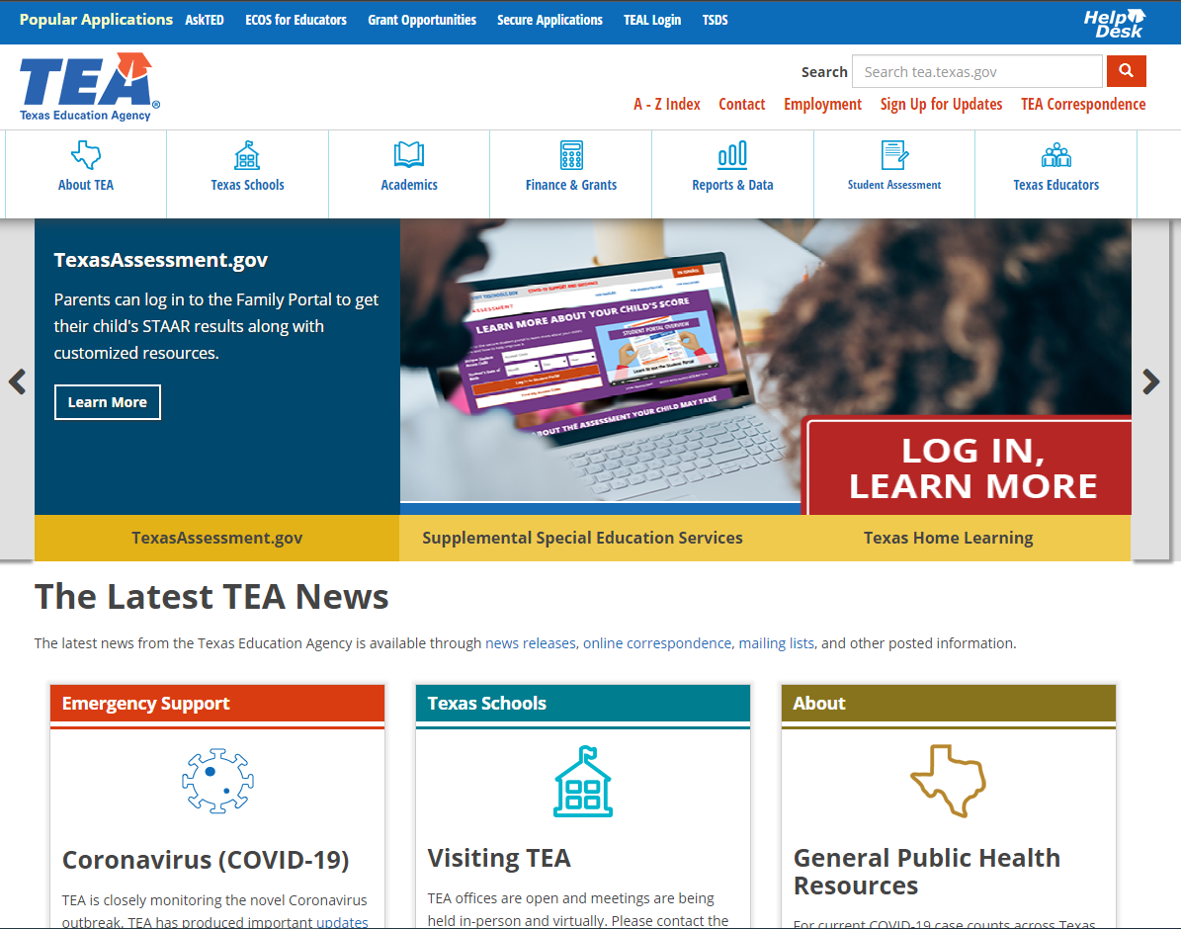
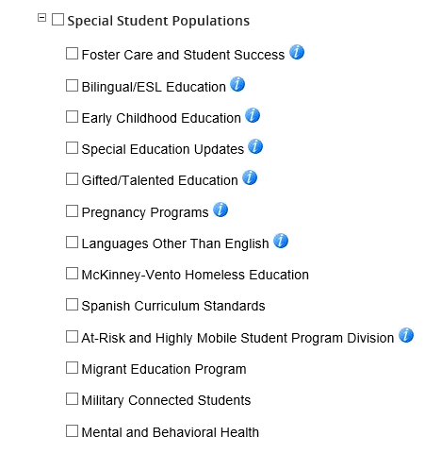
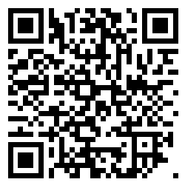
Sign Up for Updates!
Notes:
Pl

Slide 26
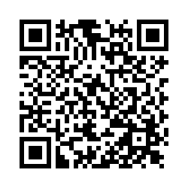
Thank you!
Feedback Survey
Subscribe to Updates
**The presentation and a recording will be posted on the HM&AR website.
Notes:
Please make sure to fill out survey Q/R code on left. Sign-up for Listservs on right
Thank you for joining us!
Have a wonderful Holiday season! Thank you for all that you do serve the students and families of Texas...

