Slide 1
Military-Connected Student Program Updates

Slide 2
Why Identify Military-Connected Students?
The Every Student Succeeds Act (ESSA, 2015) requires local education agencies to identify military-connected students as a unique subgroup
Their progress on standardized assessments must be reported annually along with other highly mobile groups
In Texas and other states, military-connected students are identified using a Military Student Identifier, or MSI

Slide 3
Who are our military-connected students?
TEC §26.006(d) - “Military-connected student” means a student enrolled in a school district or open-enrollment charter school who:
(1) is a dependent of a current or former member of:
the United States military;
the Texas National Guard; or
a reserve force of the United States military; or
(2) was a member of a military or reserve force described by Subdivision (1) who was killed in the line of duty

Slide 4
Capturing the Military Student Identifier in PEIMS
Students identified as a military-connected student are captured in PEIMS using one of six “military identifier” codes

Slide 5
Military-Connected Students
Texas is home to 15 active-duty military installations and over 199,000 military-connected students (2nd most nationally)
School-age dependents of military personnel are faced with numerous transitions during their formative years
On average, military children move 3x more often than civilian peers^
Military dependents who move from one school to another during high school years are faced with special challenges to learning and future achievement
Sources:
^ Revolving Doors: The Impact of Multiple School Transitions on Military Children

Slide 6
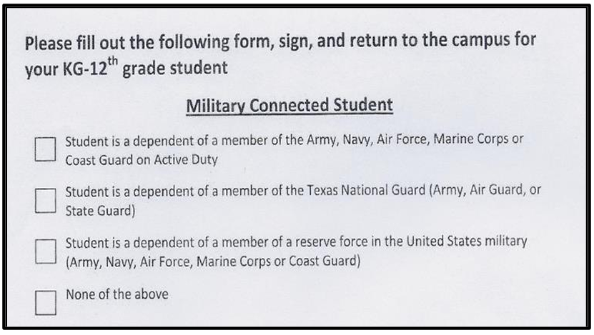
Capturing the MSI
How should a school ask the MSI question in an easy-to-understand way?

Slide 7
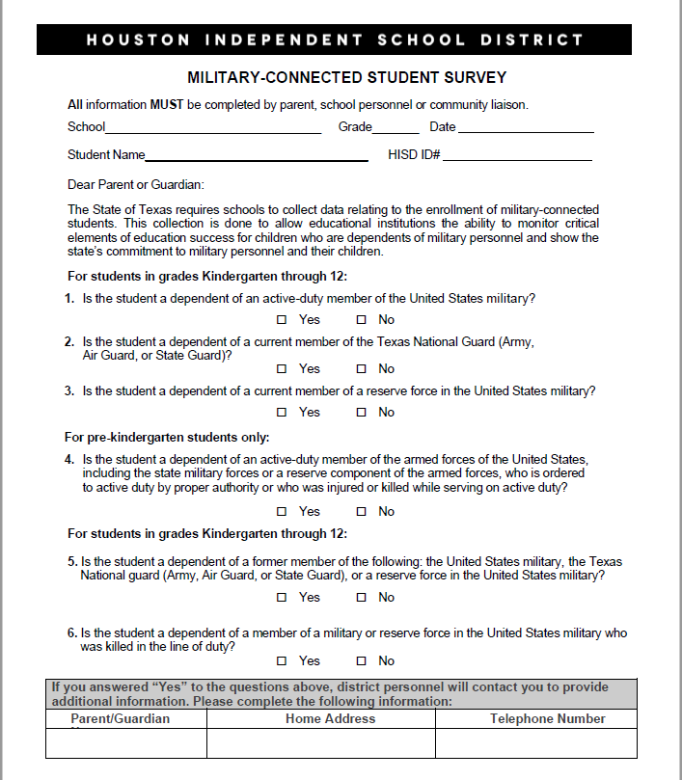
Sample Questionnaire
Here is a sample paper military student identifier questionnaire from Houston ISD

Slide 8
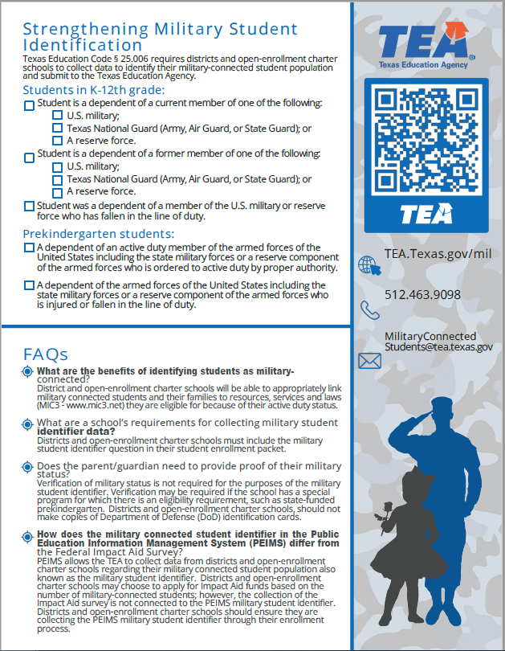
Military Identifier Infographic
https://tea.texas.gov/about-tea/other-services/school-support

Slide 9
SY 2023 Military-Connected Students by ESC Region
REGION | AREA | M-C STUDENTS
20 | San Antonio | 41,303
12 | Waco | 33,746
4 | Houston | 26,906
11 | Fort Worth | 24,634
10 | Richardson | 17,187
19 | El Paso | 15,010
13 | Austin | 9,376
6 | Huntsville | 4,684
1 | Edinburg | 4,373
7 | Kilgore | 4,191
14 | Abilene | 3,377
9 | Wichita Falls | 2,509
15 | San Angelo | 2,506
2 | Corpus Christi | 2,428
5 | Beaumont | 1,799
8 | Mount Pleasant | 1,239
16 | Amarillo | 1,150
17 | Lubbock | 1,091
18 | Midland | 1,010
3 | Victoria | 807
This table shows the number of military-connected students by ESC Region listed in descending order
Some areas with large military-connected populations are not near a military installation but are near an ESC
Partnering with ESCs could help bridge the knowledge gap between TEA and LEAs
*SY 2023 Data (Based on Fall 2022 Snapshot Submission)

Slide 10
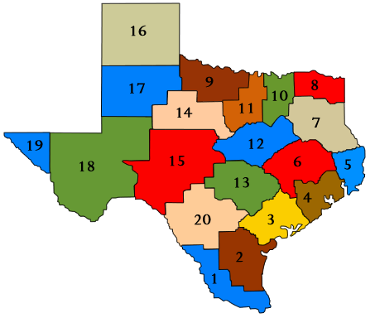
SY 2023 Military-Connected Student Distribution by ESC Region

Slide 11
SY 2022 Military-Connected Students by ESC Region
REGION | AREA | SY 2023 M-C STUDENTS | SY 2022 M-C STUDENTS | CHANGE
20 | San Antonio | 41,303 | 36,696 | 12.55%
12 | Waco | 33,746 | 24,034 | 40.41%
4 | Houston | 26,906 | 24,142 | 11.45%
11 | Fort Worth | 24,634 | 22,507 | 9.45%
10 | Richardson | 17,187 | 19,344 | -11.15%
19 | El Paso | 15,010 | 14,611 | 2.73%
13 | Austin | 9,376 | 9,579 | -2.12%
6 | Huntsville | 4,684 | 3,237 | 44.70%
1 | Edinburg | 4,373 | 3,915 | 11.70%
7 | Kilgore | 4,191 | 3,032 | 38.23%
14 | Abilene | 3,377 | 3,265 | 3.43%
9 | Wichita Falls | 2,509 | 1,870 | 34.17%
15 | San Angelo | 2,506 | 2,273 | 10.25%
2 | Corpus Christi | 2,428 | 2,226 | 9.07%
5 | Beaumont | 1,799 | 1,301 | 38.28%
8 | Mount Pleasant | 1,239 | 779 | 59.05%
16 | Amarillo | 1,150 | 691 | 66.43%
17 | Lubbock | 1,091 | 1,126 | -3.11%
18 | Midland | 1,010 | 827 | 22.13%
3 | Victoria | 807 | 691 | 16.79%
This table shows the change in the number of military-connected students by region from SY 2022 to SY 2023
Though most areas showed growth, some areas showed negative growth
Under-identification of military-connected students can be addressed through a strengthened relationship with our partnership with ESC PEIMS coordinators
Partnering with ESCs could help bridge the knowledge gap between TEA and LEAs
*SY 2023 Data (Based on Fall 2022 Snapshot Submission)

Slide 12
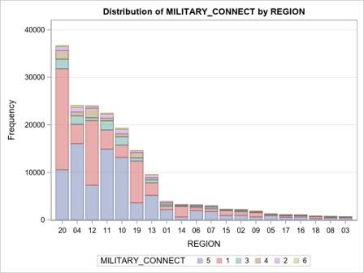
Military-Connected Students by ESC Region
This table shows the number of military-connected in each ESC by MSI (military student identifier) as coded in PEIMS
1
Current Member on Active-Duty in US Military
2
Current Member of National Guard
3
Current Member of Reserve Force in US Military
4
Applies to Pre-K only – Member of active duty or state guard or reserve forces called to active duty under Title 10 and/or was killed or injured in the line of duty while on active orders
5
Former member of US Military, Guard or Reserve Force in US Military
6
Member of military or reserve force in US military killed in the line of duty

Slide 13
Military Student Identifier SY 2020-SY 2022
Military Status | 2020 | 2021 | 2022
Active Duty (1) | 72,442 | 71,131 | 68,103
TX National Guard (2) | 6,136 | 6,599 | 6,665
Reserve Force (3) | 12,498 | 12,366 | 11,440
Pre-K (4) | 9,405 | 8,525 | 8,878
Veteran (5) | 15,175 | 66,118 | 102,483
Fallen in the Line of Duty (6) | 212 | 1,182 | 1,757
Total | 115,868 | 176,554 | 199,326

Slide 14
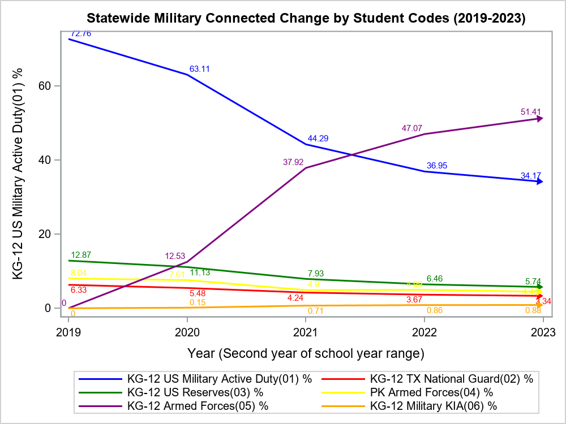
Change Over Time in Statewide PEIMS MSI Rates
1
Current Member on Active-Duty in US Military
2
Current Member of National Guard
3
Current Member of Reserve Force in US Military
4
Applies to Pre-K only – Member of active duty or state guard or reserve forces called to active duty under Title 10 and/or was killed or injured in the line of duty while on active orders
5
Former member of US Military, Guard or Reserve Force in US Military
6
Member of military or reserve force in US military killed in the line of duty
PEIMS codes 1-4 were created as a requirement of the Every Students Succeeds Act (ESSA). Codes 5 and 6 were added as a result of state law to expand the definition of military-connected students to include these two additional categories.

Slide 15
Frequently Asked Questions
What are the benefits of identifying students as military-connected (Military Student Identifier or MSI)?
District and open-enrollment charter schools will be able to appropriately link military connected students and their families to resources, services and laws (MIC3 - www.mic3.net) they are eligible for because of their active-duty or veteran status.
What are a school’s requirements for collecting military identifier data?
Districts and open-enrollment charter schools must include the military student identifier question in their student enrollment packet.

Slide 16
Frequently Asked Questions 1
Does the parent/guardian need to provide proof of their military status?
Verification of military status is not required for the purposes of the military student identifier.
Verification may be required if the school has a special program for which there is an eligibility requirement, such as state-funded prekindergarten.
Districts and open-enrollment charter schools, should not make copies of Department of Defense (DoD) identification cards.

Slide 17
Frequently Asked Questions 2
How does the military connected student identifier in the Public Education Information Management System (PEIMS) differ from the Federal Impact Aid Survey?
The MSI and the Federal Impact Aid Survey are not connected in PEIMS
The Impact Aid Law (Title VII of ESEA) allows local school districts to apply for financial assistance if the school district’s boundaries include federal land, including Indian lands, that are otherwise exempt from school district tax rolls

Slide 18
What’s Next? (Call to Action)
Talk to your school leaders about the federal and state law requirements to collect data on the Military Student Identifier (MSI)
How is this collected during the enrollment process?
Is the MSI questionnaire easy to understand so it doesn’t confuse parents?
Does every student in the school have a MSI code?
All students should have a code 0, 1, 2, 3, 4, 5, or 6
If the parent selects PEIMS code #6 (service member killed in action), does your campus have a process is place for counseling services?
Is it possible for the Counseling Department to form a group specifically for kids who have lost a parent for any reason?

Slide 19
Upcoming Trainings and Events
Military Connected Students & Purple Star Presentations:
Purple Star Application Process Opens Monday, April 3, 2023 – Friday, June 2, 2023, SY 2023-24
Purple Star Application Training Meetings
Thursday, March 30, 2023, at 1pm
Thursday, April 6, 2023, at 10am

Slide 20
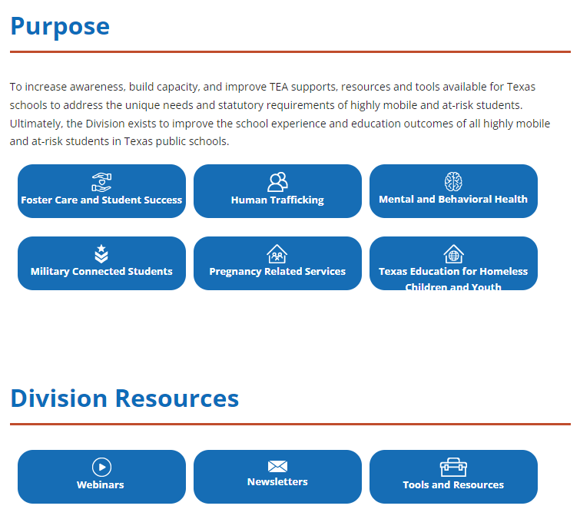
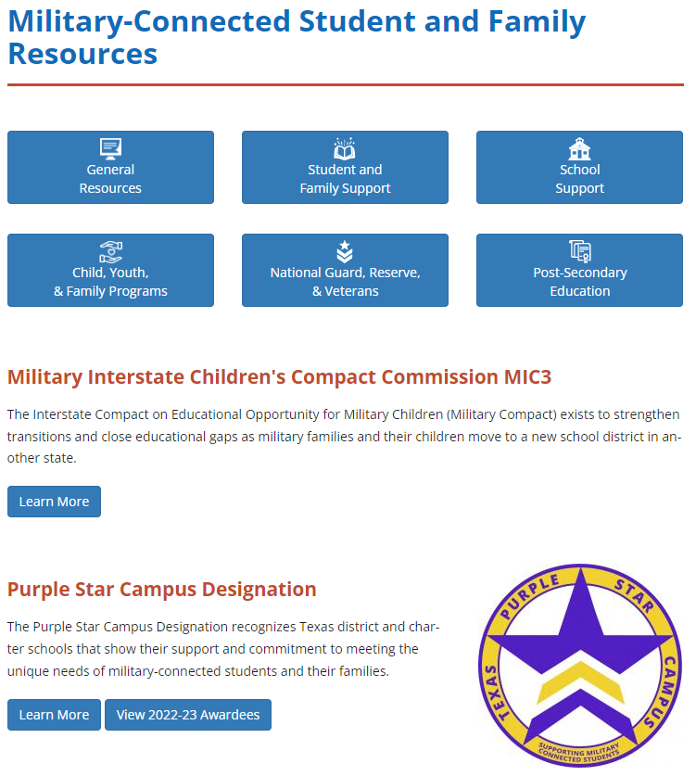
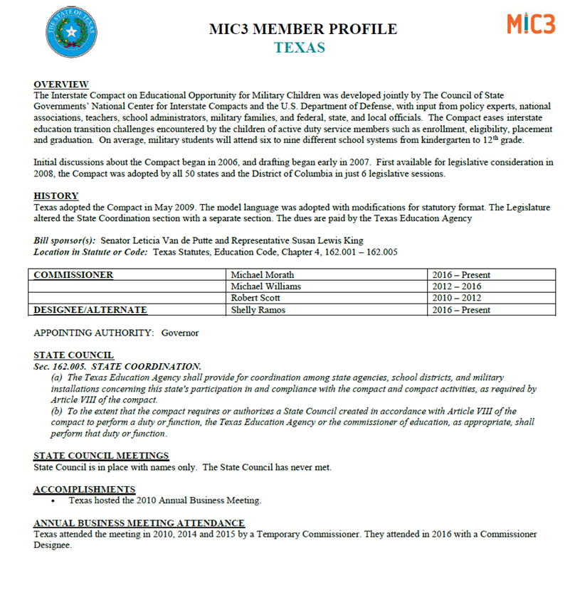
Key Resources and Supports
1) TEA HMAR Division Resources
2) Students, Families & Schools Support
3) Military Interstate Compact (MIC3)
HMAR Division Website
Military-Connected Website
MIC3 Website

Slide 21
Pause to Process
Comments?
Questions?

Slide 22
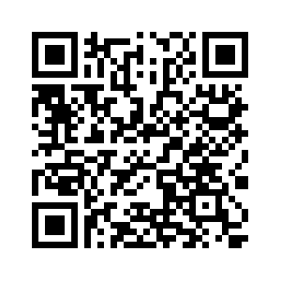
Contact Us
Dr. Jimmy Bowser
Highly Mobile State Coordinator
militaryconnectedstudents@tea.texas.gov
Tea.texas.gov/mil
Sign-up for TEA Military Newsletter here: https://public.govdelivery.com/accounts/TXTEA/subscriber/new

