Slide 1
RESIDENTIAL FACILITY TRACKER

Slide 2
Note
The focus of this presentation is on the changes for the official XML data submissions during the 2023-2024 school year.

Slide 3
Agenda
Residential Facility (RF) Tracker
Program Area Contacts
2022-2023
Submission Updates
Reminders
Current Known Issues
Timeline
2023-2024
Application Updates
Updates
Timeline
Frequently Asked Questions
Technical Resources
Questions

Slide 4
Program Area Contacts
Office of Special Populations and Monitoring
Ramonda Olaloye, Director, Department of Review and Support - ramonda.olaloye@tea.texas.gov

Slide 5
2022-2023

Slide 6
Submission Updates
Resolved with the software release on January 27, 2023:
RF Tracker Application:
The promotion process was using the PEIMS Summer Submission 3 (working collection) data to promote to RF Tracker. The RF Tracker promotion process has been corrected to only promote data from PEIMS Summer Submissions 1 or 2.
Notes:
This happened only if the working collection data had been loaded to the ODS

Slide 7
Submission Updates
Resolved with the software release on February 24, 2023:
Report RFT0-100-002 Residential Facilities
There was an issue with the calculation for the average number of students residing at the facility.
The promotion process calculates the total number of students residing in a residential facility for a school year. This number is used in calculating the average number of students.
A dependency was added to the promotion process for the ResidentialFacility and StudentResidentialFacilityAssociationExtension complex types.
Notes:
As we moved over from using the legacy report data and started using just the TSDS data for prior years
The process counts the students(distinct) at each residential facility during the year studentresidentailfacilityassociationextension
Stores the total for each residential facility for each school year in the core data mart

Slide 8
Submission Updates
Report RFT0-100-002 Residential Facilities – cont.
Average Number of Students Residing at Facility calculation:
The total number of RF students (unduplicated count) for the prior 3 years, divided by 3*.
* The divisor is equal to the number of years the facility was in use by the LEA.
Example: Use 2 for the divisor if the LEA served RF students residing in the facility for 2 years.
For 2019-2020 and forward, the data will come from TSDS.

Slide 9
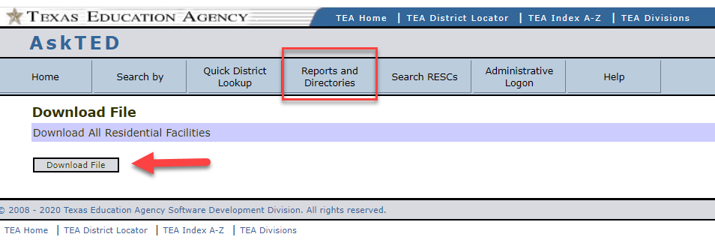
Reminders
Residential Facility report in AskTED
AskTED has a report of all Residential Facilities with detailed information and their statuses.
Select Download Residential Facilities from the Reports and Directories menu.
Notes:
Use this report to check to see if a residential facility exists and/or if it is active
Choose Residential Facilities reports and select download file

Slide 10
Reminders
Residential Facility report in AskTED
Open the downloaded ResidentialFacilities.csv file.
Notes:
This report has detailed information about every residential facility, contacts, emails, physical and mailing address
Also, has the status and when the status was last updated
The reason we have these saved in AskTED is to try and avoid adding duplicate facilities
Fatal Rule 10025-0001 will fire if the residential facility ID is not valid or inactive

Slide 11
Current Known Issues
Report RFT0-100-004 Individual Student Detail Summary
There is an issue with the student special education information repeating each time a student entered/exited a residential facility.
The report sections are being reworked.
The Student’s Residential Facility History section will first display all the residential facilities where the student resided and the entry and exit dates for each residential facility.
The next section will have the residential facilities and special education information by entry/exit/effective dates.
This issue is tentatively scheduled for the May 5, 2023, software release.

Slide 12
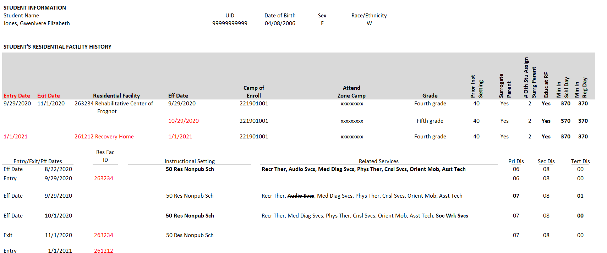
Current Known Issues
SAMPLE REPORT AFTER RELEASE ON MAY 5, 2023
Notes:
Here is how the report will look after the release.

Slide 13
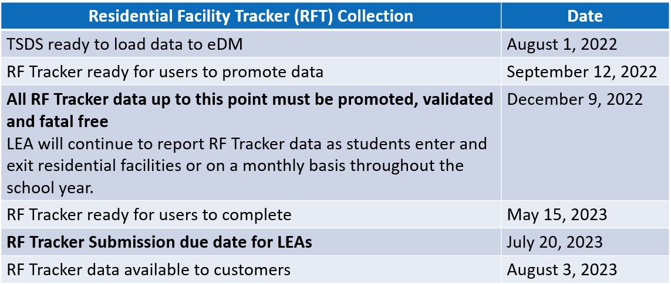
Timeline

Slide 14
2023-2024

Slide 15
Application Updates
There are no new mandatory data elements added or removed from the PEIMS Summer complex types that are promoted by RF Tracker.
There are no optional data elements removed from the PEIMS Summer complex types that are promoted by RF Tracker.
Notes:
As of now this is true. Need to double check 3/1 data standards
Is there anything coming up in TEDS addendum in July?

Slide 16
Updates
No New Data Elements, Code Tables, Reports, or Business Validations
No Updated Data Elements, Code Tables, Reports, or Business Validations
No Deleted Data Elements, Code Tables, Reports, or Business Validations

Slide 17
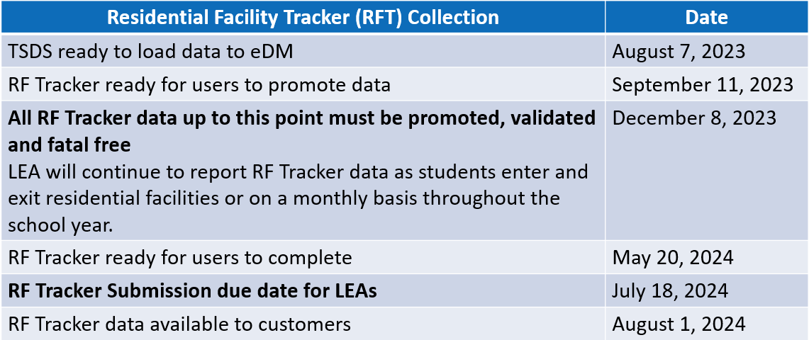
Timeline

Slide 18
Frequently Asked Questions
What should an LEA do if they cannot meet the data checkpoint deadline in December?
1. Email the Review and Support program area to let them know the LEA cannot meet the deadline. (reviewandsupport@tea.Texas.gov)
2. Include a date when the LEA will have their RF Tracker data loaded, promoted and fatal free.
3. Once the LEA has their RF Tracker data loaded, promoted, and fatal free, please send the program area an email to notify them that the LEA’s RF Tracker data is ready for review.
Notes:
This is not a hard deadline and LEAs do not complete until the submission is due in July.
The program area will begin their review of the RF Tracker data so they need to know if an LEA is not loaded, promoted and fatal free

Slide 19
Technical Resources
Technical Support:
TSDSCustomerSupport@tea.texas.gov
RF Tracker Program Area:
ReviewandSupport@tea.texas.gov
TIMS Knowledge Based Articles:
TSDSKB-586 Frequently Asked Questions
TSDSKB-589 Process for adding or updating the Residential Facilities IDs

Slide 20
Questions?
Thank you for attending.

