Slide 1

Special Education Language Acquisition (SELA)

Slide 2
Note
The focus of this presentation is on the changes for the official XML data submissions during the 2023-2024 school year.

Slide 3
Agenda
SELA
  Program Area Contacts
  Program Area Updates and Guidance
  2022-2023
    Submission Updates
    Reminders
    Timeline
    Frequently Asked Questions
  2023-2024
    Application Updates
    Data Element Updates
    Code Table Updates
    Report Updates
    Business Rule Updates
    Timeline
  Technical Resources
  Questions

Slide 4
Program Area Contacts
Special Education Programs Division
  Emily Robinson, Director, Deaf & Hard of Hearing Program Admin. and State Director of Regional Day School Program for the Deaf - SELA@tea.texas.gov

Slide 5
Program Area Updates & Guidance
State guidance resources for DHH students
  Frequently Asked Questions – HB 548
  HB 548 Language Acquisition Assessments
  Approved Assessments and Tools List
  Scoring Rubric for HB 548 Language Acquisition

Slide 6
2022-2023

Slide 7
Submission Updates
The translation for code 06 on the DC142 DISABILITY-TYPE code table was updated to ‘Deaf And Hard Of Hearing’ in TEDS for the 2022-2023 school year.
  The promotion logic has been updated to promote any student 8 years of age or younger that is reported with a disability code of either ‘Deaf And Hard Of Hearing’ or ‘Deaf-Blindness (Deaf-Blind)’.
  Report SEL0-100-001 has been updated to display a short description of ‘DHH’ for any student reported with this disability code.
    The rule text in 40100-0204 has been updated to reflect this change.

Slide 8
Reminders
EFFECTIVE-DATE (E1632) vs ELIGIBILITY-DATE (E1723)
  EFFECTIVE-DATE (E1632) – indicates the date upon which the disability being reported is considered to take effect.
    This data element IS NOT promoted to the SELA data mart.
    It is REQUIRED to load disability data to the ODS.

Slide 9
Reminders
EFFECTIVE-DATE (E1632) vs ELIGIBILITY-DATE (E1723) cont’d
  ELIGIBILITY-DATE (E1723) – indicates the date when an LEA identifies that a student who is deaf or hard of hearing is enrolled and eligible for services.
    This date may be outside of the current school year.
    Typically, this is when the ARD committee identifies a student as being deaf or hard of hearing and it is recorded in their IEP.
    This data element is only collected for the SELA data collection and shall only be reported with the following two DISABILITY codes:
      Deaf And Hard Of Hearing
      Deaf-Blindness (Deaf-Blind)
    Fatal validation 40100-0205 will fire if it is not provided for the two disability codes listed above.

Slide 10
Reminders
Students may only be reported with each code value once for the following data elements:
  LANG-ACQ-SERVICES-PROVIDED (E1662)
  HEARING-AMPLIFICATION-TYPE (E1666)
  TOOL-OR-ASSESSMENT-USED (E1668)
Loading multiple records for a single student with the same code value for the above data elements will result in data loading errors or one record overwriting the other.

Slide 11
Reminders
Example: If a student is provided two separate ‘Indirect/Consultative’ language acquisition services, the LEA should report the one with the highest FREQUENCY-OF-SERVICES (E1663).
  However, if they were provided one ‘Indirect/Consultative’ service and one ‘Direct’ service, both records should be reported for the student and will not result in data loading errors.

Slide 12
Timeline
Special Education Language Acquisition (SELA) | Date
TSDS ready to load data to eDM | August 1, 2022
SELA ready for users to promote data | September 12, 2022
SELA ready for users to complete | May 15, 2023
SELA Submission due date for LEAs | June 22, 2023
SELA data available to customers | July 6, 2023

Slide 13
Frequently Asked Questions
When a student is being reported with two DISABILITY (E1220) codes (‘Deaf And Hard Of Hearing’ and ‘Developmental Delay’), does ELIGIBILITY-DATE (E1723) need to be reported for both disabilities? What about the EFFECTIVE-DATE (E1632)?
ELIGIBILITY-DATE (E1723) shall only be reported with the ‘Deaf And Hard Of Hearing’ disability code. It does not need to be reported with ‘Developmental Delay’.
EFFECTIVE-DATE (E1632) will need to be reported for both disabilities. However, this date is not promoted to the SELA data mart for either. It is only required to load the data to the ODS.

Slide 14
Frequently Asked Questions
Which one of these language acquisition services should be reported in this scenario?
A student receives two ‘Direct’ language acquisition services: one service daily, and one service monthly.
The LEA should report the most frequent direct language acquisition service. In this case, the LEA should report “Direct” for the LANG-ACQ-SERVICES-PROVIDED (E1662) data element and “Daily” for FREQUENCY-OF-SERVICES (E1663).

Slide 15
2023-2024

Slide 16
Application Updates
No application updates are currently scheduled for the 2023-2024 school year.

Slide 17
Data Element Updates
No New Data Elements
No Updated Data Elements
No Deleted Data Elements

Slide 18
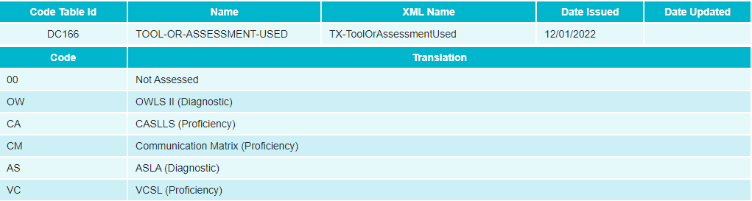
Code Table Updates
Deleted TOOL-ASSESSMENT-CODE (DC162) code table.
Added TOOL-OR-ASSESSMENT-USED (DC166) code table:

Slide 19
Report Updates
No New Reports
No Updated Reports
No Deleted Reports

Slide 20
Business Rule Updates
No New Business Rules
No Updated Business Rules
No Deleted Business Rules

Slide 21
Timeline
Special Education Language Acquisition (SELA) | Date
TSDS ready to load data to eDM | August 7, 2023
SELA ready for users to promote data | September 11, 2023
SELA ready for users to complete | May 20, 2024
SELA Submission due date for LEAs | June 27, 2024
SELA data available to customers | July 11, 2024

Slide 22
Technical Resources
Technical Support
  TSDSCustomerSupport@tea.texas.gov
TIMS Knowledge Base Articles
  TSDSKB-612 Frequently Asked Questions (FAQs)
  TSDSKB-615 Definition of Learning Acquisition Services
  TSDSKB-616 Definition of Assessment Types

Slide 23
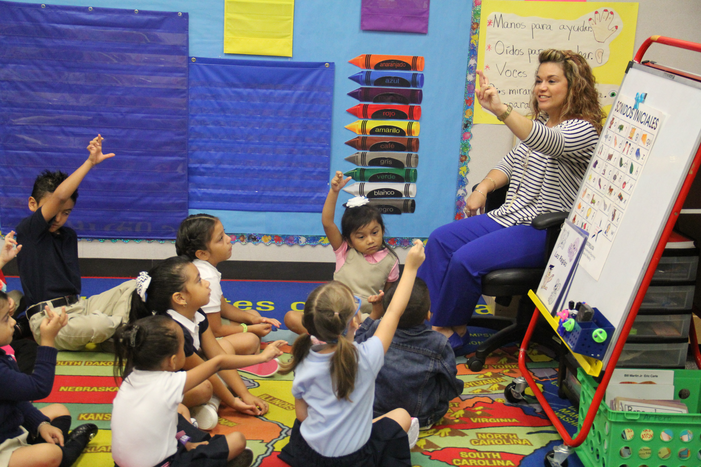
Questions?
Thank you for attending.

