Slide 1
Child Find

Slide 2
Note
The focus of this presentation is on the changes for the official XML data submissions during the 2023-2024 school year.

Slide 3
Agenda
Child Find
Program Area Contacts
Program Area Updates and Guidance
2023-2024
Application Updates
Data Element Updates
Code Table Updates
Report Updates
Business Rule Updates
Timeline
Frequently Asked Questions
Technical Resources
Questions

Slide 4
Program Area Contacts
Department of Special Populations Policy and Programs
Zane Wubbena, Ph.D., State Performance SPED Data Manager
Donna Holmes, State Performance Plan and Website Coordinator
spp@tea.texas.gov

Slide 5
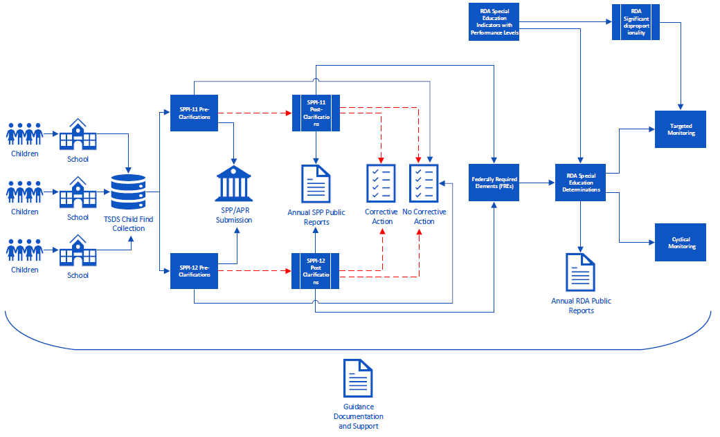
Program Area Updates & Guidance
* New slide since Spring 2023 training

Slide 6
2023-2024

Slide 7
Application Updates
No application updates are currently scheduled for the 2023-2024 school year.

Slide 8
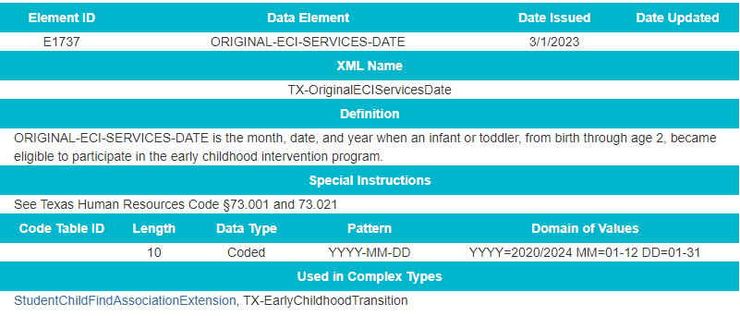
Data Element Updates
Added ORIGINAL-ECI-SERVICES-DATE (E1737) as conditionally mandatory

Slide 9
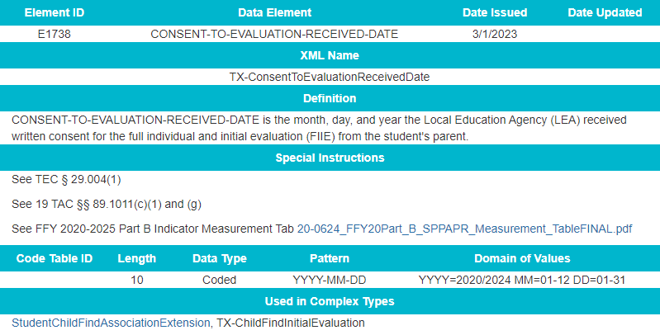
Data Element Updates 3
Added CONSENT-TO-EVALUATION-RECEIVED-DATE (E1738) as mandatory

Slide 10
Data Element Updates 4
Removed PARENTAL-CONSENT-DATE (E1714)
Updated ECI-TRANSITION-CONFERENCE-DATE (E1713) from conditionally mandatory to optional

Slide 11
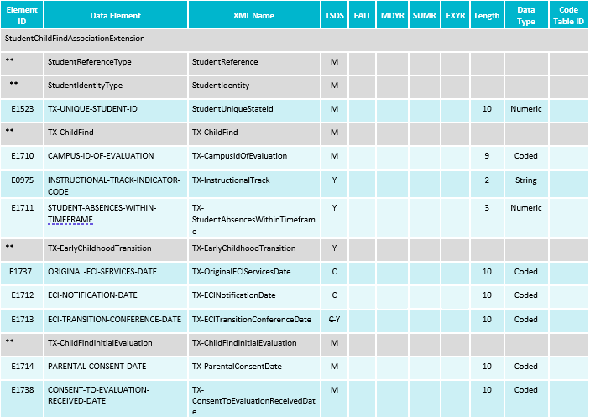
Data Element Updates 5

Slide 12
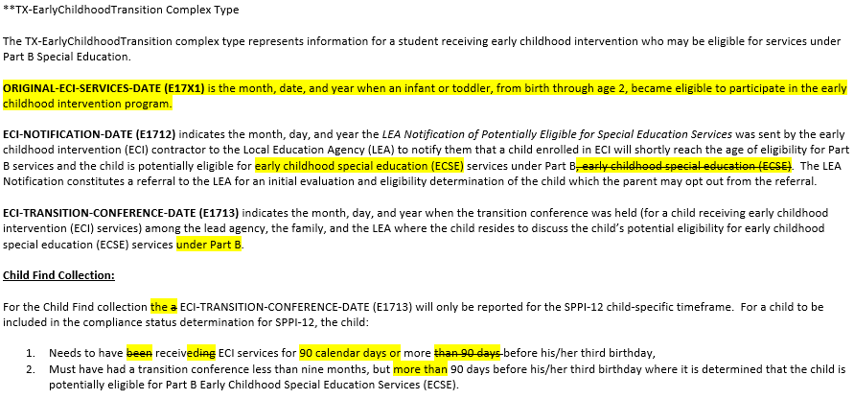
Data Element Updates 6
Updated Data Element Reporting Requirements for the added and deleted data elements in the StudentChildFindAssociationExtension complex type

Slide 13
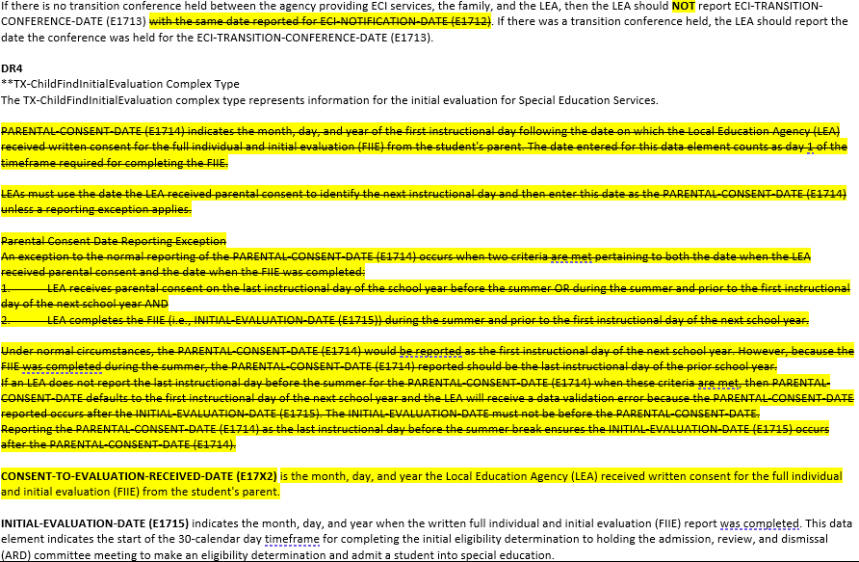
Data Element Updates 7

Slide 14
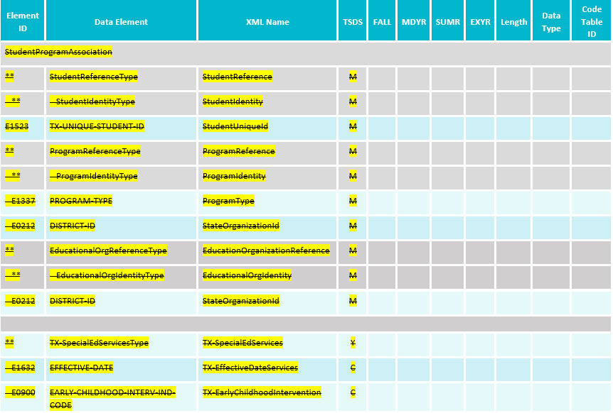
Data Element Updates 8
Removed StudentSpecialEdProgramAssociationExtension complex type:

Slide 15
Code Table Updates
No New Code Tables
No Updated Code Tables
No Deleted Code Tables

Slide 16
Report Updates
The following reports will be updated to add/remove columns for the previously mentioned data element updates.
CHF0-100-001: SPPI-11 Student Compliance Report
CHF0-100-002: SPPI-12 Student Compliance Report
CHF0-100-005: SPPI-11 Calculations Report

Slide 17
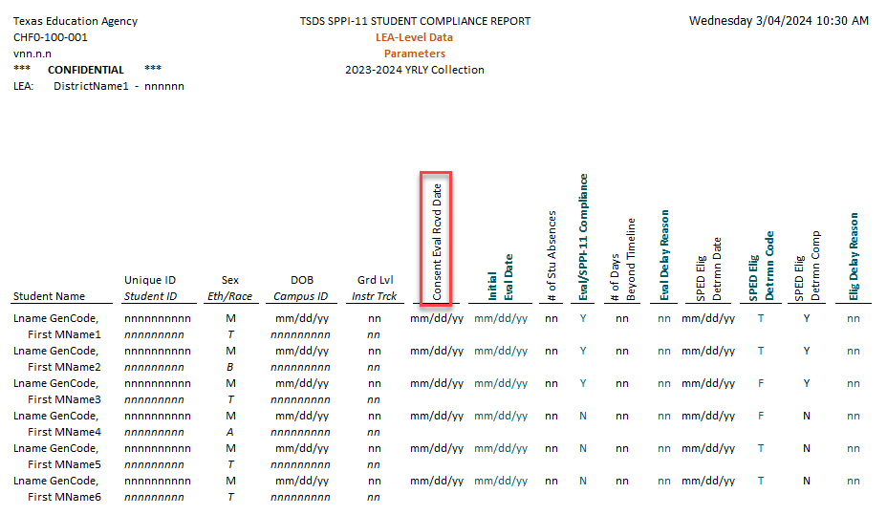
CHF0-100-001
* New slide since Spring 2023 training

Slide 18
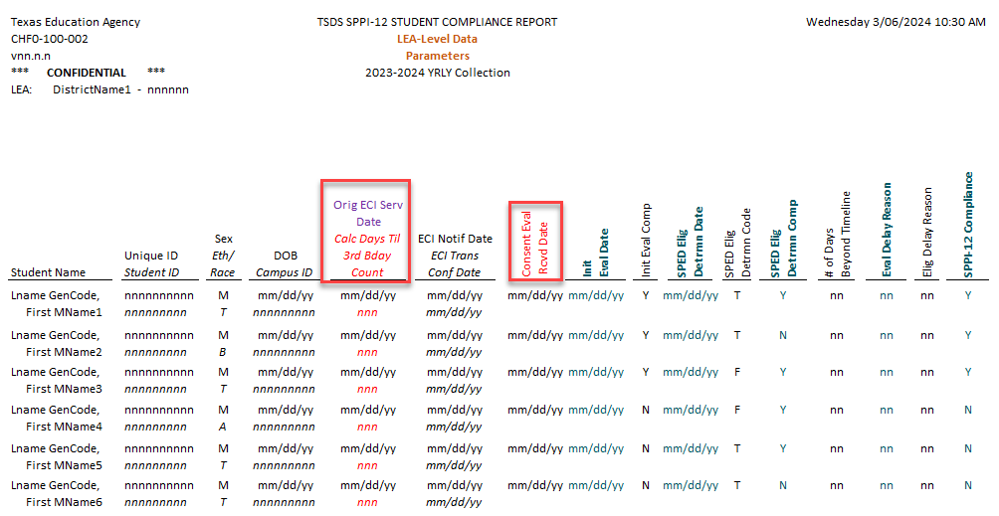
CHF0-100-002
* New slide since Spring 2023 training

Slide 19
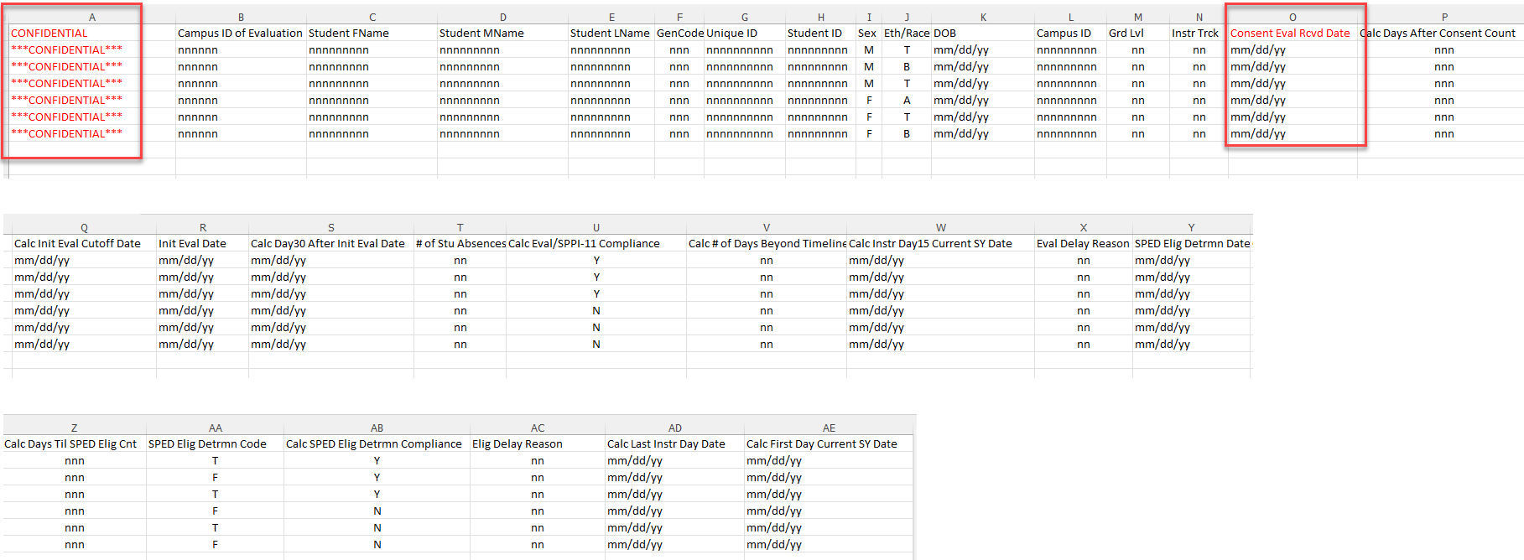
CHF0-100-005
* New slide since Spring 2023 training

Slide 20
Business Rule Updates
Deleted the following business rules from the Child Find Collection:
41163-0075
41163-0076
41163-0077
41163-0079
41163-0081
41163-0084

Slide 21
Business Rule Updates
Updated the following rules for the Child Find Collection:
* New slide since Spring 2023 training

Slide 22
Business Rule Updates 9
Added the following business rules for the Child Find Collection:

Slide 23
Business Rule Updates 1
Added the following business rules for the Child Find Collection:

Slide 24
Timeline 1
Child Find | Date
TSDS ready to load data to eDM | August 7, 2023
Child Find ready for users to promote data | September 11, 2023
Child Find ready for users to complete | May 20, 2024
Child Find Submission due date for LEAs | July 25, 2024
Child Find data available to customers | August 8, 2024

Slide 25
Technical Resources
Technical Support
TSDSCustomerSupport@tea.texas.gov
Child Find Program Area
SPPI-11 Guidance Documents SPPI-12 Guidance Documents
TIMS Knowledge Base Articles
TSDSKB-620: SPPI-11 Compliance Flow Chart | TSDSKB-645: SPPI-12 Frequently Asked Questions
TSDSKB-621: SPPI-12 Compliance Flow Chart | TSDKSB-646: SPPI-11 Frequently Asked Questions
TSDSKB-622: Child Find Frequently Asked Questions | TSDSKB-650: Child Find Interactive Flowchart
TSDSKB-642: Child Find Program Guidance
* Updated slide since Spring 2023 training

Slide 26
Frequently Asked Questions
If the PARENTAL-CONSENT-DATE (E1714) is the last day of school, what would the Local Education Agency (LEA) report as the INITIAL-EVALUATION-DATE (E1715)?
The LEA should always report the actual date the initial evaluation took place for the data element INITIAL-EVALUATION-DATE (E1715).
The additional guidance discussed during the training was around the former PARENTALCONSENT-DATE (E1714), which has been replaced with the new data element, CONSENT-TO-EVALUATION-RECEIVED-DATE (E1738). When the CONSENT-TO-EVALUATION-RECEIVED-DATE (E1738) date occurs during the summer (or on the last day of school), and the INITIAL-EVALUATION-DATE (E1715) also occurs during the summer, the LEA should backdate the CONSENT-TO-EVALUATION-RECEIVED-DATE (E1738) to the last instructional day in the prior school year.
When the CONSENT-TO-EVALUATION-RECEIVED-DATE (E1738) occurs during the summer (or on the last day of school), and the INITIAL-EVALUATION-DATE (E1715) takes place on the first instructional day of school or later during the new school year, then the LEA would report the CONSENT-TO-EVALUATION-RECEIVED-DATE (E1738) as the first instructional day of the new school year.

Slide 27
Frequently Asked Questions - 1
How would an LEA report STUDENT-ABSENCES-WITHIN-TIMEFRAME (E1711) for a student attending an Optional Flexible School Day Program (OFSDP)?
For a student who attends an OFSDP, if the student were certified by the teacher of record or otherwise appropriately documented to have attended school on the day in question, then the student would not be considered absent. However, if there is no certification or documented record that the student attended school on a particular day, the student would be counted absent. The data element, STUDENT-ABSENCES-WITHIN-TIMEFRAME (E1711) would be reported for these students.

Slide 28
Frequently Asked Questions -31
Should students with an effective date less than 90 calendar days before their third birthday be reported under SPPI-11?
In the 2022-2023 school year, any child reported with an effective date less than 90 calendar days before their third birthday must be reported using the StudentChildFindAssociationExtension and Early Childhood Intervention (ECI)-related data elements. This includes the ECI-NOTIFICATION-DATE (E1712), ECI-TRANSITION-CONFERENCE-DATE (E1713), and ORIGINAL-ECI-SERVICES-DATE (E1737).
The Child Find Collection automatically determines if the student’s compliance will be determined through SPPI-11 or SPPI-12.

Slide 29
Questions?
Thank you for attending.

