Slide 1

TSDS UPGRADE PROJECT - VENDOR

Slide 2

AGENDA
DATA STANDARDS
Submission Requirements and Technical Resources
PROJECT UPDATES
Pilot Program, Demonstration, Certification
NEXT STEPS
How to Prepare for Parallel Submission

Slide 3

DATA STANDARDS

Slide 4


TEXAS EDUCATION DATA STANDARDS
Texas Student Data System

Slide 5
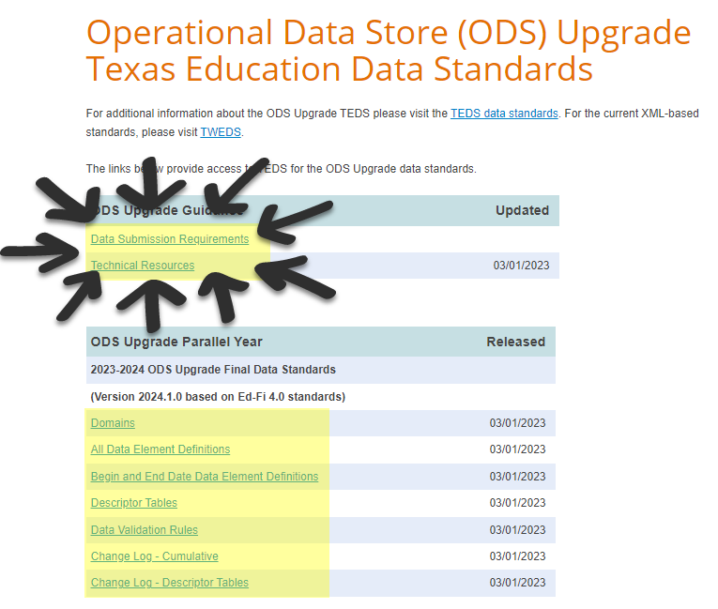

NEW RESOURCES
ODS Upgrade Data Standards

Slide 6
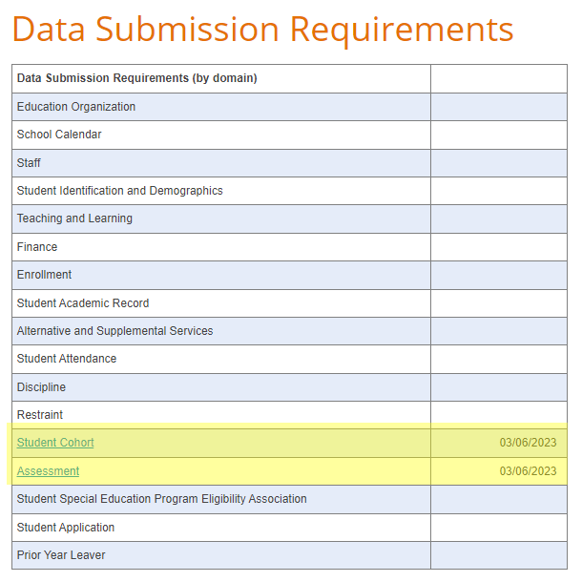
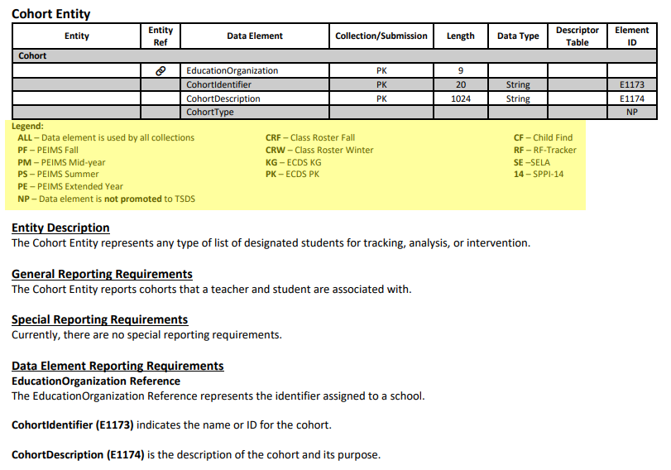
DATA SUBMISSION REQUIREMENTS

Slide 7
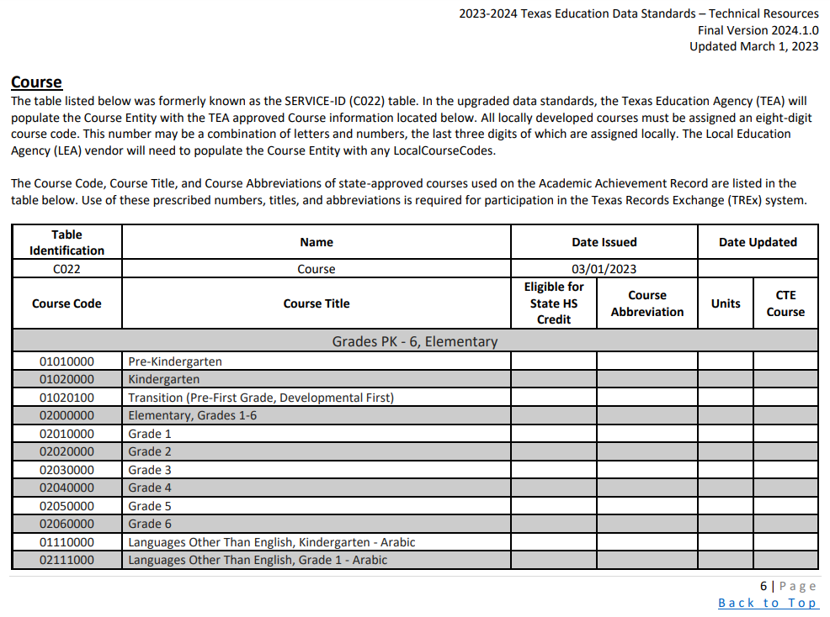
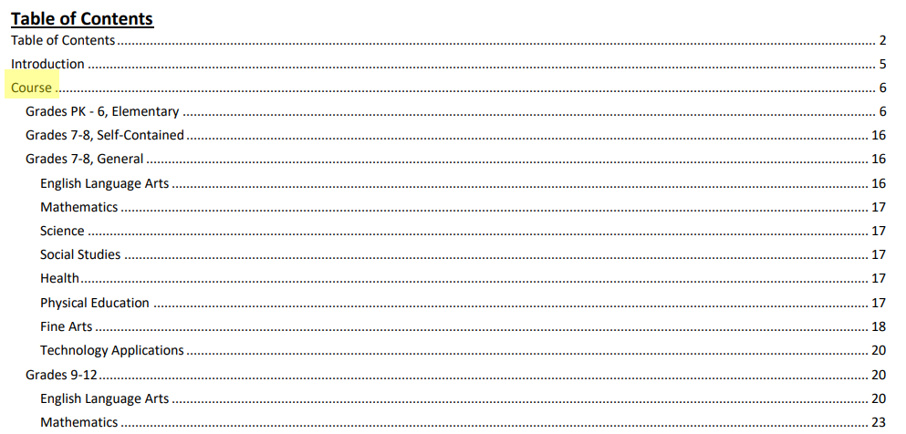

TECHNICAL RESOURCES: COURSE

Slide 8
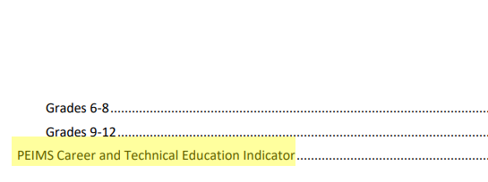
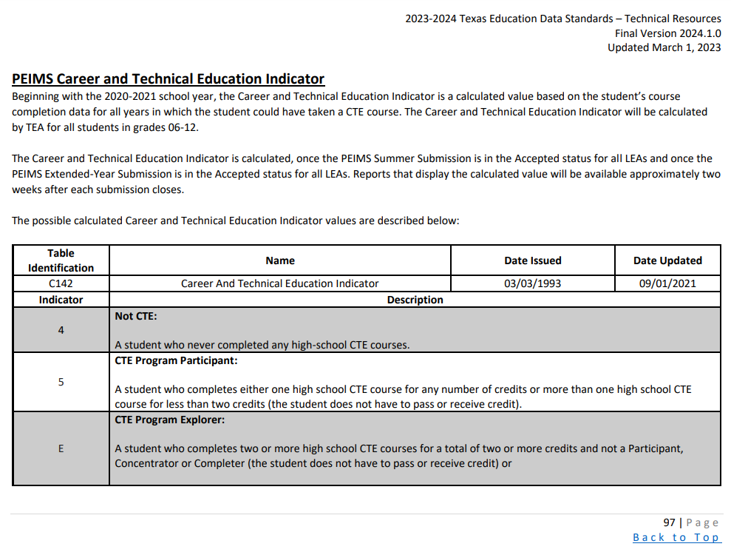

TECHNICAL RESOURCES: CTE INDICATOR

Slide 9
FREQUENTLY ASKED QUESTIONS
How should vendors report a local education agency (LEA) ID that begins with zeros? Ed-Fi requires an integer which removes the leading zero.
Vendors should publish the LEA ID number as an integer. TEA has implemented logic to replace the leading zeros. TEA is continuing to work with Ed-Fi on this and will provide additional guidance as needed.

Slide 10
FREQUENTLY ASKED QUESTIONS1
Will SIS vendors still be expected to generate the Student Detail and District/Campus Summary Reports?
The Student Attendance Accounting Handbook requires LEAs to generate Student Detail Reports, Campus Summary Reports, and District Summary Reports for audit purposes.
Therefore, the SIS vendor will still need to provide the LEA with a method to generate these reports.

Slide 11
FREQUENTLY ASKED QUESTIONS2
Which staff is reported for the following and can one staff be reported for both?
  StaffEducationOrganizationAssignmentAssociation
  StaffSectionAssociation
TEA is currently reviewing the Staff Responsibility data in TEDS. A staff member can have both a StaffSectionAssociation and StaffEducationOrganizationAssignmentAssociation.
Once TEA has completed a full review of each StaffClassification (E0721), TEA will publish a document outlining additional information.

Slide 12
FREQUENTLY ASKED QUESTIONS62
How should HR/Finance vendors report payroll for employees that change positions during the year?
In the March 1, 2023, publication of the TEA Domain Document Final Version 2024.1.0, TEA added the data elements BeginDate (E3010) and EndDate (E3020) to the PayrollExt entity to allow an HR/Finance vendor to report payroll for employees that change positions during the year.
If the vendor reports the PayrollExt when employees change positions during the year, through these new data elements, TEA can promote the payroll information based on the last Friday in October (PEIMS Fall Snapshot).

Slide 13

PROJECT UPDATES

Slide 14
PROJECT TIMELINE
Pilot
Parallel
Go Live
September 2021 – August 2023
  Optional: TSDS vendors can participate in pilot program to develop and test their product solutions.
  Optional: LEAs can partner with their vendors to conduct end-to-end testing in preparation to parallel submission.
August 2023 – August 2024
  Required: All TSDS vendors test their product solutions.
  Optional: LEAs will submit both API transactions and XML submissions and compare results to ensure vendor readiness.
August 2024 – August 2025
  Required: All LEAs will submit their TSDS official data through API transactions.
  XML submissions no longer accepted for TSDS.
EXTENDED

Slide 15

PILOT PROGRAM

Slide 16
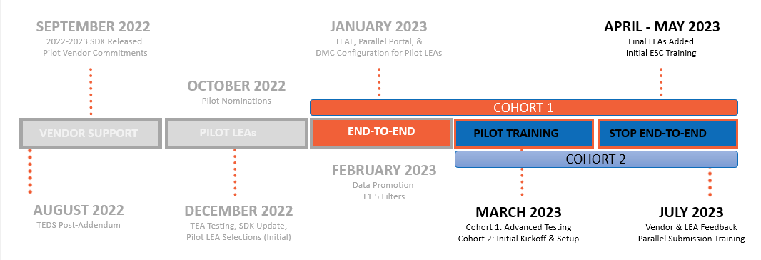
TIMELINE OF EVENTS

Slide 17
PILOT PROGRAM FUNCTIONALITY
  TEA-defined claim sets:
      HR Vendor
      Finance Vendor
      HR/Finance Vendor
      SIS/HR/Finance Vendor
    Data Management Center (DMC)
      Level 1.5 Filter Details
  TEA-defined claim sets:
      Assessment Vendor
      Read Only All Resources
    Data Management Center (DMC)
      Manage Claim Set Functionality
      Level 2 Validations
    Software Development Kit (SDK)
      Updates for 2023-2024 school year
RECENTLY RELEASED
IN PROGRESS

Slide 18
SOFTWARE DEVELOPMENT KIT (SDK)
UPDATED VERSION
SDK version 1.0.3.1: March 23, 2023
Enabled PUT in the API and resolved several bug fixes. Refer to change log.
Still based upon TEDS 2023.2.2.3x published on August 19, 2023.
Includes the following TEA claim sets:
SIS Vendor
This SDK version is intended for pilot year.
Changes for 2023-2024 Parallel Submission
coming Summer 2023.
HR Vendor
Finance Vendor
HR/Finance Vendor
SIS/HR/Finance Vendor
Hosted Sandbox (Staging)
Local Development
Available to All Vendors
Pilot Vendors
Local ODS
WebAPI
Swagger
Admin App
Setup by TEA
Anonymized Data
Vendor Integration
Prepare for End-to-End Testing
DOWNLOAD: SDK version 1.0.3.1

Slide 19
FREQUENTLY ASKED QUESTIONS4
What is the difference between the SDK and the Hosted Sandbox (Staging) environment?
The SDK is provided to all vendors and is intended for the local development. It allows the most control of ODS management/configuration and includes the Ed-Fi Admin App. TEA recommends that vendors start their development and testing with this resource.
The Hosted Sandbox (Staging) environment is provided by TEA upon request. It is intended to be an additional testing resource to a vendor prior to sending Production data for their LEA(s) to conduct End-to-End testing. This environment does not include any ODS management features and may require TEA intervention for support.

Slide 20
FREQUENTLY ASKED QUESTIONS7
Is the SDK, Hosted Sandbox (Staging), and the environment used for End-to-End Testing by LEAs all based upon the same TEDS publication?
Yes. TEA is continuing to make a dedicated effort to keep all these resources in sync. They all are currently built upon the 2022-2023 ODS 3.x Post-Addendum Data Standards.
With the upcoming SDK release in March 2023, all resources will be aligned in terms of software updates.

Slide 21

PILOT PROGRAM ACCOMPLISHMENTS
  Data Published:
      4 vendors have published for 7 LEAs
      620,000 resources published to 30 entities
    Data Promoted
      6 LEAs have promoted to PEIMS or CORE
      90,200 records for PEIMS Fall
      69,900 records for Class Roster Fall
    Support Tickets
      ~100 TSDS Vendor Support Portal tickets
PROGRESS REPORT

Slide 22









PILOT PROGRAM VENDORS
COHORT 1 VENDORS
Aeries
SIS
PowerSchool
SIS (2), HR/Finance (2)
Infinite Campus
SIS
Frontline
SIS, HR/Finance
Skyward
SIS (2), HR/Finance (2)
COHORT 2 VENDORS
Ascender
Harris School
Solutions
Focus School Software
Tyler Technologies

Slide 23
COHORT 1: PILOT LEAS
Edna ISD
Lake Worth ISD
Lorena ISD
Princeton ISD
Magnolia ISD
Royse City ISD
San Angelo ISD
San Benito CISD
Sharyland ISD

Slide 24
COHORT 2: PILOT LEAS
Cedars International Academy
Coppell ISD
Eagle Pass ISD
Leon ISD
Little Elm ISD
Perryton ISD
Sweetwater ISD

Slide 25
SCALING THE PILOT PROGRAM
Arlington ISD
Basis Texas
Bryan ISD
Gainesville ISD
Fort Worth ISD
Hurst-Euless-Bedford ISD
Gladewater ISD
Gold-Burg ISD
Keller ISD
Moody ISD
Richardson ISD
Tomball ISD
Texas Tech University K-12
Uplift Education
Woodville ISD
Yselta ISD

Slide 26
BREAKDOWN OF LEAS BY VENDOR
Edna ISD, Keller ISD, Moody ISD
Eagle Pass ISD, Gainesville ISD, Gladewater ISD, Gold-Burg ISD, Leon ISD, Perryton ISD , Sweetwater ISD, Woodville ISD
Arlington ISD,
Magnolia ISD
Cedars International Academy
Fort Worth ISD, Little Elm ISD, Richardson ISD, Texas Tech University K-12
Princeton ISD
Basis Texas, Bryan ISD, Hurst-Euless-Bedford ISD, Lorena ISD, San Angelo ISD, Tomball ISD, Uplift Education
Lake Worth ISD, Royse City ISD, San Benito CISD, Sharyland ISD
Coppell ISD, Ysleta ISD

Slide 27



ACHIEVING PILOT PROGRAM GOALS
GOAL
ACTUAL
At least one LEA from each ESC
At least one Charter School
LEA with in-house solution
LEA with multiple vendors
Early testing of ECDS KG
Wide range of data diversity
25+ LEAs by the end of July
17 ESC regions with a pilot LEA
3 Charter Schools accepted
*Several LEAs in consideration
9 LEAs with multiple vendors
*LEAs with CLI in consideration
LEA and vendor hosted systems
32 LEAs accepted
* TEA may add LEA(s) to fulfill this goal later in Pilot

Slide 28
FREQUENTLY ASKED QUESTIONS8
Will additional LEAs be added to the Pilot Program?
TEA is not expecting to accept any additional LEAs to the 2022-2023 Pilot Program after April 2023. All accepted LEAs were informed on or before March 20, 2023. LEAs were accepted based upon discussion and coordination with their pilot vendor(s) and the goals of the pilot program.
Any LEA that has previously expressed interest through the LEA Nomination Form and was not included in the 2022-2023 Pilot Program will be accepted for the 2023-2024 Parallel Submission.

Slide 29
FREQUENTLY ASKED QUESTIONS9
Will LEAs currently participating in the Pilot Program be automatically included for the 2023-2024 Parallel Submission?
Yes. All LEAs currently participating in the Pilot Program will be included in the list of accepted LEAs for the 2023-2024 Parallel Submission. They will be informed of their acceptance prior to the start of school year.

Slide 30
FREQUENTLY ASKED QUESTIONS10
How and when will LEAs be accepted for the 2023-2024 Parallel Submission?
TEA will be sending additional correspondence in May 2023 to all LEAs to solicit participation for the 2023-2024 Parallel Submission. Any LEA that has previously submitted their interest through the LEA Nomination Form will not need to apply again. TEA will coordinate with their vendor(s) and ESC prior to LEA acceptance. LEAs will be informed of their acceptance prior to the start of the 2023-2024 school year.
More information will be shared in the upcoming FCN webinars as it becomes available.

Slide 31
FREQUENTLY ASKED QUESTIONS13
When will vendors need to be ready support the TSDS data submission by our education support centers (ESCs)?
TEA is expecting all twenty ESCs to participate in the 2023-2024 Parallel Submission. They will be provided their own IODS and DMC application in order to test their PEIMS Fall and PEIMS Mid-year data submissions.
For vendors that currently provide a technical solution for TSDS reporting by an ESC, please begin communicating and coordinating with them to ensure they are prepared for the 2023-2024 Parallel Submission.

Slide 32

VALIDATIONS

Slide 33
LEVELS OF VALIDATIONS
LEVEL 1
Includes basic data integrity checks that occur during the process of loading data via API transactions into the Individual Operational Data Store (IODS) in the Landing Zone. Data that fails Level 1 validations does not enter the IODS.
LEVEL 1.5
Includes filters that prevent invalid or non-TSDS data from being loaded into TSDS. These filters include Unique ID checks, descriptor value checks, Do Not Report flag checks, and Course ID checks.
LEVEL 3
Business rules that are executed in TSDS. Level 3 validations contain all Level 2 validations, plus any additional validations required for the TSDS submissions. Fatal errors prevent TSDS submissions from being completed or finalized.
LEVEL 2
Business rules that are executed on the data destined for TSDS. Fatal, Special Warning, and Warning validation errors do not prevent data from being loaded to TSDS.

Slide 34
HIGH-LEVEL ARCHITECTURE
Data
Level 1
These occur during the API transactions and prevent data from being loaded to the IODS in the Landing Zone.
These must be resolved by the source system vendor.

Slide 35
HIGH-LEVEL ARCHITECTURE1
Data
LEVEL 1.5
These filter checks occur in the IODS in the Landing Zone and prevent data from being loaded to TSDS.
Checks the values of Course IDs, descriptor values, Unique IDs, and data flagged as “Do Not Report”.

Slide 36
HIGH-LEVEL ARCHITECTURE2
Data
LEVEL 2
These business rule validation checks are run against the data prior to promoting to PEIMS or CORE data mart.
These include Fatals, Special Warnings, and Warnings and do not prevent the data from being loaded to TSDS.
LEAs will need to resolve the Fatal errors prior to completing their TSDS data submissions.

Slide 37
HIGH-LEVEL ARCHITECTURE3
Data
VIEW IN DMC
Level 1.5 and Level 2 results are displayed in the DMC application.

Slide 38
HIGH-LEVEL ARCHITECTURE4
Data
Data
LEVEL 3
These business rule validation checks are run against the data after promoting to the PEIMS or CORE data marts. These will include some validations that could not be run at Level 2.
These include Fatals, Special Warnings, and Warnings.
LEAs will need to resolve the Fatal errors prior to completing their TSDS data submissions.

Slide 39
FREQUENTLY ASKED QUESTIONS21
Will vendors be responsible for capturing and reporting upon Level 1 validation errors?
Yes. Level 1 validations occur during the API transactions from the LEA’s source system(s) to the IODS in the Landing Zone. Vendors would be responsible for informing the LEA of any Level 1 validation errors through their products or own reporting.
Any data that results in a Level 1 validation error will not be loaded into the IODS in the Landing Zone.

Slide 40
FREQUENTLY ASKED QUESTIONS22
Will vendors have access to the DMC for Level 1.5 filter results?
No. Vendors will need to rely upon their LEA to provide any information on Level 1.5 filter results. Any data identified in the Level 1.5 filter results will not be loaded to TEA’s Transition Zone and will not be made available for TSDS reporting purposes.

Slide 41
FREQUENTLY ASKED QUESTIONS23
How do Level 2 and Level 3 validation differ?
Level 2 validations are the business rules that are run against the data prior to promoting to the PEIMS and CORE data marts. These validations do not prevent the data from being loaded to TEA’s Transition Zone and do not need to be resolved. An LEA would be able to view the Fatals, Special Warnings, and Warnings in the DMC application.
Level 3 validations include all Level 2 validations, plus any additional business rule validations required for the TSDS submissions. These validations are executed when promoting the data to the PEIMS and CORE data marts. Fatal errors would need to be resolved prior to completing any TSDS data submission.

Slide 42
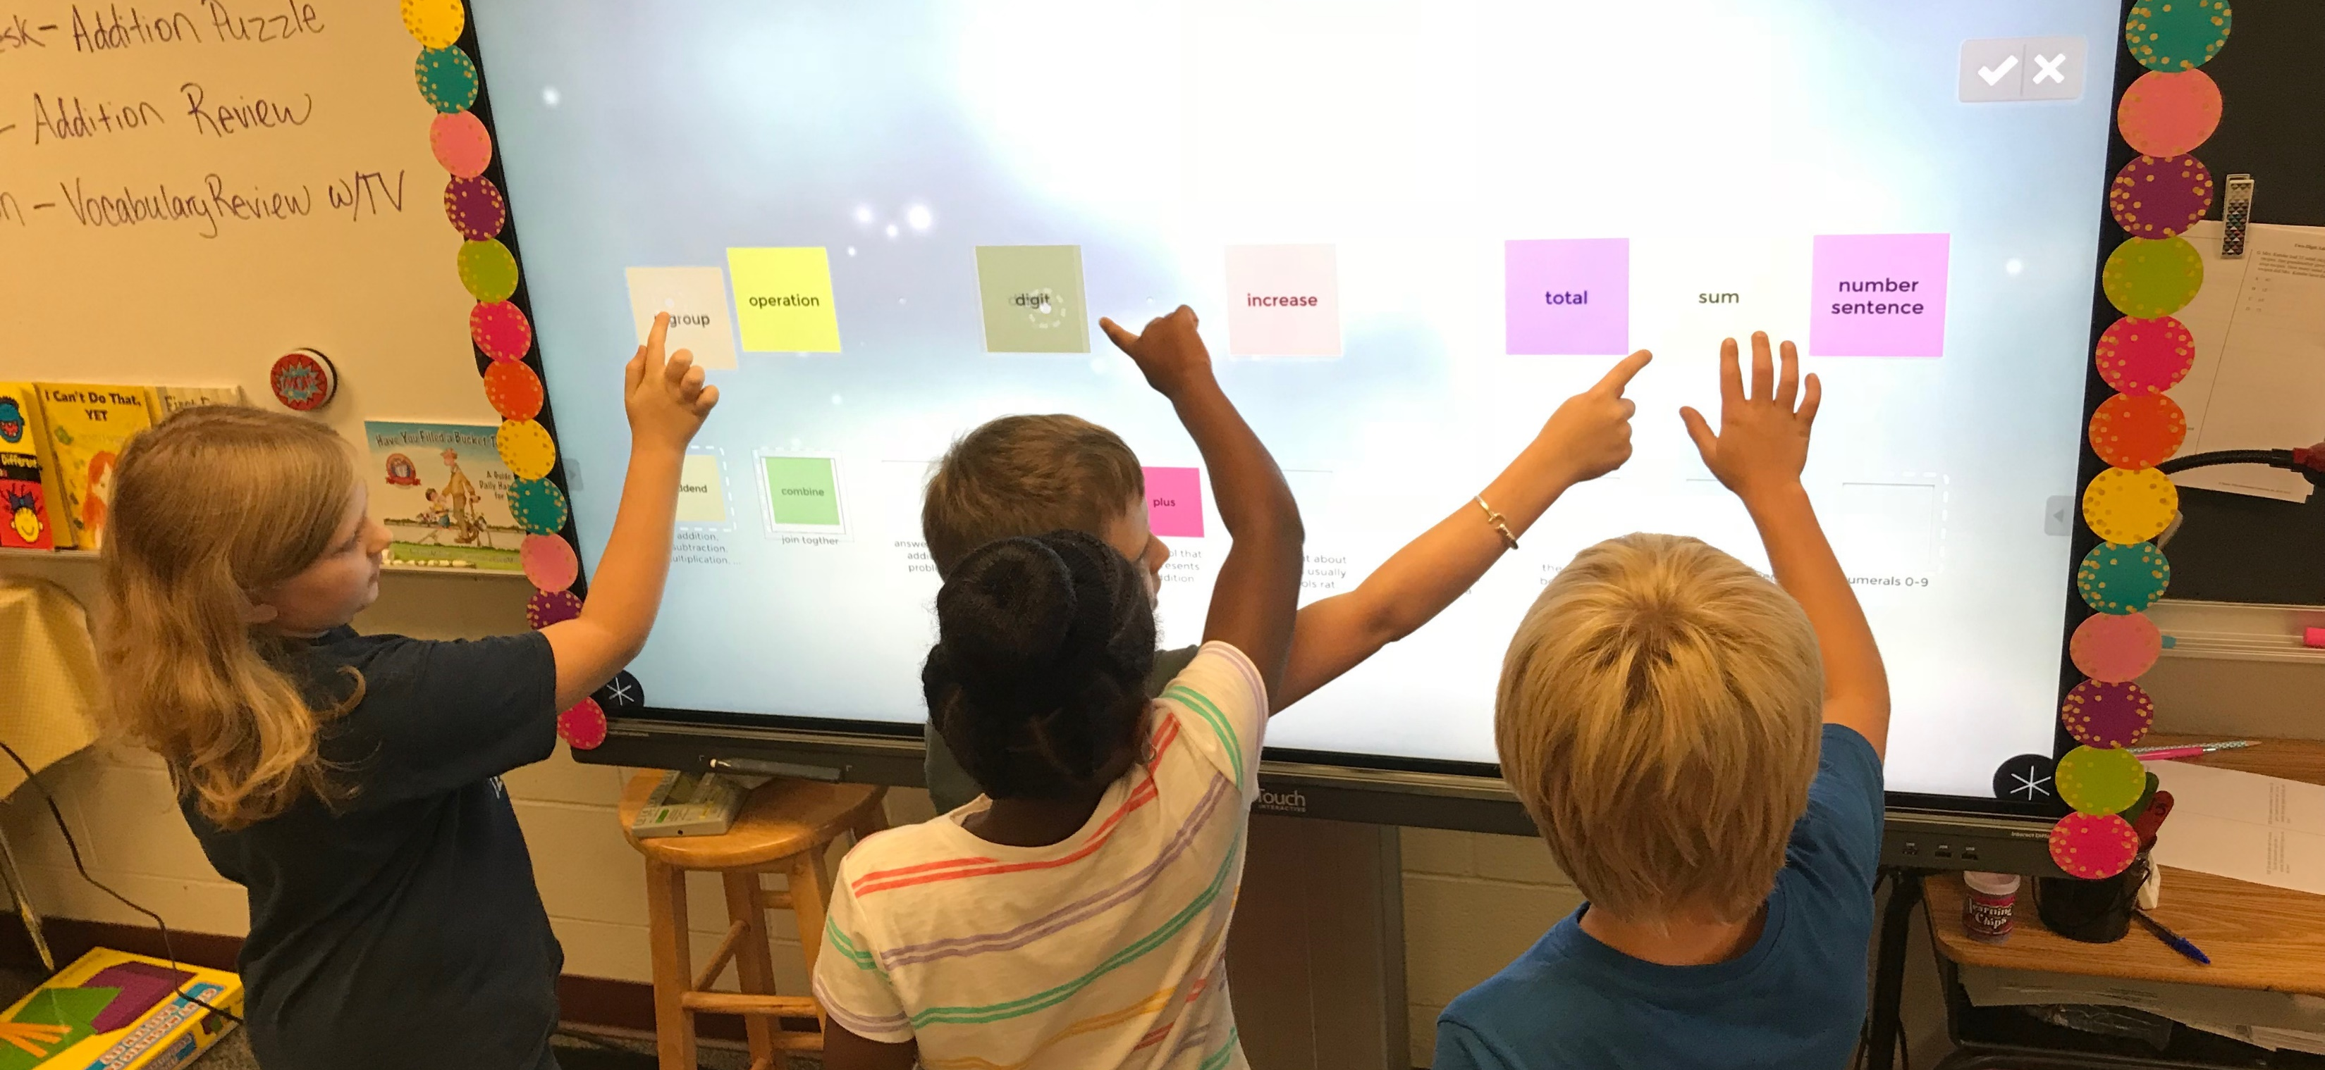
DEMONSTRATION

Slide 43
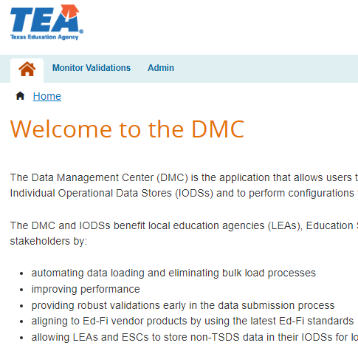
DATA MANAGEMENT CENTER
What the demo will be covering:
  Administrator Functionality:
      Manage Claim Sets
      Manage Keys and Secrets
      Map Descriptors
  Monitor Validations Functionality:
      View L1.5 Filter Details
DMC

Slide 44

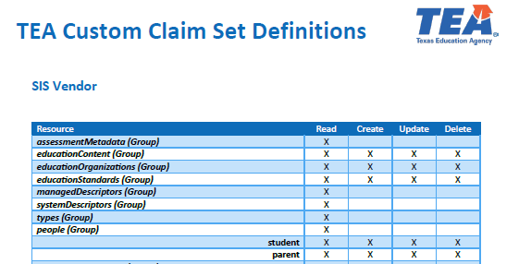
CLAIM SET DOCUMENTATION
Download Here

Slide 45
FREQUENTLY ASKED QUESTIONS24
Will vendors have access to the DMC application?
No. The DMC application relies upon TEA Login (TEAL) security and will require the proper TEAL role(s) and privilege(s) by the LEA for access.
The LEA will be responsible for managing claim set(s), generating the key and secret, and providing it to their vendor.

Slide 46
FREQUENTLY ASKED QUESTIONS25
Does the key and secret need to be generated every school year?
No. The LEA will not need to generate a new key and secret every school year. The LEA would only need to generate a key and secret when a new application is added or if they switch vendors.

Slide 47
FREQUENTLY ASKED QUESTIONS26
When does the LEA need to perform descriptor mapping?
The LEA would need to perform the necessary descriptor mapping for any descriptor value that is loaded into the IODS that does not match a TEDS defined code value and is intended to be used for TSDS reporting.
Example: “High School Diploma” is loaded to the IODS, but the LEA wants to report “No Degree” for TSDS purposes. The LEA would map “High School Diploma” to “0 (No Degree)” in the DMC application.

Slide 48
FREQUENTLY ASKED QUESTIONS27
If the source system vendor loads the TEDS defined code values to the IODS, does the LEA need to perform descriptor mapping in the DMC application?
The LEA would not need to perform descriptor mapping in the DMC application for data loaded into the IODS with TEDS defined code values. Additionally, if the LEA and/or vendor performs cross-walks or mapping of the data prior to sending to the IODS, then descriptor mapping in the DMC application may not be needed. LEAs should verify and confirm any descriptor values marked as “unmapped” in the DMC application.

Slide 49
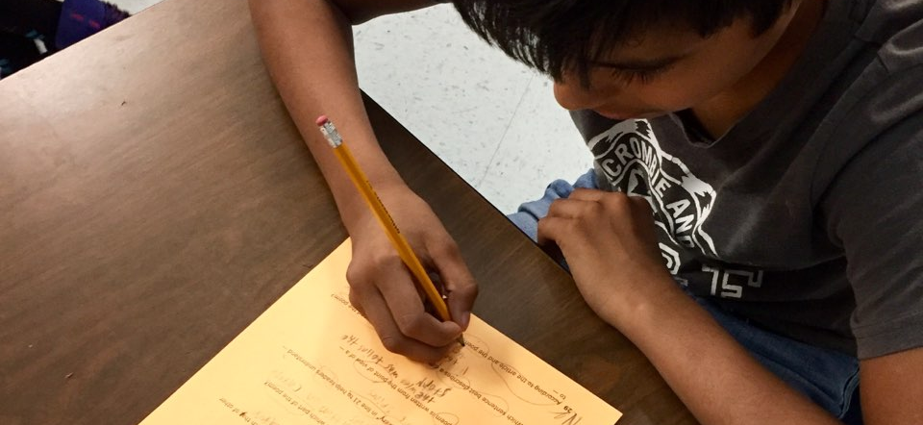
CERTIFICATION

Slide 50

ENSURING VENDOR READINESS
CERTIFICATION & BADGING
COMPATIBLE DESIGNATION

Slide 51
CERTIFICATION VS DESIGNATION
Ed-Fi Certification:
  Provided through the Ed-Fi Alliance
  Includes all required and optional Ed-Fi Core entities
  Student Information Systems API for Data Standard v4 Certification
  Badging (API Provider/Consumer) for ERP and other vendors
TSDS Compatible Designation
  Provided through TEA
  Includes all required and optional entities for TSDS data submissions
  Required for SIS, HR/Finance, and ECDS assessment vendors
  Validated by LEAs during the 2023-2024 Parallel Submission
DECEMBER 2023
JULY 2024

Slide 52


TIMING MATTERS!
COHORT 1 VENDORS
Schedule your initial meeting with the Ed-Fi Alliance by April 3, 2023.
COHORT 2 VENDORS:
Schedule your initial meeting with the Ed-Fi Alliance by May 1, 2023.
ALL OTHER VENDORS:
Schedule your initial meeting with the Ed-Fi Alliance by June 1, 2023.
jeff.putnam@ed-fi.org

Slide 53

ENSURING PROGRESS & PROVIDING SUPPORT
MONTHLY MEETINGS
Establish monthly meetings with the Ed-Fi Alliance and TEA to effectively meet milestones.
ACHIEVABLE MILESTONES:
Stage 1: core student/staff domains
Stage 2: core supporting domains
Stage 3: all remaining core domains
June 2023
August 2023
December 2023

Slide 54
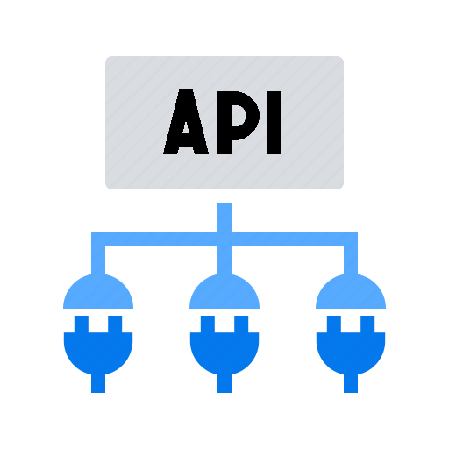


TSDS COMPATIBLE DESIGNATION
PARALLEL SUBMISSION
LEAs will validate their vendor(s) product readiness during the 2023-2024 Parallel Submission.
LEAs will compare all TSDS submissions to ensure required and optional entities are being submitted as expected.
LEAs will complete any any necessary forms issued by TEA to designate a vendor product as compatible.
TEA will publish all vendor products deemed TSDS compatible on the Texas Student Data System website.

Slide 55

NEXT STEPS

Slide 56
HOW TO PREPARE FOR PARALLEL
1
2
Communicate
Develop
By April 2023
By August 2023
Vendors should inform their LEA(s) on their product readiness and encourage their participation in the 2023-2024 Parallel Submission.
Vendors should develop their solutions for 2023-2024. Participating LEAs are expected to run comparisons prior to submission due dates.
3
4
Certify
Support
By December 2023
Throughout 2023-2024
Vendors should establish meeting cadence with the Ed-Fi Alliance and develop an effective plan of action to obtain Ed-Fi certification and/or badging.
Vendors should implement an effective support framework to respond to feedback and issues reported during the 2023-2024 Parallel Submission.

Slide 57

HOW CAN WE SUPPORT YOU?
Vendor Webinars
Let us know what additional topics and guidance to provide in upcoming webinars by contacting TSDSDeployment@tea.texas.gov.
Vendor Coordinator
Let us know what additional support you need by contacting our vendor coordinator at Donna.Pruitt@tea.texas.gov.
Ed-Fi Alliance
Join the Ed-Fi community by creating an account here. Setup your initial meeting by contacting jeff.putnam@ed-fi.org.
Technical Resources
Let us know any feedback you have on TEDS documents, or any additional technical resources TEA should consider developing.

Slide 58
KEY TAKE-AWAYS
New resources have been published on the Texas Education Data Standards website.
SDK version 1.0.3.1 will be released on March 23, 2023. The SDK for 2023-2024 will be released in Summer 2023.
Additional LEAs were just added to the Pilot Program. No additional LEAs will be added after April 2023.
Vendors will be responsible for capturing and reporting Level 1 validation (API errors) to their LEA(s).
ED-FI CERTIFICATION
  Kickoff Meeting:
  Contact the Ed-Fi Alliance and schedule meeting
  Determine Plan:
  Develop an effective plan to meet the recommended milestone stages
  Communicate Early & Often:
  Inform the Ed-Fi Alliance and TEA of any roadblocks or challenges with obtaining certification

Slide 59

QUESTIONS

