Slide 1
OPEN PEIMS SUBMISSIONS
2024-2025
REACHING THE FINISH LINE

Slide 2
SESSION AGENDA
PEIMS Summer
PEIMS Extended Year

Slide 3
PEIMS Summer
Reference Slides 32 to 116

Slide 4
PEIMS Summer New Reporting Requirements
SUMMER TRAINING 2024 Data Reporting:
Rural Pathway Excellence Partnership (RPEP)
NumberOfHoursInRPEP (E3090)
New descriptor as part of the Student Characteristics descriptor table (344)
Two new reports
PDM3-120-027 Roster of Students Participating in R-PEP
PDM3-130-021 Superintendent's Report of Rural Pathway Excellence Partnership (R-PEP) Hours & FTEs
Three new business rules
42400-0096
42400-0097
42400-0098
Details on the newly reported data start on slide 50.

Slide 5
PDM3-120-027 Roster of Students Participating in R-PEP

Slide 6
PDM3-130-021 Superintendent's Report of Rural Pathway Excellence Partnership (R-PEP) Hours & FTEs

Slide 7
PEIMS Summer New Reporting Requirements 2
SUMMER TRAINING 2024 Data Reporting:
Accelerated Instruction
StudentAcceleratedEducationPlan (E3083)
New common type AcceleratedInstructionSet
E3084 AcceleratedInstructionSubject
E3085 StudentAcceleratedInstructionParticipation
E3086 AssignedHoursAcceleratedInstruction
E3087 CompletedHoursAcceleratedInstruction
E3088 DifferenceReasonHoursAcceleratedInstruction
New descriptor tables
StudentAcceleratedInstructionParticipation (C353)
DifferenceReasonHoursAceleratedInstruction (C354)
Two new reports
PDM3-120-025 Student Accelerated Instruction Roster
PDM3-120-026 Accelerated Instruction Summary Report
New business rules
40100-0254
40100-0255
40100-0256
40100-0257
40100-0258
40100-0259
Details on the newly reported data start on slide 33.

Slide 8
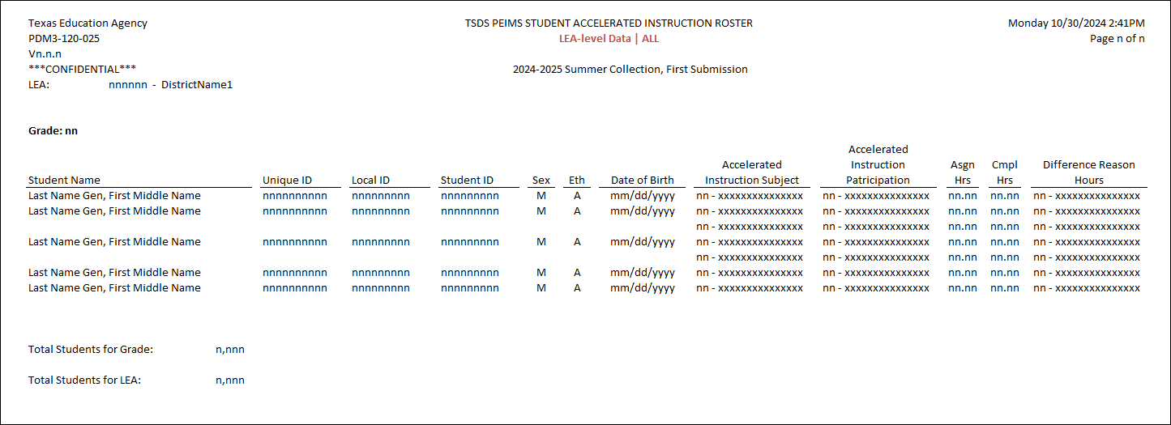
PDM3-120-025 Student Accelerated Instruction Roster

Slide 9
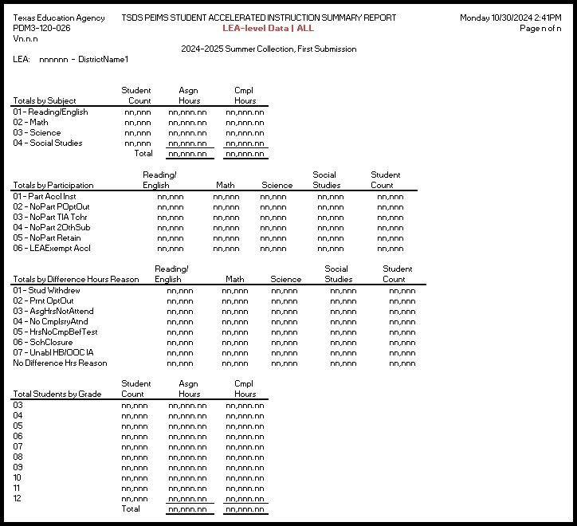
PDM3-120-026 Accelerated Instruction Summary Report

Slide 10
PEIMS Summer New Reporting Requirements
SUMMER TRAINING 2024 Data Reporting:
Dropout Recovery Education Program
DropoutRecoveryCourseCompletion (E3097)
DropoutRecoveryCourseCompletion (C355)
New descriptor as part of the Student Characteristics descriptor table (344)
New Report
PDM3-133-003 Students Participating in Dropout Recovery Program
Two new business rules
40100-0261
43415-0079
Details on the newly reported data start on slide 56.

Slide 11
PDM3-133-003* Students Participating in Dropout Recovery Program
*Final Approval Pending

Slide 12
Question Quick Stop

Slide 13
PEIMS Summer Data Element Changes
Behavior (E1006)
was DISCIPLINARY-ACTION-REASON-CODE
CalendarCode E0975
was INSTRUCTIONAL-TRACK-INDICATOR-CODE
CalendarType (E1600)
was INSTRUCTIONAL-PROGRAM-TYPE
CourseAttemptResult (E0949)
was PASS/FAIL-CREDIT-INDICATOR-CODE
CTEProgramService (E3012)
was OUT-OF-WORKFORCE-INDIVIDUAL, TRANSPORTATION-CTE-SUPPORT-SERVICE, SGL-PARENT-SGL-PREG-WOMAN-CODE
Full list found on reference slide 71

Slide 14
PEIMS Summer Descriptor Value Updates
ChildCountFunding
PKProgramType
Disability
EmergentBilingualIndicator
FosterCareType
HomelessStatus
MilitaryConnectedStudent
TitleIPartAParticipant
UnschooledAsyleeRefugee
StudentAttribution
PPCDServiceLocation
CTEProgramService
‘0’ values removed from descriptor tables

Slide 15
PEIMS Summer Report Updates
All applicable reports will be updated for the following changes below:
Remove RA/RS from all Attendance reports
CalendarCode
Length changing from 2 to 60 characters
SectionIdentifier
Length changing from 14 to 255 characters
IncidentIdentifier
Length changed from 6 to 20 characters
SUMMER TRAINING 2024 DisciplineActionIdentifier
Length changed from 3 to 20 characters
SUMMER TRAINING 2024 RestraintEventIdentifier
Length changed from 6 to 20 characters

Slide 16
PEIMS Summer Report Updates
Student & Student Restraint
PDM3-120-008
Attendance
Discipline
PDM3-131-004
PDM3-131-006
PDM3-131-007
PDM3-131-008
PDM3-131-009
PDM3-131-010
PDM3-131-011
PDM3-131-012
PDM3-131-002
PDM3-120-013
Class & Organization
PDM3-112-001
PDM3-113-001
PDM3-116-003
PDM3-132-001
PDM3-132-002
PDM3-132-004
PDM3-125-001
PDM3-125-004
PDM3-125-002
PDM3-130-006
Removed RS/RA from ALL

Slide 17
PEIMS Summer – CSV Reports Recently Added2
PDM3-120-001 Student Roster Summary by Early Reading Indicator
PDM3-120-003 Campus ID of Accountability Roster
PDM3-120-006 Students Participating in Regional Day School Program for the Deaf
PDM3-120-007 Student Indicator Report by Grade
PDM3-120-008 Students with Dual Credit Courses And College Credit Hours
PDM3-120-010 Student Advanced Academic Roster by Grade
PDM3-120-017 Prekindergarten Student Roster
PDM3-120-018 Student Dyslexia or Related Services Roster
PDM3-120-020 Student Truancy Roster
PDM3-120-021 Student Dyslexia Screening Roster By Grade
PDM3-120-022 Virtual Students Not In Membership

Slide 18
PEIMS Summer – CSV Reports Recently Added21
PDM3-120-001
PDM3-120-003
PDM3-120-006
PDM3-120-007
PDM3-120-008
PDM3-120-010
PDM3-120-017
PDM3-120-018
PDM3-120-020
PDM3-120-021
PDM3-120-022

Slide 19
PEIMS Summer – CSV Reports Coming Soon2
Coming Soon:
PDM3-120-009 Student Foundation High School Program Roster by Grade
PDM3-122-002 Career and Technical Roster by Career and Technical Indicator Code
PDM3-125-004 Law Enforcement Student Restraint Roster by Campus ID of Restraint Event
PDM3-131-007 Roster of 7th & 8th Grade Students Generating More Than One Career & Technical Contact Hour Per Day
PDM3-131-008 Roster of Students Reporting More Than Three Excess Contact Hours Per Day

Slide 20
PEIMS Summer – CSV Reports Coming Soon 2 1
STUDENT
PDM3-120-009
CTE
PDM3-122-002
STUDENT RESTRAINT
PDM3-125-004
ATTENDANCE DIAGNOSTIC
PDM3-131-007 & PDM3-131-008

Slide 21
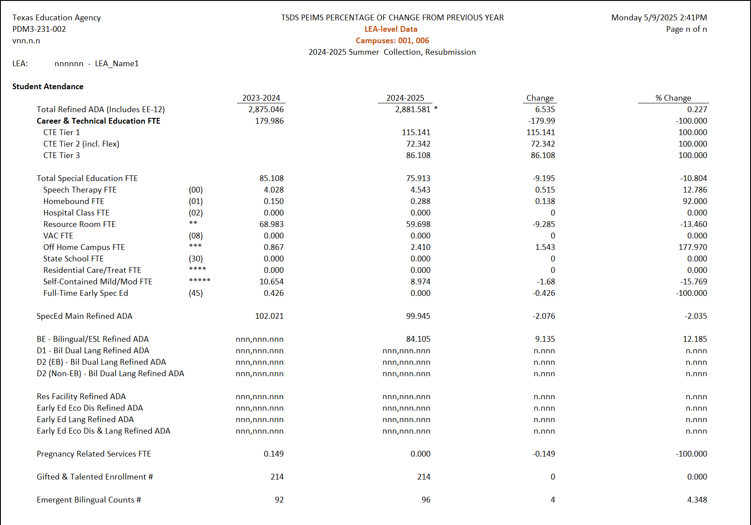
PEIMS Summer New Report
NEW PEIMS Summer Report:
PDM3-231-002 Percentage of Change from Previous Year
Student Attendance
College Prep and Dual Credit
Student Demographics, Characteristics & Programs
COMING SOON

Slide 22
PEIMS Summer New Business Rules
In School Suspension (ISS)
44425-0082 – replaced 44425-0048 to check ActualLengthOfDisciplinaryAssignment for ISS
Out-of-School Suspension (OSS)
44425-0084 – replaced 44425-0048 to check ActualLengthOfDisciplinaryAssignment for OSS
44425-0083 – replaced 44425-0047 to check OfficialLengthOfDisciplinaryAssignment for ISS
44425-0085 – replaced 44425-0047 to check OfficialLengthOfDisciplinaryAssignment for OSS
Details on the business rules start on slide __.

Slide 23
CURRENT KNOWN ISSUES 1
COMPO-NENT | SUB-COMPO-NENT | ISSUE | IMPACT | REPORTED DATE | TARGET RELEASE DATE
PEIMS Summer | Reports | Report PDM3-125-002 Student Disciplinary Action Detail Report for Students with Restraint Events is failing. | N/A | 10/28/24 | 02/25/25
PEIMS Summer | Validations | Fatal rule 45435-0005 is firing when it should not. If RestraintStaffType is '01', then there must be StudentSpecialEducationAssociationData for this student on the EventDate. | This rule is firing when it should not. | 11/11/24 | 02/28/25
PEIMS Summer | Reports | 2024-2025 Career and Technical (CTE) Service ID Tier data is currently not available from the program area. The following reports will not have CTE data: PDM3-130-001 Superintendent’s/Principal’s Report of Student Attendance, PDM3-130-002 Superintendent's/Principal's Report of Career & Technical Education Eligible Days, PDM3-130-005 Comparison of Current and Prior Year Attendance, and PDM3-130-008 Superintendent's/Principal's Summary Report of Student Attendance. | No CTE data will print on the reports. | 10/30/24 | 03/31/25
PEIMS Summer | Data Promotion | PEIMS Summer Student > Course Completion promotions are resulting in duplicates when there is more than one course sequence code for the course being reported. | LEAs are unable to promote Course Completion data when more than one course sequence code is reported for the same course completion record. | 02/12/25 | TBD
PEIMS Summer | Data Validations | Fatal validation rule 44425-0075 is firing when no data is reporting due to promotion logic forcing a '0' to be inserted. | LEAs will not be able to complete this submission until the fatal is resolved. The promotion logic will be updated to allow a null value to promote into the data mart. | 12/04/24 | 04/04/25

Slide 24
Question Quick Stop 1

Slide 25
PEIMS Extended Year
Reference Slides 117 - 156

Slide 26
PEIMS Extended Year Additional Days School Year
Reminders – Student
Grades PK – 5
Attendance tracked daily
Total days reported in PEIMS EXYR
Reported in ReportingPeriodExt entity
Uses Reporting Period 9
Reminders – Staff
AdditionalDaysProgramTeacher (E1673)
Reports in StaffSectionAssociation
Reminders – Calendar
ADSY CalendarType (E1600) ‘16’
180 days minimum submitted in PEIMS Summer
Up to 30 days submitted in PEIMS Extended Year
½ day funding

Slide 27
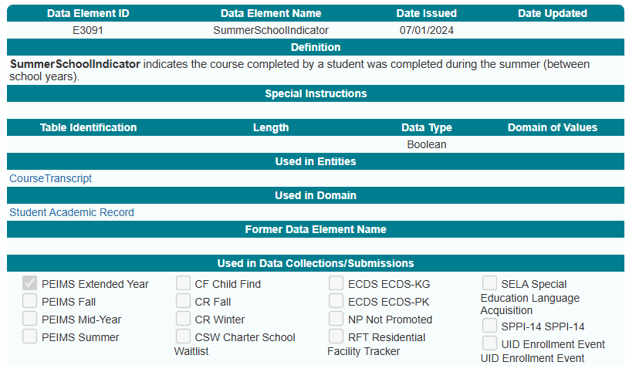
PEIMS Extended Year New Data Element
SummerSchoolIndicator (E3091)

Slide 28
PEIMS Extended Year Report Updates
Staff
PDM4-111-001
Attendance
Course Completion
PDM4-131-001
Organization
PDM4-133-001
PDM4-133-004
PDM4-116-003
COMING SOON
CSV & SOA Reports

Slide 29
CURRENT KNOWN ISSUES 1
No current known issues as of March 20, 2025.

Slide 30
Promotion Logic Document Updates
Data Collection Documentation
PEIMS Summer
2024-2025 updates coming soon!
PEIMS Extended Year
2024-2025 updates coming soon!

Slide 31
QUESTIONS

Slide 32
PEIMS Summer Resource Slides #32 to #116

Slide 33
DATA GOVERNANCE UPDATES1
Legislative Update (HB1416) – Accelerated Instruction:
HB 1416, passed during the 88th legislative session, amends Section 28.0211, Education Code related to accelerated and supplemental instruction for students. Each student that fails to achieve at least satisfactory performance on each assessment instrument administered under Section 39.023, Education Code must be provided supplemental instruction for no less than 15 hours or 30 hours for a student whose performance on the applicable assessment instrument was significantly below satisfactory, as defined by commissioner rule.
The Texas Tutoring Supports division at the Texas Education Agency (TEA) has requested that local education agencies (LEAs) have a method to transfer the accelerated education plan developed for each student when the student transfers to a new LEA. Additionally, the division has requested that information be reported to TEA to monitor and evaluate the effectiveness of the accelerated instruction provided by each LEA.
Return to slide 7

Slide 34
DATA ELEMENT UPDATES 0
Added new data element, E3083 StudentAcceleratedEducationPlan, to the StudentEducationOrganizationAssociation entity in the Student Identification and Demographics domain.

Slide 35
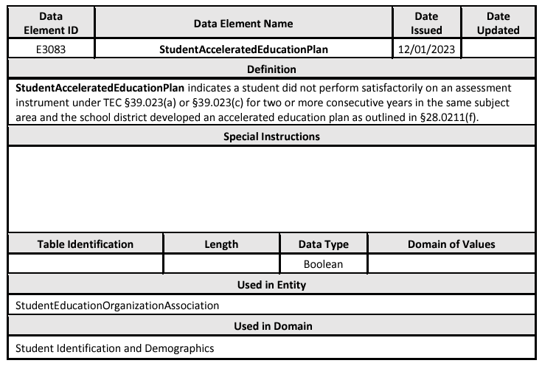
DATA ELEMENT UPDATES 1
Added new data element E3083 StudentAcceleratedEducationPlan.

Slide 36
DATA ELEMENT UPDATES 2
Added new common type AcceleratedInstructionSet to the StudentEducationOrganizationAssociation entity in the Student Identification and Demographics domain for the PEIMS Summer Submission that includes the following data elements:
E3084 AcceleratedInstructionSubject
E3085 StudentAcceleratedInstructionParticipation
E3086 AssignedHoursAcceleratedInstruction
E3087 CompletedHoursAcceleratedInstruction
E3088 DifferenceReasonHoursAcceleratedInstruction
Return to slide 7

Slide 37
DATA ELEMENT UPDATES 3
New common type AcceleratedInstructionSet.

Slide 38
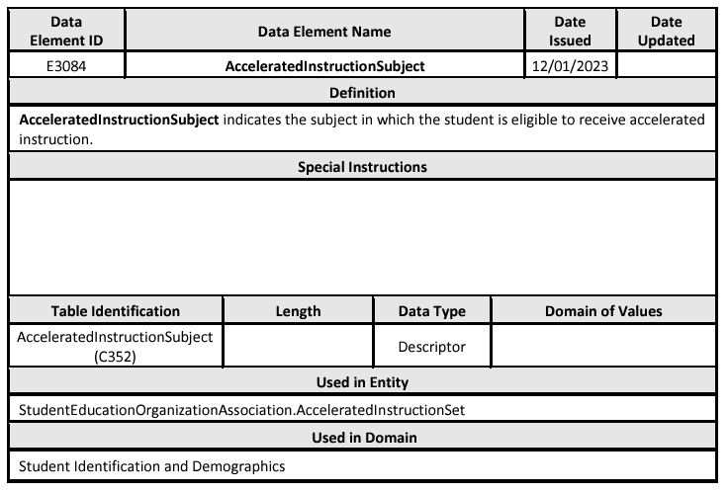
DATA ELEMENT UPDATES 4
Added new data element E3084 AcceleratedInstructionSubject.

Slide 39
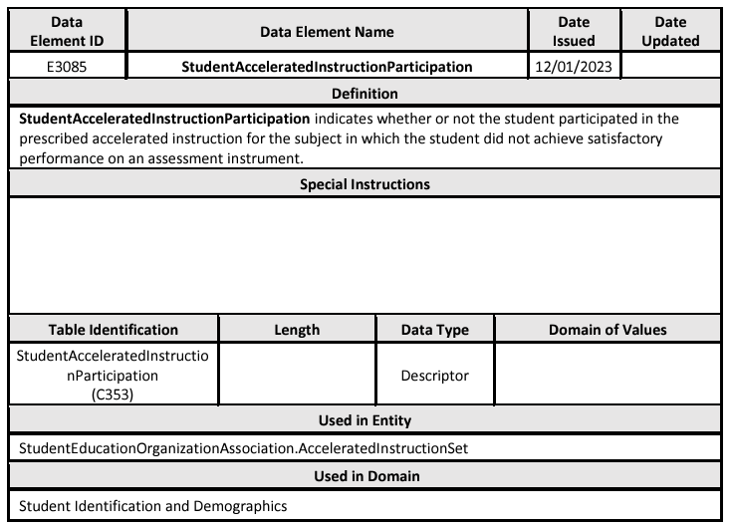
DATA ELEMENT UPDATES 5
Added new data element E3085 StudentAcceleratedInstructionParticipation.

Slide 40
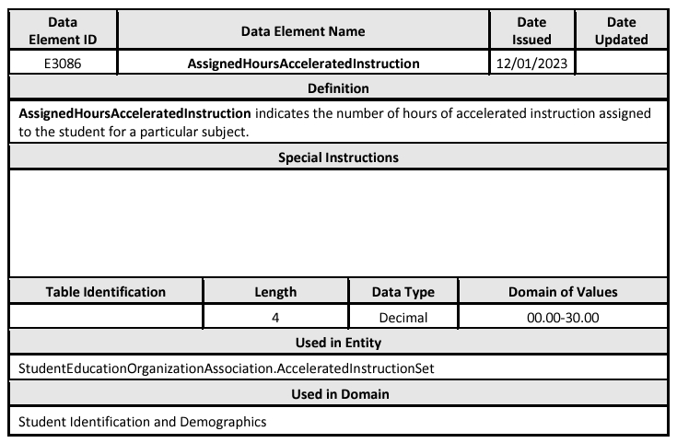
DATA ELEMENT UPDATES 6
Added new data element E3086 AssignedHoursAcceleratedInstruction.

Slide 41
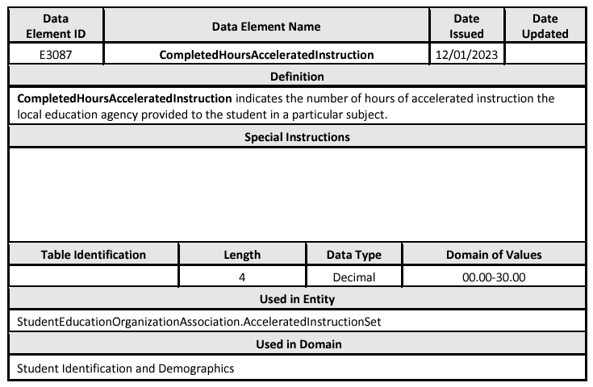
DATA ELEMENT UPDATES 7
Added new data element E3087 CompletedHoursAcceleratedInstruction.

Slide 42
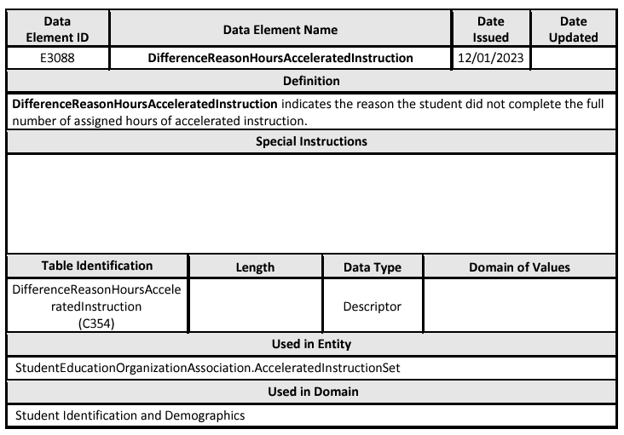
DATA ELEMENT UPDATES 8
Added new data element E3088 DifferenceReasonHoursAcceleratedInstruction.

Slide 43
DESCRIPTOR TABLE UPDATES
Added new descriptor table C352 AcceleratedInstructionSubject.

Slide 44
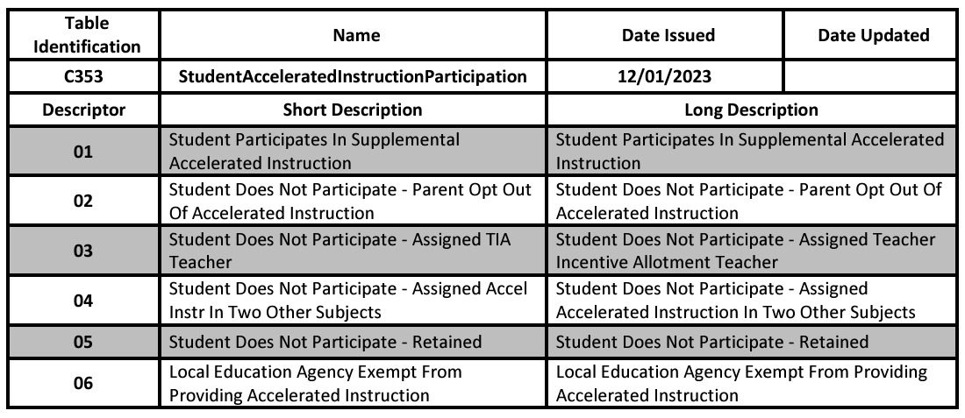
DESCRIPTOR TABLE UPDATES 1
Added new descriptor table C353 StudentAcceleratedInstructionParticipation.

Slide 45
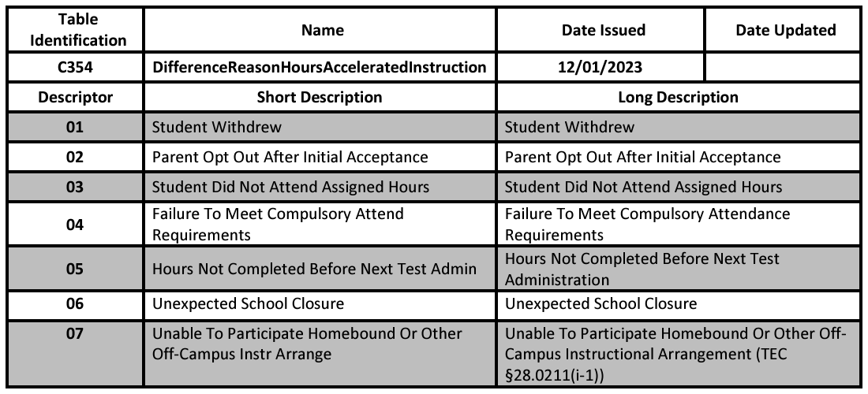
DESCRIPTOR TABLE UPDATES 2
Added new descriptor table C354 DifferenceReasonHoursAcceleratedInstruction.

Slide 46
REPORT UPDATES
Two new reports will be added to the PEIMS Summer Submission.
One student level, roster style report.
One campus, summary style report.

Slide 47
BUSINESS RULE UPDATES 4
SUMMER TRAINING 2024 Business Rules:

Slide 48
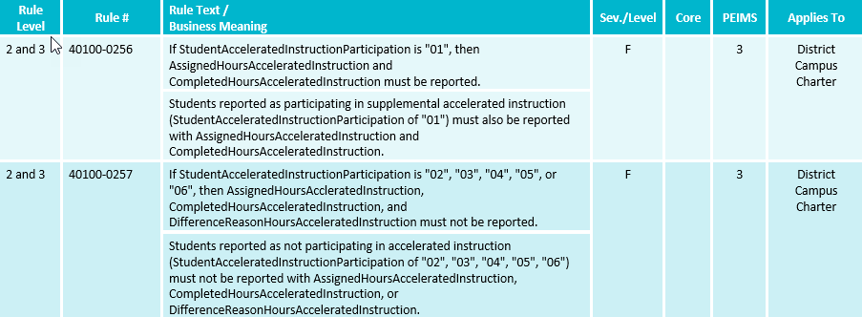
BUSINESS RULE UPDATES 5
SUMMER TRAINING 2024 Business Rules:

Slide 49
BUSINESS RULE UPDATES 11
SUMMER TRAINING 2024 Business rules:

Slide 50
DATA GOVERNANCE UPDATES 13
Legislative Update (HB 2209) – Rural Pathway Excellence Partnership
HB 2209, passed during the 88th Legislative Regular Session, added Texas Education Code Section 29.912 for the Rural Pathway Excellence Partnership (R-PEP). This partnership allows rural school districts to enter into agreements with other districts to develop rural college and career pathway partnerships. The funding for the program comes from the Foundation School Program. The program area has requested a student-level indicator to determine which students participate in the R-PEP program. The indicator will be used to calculate the ADA allotment funding.
During the October 17, 2023, ITF meeting, the committee approved a student level-indicator to indicate the students who participate in a Rural Pathway Excellence Partnership (R-PEP) program as outlined by HB 2209, passed during the 88th Legislative Regular Session. Since then, the program area has requested an additional data element be added to track the hours a student participates in the R-PEP program.
Return to slide 4

Slide 51
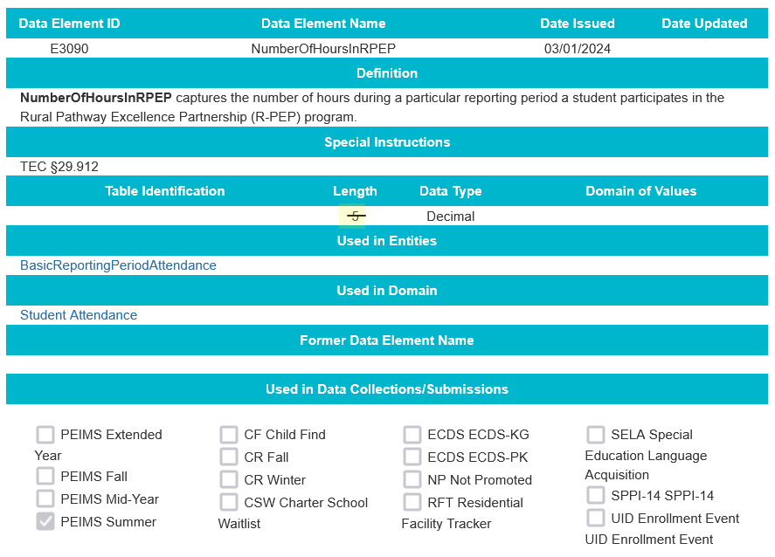
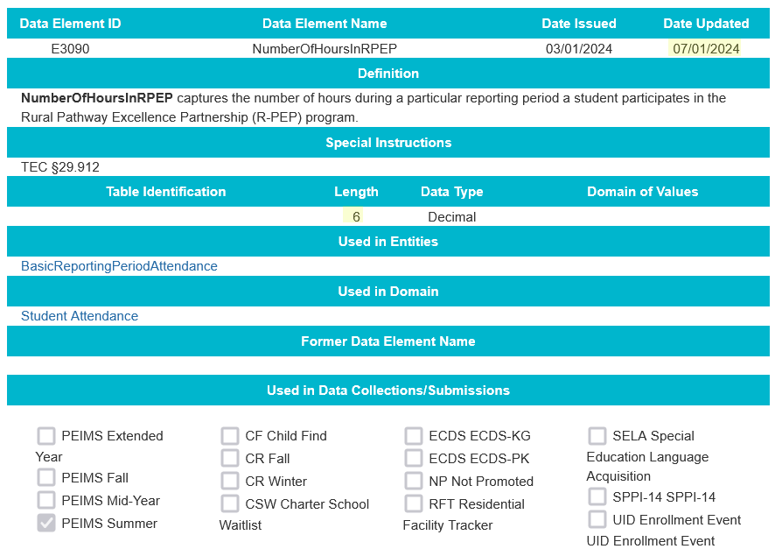
DATA ELEMENT UPDATES 9
Added new data element E3090 NumberOfHoursInRPEP.
SUMMER TRAINING 2024 Revised length from 5 to 6.

Slide 52
DESCRIPTOR TABLE UPDATES 3
Added new descriptor to the (C344) StudentCharacteristic descriptor table.
The Rural Pathway Excellence Partnership Participation student characteristic indicates the student participated in the Rural Pathway Excellence Partnership program.

Slide 53
REPORT UPDATES 26
Two new reports will be added to the 2024-2025 PEIMS Summer Submission.
One student level, roster style report.
One campus, summary style report.

Slide 54
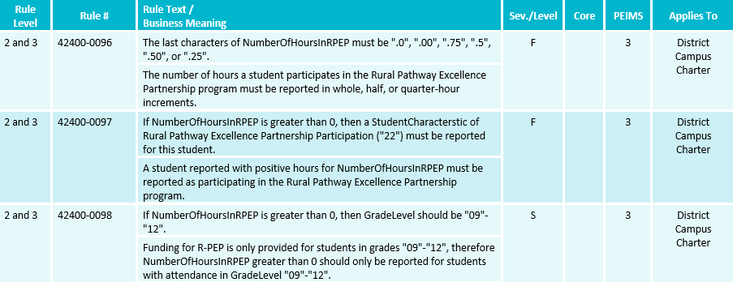
BUSINESS RULE UPDATES 12
SUMMER TRAINING 2024 Business rules:

Slide 55
DATA GOVERNANCE UPDATES 2
SUMMER TRAINING 2024 Legislative Update (SB 1647) – Dropout Recovery Education Program
SB 1647, passed during the 88th Legislative Regular Session, amended Texas Education Code Section 29.081 for dropout recovery education programs. A school district or open-enrollment charter school may use a private or public community-based dropout recovery education program or education management organization to provide alternative education programs for students at risk of dropping out of school. The program may be offered in person at a campus, remotely, or through a hybrid of in-person and remote instruction. A student who successfully completes a course offered through a dropout recovery program will be included in the district’s or school’s average daily attendance for funding purposes. Students participating in the dropout recovery program can be reported with regular attendance or optional flexible school day program attendance, depending on the program offered by the district or open-enrollment charter school.
Return to slide 10

Slide 56
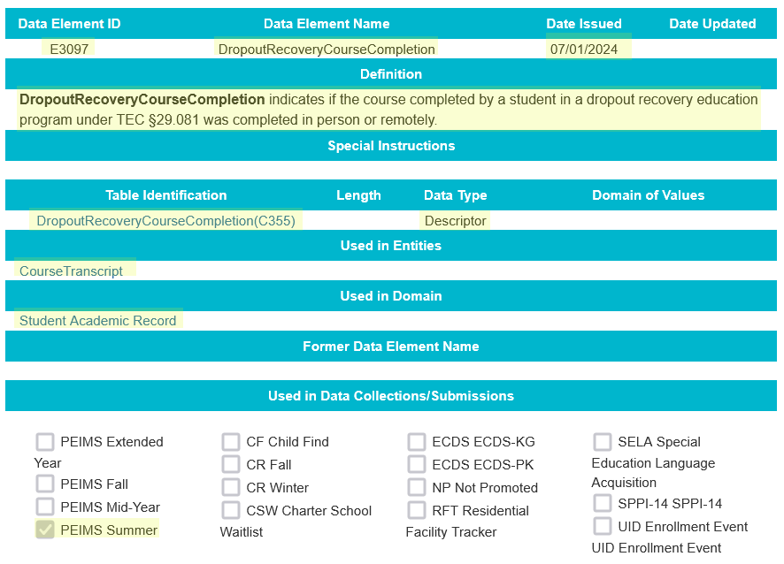
DATA ELEMENT UPDATES 91
SUMMER TRAINING 2024 Added new data element E3097 DropoutRecoveryCourseCompletion.

Slide 57
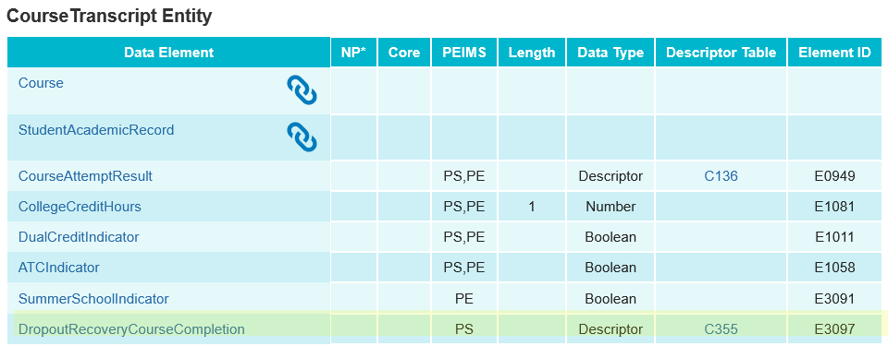
DATA ELEMENT UPDATES 92
SUMMER TRAINING 2024 Added new data element E3097 DropoutRecoveryCourseCompletion and associated guidance to the CourseTranscript entity in the Student Academic Record Domain to be reported as optional in the PEIMS Summer Submission.

Slide 58
DESCRIPTOR TABLE UPDATES 33
SUMMER TRAINING 2024 Added new descriptor table DropoutRecoveryCourseCompletion (C355).

Slide 59
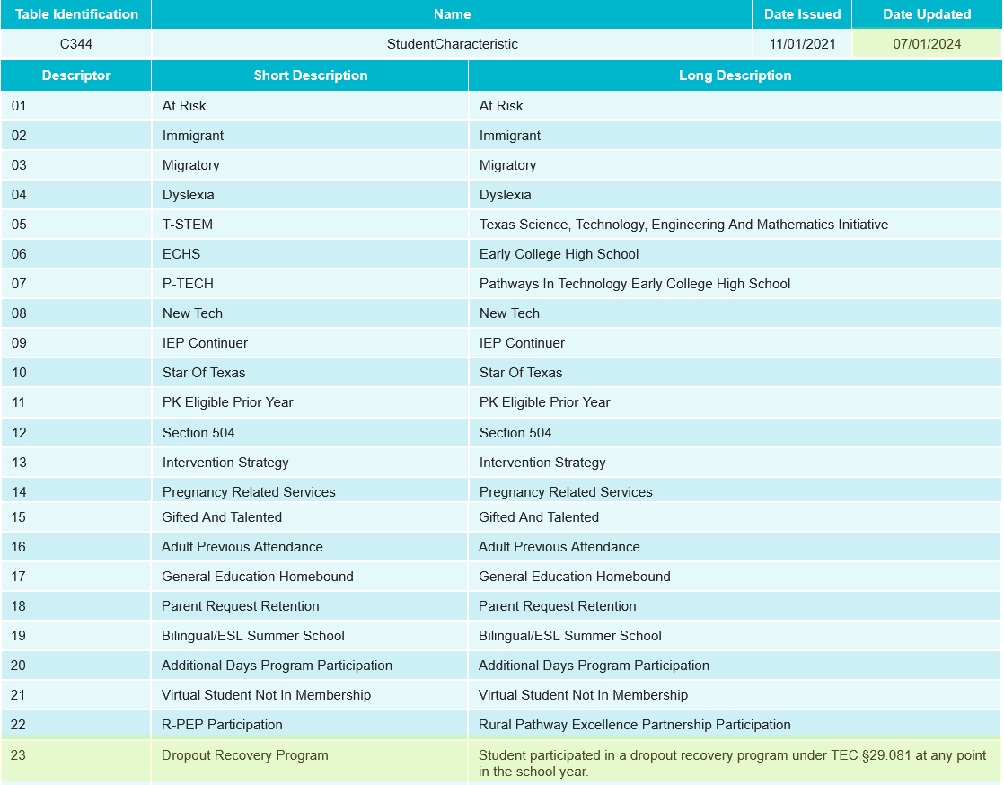
DESCRIPTOR TABLE UPDATES 34
SUMMER TRAINING 2024 Added new descriptor to the (C344) StudentCharacteristic descriptor table.
The Dropout Recovery Program student characteristic identifies a student who participated in a dropout recovery program under TEC §29.081 at any point in the school year.

Slide 60
REPORT UPDATES 265
SUMMER TRAINING 2024 PEIMS Summer reports will be analyzed to determine changes needed for the 2024-2025 school year for the new DropoutRecoveryCourseCompletion data element as well as the Dropout Recovery Program student characteristic.

Slide 61
BUSINESS RULE UPDATES 126
SUMMER TRAINING 2024 New Business rules:

Slide 62
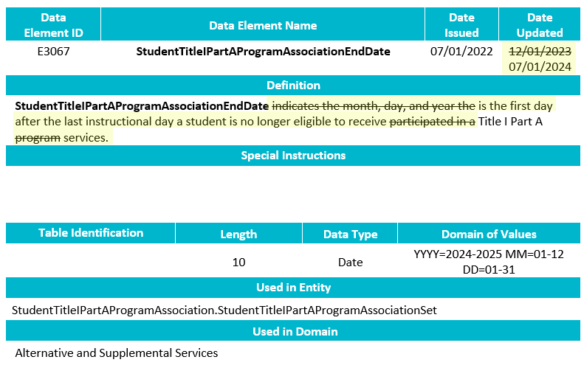
TSDS UPGRADE PROJECT UPDATES
SUMMER TRAINING 2024 Data Element Change:
E3067 StudentTitleIPartAProgramAssociationEndDate
Revised the definition.

Slide 63
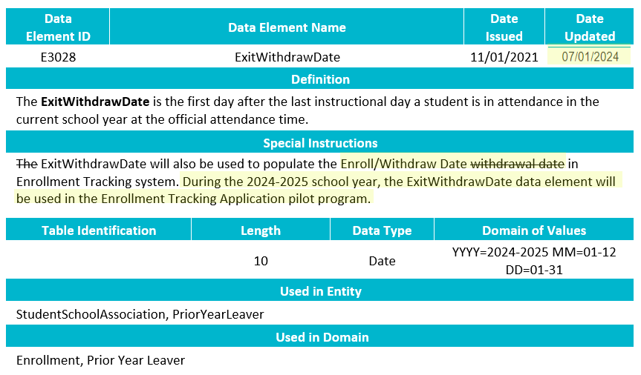
TSDS UPGRADE PROJECT UPDATES 8
SUMMER TRAINING 2024 Data Element Change:
E3028 ExitWithdrawDate
Revised the special instructions.

Slide 64
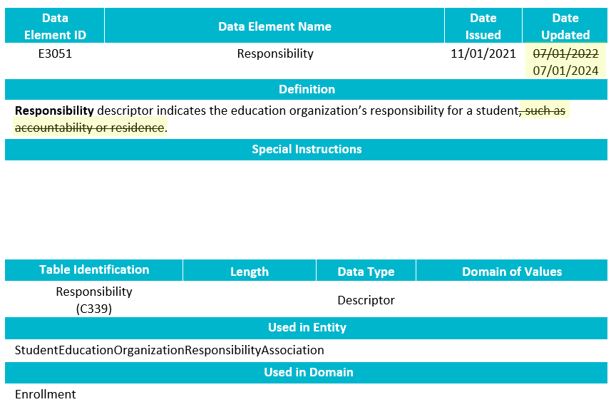
TSDS UPGRADE PROJECT UPDATES 87
SUMMER TRAINING 2024 Data Element Change:
E3051 Responsibility
Revised the definition.

Slide 65
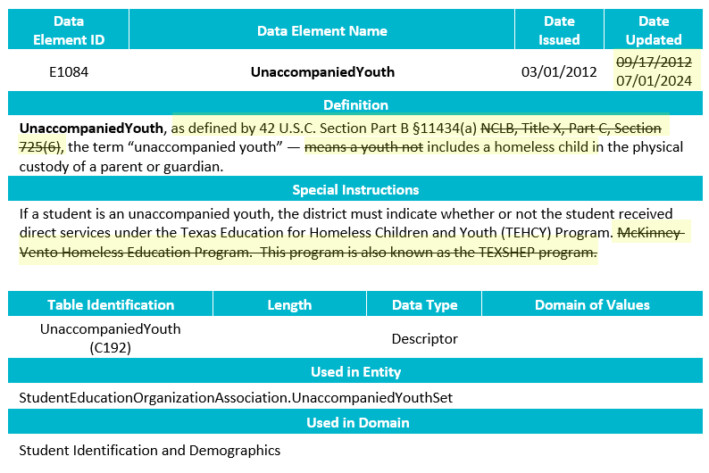
TSDS UPGRADE PROJECT UPDATES 88
SUMMER TRAINING 2024 Data Element Change:
E1084 UnaccompaniedYouth
Revised the definition and special instructions.

Slide 66
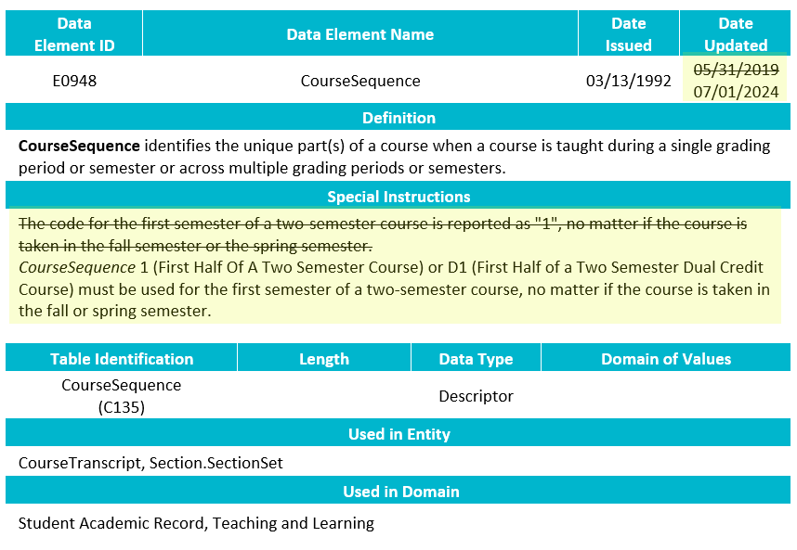
TSDS UPGRADE PROJECT UPDATES 89
SUMMER TRAINING 2024 Data Element Change:
E0948 CourseSequence
Revised the special instructions.

Slide 67
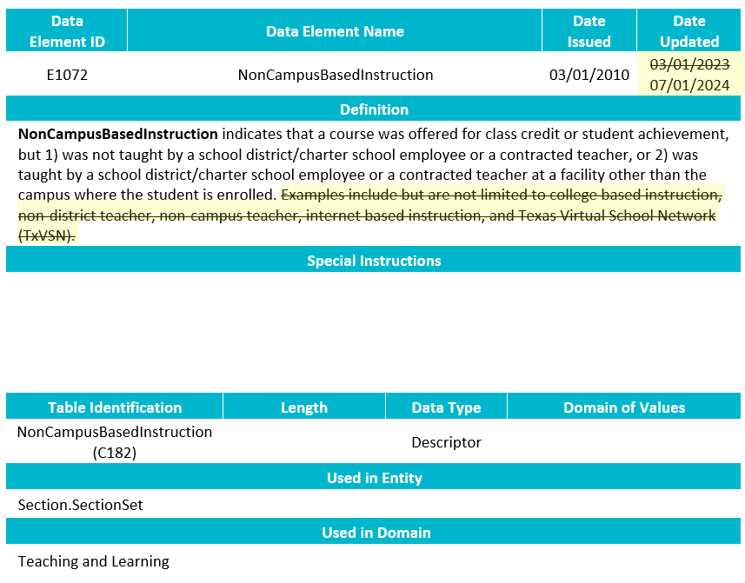
TSDS UPGRADE PROJECT UPDATES 810
SUMMER TRAINING 2024 Data Element Change:
E1072 NonCampusBasedInstruction
Revised the definition.

Slide 68
TSDS UPGRADE PROJECT UPDATES 12
Data Element Summary (PEIMS application function)
Removing the column Data Element.
Removing the column Code Table.
Removing the column Subcat.
Before
After

Slide 69
TSDS UPGRADE PROJECT UPDATES 1
Data Element Summary (PEIMS application function)
New Data Elements & Descriptors will use new format
Ex: New StudentCharacteristic – 22 (R-PEP Participation)

Slide 70
TSDS UPGRADE PROJECT UPDATES 2
Data Element Length Changes:
CalendarCode
Length changed from 2 to 60 characters.
SectionIdentifier
Length changed from 14 to 255 characters.
IncidentIdentifier
Length changed from 6 to 20 characters.
SUMMER TRAINING 2024 DisciplineActionIdentifier
Length changed from 3 to 20 characters.
SUMMER TRAINING 2024 RestraintEventIdentifier
Length changed from 6 to 20 characters.

Slide 71
TSDS UPGRADE PROJECT UPDATES 4
Data Element ID | XML Data Element Name | Upgrade Data Element Name
E1006 | DISCIPLINARY-ACTION-REASON-CODE | Behavior
E0975 | INSTRUCTIONAL-TRACK-INDICATOR-CODE | CalendarCode
E1582 | SCHOOL-DAY-EVENT-CODE | CalendarEvent
E1600 | INSTRUCTIONAL-PROGRAM-TYPE | CalendarType
E0949 | PASS/FAIL-CREDIT-INDICATOR-CODE | CourseAttemptResult
E3012 (was E1039) | OUT-OF-WORKFORCE-INDIVIDUAL | CTEProgramService
E3012 (was E0917) | TRANSPORTATION-CTE-SUPPORT-SERVICE | CTEProgramService
E3012 (was E0829) | SGL-PARENT-SGL-PREG-WOMAN-CODE | CTEProgramService
E1168 | CALENDAR-DATE | Date
E3015 (was E0041) | PRIMARY-DISABILITY-CODE | Disability
E1016 | DISCIPLINE-INCIDENT-NUMBER | IncidentIdentifier
E1083 | BEHAVIOR-LOCATION-CODE | IncidentLocation
E0173 | INSTRUCTIONAL-SETTING-CODE | InstructionalSetting
E1056 | CLASS-ID-NUMBER | SectionIdentifier
E3010 | N/A | BeginDate
E3020 | N/A | EndDate

Slide 72
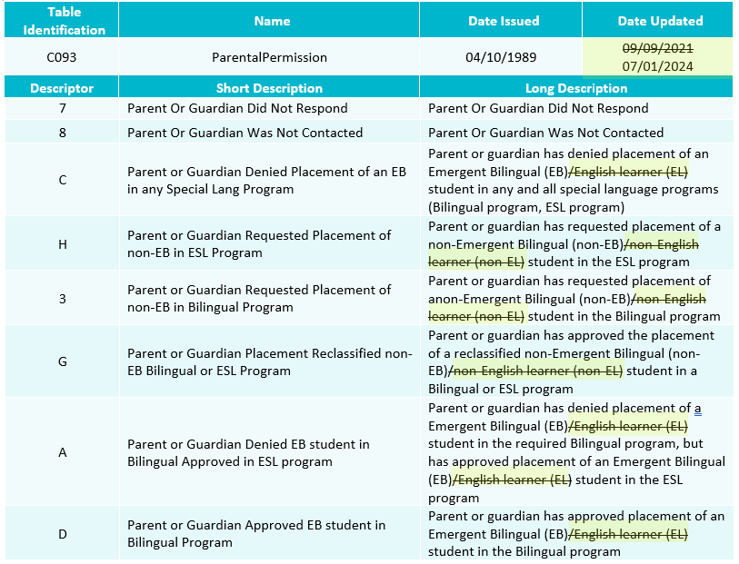
TSDS UPGRADE PROJECT UPDATES 813
SUMMER TRAINING 2024 Descriptor Change:
C093 ParentalPermission
Revised

Slide 73
TSDS UPGRADE PROJECT UPDATES 814
SUMMER TRAINING 2024 Descriptor Change:
C214 PostSecondaryCertificationLicensure
Revised

Slide 74
TSDS UPGRADE PROJECT UPDATES 3
Descriptor Table Changes:
‘0’ values being removed from descriptor tables
ChildCountFunding
Disability
EmergentBilingualIndicator
FosterCareType
HomelessStatus
MilitaryConnectedStudent
PKProgramType
TitleIPartAParticipant
UnschooledAsyleeRefugee
StudentAttribution
PPCDServiceLocation
CTEProgramService

Slide 75
TSDS UPGRADE PROJECT UPDATES 6
Report Updates:
All applicable reports will be updated for the following changes below:
Descriptor values of ‘0’ removed.
CalendarCode
Length changed from 2 to 60 characters.
SectionIdentifier
Length changed from 14 to 255 characters.
IncidentIdentifier
Length changed from 6 to 20 characters.
SUMMER TRAINING 2024 DisciplineActionIdentifier
Length changed from 3 to 20 characters.
SUMMER TRAINING 2024 RestraintEventIdentifier
Length changed from 6 to 20 characters.

Slide 76
TSDS UPGRADE PROJECT UPDATES 25
Updated Business Rules:

Slide 77
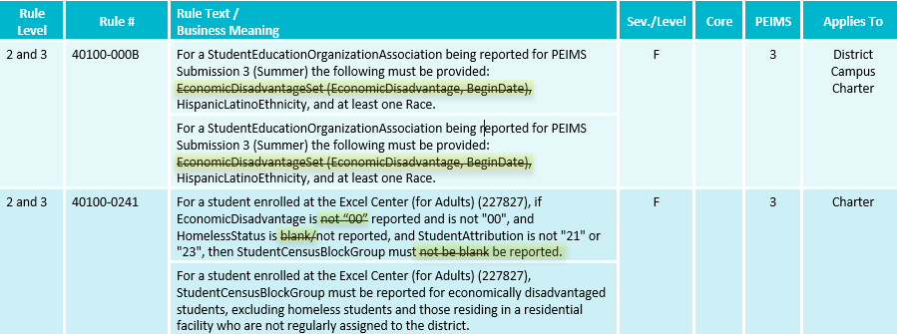
TSDS UPGRADE PROJECT UPDATES 24
Updated Business Rules:

Slide 78
TSDS UPGRADE PROJECT UPDATES 23
Updated Business Rules:

Slide 79
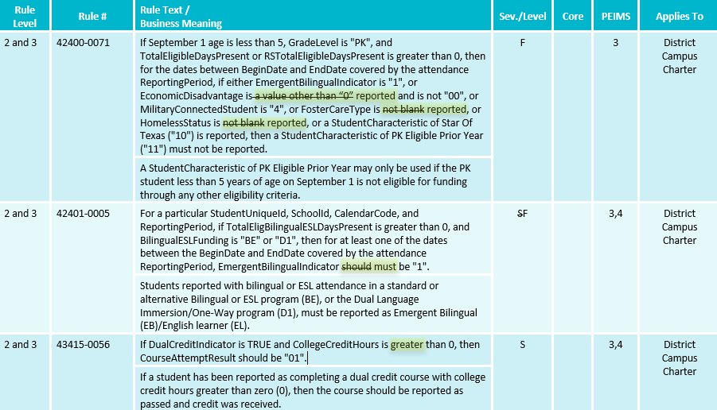
TSDS UPGRADE PROJECT UPDATES 22
Updated Business Rules:

Slide 80
TSDS UPGRADE PROJECT UPDATES 21
New Business Rules:

Slide 81
TSDS UPGRADE PROJECT UPDATES 20
Deleted Business Rules:

Slide 82
TSDS UPGRADE PROJECT UPDATES 7
Business Rule Changes:
AdditionalDaysProgram must be ‘TRUE’ (Boolean).
Boolean true or false versus a code of 1 or 0

Slide 83
TSDS UPGRADE PROJECT UPDATES 816
Business Rule Changes:
No longer using ‘0’ codes for HomelessStatus or UnaccompaniedYouth

Slide 84
TSDS UPGRADE PROJECT UPDATES 817
SUMMER TRAINING 2024 Business Rule Changes:

Slide 85
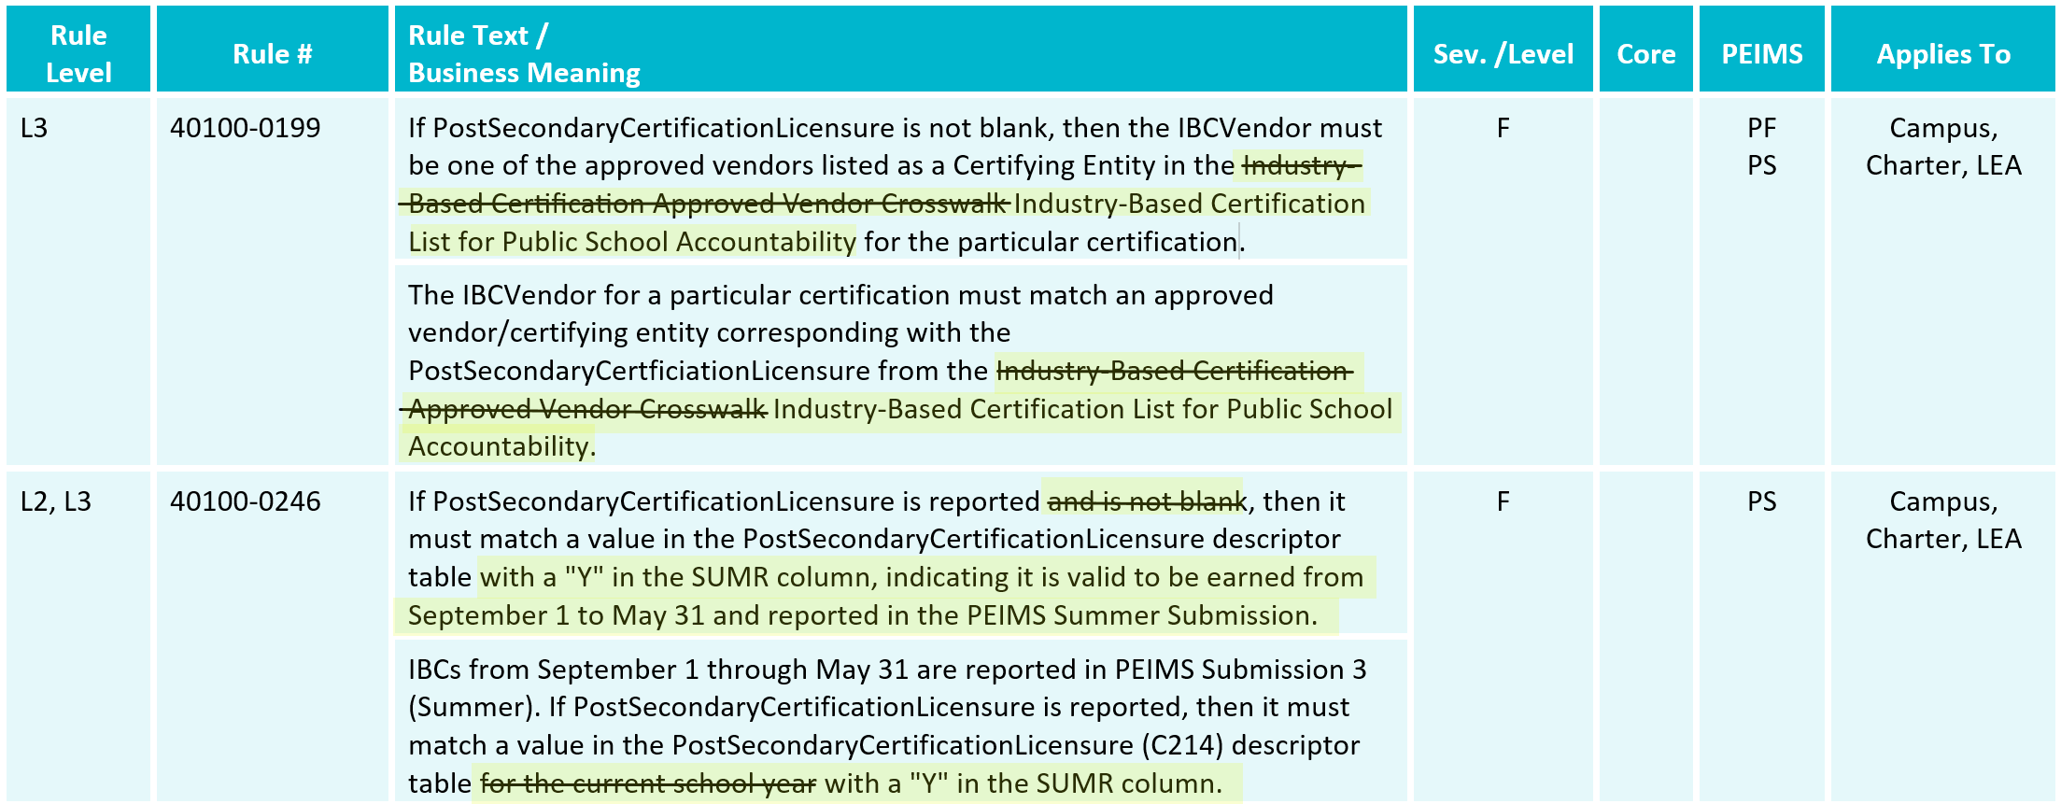
TSDS UPGRADE PROJECT UPDATES 818
SUMMER TRAINING 2024 Business Rule Changes:

Slide 86
TSDS UPGRADE PROJECT UPDATES 819
SUMMER TRAINING 2024 Business Rule Changes:

Slide 87
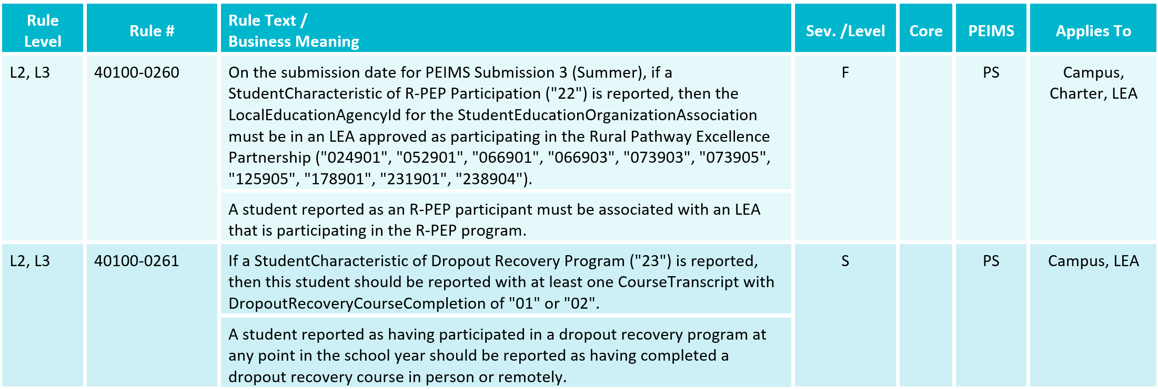
TSDS UPGRADE PROJECT UPDATES 821
SUMMER TRAINING 2024 Business Rule Changes:
New Rules

Slide 88
TSDS UPGRADE PROJECT UPDATES 822
SUMMER TRAINING 2024 Business Rule Changes:
New Rule

Slide 89
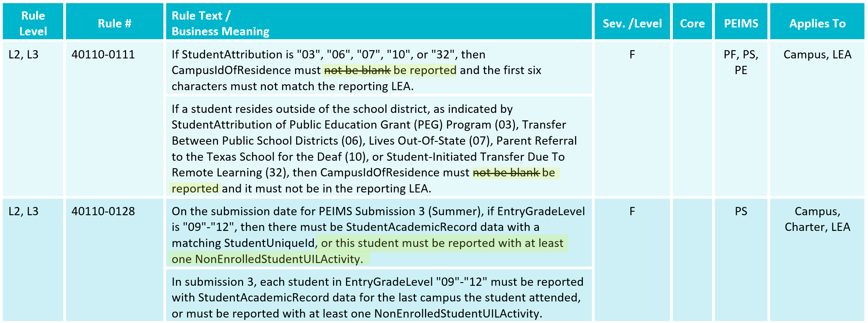
TSDS UPGRADE PROJECT UPDATES 823
SUMMER TRAINING 2024 Business Rule Changes:

Slide 90
TSDS UPGRADE PROJECT UPDATES 824
SUMMER TRAINING 2024 Business Rule Changes:

Slide 91
TSDS UPGRADE PROJECT UPDATES 825
SUMMER TRAINING 2024 Business Rule Changes:

Slide 92
TSDS UPGRADE PROJECT UPDATES 826
SUMMER TRAINING 2024 Business Rule Changes:
Deleted Rule

Slide 93
TSDS UPGRADE PROJECT UPDATES 827
SUMMER TRAINING 2024 Business Rule Changes:

Slide 94
TSDS UPGRADE PROJECT UPDATES 828
SUMMER TRAINING 2024 Business Rule Changes:

Slide 95
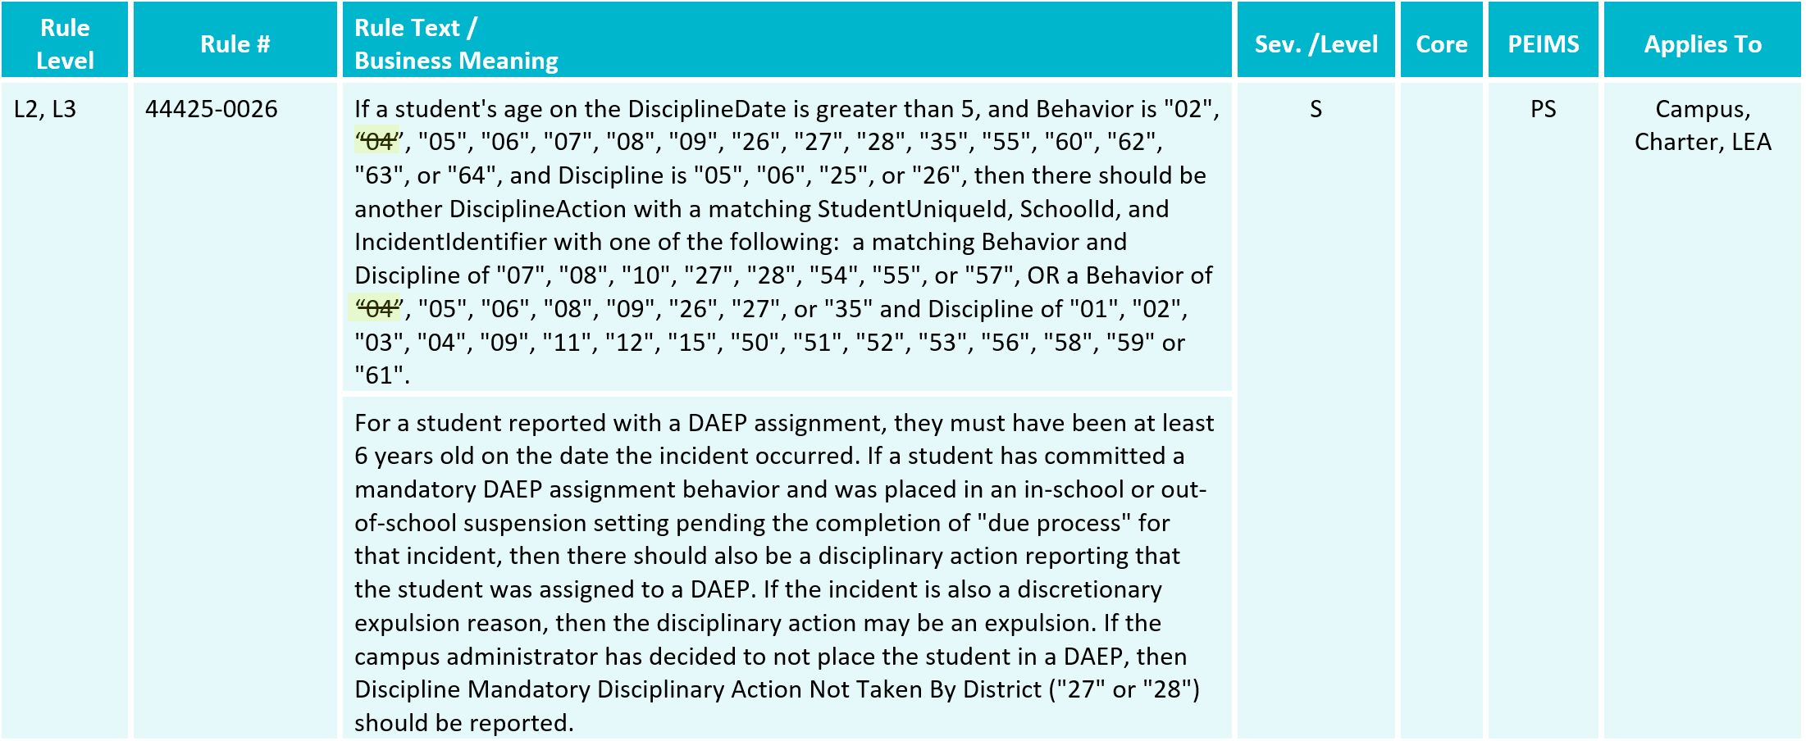
TSDS UPGRADE PROJECT UPDATES 829
SUMMER TRAINING 2024 Business Rule Changes:

Slide 96
TSDS UPGRADE PROJECT UPDATES 830
SUMMER TRAINING 2024 Business Rule Changes:

Slide 97
TSDS UPGRADE PROJECT UPDATES 831
SUMMER TRAINING 2024 Business Rule Changes:

Slide 98
TSDS UPGRADE PROJECT UPDATES 832
SUMMER TRAINING 2024 Business Rule Changes:
Deleted Rules

Slide 99
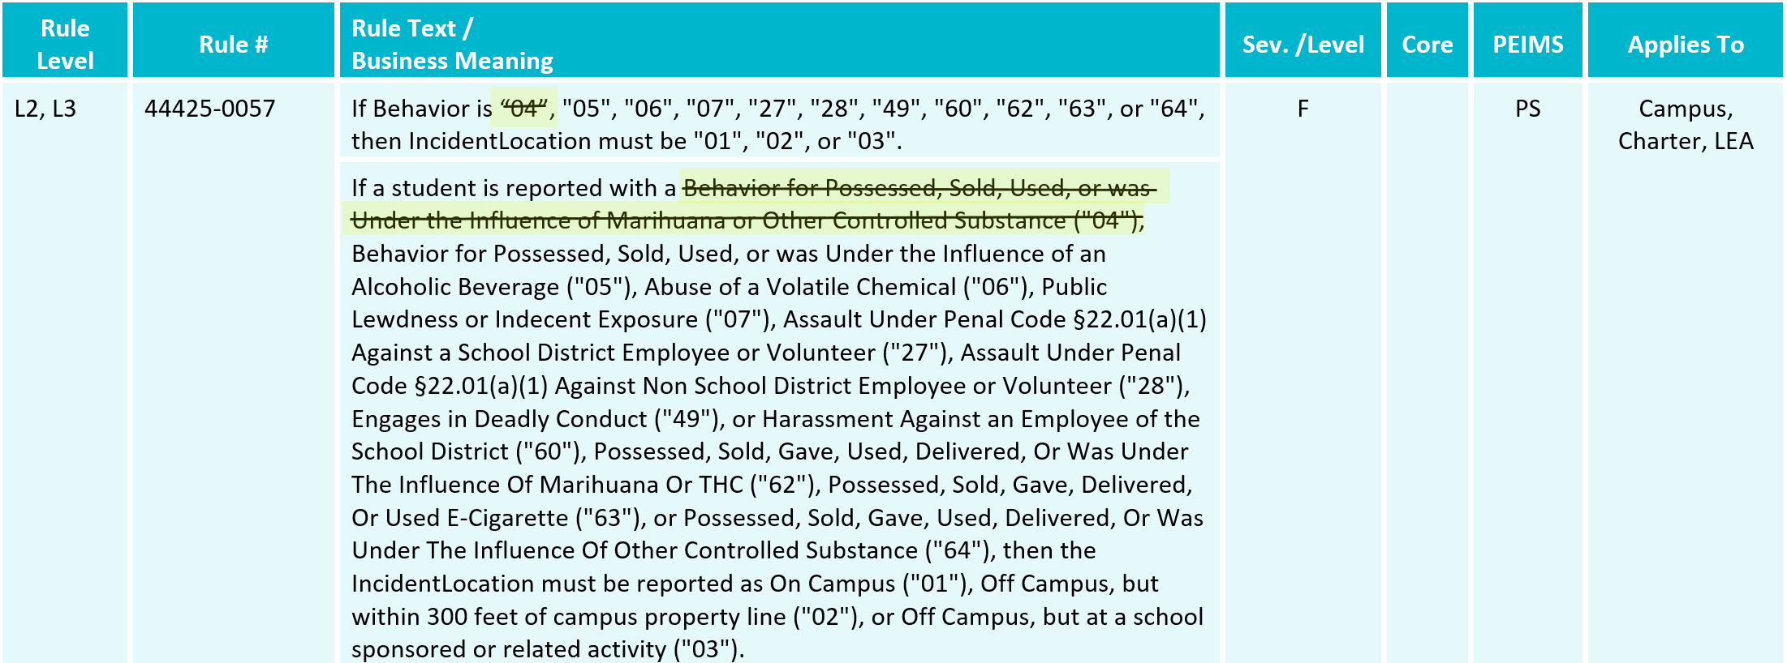
TSDS UPGRADE PROJECT UPDATES 833
SUMMER TRAINING 2024 Business Rule Changes:

Slide 100
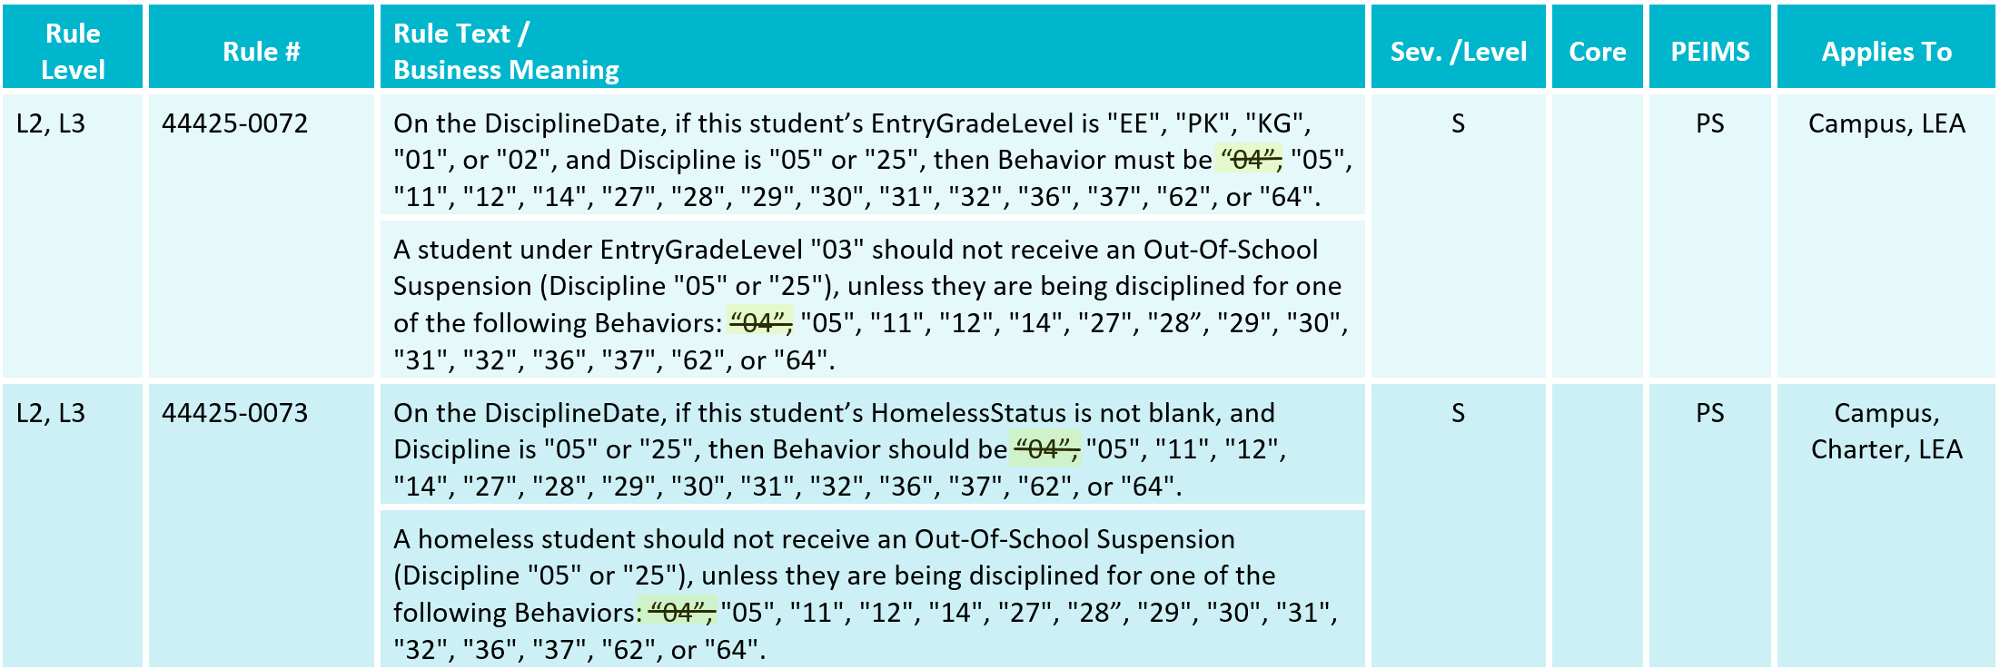
TSDS UPGRADE PROJECT UPDATES 834
SUMMER TRAINING 2024 Business Rule Changes:

Slide 101
TSDS UPGRADE PROJECT UPDATES 835
SUMMER TRAINING 2024 Business Rule Changes:
Deleted Rules

Slide 102
TSDS UPGRADE PROJECT UPDATES 836
SUMMER TRAINING 2024 Business Rule Changes:
New Rules

Slide 103
TSDS UPGRADE PROJECT UPDATES 837
SUMMER TRAINING 2024 Business Rule Changes:
New Rule

Slide 104
TSDS UPGRADE PROJECT UPDATES 838
SUMMER TRAINING 2024 Business Rule Changes:

Slide 105
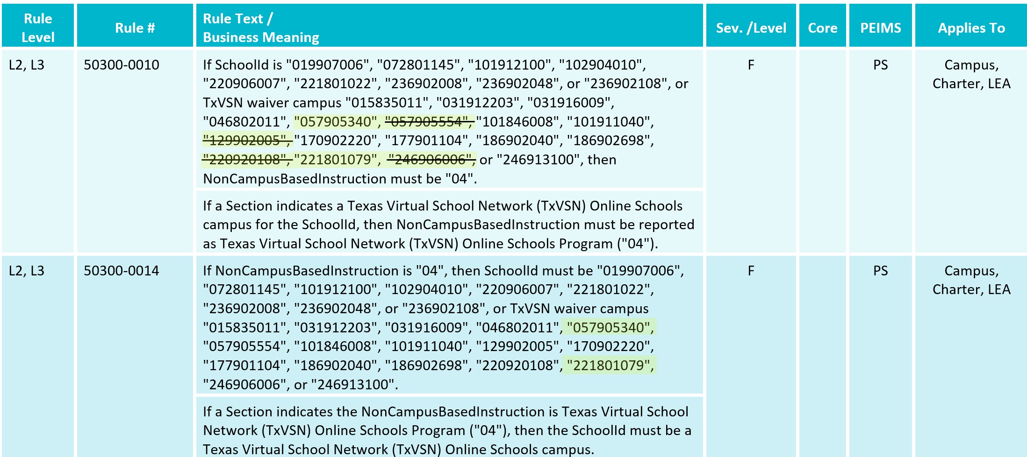
TSDS UPGRADE PROJECT UPDATES 839
SUMMER TRAINING 2024 Business Rule Changes:

Slide 106
TSDS UPGRADE PROJECT UPDATES 840
SUMMER TRAINING 2024 Business Rule Changes:
New Rule

Slide 107
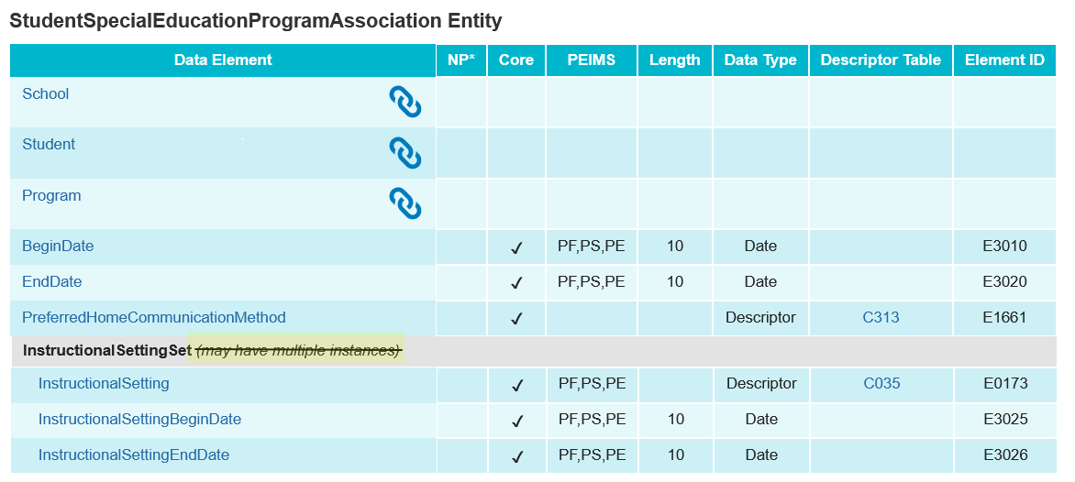
TSDS UPGRADE PROJECT UPDATES 841
SUMMER TRAINING 2024 Entity/Common Type Change:
StudentSpecialEducationProgramAssociation.InstructionalSettingSet
Removed may have multiple instances

Slide 108
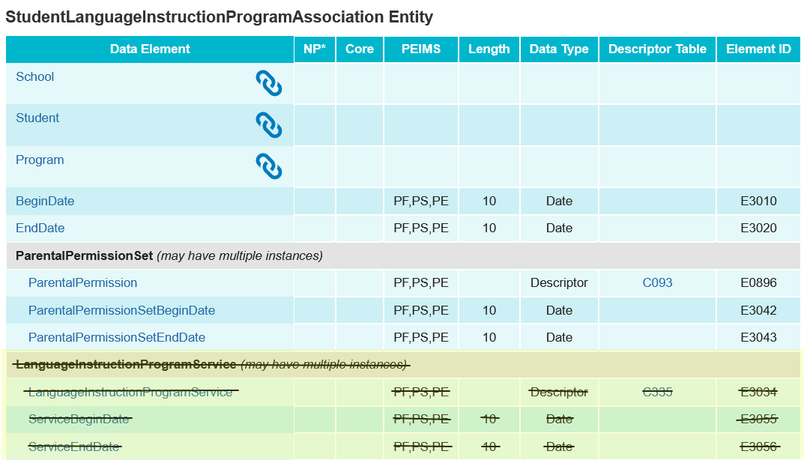
TSDS UPGRADE PROJECT UPDATES 42
SUMMER TRAINING 2024 Entity/Common Type Change:
Removed LanguageInstructionProgramService common type

Slide 109
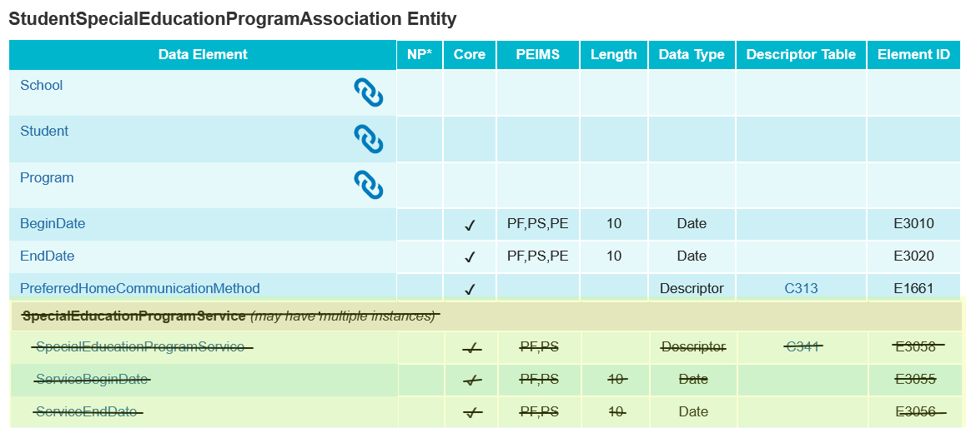
TSDS UPGRADE PROJECT UPDATES 43
SUMMER TRAINING 2024 Entity/Common Type change:
Removed SpecialEducationProgramService common type

Slide 110
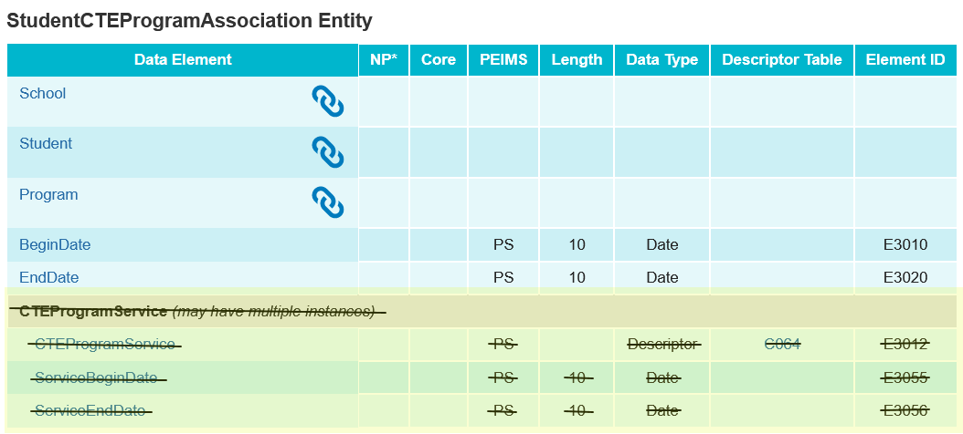
TSDS UPGRADE PROJECT UPDATES 44
SUMMER TRAINING 2024 Entity/Common Type Change:
Removed CTEProgramService common type

Slide 111
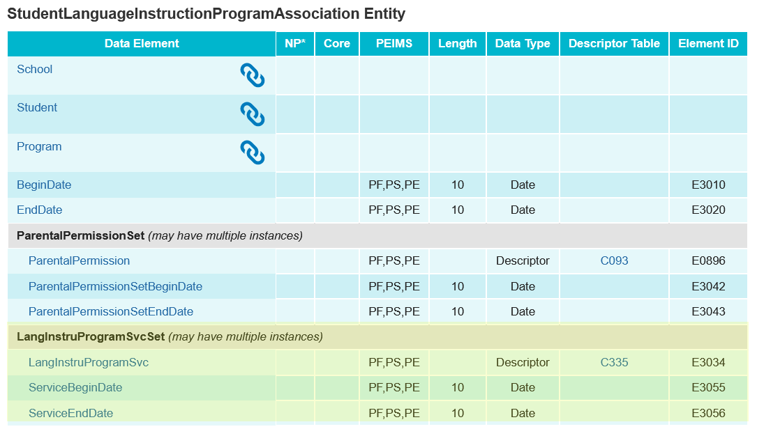
TSDS UPGRADE PROJECT UPDATES 45
SUMMER TRAINING 2024 Entity/Common Type Change:
Added LangInstruProgramSvcSet common type.

Slide 112
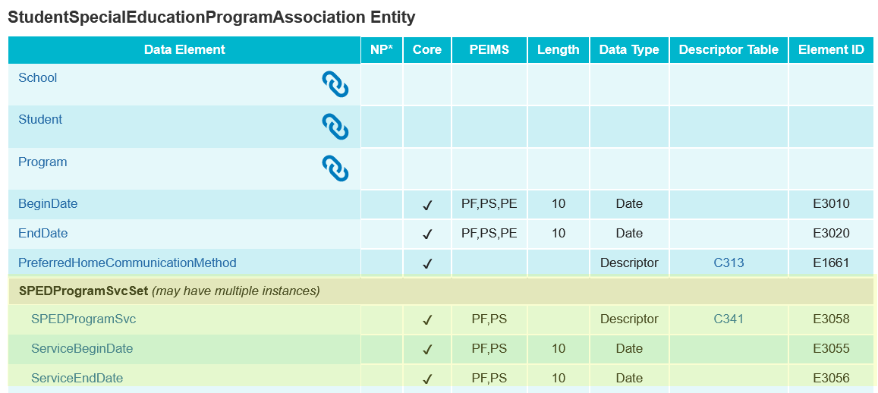
TSDS UPGRADE PROJECT UPDATES 46
SUMMER TRAINING 2024 Entity/Common Type Change:
Added SPEDProgramSvcSet common type.

Slide 113
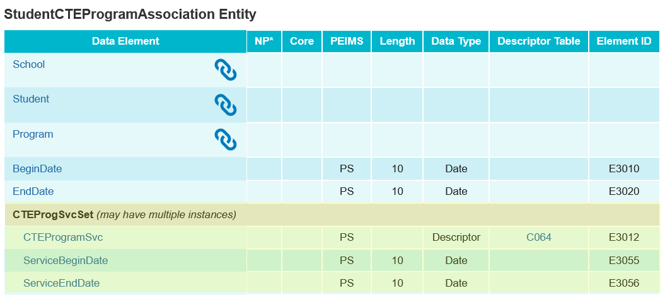
TSDS UPGRADE PROJECT UPDATES 48
SUMMER TRAINING 2024 Entity/Common Type Change:
Added CTEProgSvcSet common type.

Slide 114
TSDS UPGRADE PROJECT UPDATES 850
SUMMER TRAINING 2024 Entity/Common Type Change:
CourseTranscript
Deleted Section as a reference.

Slide 115
TSDS UPGRADE PROJECT UPDATES 851
SUMMER TRAINING 2024 Entity/Common Type Change:
ReportingPeriodExt
Reference CalendarDate
Removed may have multiple instances.

Slide 116
TIMELINE
PEIMS Summer Submission (Submission 3) | Date
TSDS PEIMS ready to load data to IODS | August 5, 2024
TSDS PEIMS ready for users to complete, approve, and accept submissions | May 19, 2025
Requests to retire Unique IDs due at TEA for PEIMS Summer First Submission | June 13, 2025
PEIMS Summer First Submission due date for LEAs | June 20, 2025
Requests to retire Unique IDs due at TEA for PEIMS Summer Resubmission | July 11, 2025
PEIMS Summer Resubmission due date for LEAs | July 17, 2025
LEAs registered with TEA with year-round tracks ending later than June 20, 2025, may delay PEIMS Summer Resubmission until two weeks following completion of the latest year-round track or August 21, 2025, whichever comes first.
However, the initial data delivery for Submission 3 must still be made by June 20, 2025, for all LEAs.
In no case will any Resubmission be processed after August 21, 2025. Data corrections made after August 21, 2025, will be processed by State Funding.
PEIMS Summer data available to customers | September 18, 2025

Slide 117
PEIMS Extended Year Resource Slides #117 to #156

Slide 118
DATA ELEMENT UPDATES
ReportingPeriodExt (TX) entity
CalendarDate (reference) data element
may have multiple instances – SUMMER TRAINING 2024 removed in TEDS publication 2025.2.0

Slide 119
BUSINESS RULE UPDATES 44
Updated Data Validation Rules 10020-0051, 10020-0052:

Slide 120
BUSINESS RULE UPDATES 2
Updated Data Validation Rule 42401-0005:

Slide 121
BUSINESS RULE UPDATES 75
Updated Data Validation Rule 43415-0056:

Slide 122
BUSINESS RULE UPDATES 7
Added New Data Validation Rule 42500-0051:

Slide 123
TSDS UPGRADE PROJECT UPDATES 55 7
Data Element ID | XML Data Element Name | Upgrade Data Element Name
E0975 | INSTRUCTIONAL-TRACK-INDICATOR-CODE | CalendarCode
E1585 | SCHOOL-DAY-EVENT-CODE | CalendarEvent
E1600 | INSTRUCTIONAL-PROGRAM-TYPE | CalendarType
E0949 | PASS/FAIL-CREDIT-INDICATOR-CODE | CourseAttemptResult
E3071 | SERVICE-ID | CourseCode
E1168 | CALENDAR-DATE | Date
E0173 | INSTRUCTIONAL-SETTING-CODE | InstructionalSetting
E1056 | CLASS-ID-NUMBER | SectionIdentifier
E3063 | Various | StudentCharacteristic
E3010 | N/A | BeginDate
E3020 | N/A | EndDate

Slide 124
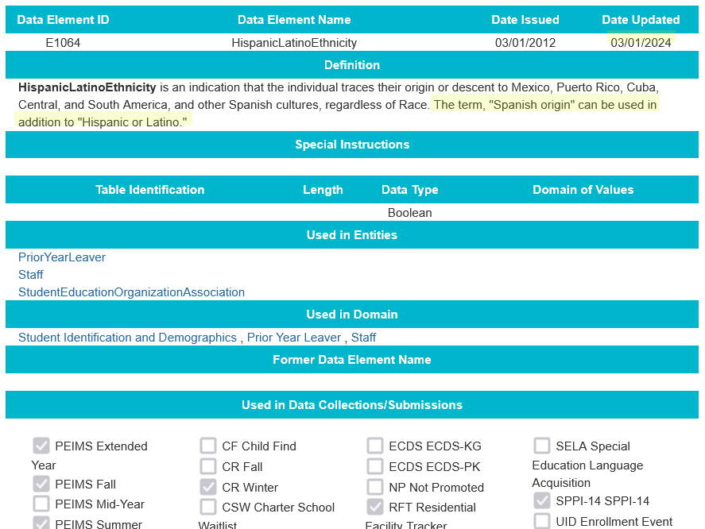
TSDS UPGRADE PROJECT UPDATES 9 1
SUMMER TRAINING 2024 Data Element Change:
E1064 HispanicLatinoEthnicity
Revised the definition

Slide 125
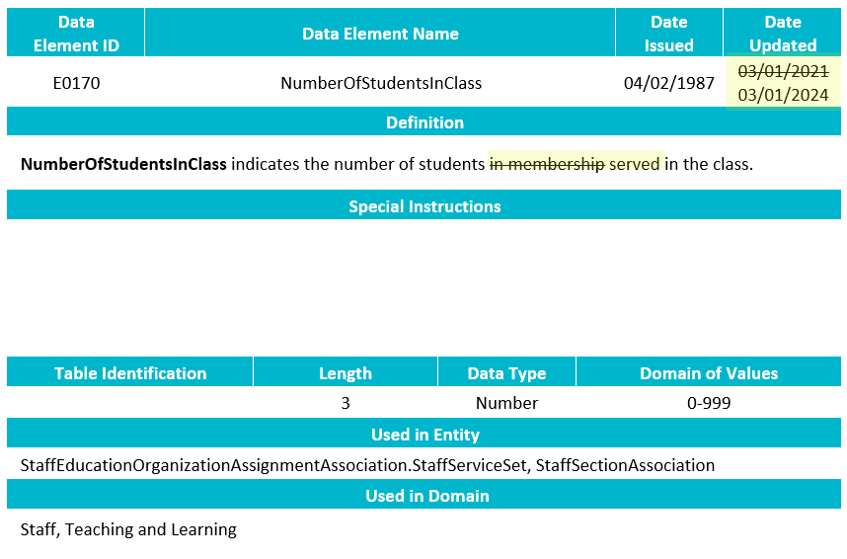
TSDS UPGRADE PROJECT UPDATES 11
SUMMER TRAINING 2024 Data Element Change:
E0170 NumberOfStudentsInClass
Revised the definition

Slide 126
TSDS UPGRADE PROJECT UPDATES 10 12
SUMMER TRAINING 2024 Data Element Change:
E0948 CourseSequence
Revised the definition

Slide 127
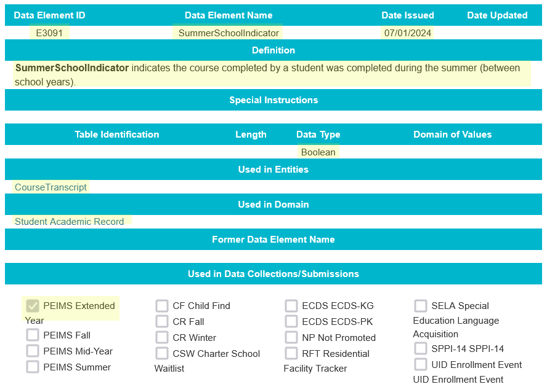
TSDS UPGRADE PROJECT UPDATES 13
SUMMER TRAINING 2024 Data Element Change:
E3091 SummerSchoolIndicator
New Data Element

Slide 128
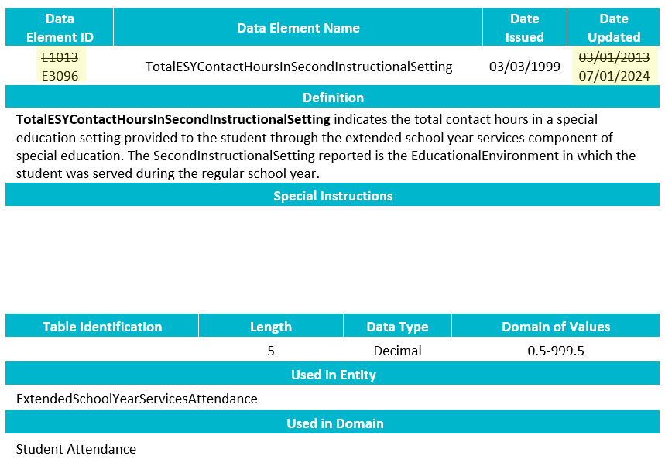
TSDS UPGRADE PROJECT UPDATES 14
SUMMER TRAINING 2024 Data Element Change:
E3096 TotalESYContactHoursInSecondInstructionalSetting
Revised the data element ID

Slide 129
TSDS UPGRADE PROJECT UPDATES 15
Data Element Length Changes:
CalendarCode
Length changing from 2 to 60 characters
SectionIdentifier
Length changing from 14 to 255 characters

Slide 130
TSDS UPGRADE PROJECT UPDATES 112
Descriptor Table Changes:
‘0’ values being removed from descriptor tables
ChildCountFunding
Disability
EmergentBilingualIndicator
FosterCareType
HomelessStatus
MilitaryConnectedStudent
PKProgramType
TitleIPartAParticipant
UnschooledAsyleeRefugee
StudentAttribution
PPCDServiceLocation
CTEProgramService

Slide 131
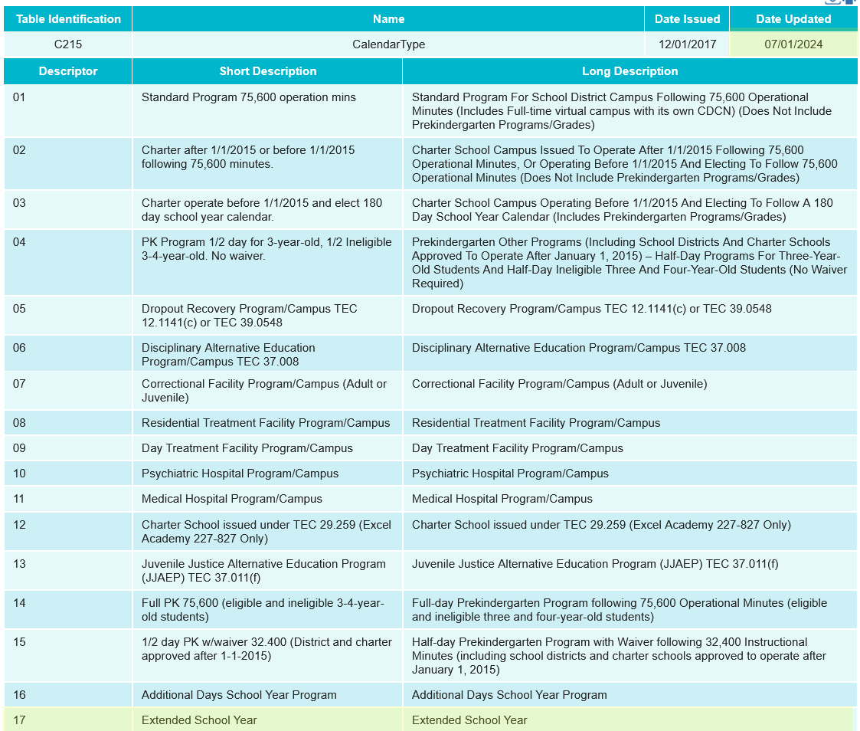
TSDS UPGRADE PROJECT UPDATES 16
SUMMER TRAINING 2024 Descriptor Table Changes:
C215 CalendarType

Slide 132
TSDS UPGRADE PROJECT UPDATES 2
Report Updates:
All applicable reports will be updated for the following changes below:
Descriptor values of ‘0’ removed.
CalendarCode
Length changing from 2 to 60 characters
SectionIdentifier
Length changing from 14 to 255 characters
TEA is actively working to update impacted reports by the start of the 2024-2025 school year.

Slide 133
TSDS UPGRADE PROJECT UPDATES 5
Business Rule Changes:
Added new rule 10050-000G for 2024-2025 to clarify required fields.
The eDM file manager XSD validation is now a PDM validation rule to verify all required fields are promoted to PDM.
Rule 10050-000G was added in a previous TEDS publication. The rule has been deleted in TEDS 2025.2.0 publication.

Slide 134
TSDS UPGRADE PROJECT UPDATES 136
Business Rule Changes:
StaffSectionAssociation was not a complex type from XML that was promoted but this Entity is promoted.

Slide 135
TSDS UPGRADE PROJECT UPDATES 14 7
Business Rule Changes:
Where to find which courses are eligible for HS credit = “Y”?
References document from TEDS upgrade page
https://www.texasstudentdatasystem.org/tsds/texas-education-data-standards-references

Slide 136
TSDS UPGRADE PROJECT UPDATES 158
Business Rule Changes:
CourseCompletionIndicator must be ‘TRUE’ (Boolean)
Boolean true or false versus a code of 1 or 0.

Slide 137
TSDS UPGRADE PROJECT UPDATES 1687
SUMMER TRAINING 2024 Business Rule Changes:
This rule was reinstated.

Slide 138
TSDS UPGRADE PROJECT UPDATES 8178
SUMMER TRAINING 2024 Business Rule Changes:
New Rules

Slide 139
TSDS UPGRADE PROJECT UPDATES 8189
SUMMER TRAINING 2024 Business Rule Changes:
Revised Rules

Slide 140
TSDS UPGRADE PROJECT UPDATES 81910
SUMMER TRAINING 2024 Business Rule Changes:
Revised Rules

Slide 141
TSDS UPGRADE PROJECT UPDATES 811
SUMMER TRAINING 2024 Business Rule Changes:
Revised Rules

Slide 142
TSDS UPGRADE PROJECT UPDATES 812
SUMMER TRAINING 2024 Business Rule Changes:
Revised Rules

Slide 143
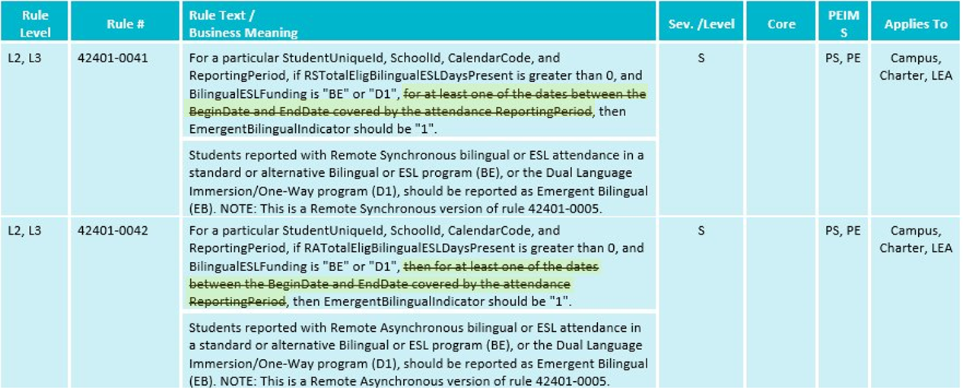
TSDS UPGRADE PROJECT UPDATES 82013
SUMMER TRAINING 2024 Business Rule Changes:
Revised Rules

Slide 144
TSDS UPGRADE PROJECT UPDATES 82214
SUMMER TRAINING 2024 Business Rule Changes:
Revised Rules

Slide 145
TSDS UPGRADE PROJECT UPDATES 815
SUMMER TRAINING 2024 Business Rule Changes:
Revised Rules

Slide 146
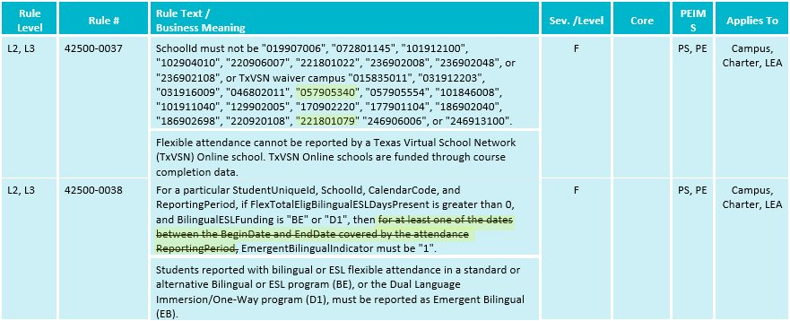
TSDS UPGRADE PROJECT UPDATES 82116
SUMMER TRAINING 2024 Business Rule Changes:
Revised Rules

Slide 147
TSDS UPGRADE PROJECT UPDATES 81237
SUMMER TRAINING 2024 Business Rule Changes:
Deleted Rules

Slide 148
TSDS UPGRADE PROJECT UPDATES 81228
SUMMER TRAINING 2024 Business Rule Changes:
Deleted Rules

Slide 149
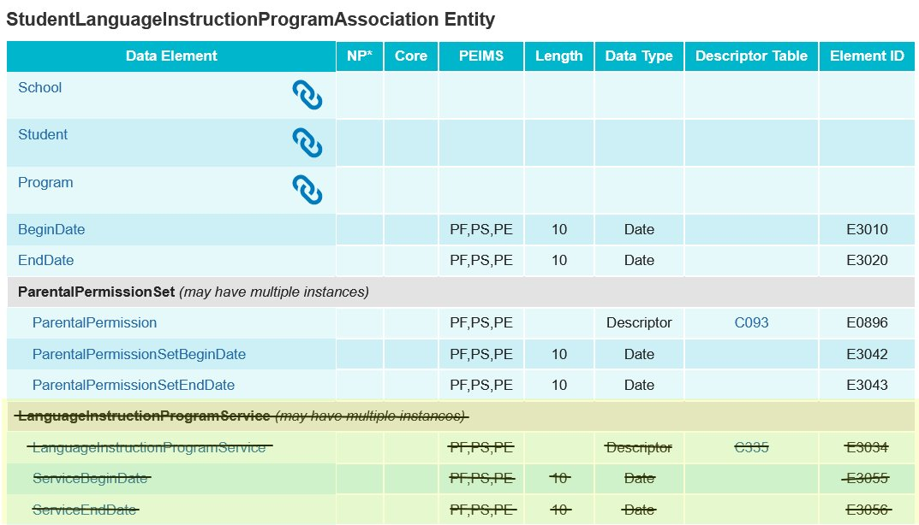
TSDS UPGRADE PROJECT UPDATES 11249
SUMMER TRAINING 2024 Entity/Common Type Change:
Removed LanguageInstructionProgramService common type

Slide 150
TSDS UPGRADE PROJECT UPDATES 12250
SUMMER TRAINING 2024 Entity/Common Type Change:
Add LangInstruProgramSvcSet common type

Slide 151
TSDS UPGRADE PROJECT UPDATES 121
SUMMER TRAINING 2024 Entity/Common Type Change:
ExtendedSchoolYearServicesAttendance Entity
Removed may have multiple instances

Slide 152
TSDS UPGRADE PROJECT UPDATES 122
SUMMER TRAINING 2024 Entity/Common Type Change:
Staff Entity
Removed AdditionalDaysProgramTeacher

Slide 153
TSDS UPGRADE PROJECT UPDATES 123
SUMMER TRAINING 2024 Entity/Common Type Change:
StaffSectionAssociation Entity
Added AdditionalDaysProgramTeacher
Added NumberOfStudentsInClass for PEIMS Extended Year

Slide 154
TSDS UPGRADE PROJECT UPDATES 124
SUMMER TRAINING 2024 Entity/Common Type Change:
CourseTranscript Entity
Added SummerSchoolIndicator

Slide 155
TIMELINE 1
PEIMS Extended Year Submission (Submission 4) | Date
TSDS PEIMS ready to load data to IODS | August 5, 2024
TSDS PEIMS ready for users to complete, approve, and accept submissions | July 28, 2025
Requests to retire Unique IDs due at TEA for PEIMS Extended Year First Submission | August 22, 2025
PEIMS Extended Year First Submission due date for LEAs | August 28, 2025
Requests to retire Unique IDs due at TEA for PEIMS Extended Year Resubmission | September 12, 2025
PEIMS Extended Year Resubmission due date for LEAs | September 18, 2025
PEIMS Extended Year data available to customers | October 16, 2025

Slide 156
TECHNICAL RESOURCES
Technical Support
TSDSCustomerSupport@tea.texas.gov
Technical Specification
2024-2025 TSDS Web-Enabled Data Standards (TWEDS)
Known Issues
TSDS Incident Management System (TIMS)
TSDS Incident Management System (TIMS) Support Application
TIMS Knowledge Base Article Repository
Additional Resources
Student Attendance Accounting Handbook (SAAH)

