Slide 1

TITLE SLIDE: ESC Vendor Training for One Component
<NAME OF COMPONENT> (ALL CAPS)
MARCH 19-21, 2024
CHANGES TO REPORTING LEAVERS AND GRADUATES
April 2-3, 2025

Slide 2

Agenda – Changes to Reporting Leavers and Graduates
Overview
Timeline
Data Collection Changes
  PEIMS Summer Submission
  PEIMS Extended Year Submission
Scenarios
Business Validations
Reports
Deliverables
Communication Plan
Questions

Slide 3

TITLE SLIDE: Overview
OVERVIEW
NAME OF COMPONENT (ALL CAPS)
MARCH 19-21, 2024

Slide 4
Background
The U.S. Department of Education (ED) expects state data submissions to be timely, complete, and accurate on the due date. The Texas Education Agency (TEA) has never been in compliance with meeting federal reporting deadlines for certain EDFacts and Perkins files. TEA is unable to come into compliance because the data are not available for use until after the federal deadlines have passed.
For the second year in a row, ED has placed a condition on TEA’s Title I and Perkins funds, required corrective action on the Perkins grant, excluded Texas data from publicly available graduation rate reports, and excluded Texas from nationwide, public directory of districts and campuses.

Slide 5
Discussions
TEA had discussions regarding the current issues TEA is facing with federal reporting deadlines and the consequence of late reporting with internal TEA leadership, program area stakeholders, data governance committees (Information Task Force, Policy Committee on Public Education Information, and TEA Data Governance Board), and formed a focus group consisting of district, charter, and ESC PEIMS Coordinators.
TEA has determined that the 2026-2027 school year is the first TEA could submit data on time due to the implementation of the Ed-Fi upgrade in 2024-2025.
The Research and Analysis Division met with the ED to provide a proposal to be on time with federal reporting by January 2027.

Slide 6
Resulting Changes
The Leavers and Graduates from the 2024-2025 school year will be reported in the 2025-2026 PEIMS Fall Submission.
The Leavers and Graduates from the 2025-2026 school year will be reported in the 2025-2026 PEIMS Summer and Extended Year Submissions.
The Leavers and Graduates from the 2026-2027 school year will be reported in the PEIMS Summer and Extended Year Submissions.

Slide 7
TITLE SLIDE: Timeline
TIMELINE
NAME OF COMPONENT (ALL CAPS)
MARCH 19-21, 2024

Slide 8
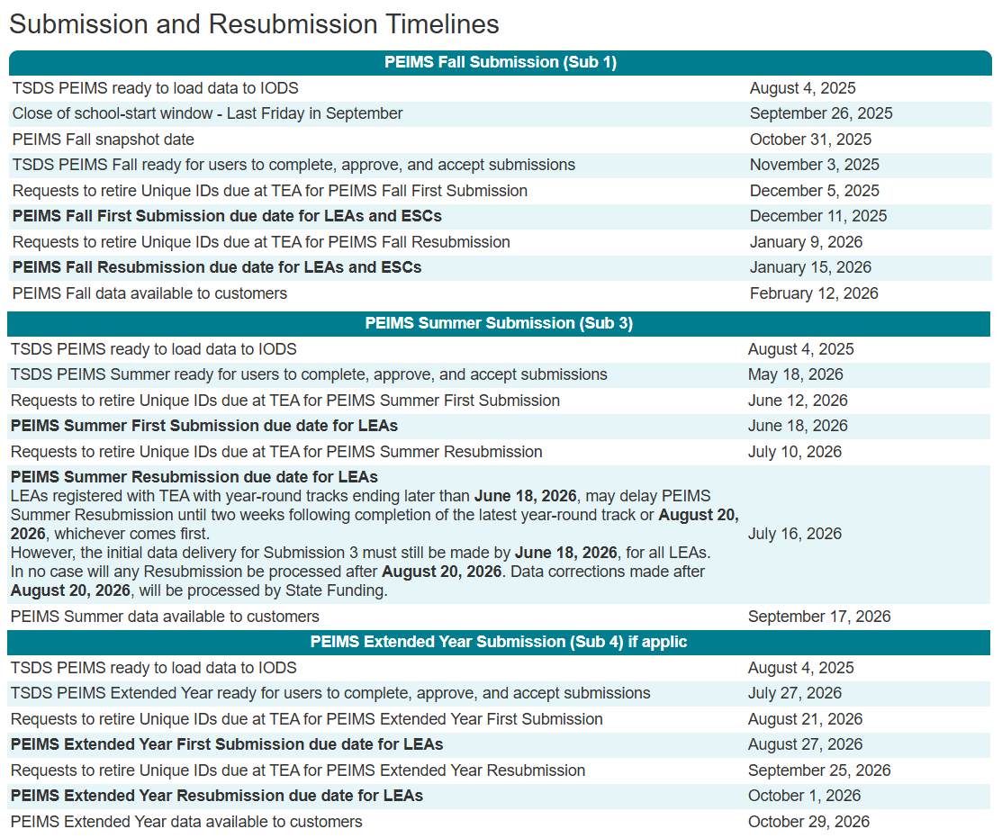
Timeline
2025-2026 School Year (Transition Year)
2024-2025 school year Leavers and Graduates reported in the 2025-2026 PEIMS Fall Submission.
2025-2026 school year Leavers and Graduates reported in the 2025-2026 PEIMS Summer and Extended Year Submissions.

Slide 9
TITLE SLIDE: Data Collection Changes
DATA COLLECTION CHANGES
NAME OF COMPONENT (ALL CAPS)
MARCH 19-21, 2024

Slide 10

TITLE SLIDE: PEIMS Summer
PEIMS SUMMER
NAME OF COMPONENT (ALL CAPS)
MARCH 19-21, 2024

Slide 11
PEIMS Summer Submission
2025-2026 School Year Leavers and Graduates
  PEIMS Summer First Submission and Resubmission students in grades 7 through 12:
    Who were enrolled at some time during the year but not on the final day of the school year (AsOfStatusLastDayEnrollment (C323) “I”).
    Who were enrolled on the final day of the school year (AsOfStatusLastDayEnrollment (C323) “H”), and the LEA now has documentation that the student has since entered a new educational setting. (Atypical situation).
    Who graduated between the first and last day of school.

Slide 12
Important Summer Information
Between the PEIMS Summer First Submission and Resubmission, TEA will reconcile any school-year movers and provide a preliminary list of underreported students.
Once the LEA meets the documentation standard that supports the exit withdraw type used, the LEA can but is not required to obtain additional leaver information for the student.

Slide 13
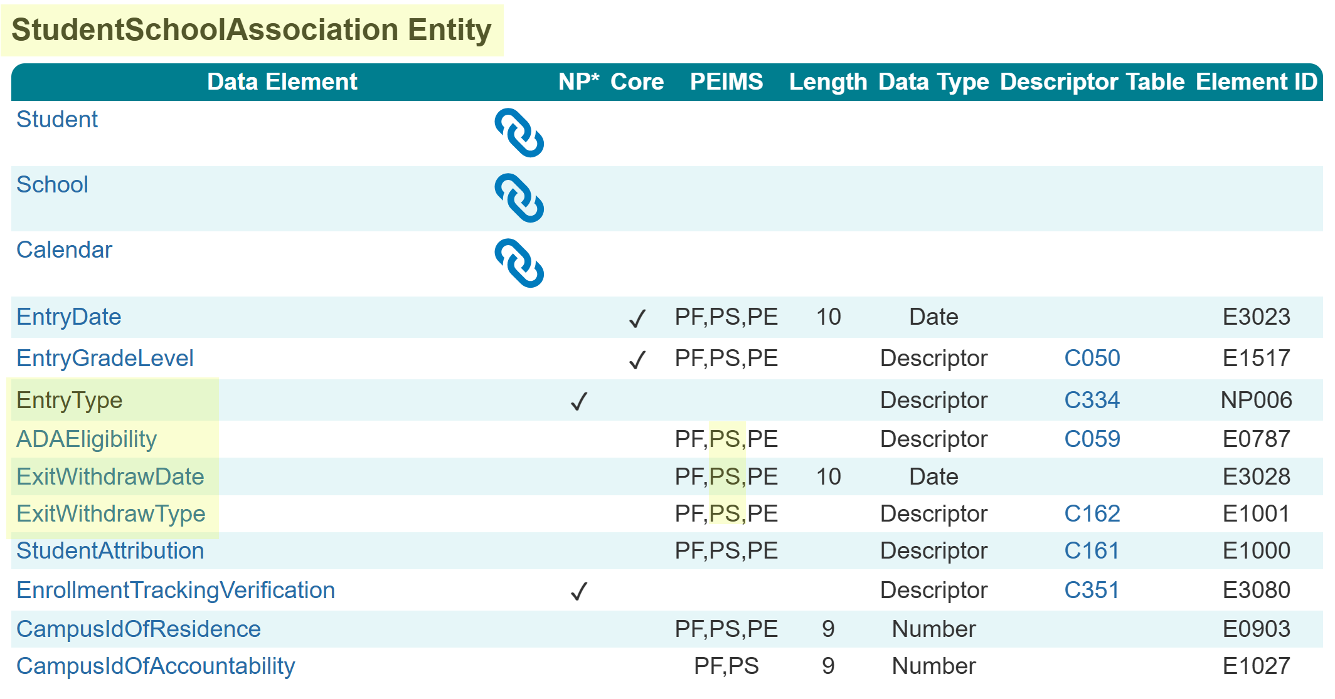
StudentSchoolAssociation Entity Summer
The following is added to the PEIMS Summer Submission:
  Data Elements:
    EntryType (NP006)
    ADAEligibility (E0787)
    ExitWithdrawDate (E3028)
    ExitWithdrawType (E1001)

Slide 14
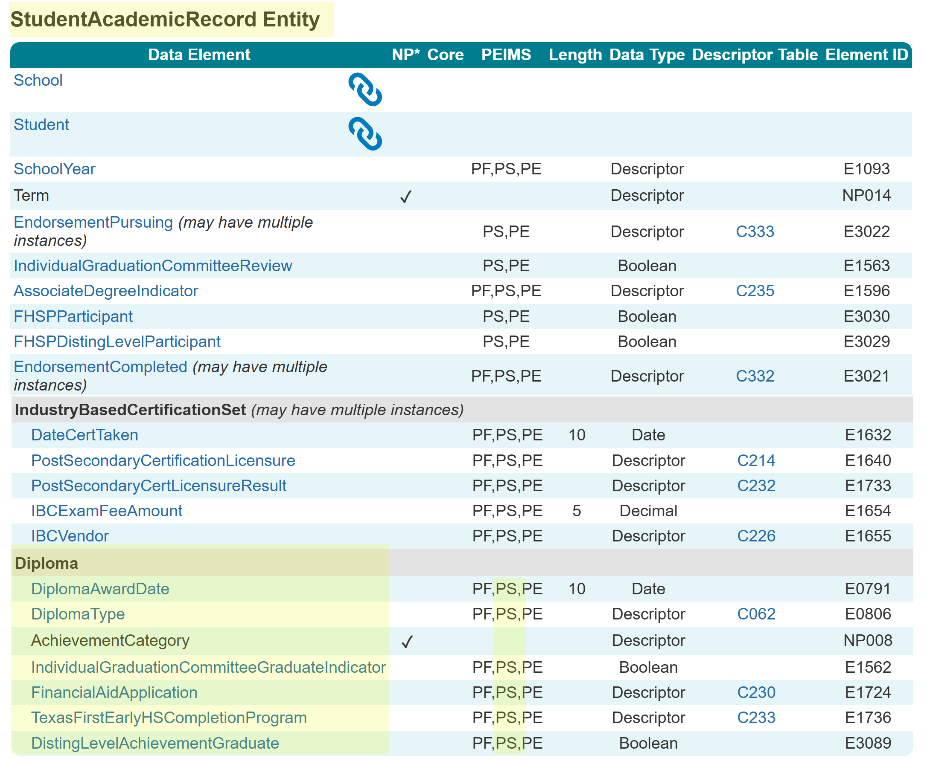
StudentAcademicRecord Entity Summer
The following is added to the PEIMS Summer Submission:
  Common Type:
    Diploma
  Data Elements:
    DiplomaAwardDate (E0791)
    DiplomaType (E0806)
    AchievementCategory (NP008)
    IndividualGraduationCommitteeGraduateIndicator (E1562)
    FinancialAidApplication (E1724)
    TexasFirstEarlyHSCompletionProgram (E1736)
    DistingLevelAchievementGraduate (E3089)

Slide 15
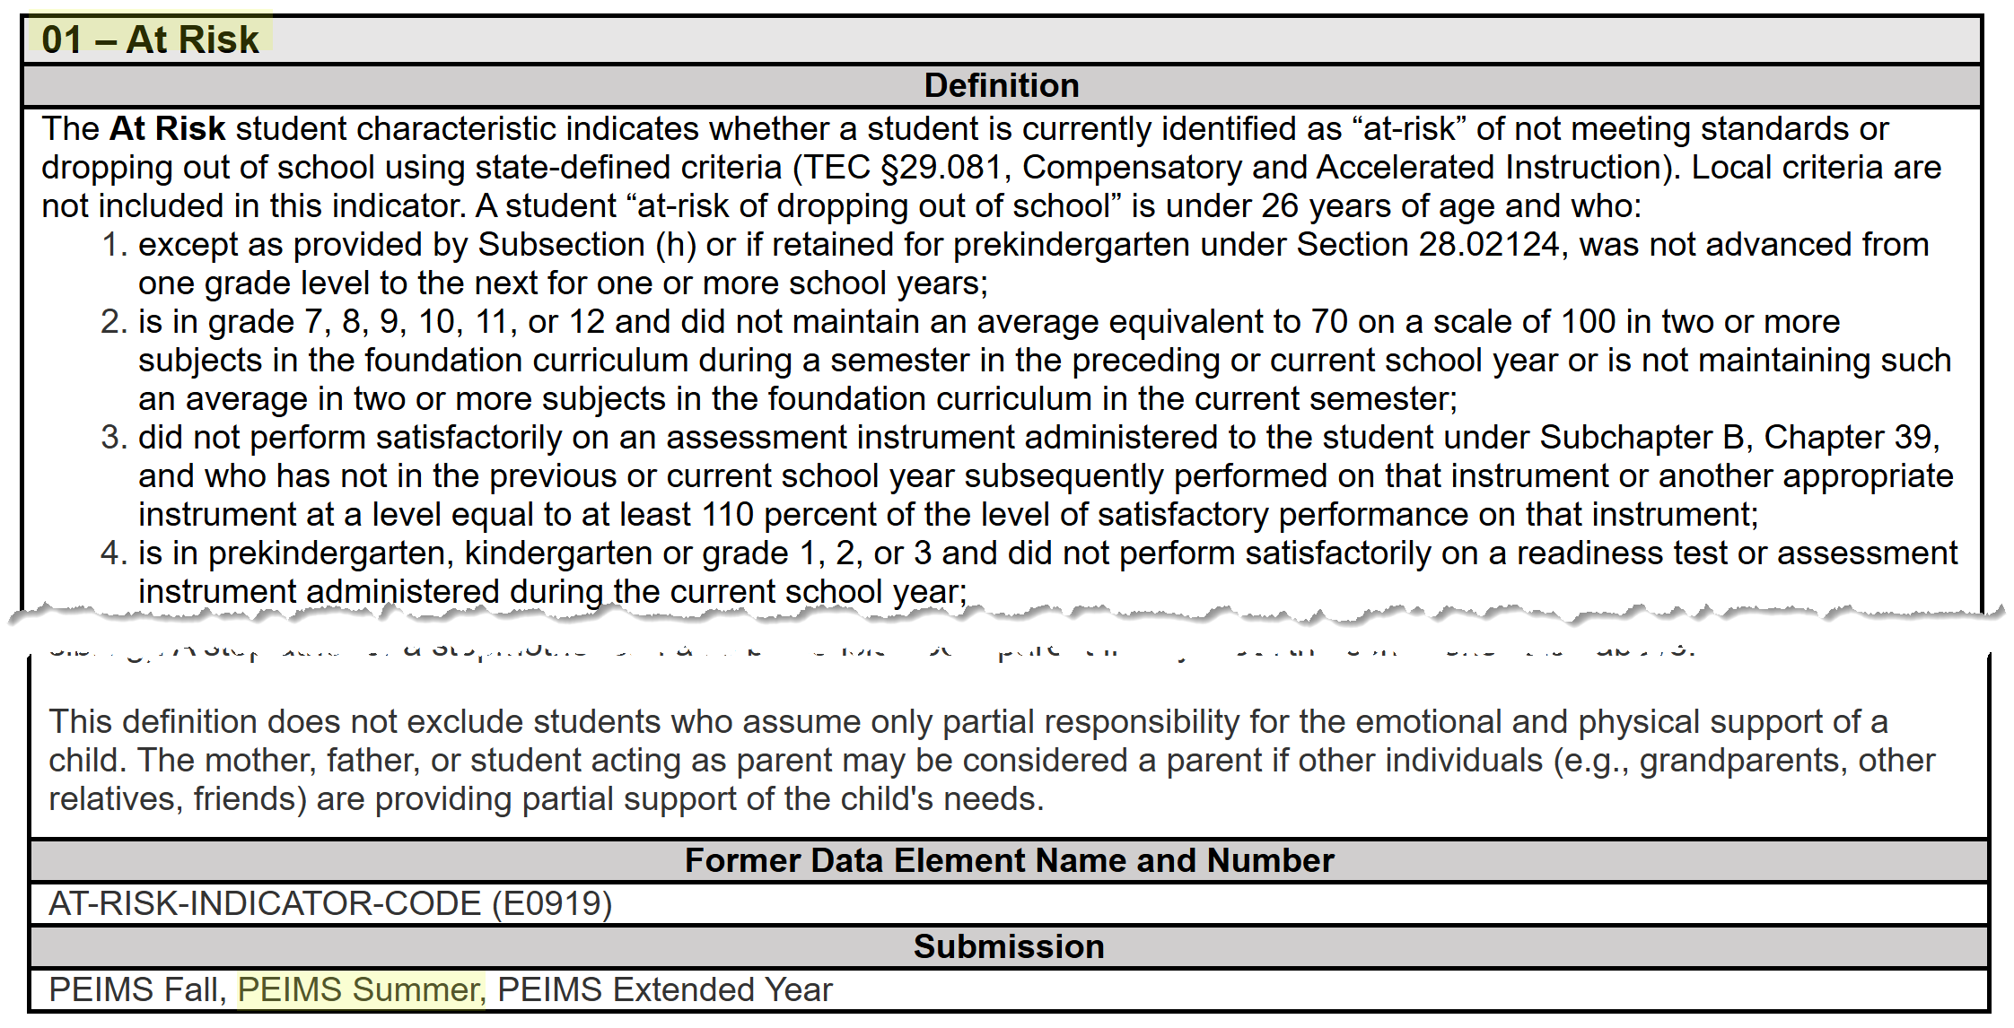
StudentCharacteristic – At Risk Summer
The StudentCharacteristic (C344) “01” At Risk will be added to the PEIMS Summer Submission:

Slide 16
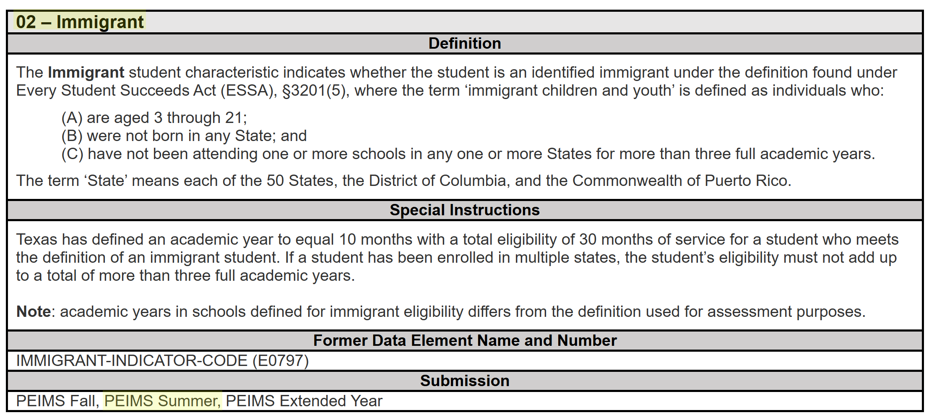
StudentCharacteristic – Immigrant Summer
The StudentCharacteristic (C344) “02” Immigrant will be added to the PEIMS Summer Submission:

Slide 17
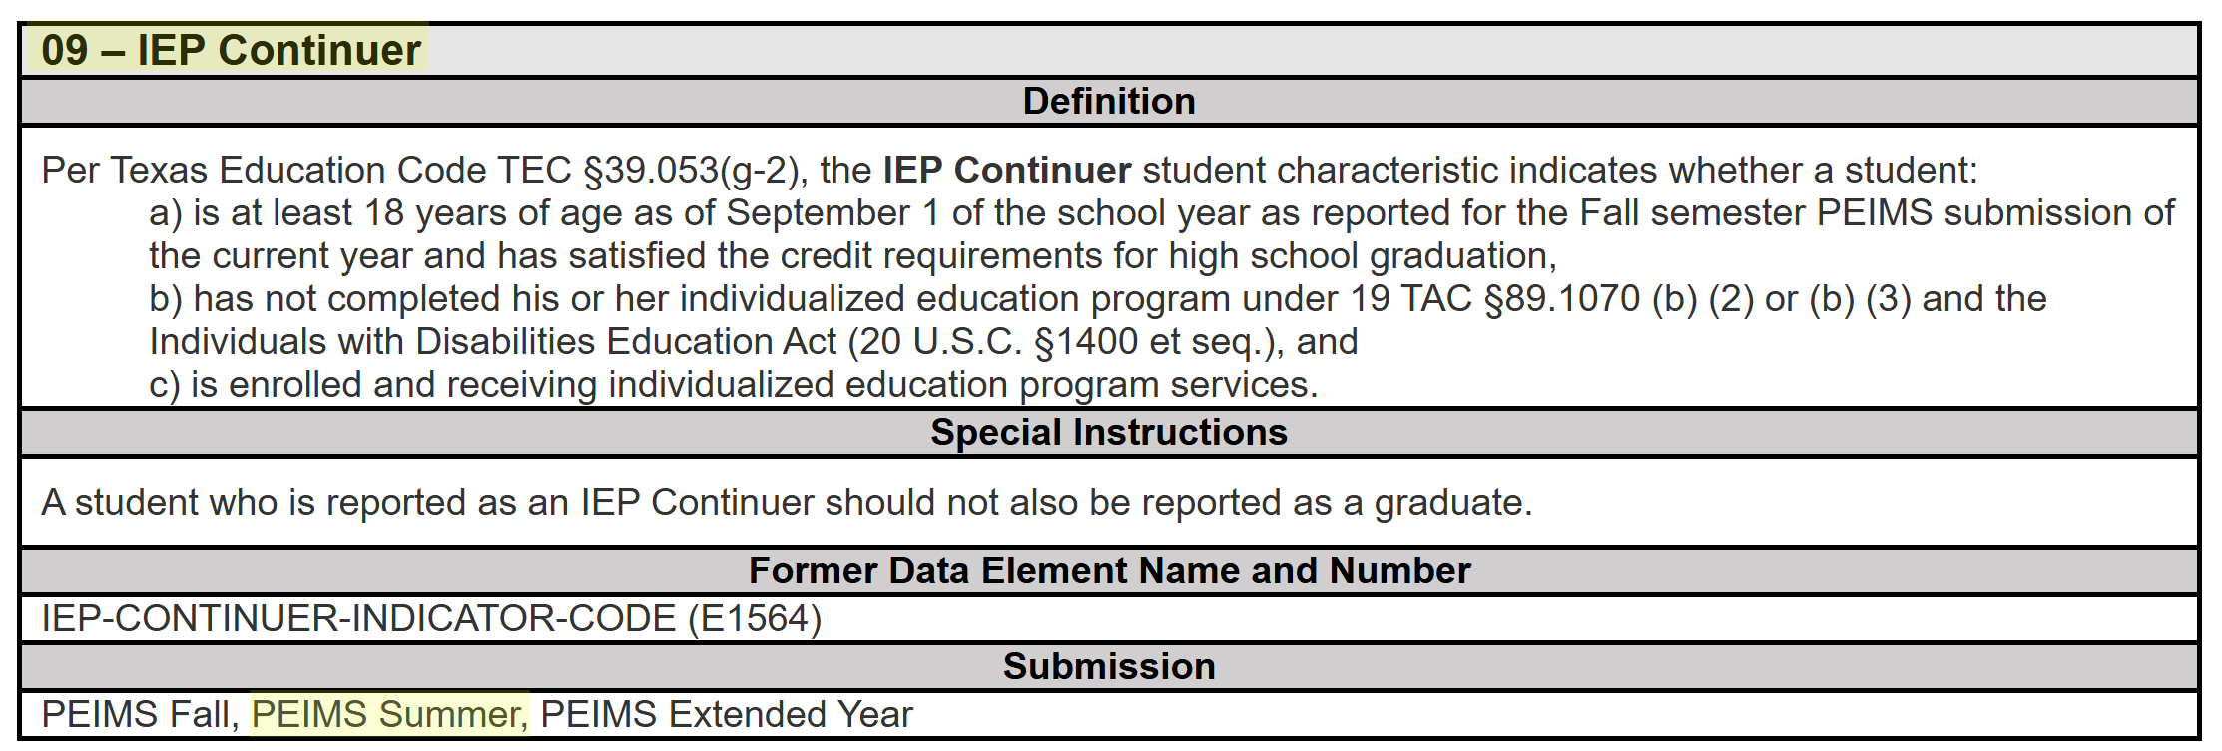
StudentCharacteristic – IEP Continuer Sum
The StudentCharacteristic (C344) “09” IEP Continuer will be added to the PEIMS Summer Submission:

Slide 18
TITLE SLIDE: PEIMS Extended Year
PEIMS EXTENDED YEAR
NAME OF COMPONENT (ALL CAPS)
MARCH 19-21, 2024

Slide 19
PEIMS Extended Year Submission
2025-2026 School Year Leavers and Graduates
  PEIMS Extended Year First Submission and Resubmission students in grades 7 through 12:
    Who were enrolled on the final day of the school year (AsOfStatusLastDayEnrollment (C323) “H”) and did not return during the school-start window.
    Who graduated during the summer months (Until August 31).
    For which additional leaver documentation was received, resulting in more accurate leaver information. When additional information is received, local policy will determine if a student's existing ExitWithdrawType (C162) is updated.

Slide 20
Important Extended Year Information
Between the PEIMS Extended Year First Submission and Resubmission, TEA will reconcile any movers and provide a preliminary list of underreported students.
If leaver or graduate information is reported in both the PEIMS Summer and Extended Year Submissions for a student, TEA will use the information provided in the PEIMS Extended Year Submission for state and federal reporting purposes.

Slide 21
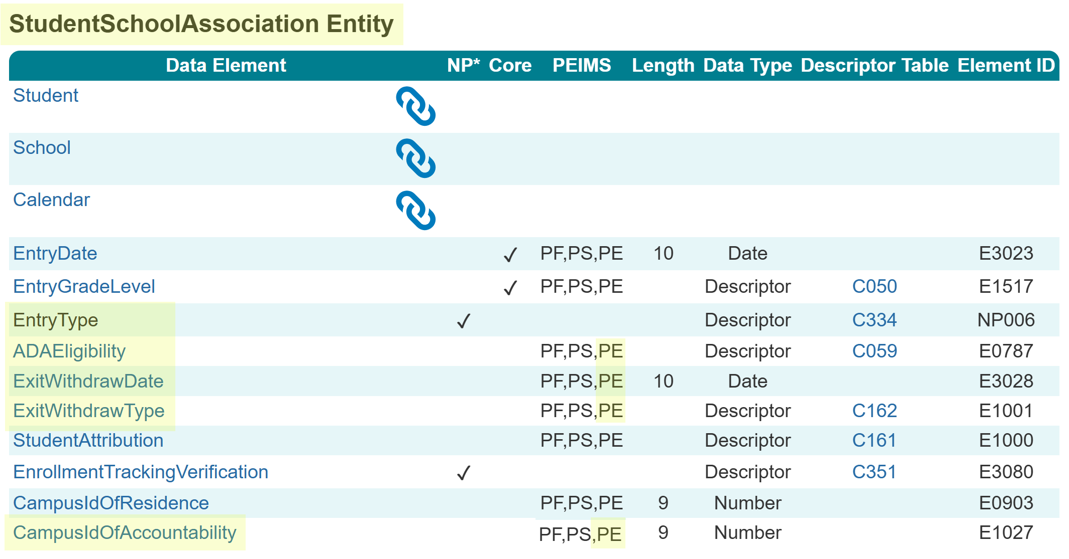
StudentSchoolAssociation Entity Extended
The following is added to the PEIMS Extended Year Submission:
  Data Elements:
    EntryType (NP006)
    ADAEligibility (E0787)
    ExitWithdrawDate (E3028)
    ExitWithdrawType (E1001)
    CampusIdOfAccountability (E1027)

Slide 22
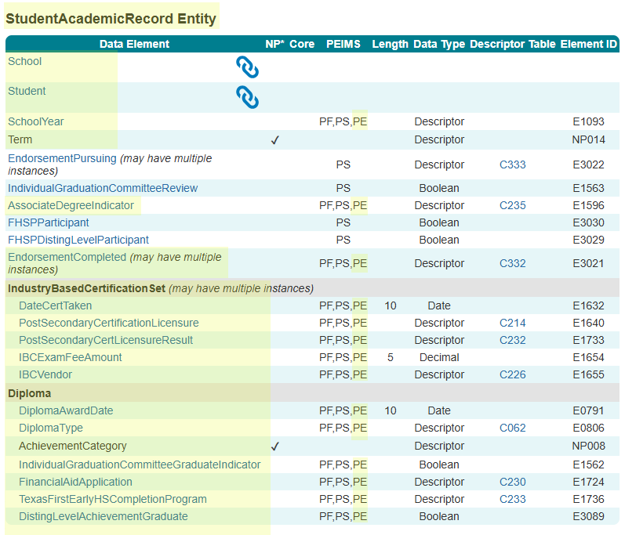
StudentAcademicRecord Entity Extended
The following is added to the PEIMS Extended Year Submission:
  Common Types:
    IndustryBasedCertificationSet
    Diploma
  Data Elements:
    AssociateDegreeIndicator (E1596)
    EndorsementCompleted (E3021)
    DateCertTaken (E1632)
    PostSecondaryCertificationLicensure (E1640)
    PostSecondaryCertLicensureResult (E1733)
    IBCExamFeeAmount (E1654)
    IBCVendor (E1655)

Slide 23
StudentAcademicRecord Entity Continued
  Data Elements Continued:
    DiplomaAwardDate (E0791)
    DiplomaType (E0806)
    AchievementCategory (NP008)
    IndividualGraduationCommitteeGraduateIndicator (E1562)
    FinancialAidApplication (E1724)
    TexasFirstEarlyHSCompletionProgram (E1736)
    DistingLevelAchievementGraduate (E3089)

Slide 24
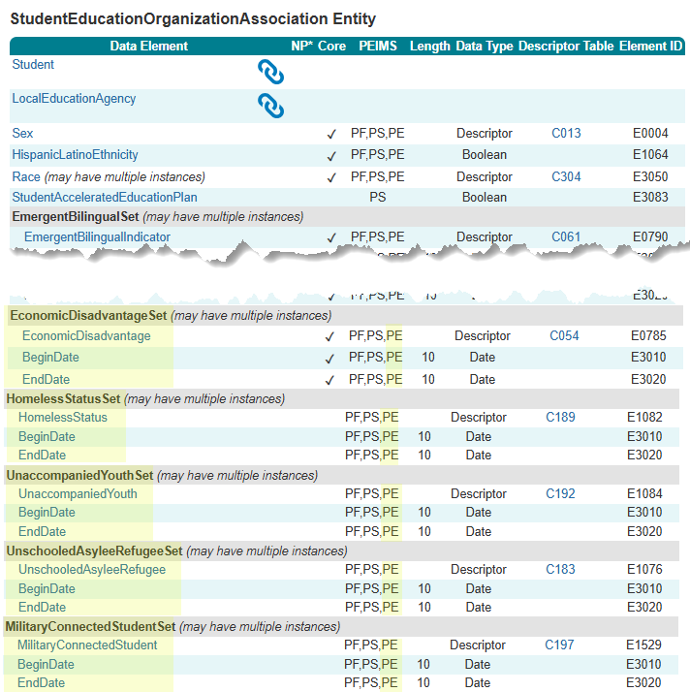
StudentEducationOrganizationAssociation Entity
The following is added to the PEIMS Extended Year Submission:
  Common Types:
    EconomicDisadvantageSet
    HomelessStatusSet
    UnaccompaniedYouthSet
    UnschooledAsyleeRefugeeSet
    MilitaryConnectedStudentSet
  Data Elements:
    EconomicDisadvantage (E0785)
    HomelessStatus (E1082)
    UnaccompaniedYouth (E1084)
    UnschooledAsyleeRefugee (E1076)
    MilitaryConnectedStudent (E1529)

Slide 25
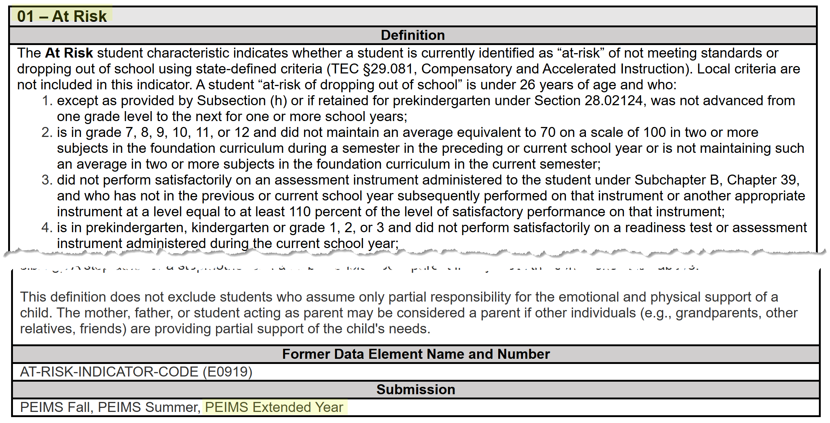
StudentCharacteristic – At Risk Extended
The StudentCharacteristic (C344) “01” At Risk will be added to the PEIMS Extended Year Submission:

Slide 26
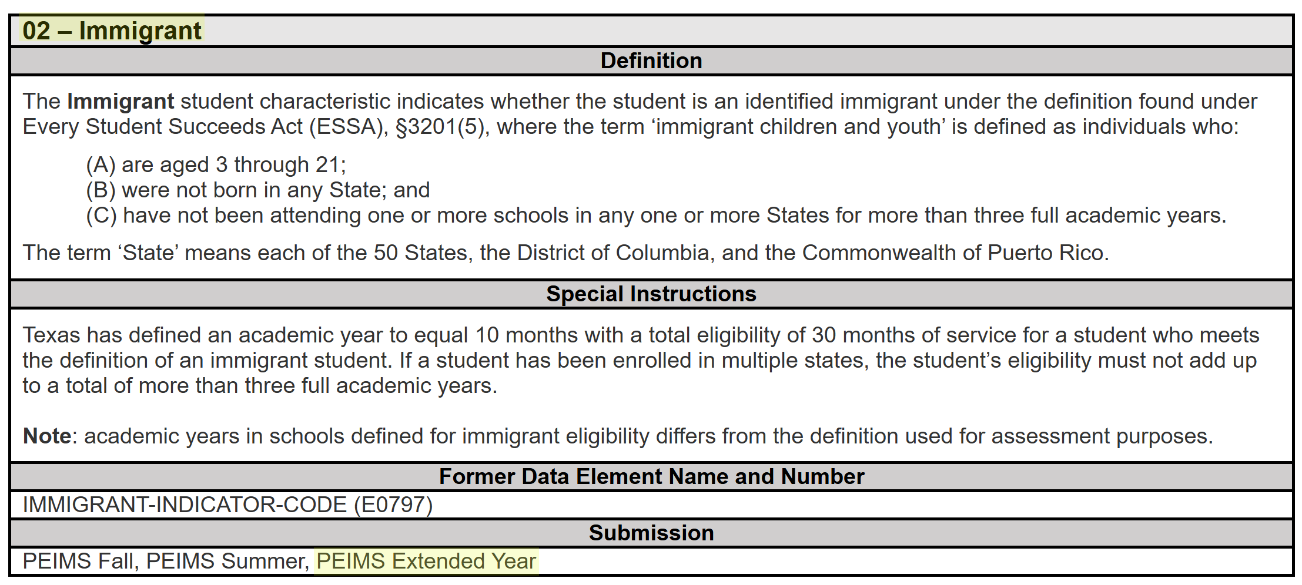
StudentCharacteristic – Immigrant Extended
The StudentCharacteristic (C344) “02” Immigrant will be added to the PEIMS Extended Year Submission:

Slide 27
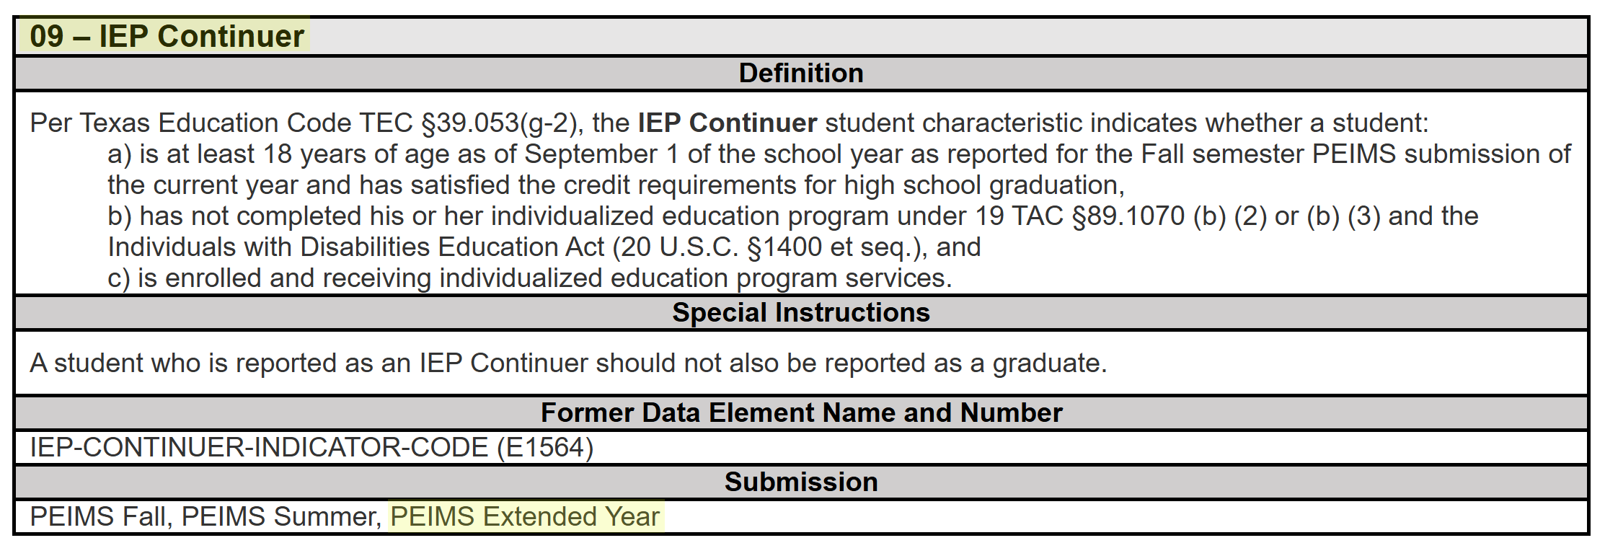
StudentCharacteristic – IEP Continuer Ext
The StudentCharacteristic (C344) “09” IEP Continuer will be added to the PEIMS Extended Year Submission:

Slide 28
TITLE SLIDE: Scenarios
SCENARIOS
NAME OF COMPONENT (ALL CAPS)
MARCH 19-21, 2024

Slide 29
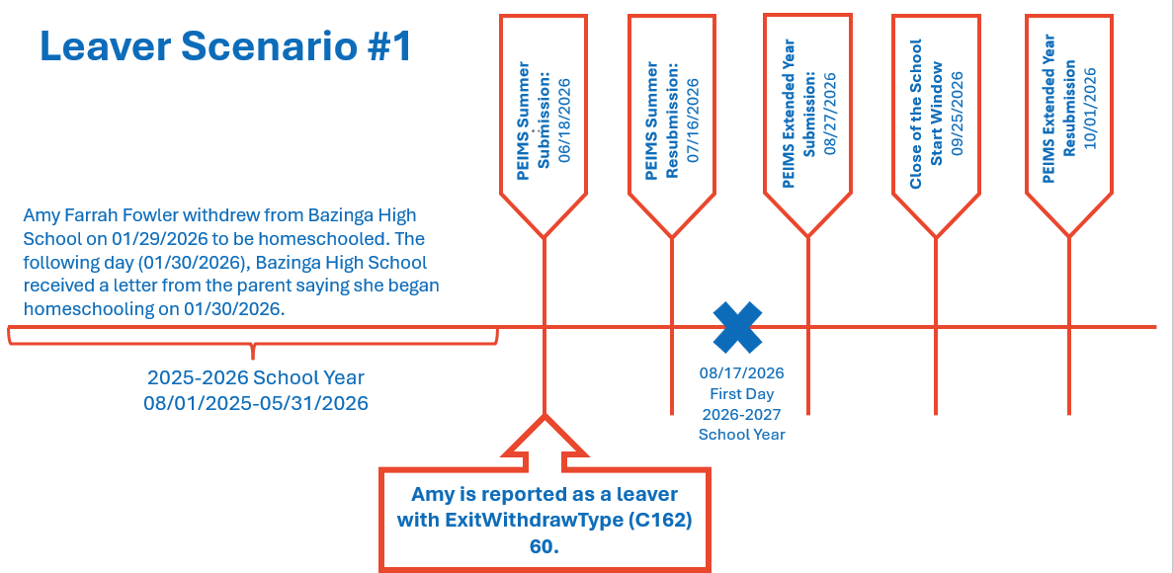
Leaver Scenario #1

Slide 30
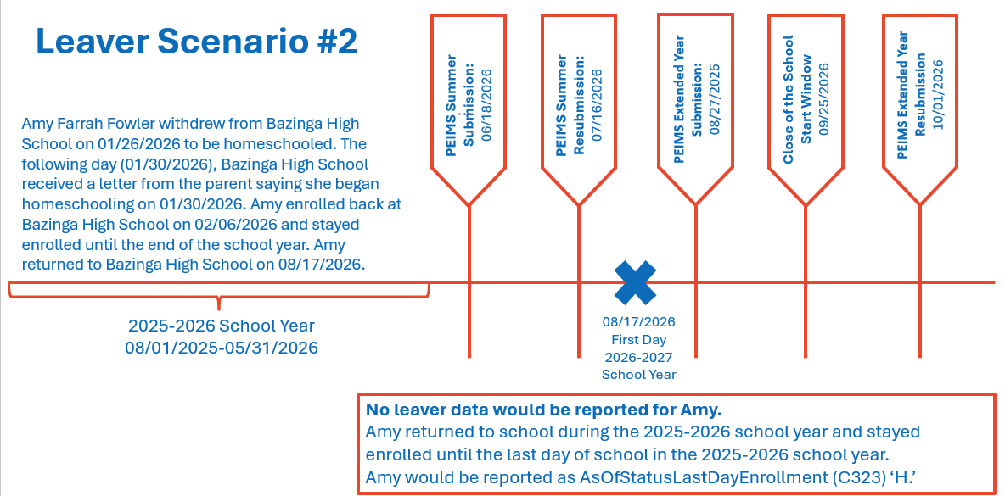
Leaver Scenario #2

Slide 31
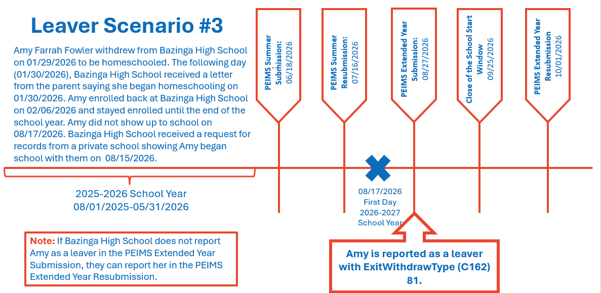
Leaver Scenario #3

Slide 32
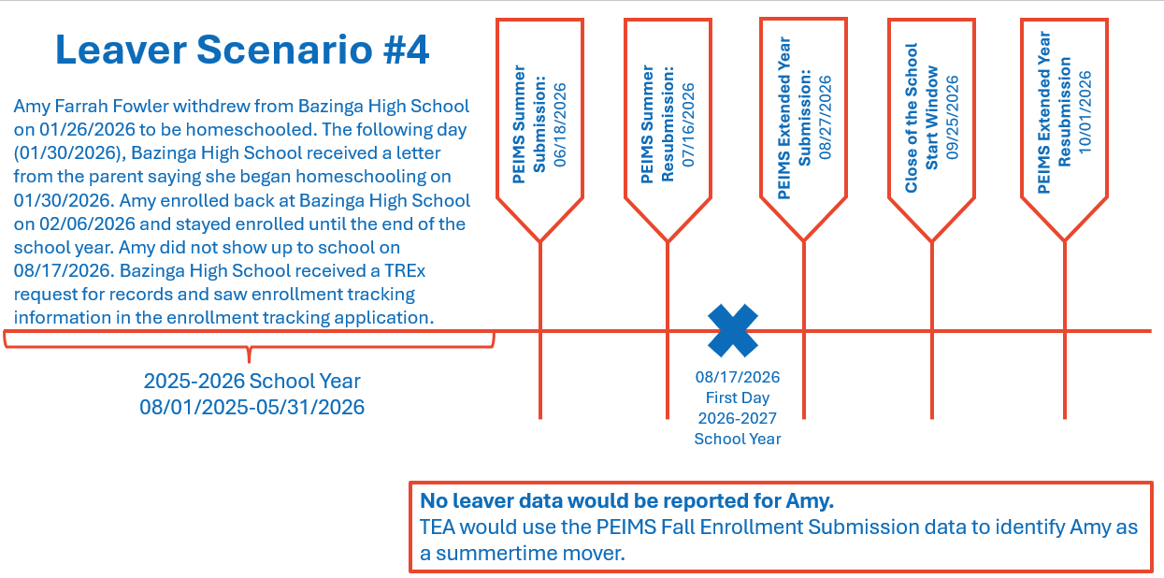
Leaver Scenario #4

Slide 33
TITLE SLIDE: Business Validations
BUSINESS VALIDATIONS
NAME OF COMPONENT (ALL CAPS)
MARCH 19-21, 2024

Slide 34
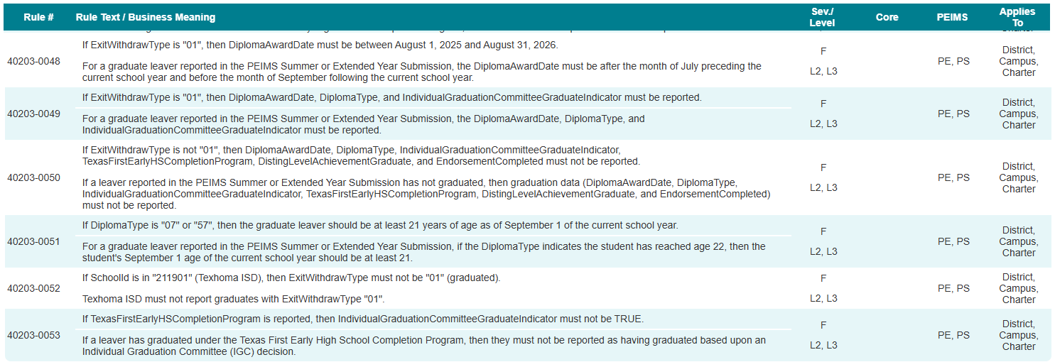
School Leaver Category
New rules added to the PEIMS Summer and Extended Year Submissions:

Slide 35
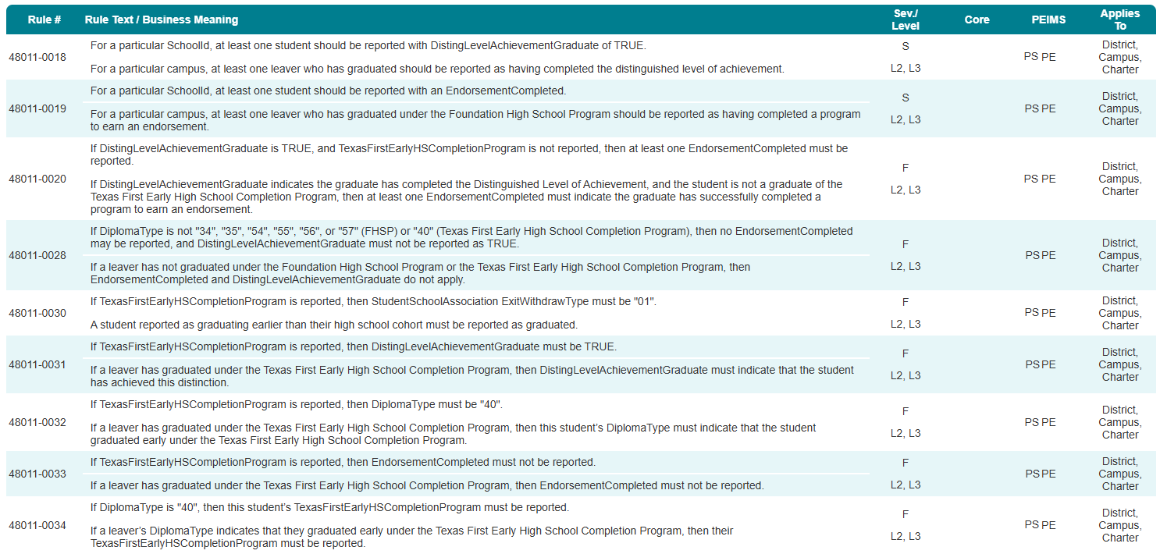
Student Graduation Program Category
PEIMS Fall Submission rules added to the PEIMS Summer and Extended Year Submissions:

Slide 36
Rule Summary
Rules added to the PEIMS Summer and Extended Year Submissions:
40203-0048 (New)
40203-0049 (New)
40203-0050 (New)
40203-0051 (New)
40203-0052 (New)
40203-0053 (New)
48011-0018 (PEIMS Fall)
48011-0019 (PEIMS Fall)
48011-0020 (PEIMS Fall)
48011-0026 (PEIMS Fall)
48011-0030 (PEIMS Fall)
48011-0031 (PEIMS Fall)
48011-0032 (PEIMS Fall)
48011-0033 (PEIMS Fall)
48011-0034 (PEIMS Fall)

Slide 37
TITLE SLIDE: Reports
REPORTS
NAME OF COMPONENT (ALL CAPS)
MARCH 19-21, 2024

Slide 38
Summer Submission Report Changes
The following PEIMS Summer Submission reports will need to be updated to include the new data collected:
PDM3-120-007 – Student Indicator Report by Grade
The Student Indicator Report by Grade lists students according to various demographics and program enrollment.
PDM3-230-001 – Data Element Summary Report
This report summarizes all data reported. This report provides an analysis of data submitted, including elements, descriptor tables, subcategories, and record counts.

Slide 39
Extended Year Submission Report Changes
The following PEIMS Extended Year Submission reports will need to be updated to include the new data collected:
PDM4-120-003 – Student Indicator Report by Grade
The Student Indicator Report by Grade lists students according to various demographics and program enrollment.
PDM4-230-001 – Data Element Summary Report
This report summarizes all data reported. The report provides an analysis of data submitted, including elements, descriptor tables, subcategories, and record counts.

Slide 40
Extended Year Submission New Reports
The following PEIMS Summer Submission reports will be added to the PEIMS Extended Year Submission:
PDM3-120-003 – Campus ID of Accountability Roster
This report lists students with a campus ID in the Campus ID of Accountability.
PDM3-120-009 – Student Foundation High School Program Roster by Grade
This report lists students who are in the Foundation High School Program (FHSP) and have a participating code of 1 (pursuing) or 2 (completed).
PDM3-120-019 – Industry-Based Certification Roster
The Industry-Based Certification Roster report displays a student's post-secondary industry certification and licensure information reported.

Slide 41
Fall Reports to Summer and Extended Year
The following PEIMS Fall Submission reports will be added to the PEIMS Summer and Extended Year Submissions:
PDM1-120-005 – Student Data Review
This report summarizes student counts by grade, ethnicity, graduates, dropouts, economically disadvantaged, emergent bilingual (EB), and special programs.
PDM1-120-007 – Underreported Students Presumed At Risk
The report lists students who are presumed at risk of dropping out based on verifiable criteria but have not been reported by the LEA as being at risk.
PDM1-120-018 – Student Foundation High School Program Graduate Roster
This report lists students who have graduated from the Foundation High School Program (FHSP) under the FHSP graduation plan.

Slide 42
Fall Reports to Summer and Extended Year Continued
PDM1-320-001 – Interim List to Assist LEAs in Leaver Record Submission
This report lists students who attended or were enrolled in grades 7-12 during the prior school year.
PDM1-320-002 – Preliminary Presumed Underreported Students List
This report lists students who attended or were enrolled in grades 7-12 during the prior school year.
PDM1-321-001 – Presumed Underreported Students List
This report lists students who attended or were enrolled in grades 7-12 during the prior school year. The current processes that are run in the PEIMS Fall Submission will need to be run in the PEIMS Summer and Extended Year Submissions.
PDM1-403-001 – Duplicate Student Report for Enrollment and Graduates
This report lists all students submitted on an enrollment or graduate record by more than one LEA in the state. The current processes that are run in the PEIMS Fall Submission will need to be run in the PEIMS Summer and Extended Year Submissions.

Slide 43
Leaver Reports to Summer and Extended Year
The following leaver reports from the PEIMS Fall Submission will be added to the PEIMS Summer and Extended Year Submissions:
PDM1-124-001 – Dropout Students by Gender, Ethnicity & Grade
This report summarizes dropout students by gender, ethnicity, and grade.
PDM1-124-002 – Dropout Roster
This report lists demographic and program information for dropout students alphabetically by last name and sorted by grade.
PDM1-124-003 – Graduates by Gender, Ethnicity and Graduation Type
This report summarizes graduated students according to sex and ethnicity.
PDM1-124-004 – School Leaver Roster
This report provides a list of all school leavers, arranged alphabetically by name, along with basic information on each student.

Slide 44
Leaver Reports to Summer and Extended Continued 1
PDM1-124-006 – Non-Dropout Non-Graduates Leaver Roster
This report lists school leavers, arranged alphabetically by last name, who are not dropouts or graduates.
PDM1-124-007 – Graduate Roster by Graduation Type
This report lists basic information about students who have graduated, arranged alphabetically by last name.
PDM1-124-008 – School Leaver Data Report
This report contains data about students who were served in the prior school year in grades 7-12 but were not enrolled in the current year.
PDM1-220-001 – Graduates Already Reported in Previous Year
This report lists all students who were reported as graduates this year but were also reported last year by any local education agency.

Slide 45
TITLE SLIDE: Deliverables
DELIVERABLES
NAME OF COMPONENT (ALL CAPS)
MARCH 19-21, 2024

Slide 46
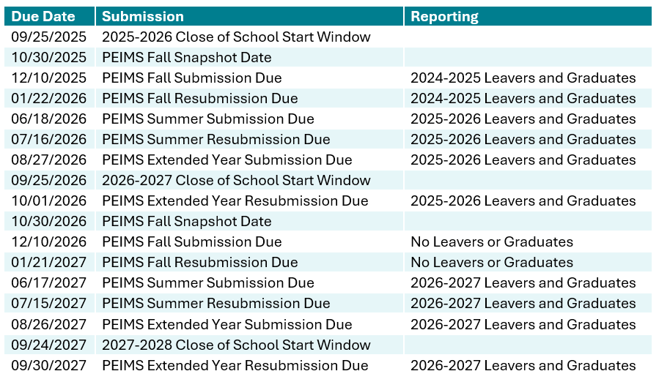
Timeline for Leavers and Graduates
Clear and concise timeline that can be presented to directors, administrators, and campus data entry clerks to help understand changes to reporting leavers and graduates.

Slide 47
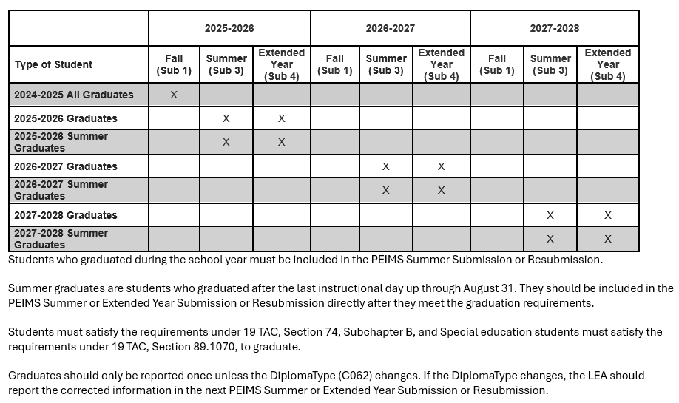
Graduates
Chart showing which graduating classes will be reported in which submission will be added to the Texas Education Data Standards.

Slide 48
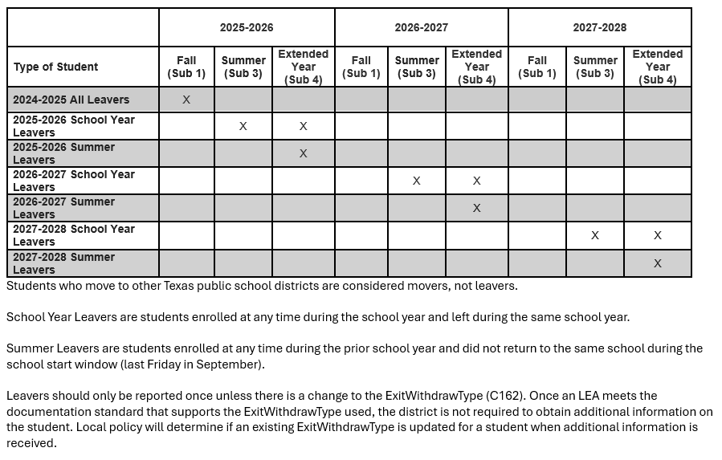
Leavers
Chart that shows when a student should be reported for each submission and resubmission.

Slide 49
TITLE SLIDE: Communication Plan
COMMUNICATION PLAN
NAME OF COMPONENT (ALL CAPS)
MARCH 19-21, 2024

Slide 50
Communication
Early Notice for Leaver and Graduate changes published in TEDS – September 3, 2024
To the Administrator Addressed Letter – September 5, 2024
Leaver and Graduate changes published in TEDS – December 2, 2024
Field Coordinator Network (FCN) Webinar – February 19, 2025
TASBO Annual Conference – February 26, 2025

Slide 51
Communication Continued
Internal Information Technology TEA Webinar – February 11, 2025
ESC and Vendor Training – April 1-3, 2025
Internal TEA Webinar (For TEA Program Areas) – May 2025
TEA State-Wide Webinar – May 2025
TASBO PEIMS Fundamentals – September 24, 2025
TASBO PEIMS Academy – September 25-26, 2025

Slide 52

QUESTIONS
QUESTIONS?

