Slide 1

TITLE SLIDE: ESC Vendor Training for One Component January
<NAME OF COMPONENT> (ALL CAPS)
MARCH 19-21, 2024
SPECIAL EDUCATION DATA SYSTEM
SUMMER SUBMISSION
April 2-3, 2025

Slide 2

AGENDA – SPECIAL EDUCATION DATA SYSTEM
Background
Timeline
TEAL Roles and Privileges
Data Collection
Business Validations
Reports
Questions
Additional Resources

Slide 3

TITLE SLIDE: BACKGROUND
BACKGROUND
NAME OF COMPONENT (ALL CAPS)
MARCH 19-21, 2024

Slide 4
BACKGROUND
The Special Education Data System Summer Submission will combine the following:
  Child Find Collection
  SPPI-7 – Preschool Outcomes
  SPPI-13 – Secondary Transition

Slide 5
BACKGROUND – CHILD FIND
Child Find (SPPI-11 and 12)
  SPPI-11 – Timely Initial Evaluation
    Refers to compliance with state-established timeframes (19 TAC §89.1011) for evaluating children, ages 3-21, for special education under Part B of the Individuals with Disabilities Education Act (IDEA).
  SPPI-12 – Early Childhood Transition
    Refers to compliance for children referred from Part C of IDEA before age three, found eligible for Part B, and have an individualized education program (IEP) developed and implemented by their third birthday to receive early childhood special education (ECSE) services.

Slide 6
BACKGROUND – SPPI-7
SPPI-7 – Preschool Outcomes
  Measures the demonstrated improvement for preschool children aged three through five with IEPs in the following areas:
    Positive social-emotional skills (including social relationships);
    Acquisition and use of knowledge and skills (including early language/communication and early literacy); and
    Use of appropriate behaviors to meet their needs.
  Local Education Agencies (LEA) utilize the Childhood Outcomes Summary Process to document children’s progress in the three outcomes. LEAs report these outcomes using a specific rating category on a seven-point scale at entry and exit for all students aged three through five (not in kindergarten) who receive early childhood special education (ECSE) services for six months or more during the school year.

Slide 7
BACKGROUND – SPPI-13
SPPI-13 – Secondary Transition
  Measures the percentage of youth with IEPs aged 16 up to age 21 with an IEP that includes:
    Appropriate measurable postsecondary goals that are annually updated and based upon an age-appropriate transition assessment;
    Transition services, including courses of study, that will reasonably enable the student to meet those postsecondary goals; and
    Annual IEP goals related to the student’s transition service needs.
  There must be documented evidence that the student was invited to the admission, review, and dismissal (ARD) committee meeting where transition services are to be discussed and evidence that, if appropriate, a representative of any participating agency that is likely to be responsible for providing or paying for transition services be invited to the ARD meeting with prior consent of the parent or student who has reached the age of majority.

Slide 8
BACKGROUND – CURRENT COLLECTION
SPPI-7 data are collected through the SPP 7 Early Childhood Outcomes application in TEAL.
SPPI-13 data are collected through the SPP 13 Secondary Transition application in TEAL. SPPI-13 is currently collected on only a select number of students. Once moved into TSDS, the data will be collected on all students aged 16 through 21 during the data collection year, which runs from July 1 to June 30.
Child Find (combination of SPPI-11 and 12) is currently collected in TSDS through the Child Find Collection.

Slide 9
TITLE SLIDE: TIMELINE
TIMELINE
NAME OF COMPONENT (ALL CAPS)
MARCH 19-21, 2024

Slide 10
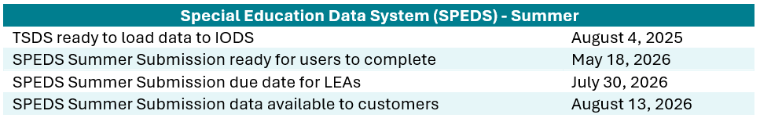
TIMELINE – 2025-2026 SCHOOL YEAR

Slide 11
TITLE SLIDE: TEAL ROLES AND PRIVILEGES
TEAL ROLES AND
NAME OF COMPONENT (ALL CAPS)
MARCH 19-21, 2024
PRIVILEGES

Slide 12
TEAL ROLES AND PRIVILEGES
The existing TSDS Core roles will be used for the SPEDS Summer Submission.
  Core LEA Data Approver
  Core LEA Data Completer
  Core LEA Data Promoter
  Core LEA Data Viewer
  Core ESC Data Viewer
  Core TEA Data Viewer
No new TEAL roles will be added for the SPEDS Summer Submission.

Slide 13
TEAL ROLES AND PRIVILEGES CONT.
Each of the TSDS Core roles listed on the previous page currently have a “Child Find Access” privilege.
Current plan is to utilize this existing privilege but rename it “SPEDS Summer Access”.
  This will ensure users who currently have the “Child Find Access” privilege will not need to reapply for access to SPEDS Summer.
  By adding “Summer” to the privilege name, we are future-proofing the privileges in the event any additional submissions are added to the SPEDS data collection at a later date.

Slide 14
TITLE SLIDE: DATA COLLECTION
DATA
NAME OF COMPONENT (ALL CAPS)
MARCH 19-21, 2024
COLLECTION

Slide 15
DATA COLLECTION - OVERVIEW
The following students will be collected in the new SPEDS Summer Submission:
  Child Find: children aged 3-21 evaluated for special education services, and students with an IEP developed and implemented by their third birthday.
  SPPI-7: children aged 3-5 (not in kindergarten) who receive ECSE services for six months or more during the school year. Collected at entry to and exit from ECSE services.
  SPPI-13: all children with an IEP aged 16 up to age 21.
The annual data collection period occurs from July 1 to June 30.

Slide 16
DATA COLLECTION - DOMAINS
Domains:
  Education Organization
  School Calendar
  Enrollment
  Student Identification and Demographics
  Alternative and Supplemental Services
  Student Special Education Program Eligibility Association

Slide 17

EDUCATION ORGANIZATION DOMAIN
EDUCATION ORGANIZATION DOMAIN
NAME OF COMPONENT (ALL CAPS)
MARCH 19-21, 2024

Slide 18
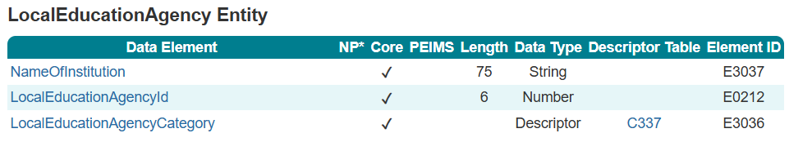
LocalEducationAgency

Slide 19
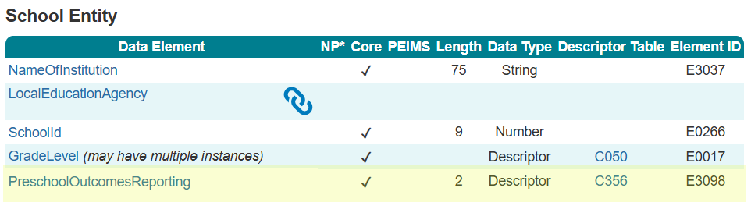
School

Slide 20
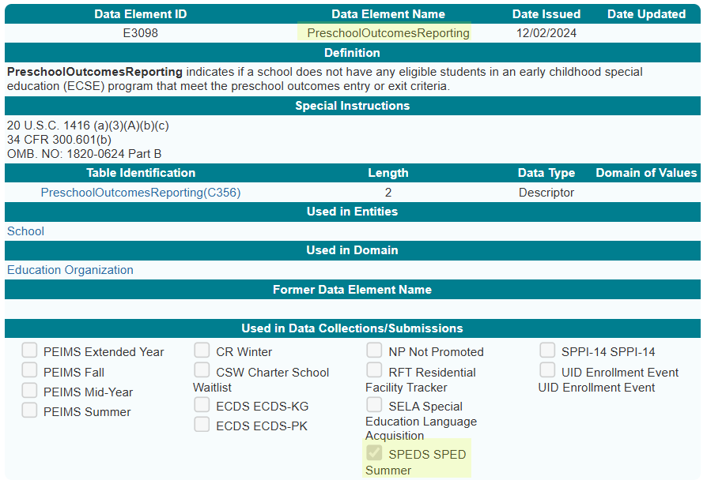
PreschoolOutcomesReporting

Slide 21
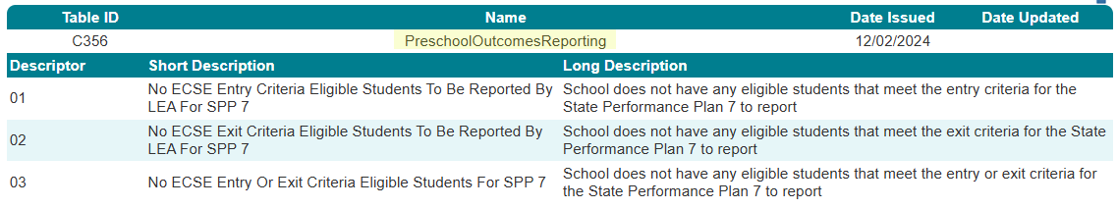
PreschoolOutcomesReporting `

Slide 22
SCHOOL CALENDAR DOMAIN
SCHOOL CALENDAR DOMAIN
NAME OF COMPONENT (ALL CAPS)
MARCH 19-21, 2024

Slide 23
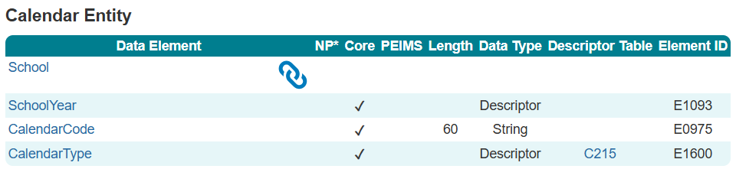
Calendar

Slide 24
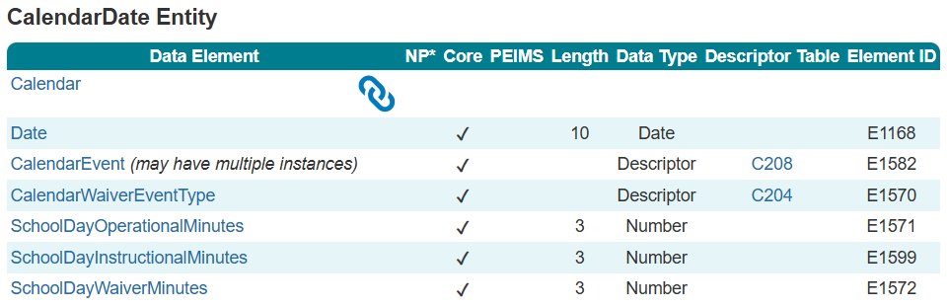
CalendarDate

Slide 25
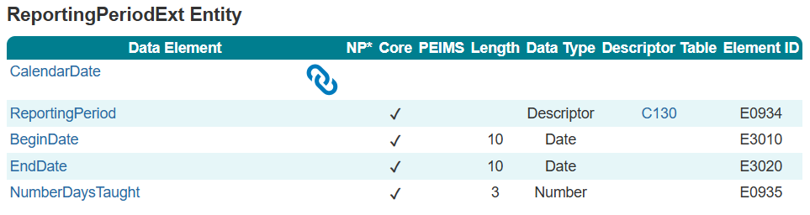
ReportingPeriodExt

Slide 26
ENROLLMENT DOMAIN
ENROLLMENT DOMAIN
NAME OF COMPONENT (ALL CAPS)
MARCH 19-21, 2024

Slide 27
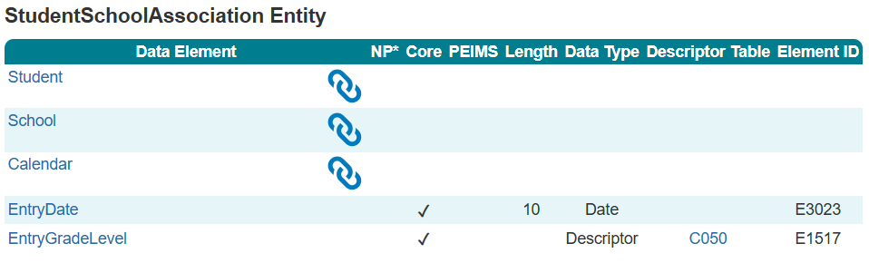
StudentSchoolAssociation

Slide 28
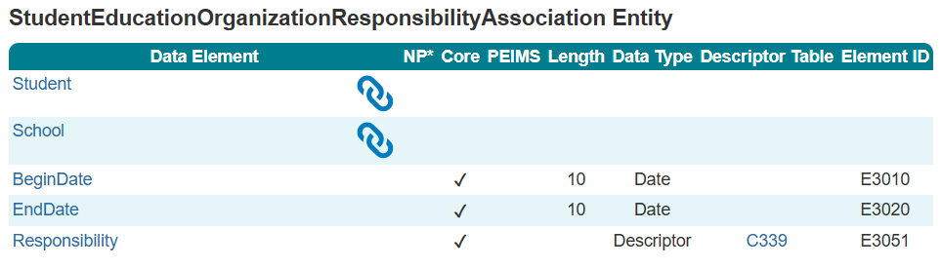
StudentEducationOrganizationResponsibility
Association

Slide 29
STUDENT IDENTIFICATION AND DEMOGRAPHICS DOMAIN
STUDENT IDENTIFICATION AND DEMOGRAPHICS DOMAIN
NAME OF COMPONENT (ALL CAPS)
MARCH 19-21, 2024

Slide 30
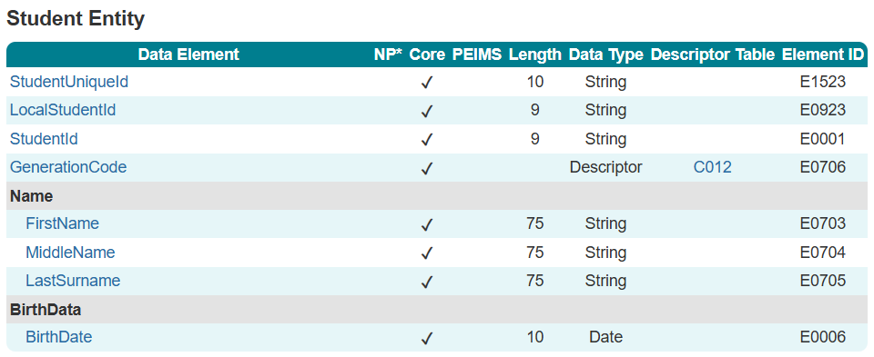
Student

Slide 31
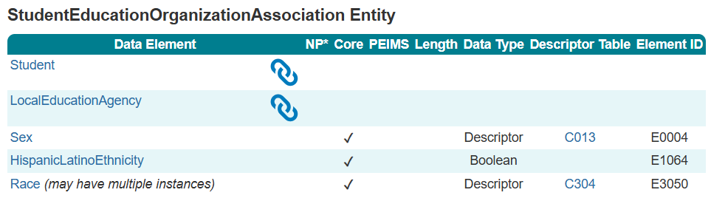
StudentEducationOrganizationAssociation

Slide 32
ALTERNATIVE AND SUPPLEMENTAL SERVICES DOMAIN
ALTERNATIVE AND SUPPLEMENTAL SERVICES DOMAIN
NAME OF COMPONENT (ALL CAPS)
MARCH 19-21, 2024

Slide 33
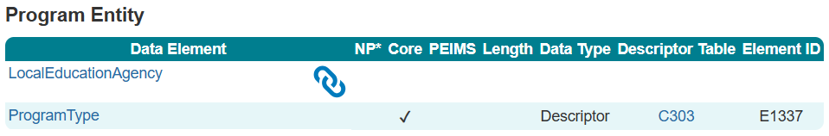
Program

Slide 34
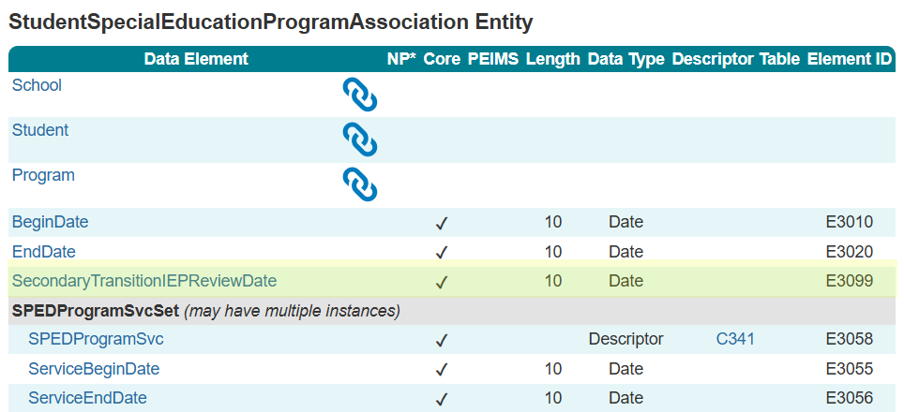
StudentSpecialEducationProgram
Association

Slide 35
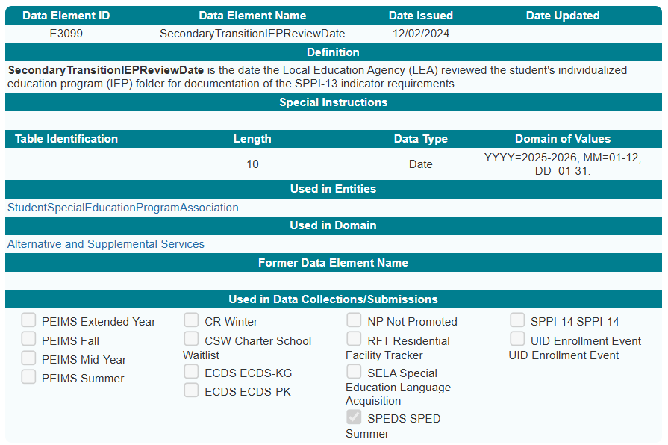
SecondaryTransitionIEPReviewDate

Slide 36
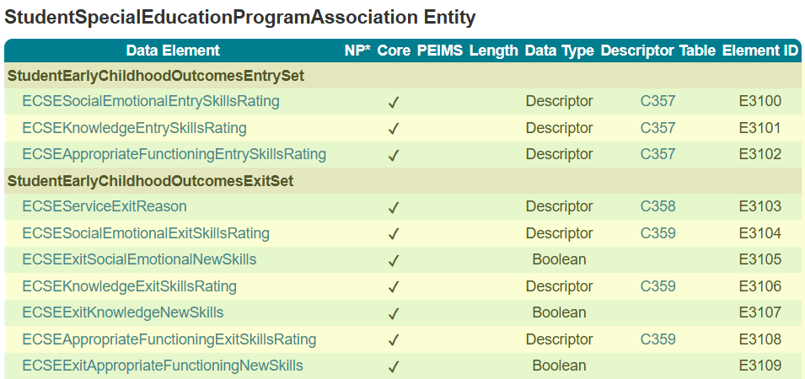
StudentSpecialEducationProgram
Association

Slide 37
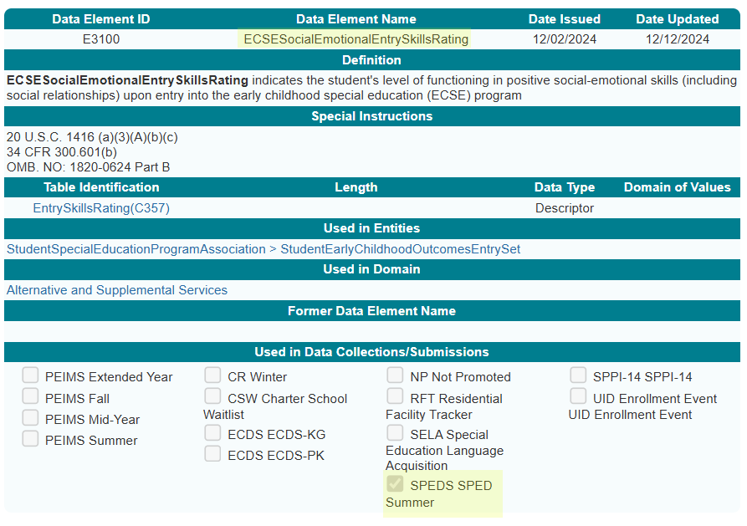
ECSESocialEmotionalEntrySkillsRating

Slide 38
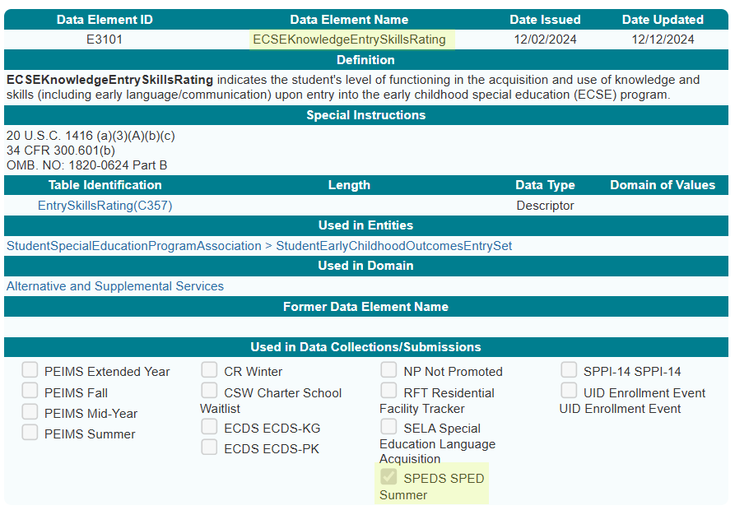
ECSEKnowledgeEntrySkillsRating

Slide 39
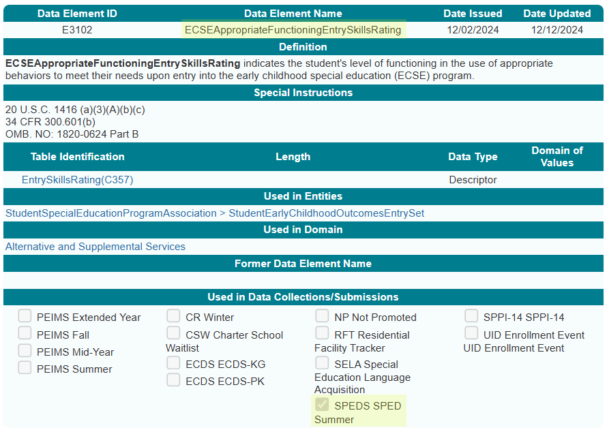
ECSEAppropriateFunctioningEntrySkillsRating

Slide 40
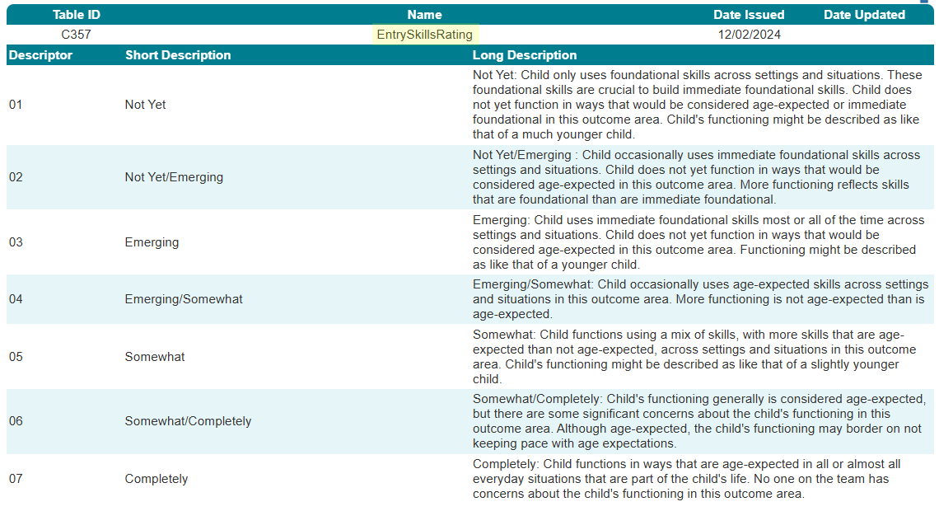
EntrySkillsRating Descriptor Table

Slide 41
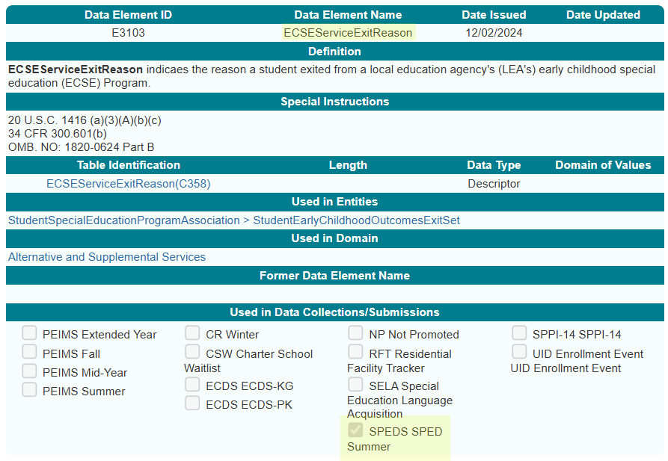
ECSEServiceExitReason

Slide 42
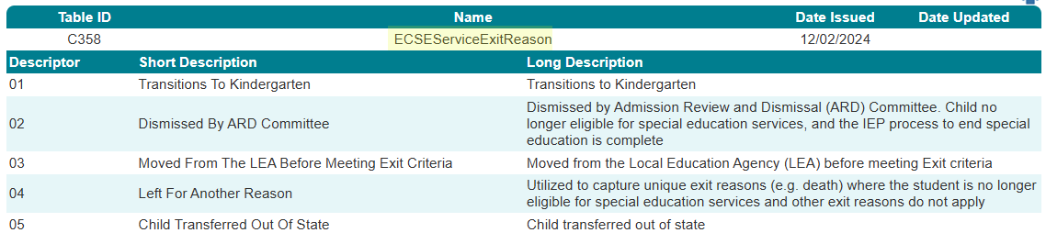
ECSEServiceExitReason Descriptor Table

Slide 43
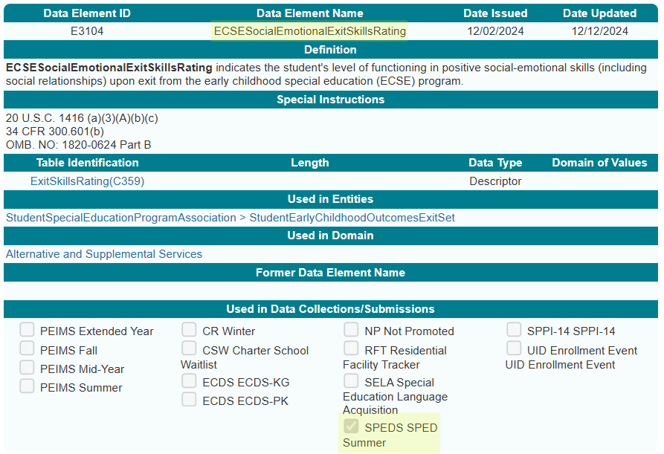
ECSESocialEmotionalExitSkillsRating

Slide 44
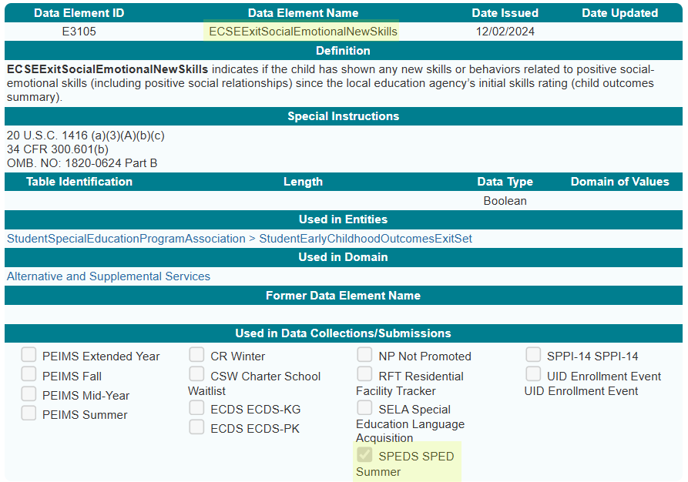
ECSEExitSocialEmotionalNewSkills

Slide 45
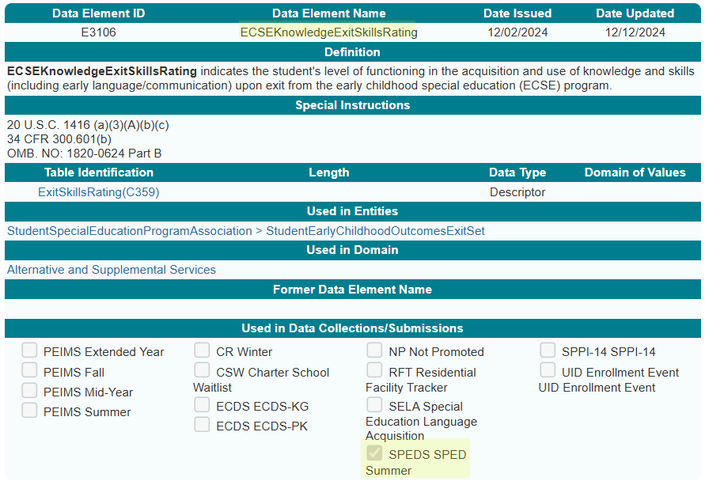
ECSEKnowledgeExitSkillsRating

Slide 46
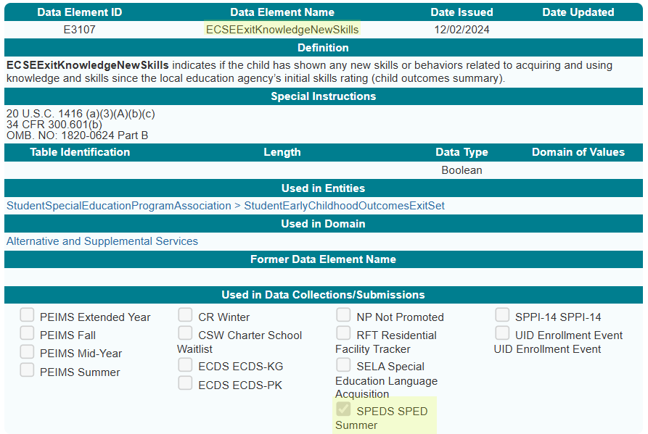
ECSEExitKnowledgeNewSkills

Slide 47
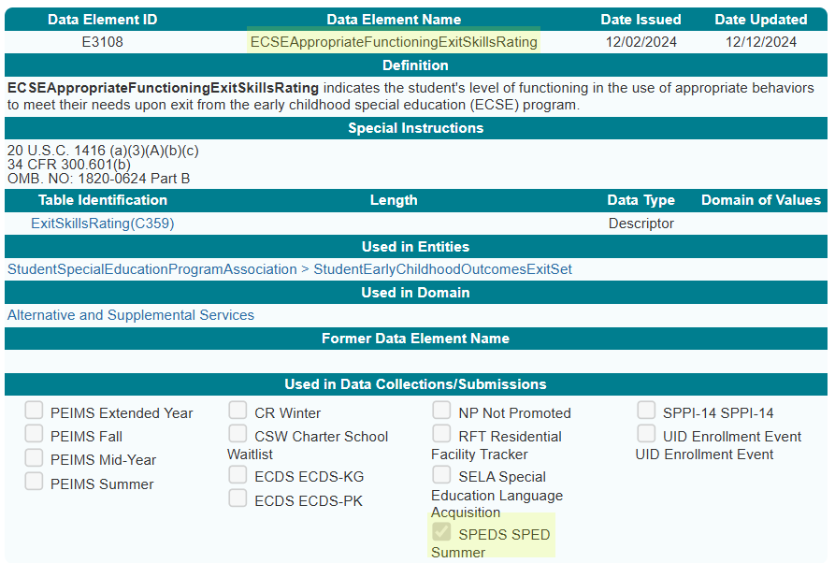
ECSEAppropriateFunctioningExitSkillsRating

Slide 48
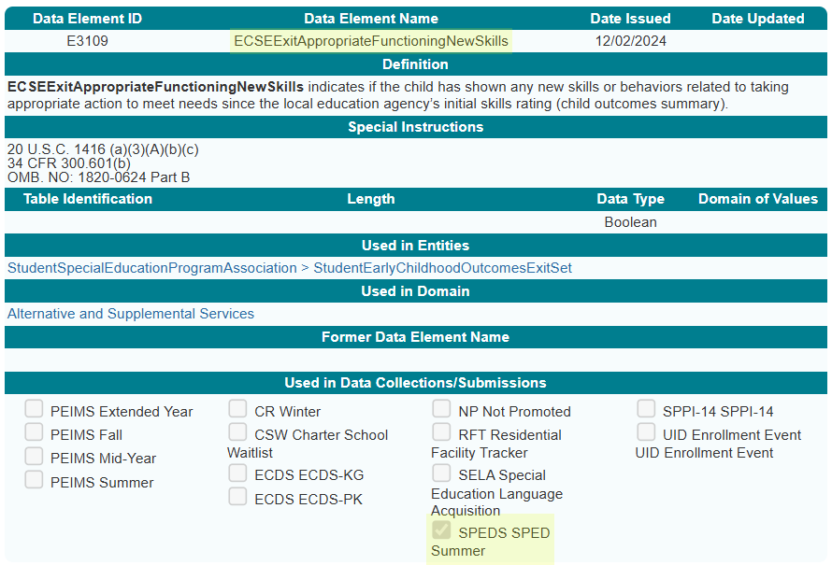
ECSEExitAppropriateFunctioningNewSkills

Slide 49
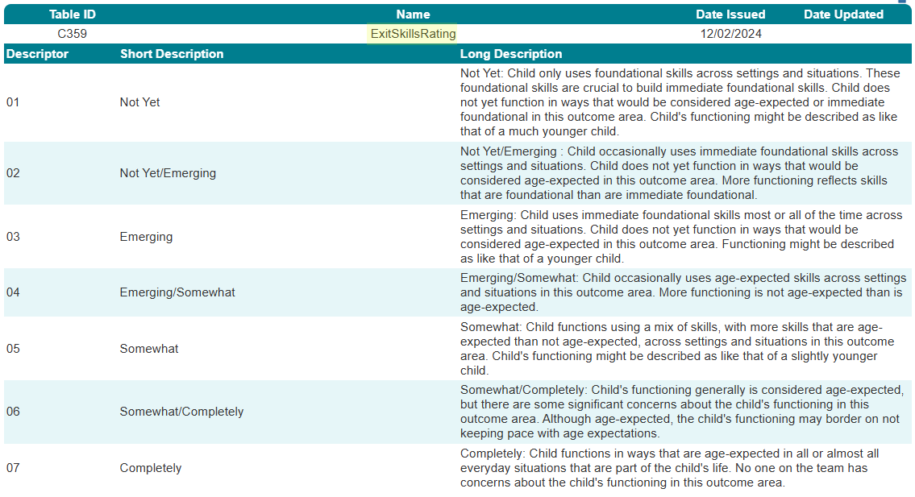
ExitSkillsRating Descriptor Table

Slide 50
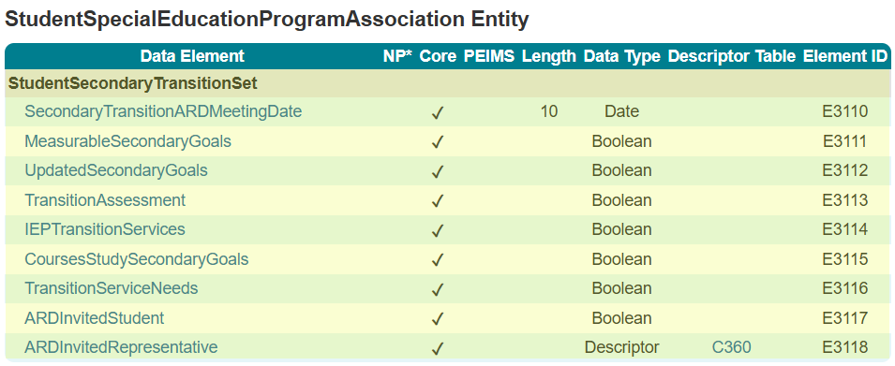
StudentSpecialEducationProgram
Association 1

Slide 51
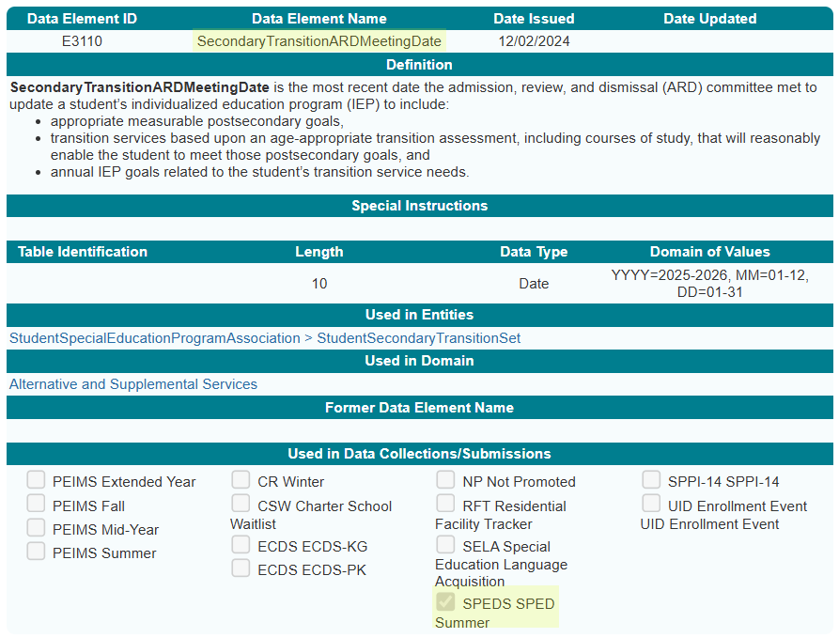
SecondaryTransitionARDMeetingDate

Slide 52
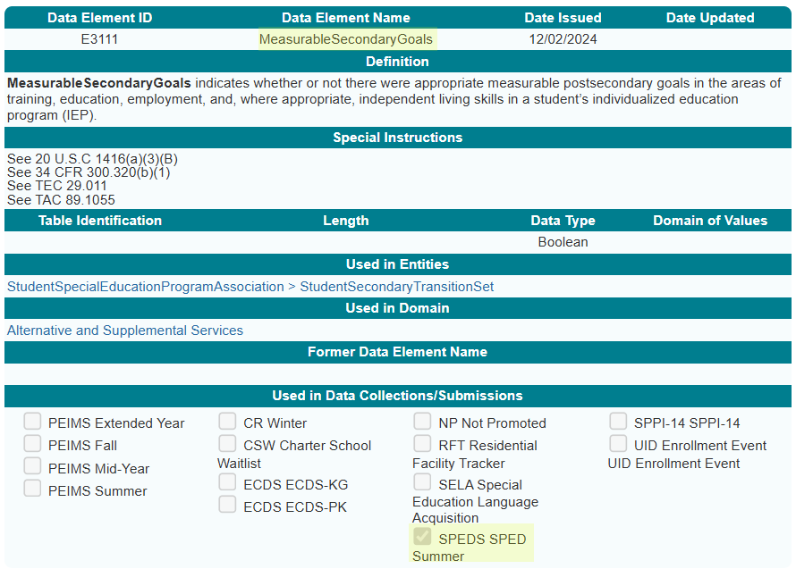
MeasurableSecondaryGoals

Slide 53
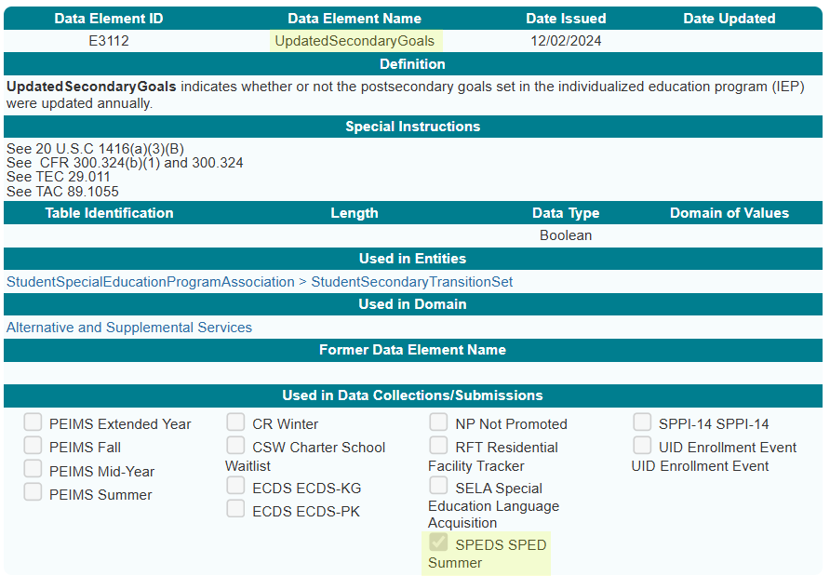
UpdatedSecondaryGoals

Slide 54
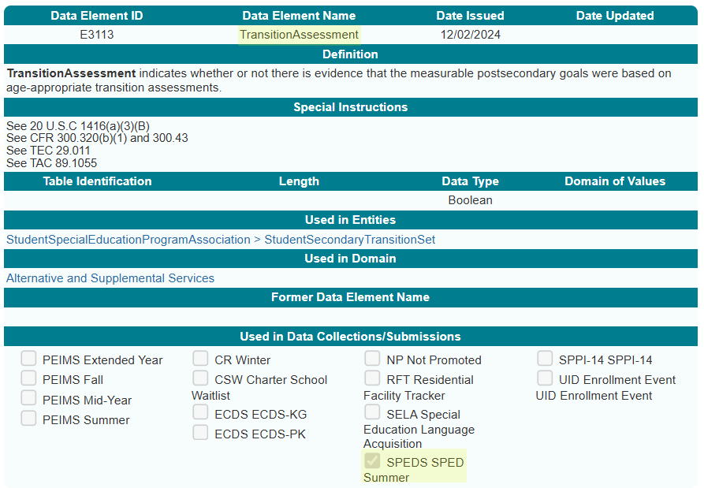
TransitionAssessment

Slide 55
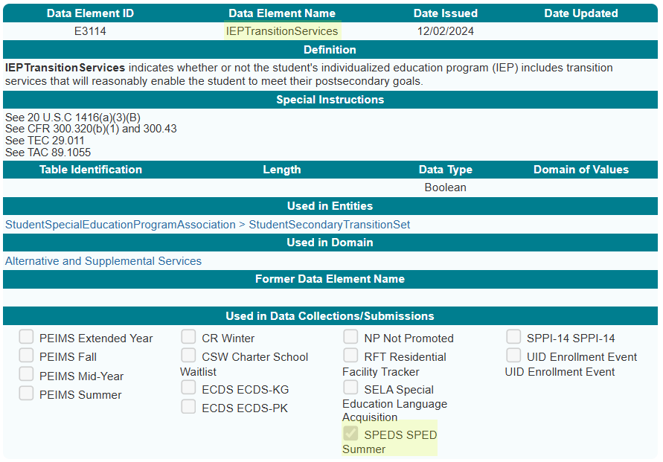
IEPTransitionServices

Slide 56
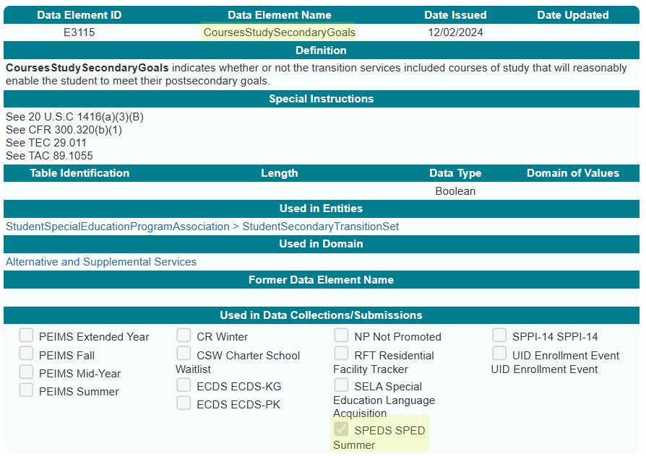
CoursesStudySecondaryGoals

Slide 57
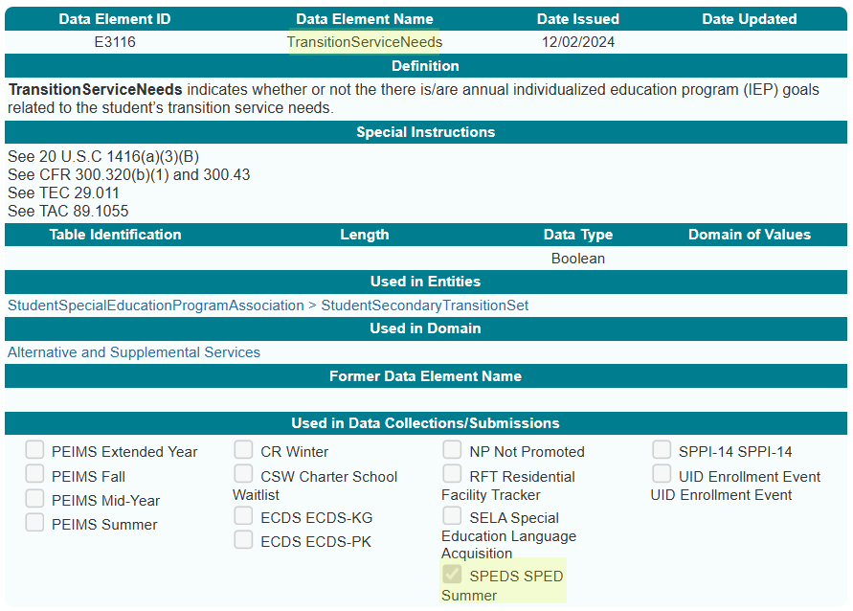
TransitionServiceNeeds

Slide 58
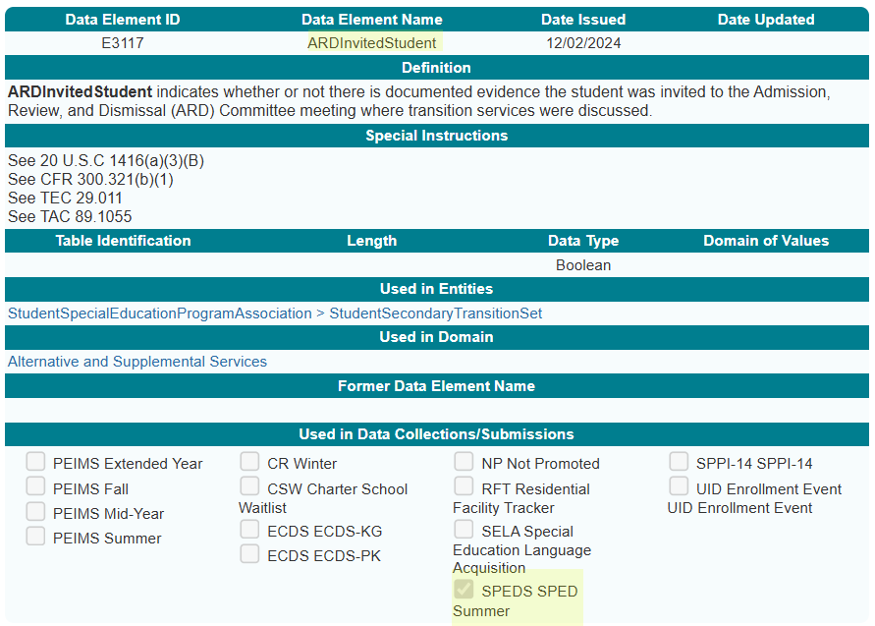
ARDInvitedStudent

Slide 59
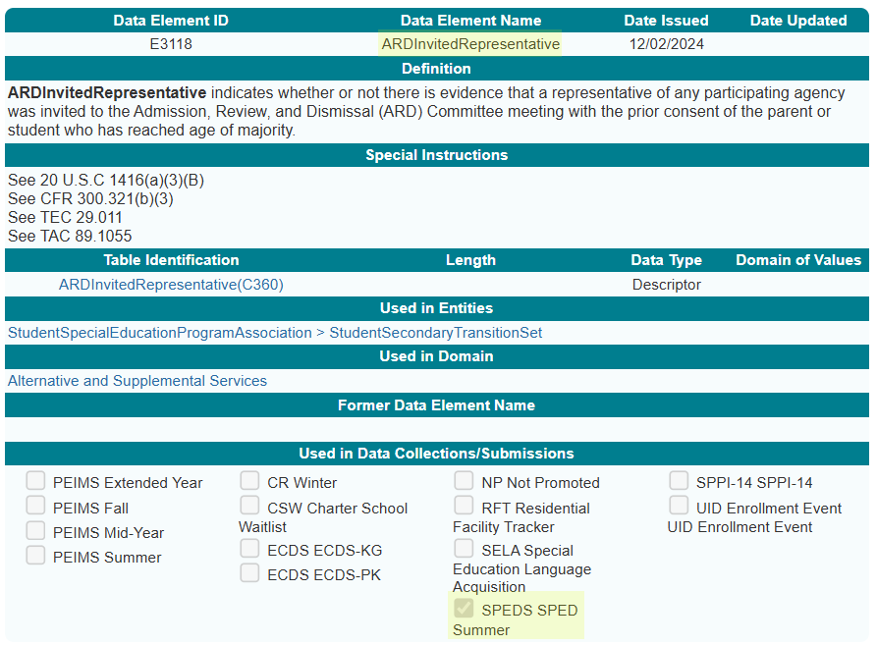
ARDInvitedRepresentative

Slide 60
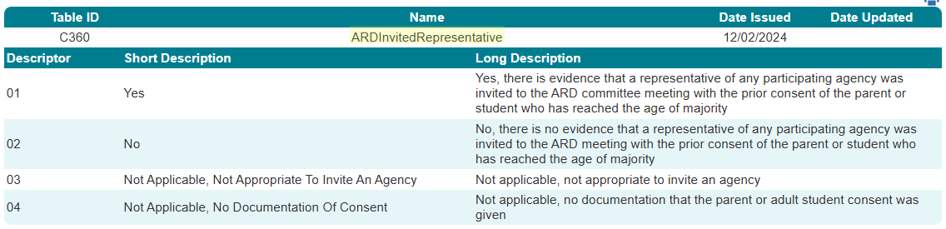
ARDInvitedRepresentative Descriptor Table

Slide 61
STUDENT SPECIAL EDDUCATION PROGRAM ELIGIBILITY ASSOCIATION DOMAIN
STUDENT SPECIAL EDUCATION PROGRAM ELIGIBILITY ASSOCIATION DOMAIN
NAME OF COMPONENT (ALL CAPS)
MARCH 19-21, 2024

Slide 62
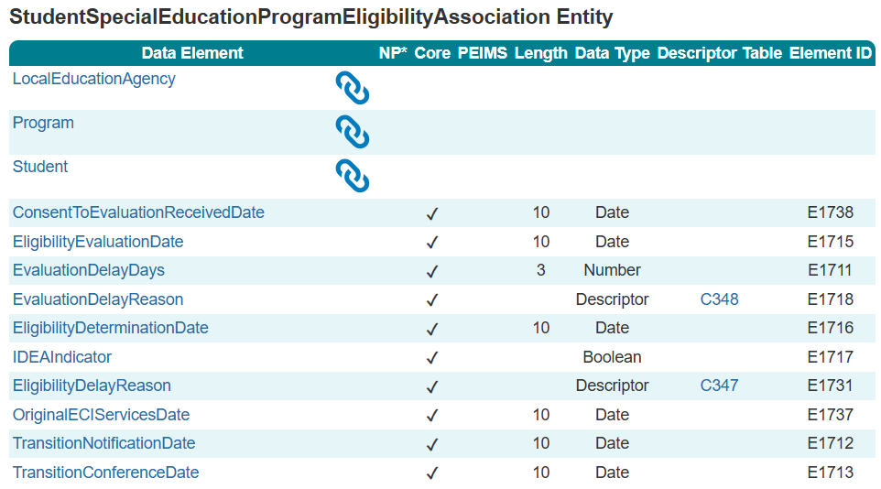
StudentSpecialEducationProgramEligibility
Association

Slide 63
TITLE SLIDE: BUSINESS VALIDATIONS
BUSINESS
NAME OF COMPONENT (ALL CAPS)
MARCH 19-21, 2024
VALIDATIONS

Slide 64
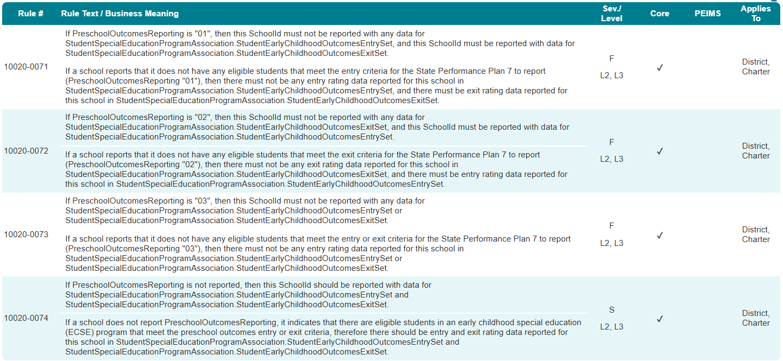
CAMPUS CATEGORY

Slide 65
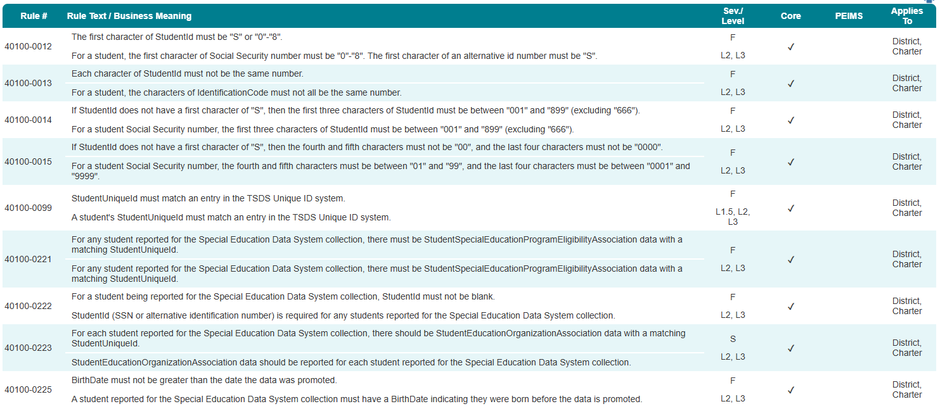
STUDENT BASIC CATEGORY

Slide 66
ENROLLMENT CATEGORY

Slide 67
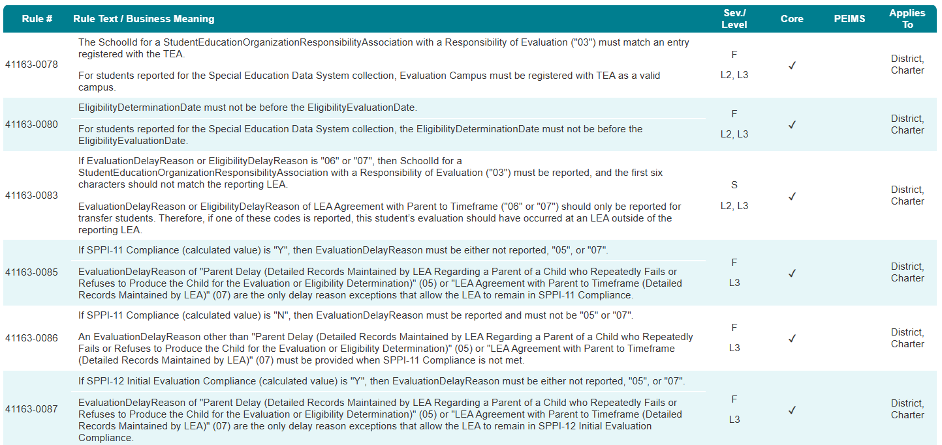
SPECIAL EDUCATION PROGRAM CATEGORY 1

Slide 68
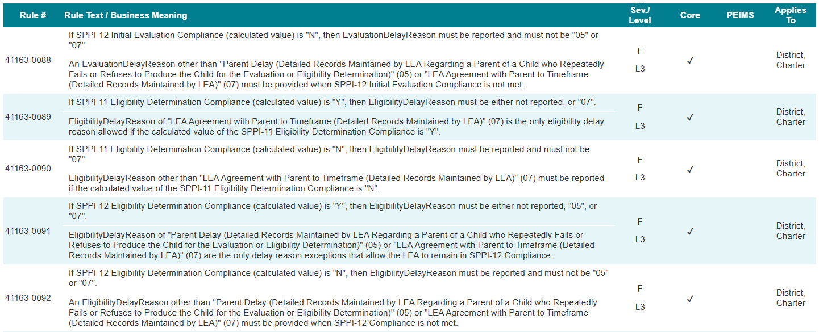
SPECIAL EDUCATION PROGRAM CATEGORY 2

Slide 69
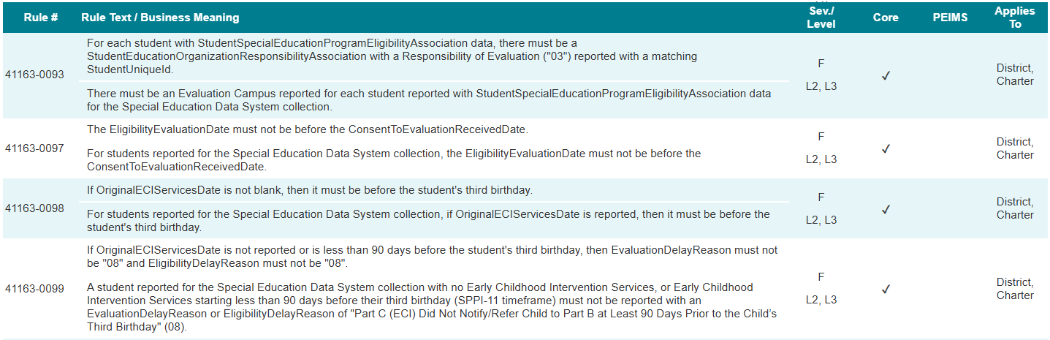
SPECIAL EDUCATION PROGRAM CATEGORY 3

Slide 70
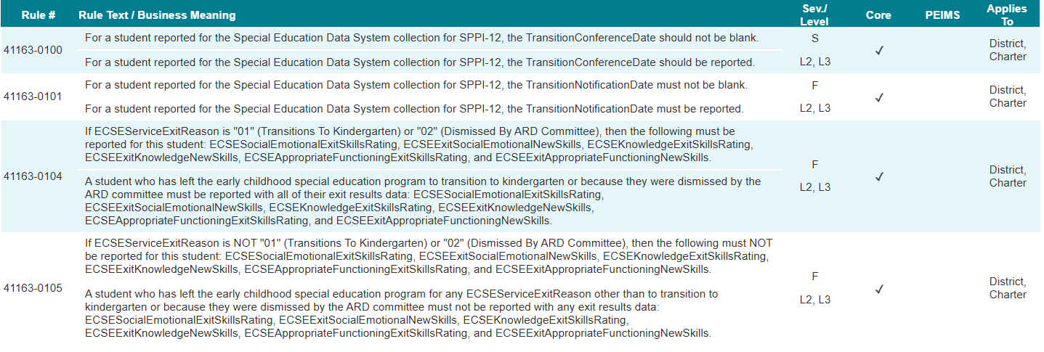
SPECIAL EDUCATION PROGRAM CATEGORY 4

Slide 71
TITLE SLIDE: REPORTS
REPORTS
NAME OF COMPONENT (ALL CAPS)
MARCH 19-21, 2024

Slide 72
REPORTS
The existing Child Find reports will be retained in the SPEDS Summer Submission.
  CHF0-100-001 SPPI-11 Student Compliance Report
  CHF0-100-002 SPPI-12 Student Compliance Report
  CHF0-100-003 SPPI-11 Aggregate Report
  CHF0-100-004 SPPI-12 Aggregate Report
  CHF0-100-005 SPPI-11 Calculations Report
Preferably, the report number prefixes (“CHF0”) would be renamed to follow the naming convention for the SPEDS Summer Submission.

Slide 73
REPORTS CONT.
In addition to the existing Child Find reports, additional reports will be needed for both the SPPI-7 and SPPI-13 data being collected.
  SPPI-7 and SPPI-13 student-level reports (two separate reports).
    Similar to the CHF0-100-001 and CHF0-100-002 reports.
    Lists all students reported for SPPI-7 and SPPI-13, including all pertinent data elements reported for the student.
    Allows LEAs to verify data being submitted at a granular level.
  SPPI-7 and SPPI-13 aggregate/summary reports (two separate reports).
    Similar to the CHF0-100-003 and CHF0-100-004 reports.
    Lists the sums and percentages for various SPPI-7 and SPPI-13 calculations.
    Allows LEAs to verify data at an aggregate level.

Slide 74

QUESTIONS
QUESTIONS?

Slide 75

ADDITIONAL RESOURCES
ADDITIONAL RESOURCES

Slide 76
DATA ELEMENTS IN SUBMISSION 1
Data Element Names | Data Element Names
ARDInvitedRepresentative (E3118) | ARDInvitedStudent (E3117)
BeginDate (E3010) | BirthDate (E0006)
CalendarCode (E0975) | CalendarEvent (E1582)
CalendarType (E1600) | CalendarWaiverEventType (E1570)
ConsentToEvaluationReceivedDate (E1738) | CoursesStudySecondaryGoals (E3115)
Date (E1168) | ECSEAppropriateFunctioningEntrySkillsRating (E3102)
ECSESocialEmotionalEntrySkillsRating (E3100) | ECSEKnowledgeEntrySkillsRating (E3101)
ECSEExitKnowledgeNewSkills (E3107) | ECSEAppropriateFunctioningEntrySkillsRating (E3102)
ECSEExitSocialEmotionalNewSkills (E3105) | ECSEExitAppropriateFunctioningNewSkills (E3109)
ECSEKnowledgeEntrySkillsRating (E3101) | ECSEAppropriateFunctioningExitSkillsRating (E3108)
New data elements are in green.

Slide 77
DATA ELEMENTS IN SUBMISSION 2
Data Element Names | Data Element Names
ECSEServiceExitReason (E3103) | ECSEKnowledgeExitSkillsRating (E3106)
ECSESocialEmotionalExitSkillsRating (E3104) | EndDate (E3020)
EligibilityEvaluationDate (E1715) | EntryGradeLevel (E1517)
EntryDate (E3023) | EvaluationDelayReason (E1718)
EvaluationDelayDays (E1711) | GenerationCode (E0706)
FirstName (E0703) | HispanicLatinoEthnicity (E1064)
GradeLevel (E0017) | IEPTransitionServices (E3114)
IDEAIndicator (E1717) | LocalEducationAgencyCategory (E3036)
LastSurname (E0705) | LocalStudentId (E0923)
LocalEducationAgencyId (E0212) | MeasurableSecondaryGoals (E3111)
New data elements are in green.

Slide 78
DATA ELEMENTS IN SUBMISSION 3
Data Element Names | Data Element Names
NameOfInstitution (E3037) | MiddleName (E0704)
OriginalECIServicesDate (E1737) | NumberDaysTaught (E0935)
ProgramType (E1337) | PreschoolOutcomesReporting (E3098)
ReportingPeriod (E0934) | Race (E3050)
SchoolDayInstructionalMinutes (E1599) | Responsibility (E3051)
SchoolDayWaiverMinutes (E1572) | SchoolDayOperationalMinutes (E1571)
SchoolYear (E1093) | SchoolId (E0266)
SecondaryTransitionIEPReviewDate (E3099) | SecondaryTransitionARDMeetingDate (E3110)
New data elements are in green.

Slide 79
DATA ELEMENTS IN SUBMISSION 4
Data Element Names | Data Element Names
ServiceBeginDate (E3055) | Sex (E0004)
ServiceEndDate (E3056) | StudentId (E0001)
SPEDProgramSvc (E3058) | TransitionAssessment (E3113)
StudentUniqueId (E1523) | TransitionNotificationDate (E1712)
TransitionConferenceDate (E1713) | UpdatedSecondaryGoals (E3112)
TransitionServiceNeeds (E3116)
New data elements are in green.

Slide 80
DESCRIPTOR TABLES IN SUBMISSION
Descriptor Table Names | Descriptor Table Names
ARDInvitedRepresentative (C360) | CalendarEvent (C208)
CalendarType (C215) | CalendarWaiverEventType (C204)
ECSEServiceExitReason (C358) | EligibilityDelayReason (C347)
EntrySkillsRating (C357) | EvaluationDelayReason (C348)
ExitSkillsRating (C359) | GenerationCode (C012)
GradeLevel (C050) | ProgramType (C303)
ReportingPeriod (C130) | LocalEducationAgencyCategory (C337)
Race (C304) | Sex (C013)
PreschoolOutcomesReporting (C356) | SPEDProgramSvc (C341)
Responsibility (C339)
New data elements are in green.

