Slide 1
Statewide Emergency Management Reporting
Standardized Threat Assessment Manual and Instrument
Document Repository and Sharing
Staffing Turnover
Historical Data and Documents
Statutory Reporting and Data Collection
School Safety Requirements and Resources
Tracking Requirements, Changes, and Implementation Efforts
Confidentiality of Information
Stakeholder Engagement and Feedback
Incident Response and After-Action Reporting
Calendar Management
The Future Expansion of Safety Programs and Supports

Slide 2
Program Overview
Data Integration
Student Information Systems
Emergency Operation Plans
Public Education Information
Management System
Waivers
Grants
Tools and Resources
Data Tables and Visualizations
Policy and Rulemaking
Report Creation
Automated Notifications
Action Items Reminders
Direct and System-wide Communications
District Calendar
Door Check Tool
System Supports
Helpdesk System
Exercise and Training Registration
Streamlined Required Reporting
On-site Technical Assistance Requests
Centralized Programmatic Reporting
Intruder Detection Audits
District Vulnerability Assessments
Emergency Management
Technical Assistance And Training
Behavioral Threat Assessments

Slide 3
System Overview
Search
Logout
District Dashboard
Data Integration
Student Information Systems
Emergency Operation Plans
Public Education Information
Management System
Waivers
Grants
Tools and Resources
Data Tables and Visualizations
Policy and Rulemaking
Report Creation
Automated Notifications
Action Items Reminders
Direct and System-wide Communications
District Calendar
Door Check Tool
System Supports
Helpdesk System
Exercise and Training Registration
Streamlined Required Reporting
On-site Technical Assistance Requests
Centralized Programmatic Reporting
Intruder Detection Audits
Updated Interface
Easier Corrective Actions Process
Optional Door Sweep Tool
District Vulnerability Assessments
Emergency Management
Technical Assistance And Training
Behavioral Threat Assessments

Slide 4
Search
Logout
District Dashboard
Intruder Detection Audits
Intruder Detection Audits
District Vulnerability Assessments
District Vulnerability Assessments
Emergency Management
Emergency Management
Technical Assistance And Training
Behavioral Threat Assessments
Technical Assistance And Training
Behavioral Threat Assessments
Resources and Supports
LAUNCH

Slide 5
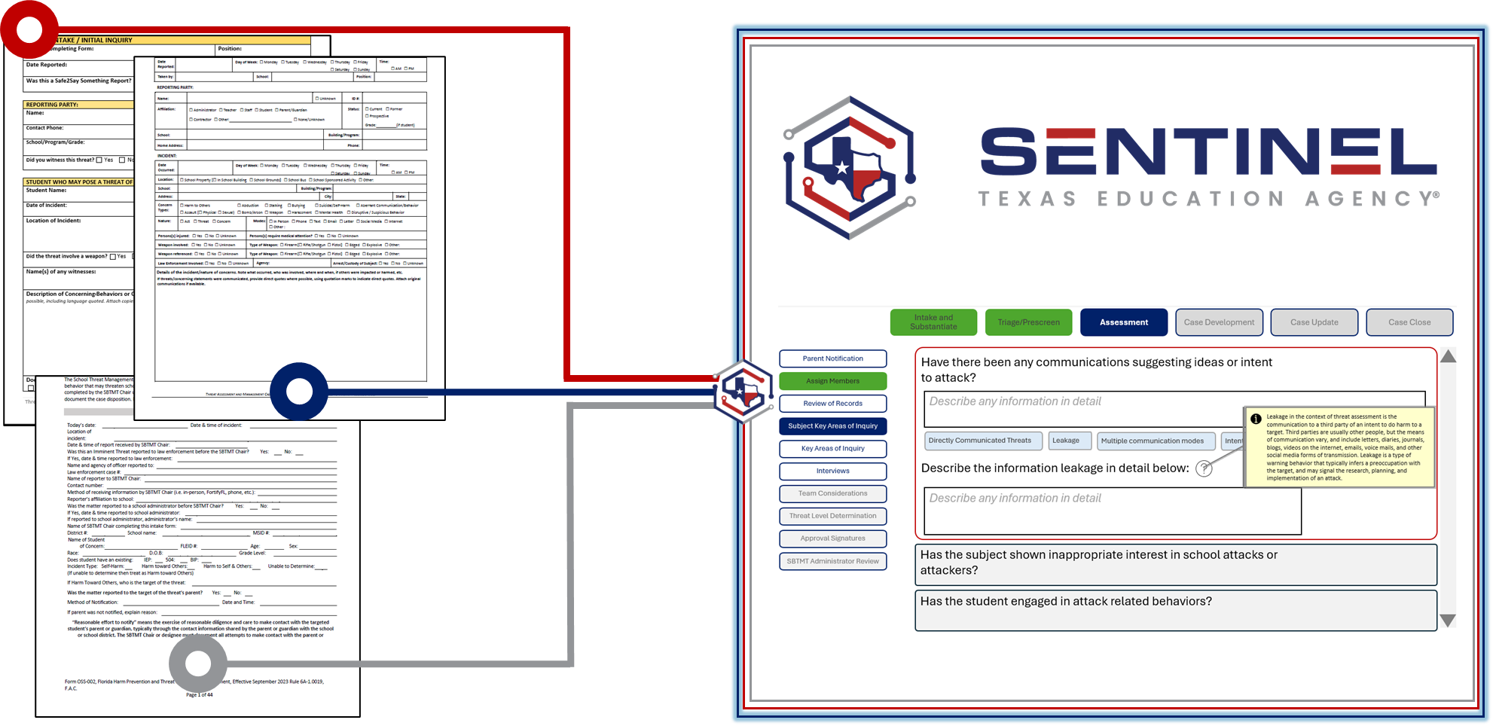
Search
Logout
Program Overview
Behavioral Threat Assessments
Intruder Detection Audits
Updated Interface
Easier Corrective Actions Process
Optional Door Sweep Tool
Complete Behavioral Threat Assessment Manual
Pilot Program
District Vulnerability Assessments
Emergency Management
Standardized Online Instrument
Fall 2024
Technical Assistance And Training
Transfer of Threat Assessment Data
Behavioral Threat Assessments
Trainings and Scenario-based Exercises
Resources and Supports

Slide 6
Educ. Code Section 37.115 Threat Assessment and Safe and Supportive School Program and Team
(f-1) Before a team may conduct a threat assessment of a student, the team must notify the parent of or person standing in parental relation to the student regarding the assessment. In conducting the assessment, the team shall provide an opportunity for the parent or person to:
(1) participate in the assessment, either in person or remotely; and
(2) submit to the team information regarding the student.
(f-2) After completing a threat assessment of a student, the team shall provide to the parent of or person standing in parental relation to the student the team’s findings and conclusions regarding the student.
(j-1) Materials and information provided to or produced by a team during a threat assessment of a student under this section must be maintained in the student’s school record until the student’s 24th birthday.
Educ. Code Section 25.036 Transfer of Student
(c) In the case of a transfer under this section, a child’s school district of residence shall provide the receiving district with the child’s disciplinary record and any threat assessment involving the child’s behavior conducted under Section 37.115 (Threat Assessment and Safe and Supportive School Program and Team).

