Slide 1

TITLE SLIDE: ESC Vendor Training for One Component
CHILD FIND
MARCH 19-21, 2024

Slide 2

AGENDA – CHILD FIND
PROGRAM AREA
2023-2024 SCHOOL YEAR
  Submission Updates
  Report Updates
  Business Rule Updates
  Reminders
  Current Known Issues
  Timeline
  Frequently Asked Questions
2024-2025 SCHOOL YEAR
  Application Updates
  TSDS Upgrade Project Updates
CLOSEOUT
  Timeline
  Technical Resources
  Questions

Slide 3
PROGRAM AREA UPDATES & GUIDANCE
Special Populations Strategic Supports and Reporting Division
  Donna Holmes – State Performance Plan and Website Coordinator
  Program-related questions can be submitted through TIMS and will be routed accordingly.
Monitoring, Review and Support
  Lori Merrell, MS CCC/SLP – Director

Slide 4

TITLE SLIDE: 2023-2024 School Year
2023-2024
SCHOOL YEAR
NAME OF COMPONENT (ALL CAPS)
MARCH 19-21, 2024

Slide 5
SUBMISSION UPDATES 1
The following code value has been removed as an acceptable ELIGIBILITY-DELAY-REASON for SPPI-11 Eligibility Determination compliance calculations:
  05 – Parent Delay (Detailed Records Maintained by LEA Regarding a Parent of a Child who Repeatedly Fails or Refuses to Produce the Child for the Evaluation or Eligibility Determination)
ELIGIBILITY-DELAY-REASON code ‘05’ can still be reported but will no longer automatically mark the student as compliant for their eligibility determination.

Slide 6
SUBMISSION UPDATES 2
LEAs that reported an ELIGIBILITY-DELAY-REASON code ‘05’ for any of their students prior to March 23, 2024, must re-promote their Child Find data prior to marking the submission as ‘Complete’.
  TEA will be reaching out to LEAs who have reported this value and have not re-promoted their data.
This change does not affect the SPPI-11 initial evaluation compliance, nor the compliance calculated for SPPI-12. Code ‘05’ is still considered an acceptable delay reason for those compliance calculations.
  Additionally, ELIGIBILITY-DELAY-REASON code ‘07’ is still considered an acceptable delay reason for SPPI-11 Eligibility Determination compliance calculations.

Slide 7
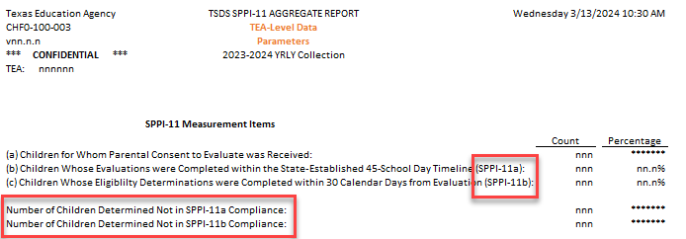
REPORT UPDATES 1
CHF0-100-003 SPPI-11 Aggregate Report – tentatively scheduled for the April 19, 2024, software release.
  SPPI-11 Measurement Items
    Row (b) label will be updated to indicate the measurement is for SPPI-11a.
    Row (c) label will be updated to indicate the measurement is for SPPI-11b.
    Number of Children Not in SPPI-11 Compliance will be split into two pieces – SPPI-11a and SPPI-11b.

Slide 8
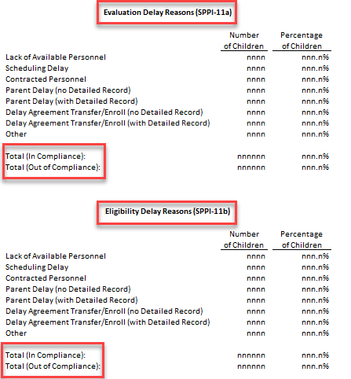
REPORT UPDATES 2
  Delay Reasons will be split into two sections
    Evaluation Delay Reasons (SPPI-11a)
    Eligibility Delay Reasons (SPPI-11b)
  The Total row will be split into two pieces for each section:
    Total (In Compliance)
      For SPPI-11a, this will include EVALUATION-DELAY-REASON codes equal to ‘05’ and ‘07’.
      For SPPI-11b, this will include ELIGIBILITY-DELAY-REASON code equal to ’07’ only.
    Total (Out of Compliance)

Slide 9
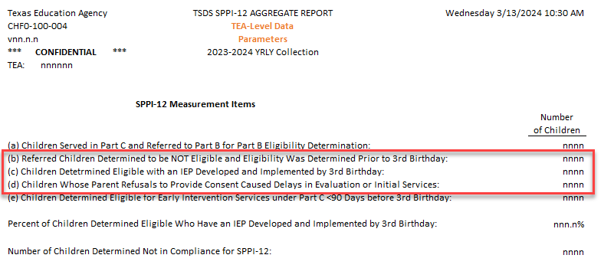
REPORT UPDATES 3
CHF0-100-004 SPPI-12 Aggregate Report – tentatively scheduled for the April 19, 2024, software release.
  SPPI-12 Measurement Items
    Row (b), (c), and (d) calculations will be updated to include ELIGIBILITY-DELAY-REASON.

Slide 10
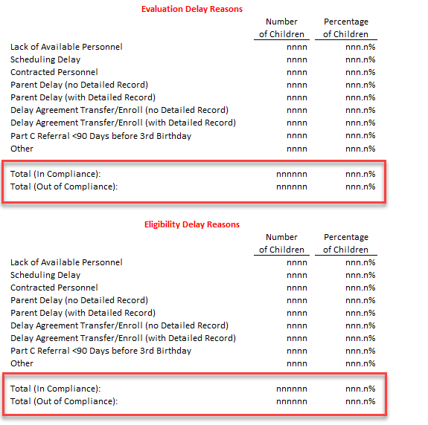
REPORT UPDATES 4
  Delay Reasons will be split into two sections
    Evaluation Delay Reasons
    Eligibility Delay Reasons
  The Total row will be split into two pieces for each section:
    Total (In Compliance)
      For Evaluation Delay Reasons, this will include EVALUATION-DELAY-REASON codes equal to ‘05’ and ‘07’.
      For Eligibility Delay Reasons, this will include ELIGIBILITY-DELAY-REASON codes equal to ’05 and ’07’.
    Total (Out of Compliance)

Slide 11
BUSINESS RULE UPDATES
The following validation rules will be updated in the Core application on March 22, 2024, to account for the SPPI-11 Eligibility Determination calculation change:
  41163-0089 – If SPPI-11 Eligibility Determination Compliance (calculated value) is "Y", then ELIGIBILITY-DELAY-REASON must be either not reported, "05", or "07".
  41163-0090 – If SPPI-11 Eligibility Determination Compliance (calculated value) is "N", then ELIGIBILITY-DELAY-REASON must be reported and must not be "05" or "07".
These changes will be updated in TEDS for the 2024-2025 school year.

Slide 12
REMINDERS 1
2023-2024 Data Element Changes
  ORIGINAL-ECI-SERVICES-DATE (E1737)
    Replaced EFFECTIVE-DATE and EARLY-CHILDHOOD-INTERV-IND-CODE.
    Only reported for children receiving early childhood intervention (ECI) services.
      Date must come before child’s 3rd birthday.
      Memorandum of Understanding (MOU) between ECI providers and LEAs has been updated to where this date must be supplied by the ECI provider.
    Children reported with a date less than 90 days before their 3rd birthday will have their compliance calculated through the SPPI-11 timeline.
      CHF0-100-002 SPPI-12 Student Compliance Report – review the ‘Calc Days Til 3rd Bday Count’ column on this report.
      These children will show up on both the CHF0-100-001 and CHF0-100-002 reports and will also be counted in both the CHF0-100-003 and CHF0-100-004 reports.

Slide 13
REMINDERS 2
  CONSENT-TO-EVALUATION-RECEIVED-DATE (E1738)
    Replaced PARENTAL-CONSENT-DATE
    Guidance changes
      Report the actual date the written consent was received by the LEA, not the next instructional date as was the guidance with the previous data element.
      No longer need to back-date consent received during the summer months.
  ECI-TRANSITION-CONFERENCE-DATE (E1713)
    Only reported for children receiving ECI services.
    No longer mandatory. This does not need to be reported if the parent opted out of the transition conference.

Slide 14
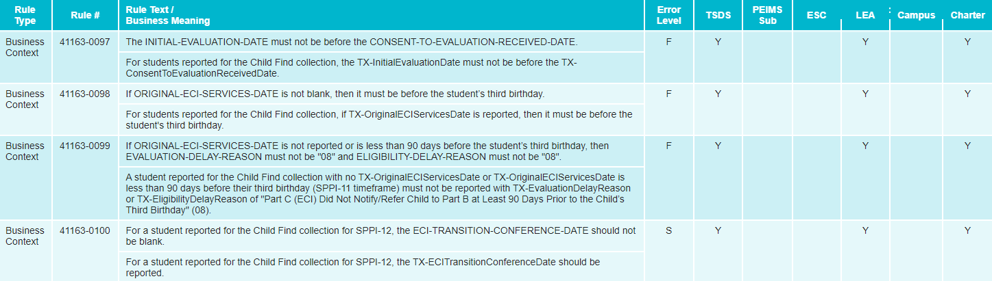
REMINDERS 3
2023-2024 Rule Changes

Slide 15
REMINDERS 4
CHF0-100-005 SPPI-11 Calculations Report
  The report is available to LEA users in CSV format only.
  It displays all the intermediate calculations performed by the Core application that go into determining the SPPI-11 compliance.
  Users can utilize the report in conjunction with the SPPI-11 compliance flowchart for troubleshooting student non-compliance issues.

Slide 16
REMINDERS 5
  Important columns to pay attention to:
    Calc Days After Consent Count – indicates the number of instructional days remaining in the school year starting on the parental consent date. This is the first step in determining the compliance timeframe.
    Calc Init Eval Cutoff Date – indicates the calculated compliance cutoff date (i.e., due date) for the initial evaluation. An evaluation reported after this date results in non-compliance.
    Calc Day 30 After Init Eval Date – indicates the 30th calendar date after the initial evaluation. Under most scenarios, this acts as the cutoff date for the eligibility determination (unless it falls during the summer).

Slide 17
CURRENT KNOWN ISSUES 1
The following issues are tentatively scheduled to be resolved in the software release on March 22, 2024:
  For the SPPI-11 Eligibility Determination compliance calculation, the system is calculating a compliance value of ‘Y’ when ELIGIBILITY-DELAY-REASON code ‘05’ is reported. This code is no longer considered an acceptable delay reason for SPPI-11 Eligibility Determination compliance calculations. LEAs who have reported this value will need to re-promote their data to Child Find once a fix has been released.
  The following validation rules are misfiring when ELIGIBILITY-DELAY-REASON code ‘05’ is reported.
    41163-0089
    41163-0090

Slide 18
CURRENT KNOWN ISSUES 2
The following issue will be resolved with an upcoming software release:
  For the CHF0-100-004 SPPI-12 Aggregate Report, SPPI-12 Measurement Items (b), (c), and (d) do not include checks for ELIGIBILITY-DELAY-REASON codes. This caused the report to display incorrect counts for these three items, as well as an inaccurate measure of the ‘Percent of Children Determined Eligible Who Have an IEP Developed and Implemented by 3rd Birthday’ and ‘Number of Children Determined Not in Compliance for SPPI-12’.

Slide 19
TIMELINE 1
Child Find | Date
TSDS ready to load data to eDM | August 7, 2023
Child Find ready for users to promote data | September 11, 2023
Child Find ready for users to complete | May 20, 2024
Child Find Submission due date for LEAs | July 25, 2024
Child Find data available to customers | August 8, 2024

Slide 20
FREQUENTLY ASKED QUESTIONS 1
What date should the LEA report for the CONSENT-TO-EVALUATION-RECEIVED-DATE (E1738) if it occurs on the last day of school or over the summer before the new school year begins?
With the removal of PARENTAL-CONSENT-DATE and addition of CONSENT-TO-EVALUATION-RECEIVED-DATE in the 2023-2024 school year, LEAs should now report the date that the written consent was received. This is unlike the guidance from previous years where the next instructional date was to be reported. Additionally, there are no longer any workarounds needed when the date occurs on the last day of school or over the summer.

Slide 21
FREQUENTLY ASKED QUESTIONS 2
Which days should be counted for a student for the STUDENT-ABSENCES-WITHIN-TIMEFRAME (E1711) data element?
A student is considered absent for the school day if the student is not in attendance at the school's official attendance taking time or at the alternate attendance taking time set for that student. A student is considered in attendance if the student is off campus participating in an activity that is approved by the school board and is under the direction of a professional staff member of the school district, or an adjunct staff member who has a minimum of a bachelor's degree and is eligible for participation in the Teacher Retirement System of Texas.

Slide 22
FREQUENTLY ASKED QUESTIONS 3
I have a child to report for SPPI-12. The ECI provider is not supplying my LEA with the date that the child began receiving ECI services. What should be reported for the child’s ORIGINAL-ECI-SERVICES-DATE (E1737)?
LEAs should make every effort to obtain the exact date the child began receiving ECI services. The Memorandum of Understanding (MOU) with the ECI provider(s) has been updated to where they must supply this date to an LEA reporting a child for the Child Find data collection. In the event the exact date cannot be obtained, LEAs may use a “proxy” date. For example, LEAs could report the same date being reported for the ECI-NOTIFICATION-DATE (E1712). As always, LEAs should maintain local documentation in this scenario.

Slide 23
TITLE SLIDE: 2024-2025 School Year
2024-2025
SCHOOL YEAR
NAME OF COMPONENT (ALL CAPS)
MARCH 19-21, 2024

Slide 24
APPLICATION UPDATES
No application updates for the following:
  Data Elements
  Descriptor Tables
  Reports
  Business Rules

Slide 25
TSDS UPGRADE PROJECT UPDATES 1
Data Element Name Changes:
Data Element ID | XML Data Element Name | Upgrade Data Element Name
E0975 | INSTRUCTIONAL-TRACK-INDICATOR-CODE | CalendarCode
E1168 | CALENDAR-DATE | Date
E1582 | SCHOOL-DAY-EVENT-CODE | CalendarEvent
E1600 | INSTRUCTIONAL-PROGRAM-TYPE | CalendarType
E3051 (was E1710) | CAMPUS-ID-OF-EVALUATION | Responsibility (where descriptor = ’03’ Evaluation)

Slide 26
TSDS UPGRADE PROJECT UPDATES 2
Data Element Name Changes:
Data Element ID | XML Data Element Name | Upgrade Data Element Name
E1711 | STUDENT-ABSENCES-WITHIN-TIMEFRAME | EvaluationDelayDays
E1712 | ECI-NOTIFICATION-DATE | TransitionNotificationDate
E1713 | ECI-TRANSITION-CONFERENCE-DATE | TransitionConferenceDate
E1715 | INITIAL-EVALUATION-DATE | EligibilityEvaluationDate
E1716 | SPED-ELIGIBILITY-DETERMINATION-DATE | EligibilityDeterminationDate
E1717 | SPED-ELIGIBILITY-DETERMINATION-CODE | IDEAIndicator

Slide 27
TSDS UPGRADE PROJECT UPDATES 3
Descriptor Table Name Changes:
Descriptor Table ID | XML Code Table Name | Upgrade Descriptor Table Name
C208 | SCHOOL-DAY-EVENT-CODE | CalendarEvent
C215 | INSTRUCTIONAL-PROGRAM-TYPE | CalendarType
C339 | N/A | Responsibility
C347 (was DC164) | DELAY-REASON-CODE | EligibilityDelayReason
C348 (was DC164) | DELAY-REASON-CODE | EvaluationDelayReason

Slide 28
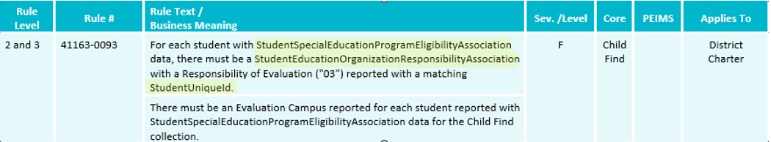
TSDS UPGRADE PROJECT UPDATES 4
Business Rule Changes:
  The following business rule has been added to ensure all students reported for Child Find are also reported with an evaluation campus.
    The evaluation campus is the EducationOrganization (reference) reported in the StudentEducationOrganizationResponsibilityAssociation where Responsibility (E3051) = ‘03’ (Evaluation).
Notes:
41163-0078 and 41163-0093 are examples of rules that changed because of the way the evaluation campus is now being collected.
40100-0017, 40110-0001, and 41163-0073 were removed as they should now be caught by L1 API errors.

Slide 29
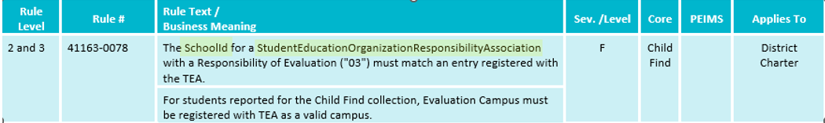
TSDS UPGRADE PROJECT UPDATES 5
Business Rule Changes:
  The following rule has been updated to reflect the terminology changes made to the collection of evaluation campus information.
    41163-0078 states that the SchoolId reported with a Responsibility = ‘03’ (Evaluation) must match an entry registered with TEA.
    In the XML submission, this rule stated that the CAMPUS-ID-OF-EVALUATION must be a valid campus.
Notes:
41163-0078 and 41163-0093 are examples of rules that changed because of the way the evaluation campus is now being collected.
40100-0017, 40110-0001, and 41163-0073 were removed as they should now be caught by L1 API errors.

Slide 30
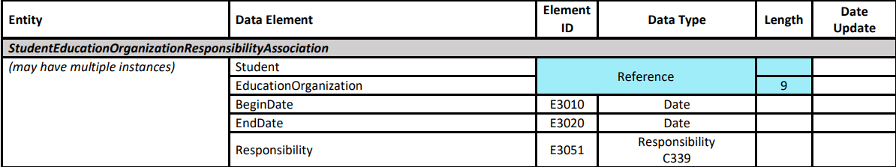
TSDS UPGRADE PROJECT UPDATES 6
Additional Changes:
  Reporting enrolled vs non-enrolled students.
    Data reported for both enrolled and non-enrolled students:
      Student Identification and Demographics
      StudentEducationOrganizationResponsibilityAssociation
        The combination of the EducationOrganization reference and Responsibility (E3051) where the descriptor is ‘03’ (Evaluation) replaces the CAMPUS-ID-OF-EVALUATION data element.
        If multiple records are reported, the application will promote the one with the latest BeginDate (E3010).

Slide 31
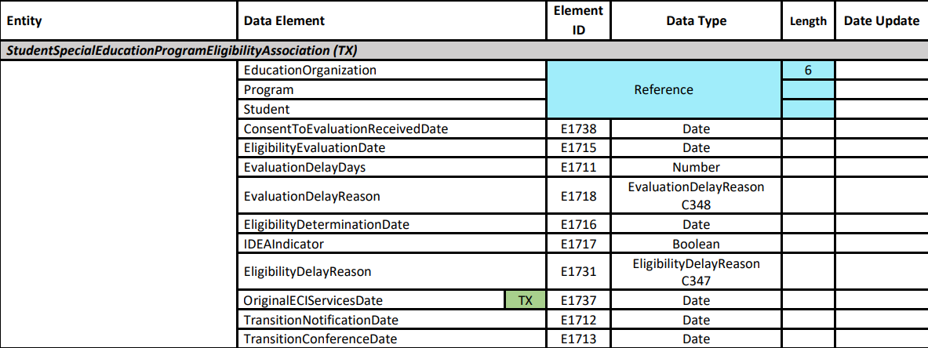
TSDS UPGRADE PROJECT UPDATES 7
Additional Changes:
  StudentSpecialEducationProgramEligibilityAssociation (TX)
    OriginalECIServicesDate (E1737), TransitionNotificationDate (E1712), and TransitionConferenceDate (E1713) are only reported for children receiving ECI services.
  Data reported only for enrolled students:
    StudentSchoolAssociation

Slide 32
TSDS UPGRADE PROJECT UPDATES 8
Additional Changes:
  Reporting calendar data
    Child Find calendar data comes from the following two entities:
      Calendar
        CalendarCode (E0975) replaces the INSTRUCTIONAL-TRACK-INDICATOR-CODE and has changed in length from 2 to 60 characters.
      CalendarDate
        The Date (E1168) data element is counted toward the SPPI-11 initial evaluation compliance timeframe where the CalendarEvent (E1582) descriptor is reported as ‘01’ (Instructional Day).
    Current issues being addressed:
      Updating default calendar logic for non-enrolled students.
      Updating report layout to account for longer CalendarCode values.

Slide 33
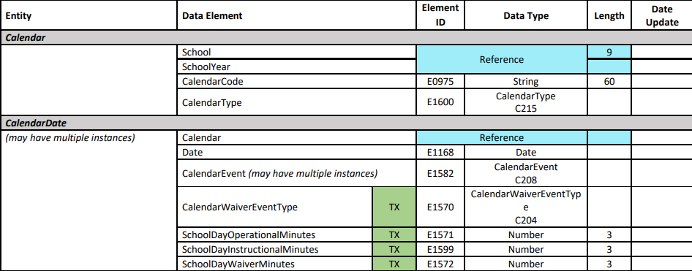
TSDS UPGRADE PROJECT UPDATES 9
Additional Changes:

Slide 34
TSDS UPGRADE PROJECT UPDATES 10
Promotion Logic Guide & Test Cases Coming Soon!
  More details will be provided in the TSDS Summer Training.

Slide 35
TITLE SLIDE: Closeout
CLOSEOUT
NAME OF COMPONENT (ALL CAPS)
MARCH 19-21, 2024

Slide 36
TIMELINE 2
Child Find | Date
TSDS ready to load data to IODS | August 5, 2024
Child Find ready for users to complete | May 19, 2025
Child Find Submission due date for LEAs | July 31, 2025
Child Find data available to customers | August 14, 2025

Slide 37
TECHNICAL RESOURCES 1
TIMS Knowledge Base Articles
  TSDSKB-620: SPPI-11 Compliance Flowchart
  TSDSKB-621: SPPI-12 Compliance Flowchart
  TSDSKB-622: Child Find Frequently Asked Questions
  TSDSKB-645: SPPI-12 Frequently Asked Questions
  TSDKSB-646: SPPI-11 Frequently Asked Questions
  TSDSKB-650: Child Find Interactive Flowchart
Please Note – these KB articles will be updated to account for the SPPI-11 Eligibility Determination compliance calculation change.

Slide 38
TECHNICAL RESOURCES 2
Technical Support
  TSDSCustomerSupport@tea.texas.gov
Technical Specification
  2024-2025 Domains
  2024-2025 Data Element Definitions
  2024-2025 Descriptor Tables
  2024-2025 Data Validation Rules
  2024-2025 Data Submission Timelines
  Known Issues
Program Area Documentation
  SPPI-11 Guidance Documents
  SPPI-12 Guidance Documents
TSDS Incident Management System (TIMS)
  TSDS Incident Management System (TIMS) Support Application
  TIMS Knowledge Base Article Repository

Slide 39

QUESTIONS
QUESTIONS?

