Slide 1

TITLE SLIDE: ESC Vendor Training for One Component
CHILD FIND
MARCH 19-21, 2024

Slide 2

AGENDA – CHILD FIND
PROGRAM AREA
2023-2024 SCHOOL YEAR
  Submission Updates
  Report Updates
  Business Rule Updates
  Reminders
  Current Known Issues
  Timeline
  Frequently Asked Questions
2024-2025 SCHOOL YEAR
  Application Updates
  TSDS Upgrade Project Updates
CLOSEOUT
  Timeline
  Technical Resources
  Questions

Slide 3
PROGRAM AREA UPDATES & GUIDANCE
Special Populations Strategic Supports and Reporting Division
  Donna Holmes – State Performance Plan and Website Coordinator
  Program-related questions can be submitted through TIMS and will be routed accordingly.
Monitoring, Review and Support
  Lori Merrell, MS CCC/SLP – Director
  Nandini Gohil – Review and Support Manager
  Cole Davis – Review and Support Education Specialist

Slide 4
TSDS Child Find Data Entry and Validation

Slide 5
Data validation via SPPI Clarification
After the State Performance Plan Indicator collection period each year, the Texas Education Agency (TEA) offers local education agencies (LEAs) who reported less than 100% compliance the opportunity to submit updated data for Compliance Indicators 11a, 11b, 12, and 13.
LEAs have the opportunity to correct data entry errors and/or to document correction of any potential noncompliance found in the State's database for these indicators prior to the State issuing a finding of noncompliance.
LEA participation in the clarification period is voluntary.
Notes:
Read slide

Slide 6
State Performance Indicators (SPPI) 11, 12 & 13
SPPI 11: Child Find- Timely Evaluation (11a) and Eligibility Determination (11b)
  Data collection period: July 1, 2023-June 30, 2024
  Submission due: July 25, 2024
  TEAL TSDS Application
SPPI 12: Early Childhood Transition
  Data collection period: July 1, 2023-June 30, 2024
  Submission due: July 25, 2024
  TEAL TSDS Application
SPPI 13: Secondary Transition
  Data collection period: July 1, 2023-June 30, 2024
  Submission due: August 9, 2024
  TEAL SPP Application
Notes:
Upon completion of the SPPI 13 data submission, data is analyzed, and a preliminary compliance determination is calculated for each indicator.
The clarification process begins after LEAs receive their preliminary compliance finding and is open for 10 business days. This timeframe typically runs from the end of August into the first week of September.

Slide 7
Data Validation Process Steps
LEAs who choose to participate in the SPPI Clarification process must submit the following for review:
  Procedures related to the indicator identified noncompliant
  Training Evidence of procedures
  Self-Monitoring Plan to prevent additional noncompliance
  SPPI Verification Workbook & Attestation of Compliance showing child-specific corrections
  School Calendar(s)
Notes:
Read slide

Slide 8
Data Validation Process Steps
TEA Monitoring, Review and Support team review these items to determine if
  All child-specific noncompliance has been corrected AND
  All systemic noncompliance has been corrected
If the LEA can demonstrate correction of both child-specific and systemic noncompliance then the LEA is considered post-clarification compliant and their SPPI 11a, SPPI 11b, 12 and/or 13 SPPI compliance rating will reflect Compliant/ 100%
If correction of child-specific and/or systemic noncompliance is not demonstrated, the LEA will remain noncompliant and engage in the CAP process.
Notes:
Read slide

Slide 9
Data Entry Errors
Notes:
Some items triggering noncompliance are preventable with careful planning and data review.

Slide 10
Most Common Data Entry Errors
Attendance
Calendar issues
Human error
Transfer Students
Notes:
As our team works with LEAs in the clarification process, we routinely see one or more of these areas noted as the reason for noncompliance. The LEA is engaging in clarifications to provide the correct data, not corrected data, correct data-meaning they are able to demonstrate they were initially compliant but for some reason data uploaded and submitted in TSDS triggered noncompliance. With proper planning and the implementation of routine data reviews, LEAs can prevent the need for clarification and have higher SPPI compliance.

Slide 11
Attendance and Full Individual and Initial Evaluation (FIIE)
§89.1011. Full Individual and Initial Evaluation
If a parent submits a written request to a school district's director of special education services or to a district administrative employee for a full individual and initial evaluation of a student, the school district must…
§89.1011 (c) Except as otherwise provided in this section, a written report of a full individual and initial evaluation of a student must be completed as follows:
  (1) not later than the 45th school day following the date on which the school district receives written consent for the evaluation from the student's parent, except that if a student has been absent from school during that period on three or more school days, that period must be extended by a number of school days equal to the number of school days during that period on which the student has been absent; …
Notes:
89.1011 defines the timeline full Individual and initial evaluations (FIIEs) must be completed within as well as allowable exceptions to the timeline. (Read slide an emphasize the bold font in 3rd bullet.

Slide 12
FIIE Absence Definition
§89.1011 (h) For purposes of subsections (c)(1) and (e) of this section, a student is considered absent for the school day if the student is not in attendance at the school's official attendance taking time or at the alternate attendance taking time set for that student. A student is considered in attendance if the student is off campus participating in an activity that is approved by the school board and is under the direction of a professional staff member of the school district, or an adjunct staff member who has a minimum of a bachelor's degree and is eligible for participation in the Teacher Retirement System of Texas…
Notes:
89.1011 (h) defines absence as it relates to the FIIE timeline compliance. Read slide emphasis on bold font

Slide 13
FIIE Absence Example
Consent signed 2/1/2024. Official attendance taking period is 2nd period. On 2/5 the student is not present and is marked absent. Student is still not present when the evaluator comes to pull the student for their evaluation. Evaluator marks the student as absent in the electronic IEP system/evaluation log. Student returns in 4th period with a doctor’s note. Absence in TSDS is changed to present. Student is absent again 2/20 and 3/8 which are captured by TSDS as absences. The evaluator shows 3 absences and extends the evaluation due date by the number of absences. The LEA submits their SPPI 11 data and is found to be noncompliant for this student. Why?
The evaluator and TSDS have competing data as the evaluator shows 3 absences for each time the student was not present at the official attendance taking period, but TSDS only shows 2 as the student returned to school in the first instance. Both are accurate however, not all systems capture the attendance taking absences when submitting the data for TSDS Child Find submissions.
Solution: LEAs should review TSDS data routinely to ensure absences as defined in §89.1011 (h) are accurately captured to avoid data entry errors and inaccurate noncompliance findings
Notes:
Let’s look at an example: Read slide

Slide 14
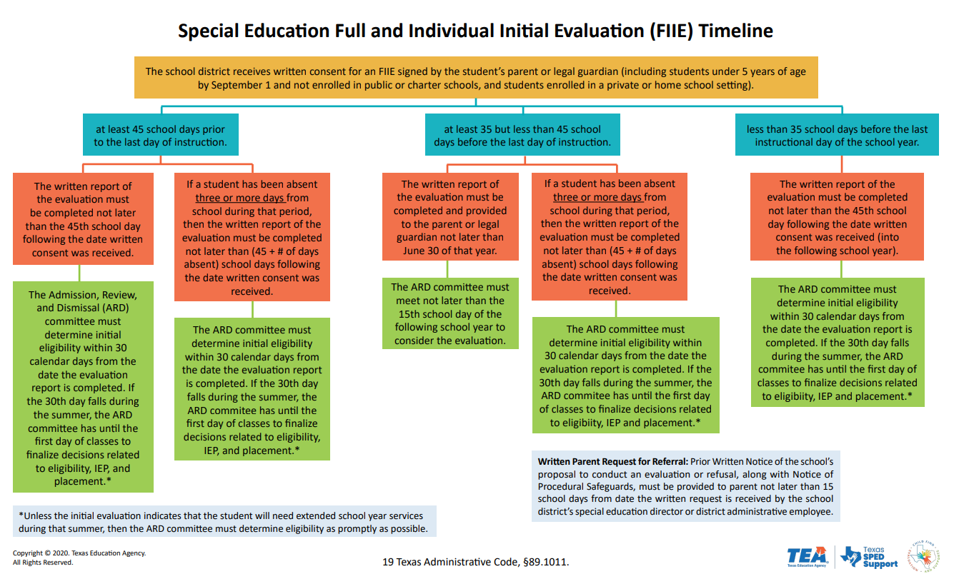
Calendar issues
FIIE compliance (11a) relies on the accurate calculation of school days.
School closures and changes to instructional days impact this calculation.
LEAs present updated calendars showing school closures and other calendar revisions during the clarification process.
Solution: Ensure the correct calendar is uploaded in the TSDS Child Find submission in July.
Notes:
Another area of preventable noncompliance stems from the version of the school calendar uploaded by the LEA during their TSDS submission. Read first two bullets and then expand on the 3rd by reading During the clarification process LEAs present updated calendars showing school closures and other calendar revisions. When SPPI 11a data is recalculated using the corrected calendar, the LEA is compliant with the FIIE timeline. Read solution bullet.

Slide 15
Human Errors
Since the TSDS Child Find collection pulls from 3rd party systems there is a possibility of data entry errors.
Most LEAs hand enter data into an electronic IEP data system that uploads into the LEA’s SIS and from there the upload to TSDS is generated.
Solution: LEAs should build a routine of checking their TSDS Child Find data reports to ensure all data is accurate and compliance checks are correct
Notes:
Read slide

Slide 16
Transfer Students §89.1011 (f)
§89.1011 (f) states:
If a student was in the process of being evaluated for special education eligibility by a school district and enrolls in another school district before the previous school district completed the full individual and initial evaluation, the new school district must coordinate with the previous school district as necessary and as expeditiously as possible to ensure a prompt completion of the evaluation in accordance with 34 CFR, §300.301(d)(2) and (e) and §300.304(c)(5). The timelines in subsections (c) and (e) of this section do not apply in such a situation if:
  the new school district is making sufficient progress to ensure a prompt completion of the evaluation; and
  the parent and the new school district agree to a specific time when the evaluation will be completed
LEAs provide the code 09 (other) to explain the delay for the student’s FIIE. During the clarification process, the LEA provides evidence that the student transferred during the evaluation process.
Solution: LEAs should use the delay reason codes 06 or 07 for transfer students when the elements of §89.1011 (f) are met by the LEA.
Notes:
The last common but preventable instance of noncompliance relates to students who transfer during the evaluation process. 89.1011 (f) states (read first bullet) Read solution and add-LEAs need to understand the purpose of each delay reason code as the accurate use of these codes could prevent the LEA from being determined noncompliant.

Slide 17
Questions?
For questions about the SPP clarifications process, please contact the Division of Review and Support by email at: ReviewandSupport@tea.texas.gov

Slide 18
Thank you

Slide 19

TITLE SLIDE: 2023-2024 School Year
2023-2024
SCHOOL YEAR
NAME OF COMPONENT (ALL CAPS)
MARCH 19-21, 2024

Slide 20
SUBMISSION UPDATES 1
The following code value has been removed as an acceptable ELIGIBILITY-DELAY-REASON for SPPI-11 Eligibility Determination compliance calculations:
  05 – Parent Delay (Detailed Records Maintained by LEA Regarding a Parent of a Child who Repeatedly Fails or Refuses to Produce the Child for the Evaluation or Eligibility Determination)
ELIGIBILITY-DELAY-REASON code ‘05’ can still be reported but will no longer automatically mark the student as compliant for their eligibility determination.

Slide 21
SUBMISSION UPDATES 2
LEAs that reported an ELIGIBILITY-DELAY-REASON code ‘05’ for any of their students prior to March 23, 2024, must re-promote their Child Find data prior to marking the submission as ‘Complete’.
  TEA will be reaching out to LEAs who have reported this value and have not re-promoted their data.
This change does not affect the SPPI-11 initial evaluation compliance, nor the compliance calculated for SPPI-12. Code ‘05’ is still considered an acceptable delay reason for those compliance calculations.
  Additionally, ELIGIBILITY-DELAY-REASON code ‘07’ is still considered an acceptable delay reason for SPPI-11 Eligibility Determination compliance calculations.

Slide 22
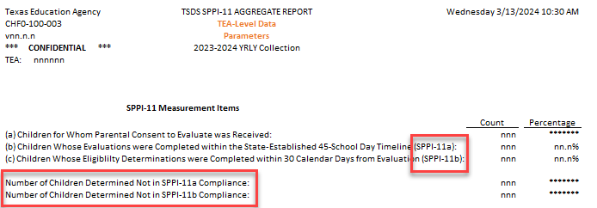
REPORT UPDATES 1
CHF0-100-003 SPPI-11 Aggregate Report – tentatively scheduled for the April 19, 2024, software release.
  SPPI-11 Measurement Items
    Row (b) label will be updated to indicate the measurement is for SPPI-11a.
    Row (c) label will be updated to indicate the measurement is for SPPI-11b.
    Number of Children Not in SPPI-11 Compliance will be split into two pieces – SPPI-11a and SPPI-11b.

Slide 23
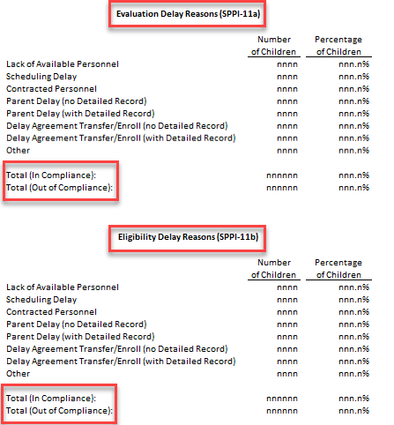
REPORT UPDATES 2
  Delay Reasons will be split into two sections
    Evaluation Delay Reasons (SPPI-11a)
    Eligibility Delay Reasons (SPPI-11b)
  The Total row will be split into two pieces for each section:
    Total (In Compliance)
      For SPPI-11a, this will include EVALUATION-DELAY-REASON codes equal to ‘05’ and ‘07’.
      For SPPI-11b, this will include ELIGIBILITY-DELAY-REASON code equal to ’07’ only.
    Total (Out of Compliance)

Slide 24
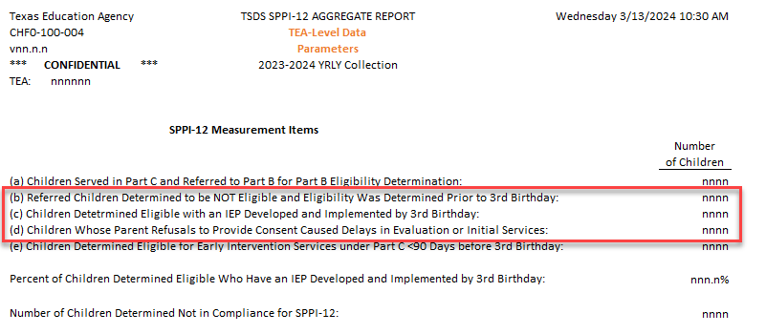
REPORT UPDATES 3
CHF0-100-004 SPPI-12 Aggregate Report – tentatively scheduled for the April 19, 2024, software release.
  SPPI-12 Measurement Items
    Row (b), (c), and (d) calculations will be updated to include ELIGIBILITY-DELAY-REASON.

Slide 25
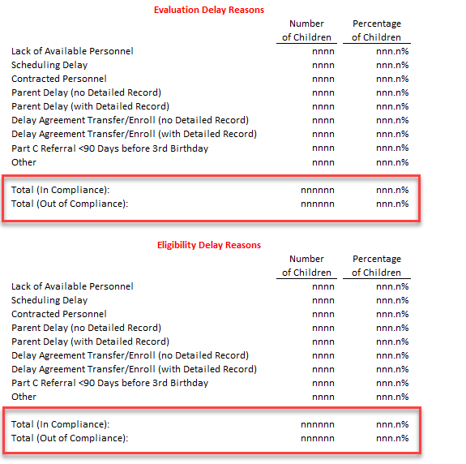
REPORT UPDATES 4
  Delay Reasons will be split into two sections
    Evaluation Delay Reasons
    Eligibility Delay Reasons
  The Total row will be split into two pieces for each section:
    Total (In Compliance)
      For Evaluation Delay Reasons, this will include EVALUATION-DELAY-REASON codes equal to ‘05’ and ‘07’.
      For Eligibility Delay Reasons, this will include ELIGIBILITY-DELAY-REASON codes equal to ’05 and ’07’.
    Total (Out of Compliance)

Slide 26
BUSINESS RULE UPDATES
The following validation rules will be updated in the Core application on March 22, 2024, to account for the SPPI-11 Eligibility Determination calculation change:
  41163-0089 – If SPPI-11 Eligibility Determination Compliance (calculated value) is "Y", then ELIGIBILITY-DELAY-REASON must be either not reported, "05", or "07".
  41163-0090 – If SPPI-11 Eligibility Determination Compliance (calculated value) is "N", then ELIGIBILITY-DELAY-REASON must be reported and must not be "05" or "07".
These changes will be updated in TEDS for the 2024-2025 school year.

Slide 27
REMINDERS 1
2023-2024 Data Element Changes
  ORIGINAL-ECI-SERVICES-DATE (E1737)
    Replaced EFFECTIVE-DATE and EARLY-CHILDHOOD-INTERV-IND-CODE.
    Only reported for children receiving early childhood intervention (ECI) services.
      Date must come before child’s 3rd birthday.
      Memorandum of Understanding (MOU) between ECI providers and LEAs has been updated to where this date must be supplied by the ECI provider.
    Children reported with a date less than 90 days before their 3rd birthday will have their compliance calculated through the SPPI-11 timeline.
      CHF0-100-002 SPPI-12 Student Compliance Report – review the ‘Calc Days Til 3rd Bday Count’ column on this report.
      These children will show up on both the CHF0-100-001 and CHF0-100-002 reports and will also be counted in both the CHF0-100-003 and CHF0-100-004 reports.

Slide 28
REMINDERS 2
  CONSENT-TO-EVALUATION-RECEIVED-DATE (E1738)
    Replaced PARENTAL-CONSENT-DATE
    Guidance changes
      Report the actual date the written consent was received by the LEA, not the next instructional date as was the guidance with the previous data element.
      No longer need to back-date consent received during the summer months.
  ECI-TRANSITION-CONFERENCE-DATE (E1713)
    Only reported for children receiving ECI services.
    No longer mandatory. This does not need to be reported if the parent opted out of the transition conference.

Slide 29
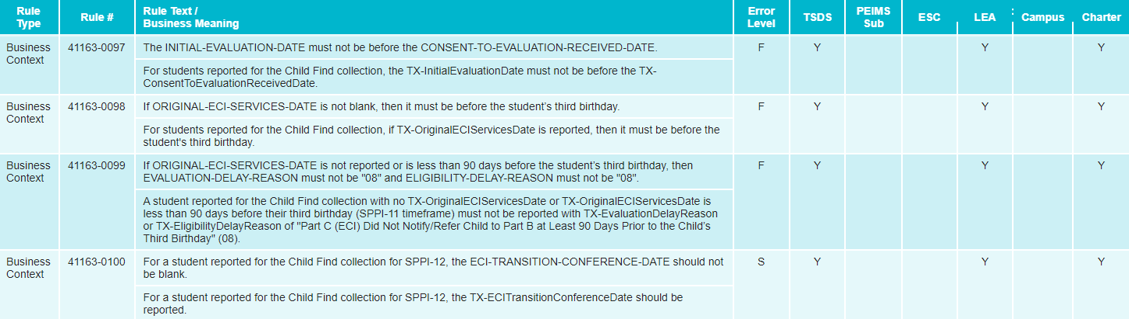
REMINDERS 3
2023-2024 Rule Changes

Slide 30
REMINDERS 4
CHF0-100-005 SPPI-11 Calculations Report
  The report is available to LEA users in CSV format only.
  It displays all the intermediate calculations performed by the Core application that go into determining the SPPI-11 compliance.
  Users can utilize the report in conjunction with the SPPI-11 compliance flowchart for troubleshooting student non-compliance issues.

Slide 31
REMINDERS 5
  Important columns to pay attention to:
    Calc Days After Consent Count – indicates the number of instructional days remaining in the school year starting on the parental consent date. This is the first step in determining the compliance timeframe.
    Calc Init Eval Cutoff Date – indicates the calculated compliance cutoff date (i.e., due date) for the initial evaluation. An evaluation reported after this date results in non-compliance.
    Calc Day 30 After Init Eval Date – indicates the 30th calendar date after the initial evaluation. Under most scenarios, this acts as the cutoff date for the eligibility determination (unless it falls during the summer).

Slide 32
CURRENT KNOWN ISSUES 1
The following issues are tentatively scheduled to be resolved in the software release on March 22, 2024:
  For the SPPI-11 Eligibility Determination compliance calculation, the system is calculating a compliance value of ‘Y’ when ELIGIBILITY-DELAY-REASON code ‘05’ is reported. This code is no longer considered an acceptable delay reason for SPPI-11 Eligibility Determination compliance calculations. LEAs who have reported this value will need to re-promote their data to Child Find once a fix has been released.
  The following validation rules are misfiring when ELIGIBILITY-DELAY-REASON code ‘05’ is reported.
    41163-0089
    41163-0090

Slide 33
CURRENT KNOWN ISSUES 2
The following issue will be resolved with an upcoming software release:
  For the CHF0-100-004 SPPI-12 Aggregate Report, SPPI-12 Measurement Items (b), (c), and (d) do not include checks for ELIGIBILITY-DELAY-REASON codes. This caused the report to display incorrect counts for these three items, as well as an inaccurate measure of the ‘Percent of Children Determined Eligible Who Have an IEP Developed and Implemented by 3rd Birthday’ and ‘Number of Children Determined Not in Compliance for SPPI-12’.

Slide 34
TIMELINE 1
Child Find | Date
TSDS ready to load data to eDM | August 7, 2023
Child Find ready for users to promote data | September 11, 2023
Child Find ready for users to complete | May 20, 2024
Child Find Submission due date for LEAs | July 25, 2024
Child Find data available to customers | August 8, 2024

Slide 35
FREQUENTLY ASKED QUESTIONS 1
What date should the LEA report for the CONSENT-TO-EVALUATION-RECEIVED-DATE (E1738) if it occurs on the last day of school or over the summer before the new school year begins?
With the removal of PARENTAL-CONSENT-DATE and addition of CONSENT-TO-EVALUATION-RECEIVED-DATE in the 2023-2024 school year, LEAs should now report the date that the written consent was received. This is unlike the guidance from previous years where the next instructional date was to be reported. Additionally, there are no longer any workarounds needed when the date occurs on the last day of school or over the summer.

Slide 36
FREQUENTLY ASKED QUESTIONS 2
Which days should be counted for a student for the STUDENT-ABSENCES-WITHIN-TIMEFRAME (E1711) data element?
A student is considered absent for the school day if the student is not in attendance at the school's official attendance taking time or at the alternate attendance taking time set for that student. A student is considered in attendance if the student is off campus participating in an activity that is approved by the school board and is under the direction of a professional staff member of the school district, or an adjunct staff member who has a minimum of a bachelor's degree and is eligible for participation in the Teacher Retirement System of Texas.

Slide 37
FREQUENTLY ASKED QUESTIONS 3
I have a child to report for SPPI-12. The ECI provider is not supplying my LEA with the date that the child began receiving ECI services. What should be reported for the child’s ORIGINAL-ECI-SERVICES-DATE (E1737)?
LEAs should make every effort to obtain the exact date the child began receiving ECI services. The Memorandum of Understanding (MOU) with the ECI provider(s) has been updated to where they must supply this date to an LEA reporting a child for the Child Find data collection. In the event the exact date cannot be obtained, LEAs may use a “proxy” date. For example, LEAs could report the same date being reported for the ECI-NOTIFICATION-DATE (E1712). As always, LEAs should maintain local documentation in this scenario.

Slide 38
TITLE SLIDE: 2024-2025 School Year
2024-2025
SCHOOL YEAR
NAME OF COMPONENT (ALL CAPS)
MARCH 19-21, 2024

Slide 39
APPLICATION UPDATES
No application updates for the following:
  Data Elements
  Descriptor Tables
  Reports
  Business Rules

Slide 40
TSDS UPGRADE PROJECT UPDATES 1
Data Element Name Changes:
Data Element ID | XML Data Element Name | Upgrade Data Element Name
E0975 | INSTRUCTIONAL-TRACK-INDICATOR-CODE | CalendarCode
E1168 | CALENDAR-DATE | Date
E1582 | SCHOOL-DAY-EVENT-CODE | CalendarEvent
E1600 | INSTRUCTIONAL-PROGRAM-TYPE | CalendarType
E3051 (was E1710) | CAMPUS-ID-OF-EVALUATION | Responsibility (where descriptor = ’03’ Evaluation)

Slide 41
TSDS UPGRADE PROJECT UPDATES 2
Data Element Name Changes:
Data Element ID | XML Data Element Name | Upgrade Data Element Name
E1711 | STUDENT-ABSENCES-WITHIN-TIMEFRAME | EvaluationDelayDays
E1712 | ECI-NOTIFICATION-DATE | TransitionNotificationDate
E1713 | ECI-TRANSITION-CONFERENCE-DATE | TransitionConferenceDate
E1715 | INITIAL-EVALUATION-DATE | EligibilityEvaluationDate
E1716 | SPED-ELIGIBILITY-DETERMINATION-DATE | EligibilityDeterminationDate
E1717 | SPED-ELIGIBILITY-DETERMINATION-CODE | IDEAIndicator

Slide 42
TSDS UPGRADE PROJECT UPDATES 3
Descriptor Table Name Changes:
Descriptor Table ID | XML Code Table Name | Upgrade Descriptor Table Name
C208 | SCHOOL-DAY-EVENT-CODE | CalendarEvent
C215 | INSTRUCTIONAL-PROGRAM-TYPE | CalendarType
C339 | N/A | Responsibility
C347 (was DC164) | DELAY-REASON-CODE | EligibilityDelayReason
C348 (was DC164) | DELAY-REASON-CODE | EvaluationDelayReason

Slide 43
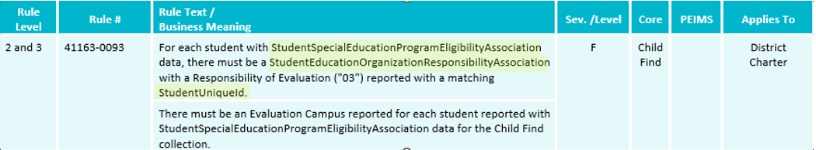
TSDS UPGRADE PROJECT UPDATES 4
Business Rule Changes:
  The following business rule has been added to ensure all students reported for Child Find are also reported with an evaluation campus.
    The evaluation campus is the EducationOrganization (reference) reported in the StudentEducationOrganizationResponsibilityAssociation where Responsibility (E3051) = ‘03’ (Evaluation).
Notes:
41163-0078 and 41163-0093 are examples of rules that changed because of the way the evaluation campus is now being collected.
40100-0017, 40110-0001, and 41163-0073 were removed as they should now be caught by L1 API errors.

Slide 44
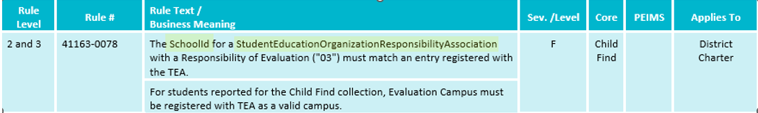
TSDS UPGRADE PROJECT UPDATES 5
Business Rule Changes:
  The following rule has been updated to reflect the terminology changes made to the collection of evaluation campus information.
    41163-0078 states that the SchoolId reported with a Responsibility = ‘03’ (Evaluation) must match an entry registered with TEA.
    In the XML submission, this rule stated that the CAMPUS-ID-OF-EVALUATION must be a valid campus.
Notes:
41163-0078 and 41163-0093 are examples of rules that changed because of the way the evaluation campus is now being collected.
40100-0017, 40110-0001, and 41163-0073 were removed as they should now be caught by L1 API errors.

Slide 45
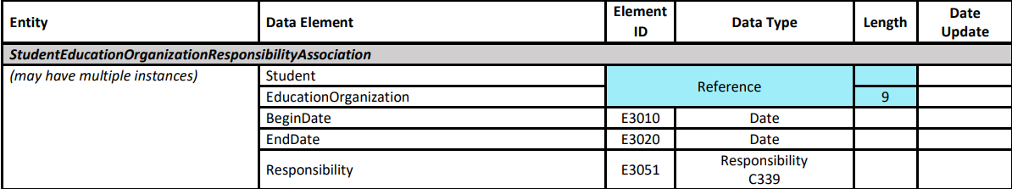
TSDS UPGRADE PROJECT UPDATES 6
Additional Changes:
  Reporting enrolled vs non-enrolled students.
    Data reported for both enrolled and non-enrolled students:
      Student Identification and Demographics
      StudentEducationOrganizationResponsibilityAssociation
        The combination of the EducationOrganization reference and Responsibility (E3051) where the descriptor is ‘03’ (Evaluation) replaces the CAMPUS-ID-OF-EVALUATION data element.
        If multiple records are reported, the application will promote the one with the latest BeginDate (E3010).

Slide 46
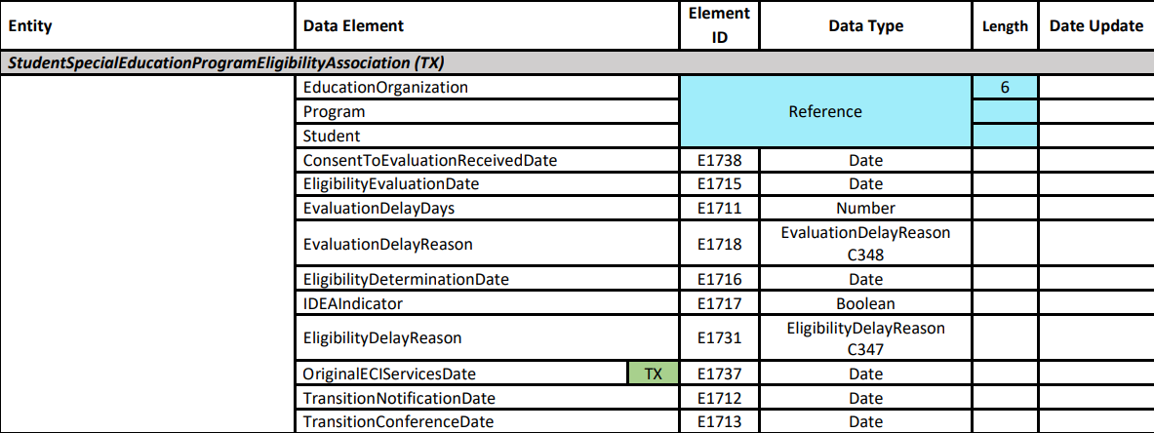
TSDS UPGRADE PROJECT UPDATES 7
Additional Changes:
  StudentSpecialEducationProgramEligibilityAssociation (TX)
    OriginalECIServicesDate (E1737), TransitionNotificationDate (E1712), and TransitionConferenceDate (E1713) are only reported for children receiving ECI services.
  Data reported only for enrolled students:
    StudentSchoolAssociation

Slide 47
TSDS UPGRADE PROJECT UPDATES 8
Additional Changes:
  Reporting calendar data
    Child Find calendar data comes from the following two entities:
      Calendar
        CalendarCode (E0975) replaces the INSTRUCTIONAL-TRACK-INDICATOR-CODE and has changed in length from 2 to 60 characters.
      CalendarDate
        The Date (E1168) data element is counted toward the SPPI-11 initial evaluation compliance timeframe where the CalendarEvent (E1582) descriptor is reported as ‘01’ (Instructional Day).
    Current issues being addressed:
      Updating default calendar logic for non-enrolled students.
      Updating report layout to account for longer CalendarCode values.

Slide 48
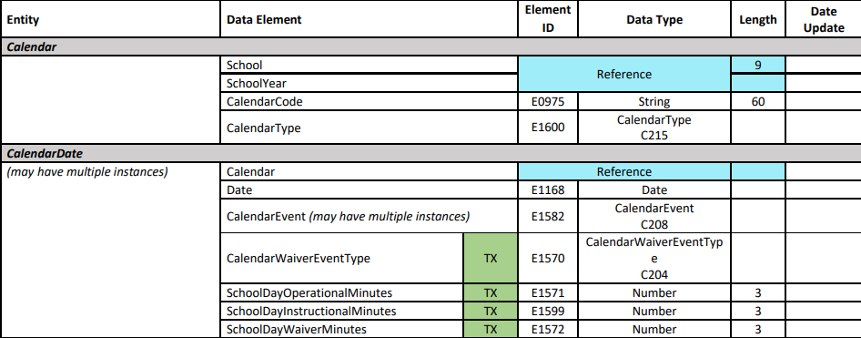
TSDS UPGRADE PROJECT UPDATES 9
Additional Changes:

Slide 49
TSDS UPGRADE PROJECT UPDATES 10
Promotion Logic Guide & Test Cases Coming Soon!
  More details will be provided in the TSDS Summer Training.

Slide 50
TITLE SLIDE: Closeout
CLOSEOUT
NAME OF COMPONENT (ALL CAPS)
MARCH 19-21, 2024

Slide 51
TIMELINE 2
Child Find | Date
TSDS ready to load data to IODS | August 5, 2024
Child Find ready for users to complete | May 19, 2025
Child Find Submission due date for LEAs | July 31, 2025
Child Find data available to customers | August 14, 2025

Slide 52
TECHNICAL RESOURCES 1
TIMS Knowledge Base Articles
  TSDSKB-620: SPPI-11 Compliance Flowchart
  TSDSKB-621: SPPI-12 Compliance Flowchart
  TSDSKB-622: Child Find Frequently Asked Questions
  TSDSKB-645: SPPI-12 Frequently Asked Questions
  TSDKSB-646: SPPI-11 Frequently Asked Questions
  TSDSKB-650: Child Find Interactive Flowchart
Please Note – these KB articles will be updated to account for the SPPI-11 Eligibility Determination compliance calculation change.

Slide 53
TECHNICAL RESOURCES 2
Technical Support
  TSDSCustomerSupport@tea.texas.gov
Technical Specification
  2024-2025 Domains
  2024-2025 Data Element Definitions
  2024-2025 Descriptor Tables
  2024-2025 Data Validation Rules
  2024-2025 Data Submission Timelines
  Known Issues
Program Area Documentation
  SPPI-11 Guidance Documents
  SPPI-12 Guidance Documents
TSDS Incident Management System (TIMS)
  TSDS Incident Management System (TIMS) Support Application
  TIMS Knowledge Base Article Repository

Slide 54

QUESTIONS
QUESTIONS?

