Slide 1

TITLE SLIDE: ESC Vendor Training for One Component
CHILD FIND
July 30-31, 2024 and August 1, 2024

Slide 2

AGENDA – CHILD FIND
PROGRAM AREA
2024-2025 SCHOOL YEAR
  Data Governance Updates
  TSDS Upgrade Project Updates
  Current Known Issues
CLOSEOUT
  Timeline
  Frequently Asked Questions
  Technical Resources
  Questions

Slide 3
PROGRAM AREA UPDATES & GUIDANCE
Special Populations Strategic Supports and Reporting Division
  Donna Holmes – Program Specialist
  Program-related questions can be submitted through TIMS and will be routed accordingly.
Monitoring, Review and Support
  Lori Merrell, MS CCC/SLP – Director
  For questions about the SPP clarifications process, please contact ReviewandSupport@tea.texas.gov

Slide 4

TITLE SLIDE: 2024-2025 School Year
2024-2025
SCHOOL YEAR
NAME OF COMPONENT (ALL CAPS)
MARCH 19-21, 2024

Slide 5
DATA GOVERNANCE UPDATES
No updates to the following since TSDS Spring Training:
  Reports

Slide 6
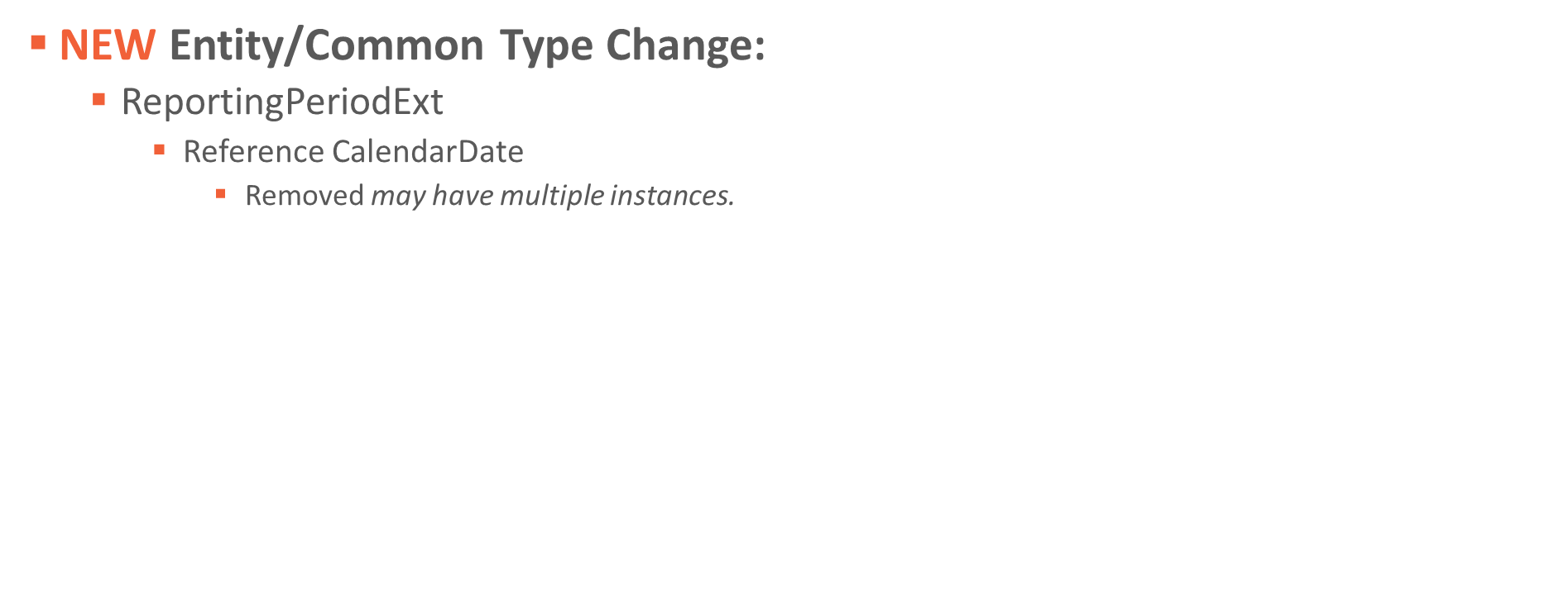
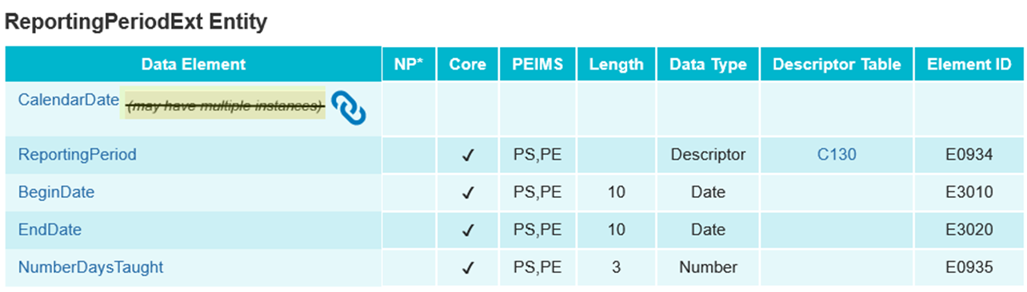
DATA GOVERNANCE UPDATES 1

Slide 7
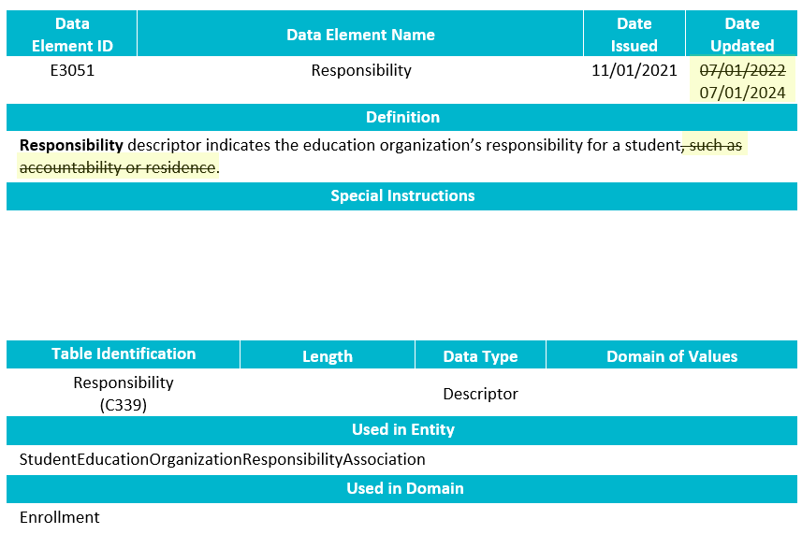
DATA GOVERNANCE UPDATES8
NEW Data Element Change:
  E3051 Responsibility
    Revised the definition.

Slide 8
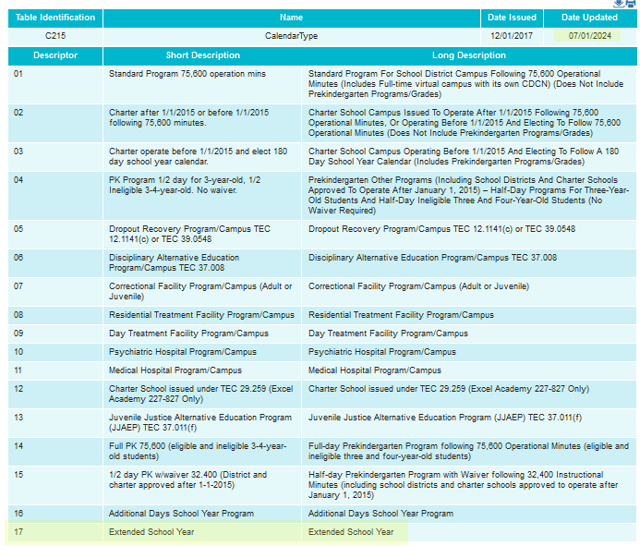
DATA GOVERNANCE UPDATES 2
NEW Descriptor Table Updates:

Slide 9
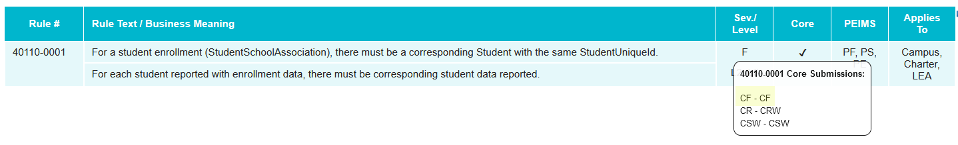
DATA GOVERNANCE UPDATES 3
NEW Business Rule Changes:
  The following business rules have been added:

Slide 10
TSDS UPGRADE PROJECT UPDATES 1
Data Element Name Changes:
Data Element ID | XML Data Element Name | Upgrade Data Element Name
E0975 | INSTRUCTIONAL-TRACK-INDICATOR-CODE | CalendarCode
E1168 | CALENDAR-DATE | Date
E1582 | SCHOOL-DAY-EVENT-CODE | CalendarEvent
E1600 | INSTRUCTIONAL-PROGRAM-TYPE | CalendarType
E3051 (was E1710) | CAMPUS-ID-OF-EVALUATION | Responsibility (where descriptor = ’03’ Evaluation)

Slide 11
TSDS UPGRADE PROJECT UPDATES 2
Data Element Name Changes:
Data Element ID | XML Data Element Name | Upgrade Data Element Name
E1711 | STUDENT-ABSENCES-WITHIN-TIMEFRAME | EvaluationDelayDays
E1712 | ECI-NOTIFICATION-DATE | TransitionNotificationDate
E1713 | ECI-TRANSITION-CONFERENCE-DATE | TransitionConferenceDate
E1715 | INITIAL-EVALUATION-DATE | EligibilityEvaluationDate
E1716 | SPED-ELIGIBILITY-DETERMINATION-DATE | EligibilityDeterminationDate
E1717 | SPED-ELIGIBILITY-DETERMINATION-CODE | IDEAIndicator

Slide 12
TSDS UPGRADE PROJECT UPDATES 3
Descriptor Table Name Changes:
Descriptor Table ID | XML Code Table Name | Upgrade Descriptor Table Name
C208 | SCHOOL-DAY-EVENT-CODE | CalendarEvent
C215 | INSTRUCTIONAL-PROGRAM-TYPE | CalendarType
C339 | N/A | Responsibility
C347 (was DC164) | DELAY-REASON-CODE | EligibilityDelayReason
C348 (was DC164) | DELAY-REASON-CODE | EvaluationDelayReason

Slide 13
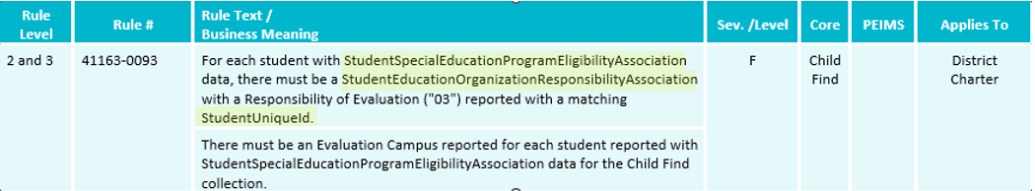
TSDS UPGRADE PROJECT UPDATES 4
Business Rule Changes:
  The following business rule has been added to ensure all students reported for Child Find are also reported with an evaluation campus.
    The evaluation campus is the EducationOrganization (reference) reported in the StudentEducationOrganizationResponsibilityAssociation where Responsibility (E3051) = ‘03’ (Evaluation).

Slide 14
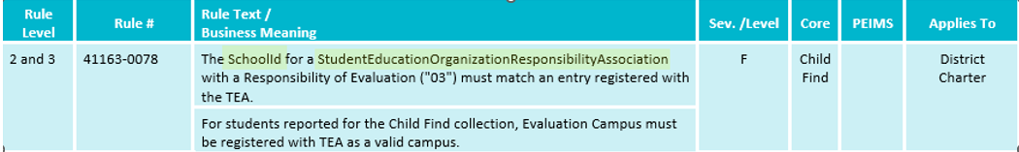
TSDS UPGRADE PROJECT UPDATES 5
Business Rule Changes:
  The following rule has been updated to reflect the terminology changes made to the collection of evaluation campus information.
    41163-0078 states that the SchoolId reported with a Responsibility = ‘03’ (Evaluation) must match an entry registered with TEA.
    In the XML submission, this rule stated that the CAMPUS-ID-OF-EVALUATION must be a valid campus.

Slide 15
TSDS UPGRADE PROJECT UPDATES 10
NEW Promotion Logic:
  Child Find Promotion Logic
  Student > Special Education Program Association
    The combination of the EducationOrganization reference and Responsibility (E3051) where the descriptor is ‘03’ (Evaluation) replaces the CAMPUS-ID-OF-EVALUATION data element.
      If multiple records are reported, the one with the latest BeginDate (E3010) will be promoted.
    OriginalECIServicesDate (E1737), TransitionNotificationDate (E1712), and TransitionConferenceDate (E1713) are only reported for children receiving ECI services.
  Education Organization > Calendar
    CalendarCode (E0975) replaces the INSTRUCTIONAL-TRACK-INDICATOR-CODE and is now 60 characters in length.
    The Date (E1168) data element is counted toward the SPPI-11 initial evaluation compliance timeframe where the CalendarEvent (E1582) descriptor is reported as ‘01’ (Instructional Day).

Slide 16
TSDS UPGRADE PROJECT UPDATES 103
NEW Test Cases:
  Child Find Test Cases
  Test Case 1 – Verify SPPI-11 Student Data
    On the CHF0-100-005 report, review the ‘Calc Init Eval Cutoff Date’ column for students with a blank value.
  Test Case 2 – Verify SPPI-12 Student Data
    On the CHF0-100-002 report, review the ‘Calc Days Til 3rd Bday Count’ for children with a negative value or a value less than 90 days.

Slide 17
CURRENT KNOWN ISSUES 1
The SPPI-11 initial evaluation cutoff date is not calculating for students reported with a ConsentToEvaluationReceivedDate (E1738) on the last instructional day of their calendar. This is causing the SPPI-11 compliance calculation to calculate non-compliance for the student.
  Calculation logic will be updated in the 2024-2025 school year to account for students with a ConsentToEvaluationReceivedDate on or after their last instructional day. LEAs will have up to 45 instructional days (plus absence days if 3 or more) into the next school year to complete the student’s initial evaluation.

Slide 18
TITLE SLIDE: Closeout
CLOSEOUT
NAME OF COMPONENT (ALL CAPS)
MARCH 19-21, 2024

Slide 19
TIMELINE 2
Child Find | Date
TSDS ready to load data to IODS | August 5, 2024
Child Find ready for users to complete | May 19, 2025
Child Find Submission due date for LEAs | July 31, 2025
Child Find data available to customers | August 14, 2025

Slide 20
TECHNICAL RESOURCES 1
TIMS Knowledge Base Articles
  TSDSKB-620: SPPI-11 Compliance Flowchart
  TSDSKB-621: SPPI-12 Compliance Flowchart
  TSDSKB-622: Child Find Frequently Asked Questions
  TSDSKB-645: SPPI-12 Frequently Asked Questions
  TSDKSB-646: SPPI-11 Frequently Asked Questions
  TSDSKB-650: Child Find Interactive Flowchart
Please Note – these KB articles will be updated to account for the SPPI-11 Eligibility Determination compliance calculation change.

Slide 21
TECHNICAL RESOURCES 2
Technical Support
  TSDSCustomerSupport@tea.texas.gov
Technical Specification
  2024-2025 TSDS Web-Enabled Data Standards (TWEDS)
  Known Issues
Program Area Documentation
  SPPI-11 Guidance Documents
  SPPI-12 Guidance Documents
TSDS Incident Management System (TIMS)
  TSDS Incident Management System (TIMS) Support Application
  TIMS Knowledge Base Article Repository

Slide 22

QUESTIONS
QUESTIONS?

