Slide 1

TITLE SLIDE: ESC Vendor Training for One Component
CLASS ROSTER WINTER
MARCH 19-21, 2024

Slide 2

AGENDA – CLASS ROSTER WINTER
PROGRAM AREA
2023-2024 SCHOOL YEAR
  Submission Updates
  Report Updates
  Reminders
  Timeline
  Frequently Asked Questions
2024-2025 SCHOOL YEAR
  Application Updates
  Data Element Updates
  Descriptor Table Updates
  Business Rule Updates
  TSDS Upgrade Updates
CLOSEOUT
  Timeline
  Frequently Asked Questions
  Technical Resources
  Questions

Slide 3
PROGRAM AREA UPDATES & GUIDANCE
Teacher Incentive Allotment (TIA) Program Support
  Lyra Swinney – Manager of TIA Program Support
TIA discussion items:
  TIA data elements and designation status
  Understanding creditable year of service
TIA support questions - tia@tea.texas.gov

Slide 4

TITLE SLIDE: 2023-2024 School Year
2023-2024
SCHOOL YEAR
NAME OF COMPONENT (ALL CAPS)
MARCH 19-21, 2024

Slide 5
SUBMISSION UPDATES
No submission updates for the following:
  Data Elements
  Code Tables
  Business Rules

Slide 6
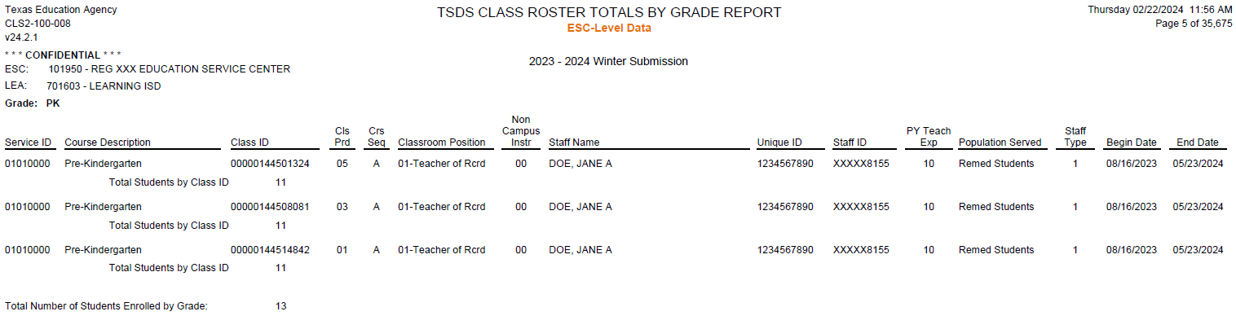
REPORT UPDATES
CLS2-100-008 CLASS ROSTER TOTALS BY GRADE REPORT
  New ESC Level report
    This ESC-level report shall provide a Class Roster WNTR Submission listing of each Service ID, including basic information about each class.
    The purpose of the report is to allow the ESC users to verify the LEA-level data they have submitted for each teacher’s Service IDs.

Slide 7
REMINDERS
LEAs should run all reports to verify their staff and student data and counts before completing their submission.
  TIA Teacher Incentive Allotment:
    CLS2-100-007 Teacher Incentive Allotment Designated Staff Report:
      Teacher data for all teachers with a TIA designation code(s)
      Campuses at which the teachers provide instruction, for LEAs to verify the designated campuses for funding.

Slide 8
TIMELINE
Class Roster Collection – Winter Submission | Date
TSDS ready to load data to eDM | August 7, 2023
Class Roster Winter ready for users to promote data | January 29, 2024
Class Roster Winter ready for users to complete | February 23, 2024
Class Roster Winter snapshot date – Last Friday in February | February 23, 2024
Class Roster Winter Submission due date for LEAs | March 28, 2024
Class Roster Winter data available to customers | April 11, 2024

Slide 9
FREQUENTLY ASKED QUESTIONS
How does an LEA maintain the begin/expiration dates of Teacher Incentive Allotment (TIA) designations?
TEA does not collect begin/end dates of designations, so it would be up to the district to track that information, but they should report only active designations. LEAs can look this information up using their SCOMS Account if they employ designated teachers.

Slide 10
TITLE SLIDE: 2024-2025 School Year
2024-2025
SCHOOL YEAR
NAME OF COMPONENT (ALL CAPS)
MARCH 19-21, 2024

Slide 11
APPLICATION UPDATES
Data Governance Updates:
  Class Roster Fall Collection:
    Has been sunset for the 2024-2025 school year.
    All Class Roster Fall Collection application items will be removed from the Class Roster Collection for the 2024-2025 school year.
    Prior school year reports and category/subcategory counts will still be available for ESCs and LEAs to view.

Slide 12
APPLICATION UPDATES 1
No application updates for the following:
  Code Tables
  Reports

Slide 13
DATA ELEMENT UPDATES
Data elements deleted:
Data Element ID | XML Data Element Name | Upgrade Data Element Name
E1074 | CLASS-PERIOD | N/A
E1088 | STAFF-IDENTIFICATION-SYSTEM-TYPE | N/A
Notes:
Deleted data elements are no longer used in TSDS upgrade for linking class information to student/staff

Slide 14
DESCRIPTOR TABLE UPDATES
Descriptor table deleted:
Descriptor ID | XML Code Table Name | Upgrade Descriptor Name
C191 | STAFF IDENTIFICATION-SYSTEM-TYPE | N/A
Notes:
Above descriptors are no longer used in TSDS upgrade for linking class information to student/staff

Slide 15
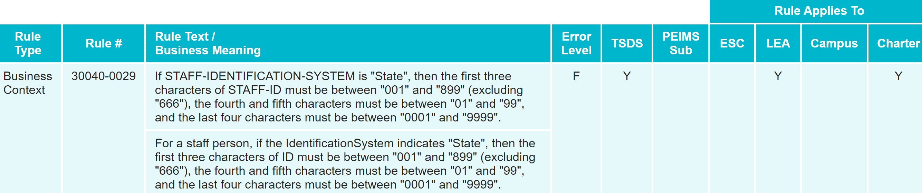
BUSINESS RULE UPDATES
Deleted Rule:
  Uses STAFF-IDENTIFICATION-SYSTEM-TYPE which is not used in TSDS Upgrade Project
    30040-0029

Slide 16
TSDS UPGRADE PROJECT UPDATES
Data Element Name Changes:
Data Element ID | XML Data Element Name | Upgrade Data Element Name
E3010 (was E1069) | STUDENT-BEGIN-DATE | BeginDate
E3020 (was E1070) | STUDENT-END-DATE | EndDate
E3010 (was E1065) | ASSIGNMENT-BEGIN-DATE | BeginDate
E3020 (was E1066) | ASSIGNMENT-END-DATE | EndDate
Notes:
Deleted data elements are no longer used in TSDS upgrade for linking class information to student/staff

Slide 17
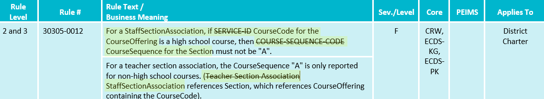
TSDS UPGRADE PROJECT UPDATES 2
Business Rule Changes:
  Uses ‘CourseCode’ descriptor values replacing ‘SERVICE-ID’

Slide 18
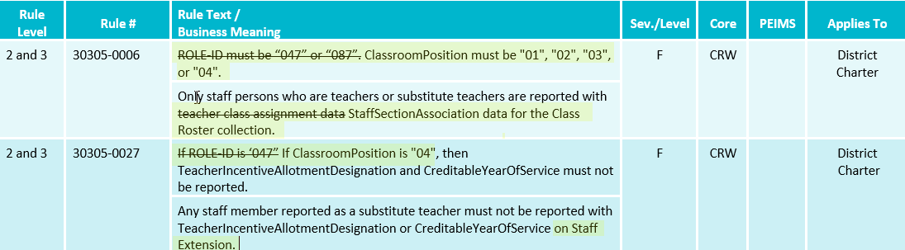
TSDS UPGRADE PROJECT UPDATES 3
Business Rule Changes:
  Uses ‘Classroom Position’ descriptor values instead of ‘ROLE-ID’ codes:

Slide 19
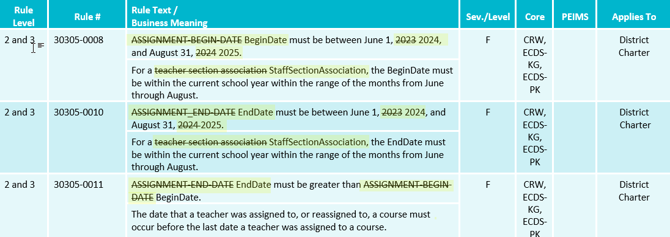
TSDS UPGRADE PROJECT UPDATES 4
Business Rule Changes:
  Uses BeginDate and EndDate:

Slide 20
TSDS UPGRADE PROJECT UPDATES 5
Promotion Logic:
  Class Roster Winter Promotion Logic
  Student > Enrollment (School Association) Categories/Subcategories:
    Discuss E1517 EntryGradeLevel promotion logic that includes CRW Entry/ExitWithdraw date
  Staff > Staff Basic Information Categories/Subcategories::
    Discuss E1073 StaffType new promotion logic that references Begin and End Date and CRW snapshot date:
Notes:
Student > Enrollment (School Association) Categories/Subcategories:
Discuss E1517 EntryGradeLevel promotion logic that includes CRW Entry/ExitWithdraw date:
Promote data where E3023 EntryDate is on or before the Class Roster Winter Snapshot date and E3028 ExitWithdrawDate is blank or after the Class Roster Winter snapshot date.
This is to promote EE-12 grade level students that have enrollment entry on or before CRW snapshot and an enrollment exit or after the CRW snapshot date.
Staff > Staff Basic Information Categories/Subcategories:
Discuss E1073 StaffType new promotion logic that references Begin and End Date and CRW snapshot date:
Promote where E3010 BeginDate is on or before the Class Roster Winter Snapshot date and E3020 EndDate is blank or after the Class Roster Winter Snapshot date. Reference pre-session use of begin and end dates
This is to promote the StaffType for Staff that have StaffSectionAssociation or StaffSchoolAssociation data on or before CRW snapshot and an enrollment exit or after the CRW snapshot date.

Slide 21
TSDS UPGRADE PROJECT UPDATES 6
Promotion Logic:
  Class Roster Winter Promotion Logic
  Staff > Teacher Class Assignment Categories/Subcategories:
    Discuss base promotion logic where Classroom position =‘01-Teacher Of Record’ OR ‘04-Substitute Teacher’ is being used instead of ROLE-ID
Notes:
Switched to ClassRoom Position to promote Teacher Class Assignment data since StaffEducationOrganizationAssignmentAssociation ROLE –ID guidance was needed to be promoted for non-teaching staff in Class Roster Fall

Slide 22
TSDS UPGRADE PROJECT UPDATES 7
Test Case:
  Class Roster Winter Test Cases
  Test Case 1 – Student Section Dates
  Test Case 2 – Staff Section Dates
  Test Case 3 – Course Verification
  Test Case 4 – Teacher Incentive Allotment (TIA)

Slide 23
TITLE SLIDE: Closeout
CLOSEOUT
NAME OF COMPONENT (ALL CAPS)
MARCH 19-21, 2024

Slide 24
TIMELINE 1
Class Roster Collection – Winter Submission | Date
TSDS ready to load data to IODS | August 5, 2024
Class Roster Winter snapshot date – Last Friday in February | February 28, 2025
Class Roster Winter ready for users to complete | February 28, 2025
Class Roster Winter Submission due date for LEAs | March 27, 2025
Class Roster Winter data available to customers | April 10, 2025

Slide 25
FREQUENTLY ASKED QUESTIONS 1
Will LEAs need to provide HR/Finance vendors a key/secret for them to send TIA (Teacher Incentive Allotment) data for their centralized staff?
Yes. All LEAs will need to work with their respective HR/Finance vendors and send them the key/secret information for the vendors to send TIA (Teacher Incentive Allotment) data to the IODS. The HR/Business Vendors claim set will include information on the centralized staff to send TIA information to the IODS.

Slide 26
TECHNICAL RESOURCES
Technical Support
  TSDSCustomerSupport@tea.texas.gov
Technical Specification
  2024-2025 Domains
  2024-2025 Data Element Definitions
  2024-2025 Descriptor Tables
  2024-2025 Data Validation Rules
  2024-2025 Data Submission Timelines
  Known Issues
TSDS Incident Management System (TIMS)
  TSDS Incident Management System (TIMS) Support Application
  TIMS Knowledge Base Article Repository

Slide 27

QUESTIONS
QUESTIONS?

