Slide 1

TITLE SLIDE: ESC Vendor Training for One Component
CLASS ROSTER WINTER
July 30-31, 2024 and August 1, 2024

Slide 2

AGENDA – CLASS ROSTER WINTER
PROGRAM AREA
2024-2025 SCHOOL YEAR
  Data Governance Updates
  Report Updates
  Data Element Updates
  Descriptor Table Updates
  Business Rule Updates
  TSDS Upgrade Updates
  Current Known Issues
CLOSEOUT
  Timeline
  Frequently Asked Questions
  Technical Resources
  Questions

Slide 3
PROGRAM AREA UPDATES & GUIDANCE
Teacher Incentive Allotment (TIA) Program Support
  Lyra Swinney – Manager of TIA Program Support
TIA support questions - tia@tea.texas.gov

Slide 4

TITLE SLIDE: 2024-2025 School Year
2024-2025
SCHOOL YEAR
NAME OF COMPONENT (ALL CAPS)
MARCH 19-21, 2024

Slide 5
DATA GOVERNANCE UPDATES
Class Roster Fall Collection has been sunset for the 2024-2025 school year.
  All Class Roster Fall Collection items will be removed from the Core application for the 2024-2025 school year.
  Prior school year reports and category/subcategory counts will still be available for ESCs and LEAs to view.

Slide 6
DATA GOVERNANCE UPDATES
No updates to the following since TSDS Spring training:
  Report Updates
  Data Elements
  Descriptor Tables
  Business Rules

Slide 7
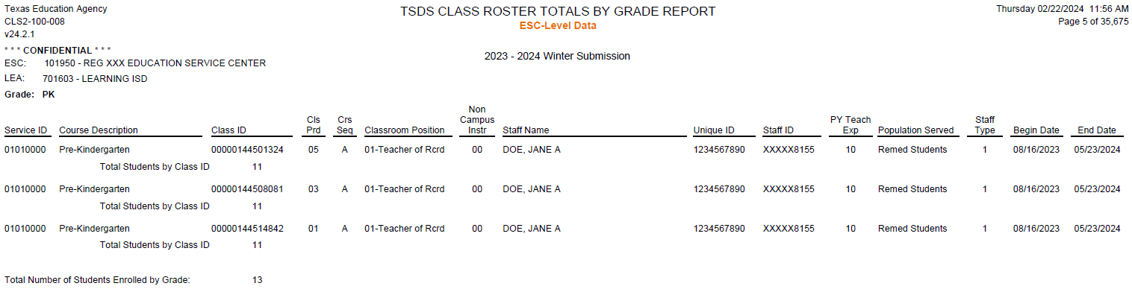
REPORT UPDATES
CLS2-100-008 CLASS ROSTER TOTALS BY GRADE REPORT
  New ESC Level report
    This ESC-level report shall provide a Class Roster WNTR Submission listing of each Service ID, including basic information about each class.
    The purpose of the report is to allow the ESC users to verify the LEA-level data they have submitted for each teacher’s Service IDs.

Slide 8
DATA ELEMENT UPDATES
Data elements deleted:
Data Element ID | XML Data Element Name | Upgrade Data Element Name
E1074 | CLASS-PERIOD | N/A
E1088 | STAFF-IDENTIFICATION-SYSTEM-TYPE | N/A

Slide 9
DESCRIPTOR TABLE UPDATES
Descriptor table deleted:
Descriptor ID | XML Code Table Name | Upgrade Descriptor Name
C191 | STAFF IDENTIFICATION-SYSTEM-TYPE | N/A

Slide 10
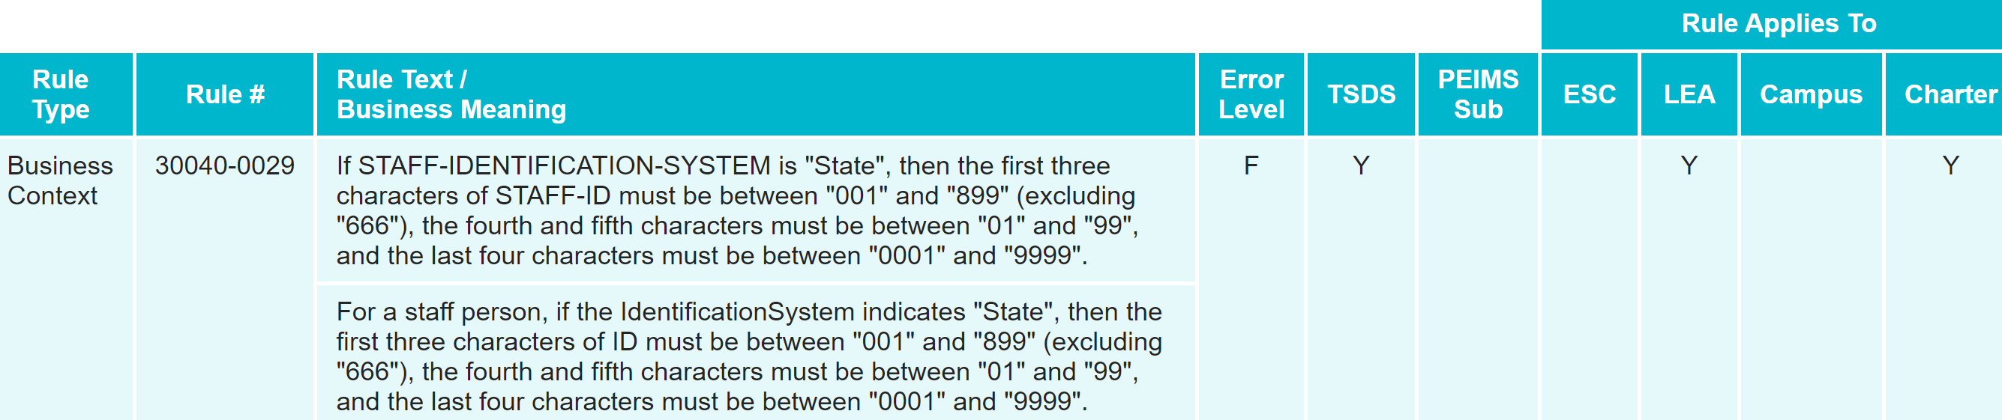
BUSINESS RULE UPDATES
Deleted Rule:
  Uses STAFF-IDENTIFICATION-SYSTEM-TYPE which is not used in TSDS Upgrade Project.
    30040-0029

Slide 11
TSDS UPGRADE PROJECT UPDATES
Data Element Name Changes:
Data Element ID | XML Data Element Name | Upgrade Data Element Name
E3010 (was E1069) | STUDENT-BEGIN-DATE | BeginDate
E3020 (was E1070) | STUDENT-END-DATE | EndDate
E3010 (was E1065) | ASSIGNMENT-BEGIN-DATE | BeginDate
E3020 (was E1066) | ASSIGNMENT-END-DATE | EndDate

Slide 12
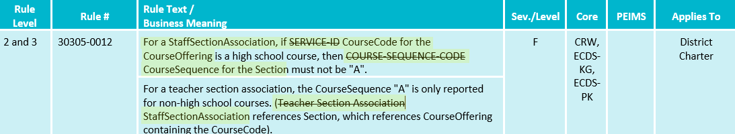
TSDS UPGRADE PROJECT UPDATES 2
Business Rule Changes:
  Uses ‘CourseCode’ descriptor values replacing ‘SERVICE-ID’

Slide 13
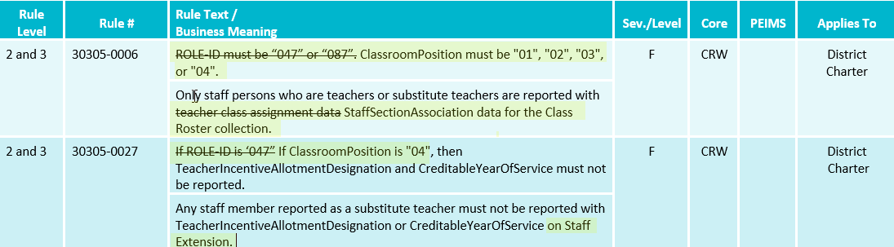
TSDS UPGRADE PROJECT UPDATES 3
Business Rule Changes:
  Uses ‘Classroom Position’ descriptor values instead of ‘ROLE-ID’ codes:

Slide 14
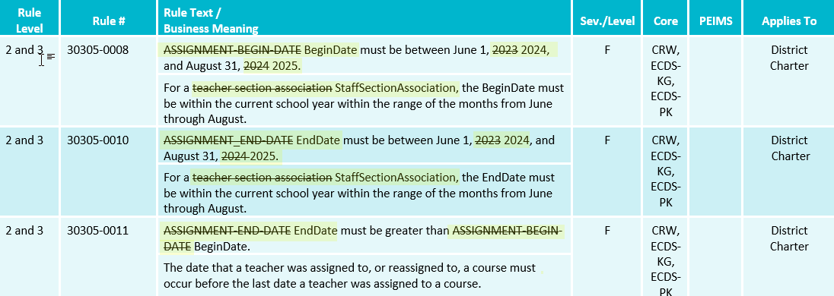
TSDS UPGRADE PROJECT UPDATES 4
Business Rule Changes:
  Uses BeginDate and EndDate:

Slide 15
TSDS UPGRADE PROJECT UPDATES 5
Promotion Logic:
  Class Roster Winter Promotion Logic
  Student > Enrollment (School Association) Categories/Subcategories:
    Discuss E1517 EntryGradeLevel promotion logic that includes CRW Entry/ExitWithdraw date
  Staff > Staff Basic Information Categories/Subcategories::
    Discuss E1073 StaffType new promotion logic that references Begin and End Date and CRW snapshot date:

Slide 16
TSDS UPGRADE PROJECT UPDATES 6
NEW Promotion Logic:
  Class Roster Winter Promotion Logic
  Staff > Teacher Class Assignment Categories/Subcategories:
    Discuss base promotion logic where Classroom position =‘01-Teacher Of Record’, ‘02-Assistant Teacher’, ‘’03-Support Teacher’, OR ‘04-Substitute Teacher’ are being used instead of ROLE-ID
    Discuss update to promotion logic impacting Common Type for ClassroomPosition to .ClassroomPositionSet and the addition of new data element E3092 ClassroomPositionBeginDate for E1454 ClassroomPosition

Slide 17
TSDS UPGRADE PROJECT UPDATES 7
Test Cases:
  Class Roster Winter Test Cases
  Test Case 1 – Student Section Dates
  Test Case 2 – Staff Section Dates
  Test Case 3 – Course Verification
  Test Case 4 – Teacher Incentive Allotment (TIA)

Slide 18
TITLE SLIDE: Closeout
CLOSEOUT
NAME OF COMPONENT (ALL CAPS)
MARCH 19-21, 2024

Slide 19
TIMELINE 1
Class Roster Collection – Winter Submission | Date
TSDS ready to load data to IODS | August 5, 2024
Class Roster Winter snapshot date – Last Friday in February | February 28, 2025
Class Roster Winter ready for users to complete | February 28, 2025
Class Roster Winter Submission due date for LEAs | March 27, 2025
Class Roster Winter data available to customers | April 10, 2025

Slide 20
FREQUENTLY ASKED QUESTIONS
How should an LEA proceed if their vendors are overwriting Staff entity data that contain Class Roster Winter Submission data elements such as TeacherIncentiveAllotment?
An LEA encountering this issue can configure the IODS read/write access through the DMC. When creating or editing an existing application, the LEA should select the appropriate Profile under the ‘Advance Security Options’. Once configured, the LEA can set the appropriate access for the following:
    E1722 TeacherIncentiveAllotmentDesignation
    E1721 CreditableYearOfService
    E1581 PKTeacherRequirement
    E1673 AdditionalDaysProgramTeacher

Slide 21
TECHNICAL RESOURCES
Technical Support
  TSDSCustomerSupport@tea.texas.gov
Technical Specification
  2024-2025 TSDS Web-Enabled Data Standards (TWEDS)
  Known Issues
TSDS Incident Management System (TIMS)
  TSDS Incident Management System (TIMS) Support Application
  TIMS Knowledge Base Article Repository

Slide 22

QUESTIONS
QUESTIONS?

