Slide 1

TITLE SLIDE: ESC Vendor Training for One Component
ECDS KINDERGARTEN
MARCH 19-21, 2024

Slide 2

AGENDA – ECDS KINDERGARTEN
PROGRAM AREA
2024-2025 SCHOOL YEAR
  Application Updates
  Report Updates
  TSDS Upgrade Project Updates
CLOSEOUT
  Timeline
  Frequently Asked Questions
  Technical Resources
  Questions

Slide 3
PROGRAM AREA UPDATES & GUIDANCE
Early Childhood Education Division
  Tori Lee – Division Director
  Sylina Valdez – Programs Director
  Rebecca Matz – Program and Enrollment Specialist
  Magali Farooqi – Early Childhood Assessment Specialist
Program-related questions can be submitted to the Early Child Education Support Portal

Slide 4

TITLE SLIDE: 2024-2025 School Year
2024-2025
SCHOOL YEAR
NAME OF COMPONENT (ALL CAPS)
MARCH 19-21, 2024

Slide 5
APPLICATION UPDATES
No application updates for the following
  Data Elements
  Descriptor Tables
  Business Rules

Slide 6
REPORT UPDATES
The following ECDS KG reports will be updated so that the header logic displays either “Promoted” or “Completed” for other Prepare/Finalize statuses. For example, “Validated, Validated without Assessments” would display “Promoted” on reports:
  ECD0-000-001 Early Childhood Assessment Completion
  ECD0-000-002 Early Childhood Assessment Summary
  ECD0-000-004 Early Childhood KG Data Submission
  ECD0-000-005 Early Childhood Incomplete Assessment Data

Slide 7
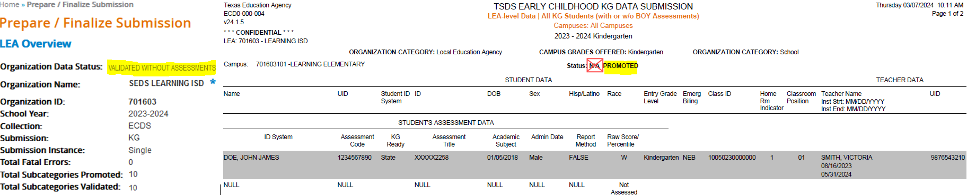
REPORT UPDATES 1
The following ECDS KG report mockup will display either “Promoted” or “Completed” for other Prepare/Finalize statuses. “N/A” will no longer display:

Slide 8
TSDS UPGRADE PROJECT UPDATES
Application Updates:
  Load Assessment Data
    Starting in the 2024-2025 school year, the "Load Assessment Data" functionality in the Core application will no longer be available as ECDS vendors will now be sending student assessment data to TSDS via API transactions. LEAs will need to coordinate with their vendor to ensure proper setup and configuration to have the data loaded into the IODS.

Slide 9
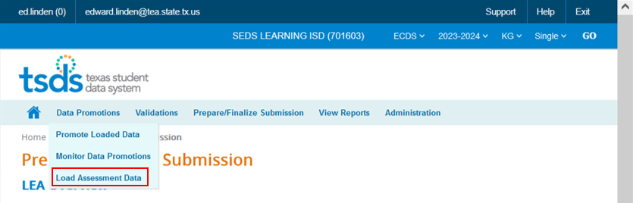
TSDS UPGRADE PROJECT UPDATES 1
Application Updates:
  Load Assessment Data
    Removal of ‘Load Assessment Data’ functionality under the Data Promotions tab:

Slide 10
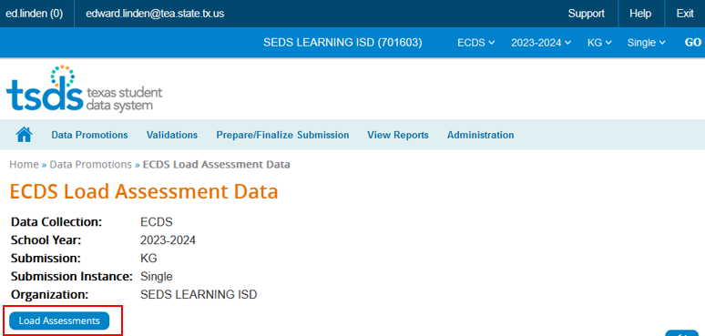
TSDS UPGRADE PROJECT UPDATES 2
Application Updates:
  Load Assessment Data
    Removal of the ‘Load Assessments’ button and the ECDS Load Assessment Data page:

Slide 11
TSDS UPGRADE PROJECT UPDATES 3
Data Element Name Changes:
Data Element ID | XML Data Element Name | Upgrade Data Element Name
E1127 | ASSESSMENT TITLE | TitleofAssessment
E1359 | SCORE RESULT | Result
E1056 | CLASS-ID-NUMBER | SectionIdentifier
E3010 (was E1069) | STUDENT-BEGIN-DATE | BeginDate
E3020 (was E1070) | STUDENT-END-DATE | EndDate
E3010 (was E1065) | ASSIGNMENT-BEGIN-DATE | BeginDate
E3020 (was E1066) | ASSIGNMENT-END-DATE | EndDate

Slide 12
TSDS UPGRADE PROJECT UPDATES 4
Descriptor Table Name Changes:
Descriptor ID | XML Code Table Name | Upgrade Descriptor Name
C328 (was DC014) | ASSESSMENT-REPORTING-METHOD | AssessmentReportingMethod
C325 (was DC002) | ACADEMIC-SUBJECT-TYPE | AcademicSubject
C061 (was DC079) | EMERGENT-BILINGUAL-TYPE | EmergentBilingualIndicator
Notes:
DC014 ASSESSMENT-REPORTING-METHOD-TYPE -> C328 AssessmentReportingMethod
C328 only includes values used in ECDS
16-“Percentile”
22-“Raw Score”
DC002 ACADEMIC-SUBJECT-TYPE -> C325 AcademicSubject
C325 only uses values used in ECDS
02-Composite
10-Mathematics
20-Emergent Literacy Reading
21-Emergent Literacy Writing
22-Language and Communication
23-Health and Wellness

Slide 13
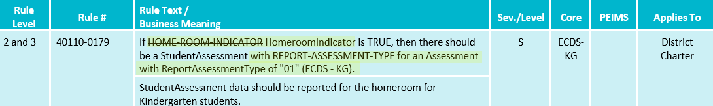
TSDS UPGRADE PROJECT UPDATES 5
Business Rule Changes:
  Uses codes instead of descriptors to trigger validations:
    “With ReportAssessmentType is "01" (ECDS - KG)

Slide 14
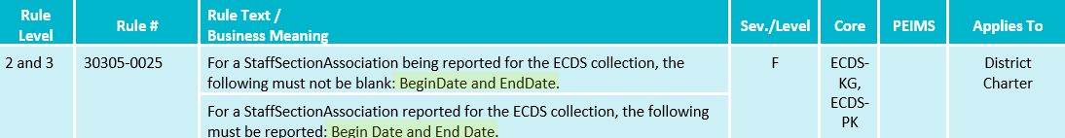
TSDS UPGRADE PROJECT UPDATES 6
Business Rule Changes:
  Business validation logic requires that a BeginDate and EndDate must be populated.

Slide 15
TSDS UPGRADE PROJECT UPDATES 7
Promotion Logic:
  ECDS Kindergarten Promotion Logic
  Student > Enrollment (School Association) and Student > Student Section Categories/Subcategories:
    New promotion logic for E1517 EntryGradeLevel based on ECDS KG submission due date.
  Assessment > AssessmentMetadata and Student > Student Assessment Categories/Subcategories:
    New promotion logic for E1144 Assessment Identifier that will convert the code value reported for the AssessmentIdentifier from the C312 code value to the short description.

Slide 16
TSDS UPGRADE PROJECT UPDATES 8 7
Promotion Logic:
  ECDS Kindergarten Promotion Logic
  Student > Student Basic Information:
    New base promotion logic using E1517 EntryGradeLevel based on ECDS KG submission due date.
  ResultDatatypeType
    Ed-fi data element required for Landing Zone only; not used in promotion logic.
Notes:
ResultDatatypeType: not

Slide 17
TSDS UPGRADE PROJECT UPDATES 9
Test Cases:
  ECDS Kindergarten Test Cases
  Test Case 1 – Student Assessment Completion
  Test Case 2 – Assessment Summary
  Test Case 3 – Teacher Data
  Test Case 4 – Student Data

Slide 18
TSDS UPGRADE PROJECT UPDATES 10
Assessment Updates:
  ECDS AssesssmentMetadata is now pre-coded in the IODS
    ECDS KG assessment vendors will only need to send the following from the StudentAssessment entity:
      Student (Reference)
      Assessment (Reference)
      E1127 TitleofAssessment
      E1573 ReportAssessmentType
      E1097 Academic Subject
      E1129 AssessedGradeLevel
      E1396 AdministrationDate
      E1154 AssessmentReportingMethod
      E1359 Result
      E3052 ResultDatatypeType (ODS only)

Slide 19
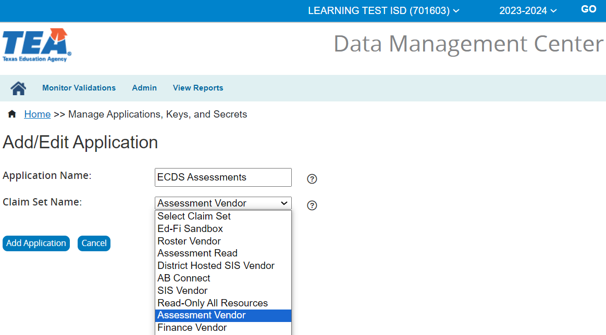
TSDS UPGRADE PROJECT UPDATES 11
Assessment Updates:
  Assessment claim sets:
    An LEA will need to assign an assessment claim set to receive student assessment data from their ECDS assessment vendor.

Slide 20
TITLE SLIDE: Closeout
CLOSEOUT
NAME OF COMPONENT (ALL CAPS)
MARCH 19-21, 2024

Slide 21
TIMELINE
Early Childhood Data System Collection (ECDS) - KG | Date
TSDS ready to load data to IODS | August 5, 2024
ECDS Kindergarten ready for users to complete | November 11, 2024
ECDS Kindergarten Submission due date for LEAs | January 30, 2025
ECDS Kindergarten data available to customers | February 13, 2025

Slide 22
FREQUENTLY ASKED QUESTIONS
Will LEAs need to provide ECDS KG assessment vendors a key/secret for them to send student assessment data?
Yes. All LEAs will need to work with their respective ECDS KG assessment vendor (CLI or Amplify) to provide the key/secret information to send ECDS KG assessment data to the IODS. Also, an LEA will need to ensure the proper ‘Assessment Vendor’ claim set is used when generating the key/secret information.

Slide 23
FREQUENTLY ASKED QUESTIONS 1
How often will ECDS KG assessment vendors be sending assessment data to the IODS?
The frequency of ECDS KG assessment data sent by ECDS KG assessment vendors to the IODS will be established by the respective vendor with guidance from the Early Childhood Education program area.

Slide 24
FREQUENTLY ASKED QUESTIONS 2
Will ECDS KG assessment vendors be able to send “non-Commissioner” approved assessment data to the IODS?
Assessment vendors can send any additional assessment data that conforms to Ed-Fi standards for an LEA's local use. An LEA would need to coordinate with their vendor(s) and complete any necessary setup in the DMC.

Slide 25
FREQUENTLY ASKED QUESTIONS 3
What will happen if the SIS vendor has not yet loaded student data to the IODS and the ECDS assessment vendor tries to send student assessment data?
A Level 1 API validation error will trigger if no student information has been submitted by the SIS:
  Example: ("message": "Access to the resource item could not be authorized because the 'Student' was not found”).
The LEA will need to work with their source system vendors to resolve the Level 1 API validation error.

Slide 26
FREQUENTLY ASKED QUESTIONS 5
Will an LEA need to continue to send student UID information to ECDS KG assessment vendors for them to generate assessment data to send to the IODS?
Yes, LEAs will need to provide student UID information to their respective ECDS assessment vendor for them to generate the student assessment result information to be sent to the IODS.

Slide 27
TECHNICAL RESOURCES
Technical Support
  TSDSCustomerSupport@tea.texas.gov
Technical Specification
  2024-2025 Domains
  2024-2025 Data Element Definitions
  2024-2025 Descriptor Tables
  2024-2025 Data Validation Rules
  2024-2025 Data Submission Timelines
  Known Issues
TSDS Incident Management System (TIMS)
  TSDS Incident Management System (TIMS) Support Application
  TIMS Knowledge Base Article Repository

Slide 28

QUESTIONS
QUESTIONS?

