Slide 1

TITLE SLIDE: ESC Vendor Training for One Component
EARLY CHILDHOOD DATA SYSTEM KINDERGARTEN
July 30-31, 2024 and August 1, 2024

Slide 2

AGENDA – ECDS KINDERGARTEN
PROGRAM AREA
2024-2025 SCHOOL YEAR
  Data Governance Updates
  Report Updates
  TSDS Upgrade Project Updates
CLOSEOUT
  Timeline
  Frequently Asked Questions
  Technical Resources
  Questions

Slide 3
PROGRAM AREA UPDATES & GUIDANCE
Early Childhood Education Division
  Tori Lee – Division Director
  Sylina Valdez – Programs Director
  Rebecca Matz – Program and Enrollment Specialist
  Magali Farooqi – Early Childhood Assessment Specialist
Program-related questions can be submitted to the Early Childhood Education Division Support Portal.

Slide 4

TITLE SLIDE: 2024-2025 School Year
2024-2025
SCHOOL YEAR
NAME OF COMPONENT (ALL CAPS)
MARCH 19-21, 2024

Slide 5
DATA GOVERNANCE UPDATES
No updates to the following since TSDS Spring training:
  Data Elements
  Reports
  Descriptor Tables
  Business Rules

Slide 6
REPORT UPDATES
The following ECDS KG reports will be updated so that the header logic displays either “Promoted” or “Completed” for other Prepare/Finalize statuses. For example, “Validated, Validated without Assessments” would display “Promoted” on reports:
  ECD0-000-001 Early Childhood Assessment Completion
  ECD0-000-002 Early Childhood Assessment Summary
  ECD0-000-004 Early Childhood KG Data Submission
  ECD0-000-005 Early Childhood Incomplete Assessment Data

Slide 7
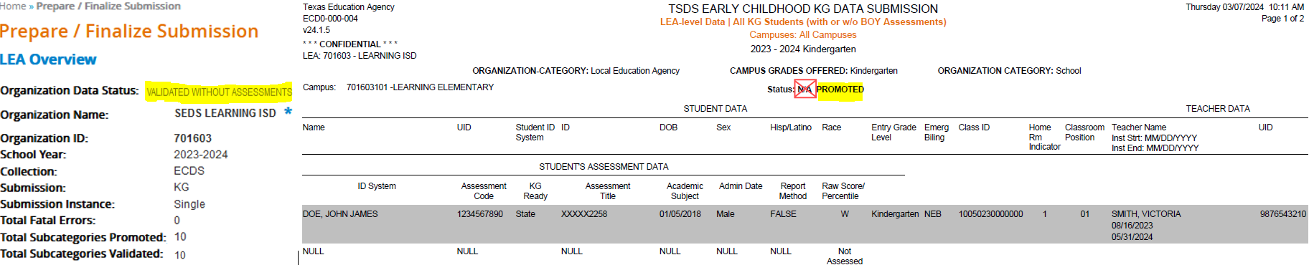
REPORT UPDATES 1
The following ECDS KG report will display either “Promoted” or “Completed” for other Prepare/Finalize statuses. “N/A” will no longer display:

Slide 8
TSDS UPGRADE PROJECT UPDATES
Application Updates:
  Load Assessment Data
    Starting in the 2024-2025 school year, the "Load Assessment Data" functionality in the Core application will no longer be available as ECDS vendors will now be sending student assessment data to TSDS via API transactions. LEAs will need to coordinate with their vendor to ensure proper setup and configuration to have the data loaded into the IODS.

Slide 9
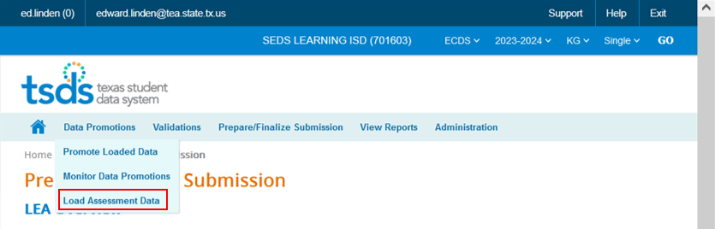
TSDS UPGRADE PROJECT UPDATES 1
Application Updates:
  Load Assessment Data
    Removal of “Load Assessment Data” functionality under the Data Promotions tab:

Slide 10
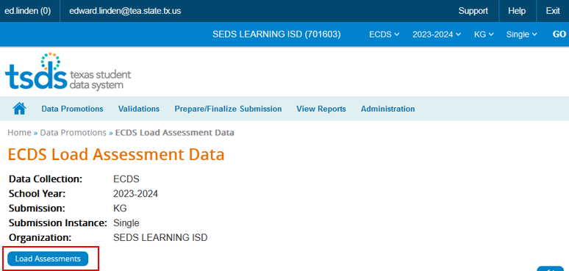
TSDS UPGRADE PROJECT UPDATES 2
Application Updates:
  Load Assessment Data
    Removal of the “Load Assessments” button and the ECDS Load Assessment Data page:

Slide 11
TSDS UPGRADE PROJECT UPDATES 3
Data Element Name Changes:
Data Element ID | XML Data Element Name | Upgrade Data Element Name
E1127 | ASSESSMENT TITLE | TitleofAssessment
E1359 | SCORE RESULT | Result
E1056 | CLASS-ID-NUMBER | SectionIdentifier
E3010 (was E1069) | STUDENT-BEGIN-DATE | BeginDate
E3020 (was E1070) | STUDENT-END-DATE | EndDate
E3010 (was E1065) | ASSIGNMENT-BEGIN-DATE | BeginDate
E3020 (was E1066) | ASSIGNMENT-END-DATE | EndDate

Slide 12
TSDS UPGRADE PROJECT UPDATES 4
Descriptor Table Name Changes:
Descriptor ID | XML Code Table Name | Upgrade Descriptor Name
C328 (was DC014) | ASSESSMENT-REPORTING-METHOD | AssessmentReportingMethod
C325 (was DC002) | ACADEMIC-SUBJECT-TYPE | AcademicSubject
C061 (was DC079) | EMERGENT-BILINGUAL-TYPE | EmergentBilingualIndicator

Slide 13
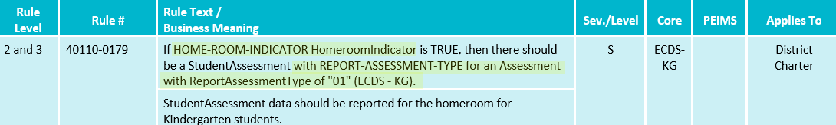
TSDS UPGRADE PROJECT UPDATES 5
Business Rule Changes:
  Uses codes instead of descriptors to trigger validations:
    With ReportAssessmentType of "01" (ECDS - KG)

Slide 14
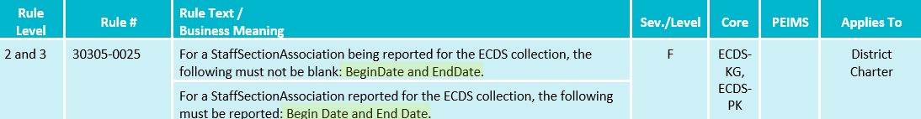
TSDS UPGRADE PROJECT UPDATES 6
Business Rule Changes:
  Business validation logic requires that a BeginDate and EndDate must be populated.

Slide 15
TSDS UPGRADE PROJECT UPDATES 7
Promotion Logic:
  ECDS Kindergarten Promotion Logic
  Student > Enrollment (School Association) and Student > Student Section Categories/Subcategories:
    Promotion logic for E1517 EntryGradeLevel based on ECDS KG submission due date.
  Assessment > AssessmentMetadata and Student > Student Assessment Categories/Subcategories:
    Promotion logic for E1144 Assessment Identifier that will convert the code value reported for the AssessmentIdentifier from the C312 code value to the short description.

Slide 16
TSDS UPGRADE PROJECT UPDATES 8 7
Promotion Logic:
  ECDS Kindergarten Promotion Logic
  Student > Student Basic Information:
    Base promotion logic using E1517 EntryGradeLevel based on ECDS KG submission due date.
  ResultDatatypeType
    Ed-fi data element required for Landing Zone only; not used in promotion logic.

Slide 17
TSDS UPGRADE PROJECT UPDATES 8 7
NEW Promotion Logic:
  ECDS Kindergarten Promotion Logic
  Staff > Teacher Class Assignment Categories/Subcategories:
    Updated promotion logic impacting Common Type for ClassroomPosition to .ClassroomPositionSet and addition of new data element E3092 ClassroomPositionBeginDate for E1454 ClassroomPosition

Slide 18
TSDS UPGRADE PROJECT UPDATES 9
Test Cases:
  ECDS Kindergarten Test Cases
  Test Case 1 – Student Assessment Completion
  Test Case 2 – Assessment Summary
  Test Case 3 – Teacher Data
  Test Case 4 – Student Data

Slide 19
TSDS UPGRADE PROJECT UPDATES 10
Assessment Updates:
  ECDS AssesssmentMetadata is now pre-coded in the IODS
    ECDS KG assessment vendors will only need to send the following from the StudentAssessment entity:
      Student (Reference)
      Assessment (Reference)
      E1127 TitleofAssessment
      E1573 ReportAssessmentType
      E1097 AcademicSubject
      E1129 AssessedGradeLevel
      E1396 AdministrationDate
      E1154 AssessmentReportingMethod
      E1359 Result
      E3052 ResultDatatypeType (IODS only)

Slide 20
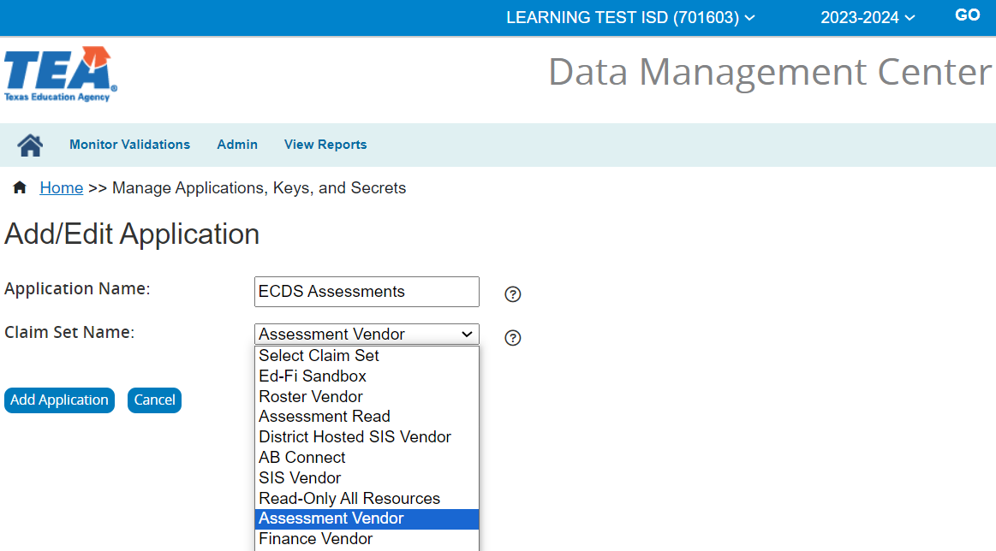
TSDS UPGRADE PROJECT UPDATES 11
Assessment Updates:
  Assessment claim sets:
    An LEA will need to assign an assessment claim set to receive student assessment data from their ECDS assessment vendor.

Slide 21
TITLE SLIDE: Closeout
CLOSEOUT
NAME OF COMPONENT (ALL CAPS)
MARCH 19-21, 2024

Slide 22
TIMELINE
Early Childhood Data System Collection (ECDS) - KG | Date
TSDS ready to load data to IODS | August 5, 2024
ECDS Kindergarten ready for users to complete | November 11, 2024
ECDS Kindergarten Submission due date for LEAs | January 30, 2025
ECDS Kindergarten data available to customers | February 13, 2025

Slide 23
FREQUENTLY ASKED QUESTIONS
Can an LEA send all course/section data, for all ECDS KG homeroom sections with begin and end dates, that include the E1440 HomeroomIndicator data element in the StudentSectionAssociation entity? Will the promotion logic select the correct section when joining to the Assessment data?
All TSDS student course/section data will be loaded into the IODS from the Student Information System (SIS). Any KG StudentSectionAssociation information that includes a boolean value for E1440 HomeroomIndicator will be promoted to the Core data mart based on the promotion logic listed in the Category/Subcategory for Student > Student Section.
In addition, a Kindergarten student can only be reported with one homeroom at the time the assessment is administered. Otherwise, the 40110-0184 validation rule will fire.

Slide 24
FREQUENTLY ASKED QUESTIONS
Where and when will ECDS assessment vendors send student assessment information for LEAs to submit in the ECDS submissions?
All TSDS ECDS assessment vendors for the 2024-2025 school year will be required to send student assessment data directly to an LEA’s IODS.
It is the LEA’s responsibility to provide their ECDS assessment vendor with the appropriate student Unique IDs for the assessment information required for ECDS submissions. The schedule and frequency of student assessment data updates to the IODS will be determined by each ECDS assessment vendor.

Slide 25
FREQUENTLY ASKED QUESTIONS 1
How can an LEA verify that Student Assessment data has been loaded into the IODS?
An LEA can use the “Load Summary” function in the Data Management Center (DMC) to determine if StudentAssessment data were successfully loaded into the IODS.
In addition, an LEA can also utilize the “Search Data” function in the DMC to identify individual students by Unique ID to view their student assessment information in JSON format.
To avoid Level 1 validation errors, student information from the SIS should be loaded prior to the assessment data being loaded into the IODS.

Slide 26
TECHNICAL RESOURCES
Technical Support
  TSDSCustomerSupport@tea.texas.gov
Technical Specification
  2024-2025 TSDS Web-Enabled Data Standards (TWEDS)
  Known Issues
TSDS Incident Management System (TIMS)
  TSDS Incident Management System (TIMS) Support Application
  TIMS Knowledge Base Article Repository

Slide 27

QUESTIONS
QUESTIONS?

