Slide 1

TITLE SLIDE: ESC Vendor Training for One Component
ECDS PREKINDERGARTEN
MARCH 19-21, 2024

Slide 2

AGENDA – ECDS PREKINDERGARTEN
PROGRAM AREA
2023-2024 SCHOOL YEAR
  Data Element Updates
  Code Table Updates
  Report Updates
  Business Rule Updates
  Reminders
  Timeline
  Frequently Asked Questions
2024-2025 SCHOOL YEAR
  Application Updates
  Descriptor Table Updates
  Report Updates
  Business Rule Updates
  TSDS Upgrade Updates
CLOSEOUT
  Timeline
  Technical Resources
  Questions

Slide 3
PROGRAM AREA UPDATES & GUIDANCE
Early Childhood Education Division
  Tori Lee – Division Director
  Sylina Valdez – Programs Director
  Rebecca Matz – Program and Enrollment Specialist
  Magali Farooqi – Early Childhood Assessment Specialist
Program-related questions can be submitted to the Early Child Education Support Portal.

Slide 4
EC Program Area Updates & Guidance
ECDS Kindergarten Assessment Guidance
  Ensure student information is loaded timely
ECDS Prekindergarten Assessment Update
  Current Commissioner's list has been extended through SY 23-24
  New list will be implemented in SY 24-25
High-Quality Prekindergarten ECDS reporting Update
  SY 23-24: Family engagement definition, program evaluation moved to LEA level, Pre-K School Type and Child Care Operation number to course section level, PK Teacher Requirement code table updated to align with HB 2729
  SY 24-25: PK Teacher Requirement code table add’l update to add a “does not meet” code and will generate a fatal error if left blank
HQPK touchpoints work and takeaways

Slide 5
PK School Type Code Table
Code | Description
01 Non-Public Pre-K Head Start ​ | would be reported for a standalone Head Start not associated with a school district.​
02 Public Pre-K ​ | would be reported for public school programs implementing prekindergarten programs (excluding partnerships).​
05 Non-Public Pre-K Licensed Child Care ​ | would be reported for standalone child care providers not associated with a school district.​
07 Public Pre-K Head Start ​ (LEA Grantee) | would be reported for public prekindergarten Head Start classrooms where the LEA is the Head Start grantee. (This school type code will NOT require the LEA to submit a Child Care Operation Number.)
08 Public Pre-K Licensed Child Care ​ | would be reported for public prekindergarten programs that partner directly with a licensed child care provider to dually enroll students (includes partnership classrooms where children are dually enrolled in both the LEA and child care provider site). (This school type code WILL require the LEA to submit a Child Care Operation Number.)​
10 Non-Public Pre-K ​ | would be reported for private prekindergarten providers not associated with a school district.​
11 In-District Charter Partnership ​ | would be reported for prekindergarten programs that are operated through an in-district charter partnership. The board of the LEA has authorized a non-profit organization, government entity, institute of higher education, and/or an existing charter as an in-district charter.​ (This school type code WILL require the LEA to submit a Child Care Operation Number.)​
12 Public Pre-K Head Start (Non-LEA Grantee) | would be reported for public prekindergarten programs that partner with a Head Start program and the Head Start grantee is not an LEA. (This school type code WILL require the LEA to submit a Child Care Operation Number.)​
99 Other ​ | would be reported when any of the codes do not describe the program.​

Slide 6
Early Childhood Program Area Contacts
Early Childhood Education (ECE) Division
  Sylina Valdez, Program Director
  Rebecca Matz, Program, Enrollment, and Partnership Specialist
  Magali Farooqi, Assessment Specialist
  Lauren Gomez, Curriculum and Instruction Specialist
  Jennifer Bruning, Family Engagement Specialist
  ECE Support Portal
Notes:
This slide includes the contacts for the EC program area as a reference. We’re happy to support you with any program related questions. We’ve also included the link to our ECE support portal where you can submit any questions or support requests.

Slide 7

TITLE SLIDE: 2023-2024 School Year
2023-2024
SCHOOL YEAR
NAME OF COMPONENT (ALL CAPS)
MARCH 19-21, 2024

Slide 8
DATA ELEMENT UPDATES
The following data element was removed from sub complex TX-ChildCarePartnership which is part of complex type LocalEducationAgency:
  E1726 CHILD-CARE-OPERATION-NUMBER
The existing data element was added to complex type SectionExtension as optional (Y) for the ECDS Prekindergarten Submission:
  E1726 CHILD-CARE-OPERATION-NUMBER

Slide 9
DATA ELEMENT UPDATES 1
The following data element E1555 PK-SCHOOL-TYPE definition and reporting requirements were updated:
  From: “PK-SCHOOL-TYPE indicates the PK program that is offered at the campus/course/section level.”
  To: “PK-SCHOOL-TYPE indicates the type of prekindergarten program that is offered.”

Slide 10
CODE TABLE UPDATES
The following DC152 PK-SCHOOL-TYPE code value description has been updated:
  From: 07 – Public Pre-K Head Start
  To: 07 – Public Pre-K Head Start (LEA Grantee)
The DC154 ASSESSMENT-TITLE-CODE has been updated for the 2023-2024 school year for ECDS PK assessments:
  Refer to: ECDS Assessment Specifications

Slide 11
CODE TABLE UPDATES 3
The following C207 PK-TEACHER-REQUIREMENT code table values have been deleted:
  02 – At least eight years’ experience of teaching in a nationally accredited child care program
  04 – A graduate or undergraduate degree in early childhood education or early childhood special education

Slide 12
CODE TABLE UPDATES 1
The following C207 PK-TEACHER-REQUIREMENT code table values have been added:
  Subheading above code 01: For teachers in a LEA-provided Prekindergarten Classroom
  07 – An associate or baccalaureate degree in early childhood education or a related field
  08 – At least eight years’ experience of teaching in a nationally accredited child care program or Texas Rising Star Program

Slide 13
CODE TABLE UPDATES 2
The following C207 PK-TEACHER-REQUIREMENT code table values have been added:
  Subheading above code 09: For teachers in a Prekindergarten Classroom provided by an entity with which a school district contracts to provide a Prekindergarten program (29.167) (b-1)
  09 – Contract Entity - At least two years’ experience of teaching in a nationally accredited child care program or Texas Rising Star Program and a Child Development Associate (CDA) credential or another early childhood education credential approved by the agency
  10 – Contract Entity - At least two years’ experience of teaching in a nationally accredited child care program or Texas Rising Star Program and a certification offered through a training center accredited by Association Montessori Internationale or through the Montessori Accreditation Council for Teacher Education

Slide 14
CODE TABLE UPDATES 5
The following C207 PK-TEACHER-REQUIREMENT code table values have been added:
  11 – Contract Entity - Been employed as a prekindergarten teacher in a school district that has ensured specific prekindergarten professional development requirements have been me
  12 – Contract Entity - An associate or baccalaureate degree in early childhood or a related field
  13 – Contract Entity - At least eight years’ experience of teaching in a nationally accredited child care program or Texas Rising Star Program

Slide 15
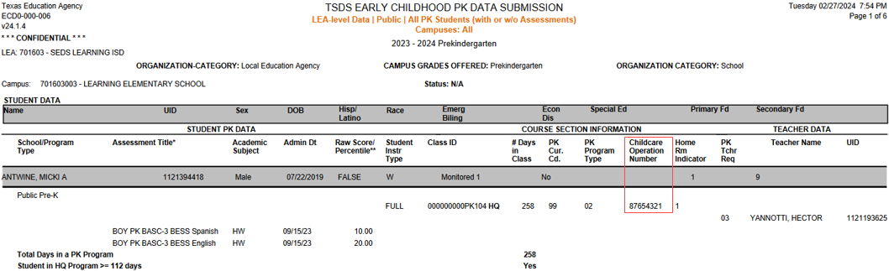
REPORT UPDATES
ECD0-000-006 Early Childhood PK Data Submission:
  Removal of PROGRAM-EVALUATION-TYPE
  Add CHILD-CARE-OPERATION-NUMBER

Slide 16
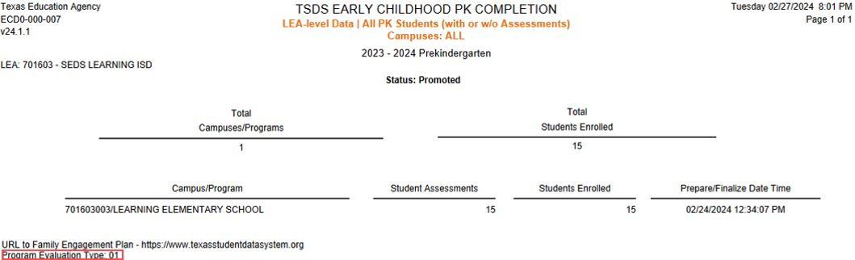
REPORT UPDATES 2
ECD0-000-007 Early Childhood PK Completion:
  Removal of CHILD-CARE-OPERATION-NUMBER
  Add of PROGRAM-EVALUATION-TYPE

Slide 17
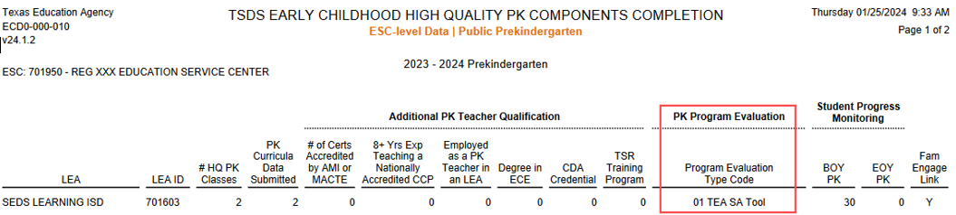
REPORT UPDATES 1
ECD0-000-010 Early Childhood High Quality PK Components Completion:
  Page 1 of report: Add of Program Evaluation Type Code column

Slide 18
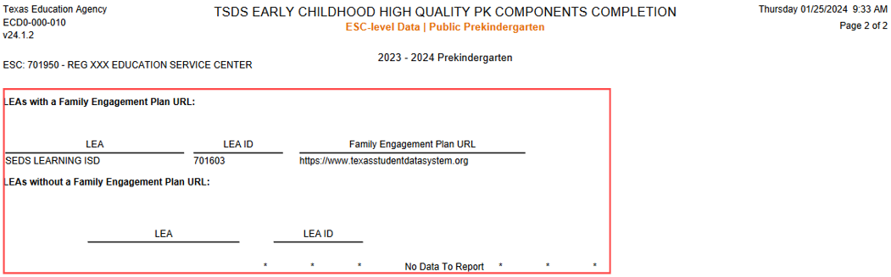
REPORT UPDATES 6
ECD0-000-010 Early Childhood High Quality PK Components Completion:
  Page 2 of report: LEAs with a Family Engagement Plan URL column, and LEAs without a Family Engagement Plan URL column

Slide 19
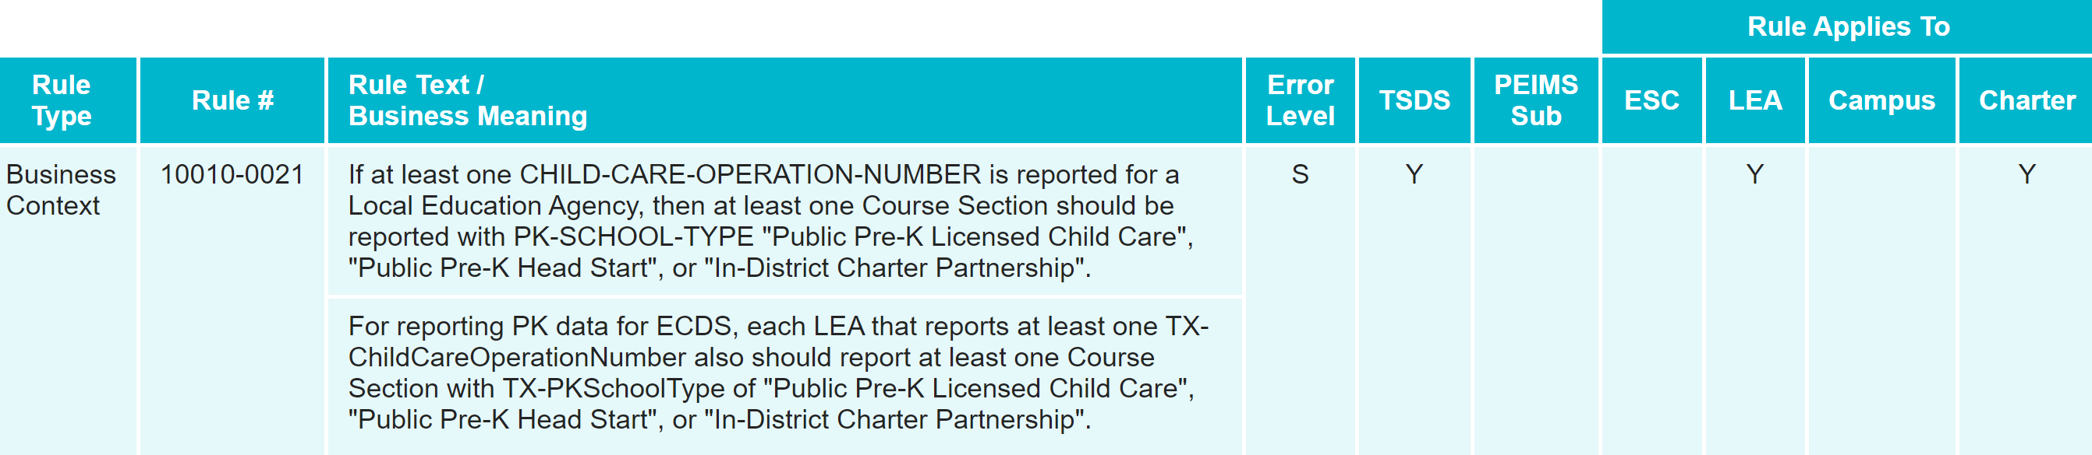
BUSINESS RULE UPDATES
The following validation rule has been deleted in the Core application:
  10010-0021: If at least one CHILD-CARE-OPERATION-NUMBER is reported for a Local Education Agency, then at least one Course Section should be reported with PK-SCHOOL-TYPE "Public Pre-K Licensed Child Care", "Public Pre-K Head Start", or "In-District Charter Partnership".

Slide 20
REMINDERS
Prekindergarten Assessment Data:
  LEAs will need to obtain their BOY/EOY PK assessment data directly from their ECDS pre-K assessment vendor and load into the ODS, as they have done in prior years.
  LEAs must load their Student Parent Extension xml from their SIS before the LEA loads their Prekindergarten Assessment Metadata and Student Assessment Data into the ODS.
  LEAs are encouraged to work as soon as possible with their ECDS PK assessment vendors to resolve any issues with their BOY/EOY assessment data related to missing or incorrect student UIDs.

Slide 21
REMINDERS 1
Prekindergarten Reports:
  LEAs should run all their ECDS PK reports and verify the student, staff, course/section, High Quality PK Data and assessment information and counts before completing their ECDS PK submission:
    ECD0-000-006 Early Childhood PK Data Submission
    ECD0-000-007 Early Childhood PK Completion
    ECD0-000-008 Early Childhood PK Proficiency Summary
    ECD0-000-009 Early Childhood Public PK Missing Assessment Data
  ESCs can monitor and assist LEAs with confirming if they are meeting their High-Quality PK requirements by running the following report:
    ECD0-000-010 Early Childhood High Quality PK Components Completion

Slide 22
TIMELINE
Early Childhood Data System Collection (ECDS) - PK | Date
TSDS ready to load data to eDM | August 7, 2023
ECDS Prekindergarten ready for users to promote data | November 13, 2023
ECDS Prekindergarten ready for users to complete | May 2, 2024
Private Prekindergarten application deadline for BPD (Business Partner Directory) Org number | May 30, 2024
ECDS Prekindergarten Submission due date for LEAs and Private Prekindergarten Organizations | June 27, 2024
ECDS Prekindergarten data available to customers | July 11, 2024

Slide 23
FREQUENTLY ASKED QUESTIONS
Are PK Classroom Aides reported for the ECDS PK Submission?
PK Aides are required to be reported for the PK ECDS submission if they provide instructional services for a particular class. 'PK Educational Aide' code is listed in the TEDS Code table DC143 CLASSROOM-POSITON-TYPE-CODE.

Slide 24
TITLE SLIDE: 2024-2025 School Year
2024-2025
SCHOOL YEAR
NAME OF COMPONENT (ALL CAPS)
MARCH 19-21, 2024

Slide 25
APPLICATION UPDATES
No application updates for the following:
  Data Elements

Slide 26
DESCRIPTOR TABLE UPDATES
The following C207 PKTeacherRequirement descriptor table values have been added:
  98 – Be employed as a prekindergarten teacher in a school district with no additional high-quality prekindergarten qualification
  99 – Contract Entity – employed as a prekindergarten teacher in a school district with no additional high-quality prekindergarten qualifications

Slide 27
REPORT UPDATES 3
The following reports will be impacted by the C207 PKTeacherRequirement descriptor table values that will be added:
  ECD0-000-006 Early Childhood PK Data Submission
  ECD0-000-010 Early Childhood High Quality PK Components Completion

Slide 28
BUSINESS RULE UPDATES 2
The following business rules will be impacted by the C207 PKTeacherRequirement descriptor table values that will be added:
  30040-0049
  30040-0057

Slide 29
TSDS UPGRADE PROJECT UPDATES
Data Element Name Changes:
Data Element ID | XML Data Element Name | Upgrade Data Element Name
E1127 | ASSESSMENT TITLE | TitleofAssessment
E1359 | SCORE RESULT | Result
E1056 | CLASS-ID-NUMBER | SectionIdentifier
E3010 (was E1069) | STUDENT-BEGIN-DATE | BeginDate
E3020 (was E1070) | STUDENT-END-DATE | EndDate
E3010 (was E1065) | ASSIGNMENT-BEGIN-DATE | BeginDate
E3020 (was E1066) | ASSIGNMENT-END-DATE | EndDate
E0790 (was E1390) | EMERGENT-BILINGUAL | EmergentBilingualIndicator
E3044 (was E1079) | PRIMARY-PK-FUNDING-SOURCE | PKFundingSource
E3044 (was E1080) | SECONDARY-PK-FUNDING-SOURCE | PKFundingSource

Slide 30
TSDS UPGRADE PROJECT UPDATES 3
Descriptor Table Name Changes:
Descriptor Table ID | XML Code Table Name | Upgrade Descriptor Table Name
C061 (was DC079) | EMERGENT-BILINGUAL-TYPE | EmergentBilingualIndicator
C303 (was DC096) | PROGRAM-TYPE | ProgramType
C310 (was DC152) | PK-SCHOOL-TYPE | PKSchoolType
C311 (was DC153) | STUDENT-INSTRUCTION-TYPE | PKStudentInstruction
C312 (was DC154) | ASSESSMENT-TITLE-CODE | TitleOfAssessment
Notes:
DC096 PROGRAM-TYPE->C303 ProgramType:
C303 now only includes the following values:
04 Bilingual
05 Career and Technical Education
12 English as a Second Language (ESL)
33 Special Education
38 Title I Part A
DC142 DISABILITY TYPE->C053 Disability
C053 descriptor value updates (description reassigned to new code values)
01-Orthopedic Impairment
02-Other Health Impairment
03-Deaf And Hard Of Hearing
04-Deaf And Hard Of Hearing
05-Deaf-Blindness
06-Intellectual Disability
07-Emotional Disturbance
08-Specific Learning Disability
09-Speech or Language Impairment
10-Autism
12-Developmental Delay
13-Traumatic Brain Injury
14-Noncategorical Early Childhood

Slide 31
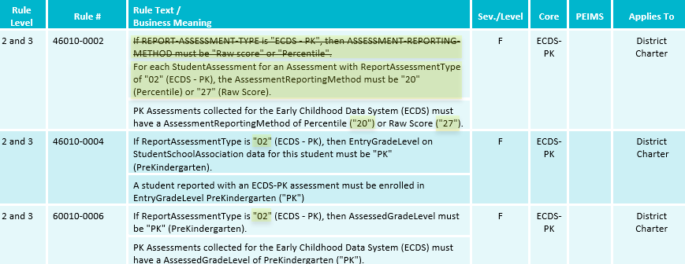
TSDS UPGRADE PROJECT UPDATES 2
Business Rule Changes:
  Uses codes instead of descriptors to trigger validations:
    “If ReportAssessmentType is "02" (ECDS - PK)…”

Slide 32
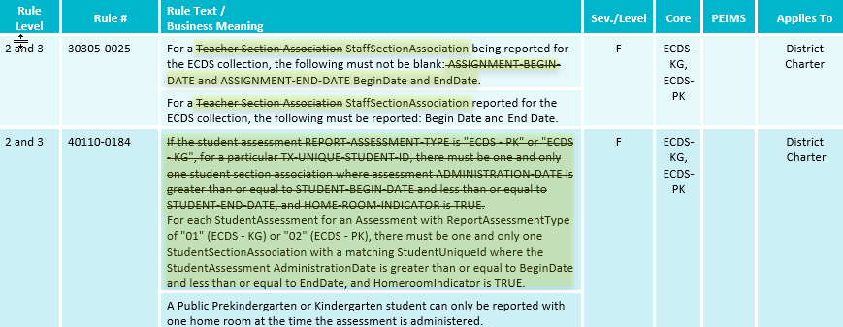
TSDS UPGRADE PROJECT UPDATES 4
Business Rule Changes:
  Business validation logic requires that a BeginDate and EndDate must be populated:

Slide 33
TSDS UPGRADE PROJECT UPDATES 5
Promotion Logic Guide & Test Cases Coming Soon!
  More details will be provided in the TSDS Summer Training.

Slide 34
TITLE SLIDE: Closeout
CLOSEOUT
NAME OF COMPONENT (ALL CAPS)
MARCH 19-21, 2024

Slide 35
TIMELINE 3
Early Childhood Data System Collection (ECDS) - PK | Date
TSDS ready to load data to IODS | August 5, 2024
ECDS Prekindergarten ready for users to complete | November 11, 2024
Private Prekindergarten application deadline for BPD (Business Partner Directory) Org number | May 29, 2025
ECDS Prekindergarten Submission due date for LEAs and Private Prekindergarten Organizations | June 26, 2025
ECDS Prekindergarten data available to customers | July 10, 2025

Slide 36
TECHNICAL RESOURCES
Technical Support
  TSDSCustomerSupport@tea.texas.gov
Technical Specifications
  2024-2025 Domains​
  2024-2025 Data Element Definitions​
  2024-2025 Descriptor Tables​
  2024-2025 Data Validation Rules​
  2024-2025 Data Submission Timelines
  Known Issues
TSDS Incident Management System (TIMS)
  TSDS Incident Management System (TIMS) Support Application
  TIMS Knowledge Base Article Repository

Slide 37

QUESTIONS
QUESTIONS?

