Slide 1

TITLE SLIDE: ESC Vendor Training for One Component
EARLY CHILDHOOD DATA SYSTEM PREKINDERGARTEN
July 30-31, 2024 and August 1, 2024

Slide 2

AGENDA – ECDS PREKINDERGARTEN
PROGRAM AREA
2024-2025 SCHOOL YEAR
  Data Governance Updates
  Descriptor Table Updates
  Report Updates
  Business Rule Updates
  TSDS Upgrade Updates
CLOSEOUT
  Timeline
  Frequently Asked Questions
  Technical Resources
  Questions

Slide 3
PROGRAM AREA UPDATES & GUIDANCE
Early Childhood Education Division
  Tori Lee – Division Director
  Sylina Valdez – Programs Director
  Rebecca Matz – Program and Enrollment Specialist
  Magali Farooqi – Early Childhood Assessment Specialist
  Lauren Gomez – Curriculum and Instruction Specialist
  Jennifer Bruning – Family Engagement Specialist
Program-related questions can be submitted to the Early Childhood Education Division Support Portal.

Slide 4
PROGRAM AREA UPDATES & GUIDANCE
ECDS Kindergarten Assessment Guidance
  Ensure student information is loaded in a timely manner – Programs team will be pulling data on when an LEA begins promoting data to determine if extensions will be granted
  There are no exemptions given for LEAs that do not use one of the two commissioner-approved kindergarten reading instruments (TX-KEA or mCLASS Texas)
ECDS Prekindergarten Assessment Update
  New list will be implemented this school year – There are no exemptions given for LEAs that do not administer commissioner-approved pre-k instruments
  There will be no collection of MOY prekindergarten data through ECDS for the 24-25 SY
High-Quality Prekindergarten ECDS Reporting Update
  SY 24-25: PK Teacher Requirement code table add’l update to add a “does not meet” code and will generate a fatal error if left blank
  Notes for PK School Type Code updated to address Child Care Operation Number (next slide)
  June 2024- Commissioner's Rule 19 TAC 102.1003 updated to align with HB 2729 and create consistency with Texas Education Code Chapter 29 Subchapter E-1.

Slide 5
PROGRAM AREA UPDATES & GUIDANCE
DR6 Notes for PK School Type Code Table have been updated.
For Codes 11 and 12:
  This school type code WILL require the LEA to submit a Child Care Operation Number, if partnering with a licensed provider. If the partnering provider is NOT licensed, eight zeros, "00000000", must be entered.)

Slide 6

TITLE SLIDE: 2024-2025 School Year
2024-2025
SCHOOL YEAR
NAME OF COMPONENT (ALL CAPS)
MARCH 19-21, 2024

Slide 7
DATA GOVERNANCE UPDATES
No updates to the following since the TSDS Spring training:
  Data Elements
  Business Rules

Slide 8
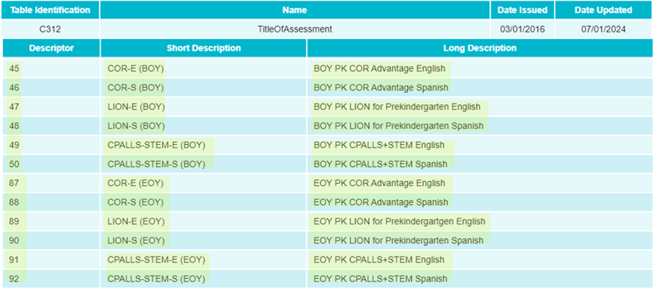
DATA GOVERNANCE UPDATES
NEW Descriptor Table Updates:
  C312 TitleOfAssessment:
    New Prekindergarten Assessments for 2024-2025 School Year

Slide 9
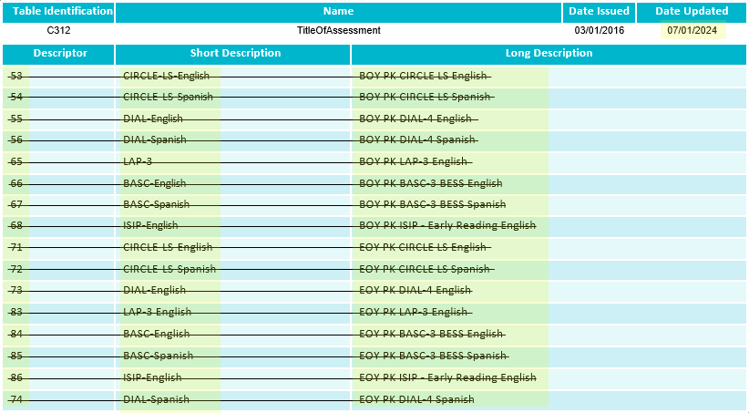
DATA GOVERNANCE UPDATES
NEW Descriptor Table Updates:
  C312 TitleOfAssessment:
    Deleted Prekindergarten Assessments for 2024-2025 School Year

Slide 10
DESCRIPTOR TABLE UPDATES
The following C207 PKTeacherRequirement descriptor table values have been added:
  98 – Be employed as a prekindergarten teacher in a school district with no additional high-quality prekindergarten qualification
  99 – Contract Entity – employed as a prekindergarten teacher in a school district with no additional high-quality prekindergarten qualifications

Slide 11
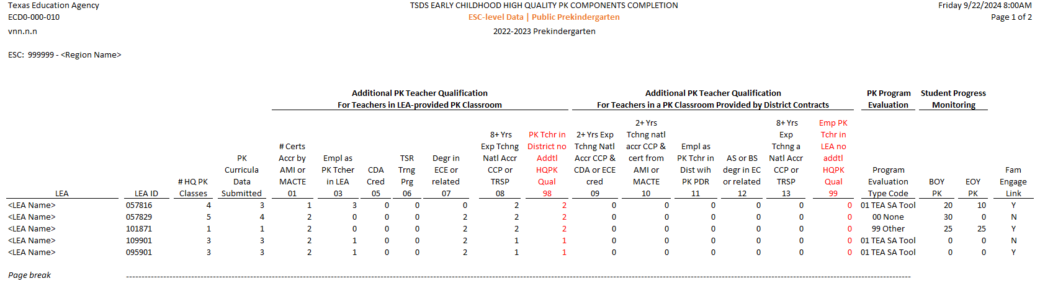
REPORT UPDATES 3
NEW The following report will be impacted by the C207 PKTeacherRequirement descriptor table values that will be added:
  ECD0-000-010 Early Childhood High Quality PK Components Completion

Slide 12
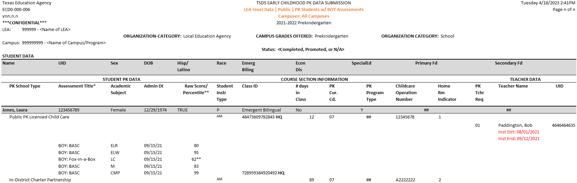
REPORT UPDATES 3
NEW The following report will be updated to include the teacher “Inst Strt” and “Inst End” dates:
  ECD0-000-006 Early Childhood PK Data Submission

Slide 13
BUSINESS RULE UPDATES 2
The following business rules will be impacted by the C207 PKTeacherRequirement descriptor table values that will be added:
  30040-0049
  30040-0057

Slide 14
TSDS UPGRADE PROJECT UPDATES
Data Element Name Changes:
Data Element ID | XML Data Element Name | Upgrade Data Element Name
E1127 | ASSESSMENT TITLE | TitleofAssessment
E1359 | SCORE RESULT | Result
E1056 | CLASS-ID-NUMBER | SectionIdentifier
E3010 (was E1069) | STUDENT-BEGIN-DATE | BeginDate
E3020 (was E1070) | STUDENT-END-DATE | EndDate
E3010 (was E1065) | ASSIGNMENT-BEGIN-DATE | BeginDate
E3020 (was E1066) | ASSIGNMENT-END-DATE | EndDate
E0790 (was E1390) | EMERGENT-BILINGUAL | EmergentBilingualIndicator
E3044 (was E1079) | PRIMARY-PK-FUNDING-SOURCE | PKFundingSource
E3044 (was E1080) | SECONDARY-PK-FUNDING-SOURCE | PKFundingSource

Slide 15
TSDS UPGRADE PROJECT UPDATES 3
Descriptor Table Name Changes:
Descriptor Table ID | XML Code Table Name | Upgrade Descriptor Table Name
C061 (was DC079) | EMERGENT-BILINGUAL-TYPE | EmergentBilingualIndicator
C303 (was DC096) | PROGRAM-TYPE | ProgramType
C310 (was DC152) | PK-SCHOOL-TYPE | PKSchoolType
C311 (was DC153) | STUDENT-INSTRUCTION-TYPE | PKStudentInstruction
C312 (was DC154) | ASSESSMENT-TITLE-CODE | TitleOfAssessment

Slide 16
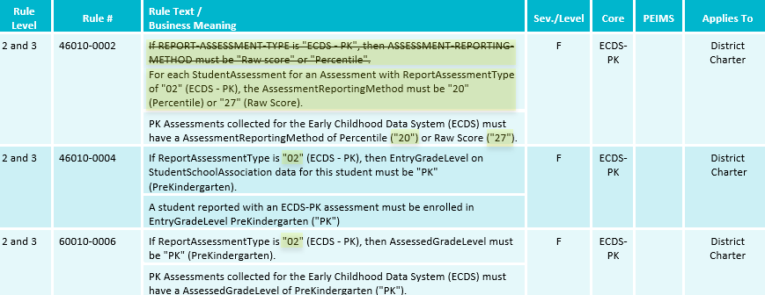
TSDS UPGRADE PROJECT UPDATES 2
Business Rule Changes:
  Uses codes instead of descriptors to trigger validations:
    “If ReportAssessmentType is "02" (ECDS - PK)…”

Slide 17
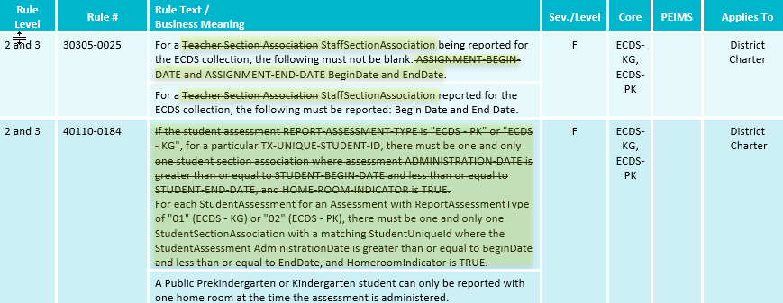
TSDS UPGRADE PROJECT UPDATES 4
Business Rule Changes:
  Business validation logic requires that a BeginDate and EndDate must be populated:

Slide 18
TSDS UPGRADE PROJECT UPDATES 5
NEW Promotion Logic:
  ECDS Prekindergarten Promotion Logic
  Student > Enrollment (School Association) Category/Subcategory:
    Promotion logic for E3044 PKFundingSource based on OrderofPKFundingSource=1
    Promotion logic for E3044 PKFundingSource based on OrderofPKFundingSource=2
  Student > Student Enrollment Program Category/Subcategory:
    Promotion logic for E1337 ProgramType descriptor value of (’33’ Special Education) will write a value of ‘1’ for the latest StudentSpecialEducationProgramAssociation.BeginDate or StudentSpecialEducationProgramAssociation EndDate is null or after the first day of school, else will write a value of ‘0’.

Slide 19
TSDS UPGRADE PROJECT UPDATES 5
NEW Promotion Logic:
  ECDS Prekindergarten Promotion Logic
  Staff > Teacher Class Assignment Categories/Subcategories:
    Updated promotion logic for E1454 ClassroomPosition which was prompted by TEDS 2025.2.0. addendum update:
      Removed Entity/CommonType StaffSectionAssociation.ClassroomPositionSet.
      Replaced E3092 ClassroomPositionBeginDate with E3010 BeginDate.
      New promotion logic for E1454 ClassroomPosition data element: “Data is promoted as of latest BeginDate.”

Slide 20
TSDS UPGRADE PROJECT UPDATES 9
NEW Test Cases:
  ECDS Prekindergarten Test Cases
  Test Case 1 – Student Data
  Test Case 2 – Teacher Data
  Test Case 3 – Student Assessment Completion
  Test Case 4 – PK Proficiency Summary

Slide 21
TITLE SLIDE: Closeout
CLOSEOUT
NAME OF COMPONENT (ALL CAPS)
MARCH 19-21, 2024

Slide 22
TIMELINE 3
Early Childhood Data System Collection (ECDS) - PK | Date
TSDS ready to load data to IODS | August 5, 2024
ECDS Prekindergarten ready for users to complete | November 11, 2024
Private Prekindergarten application deadline for BPD (Business Partner Directory) Org number | May 29, 2025
ECDS Prekindergarten Submission due date for LEAs and Private Prekindergarten Organizations | June 26, 2025
ECDS Prekindergarten data available to customers | July 10, 2025

Slide 23
FREQUENTLY ASKED QUESTIONS
How will the ECDS Private Prekindergarten data submission be impacted with the transition from XML to API?
For the 2024-2025 school year, TEA has made the decision to not collect private prekindergarten data for the optional TSDS ECDS data submission.
TEA will continue to evaluate the need and ability of private prekindergarten organizations to report this data in the future through TSDS.

Slide 24
TECHNICAL RESOURCES
Technical Support
  TSDSCustomerSupport@tea.texas.gov
Technical Specifications
  2024-2025 TSDS Web-Enabled Data Standards (TWEDS)
  Known Issues
TSDS Incident Management System (TIMS)
  TSDS Incident Management System (TIMS) Support Application
  TIMS Knowledge Base Article Repository

Slide 25

QUESTIONS
QUESTIONS?

