Slide 1

TITLE SLIDE: ESC Vendor Training for One Component
KEY CONCEPTS IN THE TSDS UPGRADE PROJECT
MARCH 19-21, 2024

Slide 2

AGENDA – KEY CONCEPTS
COMBINING DATA ELEMENTS
BEGIN AND END DATES
ZERO DESCRIPTORS
LANDING ZONE/NOT PROMOTED
CORE DESCRIPTOR TABLES
BEST PRACTICES
QUESTIONS

Slide 3

TITLE SLIDE: 2023-2024 School Year
Combining Data Elements
NAME OF COMPONENT (ALL CAPS)
MARCH 19-21, 2024

Slide 4
Combining Data Elements
Ed-Fi has a descriptor concept that TEA will now use to report student characteristics and services. StudentCharacteristic (E3063) is a descriptor that captures important characteristics of the student’s environment or situation. SpecialEducationProgramService (E3058) is a descriptor that defines the services provided by an education organization to populations of students associated with a special education program.
To align better with Ed-Fi, TEA is also using some Ed-Fi data elements such as Responsibility (E3051), LanguageInstructionProgramService (E3034), and CTEProgramService (E3012) to combine multiple TEA data elements into a corresponding descriptor table.
Ed-Fi also offers some data elements, such as LanguageUse (E3035) and Language (E3033), where TEA could use two data elements together to replace existing TEA data elements.
Lastly, TEA created some extended data elements such as Truancy (E3068), EndorsementPursuing (E3022), and EndorsementCompleted (E3021) to combine multiple TEA data elements into a corresponding descriptor table.

Slide 5
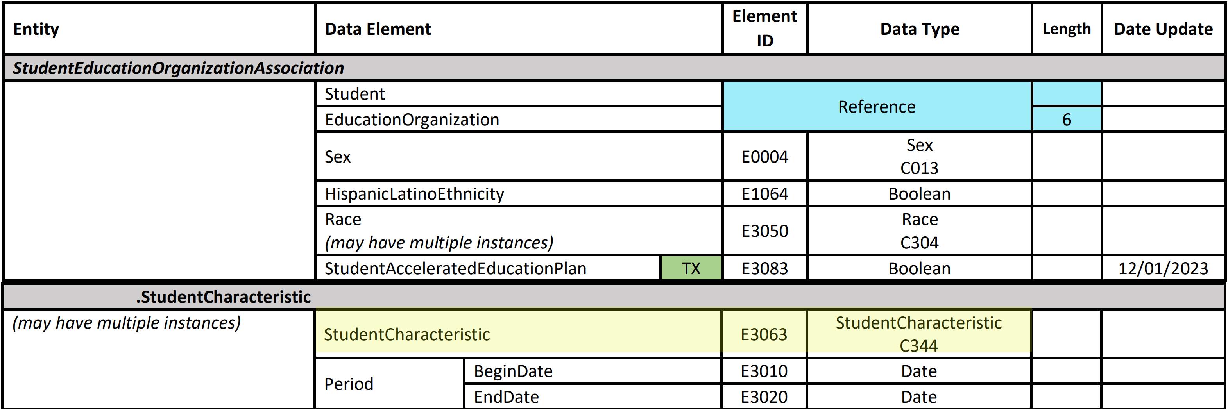
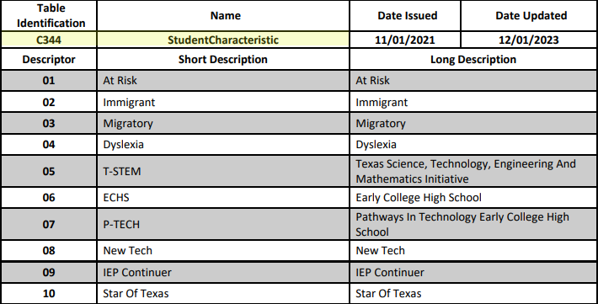
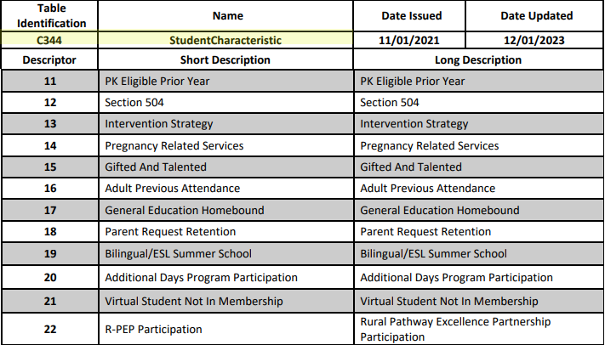
StudentCharacteristic Data Element

Slide 6
Combined for StudentCharacteristic
 | Data Element Name |  | Data Element Name
E0919 | AT-RISK-INDICATOR-CODE | E0797 | IMMIGRANT-INDICATOR-CODE
E0984 | MIGRANT-INDICATOR-CODE | E1530 | DYSLEXIA-INDICATOR-CODE
E1559 | T-STEM-INDICATOR-CODE | E1560 | ECHS-INDICATOR-CODE
E1612 | P-TECH-INDICATOR-CODE | E1647 | NEW-TECH-INDICATOR-CODE
E1564 | IEP-CONTINUER-INDICATOR-CODE | E1601 | STAR-OF-TEXAS-INDICATOR-CODE
E1649 | PK-ELIGIBLE-PREVIOUS-YEAR-INDICATOR-CODE | E1603 | SECTION-504-INDICATOR-CODE
E1602 | INTERVENTION-STRATEGY-INDICATOR-CODE | E1432 | PREGNANCY-RELATED-SERVICES
E1660 | ADULT-PREVIOUS-ATTENDANCE-INDICATOR-CODE | E0034 | GIFTED-TALENTED-INDICATOR-CODE
E1730 | GENERAL-EDUCATION-HOMEBOUND-INDICATOR | E1729 | PARENT-REQUEST-RETENTION-INDICATOR
E1028 | BILINGUAL/ESL-SUMMER-SCHOOL-INDICATOR-CODE | E1672 | ADDITIONAL-DAYS-PROGRAM-PARTICIPATION-INDICATOR-CODE

Slide 7
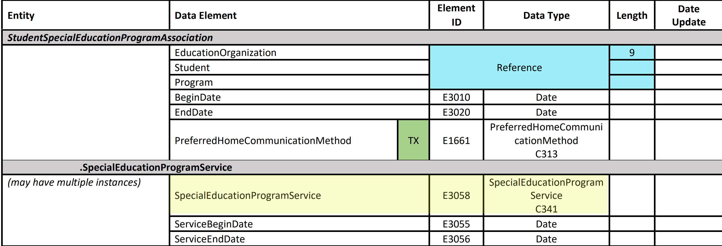
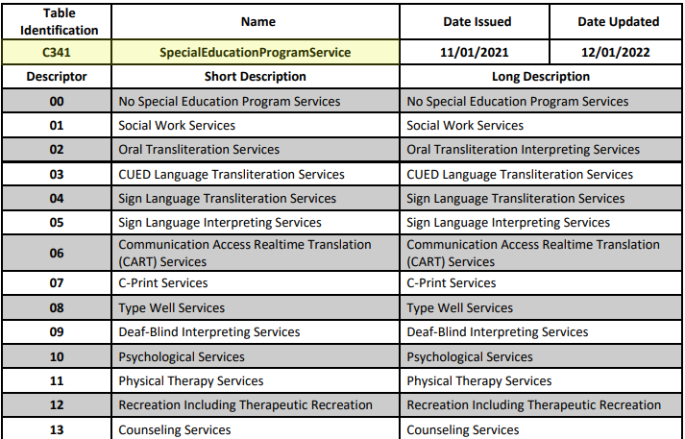
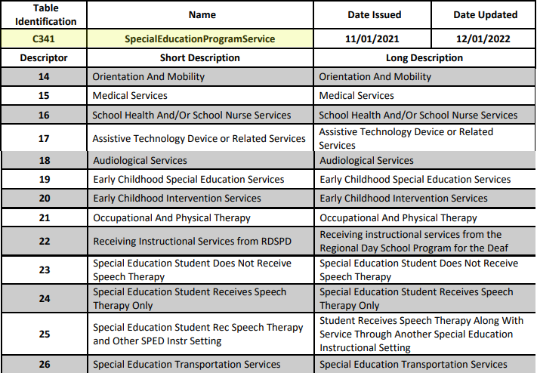
SpecialEducationProgramService Data Element

Slide 8
Combined for SpecialEducationProgramService
 | Data Element Name |  | Data Element Name
E0833 | REG-DAY-SCH-PROG-DEAF-CODE | E0838 | AUDIOLOGICAL-SERV-IND-CODE
E0840 | COUNSELING-SERVICES-IND-CODE | E0841 | MEDICAL-DIAGNOSTIC-SERV-IND-CODE
E0843 | OCCUPATIONAL-THERAPY-IND-CODE | E0844 | ORIENT-MOBILITY-TRNG-IND-CODE
E0845 | PHYSICAL-THERAPY-IND-CODE | E0846 | PSYCHOLOGICAL-SERVICES-IND-CODE
E0847 | RECREATION-IND-CODE | E0848 | SCHOOL-HEALTH-SERVICES-IND-CODE
E0849 | SOCIAL-WORK-SERVICES-IND-CODE | E0851 | TRANSPORTATION-INDICATOR-CODE
E0857 | SPEECH-THERAPY-INDICATOR-CODE | E0899 | PRESCHL-PROG-CHLDRN-WITH-DISAB-IND-CD
E0900 | EARLY-CHILDHOOD-INTERV-IND-CODE | E0997 | ASSISTIVE-TECH-INDICATOR-CODE
E1040 | INTERPRETING-SERVICES-TYPE-CODE

Slide 9
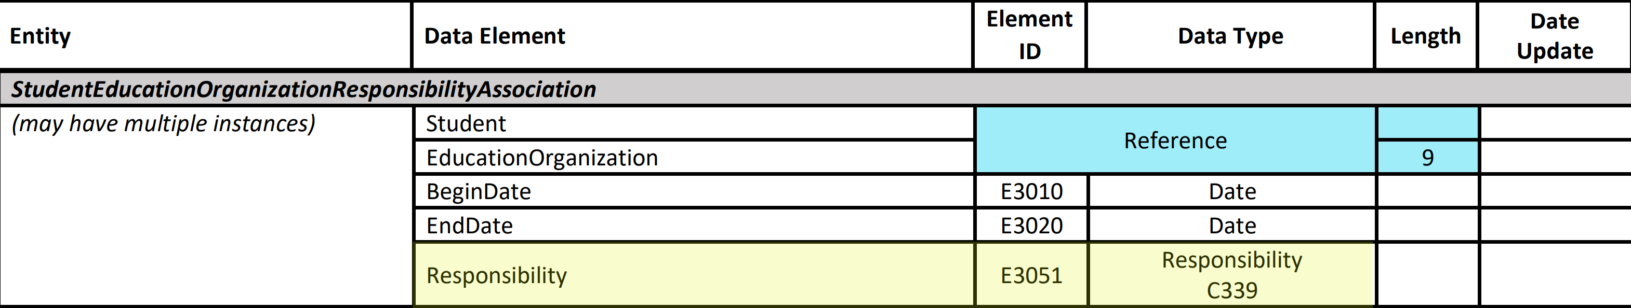
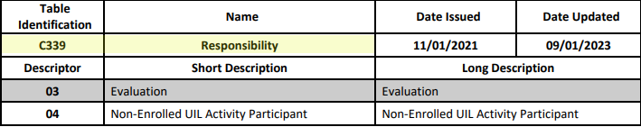
Responsibility Data Element
Data Elements:
CAMPUS-ID-OF-EVALUATION (E1710),
NON-ENROLLED-STUDENT-UIL-ACTIVITY (E1739)

Slide 10
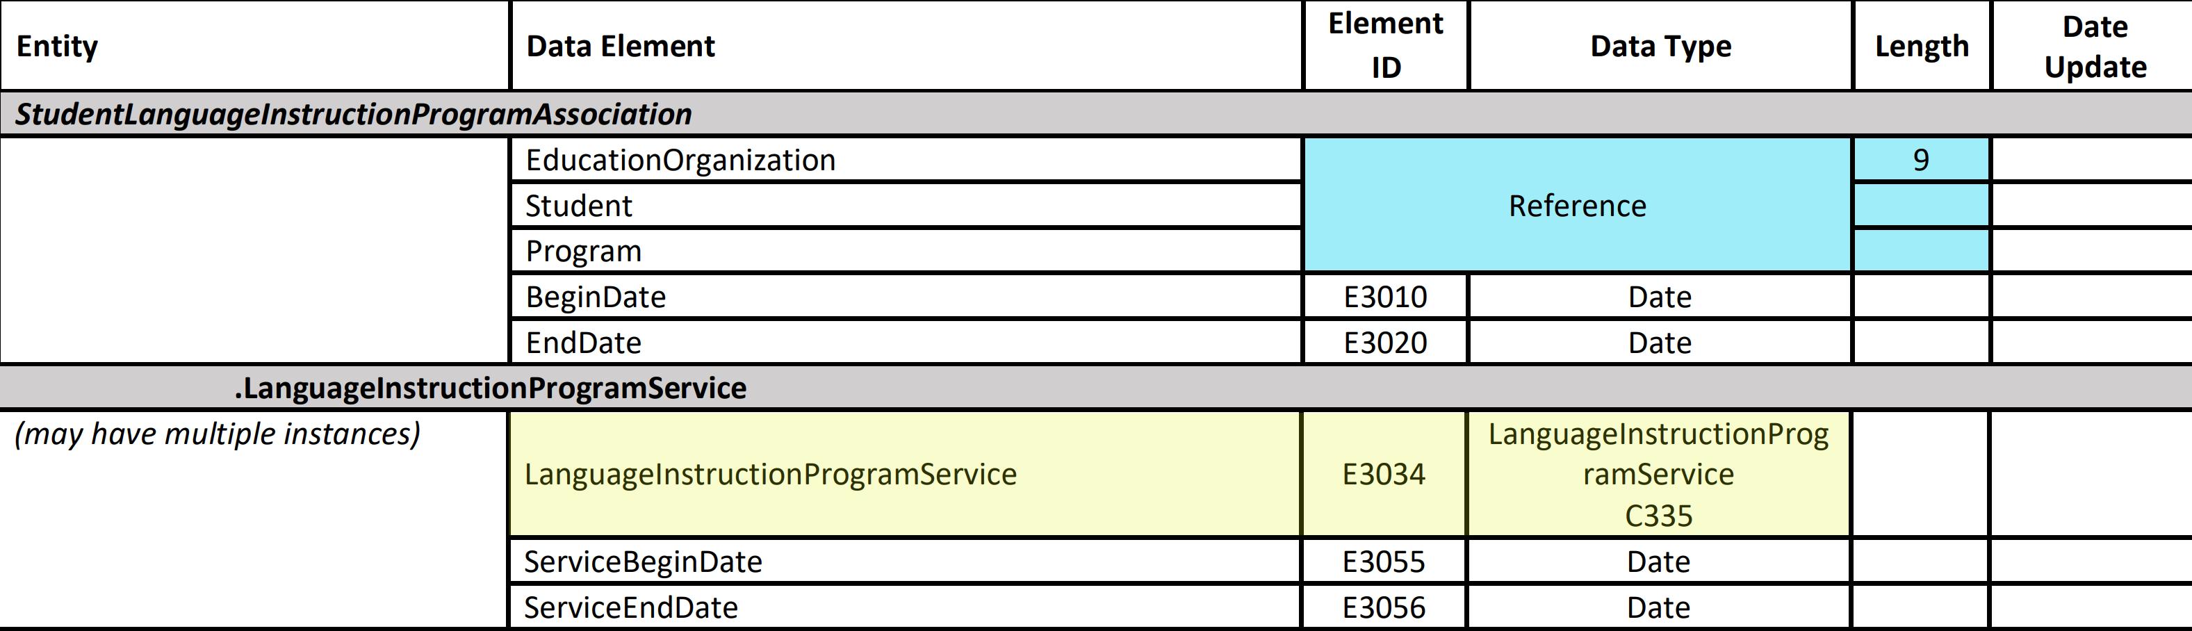
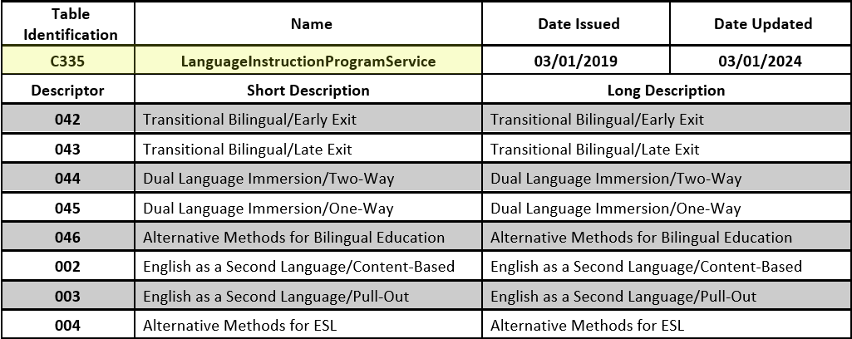
LanguageInstructionProgramService Data Element
Data Elements:
BILINGUAL-PROGRAM-TYPE-CODE (E1042)
ESL-PROGRAM-TYPE-CODE (E1043)
ALTERNATIVE-LANGUAGE-PROGRAM-CODE (E1642)

Slide 11
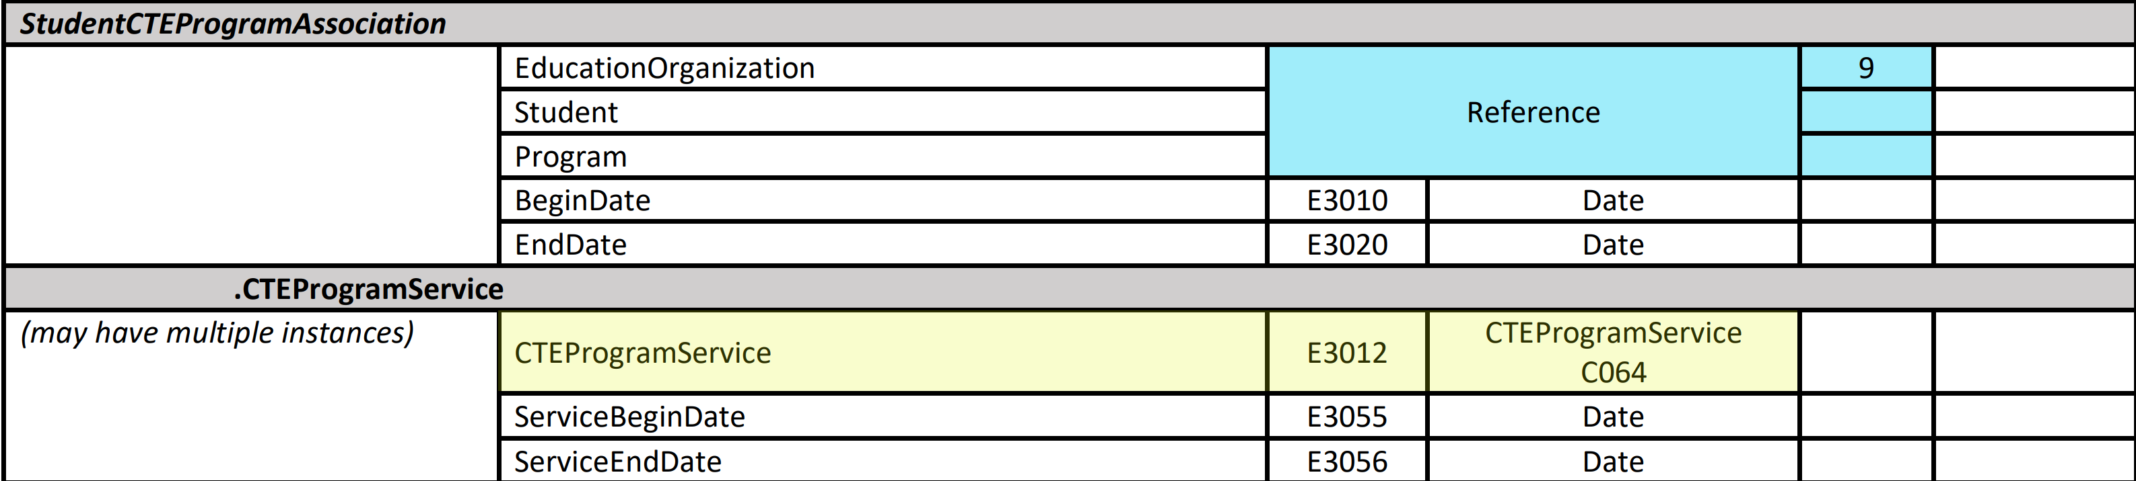
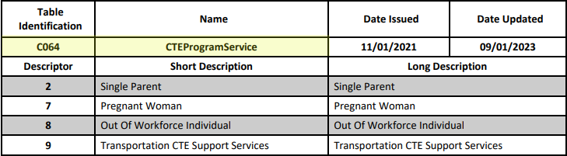
CTEProgramService
Data Elements:
SGL-PARENT-SGL-PREG-WOMAN-CODE (E0829)
OUT-OF-WORKFORCE-INDIVIDUAL (E1039)
TRANSPORTATION-CTE-SUPPORT-SERVICE (E0917)

Slide 12
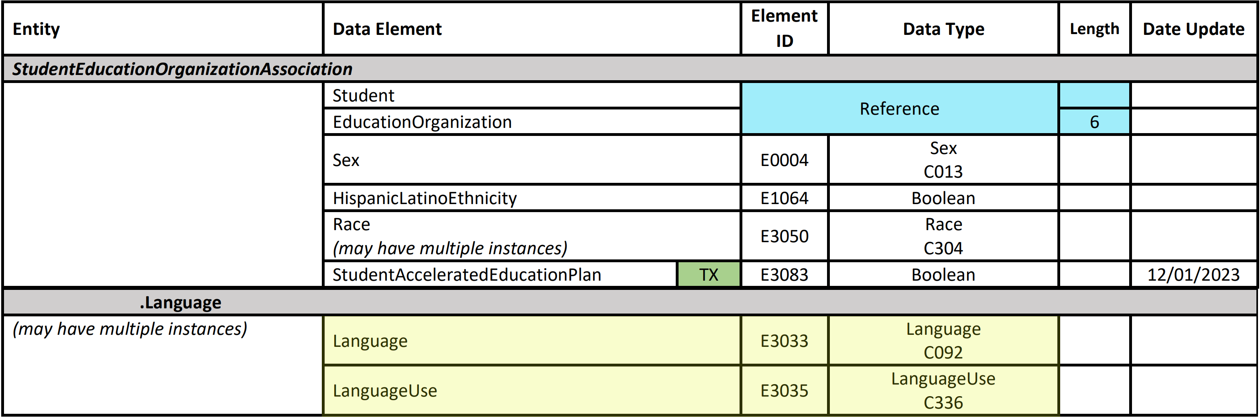
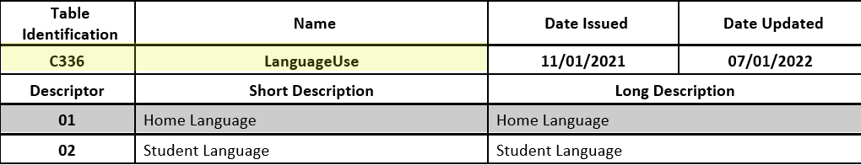
LanguageUse and Language Data Elements
Data Elements:
HOME-LANGUAGE-CODE (E0895),
STUDENT-LANGUAGE-CODE (E1590)

Slide 13
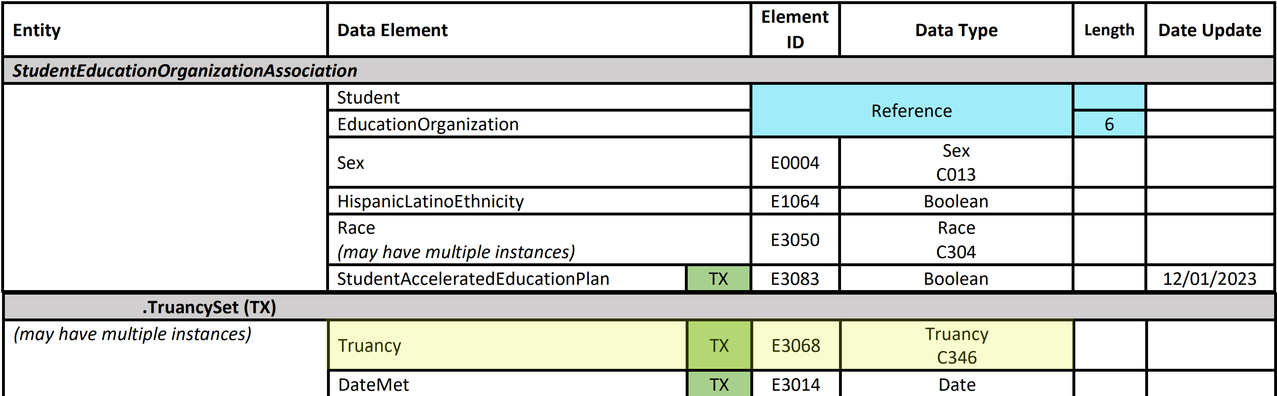
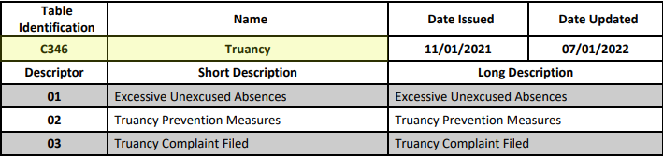
Truancy Data Element
Data Elements:
EXCESSIVE-UNEXCUSED-ABSENCE-INDICATOR-CODE (E1657)
TRUANCY-PREVENTION-MEASURE-INDICATOR-CODE (E1658) TRUANCY-COMPLAINT-FILED-INDICATOR-CODE (E1658)

Slide 14
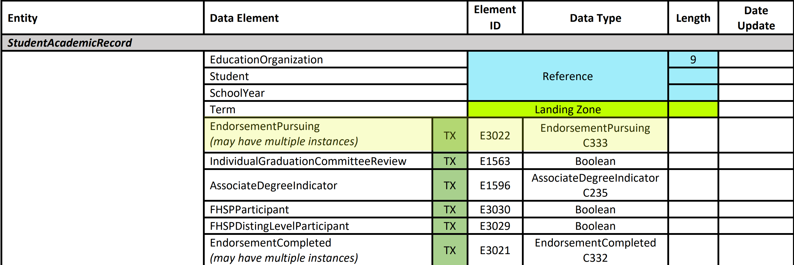
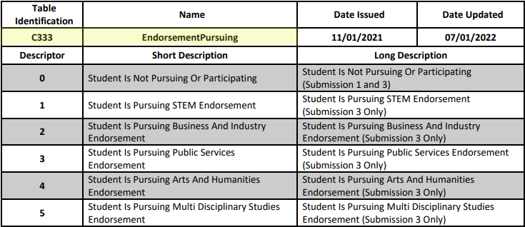
EndorsementPursuing Data Element
Data Elements:
STEM-ENDORSEMENT-INDICATOR-CODE (E1544)
BUSINESS-AND-INDUSTRY-ENDORSEMENT-INDICATOR-CODE (E1545) PUBLIC-SERVICES-ENDORSEMENT-INDICATOR-CODE (E1546)
ARTS-AND-HUMANITIES-INDICATOR-CODE (E1547)
MULTI-DISCIPLINARY-STUDIES-ENDORSEMENT-INDICATOR-CODE (E1548)

Slide 15
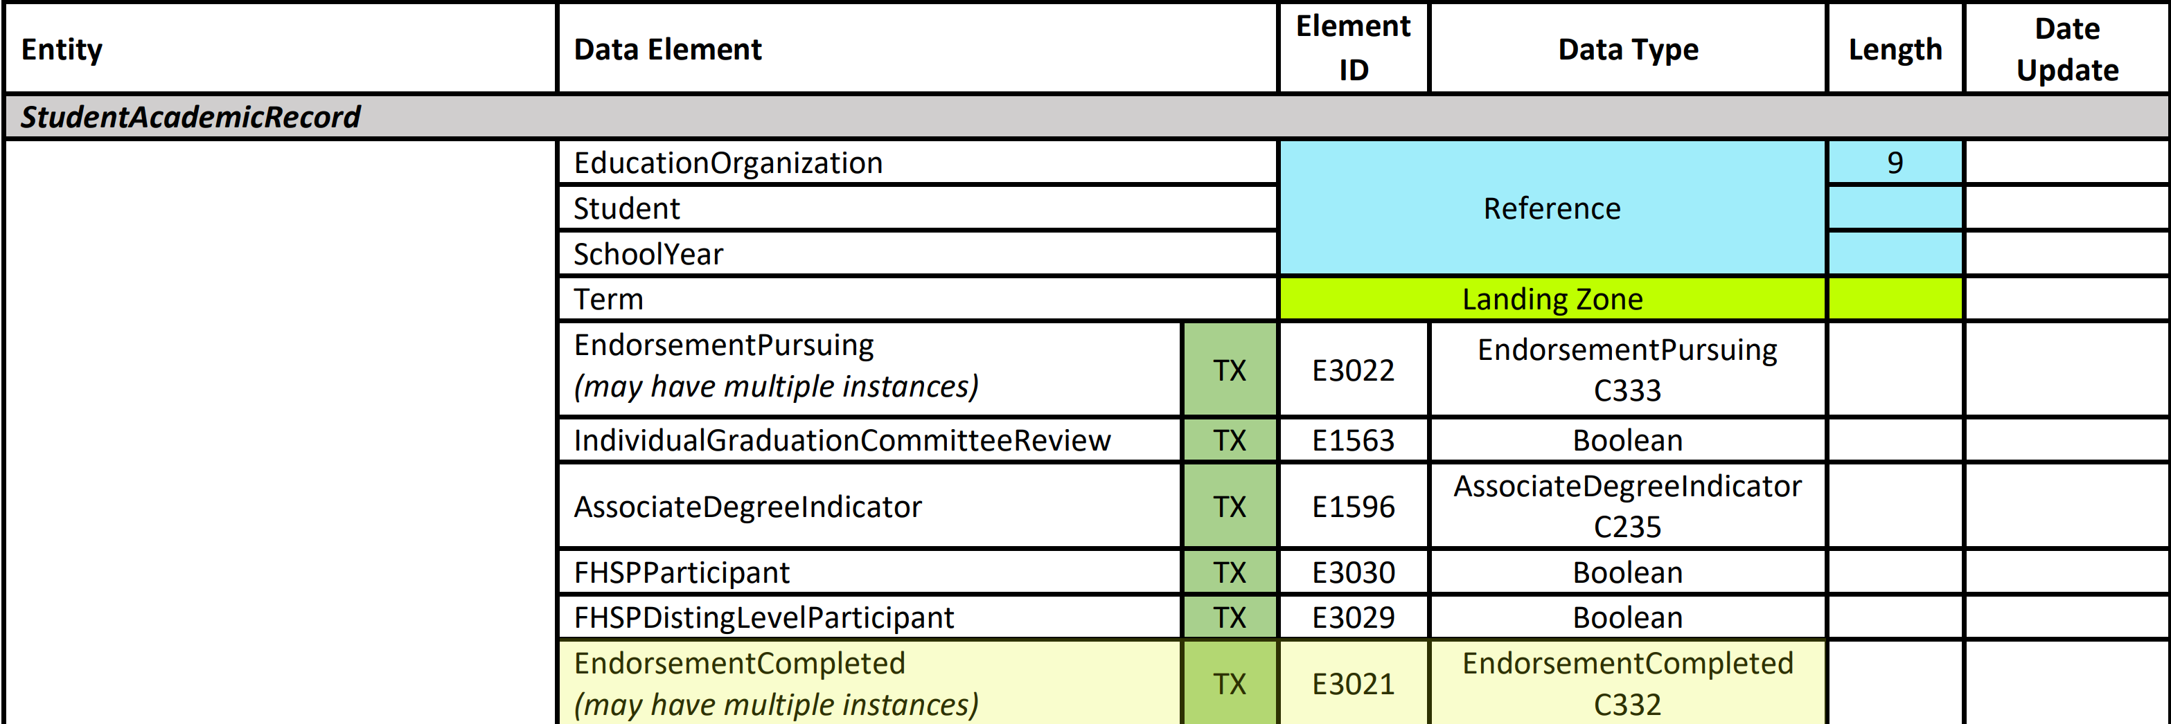
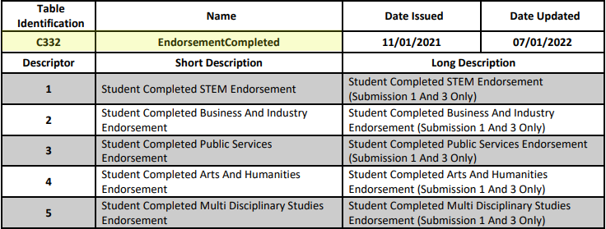
EndorsementCompleted Data Element
Data Elements:
STEM-ENDORSEMENT-INDICATOR-CODE (E1544)
BUSINESS-AND-INDUSTRY-ENDORSEMENT-INDICATOR-CODE (E1545) PUBLIC-SERVICES-ENDORSEMENT-INDICATOR-CODE (E1546)
ARTS-AND-HUMANITIES-INDICATOR-CODE (E1547)
MULTI-DISCIPLINARY-STUDIES-ENDORSEMENT-INDICATOR-CODE (E1548)

Slide 16
Combining Data Elements – PEIMS Example
PEIMS Fall Submission:
EndorsementCompleted (E3021) is used to promote completed endorsements for School Graduation Program sub-category. TEA will promote a value of ‘2’ regardless of EndorsementCompleted descriptor reported, if no EndorsementCompleted is reported, TEA will promote a value of ‘0’. This logic is used to align with 2023-2024 production promotions for parallel testing and verifications.

Slide 17
Combining Data Elements – Core Collection Example
SPPI-14:
Language (E3033) and LanguageUse (E3035) are used to promote just the student’s Home Language for SPPI-14 reporting. Any Language reported with a LanguageUse value of ‘Student Language’ will be ignored by the promotion logic.

Slide 18
Begin and End Dates
Begin and End Dates
NAME OF COMPONENT (ALL CAPS)
MARCH 19-21, 2024

Slide 19
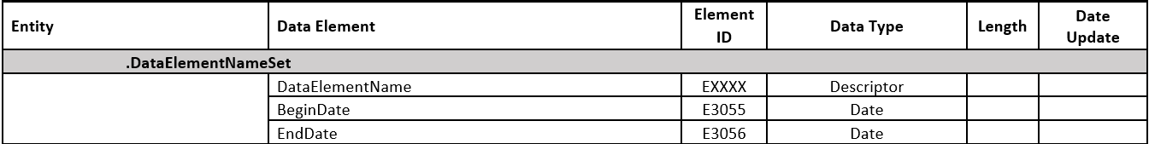
Begin and End Dates 1
To “effective date” some data elements, TEA will begin collecting the data element combined with a BeginDate and EndDate in a “set.” Some sets will have more than one data element that will be associated with the BeginDate. The BeginDate and EndDate will allow TEA to promote the correct data for snapshot purposes.
The BeginDate will be specific to one or more data elements and will be required to be reported with the data element.
The EndDate will only be reported when the data element becomes false. The EndDate will be the first day of non-participation in the program.

Slide 20
Entity with BeginDate Data Element
 | Current School Year Only | Current or Prior​ School Year
CTEProgramService | X
StudentTitleIPartAProgramAssociationSet |  | X
StudentSPEDProgramAssociationSet |  | X
InstructionalSettingSet |  | X
DisabilitySet |  | X
SpecialEducationProgramService |  | X
StudentResFacAssocSet | X
ParentalPermissionSet |  | X
 | Current School Year Only | Current or Prior​ School Year
LanguageInstructionProgramService |  | X
CampusEnrollmentTypeSet |  | X
NSLPTypeSet | X
StudentEducationOrganizationResponsibilityAssociation |  | X
BudgetExt | X
PayrollExt |  | X
ReportingPeriodExt | X
StaffTypeSet |  | X

Slide 21
Entity with BeginDate Data Element 1
 | Current School Year Only | Current or Prior​ School Year
ParaprofessionalCertificationSet |  | X
StaffEducationOrganizationAssignmentAssociation |  | X
StaffServiceSet |  | X
AuxiliaryRoleIdSet |  | X
EmploymentPeriod |  | X
StaffCohortAssociation | X
StudentCohortAssociation | X
StudentCensusBlockGroupSet | X
CrisisEventSet | X
 | Current School Year Only | Current or Prior​ School Year
EmergentBilingualSet |  | X
TruancySet | X
DyslexiaServicesSet | X
EconomicDisadvantageSet | X
FosterCareTypeSet | X
HomelessStatusSet | X
UnaccompaniedYouthSet | X
UnschooledAsyleeRefugeeSet |  | X
EarlyReadingIndicatorSet | X
MilitaryConnectedStudentSet |  | X

Slide 22
Entity with BeginDate Data Element 2
 | Current School Year Only | Current or Prior​ School Year
DyslexiaRiskSet | X
PKProgramTypeSet | X
PKFundingSourceSet | X
StudentCharacteristic |  | X
SectionSet | X
StaffSectionAssociation | X
StudentSectionAssociation | X
Specific BeginDate definitions can be found in the All Data Elements Definitions document.

Slide 23
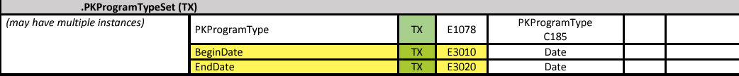
Begin and End Dates – PEIMS Example 1
PEIMS Fall Submission:
BeginDate (E3010) and EndDate (E3020) are used to promote the student’s PKProgramType (E1078) for PEIMS Fall Submission. The indicator will be promoted based on a BeginDate that is on or before the PEIMS Fall Snapshot date and an EndDate that is either not reported or is after the PEIMS Fall Snapshot date.

Slide 24
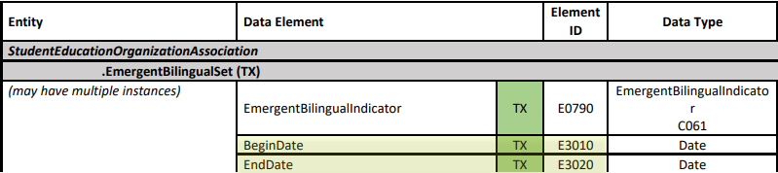
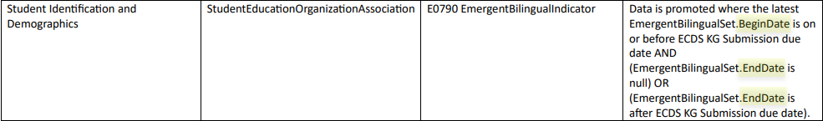
Begin and End Dates – Core Collection Example 1
ECDS KG Submission :
BeginDate (E3010) and EndDate (E3020) are used to promote the student’s EmergentBilingualIndicator (E0790) for ECDS KG reporting. The latest indicator will be promoted based on a BeginDate on or prior to the ECDS KG Submission due date and an EndDate that is either not reported or is after the ECDS KG Submission due date.

Slide 25
TITLE SLIDE: 2023-2024 School Year1
Zero Descriptors
NAME OF COMPONENT (ALL CAPS)
MARCH 19-21, 2024

Slide 26
Zero Descriptors
When TEA released the TSDS Upgrade Project data standards, LEAs and vendors asked why the LEA must report a data element when the student was not participating in the program captured by the data element.
TEA removed certain zero descriptors from the descriptor tables listed on the following slides. The LEA will no longer report the data element with the zero descriptor. The data elements on the next slides will only be reported when there is a valid descriptor for the student.
Some zero descriptors remained in tables such as EconomicDisadvantage, ADAEligibility, ArmedServicesVocAptBattery, CourseSequence, DisciplineActionLengthDifferenceReason, DyslexiaServices, InstructionalSetting, GiftedTalentedProgram, LevelOfEducation, NonCampusBasedInstruction, NSLPType, ToolOrAssessmentUsed, IncidentLocation, PKProgramEvaluationType, and SpecialEducationProgramService. These zero descriptors provide important information about the student, staff, or campus.

Slide 27
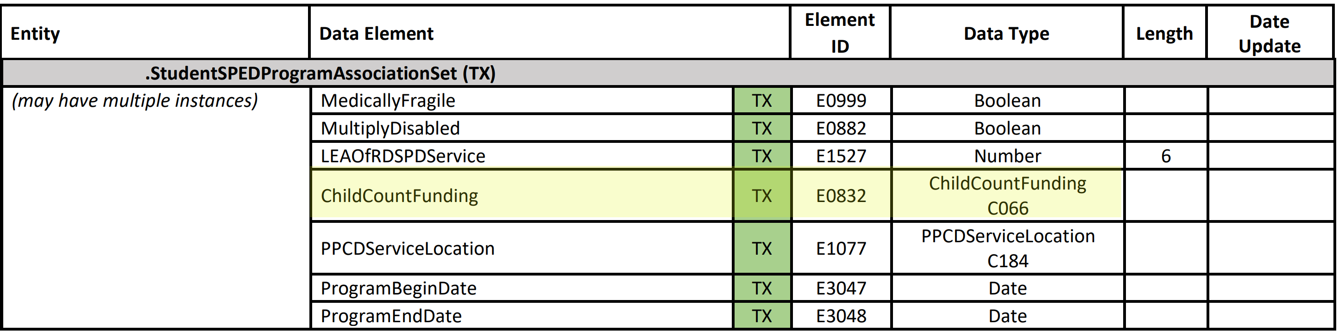
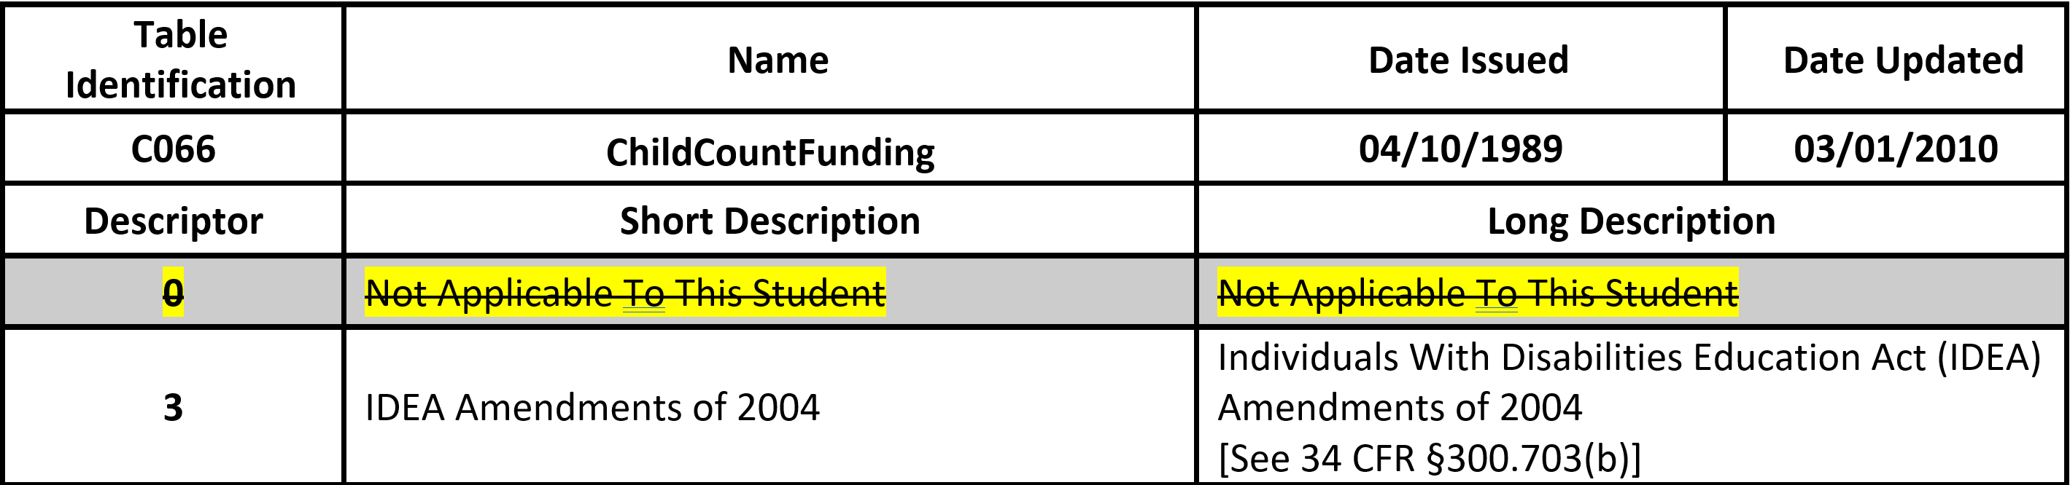
ChildCountFunding Descriptor Table

Slide 28
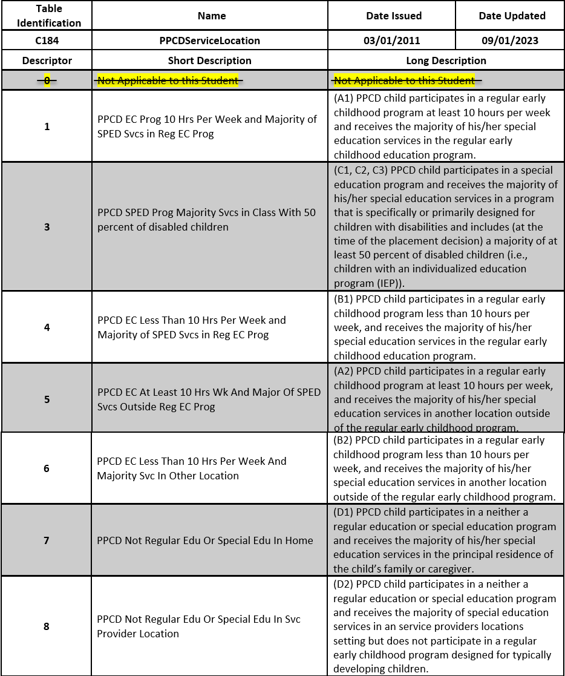
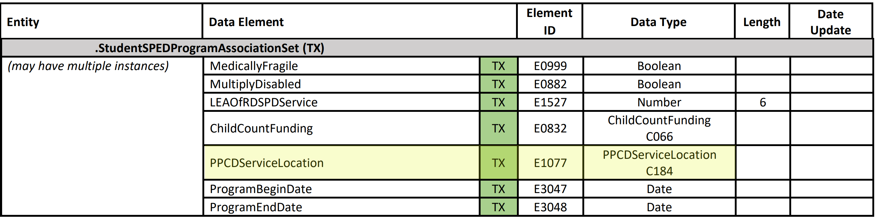
PPCDServiceLocation Descriptor Table

Slide 29
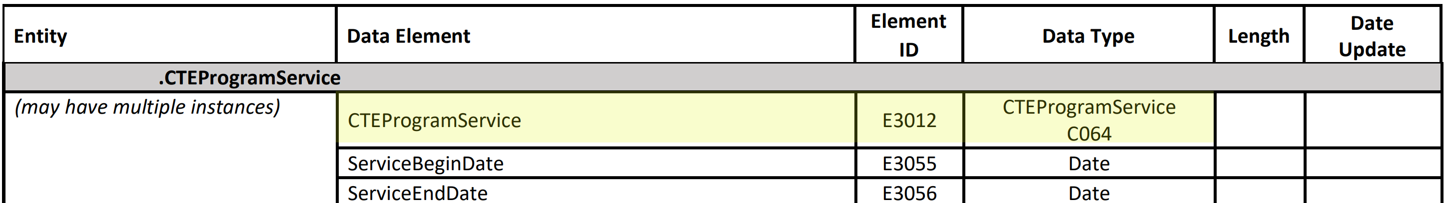
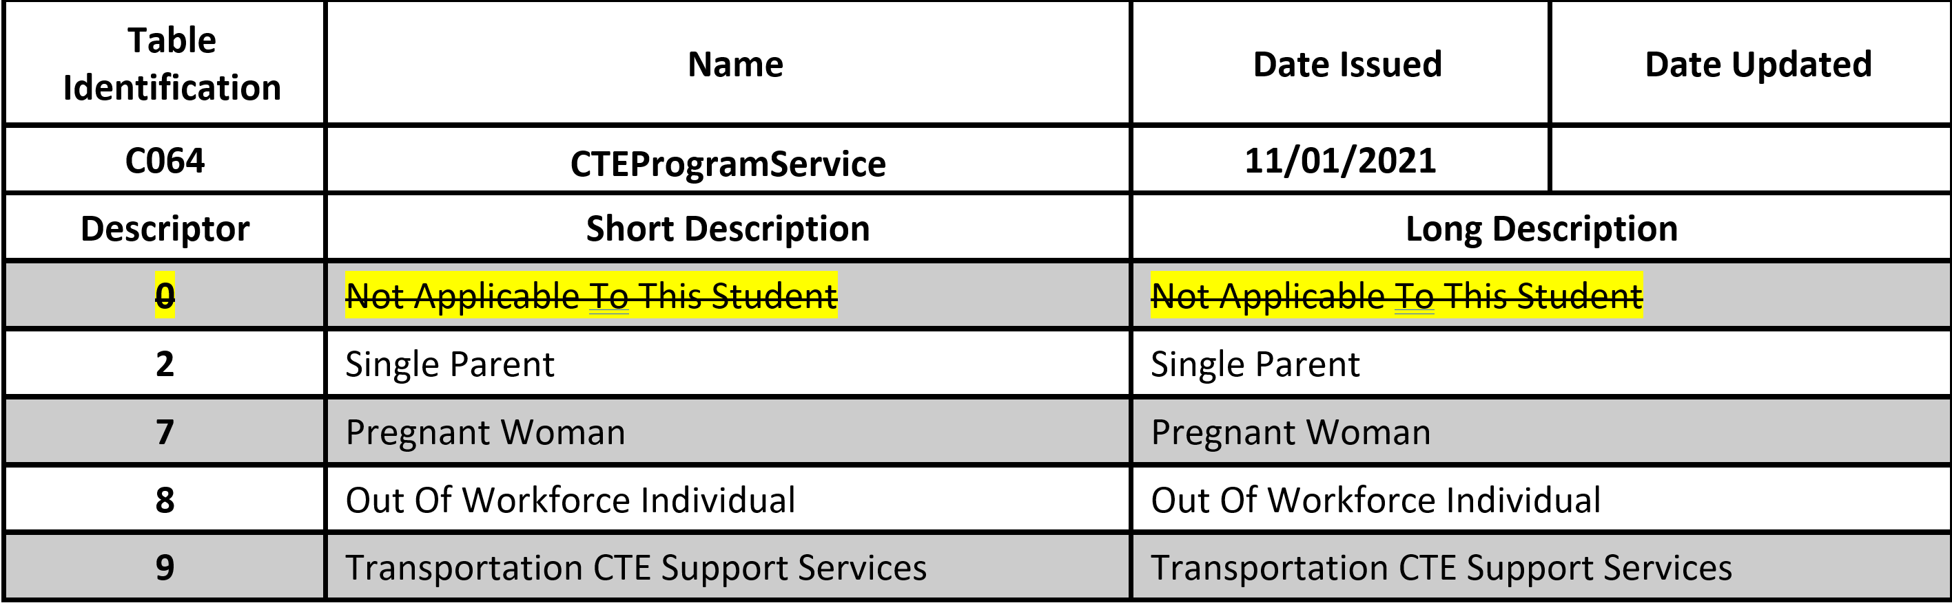
CTEProgramService Descriptor Table

Slide 30
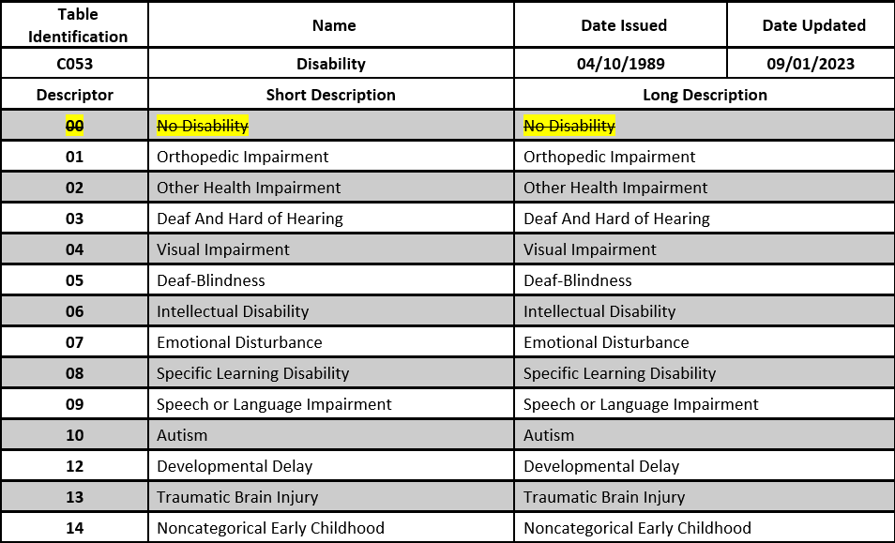
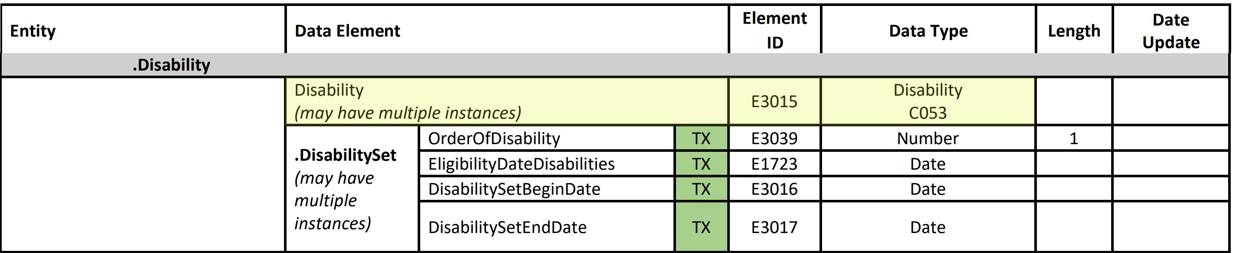
Disability Descriptor Table

Slide 31
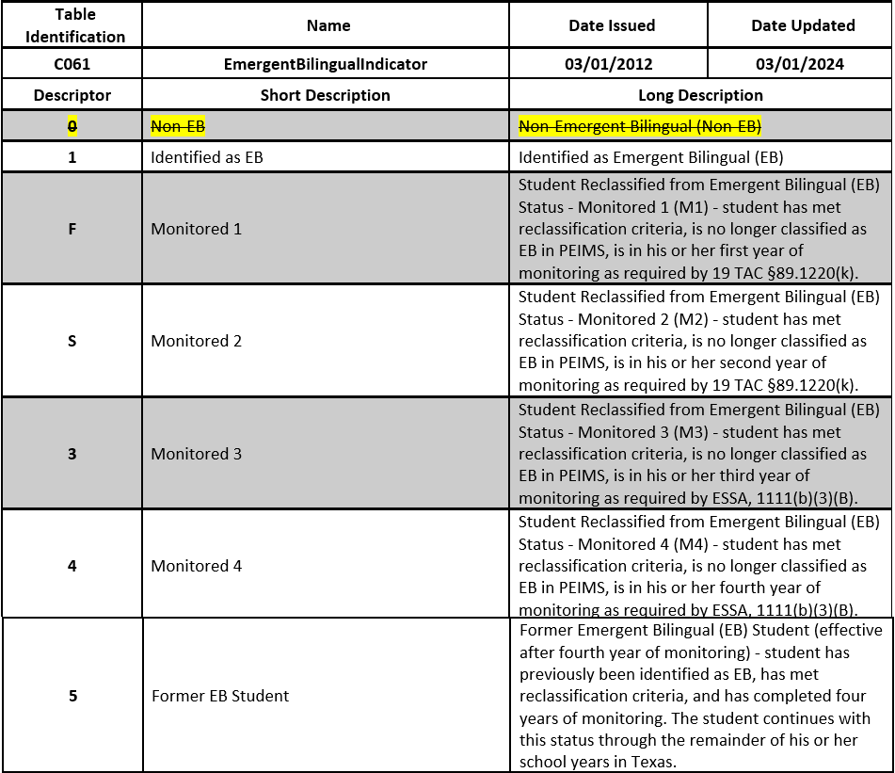
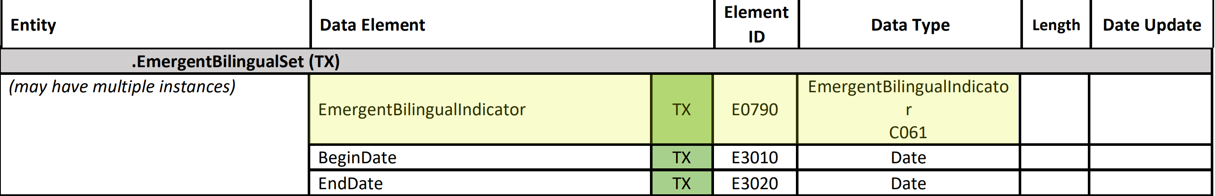
EmergentBilingualIndicator Descriptor Table

Slide 32
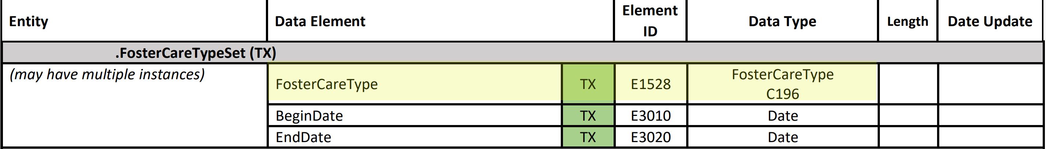
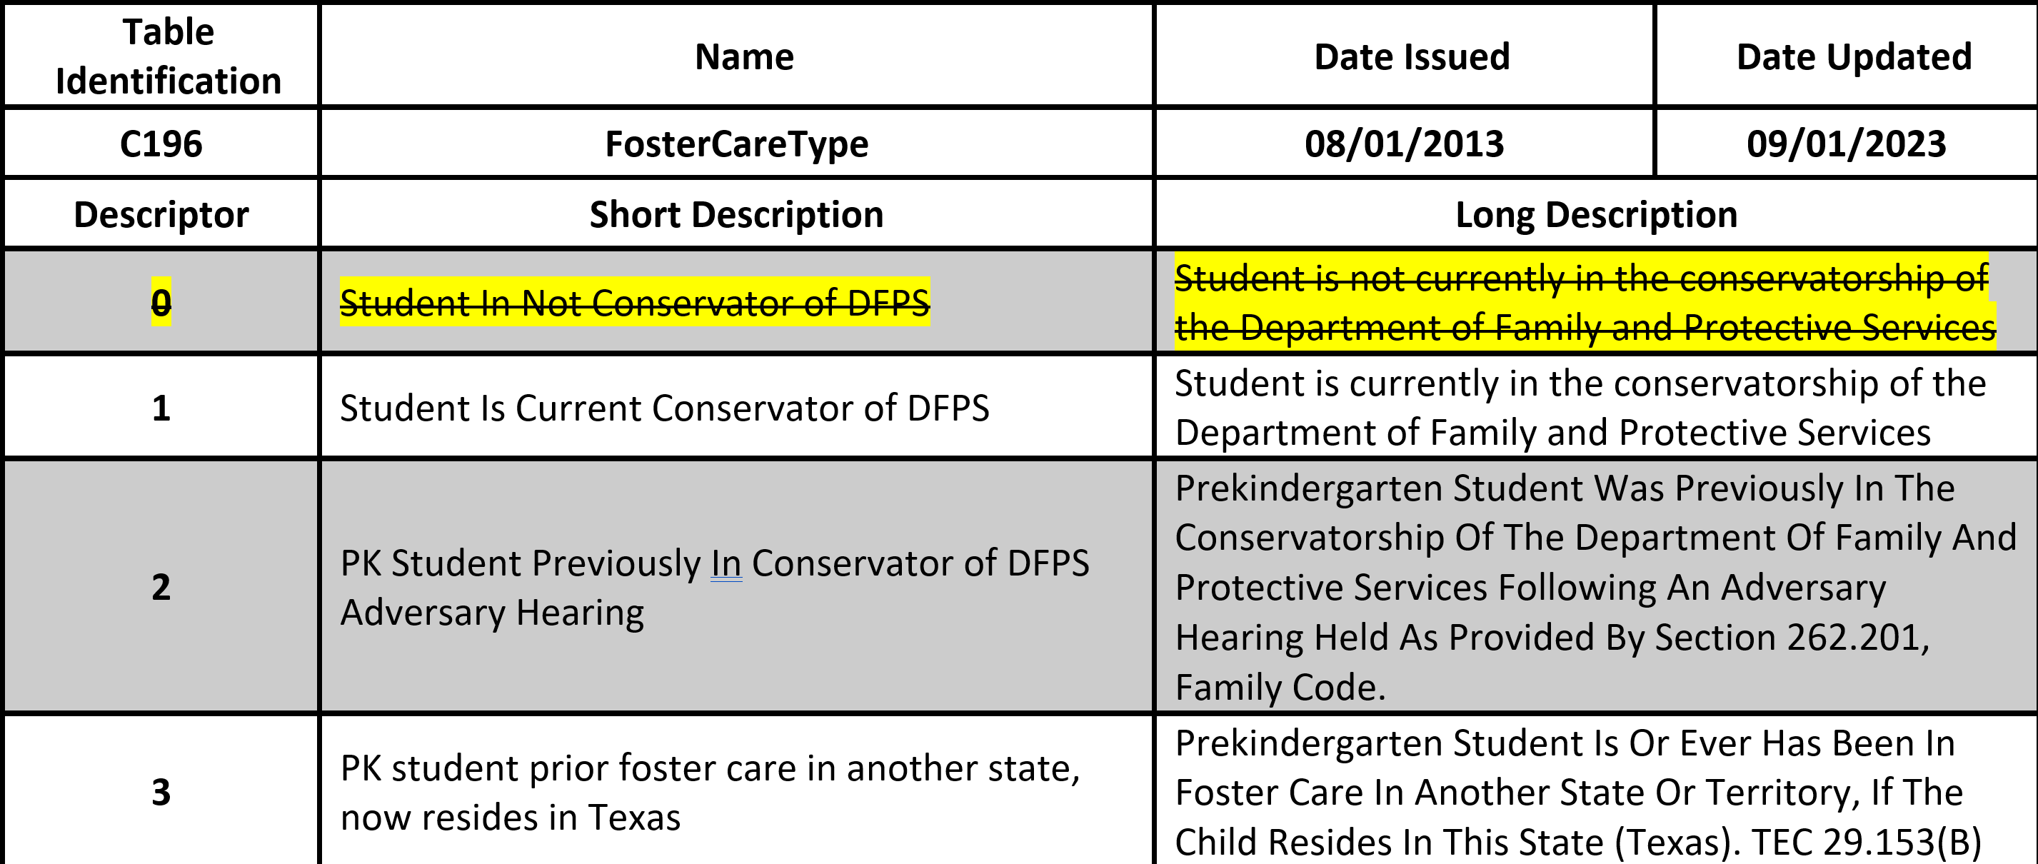
FosterCareType Descriptor Table

Slide 33
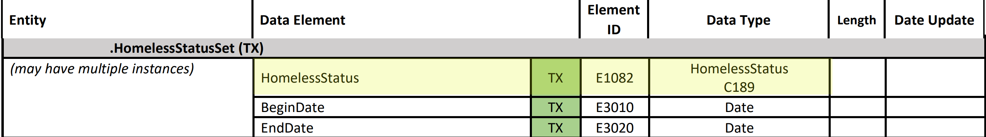
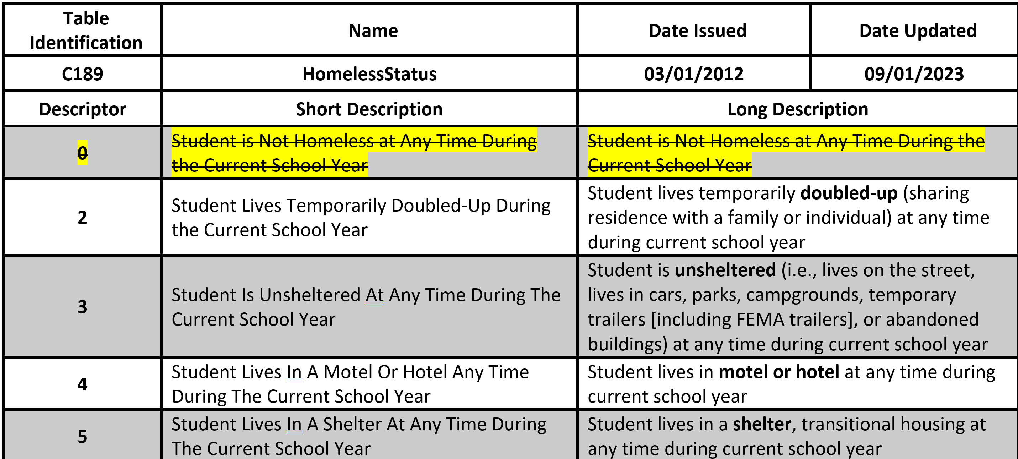
HomelessStatus Descriptor Table

Slide 34
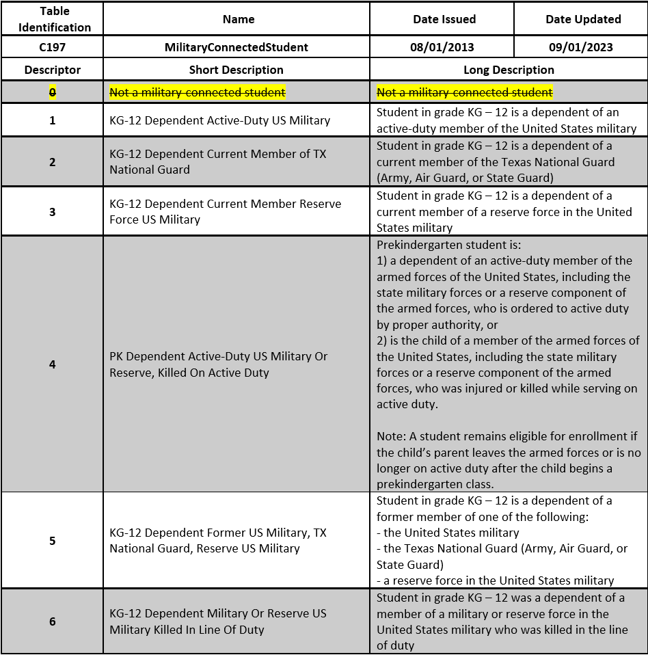
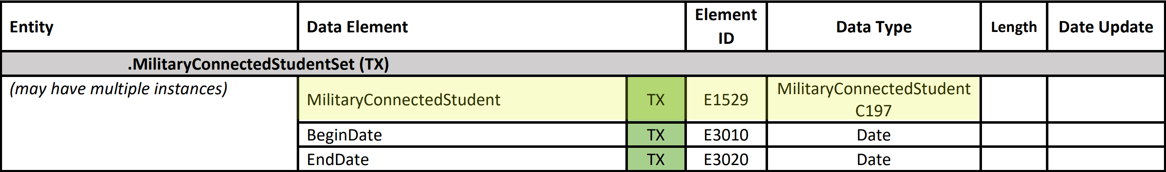
MilitaryConnectedStudent Descriptor Table

Slide 35
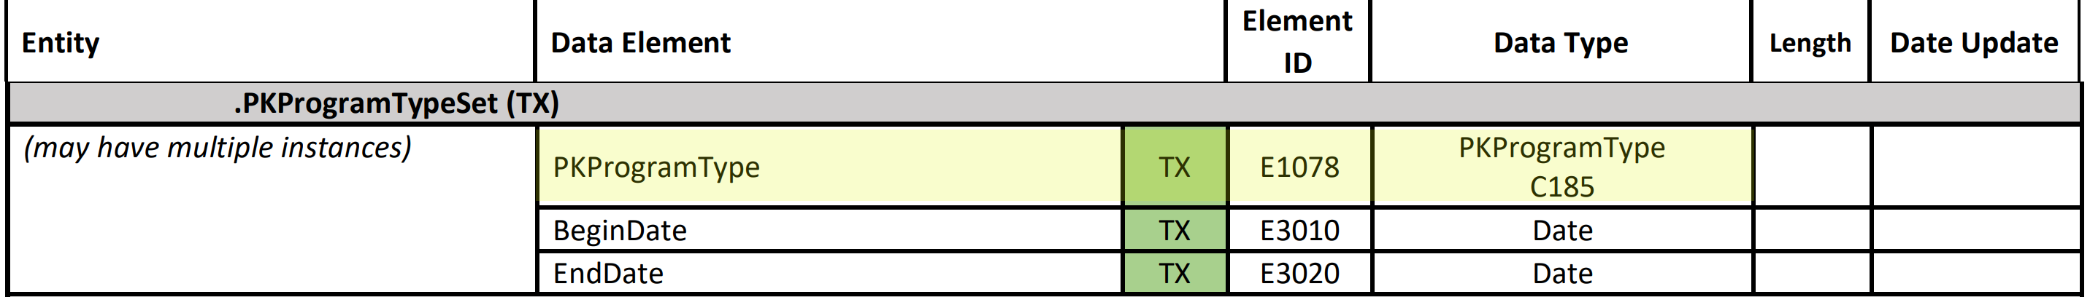
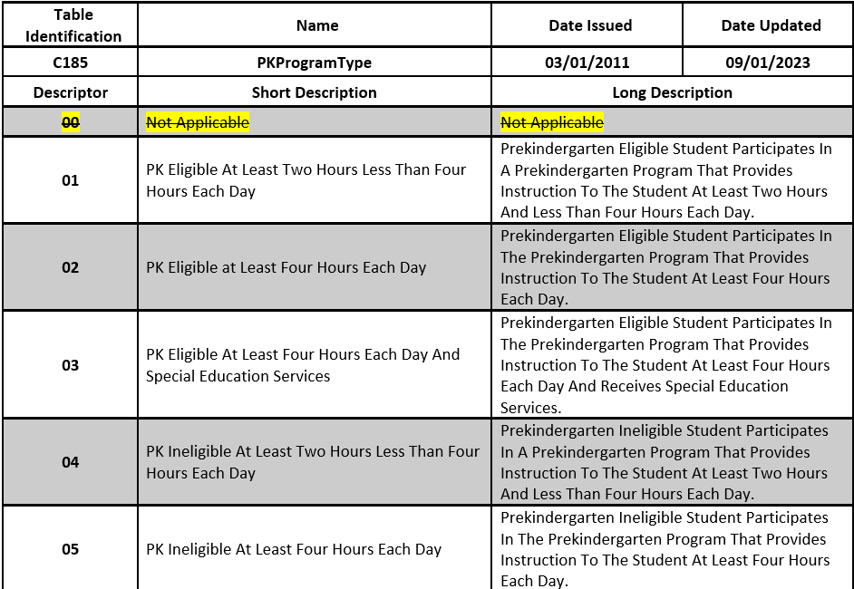
PKProgramType Descriptor Table

Slide 36
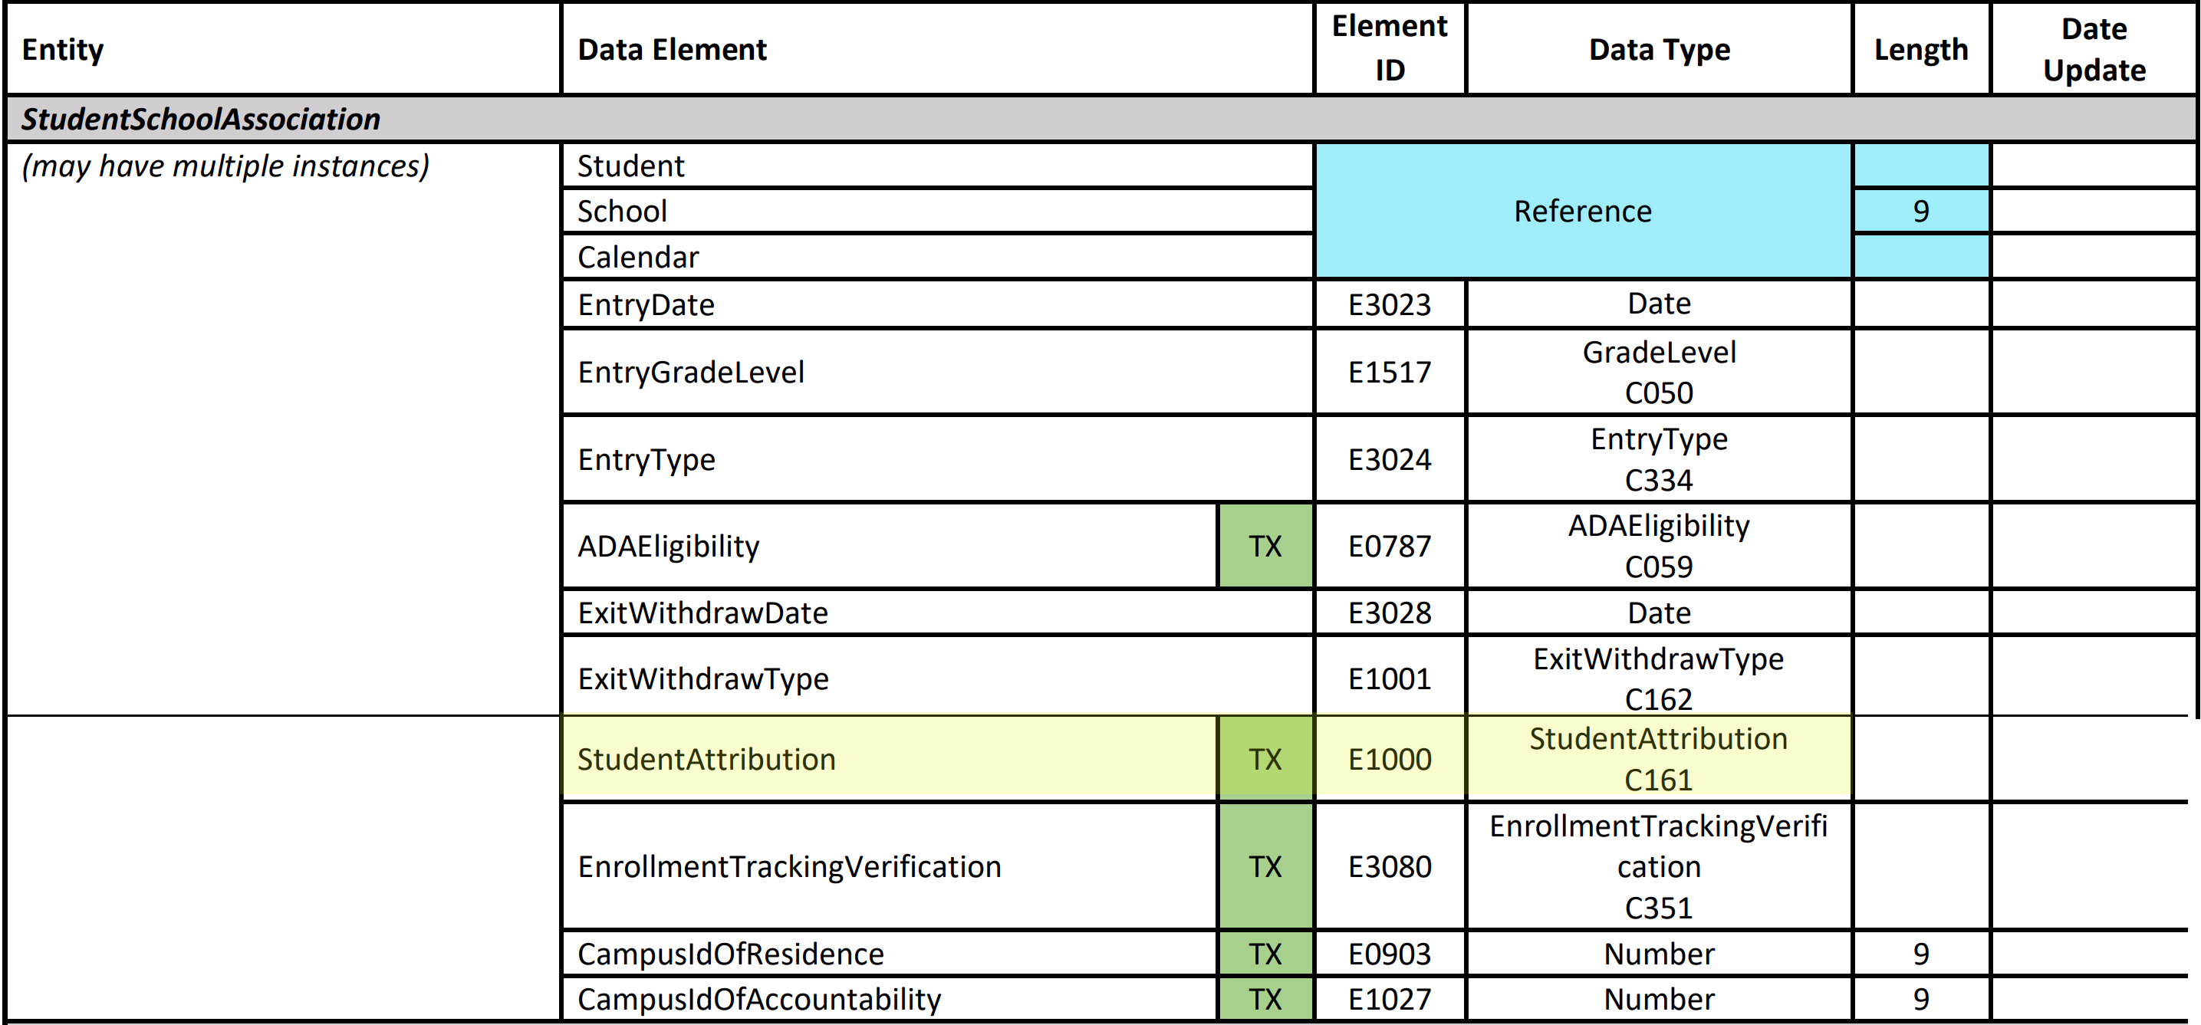
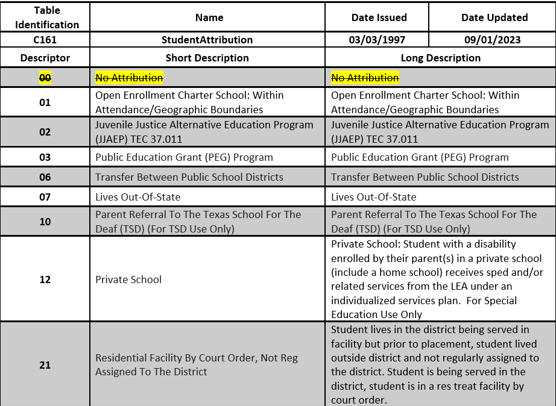
StudentAttribution Descriptor Table
Not Complete Table

Slide 37
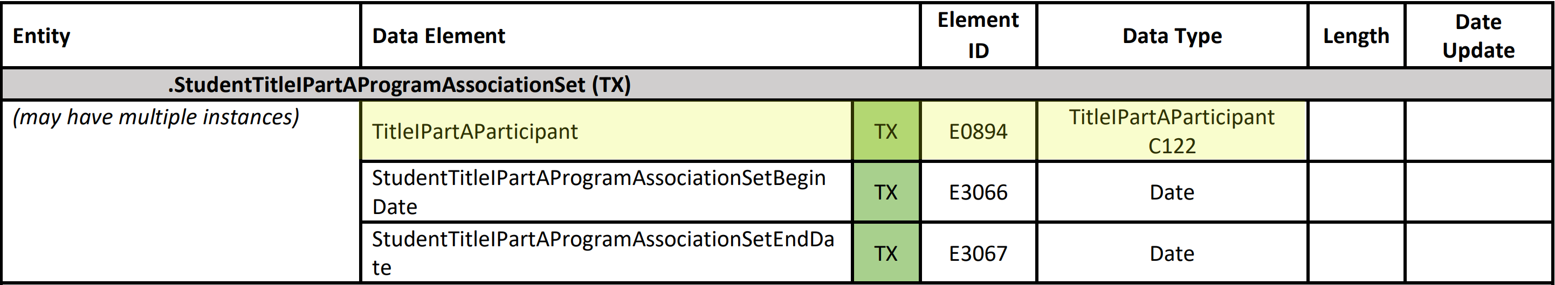
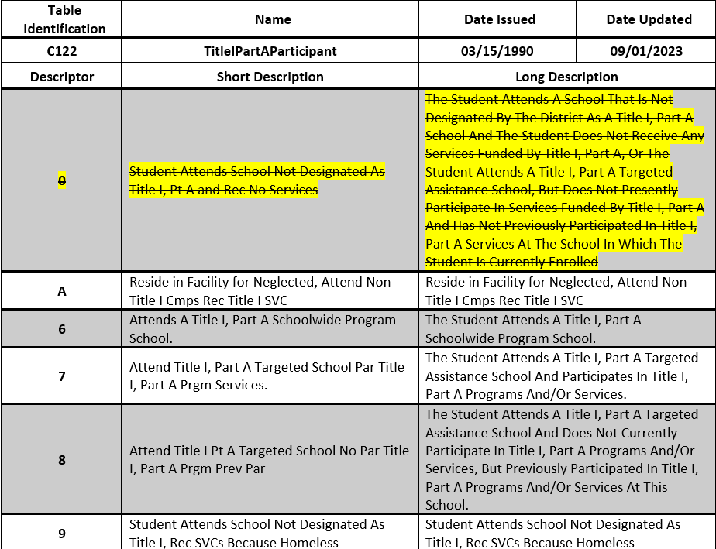
TitleIPartAParticipant Descriptor Table

Slide 38
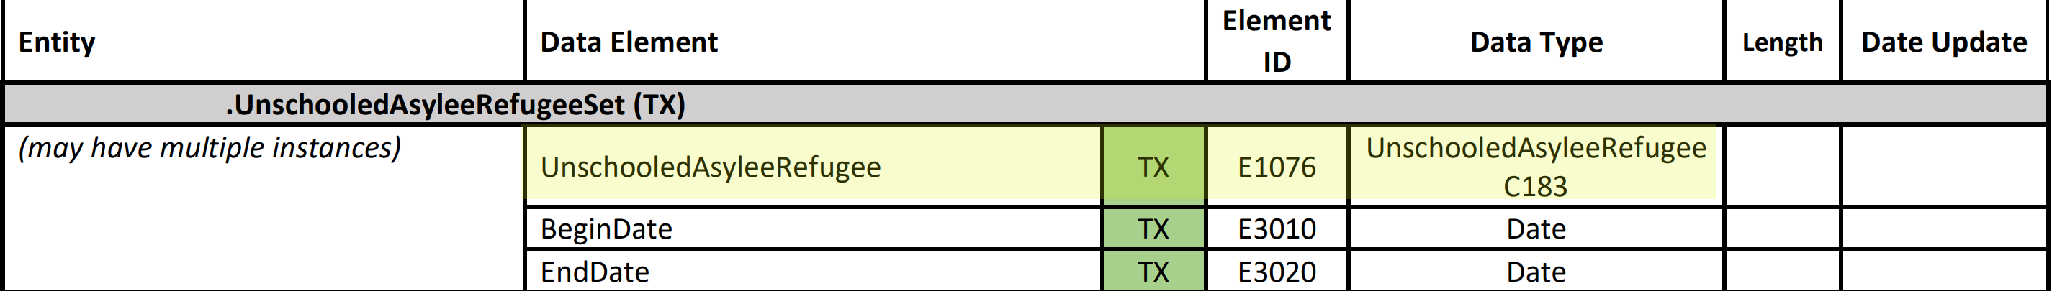
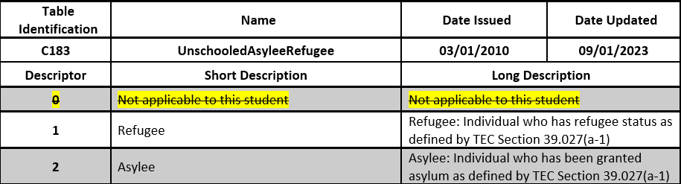
UnschooledAsyleeRefugee Descriptor Table

Slide 39
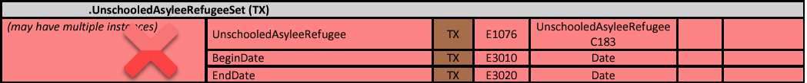
Zero Descriptors – PEIMS Example
PEIMS Fall Submission:
A student who has not been identified as an unschooled asylee or refugee does not need to be reported with any value for the UnschooledAsyleeRefugee (E1076) data element for the PEIMS Fall Submission. In this instance, no data for the entire UnschooledAsyleeRefugeeSet (TX) common type would not be reported for the student.

Slide 40
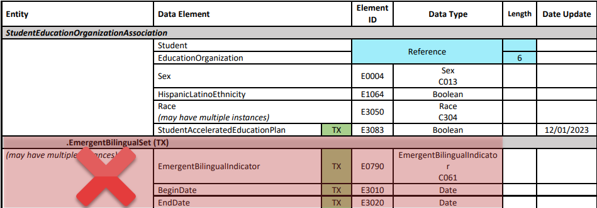
Zero Descriptors – Core Collection Example
ECDS KG Submission:
A student who has not been identified as emergent bilingual and is not being monitored does not need to be reported with any value for the EmergentBilingualIndicator (E0790) data element for the ECDS KG Submission. In this instance, no data for the entire EmergentBilingualSet (TX) common type would be reported for the student.

Slide 41

Zero Descriptors – Core Collection Example 1
Special Education Language Acquisition (SELA) Submission:
A student who is being reported for the SELA Submission and has not been assessed must still be reported with a value of ‘00’ (Not Assessed) for the ToolOrAssessmentUsed (E1668) data element. This helps ensure this critical piece of data wasn’t omitted inadvertently.

Slide 42
TITLE SLIDE: 2023-2024 School Year2
Landing Zone Not Promoted
NAME OF COMPONENT (ALL CAPS)
MARCH 19-21, 2024

Slide 43
Landing Zone/Not Promoted Data Elements
To better align with Ed-Fi, TEA is using as many of the Entities provided in the Ed-Fi model as possible for state reporting. In some instances, data elements are part of the key or mandatory for Ed-Fi but not used by TEA. These data elements will be loaded into the Landing Zone but will not be promoted to the Core Collection or PEIMS Data Marts.
Landing Zone
AssessmentTitle | IncidentDate | AchievementCategory
Session Entity | EmploymentStatus | Term
EarnedCredits | ApplicationIdentifier | CohortType
NumberOfParts

Slide 44

Landing Zone/Not Promoted – PEIMS Example
PEIMS Fall Submission:
The PEIMS Fall Submission utilizes the StaffEducationOrganizationEmploymentAssociation entity. With the exception of the EmploymentStatus, all data elements in this entity are either promoted to the PEIMS Data Mart or used in the PEIMS Fall Submission promotion logic. EmploymentStatus is not needed for state reporting and is retained in the Landing Zone.

Slide 45

Landing Zone/Not Promoted – Core Collection Example
Charter School Waitlist (CSW) Submission:
The only TSDS Data Submission that utilizes the StudentApplication (TX) entity is Charter School Waitlist. With the exception of the ApplicationIdentifier, all data elements in this entity are either promoted to the CSW Data Mart or used in the CSW promotion logic. ApplicationIdentifier is not needed for state reporting and is retained in the Landing Zone.

Slide 46
TITLE SLIDE: 2023-2024 School Year3
Core Descriptor Tables
NAME OF COMPONENT (ALL CAPS)
MARCH 19-21, 2024

Slide 47
Core Descriptor Table Changes
In the current XML version of the Texas Education Data Standards, the core collection-only data elements that are associated with a code table are reported using the translation and not the code listed in the table. Additionally, the core collection-only tables began with the letters ‘DC’.
In the TSDS Upgrade Project, the core collection-only data elements associated with a descriptor table are reported using the descriptor and not the short or long description. The ‘DC’ numbered tables have also been replaced.

Slide 48
Old and New Descriptor Table Names
 | Old Code Table |  | New Descriptor Table
DC006 | ADDRESS-TYPE | C300 | AddressType
DC163 | ASSESSMENT-RESULTS-OBTAINED-CODE | C321 | AssessmentResultsObtained
DC143 | CLASSROOM-POSITION-TYPE | C309 | ClassroomPosition
DC057 | ELECTRONIC-MAIL-ADDRESS-TYPE | C302 | ElectronicMailType
DC157 | FREQUENCY-OF-SERVICES-CODE | C315 | FrequencyOfServices
DC161 | AVERAGE-TIME-CODE | C319 | HearingAmplificationDailyUse
DC160 | PERIOD-OF-TIME-ACCESS-CODE | C318 | HearingAmplificationAccess
DC159 | HEARING-AMPLIFICATION-CODE | C317 | HearingAmplificationType
DC158 | HOURS-SPENT-SERVICES-CODE | C316 | HoursSpentReceivingServices
DC156 | LANGUAGE-ACQUISITION-SERVICES-PROVIDED-CODE | C314 | LangAcqServicesProvided
DC162 | TOOL-ASSESSMENT-CODE | C320 | ToolOrAssessmentUsed

Slide 49
Old and New Descriptor Table Names 1
 | Old Code Table |  | New Descriptor Table
DC152 | PK-SCHOOL-TYPE | C310 | PKSchoolType
DC153 | STUDENT-INSTRUCTION-TYPE | C311 | PKStudentInstruction
DC155 | PREFERRED-HOME-COMMUNICATION-CODE | C313 | PreferredHomeCommunicationMethod
DC096 | PROGRAM-TYPE | C303 | ProgramType
DC097 | RACE-ITEM-TYPE | C304 | Race
DC105 | RELATION-TYPE | C305 | Relation
DC123 | REPORT-ASSESSMENT-TYPE-CODE | C306 | ReportAssessmentType
DC124 | STATE-ABBREVIATION-TYPE | C307 | StateAbbreviation
DC165 | TEACHER-INCENTIVE-ALLOTMENT-DESIGNATION-CODE | C322 | TeacherIncentiveAllotmentDesignation
DC133 | TELEPHONE-NUMBER-TYPE | C308 | TelephoneNumberType

Slide 50


Core Descriptor Table Changes - Example
SELA Submission:
PREFERRED-HOME-COMMUNICATION-CODE (DC155) will now be descriptor table PreferredHomeCommunicationMethod (C313). While the table mostly remains the same, vendors will now supply the Descriptor value in the API rather than the Translation. For example, ’01’ will be supplied instead of ‘Visual’.

Slide 51
Best Practices
In the TSDS Upgrade Project, the first day of school is defined as the EARLIEST instructional day for the given LEA from the CalendarDate. The first day of school is used in the promotion logic for several of the submissions that collect data for the entire school year, such as the PEIMS Summer Submission and RF Tracker.
  Best Practice – the LEA must load the Calendar information first so TEA can determine the first day of school.

Slide 52

QUESTIONS
QUESTIONS?

