Slide 1

TITLE SLIDE: ESC Vendor Training for One Component
PEIMS EXTENDED YEAR
MARCH 19-21, 2024

Slide 2

AGENDA – EXTENDED YEAR
PROGRAM AREA
2023-2024 SCHOOL YEAR
  Submission Updates
  Code Table Updates
  Report Updates
  Business Rule Updates
  Timeline
2024-2025 SCHOOL YEAR
  Application Updates
  Data Element Updates
  Business Rule Updates
  TSDS Upgrade Project Updates
CLOSEOUT
  Timeline
  Technical Resources
  Questions

Slide 3
PROGRAM AREA UPDATES & GUIDANCE
College, Career, and Military Preparation Division
  Lacy Freeman - Statewide Career and Technical Education Coordinator
    Lacy.Freeman@tea.texas.gov

Slide 4

TITLE SLIDE: 2023-2024 School Year
2023-2024
SCHOOL YEAR
NAME OF COMPONENT (ALL CAPS)
MARCH 19-21, 2024

Slide 5
SUBMISSION UPDATES
No submission updates for the following:
  Data Elements
Notes:
CTE CODE TABLE UPDATES

Slide 6
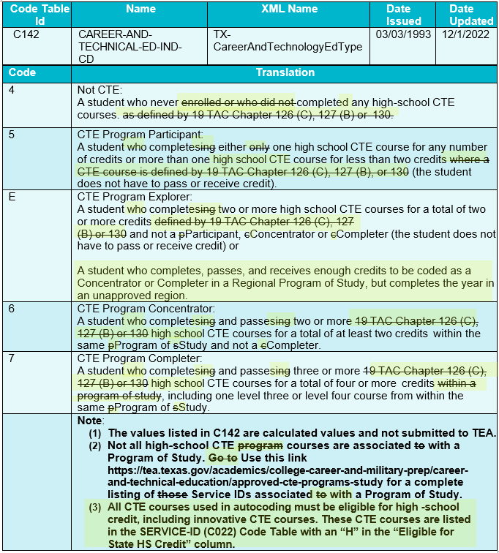
CODE TABLE UPDATES
Modified the CAREER-AND-TECHNICAL-ED-IND-CD (C142) translations.
Notes:
CTE CODE TABLE UPDATES

Slide 7
CODE TABLE UPDATES 1
C022 SERVICE-ID
  The following Service IDs have been added:
    12700110 Career and College Exploration (First Time Taken)
    12700120 Career and College Exploration (Second Time Taken)
    N1110035 Elements of Data Science
    N1130030 Ethnic Studies: American Indian/Native Studies
    N1290062 Multilingual Acculturation Studies for Newcomers
Notes:
CODE TABLE UPDATES

Slide 8
CODE TABLE UPDATES 3
C022 SERVICE-ID
  Code ’13036300’ changed as follows:
    Description changed from ‘Principles of Biosciences’ to ‘Principles of Bioscience’
Notes:
CODE TABLE UPDATES

Slide 9
CODE TABLE UPDATES 2
C022 SERVICE-ID
  The following Service IDs have been removed:
    12700300 College and Career Readiness
    12700400 Investigating Careers (First Time Taken)
    12700410 Investigating Careers (Second Time Taken)
    12700420 Investigating Careers (Third Time Taken)
    12700430 Investigating Careers (Fourth Time Taken)
    N1160011 Functional Fitness
Notes:
CODE TABLE UPDATES

Slide 10
CODE TABLE UPDATES 4
C022 SERVICE-ID
  The following Service IDs have been removed (cont.):
    N1260001 Cyber Citizenship
    N1303756 Gateway To Technology (PLTW) (First Time Taken)
    N1303757 Gateway To Technology (PLTW) (Second Time Taken)
    N1303758 Gateway To Technology (PLTW) (Third Time Taken)
    N1303759 Gateway To Technology (PLTW) (Fourth Time Taken)
    N1303752 Texas Pre-Freshman Engineering Program I

Slide 11
REPORT UPDATES 1
Flexible attendance reports will be updated to reflect the Adjusted Eligible Equivalent days.
  Adjusted Eligible Equivalent Days is calculated as the lesser of the Eligible Equivalent Days or NUMBER-DAYS-TAUGHT (E0935). (Per student, campus, instructional track, reporting period and grade level)
  TEA has determined that LEAs reported Eligible Equivalent days that were greater than the number of days taught.
  LEAs will only get funded on the Adjusted Eligible Equivalent Days.

Slide 12
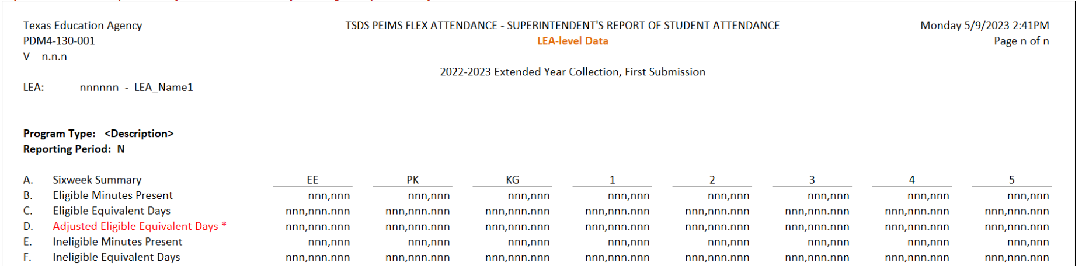
REPORT UPDATES 2
  PDM4-130-001 Flex Attendance - Superintendent's Report of Student Attendance
    Replacing Row(D)
      Old – Equivalent Days Present (Eligible Equivalent Days + Ineligible Equivalent Days)
      New - Total Adjusted Eligible Equivalent Days Present
    Adding footnote: ‘The Adjusted Eligible Equivalent Days is the lesser of Eligible Equivalent Days and Number of Days Taught. LEAs cannot be funded for more than Number of Days Taught in each reporting period.’

Slide 13
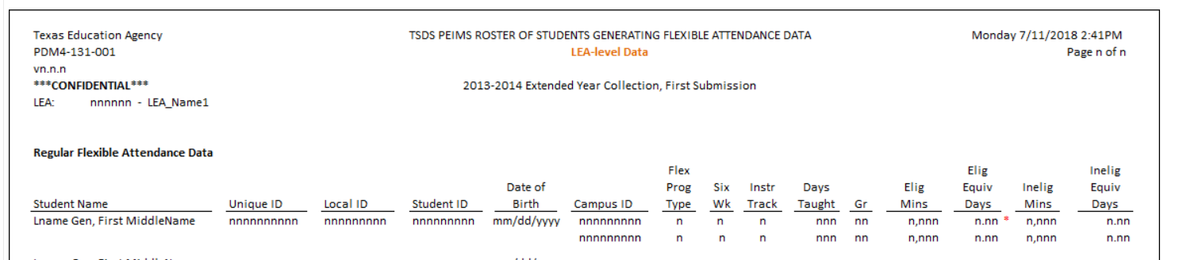
REPORT UPDATES 3
  PDM4-131-001 Roster of Students Generating Flexible Attendance Data
    If Elig Eqiv Days is greater than Days Taught, an ‘*’ will be placed to the right of Elig Eqiv Days.
    Adding footnote: ‘Eligible Equivalent Days is greater than Number of Days Taught. LEAs cannot be funded for more than Number of Days Taught in each reporting period.’

Slide 14
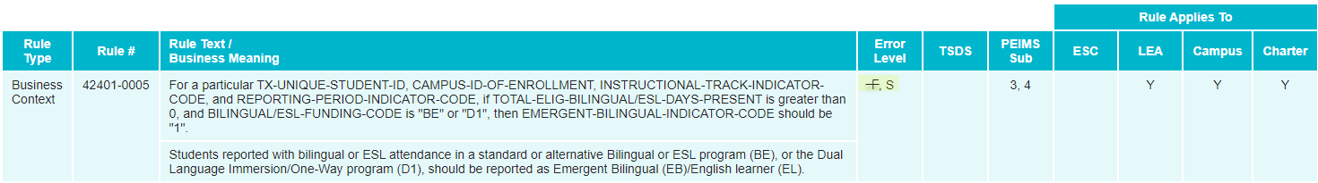
BUSINESS RULE UPDATES
Revised Business Rule 42401-0005

Slide 15
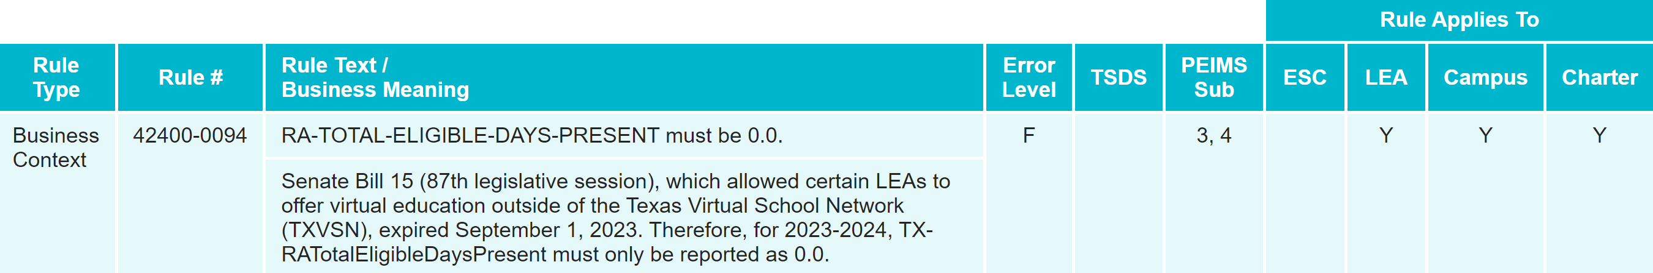
BUSINESS RULE UPDATES 1
Added Data Validation Rule 42400-0094

Slide 16
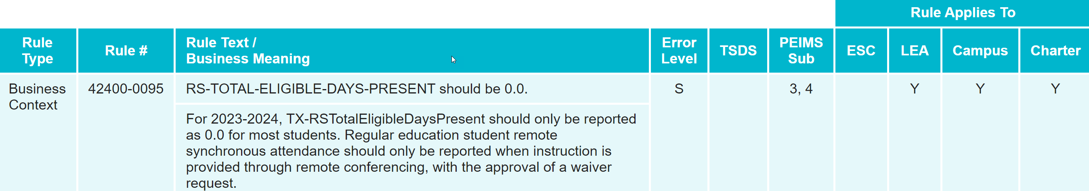
BUSINESS RULE UPDATES 3
Added Data Validation Rule 42400-0095

Slide 17
CURRENT KNOWN ISSUES
Issue: Based upon LEAs informing TEA of students being reported with incorrect CTE indicators, the CTE team has confirmed several charter school campuses are having their Regional Program of Study Concentrators (Code 6) and Completers (Code 7) incorrectly reverted to an Explorer (Code E). It is also possible that some students’ data are incorrectly coded as a 6 or 7 and should be an E, based on the physical location of the school.
This may indicate the “ESC Geographic Region” field, used to determine if a campus is in an approved region, is adopting the charter school authorizer/district “ESC Geographic Region” value, instead of the ESC value, for the physical charter campus location.
Notes:
CTE AUTO-CALCULATION UPDATES

Slide 18
CURRENT KNOWN ISSUES 1
Solution: Affected Charter LEAs will have a Campus-level Geographic Region assigned according to the charter campuses physical address.
Campus-level Geographic Region will be implemented in a TEA application that will pass ESC region to AskTED using the physical street address located in AskTED for the charter campuses.
The new Campus-level Geographic Region will not be visible to the LEA; however, it will be used when TEA processes the auto-calculated CTE indicators after the PEIMS Summer First Submission, PEIMS Summer Resubmission, PEIMS Extended Year First Submission and PEIMS Extended Year Resubmission.
Notes:
CTE AUTO-CALCULATION UPDATES

Slide 19
TIMELINE
PEIMS Extended Year Submission (Submission 4) | Date
TSDS PEIMS ready to load data to eDM | August 7, 2023
PEIMS Extended Year Submission ready for users to promote data | March 25, 2024
TSDS PEIMS Extended Year ready for users to complete, approve, and accept submissions | July 29, 2024
Requests to retire Unique IDs due at TEA for PEIMS Extended Year First Submission | August 23, 2024
PEIMS Extended Year First Submission due date for LEAs | August 29, 2024
Requests to retire Unique IDs due at TEA for PEIMS Extended Year Resubmission | September 13, 2024
PEIMS Extended Year Resubmission due date for LEAs | September 19, 2024

Slide 20
TITLE SLIDE: 2024-2025 School Year
2024-2025
SCHOOL YEAR
NAME OF COMPONENT (ALL CAPS)
MARCH 19-21, 2024

Slide 21
APPLICATION UPDATES
No application updates:
  Descriptor table

Slide 22
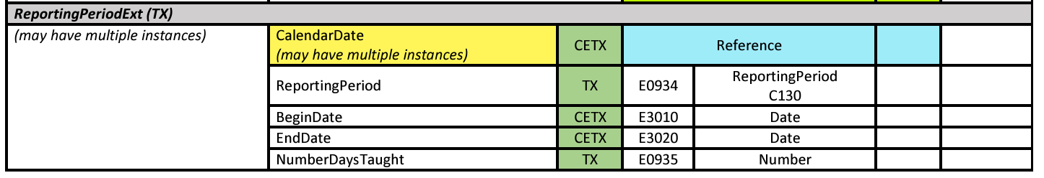
DATA ELEMENT UPDATES
ReportingPeriodExt (TX) entity
  CalendarDate (reference) data element
    may have multiple instances

Slide 23
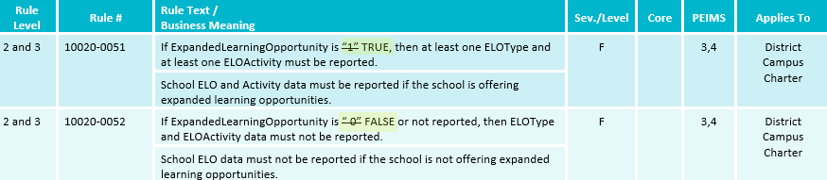
BUSINESS RULE UPDATES 4
Updated Data Validation Rules 10020-0051, 10020-0052:

Slide 24
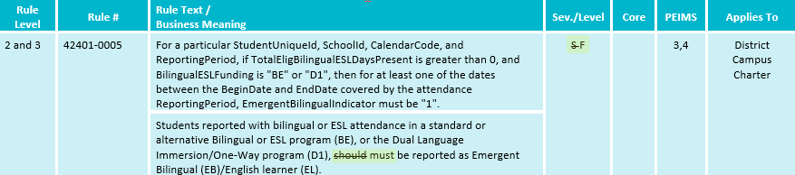
BUSINESS RULE UPDATES 2
Updated Data Validation Rule 42401-0005:

Slide 25
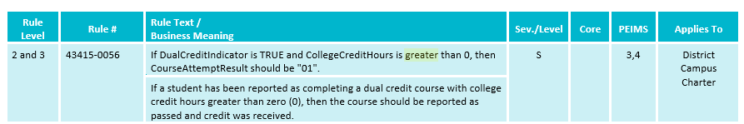
BUSINESS RULE UPDATES 5
Updated Data Validation Rule 43415-0056:

Slide 26
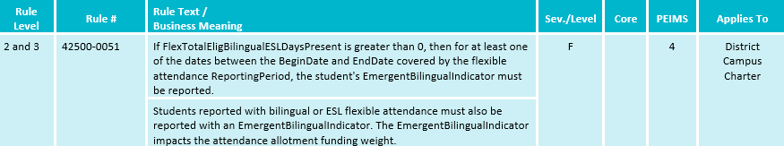
BUSINESS RULE UPDATES 7
Added New Data Validation Rule 42500-0051:

Slide 27
TSDS UPGRADE PROJECT UPDATES
Data Element Name Changes:
Data Element ID | XML Data Element Name | Upgrade Data Element Name
E0975 | INSTRUCTIONAL-TRACK-INDICATOR-CODE | CalendarCode
E1585 | SCHOOL-DAY-EVENT-CODE | CalendarEvent
E1600 | INSTRUCTIONAL-PROGRAM-TYPE | CalendarType
E0949 | PASS/FAIL-CREDIT-INDICATOR-CODE | CourseAttemptResult
E3071 | SERVICE-ID | CourseCode
E1168 | CALENDAR-DATE | Date
E0173 | INSTRUCTIONAL-SETTING-CODE | InstructionalSetting
E1056 | CLASS-ID-NUMBER | SectionIdentifier
E3063 | Various | StudentCharacteristic
E3010 | N/A | BeginDate
E3020 | N/A | EndDate

Slide 28
TSDS UPGRADE PROJECT UPDATES 1
Data Element Length Changes:
  CalendarCode
    Length changing from 2 to 60 characters
  SectionIdentifier
    Length changing from 14 to 255 characters

Slide 29
TSDS UPGRADE PROJECT UPDATES 2
Descriptor Table Changes:
  ‘0’ values being removed from descriptor tables
    ChildCountFunding
    Disability
    EmergentBilingualIndicator
    FosterCareType
    HomelessStatus
    MilitaryConnectedStudent
    PKProgramType
    TitleIPartAParticipant
    UnschooledAsyleeRefugee
    StudentAttribution
    RegionalDaySchoolProgramForDeaf
    PPCDServiceLocation
    CTEProgramService

Slide 30
TSDS UPGRADE PROJECT UPDATES 2
Report Updates:
  All applicable reports will be updated for the following changes below:
    Descriptor values of ‘0’ removed.
    CalendarCode
      Length changing from 2 to 60 characters
    SectionIdentifier
      Length changing from 14 to 255 characters
  TEA is currently analyzing other potential report impacts and will provide more information in the upcoming TSDS Summer Training.
  TEA is actively working to update impacted reports by the start of the 2024-2025 school year.

Slide 31
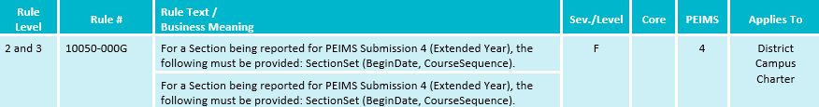
TSDS UPGRADE PROJECT UPDATES 5
Business Rule Changes:
  Added new rule 10050-000G for 2024-2025 to clarify required fields.
  The eDM file manager XSD validation is now a PDM validation rule to verify all required fields are promoted to PDM.

Slide 32
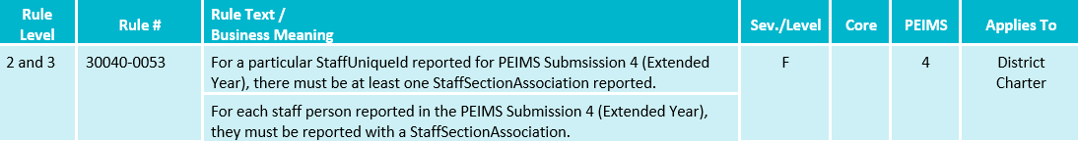
TSDS UPGRADE PROJECT UPDATES 6
Business Rule Changes:
  StaffSectionAssociation was not a complex type from XML that was promoted but this Entity is promoted.

Slide 33
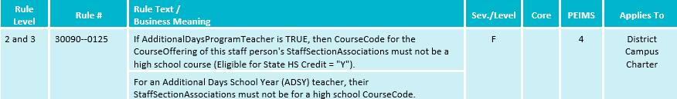
TSDS UPGRADE PROJECT UPDATES 7
Business Rule Changes:
  Where to find which courses are eligible for HS credit = “Y”?
    References document from TEDS upgrade page
      https://www.texasstudentdatasystem.org/tsds/texas-education-data-standards-references

Slide 34
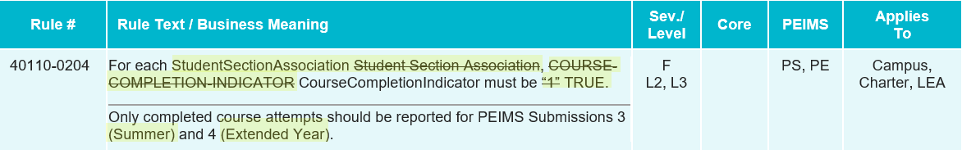
TSDS UPGRADE PROJECT UPDATES 8
Business Rule Changes:
  CourseCompletionIndicator must be ‘TRUE’ (Boolean)
    Boolean true or false versus a code of 1 or 0.

Slide 35
TSDS UPGRADE PROJECT UPDATES 9
Promotion Logic Guide & Test Cases Coming Soon!
  More details will be provided in the TSDS Summer Training.

Slide 36
TITLE SLIDE: Closeout
CLOSEOUT
NAME OF COMPONENT (ALL CAPS)
MARCH 19-21, 2024

Slide 37
TIMELINE 1
PEIMS Extended Year Submission (Submission 4) | Date
TSDS PEIMS ready to load data to IODS | August 5, 2024
TSDS PEIMS ready for users to complete, approve, and accept submissions | July 28, 2025
Requests to retire Unique IDs due at TEA for PEIMS Extended Year First Submission | August 22, 2025
PEIMS Extended Year First Submission due date for LEAs | August 28, 2025
Requests to retire Unique IDs due at TEA for PEIMS Extended Year Resubmission | September 12, 2025
PEIMS Extended Year Resubmission due date for LEAs | September 18, 2025
PEIMS Extended Year data available to customers | October 16, 2025

Slide 38
TECHNICAL RESOURCES
Technical Support
  TSDSCustomerSupport@tea.texas.gov
Technical Specifications
  2023-2024 TSDS Web-Enabled Data Standards (TWEDS)​
  2024-2025 Domains​
  2024-2025 Data Element Definitions​
  2024-2025 Descriptor Tables​
  2024-2025 Data Validation Rules​
  2024-2025 Data Submission Timelines
  Known Issues
TSDS Incident Management System (TIMS)
  TSDS Incident Management System (TIMS) Support Application
  TIMS Knowledge Base Article Repository

Slide 39

QUESTIONS
QUESTIONS?

