Slide 1

TITLE SLIDE: ESC Vendor Training for One Component
PEIMS FALL
MARCH 19-21, 2024

Slide 2

AGENDA – PEIMS FALL
PROGRAM AREA
2024-2025 SCHOOL YEAR
  Application Updates
  Data Element Updates
  Report Updates
  Business Rule Updates
  TSDS Upgrade Project Updates
CLOSEOUT
  Timeline
  Frequently Asked Questions
  Technical Resources
  Questions

Slide 3
PROGRAM AREA UPDATES & GUIDANCE
Curriculum Standards and Student Support Division
  Jessica Snyder, Director of Special Projects
    jessica.snyder@tea.texas.gov

Slide 4

TITLE SLIDE: 2024-2025 School Year
2024-2025
SCHOOL YEAR
NAME OF COMPONENT (ALL CAPS)
MARCH 19-21, 2024

Slide 5
APPLICATION UPDATES
Texas First Early High School (SB 1888):
  During the 87th legislative session, SB 1888 was passed, which amends TEC§ 28.0253. As a result, the Texas Education Agency (TEA), in coordination with the Texas Higher Education Coordinating Board (THECB), established the Texas First Early High School Completion Program. A student who graduates early through the program is considered to have earned a diploma with a distinguished level of achievement under TEC §28.025. The school district must provide each student who earns a program diploma with a designation of distinguished level of achievement on the student’s diploma.
  After passing SB 1888 during the 87th legislative session, students now have two paths to earn a diploma with the distinguished level of achievement designation. Before SB 1888, a student only earned a distinguished level of achievement under the foundation high school program by successfully completing the requirements as outlined in TEC 28.025 (b-15). After SB 1888, when a student earns a diploma under the Texas First Early High School Completion Program (TEC 28.0253), they automatically receive the distinguished level of achievement designation.

Slide 6
APPLICATION UPDATES 1
Texas First Early High School (SB 1888):
  During the TSDS Upgrade Project, TEA separated the data element FHSP-DISTING-LEVEL-ACHIEVE-INDICATOR-CODE (E1542) into two data elements. In the TSDS Upgrade Project, TEA uses the data element FHSPDistingLevelGraduate (E1542) to indicate a student has earned a designation of distinguished level of achievement and FHSPDistingLevelParticipant (E3029) to indicate the student is pursuing the distinguished level of achievement under FHSP. The program area has requested replacing the data element FHSPDistingLevelGraduate (E1542) with a more generic data element to indicate the distinguished level of achievement has been earned since it can be awarded through the Foundation High School Program or the Texas First Early High School Completion Program.

Slide 7
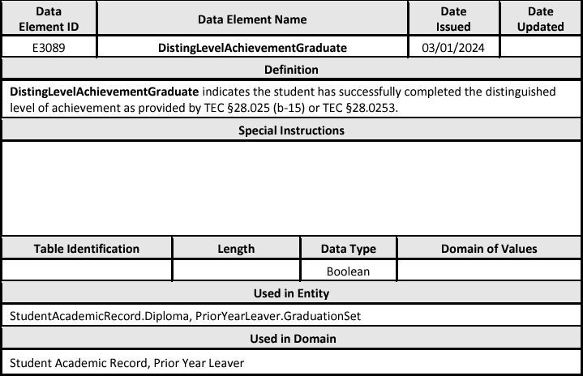
DATA ELEMENT UPDATES
Added a new data element DistingLevelAchievementGraduate (E3089) as optional in the PEIMS Fall Submission to the following common types:
  StudentAcademicRecord.Diploma in the Student Academic Record domain.
  PriorYearLeaver.GraduationSet in the Prior Year Leaver domain.

Slide 8
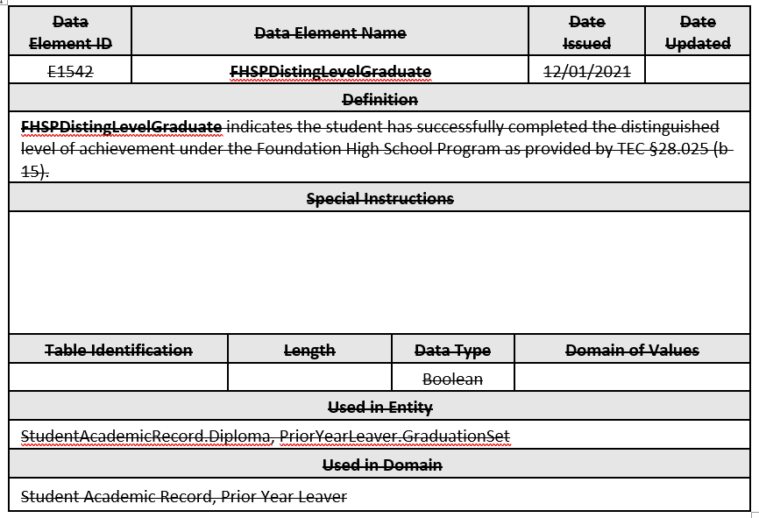
DATA ELEMENT UPDATES 1
Removed the data element FHSPDistingLevelGraduate (E1542) reported in the PEIMS Fall Submission from the following common types:
  StudentAcademicRecord.Diploma in the Student Academic Record domain.
  PriorYearLeaver.GraduatioinSet in the Prior Year Leaver domain.

Slide 9
REPORT UPDATES
TEA will add new data element DistingLevelAchievementGraduate (E3089) to the following PEIMS Fall Graduate report:
  PDM1-124-007 Graduate Roster by Graduate Type

Slide 10
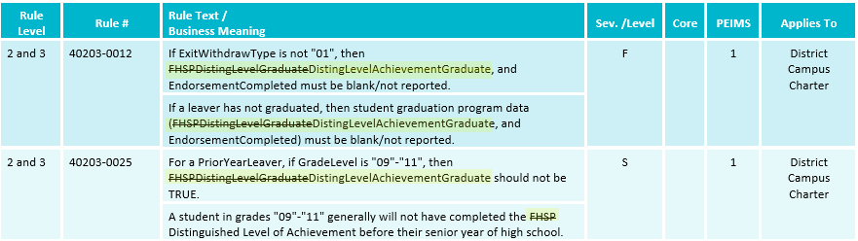
BUSINESS RULE UPDATES
Revised the following business rules:

Slide 11
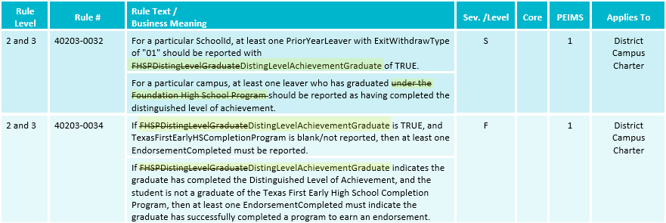
BUSINESS RULE UPDATES 1
Revised the following business rules:

Slide 12
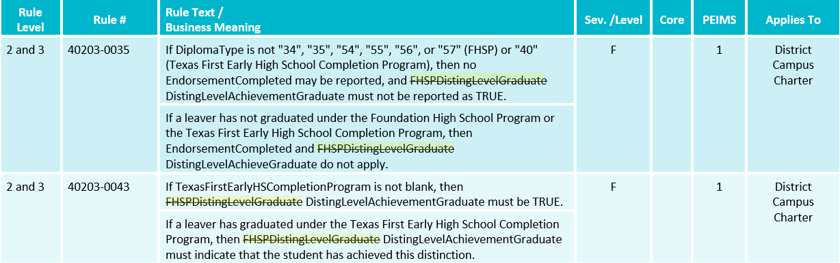
BUSINESS RULE UPDATES 2
Revised the following business rules:

Slide 13
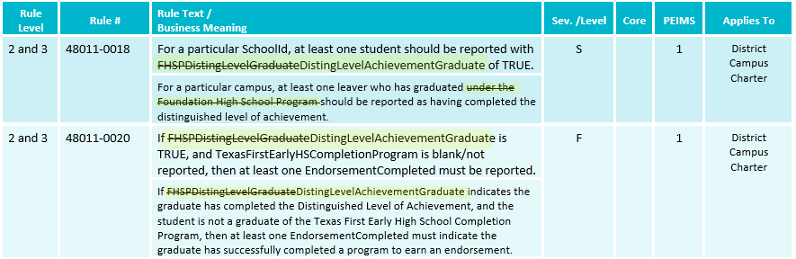
BUSINESS RULE UPDATES 3
Revised the following business rules:

Slide 14
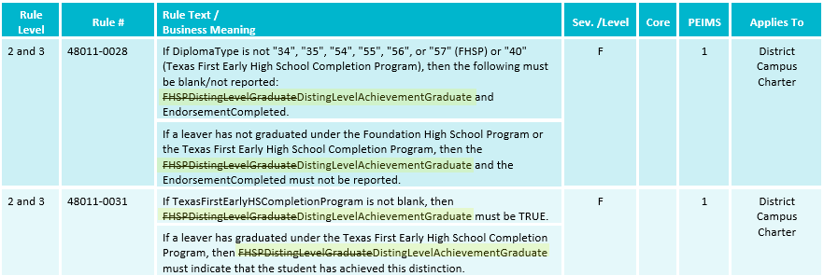
BUSINESS RULE UPDATES 4
Revised the following business rules:

Slide 15
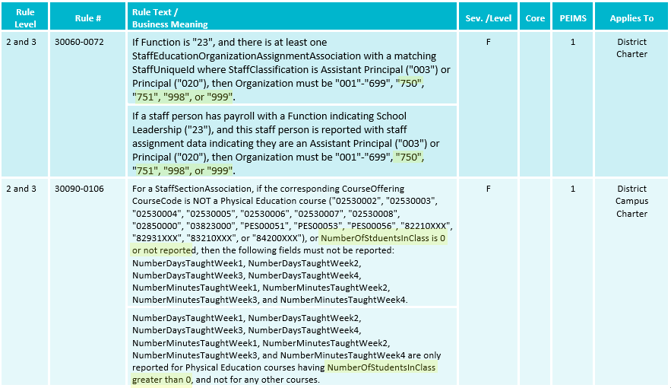
BUSINESS RULE UPDATES 5
Revised the following business rules:
Notes:
30060-0072
30060-0106

Slide 16
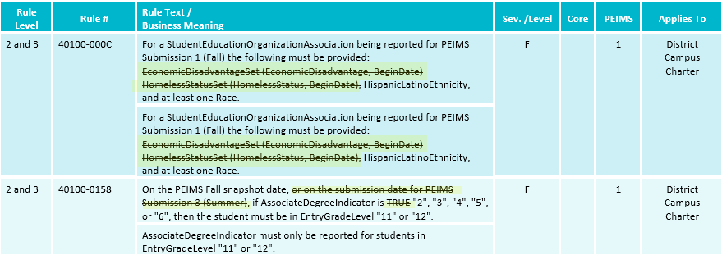
BUSINESS RULE UPDATES 6
Revised the following business rules:
Notes:
40100-000C
40100-0158

Slide 17
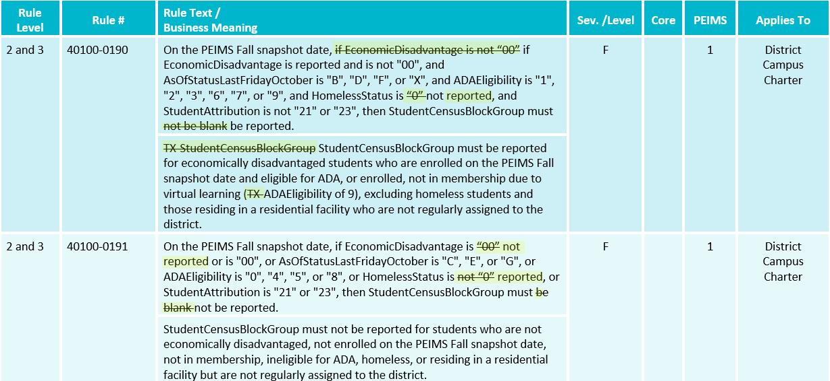
BUSINESS RULE UPDATES 7
Revised the following business rules:
Notes:
40100-0190
40100-0191

Slide 18
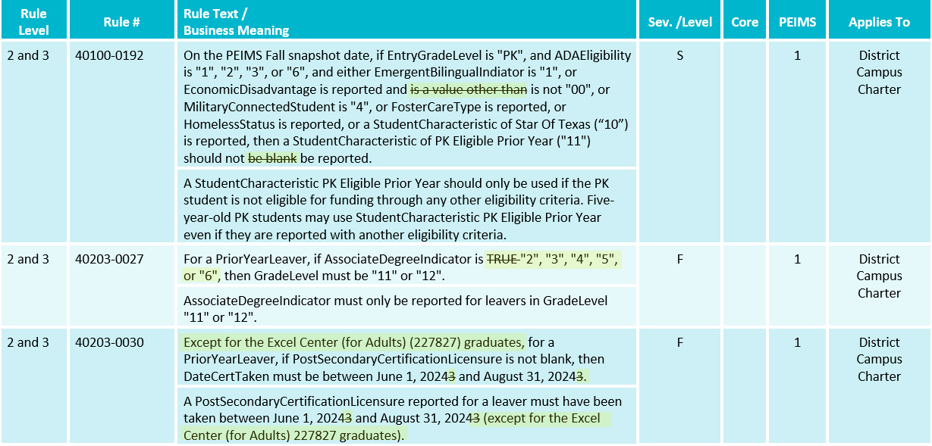
BUSINESS RULE UPDATES 8
Revised the following business rules:
Notes:
40100-0192
40203-0024
40203-0030

Slide 19
BUSINESS RULE UPDATES 9
Removed the following business rule:
  40203-0042: For the 2023-2024 PEIMS Fall Submission, AssociateDegreeIndicator must be blank/not reported, "0", or "1".
Notes:
40100-0192
40203-0024
40203-0030

Slide 20
TSDS UPGRADE PROJECT UPDATES
Data Element Name Changes:
Data Element ID | XML Data Element Name | Upgrade Data Element Name
E0316B (was E0316) | FUND-CODE | BudgetFund
E0317B (was E0317) | FUNCTION-CODE | BudgetFunction
E3018B (was E0318) | OBJECT-CODE | BudgetObject
E0320B (was E0320) | PROGRAM-INTENT-CODE | BudgetProgramIntent
E3010 | N/A | BeginDate
E3020 | N/A | EndDate

Slide 21
TSDS UPGRADE PROJECT UPDATES 1
Data Element Name Changes:
Data Element ID | XML Data Element Name | Upgrade Data Element Name
E0791 | DATE-OF-GRADUATION | DiplomaAwardDate
E3015 (was E0041) | PRIMARY-DISABILITY-CODE | Disability
E3015 (was E0834) | SECONDARY-DISABILITY-CODE | Disability
E3015 (was E0835) | TERTIARY-DISABILITY-CODE | Disability
E1001 | LEAVER-REASON-CODE | ExitWithdrawType
E1056 | CLASS-ID-NUMBER | SectionIdentifier
E1015 | ESC-SSA-STAFF-INDICATOR-CODE | SharedServicesArrangementStaff

Slide 22
TSDS UPGRADE PROJECT UPDATES 2
Descriptor Table Name Changes:
Descriptor ID | XML Code Table Name | Upgrade Descriptor Name
C145B (was C145) | FUND-CODE | BudgetFund
C146B(was C146) | FUNCTION-CODE | BudgetFunction
C159B (was C159) | OBJECT-CODE | BudgetObject
C147B (was C147) | PROGRAM-INTENT-CODE | BudgetProgramIntent

Slide 23
TSDS UPGRADE PROJECT UPDATES 3
Report Updates:
  Financial Organization Units on Financial Reports
    There have been multiple TIMS tickets regarding Organization Units 699 not showing in the aggregated data on LEA’s financial reports.
    An issue has been identified where the reports are not displaying all administration organization units in the Campus ID selection parameter for these reports.
    TEA is actively working to determine a corrective action to resolve this issue by the start of the 2024-2025 school year.

Slide 24
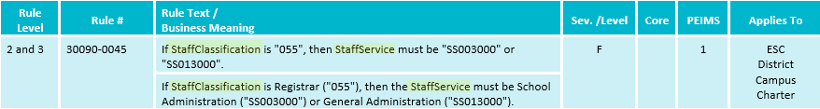
TSDS UPGRADE PROJECT UPDATES 4
Business Rule Changes:
  Rule text has been updated to reflect the change in the data element name.

Slide 25
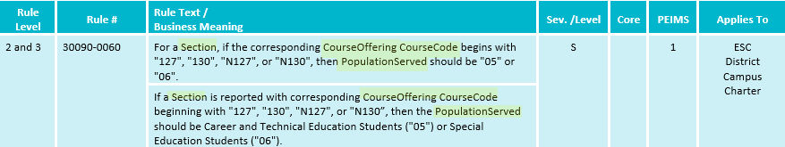
TSDS UPGRADE PROJECT UPDATES 5
Business Rule Changes:
  Rule text has been updated to reflect the change in the data element name.

Slide 26
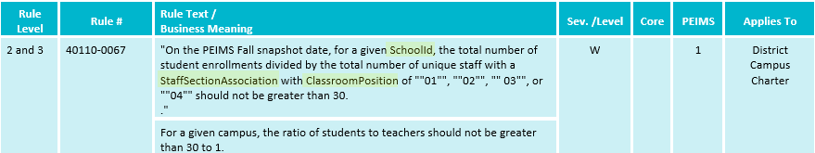
TSDS UPGRADE PROJECT UPDATES 6
Business Rule Changes:
  Rule text has been updated to reflect the change in the data element name.

Slide 27
TSDS UPGRADE PROJECT UPDATES 7
Promotion Logic:
  PEIMS Fall Promotion Logic
  Finance > Budget
    The latest BudgetExt.BeginDate
  Staff > Staff Responsibility (Non-Instructional Staff)
    Base promotion logic for non-instructional staff.
    E0721 StaffClassification
    E1056 SectionIdentifier (not collected but promoted)
  Staff > Employment Payroll Summary
    E1594 AuxiliaryRoleId

Slide 28
TSDS UPGRADE PROJECT UPDATES 8
Promotion Logic:
  PEIMS Fall Promotion Logic
  Staff > Staff Responsibility (Instructional Staff)
    Base promotion logic for instructional staff.
    E1454 ClassroomPosition
    Course – Logic was updated due to duplicates identified during promotion.
  Student > Student Basic Information
    E1648 StudentCensusBlockGroup
    StudentCharacteristics
      Presession
      At-Risk
      Star of Texas

Slide 29
TSDS UPGRADE PROJECT UPDATES 9
Promotion Logic:
  PEIMS Fall Promotion Logic
  Student > Student Basic Information (cont.)
    E3033 Language
      LanguageUse = ‘01’
      LanguageUse = ’02’
    E1640 PostSecondaryCertificationLicensure
      Based on DateCertTaken
  Student > Enrollment (Programs)
    Student (reference)
      Student is coming from different places depending on what is being promoted.
    E3034 LanguageInstructionProgramService

Slide 30
TSDS UPGRADE PROJECT UPDATES 10
Promotion Logic:
  PEIMS Fall Promotion Logic
  Student > Special Education Program
    E3015 Disability
    E3058 SpecialEducationProgramService
  Student > Leaver
    E1562 IndividualGraduationCommiteeGraduateIndicator
    E1589 MilitaryEnlistmentIndicator
  Student > Student Graduation Program
    E3021 EndorsementCompleted

Slide 31
TSDS UPGRADE PROJECT UPDATES 11
Test Cases:
  PEIMS Fall Test Cases
  Test Case 7 – Staff (Staff Demographics)
    PDM1-111-001 Individual Staff Profiles
  Test Case 11 – Student Basic Information
    PDM1-120-012 Student Indicator Report by Grade
  Test Case 12 – Student Program
    PDM1-120-003 Student Program Roster
  Test Case 16 – Student Industry-Based Certification
    PDM1-120-021 Industry-Based Certification Roster
  Test Case 17 – Student Leaver (Leaver Roster)
    PDM1-124-004 School Leaver Data

Slide 32
TITLE SLIDE: Closeout
CLOSEOUT
NAME OF COMPONENT (ALL CAPS)
MARCH 19-21, 2024

Slide 33
TIMELINE
PEIMS Fall Submission (Submission 1) | Date
TSDS PEIMS ready to load data to IODS | August 5, 2024
Close of school-start window - Last Friday in September | September 27, 2024
PEIMS Fall snapshot date | October 25, 2024
TSDS PEIMS ready for users to complete, approve, and accept submissions | October 28, 2024
Requests to retire Unique IDs due at TEA for PEIMS Fall First Submission | December 6, 2024
PEIMS Fall First Submission due date for LEAs and ESCs | December 12, 2024
Requests to retire Unique IDs due at TEA for PEIMS Fall Resubmission | January 10, 2025
PEIMS Fall Resubmission due date for LEAs and ESCs | January 16, 2025
PEIMS Fall data available to customers | February 13, 2025

Slide 34
FREQUENTLY ASKED QUESTIONS
Where can I look to find out if any staff members are reported with an FTE salary more than $350,000?
There are two ways to verify FTE salaries have not surpassed $350,000.
FTE Salary Special Warning 30060-0061 FTE Salary should not be greater than 350,000.
PDM1-110-004 Staff FTE Summary

Slide 35
FREQUENTLY ASKED QUESTIONS 1
Why did LEAs receive email after Fall 1st Submission stating staff were reported in multiple LEAs which caused their sum of PERCENT-DAY-EMPLOYED to be greater than 100%?
TEA identified this anomaly during data quality assurance. To help identify these type of anomalies earlier in the submission process a new report will be developed that will show when a staff member is reported across LEAs with more than one FTE.

Slide 36
TECHNICAL RESOURCES
Technical Support
  TSDSCustomerSupport@tea.texas.gov
Technical Specification
  2024-2025 Domains
  2024-2025 Data Element Definitions
  2024-2025 Descriptor Tables
  2024-2025 Data Validation Rules
  2024-2025 Data Submission Timelines
  Known Issues
TSDS Incident Management System (TIMS)
  TSDS Incident Management System (TIMS) Support Application
  TIMS Knowledge Base Article Repository

Slide 37

QUESTIONS
QUESTIONS?

