Slide 1

TITLE SLIDE: ESC Vendor Training for One Component
PEIMS FALL
July 30-31, 2024 and August 1, 2024

Slide 2

AGENDA – PEIMS FALL
PROGRAM AREA
2024-2025 SCHOOL YEAR
  Data Governance Updates
  Data Element Updates
  Report Updates
  Business Rule Updates
  TSDS Upgrade Project Updates
  Current Known Issues
CLOSEOUT
  Timeline
  Technical Resources
  Questions

Slide 3
PROGRAM AREA UPDATES & GUIDANCE
Curriculum Standards and Student Support Division
  Jessica Snyder, Director of Special Projects
    jessica.snyder@tea.texas.gov

Slide 4

TITLE SLIDE: 2024-2025 School Year
2024-2025
SCHOOL YEAR
NAME OF COMPONENT (ALL CAPS)
MARCH 19-21, 2024

Slide 5
DATA GOVERNANCE UPDATES
No updates to the following since TSDS Spring training:
  Data Elements
  Reports
  Descriptor Tables
  Business Rules

Slide 6
DATA GOVERNANCE UPDATES
Texas First Early High School (SB 1888):
  During the 87th legislative session, SB 1888 was passed, which amends TEC§ 28.0253. As a result, the Texas Education Agency (TEA), in coordination with the Texas Higher Education Coordinating Board (THECB), established the Texas First Early High School Completion Program. A student who graduates early through the program is considered to have earned a diploma with a distinguished level of achievement under TEC §28.025. The school district must provide each student who earns a program diploma with a designation of distinguished level of achievement on the student’s diploma.
  After passing SB 1888 during the 87th legislative session, students now have two paths to earn a diploma with the distinguished level of achievement designation. Before SB 1888, a student only earned a distinguished level of achievement under the foundation high school program by successfully completing the requirements as outlined in TEC 28.025 (b-15). After SB 1888, when a student earns a diploma under the Texas First Early High School Completion Program (TEC 28.0253), they automatically receive the distinguished level of achievement designation.

Slide 7
DATA GOVERNANCE UPDATES1
Texas First Early High School (SB 1888):
  During the TSDS Upgrade Project, TEA separated the data element FHSP-DISTING-LEVEL-ACHIEVE-INDICATOR-CODE (E1542) into two data elements. In the TSDS Upgrade Project, TEA uses the data element FHSPDistingLevelGraduate (E1542) to indicate a student has earned a designation of distinguished level of achievement and FHSPDistingLevelParticipant (E3029) to indicate the student is pursuing the distinguished level of achievement under FHSP. The program area has requested replacing the data element FHSPDistingLevelGraduate (E1542) with a more generic data element, to indicate the distinguished level of achievement has been earned since it can be awarded through the Foundation High School Program or the Texas First Early High School Completion Program.

Slide 8
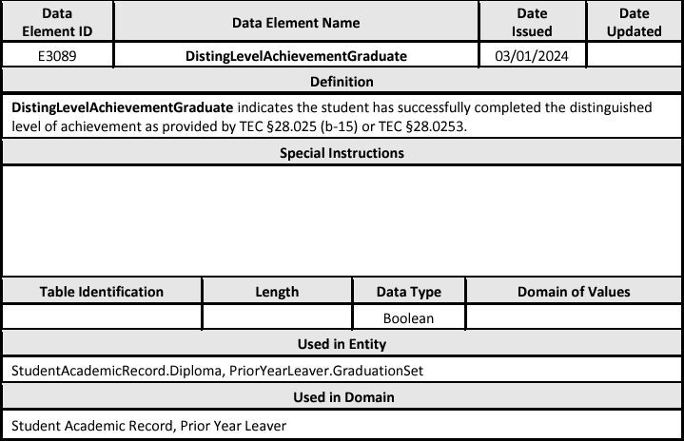
DATA ELEMENT UPDATES
Added a new data element DistingLevelAchievementGraduate (E3089) as optional in the PEIMS Fall Submission to the following common types:
  StudentAcademicRecord.Diploma in the Student Academic Record domain.
  PriorYearLeaver.GraduationSet in the Prior Year Leaver domain.

Slide 9
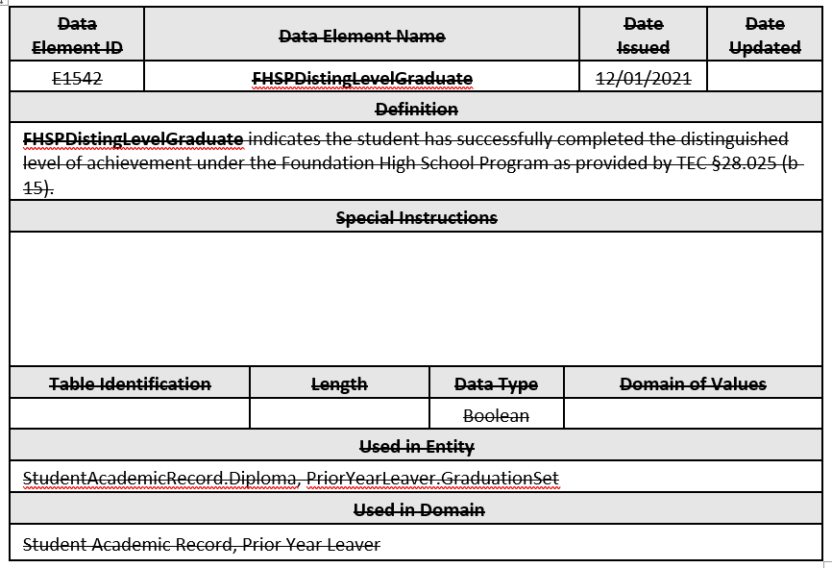
DATA ELEMENT UPDATES1
Removed the data element FHSPDistingLevelGraduate (E1542) reported in the PEIMS Fall Submission from the following common types:
  StudentAcademicRecord.Diploma in the Student Academic Record domain.
  PriorYearLeaver.GraduationSet in the Prior Year Leaver domain.

Slide 10
REPORT UPDATES
TEA will add new data element DistingLevelAchievementGraduate (E3089) to the following PEIMS Fall Graduate report:
  PDM1-124-007 Graduate Roster by Graduate Type

Slide 11
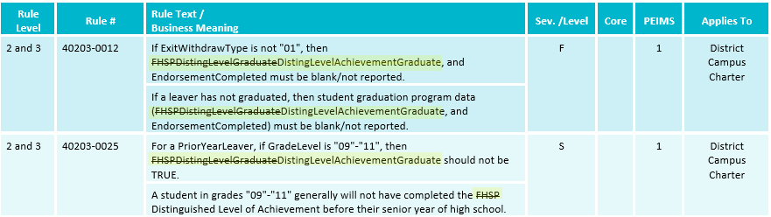
BUSINESS RULE UPDATES
Revised the following business rules:

Slide 12
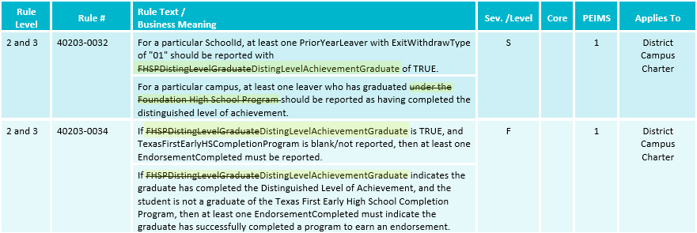
BUSINESS RULE UPDATES 1
Revised the following business rules:

Slide 13
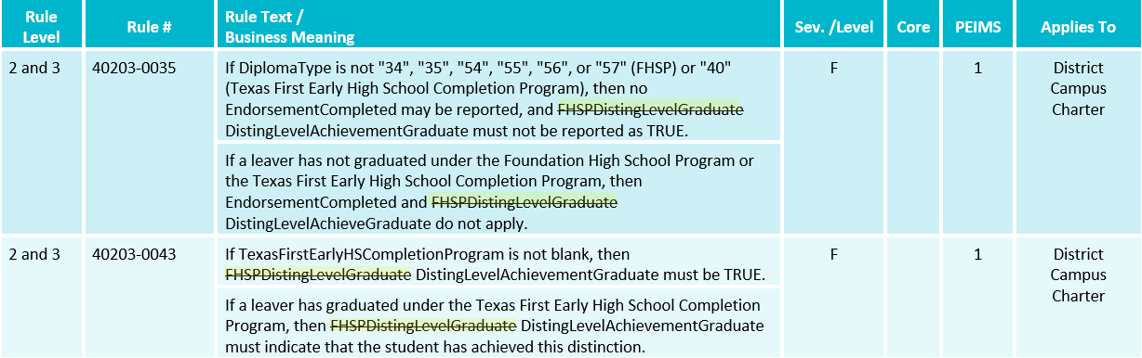
BUSINESS RULE UPDATES 2
Revised the following business rules:

Slide 14
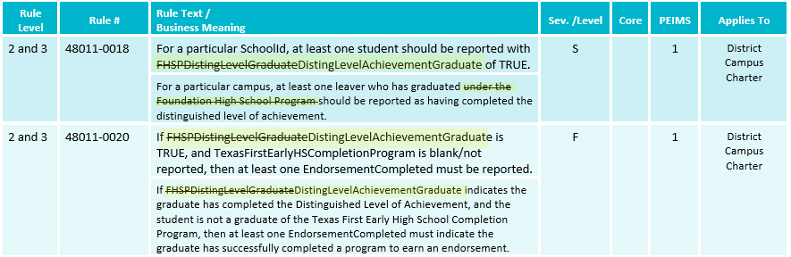
BUSINESS RULE UPDATES 3
Revised the following business rules:

Slide 15
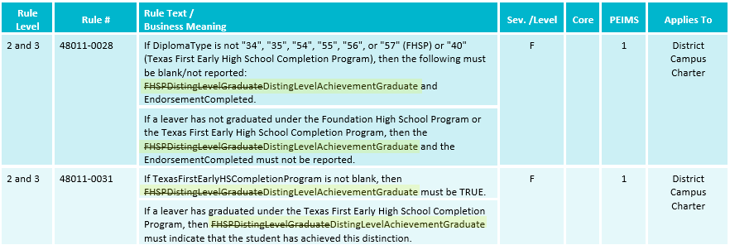
BUSINESS RULE UPDATES 4
Revised the following business rules:

Slide 16
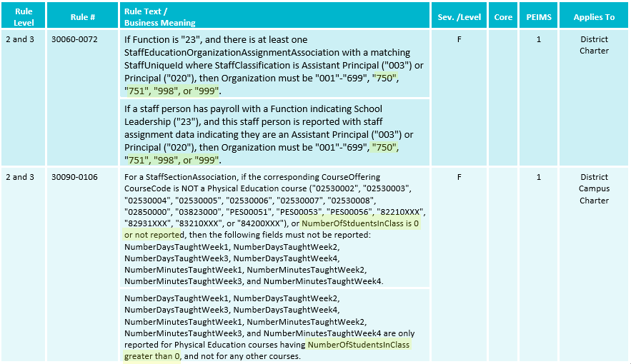
BUSINESS RULE UPDATES 5
Revised the following business rules:

Slide 17
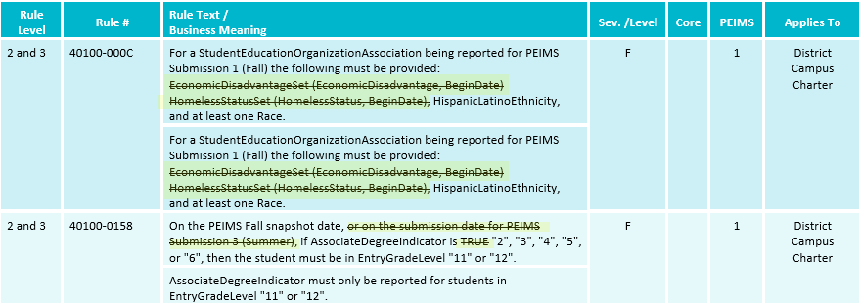
BUSINESS RULE UPDATES 6
Revised the following business rules:

Slide 18
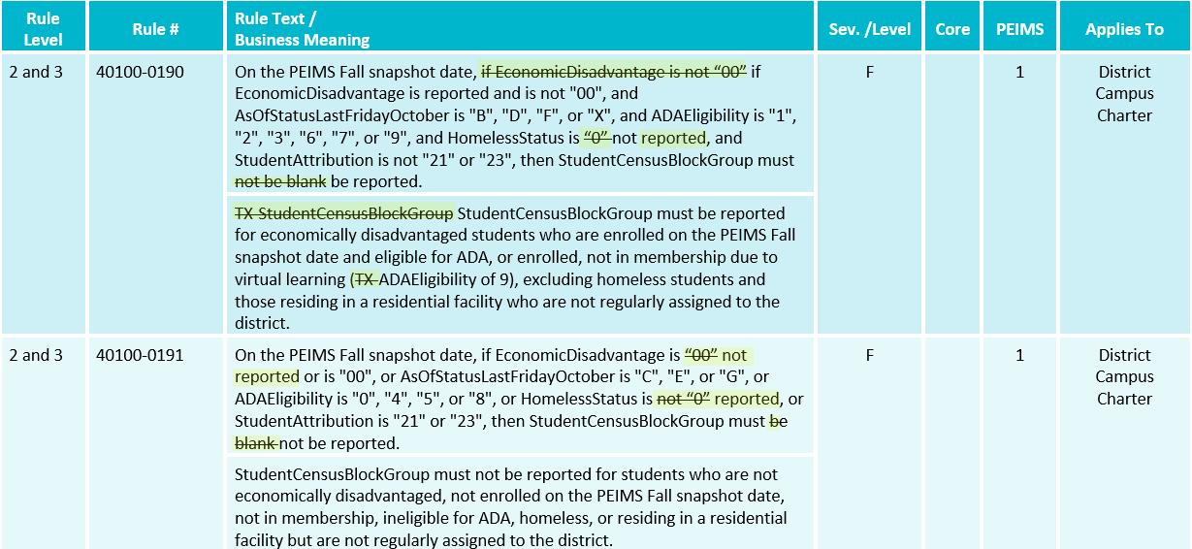
BUSINESS RULE UPDATES 7
Revised the following business rules:

Slide 19
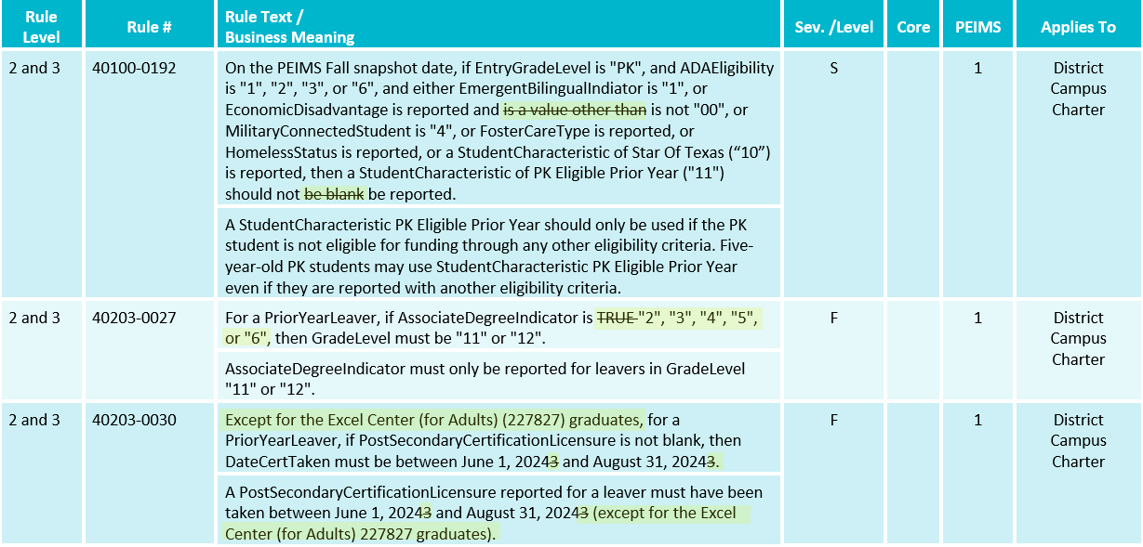
BUSINESS RULE UPDATES 8
Revised the following business rules:

Slide 20
BUSINESS RULE UPDATES 9
Removed the following business rule:
  40203-0042: For the 2023-2024 PEIMS Fall Submission, AssociateDegreeIndicator must be blank/not reported, "0", or "1".

Slide 21
TSDS UPGRADE PROJECT UPDATES
Data Element Name Changes:
Data Element ID | XML Data Element Name | Upgrade Data Element Name
E0316B (was E0316) | FUND-CODE | BudgetFund
E0317B (was E0317) | FUNCTION-CODE | BudgetFunction
E3018B (was E0318) | OBJECT-CODE | BudgetObject
E0320B (was E0320) | PROGRAM-INTENT-CODE | BudgetProgramIntent
E3010 | N/A | BeginDate
E3020 | N/A | EndDate

Slide 22
TSDS UPGRADE PROJECT UPDATES 1
Data Element Name Changes:
Data Element ID | XML Data Element Name | Upgrade Data Element Name
E0791 | DATE-OF-GRADUATION | DiplomaAwardDate
E3015 (was E0041) | PRIMARY-DISABILITY-CODE | Disability
E3015 (was E0834) | SECONDARY-DISABILITY-CODE | Disability
E3015 (was E0835) | TERTIARY-DISABILITY-CODE | Disability
E1001 | LEAVER-REASON-CODE | ExitWithdrawType
E1056 | CLASS-ID-NUMBER | SectionIdentifier
E1015 | ESC-SSA-STAFF-INDICATOR-CODE | SharedServicesArrangementStaff

Slide 23
TSDS UPGRADE PROJECT UPDATES 2
Descriptor Table Name Changes:
Descriptor ID | XML Code Table Name | Upgrade Descriptor Name
C145B (was C145) | FUND-CODE | BudgetFund
C146B(was C146) | FUNCTION-CODE | BudgetFunction
C159B (was C159) | OBJECT-CODE | BudgetObject
C147B (was C147) | PROGRAM-INTENT-CODE | BudgetProgramIntent

Slide 24
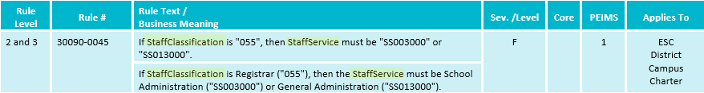
TSDS UPGRADE PROJECT UPDATES 4
Business Rule Changes:
  Rule text has been updated to reflect the change in the data element name.

Slide 25
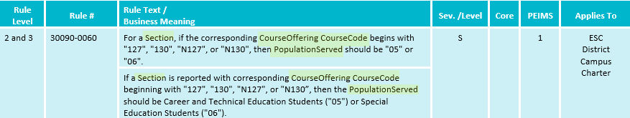
TSDS UPGRADE PROJECT UPDATES 5
Business Rule Changes:
  Rule text has been updated to reflect the change in the data element name.

Slide 26
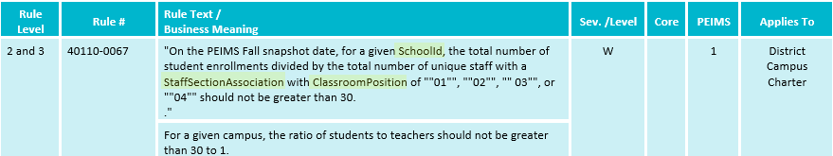
TSDS UPGRADE PROJECT UPDATES 6
Business Rule Changes:
  Rule text has been updated to reflect the change in the data element name.

Slide 27
TSDS UPGRADE PROJECT UPDATES 61
NEW Business Rule Changes:
  Revision: All references to the Function data element have been updated to the following data element name specific to the entity in which they are located:
    BudgetFunction – BudgetExt entity
    PayrollFunction – PayrollExt entity

Slide 28
TSDS UPGRADE PROJECT UPDATES 62
NEW Business Rule Changes:
  Revision: All references to the Fund data element have been updated to the following data element name specific to the entity in which they are located:
    BudgetFund – BudgetExt entity
    PayrollFund – PayrollExt entity

Slide 29
TSDS UPGRADE PROJECT UPDATES 63
NEW Business Rule Changes:
  Revision: All references to the Object data element have been updated to the following data element name specific to the entity in which they are located:
    BudgetObject – BudgetExt entity
    PayrollObject – PayrollExt entity

Slide 30
TSDS UPGRADE PROJECT UPDATES 64
NEW Business Rule Changes:
  Revision: All references to the Program Intent data element have been updated to the following data element name specific to the entity in which they are located:
    BudgetProgramIntent – BudgetExt entity
    PayrollProgramIntent – PayrollExt entity

Slide 31
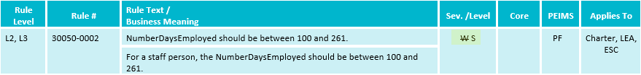
TSDS UPGRADE PROJECT UPDATES 55
NEW Business Rule Changes:
  Revision: changed severity from Warning to Special Warning

Slide 32
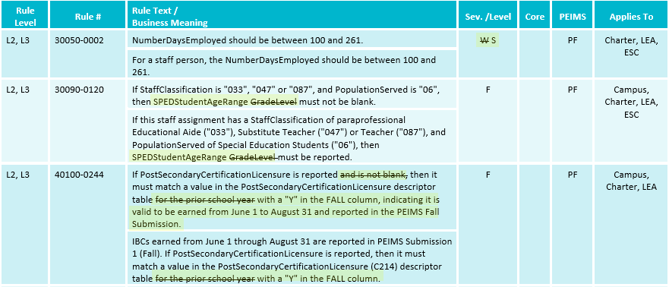
TSDS UPGRADE PROJECT UPDATES 7
NEW Business Rule Changes:

Slide 33
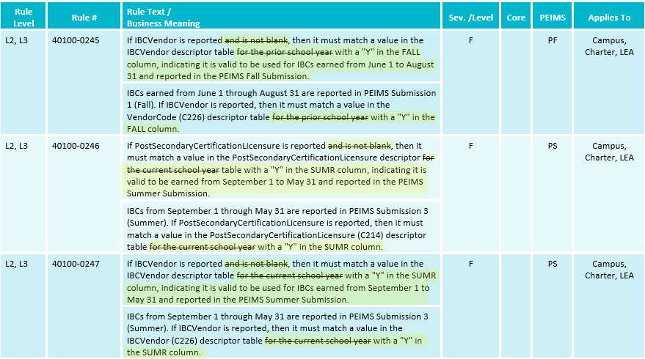
TSDS UPGRADE PROJECT UPDATES 8
NEW Business Rule Changes:

Slide 34
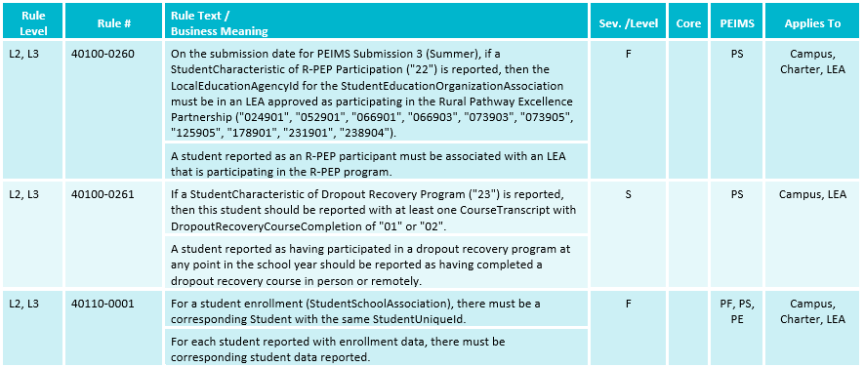
TSDS UPGRADE PROJECT UPDATES 9
NEW Business Rule Changes:
  The following business rules have been added:

Slide 35
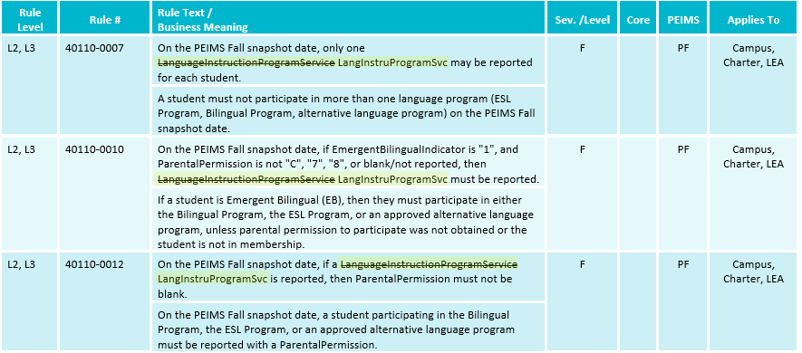
TSDS UPGRADE PROJECT UPDATES 10
NEW Business Rule Changes:

Slide 36
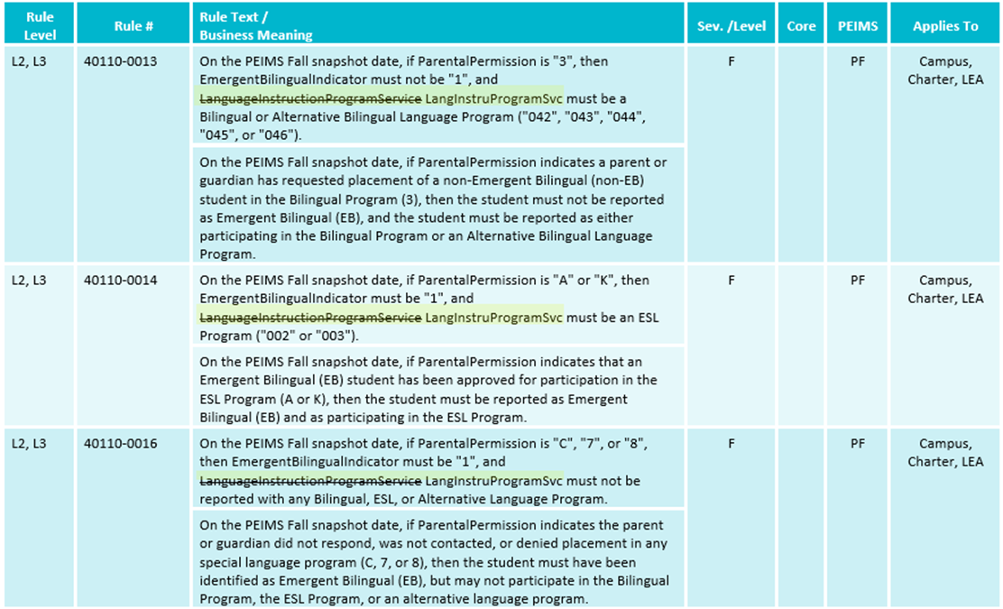
TSDS UPGRADE PROJECT UPDATES 12
NEW Business Rule Changes:

Slide 37
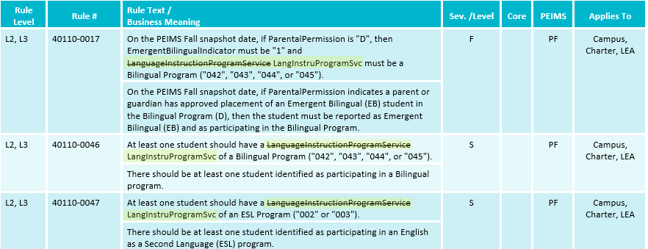
TSDS UPGRADE PROJECT UPDATES 13
NEW Business Rule Changes:

Slide 38
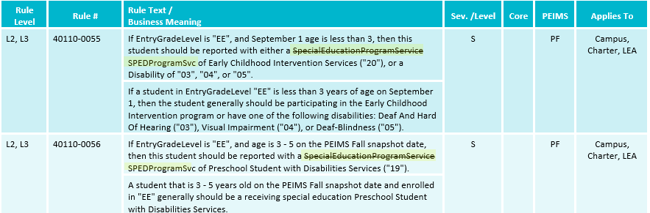
TSDS UPGRADE PROJECT UPDATES 14
NEW Business Rule Changes:

Slide 39
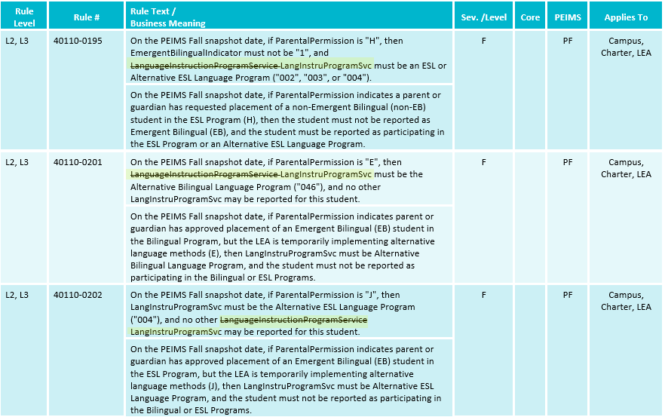
TSDS UPGRADE PROJECT UPDATES 15
NEW Business Rule Changes:

Slide 40
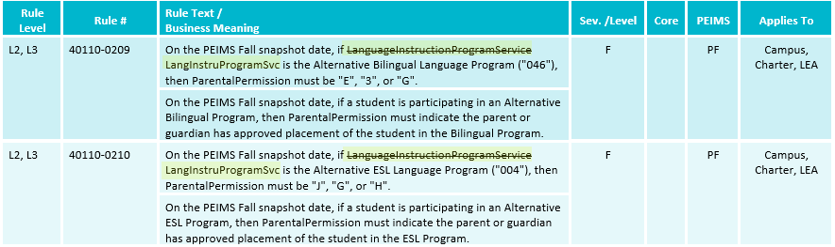
TSDS UPGRADE PROJECT UPDATES 16
NEW Business Rule Changes:

Slide 41
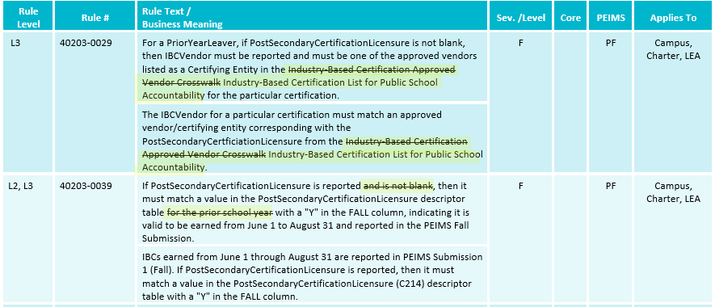
TSDS UPGRADE PROJECT UPDATES 17
NEW Business Rule Changes:

Slide 42
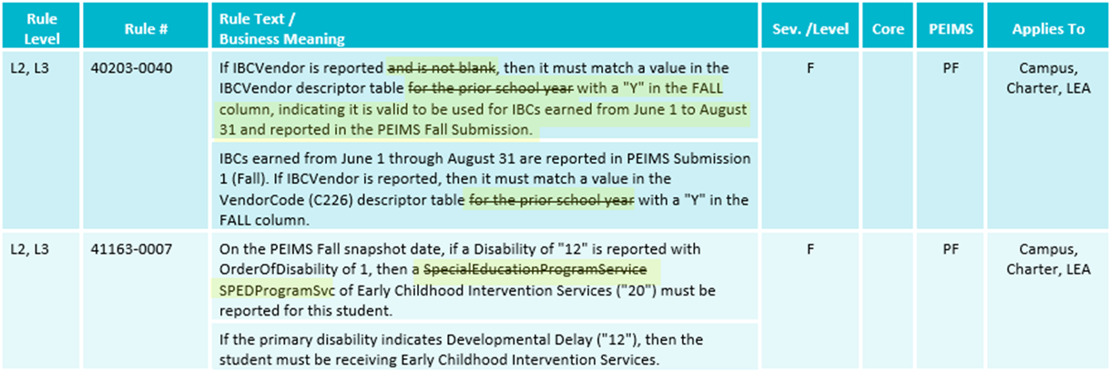
TSDS UPGRADE PROJECT UPDATES 18
NEW Business Rule Changes:

Slide 43
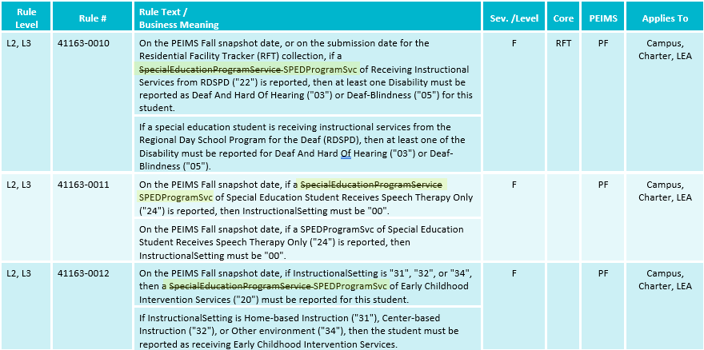
TSDS UPGRADE PROJECT UPDATES 19
NEW Business Rule Changes:

Slide 44
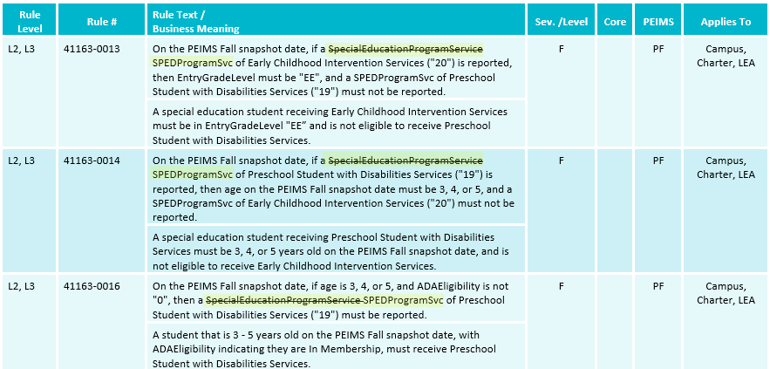
TSDS UPGRADE PROJECT UPDATES 20
NEW Business Rule Changes:

Slide 45
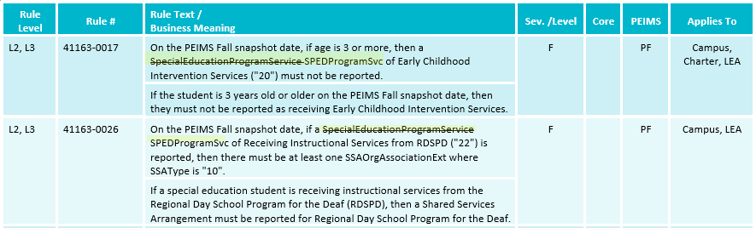
TSDS UPGRADE PROJECT UPDATES 21
NEW Business Rule Changes:

Slide 46
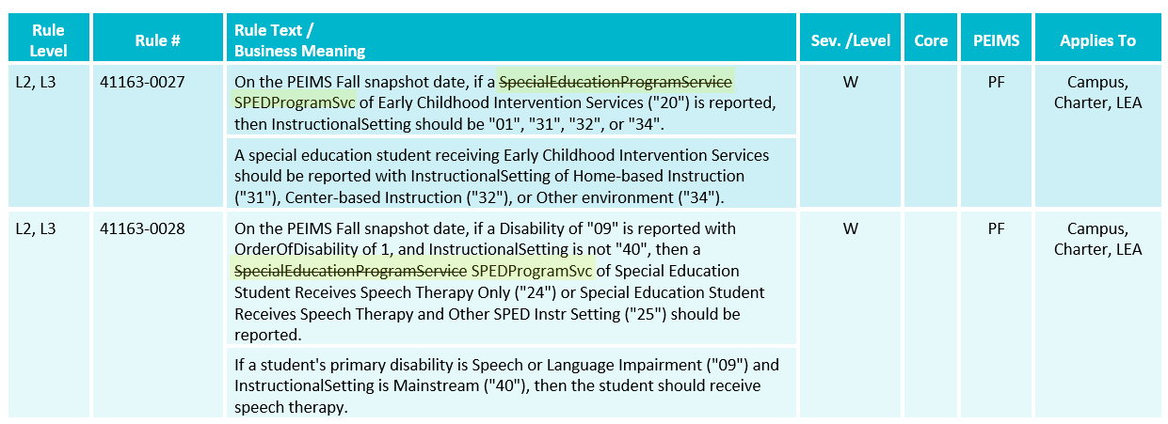
TSDS UPGRADE PROJECT UPDATES 22
NEW Business Rule Changes:

Slide 47
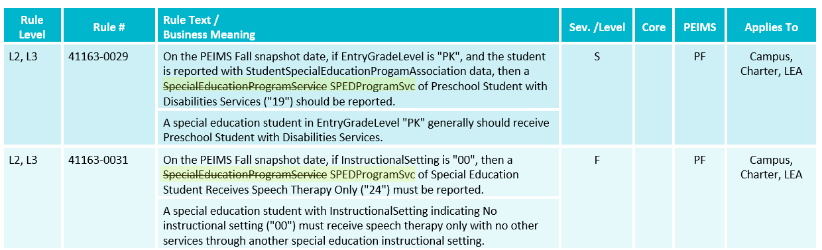
TSDS UPGRADE PROJECT UPDATES 23
NEW Business Rule Changes:

Slide 48
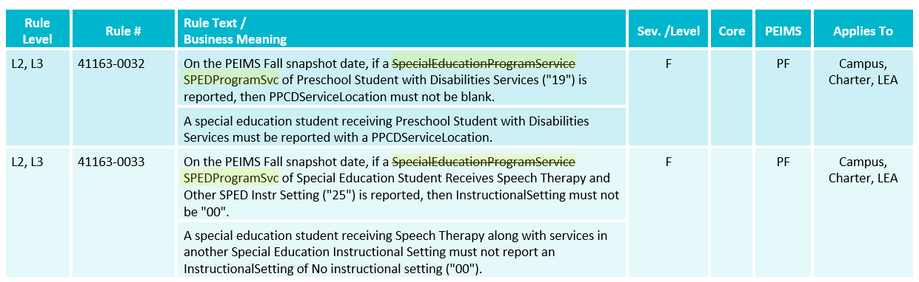
TSDS UPGRADE PROJECT UPDATES 24
NEW Business Rule Changes:

Slide 49
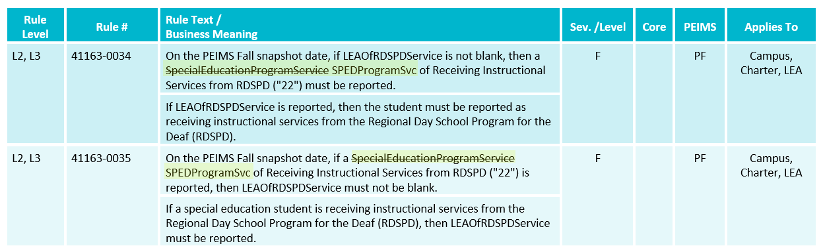
TSDS UPGRADE PROJECT UPDATES 25
NEW Business Rule Changes:

Slide 50
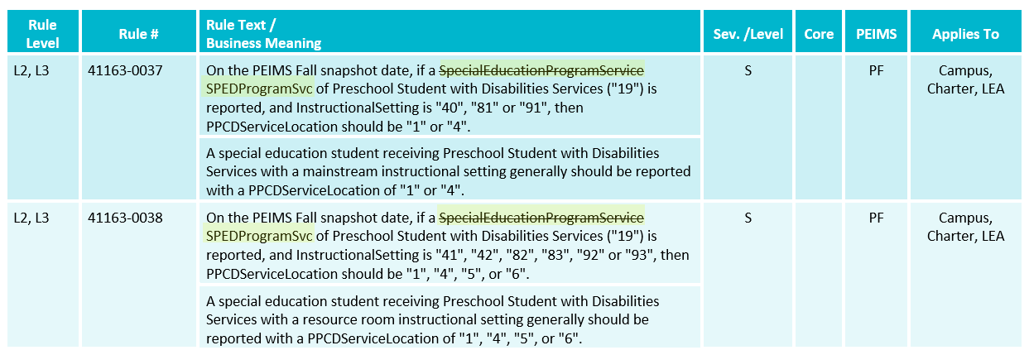
TSDS UPGRADE PROJECT UPDATES 26
NEW Business Rule Changes:

Slide 51
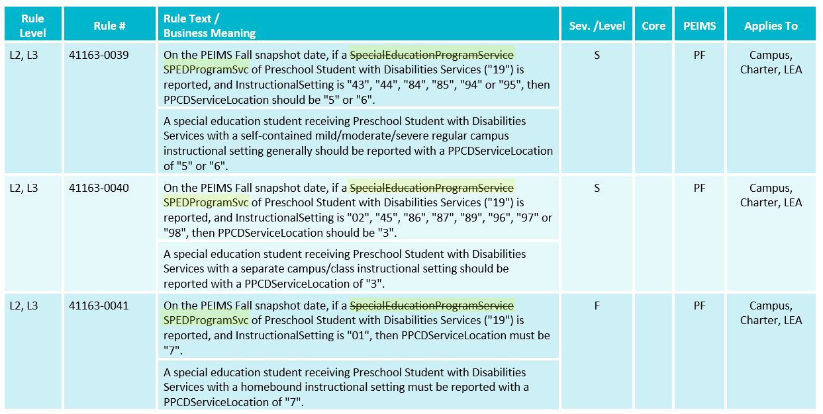
TSDS UPGRADE PROJECT UPDATES 27
NEW Business Rule Changes:

Slide 52
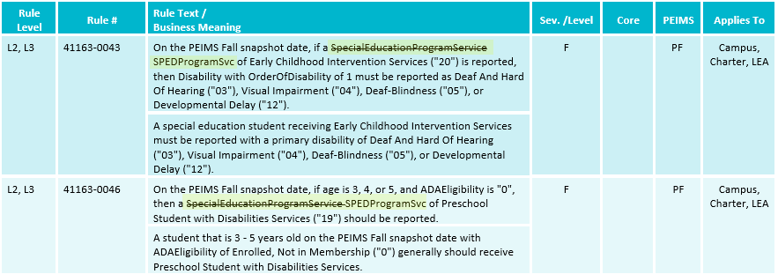
TSDS UPGRADE PROJECT UPDATES 28
NEW Business Rule Changes:

Slide 53
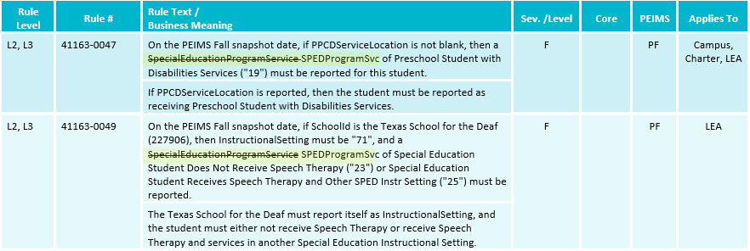
TSDS UPGRADE PROJECT UPDATES 29
NEW Business Rule Changes:

Slide 54
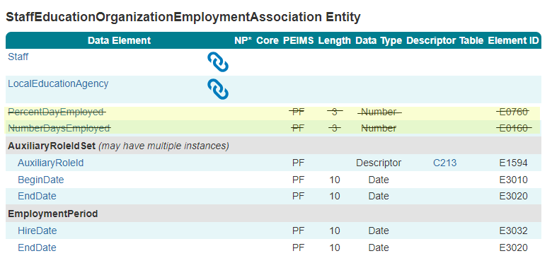
TSDS UPGRADE PROJECT UPDATES 30
NEW Data Element Changes:
  Removed the following data elements from the StaffEducationOrganizationEmploymentAssociation entity:
    E0706 PercentDayEmployed
    E0160 NumberDaysEmployed

Slide 55
TSDS UPGRADE PROJECT UPDATES 31
NEW Data Element Changes:
  Removed the following data elements from the StaffSectionAssociation entity:
    E3094 NumberOfStudentsInClassLastFridayOctober
    E3092 ClassroomPositionBeginDate
    E3093 ClassroomPositionEndDate

Slide 56
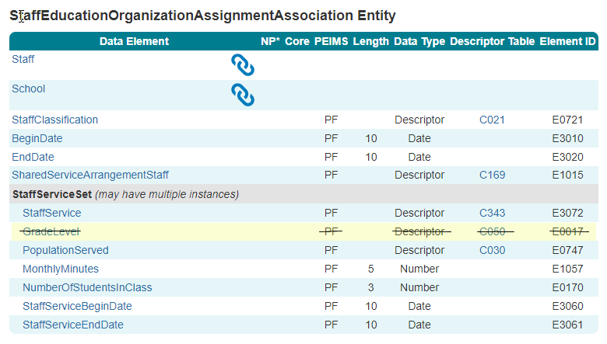
TSDS UPGRADE PROJECT UPDATES 32
NEW Data Element Change:
  Removed the following data element from the StaffEducationOrganizationAssignmentAssociation.StaffServiceSet entity:
    E0017 GradeLevel

Slide 57
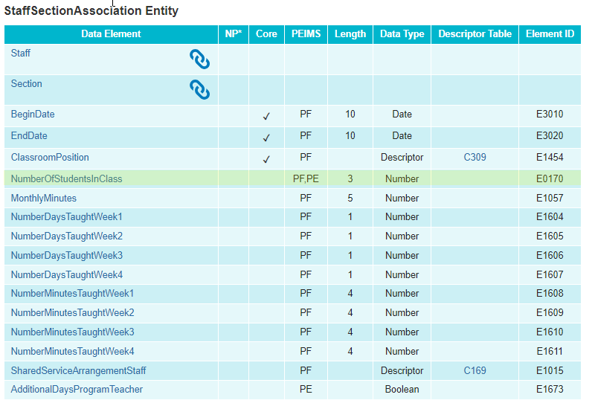
TSDS UPGRADE PROJECT UPDATES 33
NEW Data Element Change:
  Added the following data element to the StaffSectionAssociation entity:
    E0170 NumberOfStudentsInClass

Slide 58
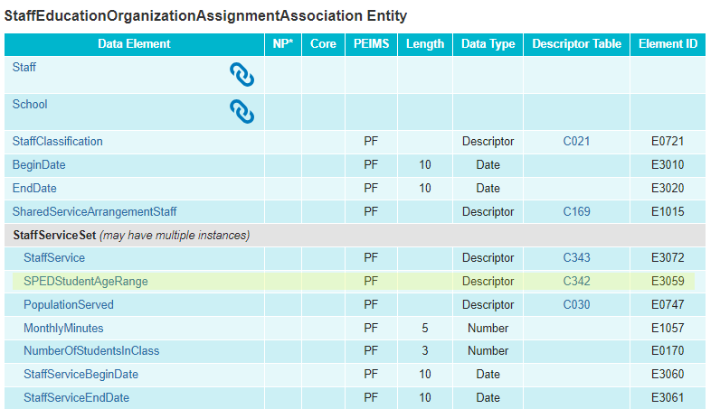
TSDS UPGRADE PROJECT UPDATES 34
NEW Data Element Change:
  Added the following data element to the StaffEducationOrganizationAssignmentAssociation.StaffServiceSet entity:
    E3059 SPEDStudentAgeRange

Slide 59
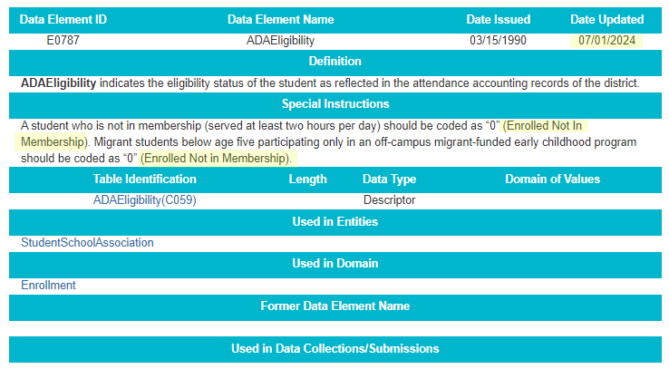
TSDS UPGRADE PROJECT UPDATES 35
NEW Data Element Change:
  E0787 ADAEligibility
    Revised the definition.

Slide 60
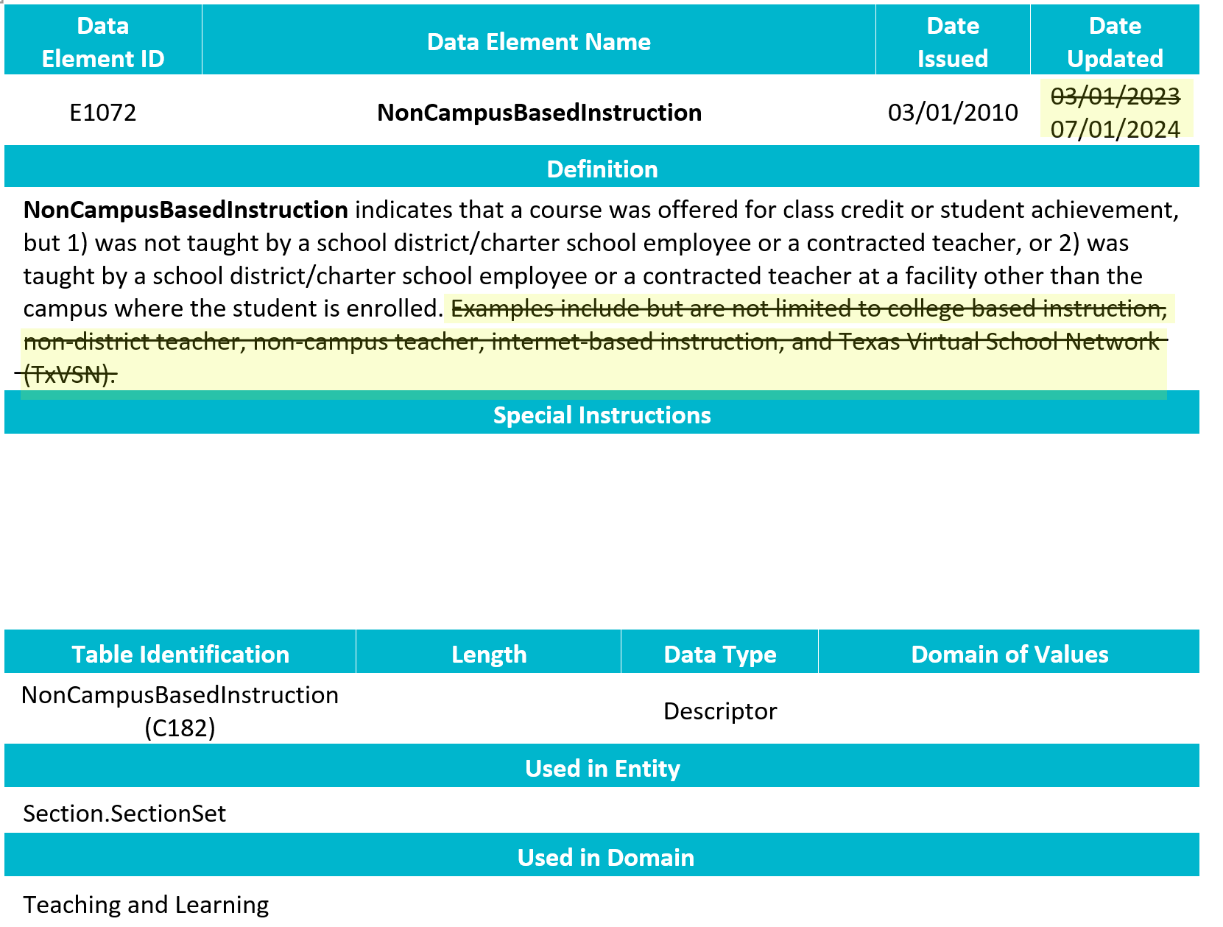
TSDS UPGRADE PROJECT UPDATES 36
NEW Data Element Change:
  E1072 NonCampusBasedInstruction
    Revised the definition.

Slide 61
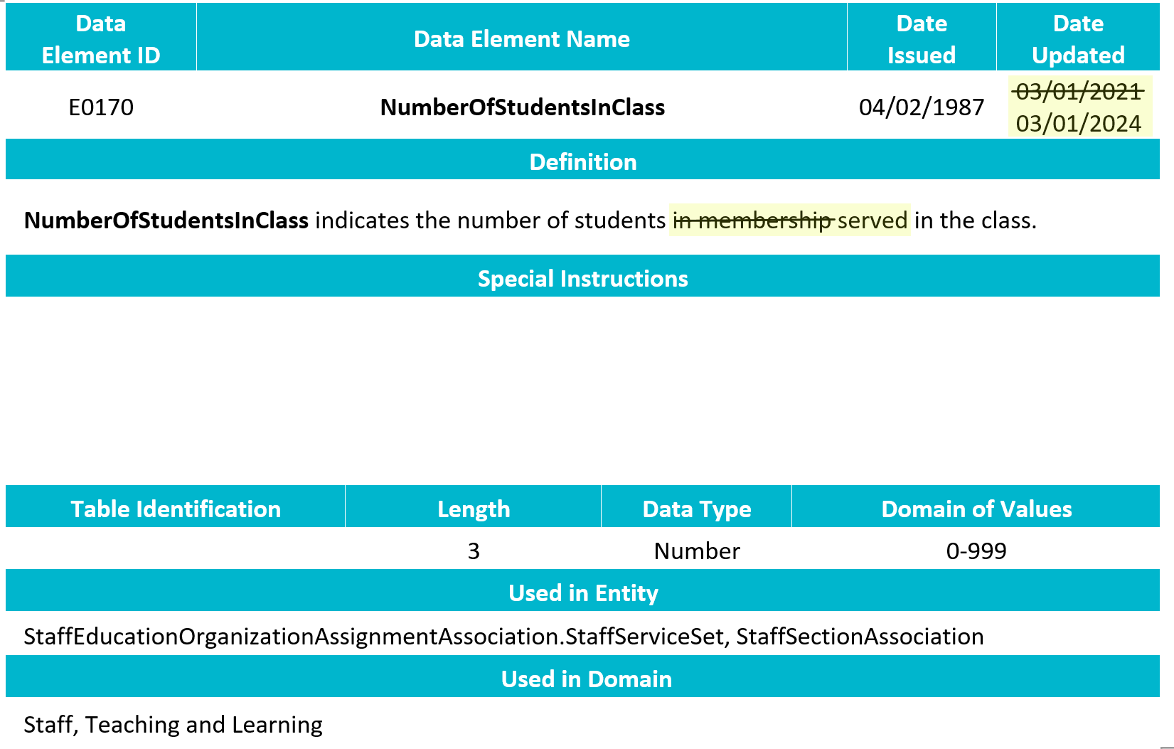
TSDS UPGRADE PROJECT UPDATES 37
NEW Data Element Change:
  E0170 NumberOfStudentsInClass
    Revised the definition.

Slide 62
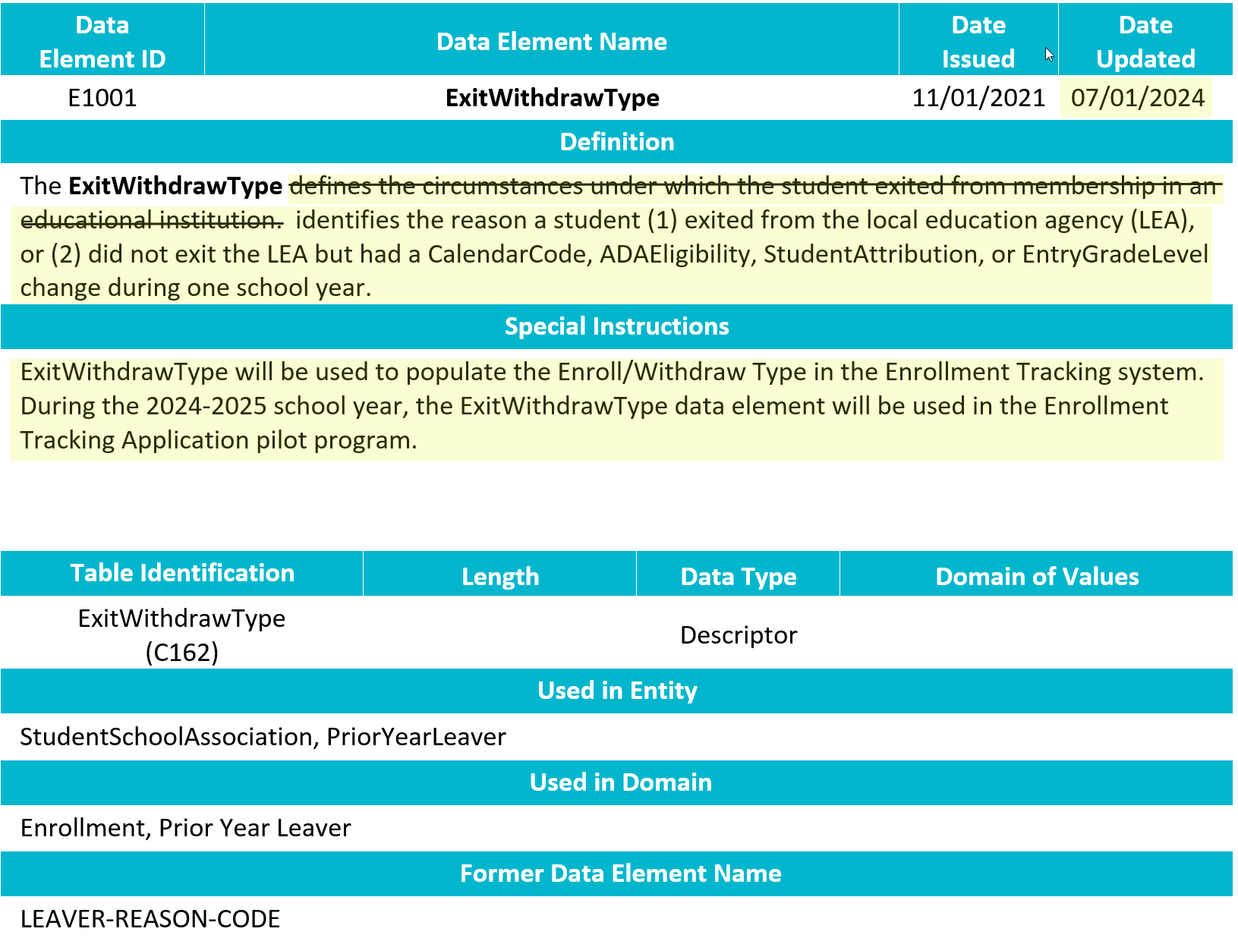
TSDS UPGRADE PROJECT UPDATES 38
NEW Data Element Change:
  E1001 ExitWithdrawType
    Revised the definition.

Slide 63
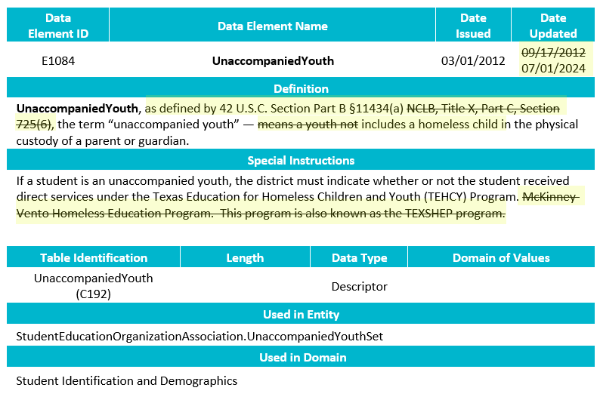
TSDS UPGRADE PROJECT UPDATES 39
NEW Data Element Change:
  E1084 UnaccompaniedYouth
    Revised the definition.

Slide 64
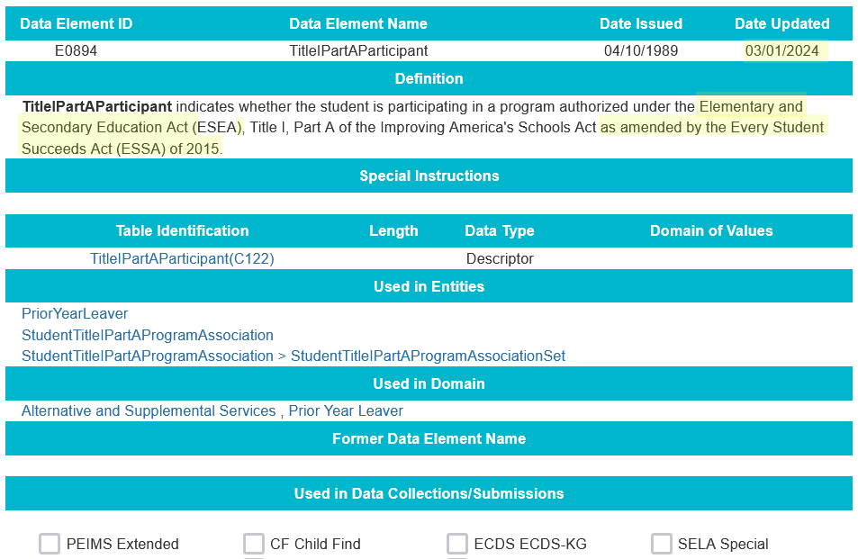
TSDS UPGRADE PROJECT UPDATES 41
NEW Data Element Change:
  E0894 TitleIPartAParticipant
    Revised the definition.

Slide 65
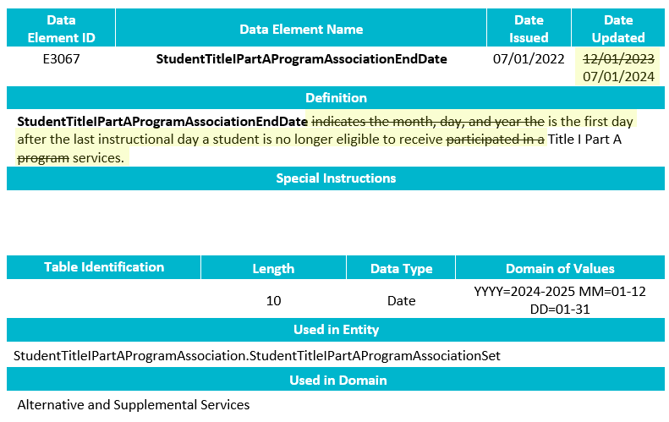
TSDS UPGRADE PROJECT UPDATES 42
NEW Data Element Change:
  E3067 StudentTitleIPartAProgramAssociationEndDate
    Revised the definition.

Slide 66
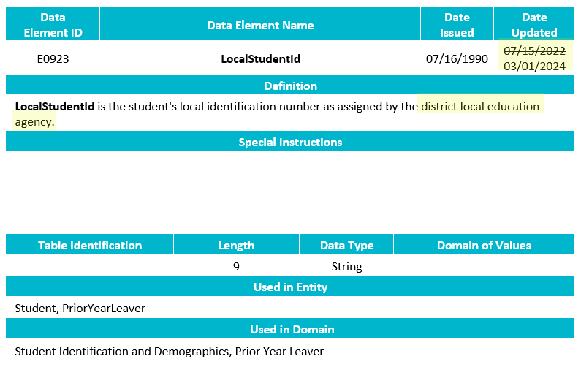
TSDS UPGRADE PROJECT UPDATES 43
NEW Data Element Change:
  E0923 LocalStudentId
    Revised the definition.

Slide 67
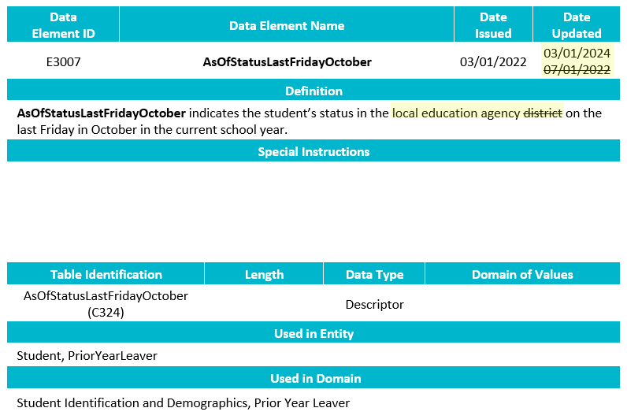
TSDS UPGRADE PROJECT UPDATES 44
NEW Data Element Change:
  E3007 AsOfStatusLastFridayOctober
    Revised the definition.

Slide 68

TSDS UPGRADE PROJECT UPDATES 45
NEW Data Element Change:
  E1724 FinancialAidApplication
    Revised the definition.

Slide 69

TSDS UPGRADE PROJECT UPDATES 46
NEW Data Element Change:
  E3021 EndorsementCompleted
    Revised the definition by spelling out Foundation High School Program and removing bullets.

Slide 70

TSDS UPGRADE PROJECT UPDATES 47
NEW Data Element Change:
  E3063 StudentCharacteristic
    Revised the definition for 18 – Parent Request Retention.

Slide 71

TSDS UPGRADE PROJECT UPDATES 48
NEW Data Element Change:
  E0790 EmergentBilingualIndicator
    Revised the definition.

Slide 72

TSDS UPGRADE PROJECT UPDATES 49
NEW Data Element Change:
  E1082 HomelessStatus
    Revised the definition.

Slide 73

TSDS UPGRADE PROJECT UPDATES 50
NEW Data Element Change:
  E3033 Language
    Revised the definition.

Slide 74

TSDS UPGRADE PROJECT UPDATES 52
NEW Data Element Change:
  E1064 HispanicLatinoEthnicity
    Revised the definition.

Slide 75

TSDS UPGRADE PROJECT UPDATES 4243
NEW Data Element Change:
  E1015 SharedServiceArrangementStaff
    Revised the definition.

Slide 76

TSDS UPGRADE PROJECT UPDATES 4445
NEW Data Element Change:
  E3034 LanguageInstructionProgramService
    Removed the special instructions.

Slide 77

TSDS UPGRADE PROJECT UPDATES 4647
NEW Descriptor Table Change:
  C220 ProgramOfStudy

Slide 78

TSDS UPGRADE PROJECT UPDATES 4849
NEW Entity/Common Type Change:
  StudentSpecialEducationProgramAssociation.InstructionalSettingSet
    Removed may have multiple instances

Slide 79

TSDS UPGRADE PROJECT UPDATES 5051
NEW Entity/Common Type Change:
  Removed LanguageInstructionProgramService common type

Slide 80

TSDS UPGRADE PROJECT UPDATES 5253
NEW Entity/Common Type change:
  Removed SpecialEducationProgramService common type

Slide 81

TSDS UPGRADE PROJECT UPDATES 54
NEW Entity/Common Type Change:
  Removed CTEProgramService common type

Slide 82
TSDS UPGRADE PROJECT UPDATES 5556
NEW Entity/Common Type Change:
  Removed ClassroomPositionSet common type

Slide 83

TSDS UPGRADE PROJECT UPDATES 57
NEW Entity/Common Type Change:
  Added LangInstruProgramSvcSet common type.

Slide 84

TSDS UPGRADE PROJECT UPDATES 58
NEW Entity/Common Type Change:
  Added SPEDProgramSvcSet common type.

Slide 85

TSDS UPGRADE PROJECT UPDATES 59
NEW Entity/Common Type Change:
  Added CTEProgSvcSet common type.

Slide 86

TSDS UPGRADE PROJECT UPDATES 60
NEW Entity/Common Type Change:
  Added DaysEmployedSet common type.

Slide 87
TSDS UPGRADE PROJECT UPDATES 3
Report Updates:
  Financial Organization Units on Financial Reports
    There have been multiple TIMS tickets regarding Organization Units 699 not showing in the aggregated data on LEA’s financial reports.
    An issue has been identified where the reports are not displaying all administration organization units in the Campus ID selection parameter for these reports.
    TEA is actively working to determine a corrective action to resolve this issue by the start of the 2024-2025 school year.
    NEW A fix for this issue was deployed to production on Friday, May 31, 2024.

Slide 88
TSDS UPGRADE PROJECT UPDATES 7
NEW Promotion Logic:
  PEIMS Fall Promotion Logic
    Student > Student Basic Information
      Updated AssociateDegreeIndicator to a descriptor table
        Updated the promotion logic to "promoted as is“
      Updated promotion logic for Student Language and Home Language.
        Promote Language where LanguageUse = 02 (Student Language). If multiple Language values are reported where LanguageUse = '02', use the following logic to promote just one Language value:
        - Exclude Language = '98' and Language = '99'
        - THEN, promote the lowest numeric value
        - ELSE, promote the lowest alpha/numeric value.
        - If the only two Language values are '98' and '99', promote Language = '99’,
        Same logic for Home Language
    Student > Graduation Program
      Updated data element from E1542 FHSPDistingLevelGraduate to E3089 DistingLevelAchievementGraduate.

Slide 89
TSDS UPGRADE PROJECT UPDATES 761
Test Cases:
  PEIMS Fall Test Cases

Slide 90
CURRENT KNOWN ISSUES 1
PDM1-120-003 (Select parameters only) Student Program Roster
  The PEIMS Fall report PDM1-120-003 is failing when certain parameters are selected. When the 'By LEA' Organization Level parameter is selected and either the 'All Students', 'All Reports', 'At-Risk', or 'Gifted and Talented' Program Type parameters are selected, the report is not running successfully. Users receive a report status of 'Failed' when the report is run with these parameters.
  Note - the report works correctly when the 'By Campus' Organization Level parameter is selected and the 'Bilingual', 'ESL', 'Intervention Strategy', 'Migratory', or 'Special Education' Program Type parameters are selected.

Slide 91
CURRENT KNOWN ISSUES 11
40100-0095
  Rule 40100-0095 is firing when data element UnaccompaniedYouth (E1084) is not reported for a Prior Year Leaver who is reported with a value for the HomelessStatus (E1082) data element. Prior Year Leavers do not report any data regarding UnaccompaniedYouth status.
  LEAs can disregard this validation in the parallel PEIMS Fall and Summer Submissions. TEA will be updating the rule for 2024-2025 to no longer apply to Prior Year Leavers.

Slide 92
CURRENT KNOWN ISSUES 12
40100-0156
  In the TEDS 2024.2.1 publication, descriptor value '0' was removed from the C122 TitleIPartAParticipant descriptor table. As such, TEA is no longer expecting StudentTitleIPartAProgramAssociation for every enrolled student.
  However, TEA did not remove fatal validation rule 40100-0156, which requires StudentTitleIPartAProgramAssociation data for all students with an AsOfStatusLastFridayOctober (E3007) equal to 'B', 'D', 'F', or 'X', from the TSDS Upgrade PEIMS environment.
  TEA has downgraded this rule in the PEIMS parallel environment from a fatal to a special warning. LEAs can ignore this validation in the parallel PEIMS Fall Submission. TEA will be updating the 2024-2025 data standards to remove this validation rule.

Slide 93
CURRENT KNOWN ISSUES 13
41461-0013
  Rule 41461-0013 is firing for Prior Year Leavers because those students will not be reported with a value of 'B', 'D', 'F', or 'X' for the AsOfStatusLastFridayOctober (E3007) data element.
  LEAs can disregard this validation error in the parallel PEIMS Fall Submission. TEA will be removing this validation rule for the 2024-2025 school year.

Slide 94
CURRENT KNOWN ISSUES 14
School Leaver Promotion
  When a student is reported in the PriorYearLeaver entity with an ExitWithdrawType (E1001) not equal to '01' (Graduate), and IndividualGraduationCommitteeGraduateIndicator (E1562) is not equal to 'true' the data element is promoted to PEIMS with a value of '00'. The result is causing rule 40203-0005 to fire.
  TEA will update the PEIMS promotion logic to not promote a value when IndividualGraduationCommitteeGraduateIndicator is not equal to 'true'.

Slide 95
CURRENT KNOWN ISSUES 15
Student Graduation Program Data Promotion
  When a student's data is published to the IODS with no value for the EndorsementCompleted (E3021) data element, the PEIMS Fall promotion logic will promote the value with a '0' to the PEIMS data mart. This is causing validation rule 48011-0028 to misfire when a student's DiplomaType (E0806) is not a value of '34', '35', '40', '54', '55', '56' or '57'.
  TEA will be updating the PEIMS Fall promotion logic to no longer default a value of '0' when the EndorsementCompleted is not supplied in the IODS. LEAs can ignore this validation rule in this scenario for the remainder of the parallel submission year.

Slide 96
CURRENT KNOWN ISSUES 16
Student Graduation Program Data Promotion
  When a student's data is published to the IODS with no value for the EndorsementCompleted (E3021) data element, the PEIMS Fall promotion logic will promote the value with a '0' to the PEIMS data mart. This is causing validation rule 48011-0028 to misfire when a student's DiplomaType (E0806) is not a value of '34', '35', '40', '54', '55', '56' or '57'.
  TEA will be updating the PEIMS Fall promotion logic to no longer default a value of '0' when the EndorsementCompleted is not supplied in the IODS. LEAs can ignore this validation rule in this scenario for the remainder of the parallel submission year.

Slide 97
CURRENT KNOWN ISSUES 17
Student Basic Information Data Promotion
  When a student is reported in the Student entity with an AsOfStatusLastFridayOctober (E3007) equal to 'X', the Student Basic Information subcategory data is not promoted to the PEIMS Fall data mart.
  TEA will update the PEIMS Fall promotion logic to promote students with an AsOfStatusLastFridayOctober equal to 'X’.

Slide 98
TITLE SLIDE: Closeout
CLOSEOUT
NAME OF COMPONENT (ALL CAPS)
MARCH 19-21, 2024

Slide 99
TIMELINE
PEIMS Fall Submission (Submission 1) | Date
TSDS PEIMS ready to load data to IODS | August 5, 2024
Close of school-start window - Last Friday in September | September 27, 2024
PEIMS Fall snapshot date | October 25, 2024
TSDS PEIMS ready for users to complete, approve, and accept submissions | October 28, 2024
Requests to retire Unique IDs due at TEA for PEIMS Fall First Submission | December 6, 2024
PEIMS Fall First Submission due date for LEAs and ESCs | December 12, 2024
Requests to retire Unique IDs due at TEA for PEIMS Fall Resubmission | January 10, 2025
PEIMS Fall Resubmission due date for LEAs and ESCs | January 16, 2025
PEIMS Fall data available to customers | February 13, 2025

Slide 100
TECHNICAL RESOURCES
Technical Support
  TSDSCustomerSupport@tea.texas.gov
Technical Specification
  2024-2025 TSDS Web-Enabled Data Standards (TWEDS)
  Known Issues
TSDS Incident Management System (TIMS)
  TSDS Incident Management System (TIMS) Support Application
  TIMS Knowledge Base Article Repository
Additional Resources
  Financial Accountability System Resource Guide
  Student Attendance Accounting Handbook (SAAH)

Slide 101

QUESTIONS
QUESTIONS?

