Slide 1

TITLE SLIDE: ESC Vendor Training for One Component
PEIMS SUMMER
MARCH 19-21, 2024

Slide 2

AGENDA – PEIMS SUMMER
PROGRAM AREA
2023-2024 SCHOOL YEAR
  Submission Updates
  Code Table Updates
  Report Updates
  Reminders
  Current Known Issues
  Timeline
2024-2025 SCHOOL YEAR
  Application Updates
  Data Element Updates
  Descriptor Table Updates
  Report Updates
  Business Rule Updates
  TSDS Upgrade Project Updates
CLOSEOUT
  Timeline
  Technical Resources
  Questions

Slide 3
PROGRAM AREA UPDATES & GUIDANCE
District Innovation and School Models Division
  Christopher DeWitt, Director of District Innovation and School Models
    christopher.dewitt@tea.texas.gov
Texas Tutoring Supports Division
  Colby Self, Director of Texas Tutoring Supports
    colby.self@tea.texas.gov
College, Career, and Military Preparation Division​
  Lacy Freeman, Statewide Career and Technical Education Coordinator
    lacy.freeman@tea.texas.gov
State Funding Division
  Kristi McCorquodale, Bond Guarantee Program Analyst
    kristi.mccorquodale@tea.texas.gov

Slide 4

Texas Rural Schools
Spring Conference
March 1, 2024

Slide 5


Pursuing our vision for Texas students
Every Child, Prepared for Success in College, a Career, or the Military
At K-12 Graduation
By 2030, at least 60% of Texans will have a degree, certificate, or other postsecondary credential of value.
Goal: 60%
Post-Secondary Attainment
High school graduates have enlisted in the military, earned an industry certification, 2-year degree, or 4-yr degree from any institution nationally within 6 years of graduation.
5

Slide 6
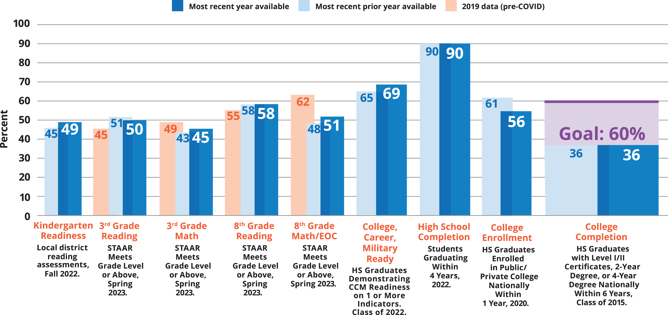
Student Outcomes
YEAR-OVER-YEAR STUDENT OUTCOMES
6

Slide 7
Rural Pathways in Excellence Partnerships (R-PEP)
The Rural Pathways Excellence Partnership (R-PEP) designation (HB2209, 88th Legislature) aims to increase access to high-quality post-secondary pathways for rural students through an allotment and increased outcomes bonus. An R-PEP is:
College and Career Pathways open to all eligible students
Coordinating Entity with capacity to operate pathways
Performance Agreement
outlining CE and LEA roles, responsibilities, and metrics for success
Collaborative of districts with fewer than 1,600 students and a wilingness to think creatively
7

Slide 8
R-PEP Allotment
The Rural Pathways Excellence Partnership program (HB2209, 88th Legislature) aims to increase access to high-quality post-secondary pathways for rural students through an allotment and increased outcomes bonus.
R-PEP Allotment
R-PEP Allotment Example:
  A high school student who spent 1/3 of their time participating in one of these pathways would generate on average an extra $2,928 per ADA if low income, and $2,546 per ADA if not.
  CCMR Outcomes bonuses are also increased.
R-PEP Designated Districts earn additional ADA Allotment for each student in a postsecondary pathway & an Outcomes Bonus for each student that earns a postsecondary credential of value up to 5 years after graduation.
The average small LEA that ensured all of its students participated in an R-PEP pathway would increase M&O funding by 9%

Slide 9











R-PEP Example: Rural Schools Innovation Zone
=
1. Districts with fewer than 1,600 students opt in
2. Select a partner and Boards approve a performance agreement with a 3rd party intermediary
3. Intermediary operates pathway programs (CTE, PTECH, or ECHS) aligned with high-wage, high-demand career open to all students in the partnership
Grow Your Own Educator Academy
at Premont High School
Citizen’s Battalion Naval JROTC Academy
at Falfurrias High School
Ignite Technical Institute Career and Technical Academy
at Falfurrias High School
Next Generation Medical Academy
at Freer High School
STEM Discovery Zone STEM Academy
at Premont Collegiate High School
4. Districts pool resources and invest in the continued excellence of pathways
9

Slide 10
Rural Schools Innovation Zone: Impact to Date
Nearly 300 participating students across 5 districts.
The RSIZ has tripled the percentage of graduating students each year completing an industry-based certification since 2019.
The RSIZ has outperformed the state and surrounding regions (Region 1 and Region 2) in CCMR score, graduation rate, and dual credit completion.
The RSIZ has more than quadrupled the percentage of graduating students earning college credit during high school.

Slide 11
R-PEP Example: Freer ISD Student Outcomes
2018
2023
Background:
Freer ISD joined the Rural Schools Innovation Zone (RSIZ) in 2019.
Freer ISD hosts the Next Generation Medical Academy.
Impact:
In 2023-2024, nearly 80 Freer ISD students attend an R-PEP pathway in one of the partner districts
Dramatically increased post-secondary readiness outcomes
College Ready Graduates
19.3%
83.1%
+63.8pts
College, Career, Military Readiness
38.6%
91.5%
+52.9pts
Industry-Based Credentials
1.8%
49.3%
+47.5pts
Career/ Military Readiness
24.6%
69.6%
+45pts
Graduation Rate
86.9%
95.5%
+8.6pts
Dual Credit Participation
n/a
60%
+60pts
Data Source: TAPR
Dropout Rate
2.2%
0.9%
-1.3pts
Notes:
College Ready Graduates rose from 19.3% in 2018 to 83.1% in 2023
CCMR rose from 38.6% in 2018 to 91.5% in 2023
IBC's from 1.8% in 2018 to 49.3% in 2023
Career/Military Ready from 24.6% in 2018 to 60.6% in 2023
TSIA in both subjects from 19.3% in 2018 to 76.1% in 2023
Graduation rate from 86.9% in 2018 to 95.5% in 2023
Dropout rate from 2.2% in 2018 to 0.9% in 2023
Dual Credit participation at 60% in 2023

Slide 12
Thank You

Slide 13
REGIONAL PROGRAM OF STUDY CALCULATIONS
FOR CTE INDICATORS
House Bill 773 (87R) added students who successfully complete a program of study in career and technical education (CTE) to the list of indicators that can be used to calculate college, career, and military readiness (CCMR).
A local education agency (LEA) may offer any approved statewide programs of study. Autocoding is used to calculate the CTE indicators for participants (code 5), explorers (non-downgraded code E), concentrators (code 6), and completers (code 7).
Regional programs of study meet a specialized industry need within a particular region(s). Therefore, regional programs of study are approved for use in regions that apply and successfully show labor market demand. CTE indicators of students who are enrolled in regional programs of study are calculated based on their campus’ address and associated region. The regional programs of study for the 2023-2024* school year are:
Printing and Imaging
Retail Management
Cosmetology and Personal Care Services
Industrial Maintenance
Geospatial Engineering and Land Surveying
Aviation
Drone
Maritime
*Regional programs of study will be updated on the website for the 2024-25 school year.

Slide 14
REGIONAL PROGRAM OF STUDY CALCULATIONS
FOR CTE INDICATORS
What does this mean for my LEA?
Independent School Districts (ISDs):
  Ensure the campus’ physical address is correct in AskTED. ISD TED administrators can update their own campuses.
Charter Schools:
  Charter school administrators should request changes to the campus’ physical address by submitting the All-In-One Charter School Update Form or emailing CharterAskTED@tea.texas.gov.
Why is it important to list the correct physical address of the school?
Each school’s physical address will be used to link it to the region in which the school is located. Ensuring the correct physical address is listed in AskTED will facilitate the correct autocoding of CTE indicators for students who are enrolled in a regional program of study, potentially affecting CCMR.

Slide 15

TITLE SLIDE: 2023-2024 School Year
2023-2024
SCHOOL YEAR
NAME OF COMPONENT (ALL CAPS)
MARCH 19-21, 2024

Slide 16
SUBMISSION UPDATES
The following PEIMS application functionality has beenupdated to include new data elements: ​
  Data Search​
  Data Retrieval​
  Data Element Summary

Slide 17
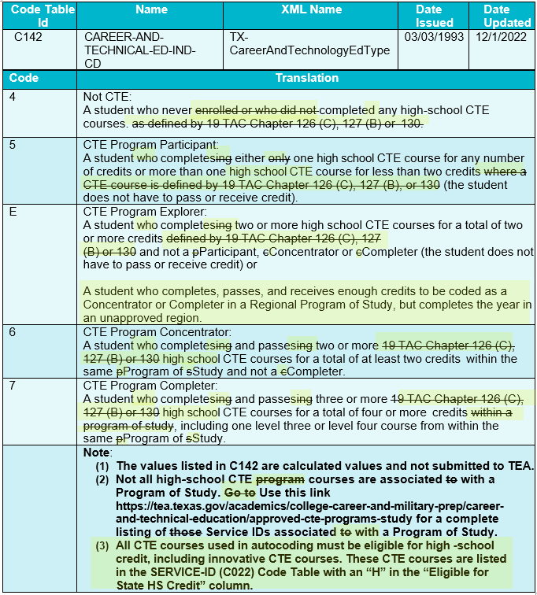
CODE TABLE UPDATES
Modified the CAREER-AND-TECHNICAL-ED-IND-CD (C142) translations.

Slide 18
CODE TABLE UPDATES 4
C022 SERVICE-ID
  The following Service IDs have been added:
    12700110 Career and College Exploration (First Time Taken)
    12700120 Career and College Exploration (Second Time Taken)
    N1110035 Elements of Data Science
    N1130030 Ethnic Studies: American Indian/Native Studies
    N1290062 Multilingual Acculturation Studies for Newcomers

Slide 19
CODE TABLE UPDATES 5
C022 SERVICE-ID
  Code ’13036300’ changed as follows:
    Description changed from ‘Principles of Biosciences’ to ‘Principles of Bioscience’.

Slide 20
CODE TABLE UPDATES 6
C022 SERVICE-ID
  The following Service IDs have been removed:
    12700300 College and Career Readiness
    12700400 Investigating Careers (First Time Taken)
    12700410 Investigating Careers (Second Time Taken)
    12700420 Investigating Careers (Third Time Taken)
    12700430 Investigating Careers (Fourth Time Taken)
    N1160011 Functional Fitness

Slide 21
CODE TABLE UPDATES 7
C022 SERVICE-ID
  The following Service IDs have been removed (cont.):
    N1260001 Cyber Citizenship
    N1303756 Gateway To Technology (PLTW) (First Time Taken)
    N1303757 Gateway To Technology (PLTW) (Second Time Taken)
    N1303758 Gateway To Technology (PLTW) (Third Time Taken)
    N1303759 Gateway To Technology (PLTW) (Fourth Time Taken)
    N1303752 Texas Pre-Freshman Engineering Program I

Slide 22
REPORT UPDATES 11
Flexible attendance reports will be updated to reflect the Adjusted Eligible Equivalent days.
  Adjusted Eligible Equivalent Days is calculated as the lesser of the Eligible Equivalent Days or NUMBER-DAYS-TAUGHT (E0935). (Per student, campus, instructional track, reporting period and grade level)
  TEA has determined that LEAs reported Eligible Equivalent days that were greater than the number of days taught.
  LEAs are funded on the Adjusted Eligible Equivalent Days.

Slide 23
REPORT UPDATES 2
The following PEIMS Summer report will be updated to use the adjusted eligible days for the flexible attendance funding calculations. The data for this report comes from the post-load calculations run during the promotion process.
  PDM3-130-005 Comparison of Current and Prior Year Attendance

Slide 24
REPORT UPDATES 32
The following PEIMS Summer reports were updated with the following:
  Replacing Row(D)
    Old – Equivalent Days Present (Eligible Equivalent Days + Ineligible Equivalent Days)
    New - Total Adjusted Eligible Equivalent Days Present
  Added footnote: ‘The Adjusted Eligible Equivalent Days is the lesser of Eligible Equivalent Days and Number of Days Taught. LEAs cannot be funded for more than Number of Days Taught in each reporting period.’
    PDM3-130-011 Flex Attendance - Superintendent's Report of Student Attendance
    PDM3-130-014 Flex Attendance - Superintendent's Summary Report of Student Attendance

Slide 25
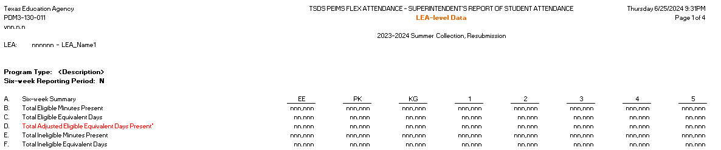
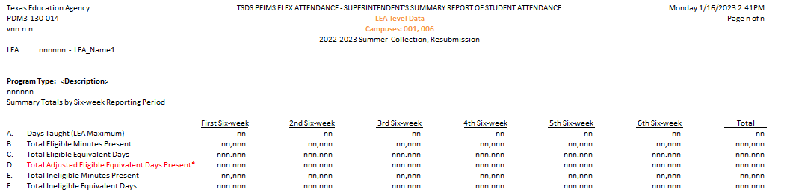
REPORT UPDATES 4

Slide 26
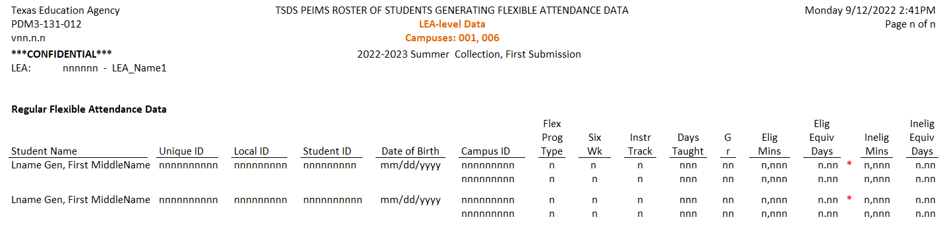
REPORT UPDATES 5
The following PEIMS Summer report will be updated.
  PDM3-131-012 Roster of Students Generating Flexible Attendance Data
    If Elig Eqiv Days is greater than Days Taught, an ‘*’ will be placed to the right of Elig Eqiv Days.
    Adding footnote: ‘Eligible Equivalent Days is greater than Number of Days Taught. LEAs cannot be funded for more than Number of Days Taught in each reporting period.’

Slide 27
REPORT UPDATES 6
The following PEIMS Summer reports will be updated to display the Adjusted Eligible Equivalent Days instead of the Eligible Equivalent Days.
  PDM3-130-012 Flex Attendance - Superintendent's Report of Career & Technical Education Eligible Days
  PDM3-130-015 Flex Attendance - Superintendent's Report of Special Education Eligible Days and Excess Hours

Slide 28
REMINDERS 1
Legislative Update (SB 1615) – Adult HS Charter School Prgm:
  During the 87th legislative session, Senate Bill (SB) 1615 was passed, which amended Chapter 12 of the TEC by adding Subchapter G, “Adult High School Charter School Program.” Additionally, SB 1615 transferred existing TEC sections 29.259(j) and (k) to Subchapter G, Chapter 12, TEC§ 12.263, Adult Education Program Funding. Under Section 12.263, any student attending an adult high school charter school program may be eligible for funding under the state compensatory education (SCE) allotment. The Excel Center (For Adults) is the only charter currently operating under TEC§ 29.259.

Slide 29
REMINDERS 2
Legislative Update (SB 1615) – Adult HS Charter School Prgm:
  Currently, TEA collects a STUDENT-CENSUS-BLOCK-GROUP (E1648) for all economically disadvantaged students enrolled as of the PEIMS Fall snapshot date (last Friday in October) and is reported in the PEIMS Fall Submission to calculate the SCE allotment funding. However, the changes in SB 1615 allow any economically disadvantaged student attending an adult high school charter school program to be included in the calculations for SCE allotment funding regardless of enrollment date. Therefore, for TEA to calculate the appropriate SCE allotment funding, the STUDENT-CENSUS-BLOCK-GROUP (E1648) must be collected for any economically disadvantaged student who attended a charter operating under TEC §29.259 at any time during the school year.

Slide 30
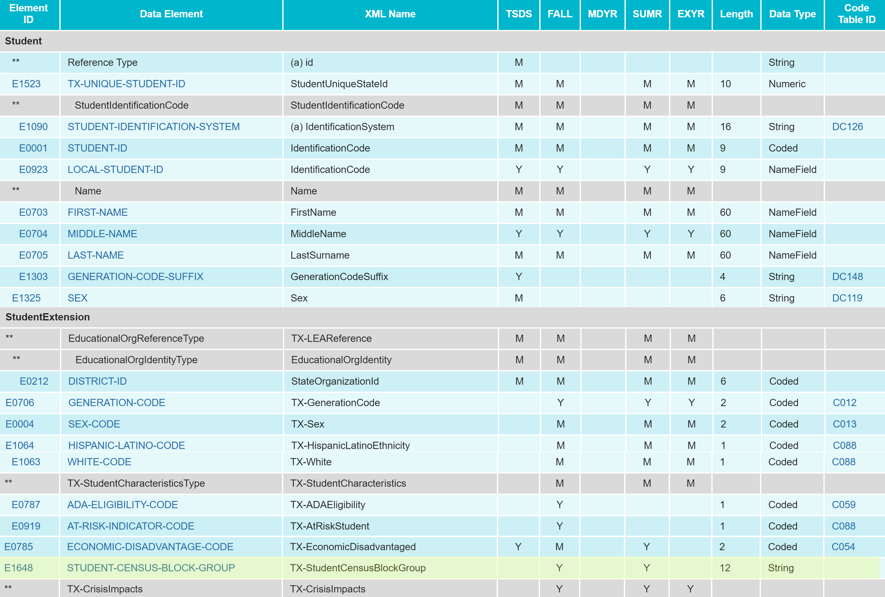
REMINDERS 3
Data Element Updates:
  Added the existing data element STUDENT-CENSUS-BLOCK-GROUP (E1648) to the StudentExtension complex type as optional for the PEIMS Summer Submission:
Notes:
Legislative Update (SB 1615) – Adult HS Charter School Prgm:

Slide 31
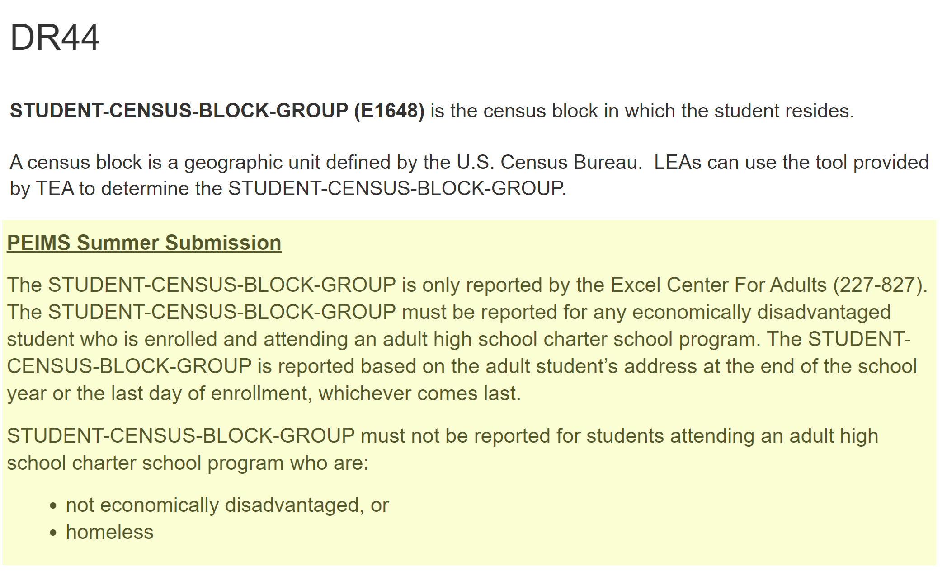
REMINDERS 4
Data Element Updates:
  Updated Data Element Reporting Requirements:
    StudentExtension complex type
Notes:
Legislative Update (SB 1615) – Adult HS Charter School Prgm:

Slide 32
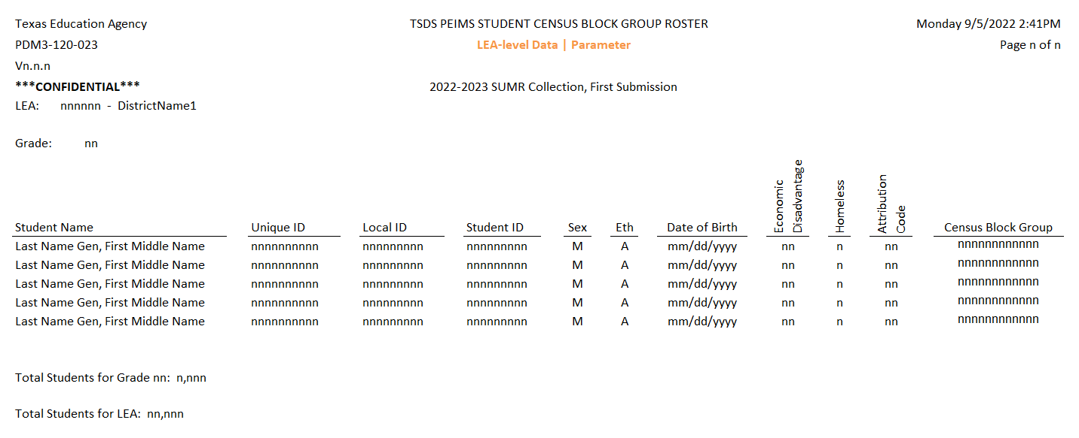
REMINDERS 5
Report Updates:
  A new report has been developed and released for the student census block group data.
    PDM3-120-023 Student Census Block Group Roster
* Updated since Spring 2023 training
Notes:
Legislative Update (SB 1615) – Adult HS Charter School Prgm:

Slide 33
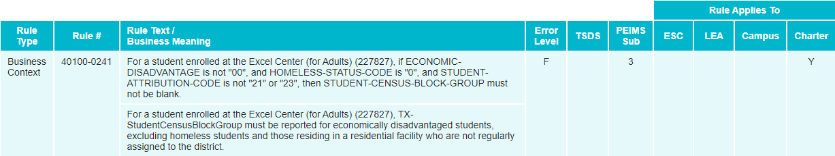
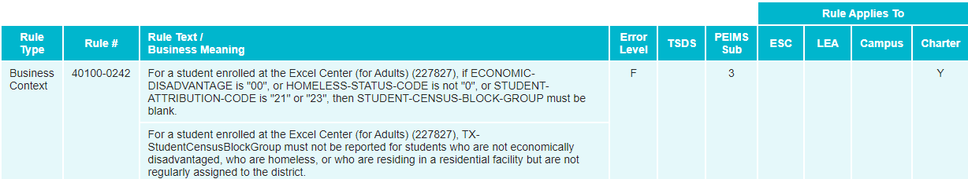
REMINDERS 6
Business Rule Updates:
  Added New Business Rules
Notes:
Legislative Update (SB 1615) – Adult HS Charter School Prgm:

Slide 34
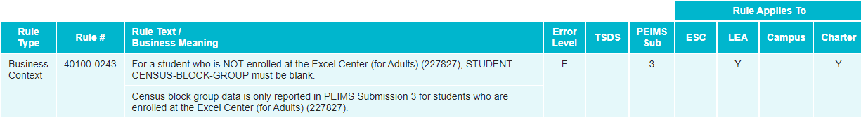
REMINDERS 7
Business Rule Updates:
  Added New Business Rules
Notes:
Legislative Update (SB 1615) – Adult HS Charter School Prgm:

Slide 35
CURRENT KNOWN ISSUES 1
Issue: Based upon LEAs informing TEA of students being reported with incorrect CTE indicators, the CTE team has confirmed several charter school campuses are having their Regional Program of Study Concentrators (Code ‘6’) and Completers (Code ‘7’) incorrectly reverted to an Explorer (Code ‘E’). It is also possible that some students’ data are incorrectly coded as a ‘6’ or ‘7’ and should be an ‘E’, based on the physical location of the school.
This may indicate the “ESC Geographic Region” field, used to determine if a campus is in an approved region, is adopting the charter school authorizer/district “ESC Geographic Region” value, instead of the ESC value, for the physical charter campus location.
Notes:
CTE AUTO-CALCULATION UPDATES

Slide 36
CURRENT KNOWN ISSUES 2
Solution: Affected Charter LEAs will have a Campus-level Geographic Region assigned according to the charter campuses physical address.
Campus-level Geographic Region will be implemented in a TEA application that will pass ESC region to AskTED using the physical street address located in AskTED for the charter campuses.
The new Campus-level Geographic Region will not be visible to the LEA; however, it will be used when TEA processes the auto-calculated CTE indicators after PEIMS Summer First Submission, PEIMS Summer Resubmission, PEIMS Extended Year First Submission and PEIMS Extended Year Resubmission.
Notes:
CTE AUTO-CALCULATION UPDATES

Slide 37
TIMELINE 1
PEIMS Summer Submission ​(Submission 4) | Date​
TSDS PEIMS ready to load data to eDM | August 7, 2023
PEIMS Summer Submission ready for users to promote data​ | February 26, 2024​
TSDS PEIMS Summer ready for users to complete, approve, and accept submissions​ | May 20, 2024​
Requests to retire Unique IDs due at TEA for PEIMS Summer First Submission​ | June 14, 2024​
PEIMS Summer First Submission due date for LEAs​ | June 20, 2024​
Requests to retire Unique IDs due at TEA for PEIMS Summer Resubmission​ | July 12, 2024​
PEIMS Summer Resubmission due date for LEAs​ LEAs registered with TEA with year-round tracks ending later than June 20, 2024 may delay PEIMS Summer Resubmission until two weeks following completion of the latest year-round track or August 15, 2024, whichever comes first. However, the initial data delivery for submission 3 must still be made by June 20, 2024, for all LEAs. In no case will any resubmission be processed after August 15, 2024. Data corrections made after August 15, 2024 will be processed by State Funding.​ | July 18, 2024​

Slide 38
TITLE SLIDE: 2024-2025 School Year
2024-2025
SCHOOL YEAR
NAME OF COMPONENT (ALL CAPS)
MARCH 19-21, 2024

Slide 39
APPLICATION UPDATES
The following PEIMS application functionality will be updated to include new data elements: ​
  Data Search​
  Data Retrieval​
  Data Element Summary

Slide 40
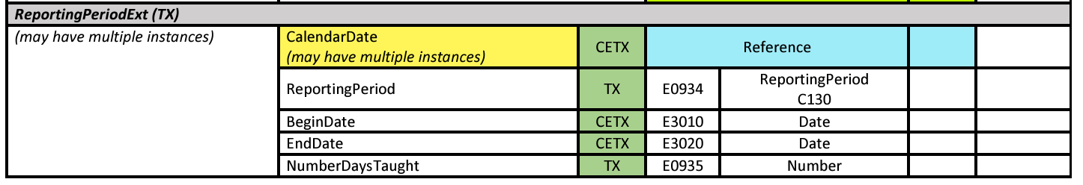
DATA ELEMENT UPDATES
ReportingPeriodExt (TX) entity
  CalendarDate (reference) data element
    may have multiple instances

Slide 41
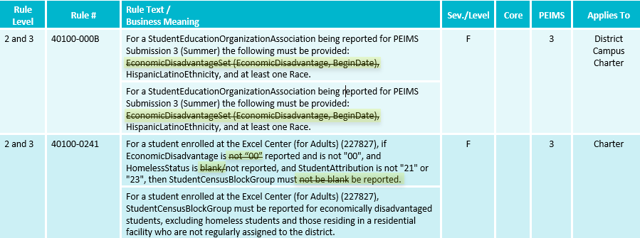
BUSINESS RULE UPDATES 1
Updated Business Rules:

Slide 42
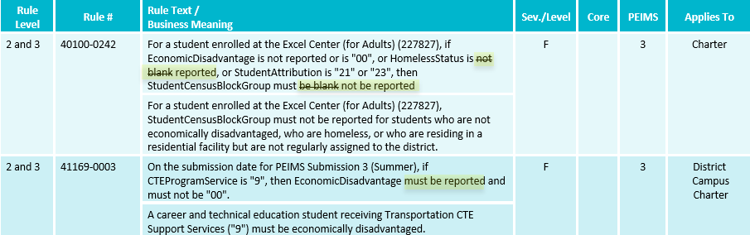
BUSINESS RULE UPDATES 2
Updated Business Rules:

Slide 43
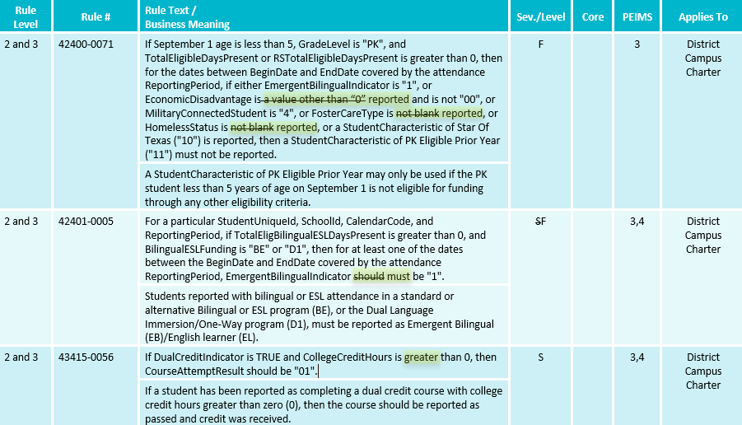
BUSINESS RULE UPDATES 3
Updated Business Rules:

Slide 44
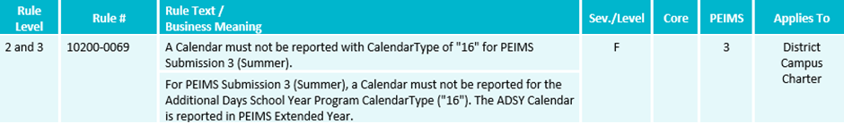
BUSINESS RULE UPDATES 6
New Business Rules:

Slide 45
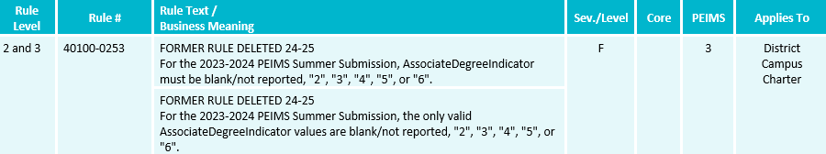
BUSINESS RULE UPDATES 7
Deleted Business Rules:

Slide 46
APPLICATION UPDATES 1
Legislative Update (HB1416) – Accelerated Instruction:
  HB 1416, passed during the 88th legislative session, amends Section 28.0211, Education Code related to accelerated and supplemental instruction for students. Each student that fails to achieve at least satisfactory performance on each assessment instrument administered under Section 39.023, Education Code must be provided supplemental instruction for no less than 15 hours or 30 hours for a student whose performance on the applicable assessment instrument was significantly below satisfactory, as defined by commissioner rule.
  The Texas Tutoring Supports division at the Texas Education Agency (TEA) has requested that local education agencies (LEAs) have a method to transfer the accelerated education plan developed for each student when the student transfers to a new LEA. Additionally, the division has requested that information be reported to TEA to monitor and evaluate the effectiveness of the accelerated instruction provided by each LEA.

Slide 47
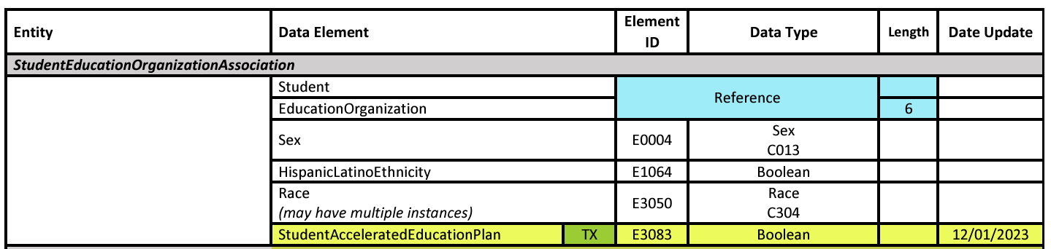
DATA ELEMENT UPDATES 0
Added new data element, E3083 StudentAcceleratedEducationPlan, to the StudentEducationOrganizationAssociation entity in the Student Identification and Demographics domain.
Notes:
Legislative Update (HB1416) – Accelerated Instruction:

Slide 48
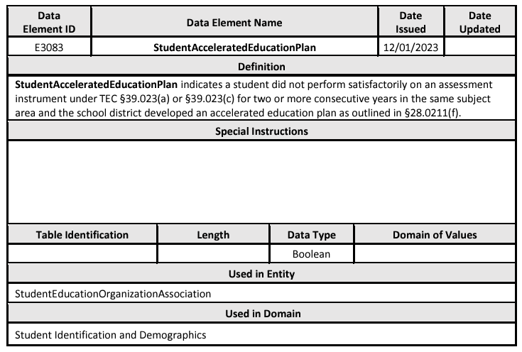
DATA ELEMENT UPDATES 1
Added new data element E3083 StudentAcceleratedEducationPlan.
Notes:
Legislative Update (HB1416) – Accelerated Instruction:

Slide 49
DATA ELEMENT UPDATES 2
Added new common type AcceleratedInstructionSet to the StudentEducationOrganizationAssociation entity in the Student Identification and Demographics domain for the PEIMS Summer Submission that includes the following data elements:
  E3084 AcceleratedInstructionSubject
  E3085 StudentAcceleratedInstructionParticipation
  E3086 AssignedHoursAcceleratedInstruction
  E3087 CompletedHoursAcceleratedInstruction
  E3088 DifferenceReasonHoursAcceleratedInstruction
Notes:
Legislative Update (HB1416) – Accelerated Instruction:

Slide 50
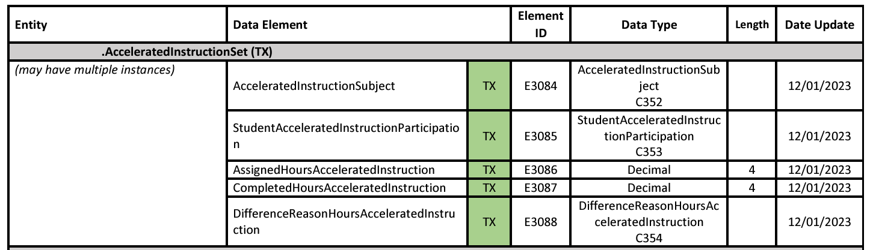
DATA ELEMENT UPDATES 3
New common type AcceleratedInstructionSet.
Notes:
Legislative Update (HB1416) – Accelerated Instruction:

Slide 51
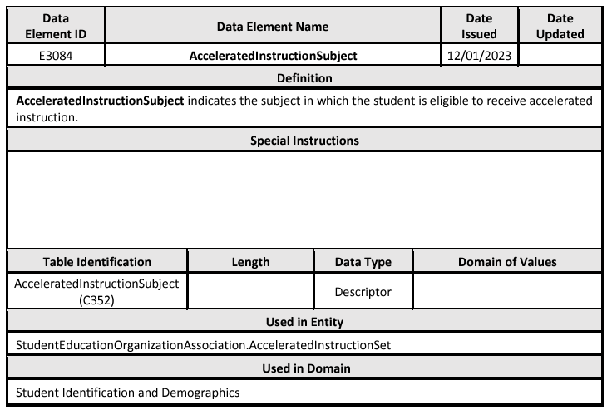
DATA ELEMENT UPDATES 4
Added new data element E3084 AcceleratedInstructionSubject.
Notes:
Legislative Update (HB1416) – Accelerated Instruction:

Slide 52
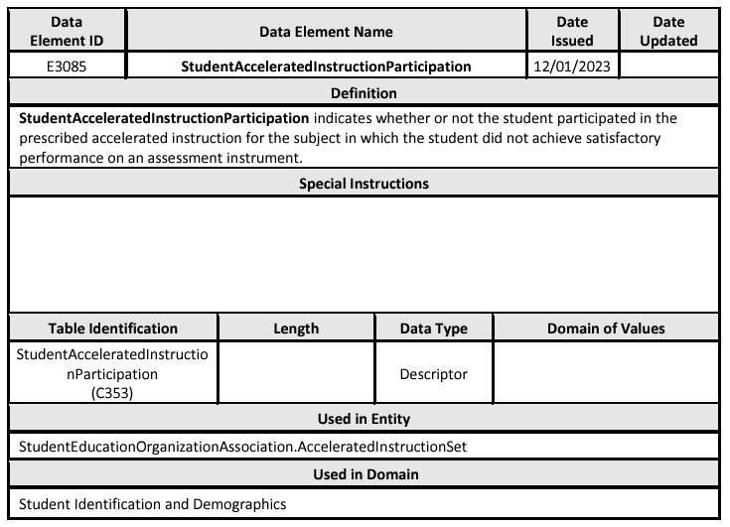
DATA ELEMENT UPDATES 5
Added new data element E3085 StudentAcceleratedInstructionParticipation.
Notes:
Legislative Update (HB1416) – Accelerated Instruction:

Slide 53
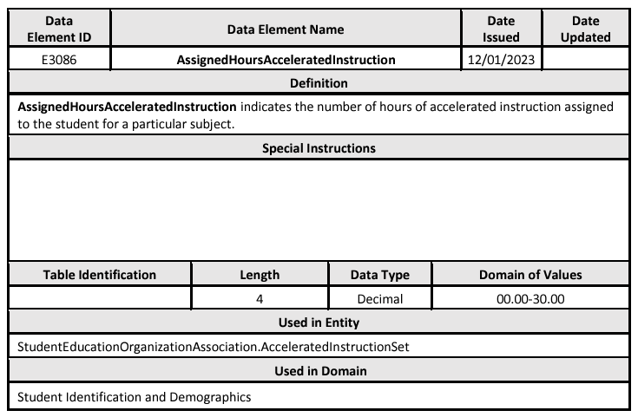
DATA ELEMENT UPDATES 6
Added new data element E3086 AssignedHoursAcceleratedInstruction.
Notes:
Legislative Update (HB1416) – Accelerated Instruction:

Slide 54
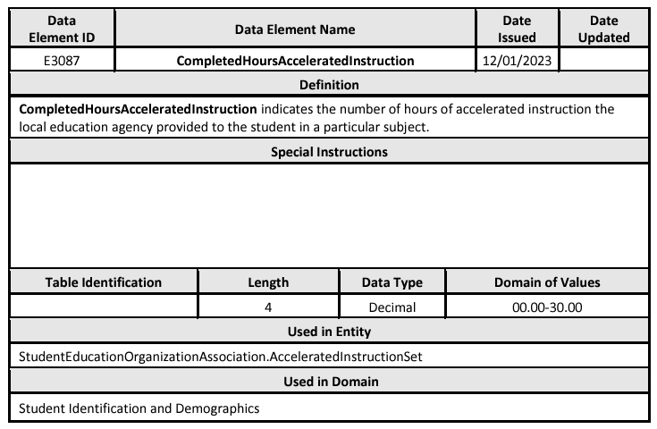
DATA ELEMENT UPDATES 7
Added new data element E3087 CompletedHoursAcceleratedInstruction.
Notes:
Legislative Update (HB1416) – Accelerated Instruction:

Slide 55
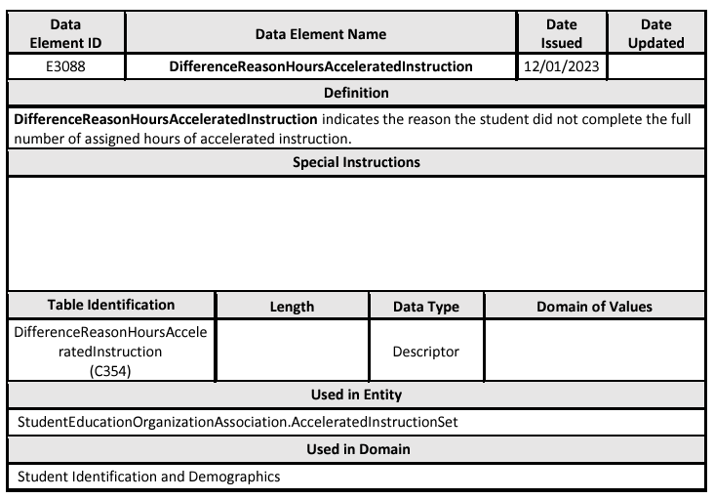
DATA ELEMENT UPDATES 8
Added new data element E3088 DifferenceReasonHoursAcceleratedInstruction.
Notes:
Legislative Update (HB1416) – Accelerated Instruction:

Slide 56
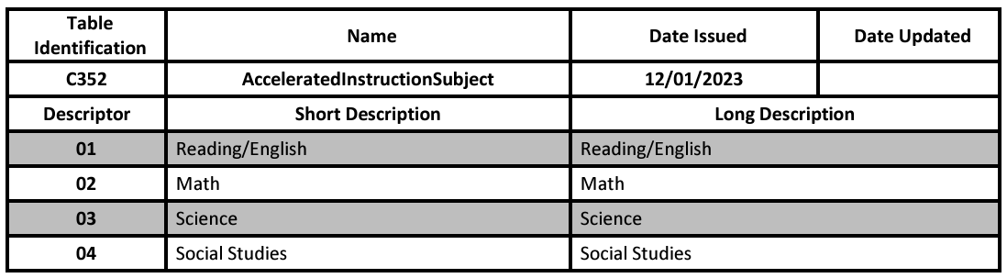
DESCRIPTOR TABLE UPDATES
Added new descriptor table C352 AcceleratedInstructionSubject.
Notes:
Legislative Update (HB1416) – Accelerated Instruction:

Slide 57
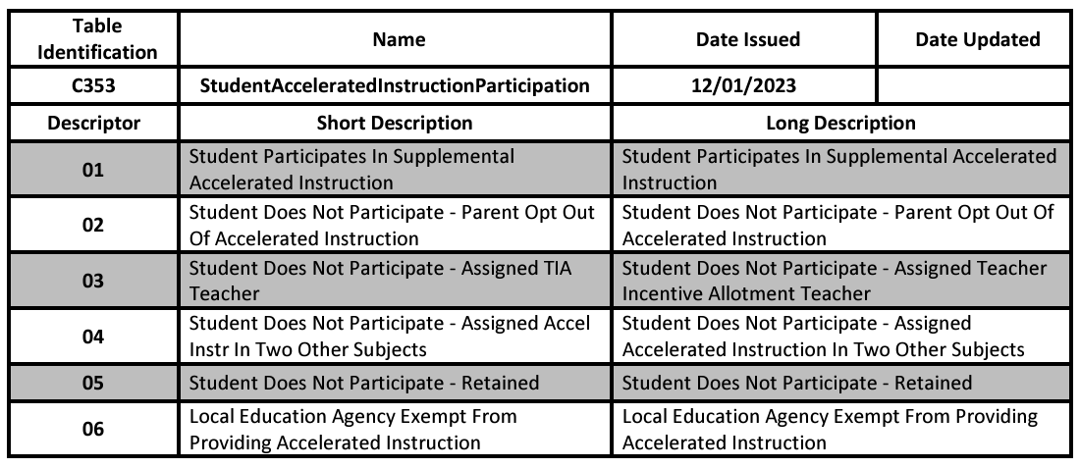
DESCRIPTOR TABLE UPDATES 1
Added new descriptor table C353 StudentAcceleratedInstructionParticipation.
Notes:
Legislative Update (HB1416) – Accelerated Instruction:

Slide 58
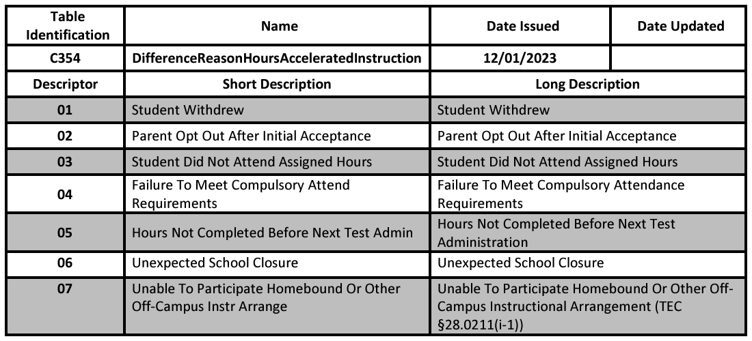
DESCRIPTOR TABLE UPDATES 2
Added new descriptor table C354 DifferenceReasonHoursAcceleratedInstruction.
Notes:
Legislative Update (HB1416) – Accelerated Instruction:

Slide 59
REPORT UPDATES
Two new reports will be added to the PEIMS Summer Submission.
  One student level, roster style report.
  One campus, summary style report.
Notes:
Legislative Update (HB1416) – Accelerated Instruction:

Slide 60
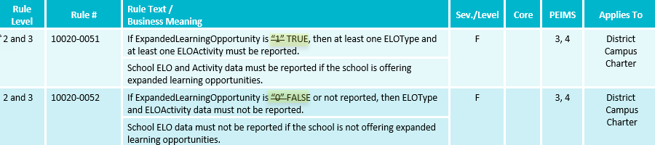
BUSINESS RULE UPDATES
Updated Business Rules:

Slide 61
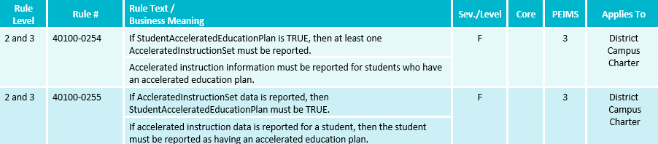
BUSINESS RULE UPDATES 4
New Business Rules:

Slide 62
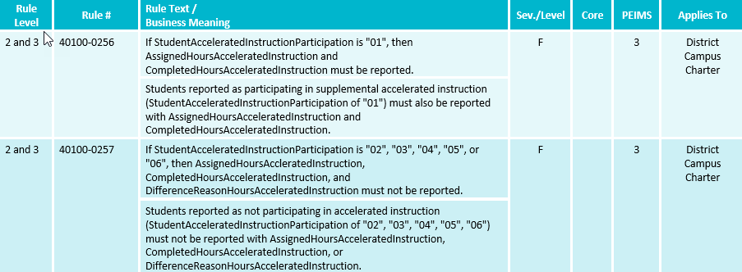
BUSINESS RULE UPDATES 5
New Business Rules:

Slide 63
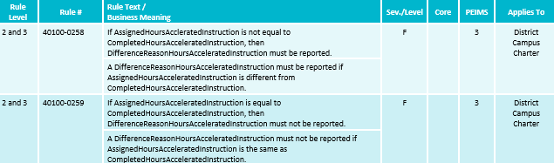
BUSINESS RULE UPDATES 11
Added new business rules:
Notes:
Legislative Update (HB1416) – Accelerated Instruction:

Slide 64
APPLICATION UPDATES 3
Legislative Update (HB 2209) – Rural Pathway Excellence Partnership
  HB 2209, passed during the 88th Legislative Regular Session, added Texas Education Code Section 29.912 for the Rural Pathway Excellence Partnership (R-PEP). This partnership allows rural school districts to enter into agreements with other districts to develop rural college and career pathway partnerships. The funding for the program comes from the Foundation School Program. The program area has requested a student-level indicator to determine which students participate in the R-PEP program. The indicator will be used to calculate the ADA allotment funding.
  During the October 17, 2023, ITF meeting, the committee approved a student level-indicator to indicate the students who participate in a Rural Pathway Excellence Partnership (R-PEP) program as outlined by HB 2209, passed during the 88th Legislative Regular Session. Since then, the program area has requested an additional data element be added to track the hours a student participates in the R-PEP program.
Notes:
Overview

Slide 65
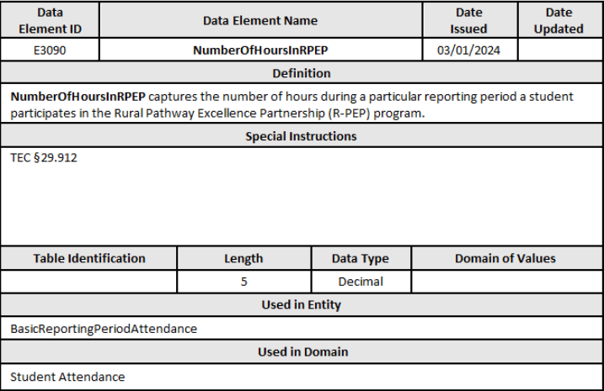
DATA ELEMENT UPDATES 9
Added new data element E3090 NumberOfHoursInRPEP.
Notes:
RURAL PATHWAY EXCELLENCE PARTNERSHIP

Slide 66
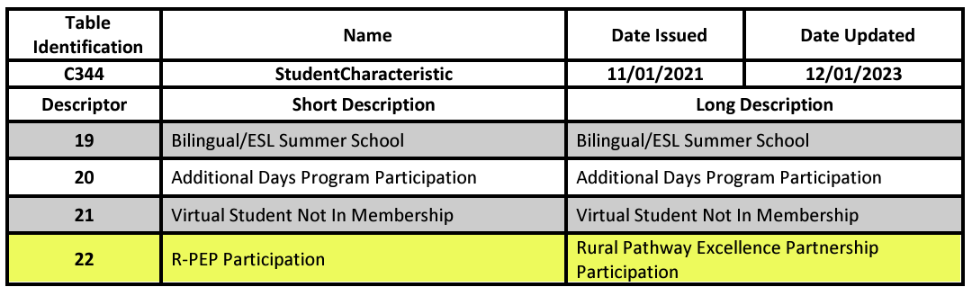
DESCRIPTOR TABLE UPDATES 3
Added new descriptor to the (C344) StudentCharacteristic descriptor table.
The Rural Pathway Excellence Partnership Participation student characteristic indicates the student participated in the Rural Pathway Excellence Partnership program.
Notes:
RURAL PATHWAY EXCELLENCE PARTNERSHIP

Slide 67
REPORT UPDATES 26
PEIMS Summer Reports will be analyzed to determine changes needed for the 2024-2025 school year for the new Rural Pathways Data Elements.
Notes:
RURAL PATHWAY EXCELLENCE PARTNERSHIP

Slide 68
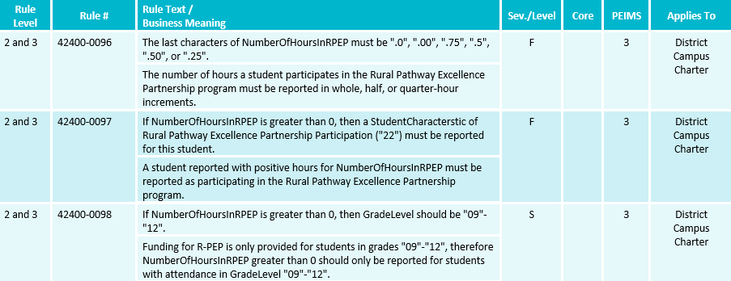
BUSINESS RULE UPDATES 12
Added new business rules:
Notes:
RURAL PATHWAY EXCELLENCE PARTNERSHIP

Slide 69
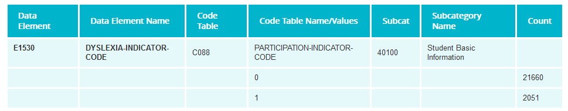
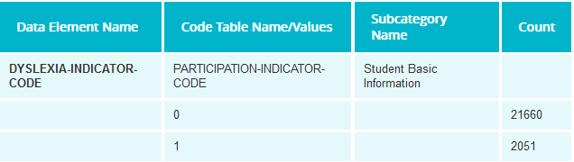
TSDS UPGRADE PROJECT UPDATES
Data Element Summary (PEIMS application function)
  Removing the column Data Element.
  Removing the column Code Table.
  Removing the column Subcat.
Before
After

Slide 70
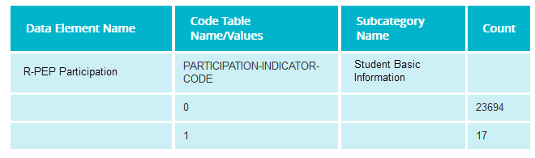
TSDS UPGRADE PROJECT UPDATES 1
Data Element Summary (PEIMS application function)
  New Data Elements & Descriptors will use new format
    Ex: New StudentCharacteristic – 22 (R-PEP Participation)

Slide 71
TSDS UPGRADE PROJECT UPDATES 2
Data Element Length Changes:
  CalendarCode
    Length changing from 2 to 60 characters.
  SectionIdentifier
    Length changing from 14 to 255 characters.
  IncidentIdentifier
    Length changing from 6 to 20 characters.

Slide 72
TSDS UPGRADE PROJECT UPDATES 3
Descriptor Table Changes:
  ‘0’ values being removed from descriptor tables
    ChildCountFunding
    Disability
    EmergentBilingualIndicator
    FosterCareType
    HomelessStatus
    MilitaryConnectedStudent
    PKProgramType
    TitleIPartAParticipant
    UnschooledAsyleeRefugee
    StudentAttribution
    RegionalDaySchoolProgramForDeaf
    PPCDServiceLocation
    CTEProgramService

Slide 73
TSDS UPGRADE PROJECT UPDATES 4
Data Element ID | XML Data Element Name | Upgrade Data Element Name
E1006 | DISCIPLINARY-ACTION-REASON-CODE | Behavior
E0975 | INSTRUCTIONAL-TRACK-INDICATOR-CODE | CalendarCode
E1582 | SCHOOL-DAY-EVENT-CODE | CalendarEvent
E1600 | INSTRUCTIONAL-PROGRAM-TYPE | CalendarType
E0949 | PASS/FAIL-CREDIT-INDICATOR-CODE | CourseAttemptResult
E3012 (was E1039) | OUT-OF-WORKFORCE-INDIVIDUAL | CTEProgramService
E3012 (was E0917) | TRANSPORTATION-CTE-SUPPORT-SERVICE | CTEProgramService
E3012 (was E0829) | SGL-PARENT-SGL-PREG-WOMAN-CODE | CTEProgramService
E1168 | CALENDAR-DATE | Date
E3015 (was E0041) | PRIMARY-DISABILITY-CODE | Disability
E1016 | DISCIPLINE-INCIDENT-NUMBER | IncidentIdentifier
E1083 | BEHAVIOR-LOCATION-CODE | IncidentLocation
E0173 | INSTRUCTIONAL-SETTING-CODE | InstructionalSetting
E1056 | CLASS-ID-NUMBER | SectionIdentifier
E3010 | N/A | BeginDate
E3020 | N/A | EndDate
Notes:
Data Element Name Changes:

Slide 74
TSDS UPGRADE PROJECT UPDATES 6
Report Updates:
  All applicable reports will be updated for the following changes below:
    Descriptor values of ‘0’ removed.
    CalendarCode
      Length changing from 2 to 60 characters
    SectionIdentifier
      Length changing from 14 to 255 characters
    IncidentIdentifier
      Length changing from 6 to 20 characters.
  TEA is currently analyzing other potential report impacts and will provide more information in the upcoming TSDS Summer Training.
  TEA is actively working to update impacted reports by the start of the 2024-2025 school year.

Slide 75
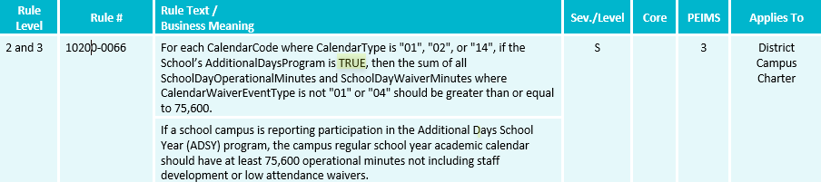
TSDS UPGRADE PROJECT UPDATES 7
Business Rule Changes:
  AdditionalDaysProgram must be ‘TRUE’ (Boolean).
    Boolean true or false versus a code of 1 or 0

Slide 76
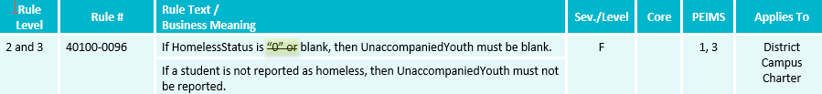
TSDS UPGRADE PROJECT UPDATES 8
Business Rule Changes:
  No longer using ‘0’ codes for HomelessStatus or UnaccompaniedYouth

Slide 77
TSDS UPGRADE PROJECT UPDATES 9
Promotion Logic Guide & Test Cases Coming Soon!
  More details will be provided in the TSDS Summer Training.

Slide 78
TITLE SLIDE: Closeout
CLOSEOUT
NAME OF COMPONENT (ALL CAPS)
MARCH 19-21, 2024

Slide 79
TIMELINE
PEIMS Summer Submission (Submission 3) | Date
TSDS PEIMS ready to load data to IODS | August 5, 2024
TSDS PEIMS ready for users to complete, approve, and accept submissions | May 19, 2025
Requests to retire Unique IDs due at TEA for PEIMS Summer First Submission | June 13, 2025
PEIMS Summer First Submission due date for LEAs | June 19, 2025
Requests to retire Unique IDs due at TEA for PEIMS Summer Resubmission | July 11, 2025
PEIMS Summer Resubmission due date for LEAs | July 17, 2025
LEAs registered with TEA with year-round tracks ending later than June 19, 2025, may delay PEIMS Summer Resubmission until two weeks following completion of the latest year-round track or August 21, 2025, whichever comes first.
However, the initial data delivery for Submission 3 must still be made by June 19, 2025, for all LEAs.
In no case will any Resubmission be processed after August 21, 2025. Data corrections made after August 21, 2025, will be processed by State Funding.
PEIMS Summer data available to customers | September 18, 2025

Slide 80
TECHNICAL RESOURCES
Technical Support
  TSDSCustomerSupport@tea.texas.gov
Technical Specification
  2023-2024 TSDS Web-Enabled Data Standards (TWEDS)
  2024-2025 Domains
  2024-2025 Data Element Definitions
  2024-2025 Descriptor Tables
  2024-2025 Data Validation Rules
  2024-2025 Data Submission Timelines
  Known Issues
TSDS Incident Management System (TIMS)
  TSDS Incident Management System (TIMS) Support Application
  TIMS Knowledge Base Article Repository

Slide 81

QUESTIONS
QUESTIONS?

