Slide 1

TITLE SLIDE: ESC Vendor Training for One Component
PEIMS SUMMER
July 30-31, 2024 and August 1, 2024

Slide 2

AGENDA – PEIMS SUMMER
PROGRAM AREA
2024-2025 SCHOOL YEAR
  Data Governance Updates
  Data Element Updates
  Descriptor Table Updates
  Report Updates
  Business Rule Updates
  TSDS Upgrade Project Updates
  Current Known Issues
CLOSEOUT
  Timeline
  Technical Resources
  Questions

Slide 3
PROGRAM AREA UPDATES & GUIDANCE
District Innovation and School Models Division
  Christopher DeWitt, Director of District Innovation and School Models
    christopher.dewitt@tea.texas.gov
Texas Tutoring Supports Division
  Colby Self, Director of Texas Tutoring Supports
    colby.self@tea.texas.gov
Department of Authorizing & Policy
  Marian Schutte, Deputy Associate Commissioner
    marian.schutte@tea.texas.gov

Slide 4

TITLE SLIDE: 2024-2025 School Year
2024-2025
SCHOOL YEAR
NAME OF COMPONENT (ALL CAPS)
MARCH 19-21, 2024

Slide 5
DATA GOVERNANCE UPDATES1
Legislative Update (HB1416) – Accelerated Instruction:
  HB 1416, passed during the 88th legislative session, amends Section 28.0211, Education Code related to accelerated and supplemental instruction for students. Each student that fails to achieve at least satisfactory performance on each assessment instrument administered under Section 39.023, Education Code must be provided supplemental instruction for no less than 15 hours or 30 hours for a student whose performance on the applicable assessment instrument was significantly below satisfactory, as defined by commissioner rule.
  The Texas Tutoring Supports division at the Texas Education Agency (TEA) has requested that local education agencies (LEAs) have a method to transfer the accelerated education plan developed for each student when the student transfers to a new LEA. Additionally, the division has requested that information be reported to TEA to monitor and evaluate the effectiveness of the accelerated instruction provided by each LEA.

Slide 6
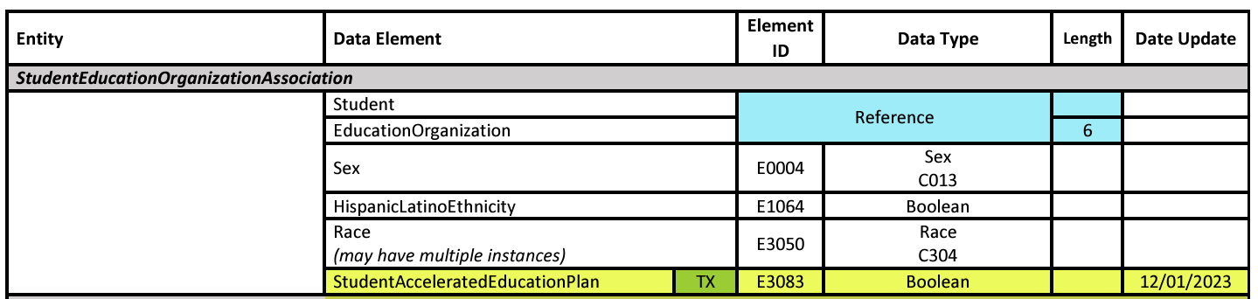
DATA ELEMENT UPDATES 0
Added new data element, E3083 StudentAcceleratedEducationPlan, to the StudentEducationOrganizationAssociation entity in the Student Identification and Demographics domain.

Slide 7
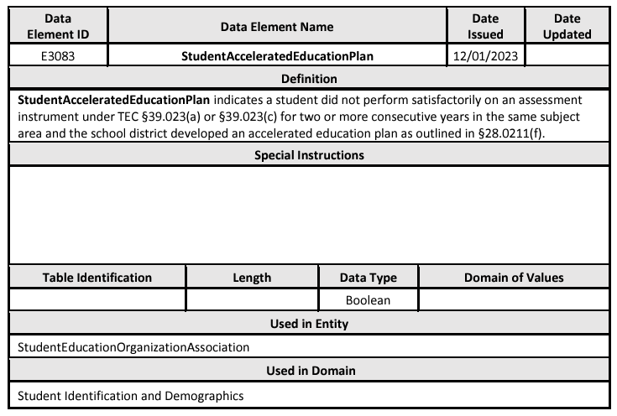
DATA ELEMENT UPDATES 1
Added new data element E3083 StudentAcceleratedEducationPlan.

Slide 8
DATA ELEMENT UPDATES 2
Added new common type AcceleratedInstructionSet to the StudentEducationOrganizationAssociation entity in the Student Identification and Demographics domain for the PEIMS Summer Submission that includes the following data elements:
  E3084 AcceleratedInstructionSubject
  E3085 StudentAcceleratedInstructionParticipation
  E3086 AssignedHoursAcceleratedInstruction
  E3087 CompletedHoursAcceleratedInstruction
  E3088 DifferenceReasonHoursAcceleratedInstruction

Slide 9
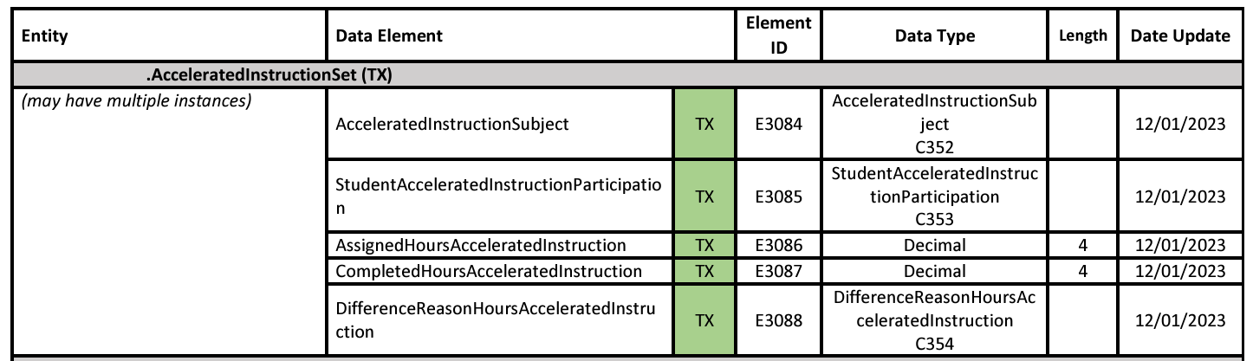
DATA ELEMENT UPDATES 3
New common type AcceleratedInstructionSet.

Slide 10
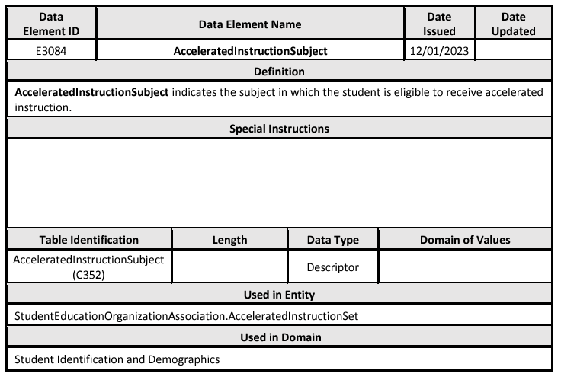
DATA ELEMENT UPDATES 4
Added new data element E3084 AcceleratedInstructionSubject.

Slide 11
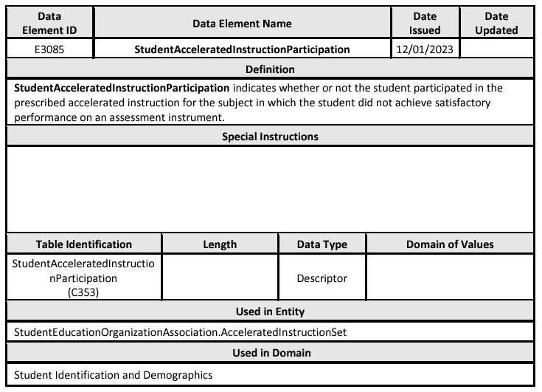
DATA ELEMENT UPDATES 5
Added new data element E3085 StudentAcceleratedInstructionParticipation.

Slide 12
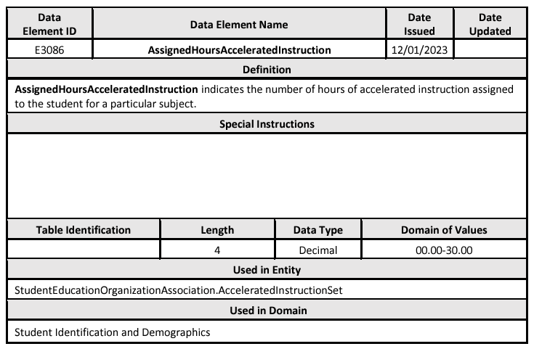
DATA ELEMENT UPDATES 6
Added new data element E3086 AssignedHoursAcceleratedInstruction.

Slide 13
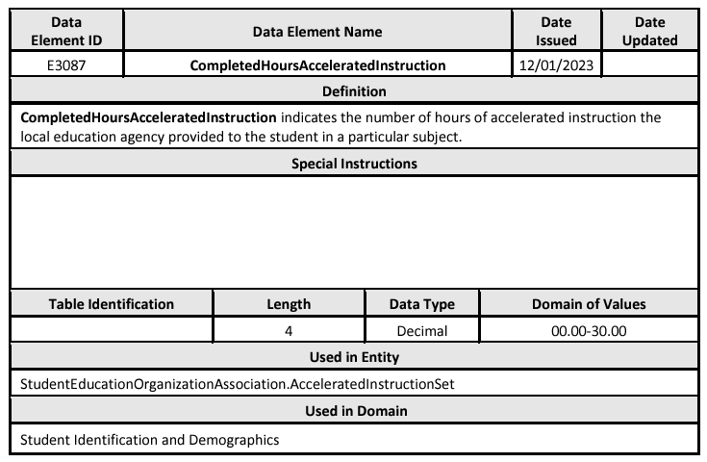
DATA ELEMENT UPDATES 7
Added new data element E3087 CompletedHoursAcceleratedInstruction.

Slide 14
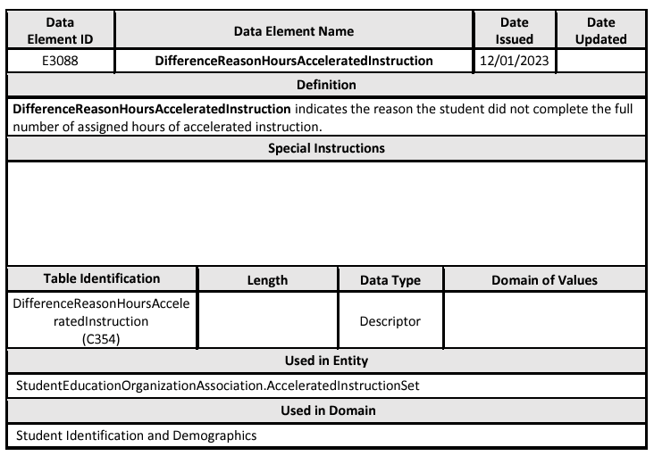
DATA ELEMENT UPDATES 8
Added new data element E3088 DifferenceReasonHoursAcceleratedInstruction.

Slide 15
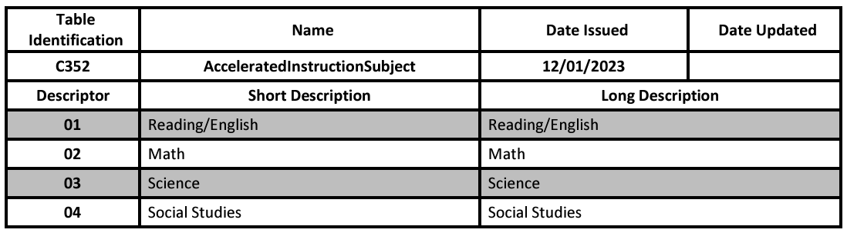
DESCRIPTOR TABLE UPDATES
Added new descriptor table C352 AcceleratedInstructionSubject.

Slide 16
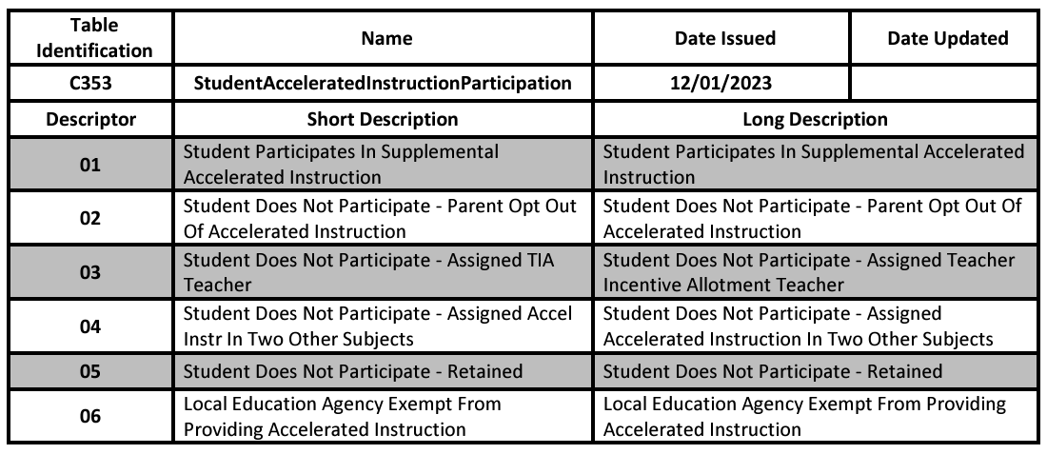
DESCRIPTOR TABLE UPDATES 1
Added new descriptor table C353 StudentAcceleratedInstructionParticipation.

Slide 17
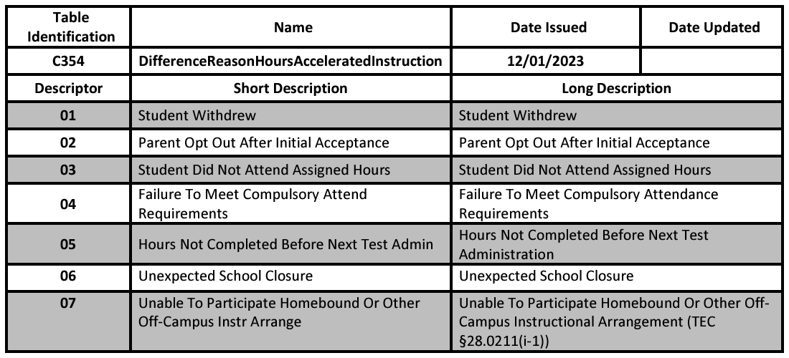
DESCRIPTOR TABLE UPDATES 2
Added new descriptor table C354 DifferenceReasonHoursAcceleratedInstruction.

Slide 18
REPORT UPDATES
Two new reports will be added to the PEIMS Summer Submission.
  One student level, roster style report.
  One campus, summary style report.

Slide 19
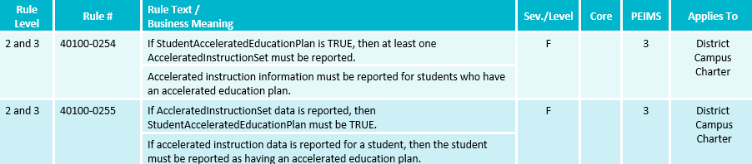
BUSINESS RULE UPDATES 4
New Business Rules:

Slide 20
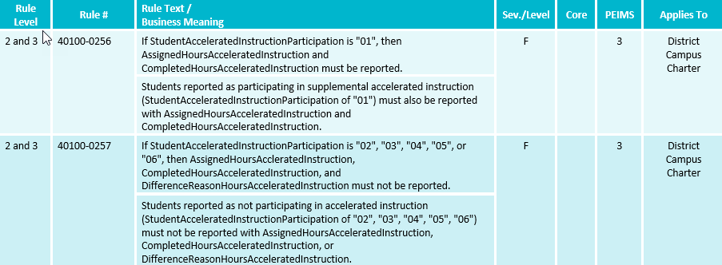
BUSINESS RULE UPDATES 5
New Business Rules:

Slide 21
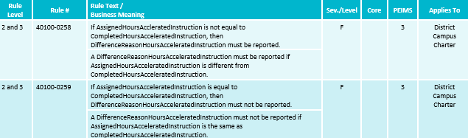
BUSINESS RULE UPDATES 11
New Business rules:

Slide 22
DATA GOVERNANCE UPDATES 13
Legislative Update (HB 2209) – Rural Pathway Excellence Partnership
  HB 2209, passed during the 88th Legislative Regular Session, added Texas Education Code Section 29.912 for the Rural Pathway Excellence Partnership (R-PEP). This partnership allows rural school districts to enter into agreements with other districts to develop rural college and career pathway partnerships. The funding for the program comes from the Foundation School Program. The program area has requested a student-level indicator to determine which students participate in the R-PEP program. The indicator will be used to calculate the ADA allotment funding.
  During the October 17, 2023, ITF meeting, the committee approved a student level-indicator to indicate the students who participate in a Rural Pathway Excellence Partnership (R-PEP) program as outlined by HB 2209, passed during the 88th Legislative Regular Session. Since then, the program area has requested an additional data element be added to track the hours a student participates in the R-PEP program.

Slide 23
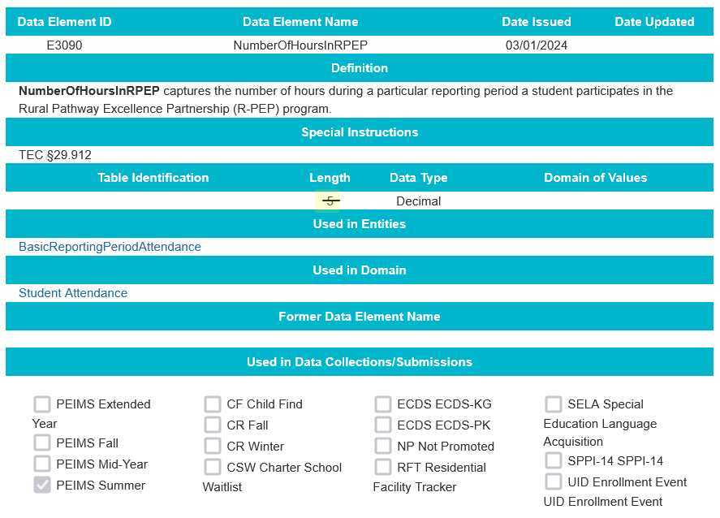
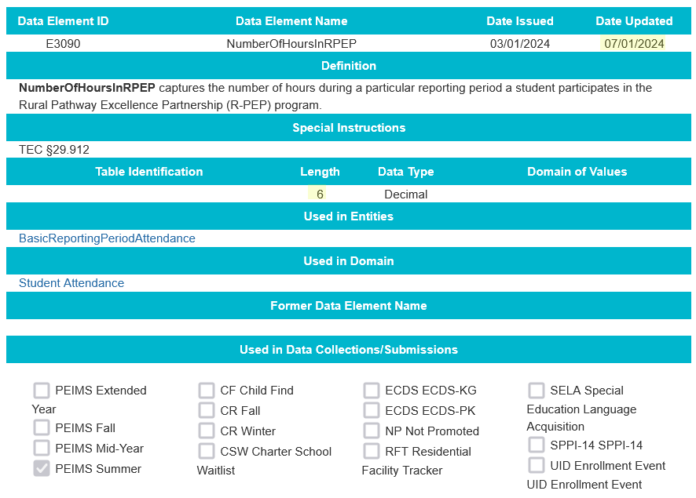
DATA ELEMENT UPDATES 9
Added new data element E3090 NumberOfHoursInRPEP.
  NEW Revised length from 5 to 6.

Slide 24
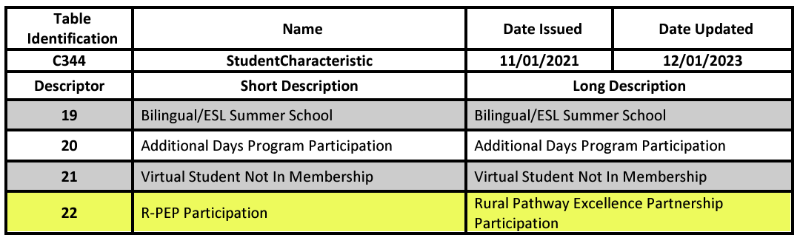
DESCRIPTOR TABLE UPDATES 3
Added new descriptor to the (C344) StudentCharacteristic descriptor table.
The Rural Pathway Excellence Partnership Participation student characteristic indicates the student participated in the Rural Pathway Excellence Partnership program.

Slide 25
REPORT UPDATES 26
Two new reports will be added to the 2024-2025 PEIMS Summer Submission.
  One student level, roster style report.
  One campus, summary style report.

Slide 26
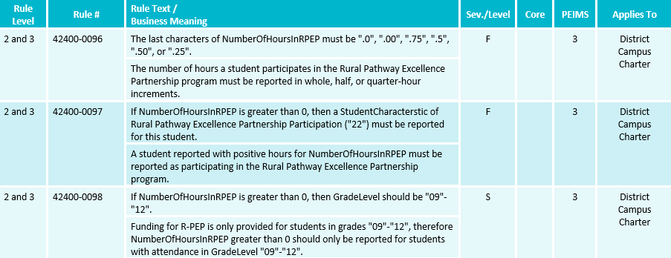
BUSINESS RULE UPDATES 12
New Business rules:

Slide 27
DATA GOVERNANCE UPDATES 2
NEW Legislative Update (SB 1647) – Dropout Recovery Education Program
  SB 1647, passed during the 88th Legislative Regular Session, amended Texas Education Code Section 29.081 for dropout recovery education programs. A school district or open-enrollment charter school may use a private or public community-based dropout recovery education program or education management organization to provide alternative education programs for students at risk of dropping out of school. The program may be offered in person at a campus, remotely, or through a hybrid of in-person and remote instruction. A student who successfully completes a course offered through a dropout recovery program will be included in the district’s or school’s average daily attendance for funding purposes. Students participating in the dropout recovery program can be reported with regular attendance or optional flexible school day program attendance, depending on the program offered by the district or open-enrollment charter school.

Slide 28
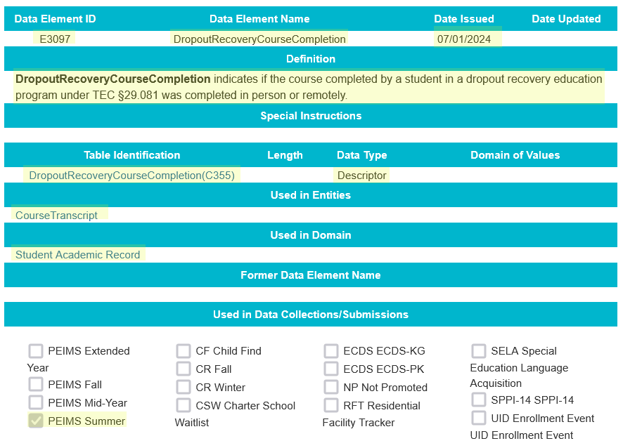
DATA ELEMENT UPDATES 91
NEW Added new data element E3097 DropoutRecoveryCourseCompletion.

Slide 29
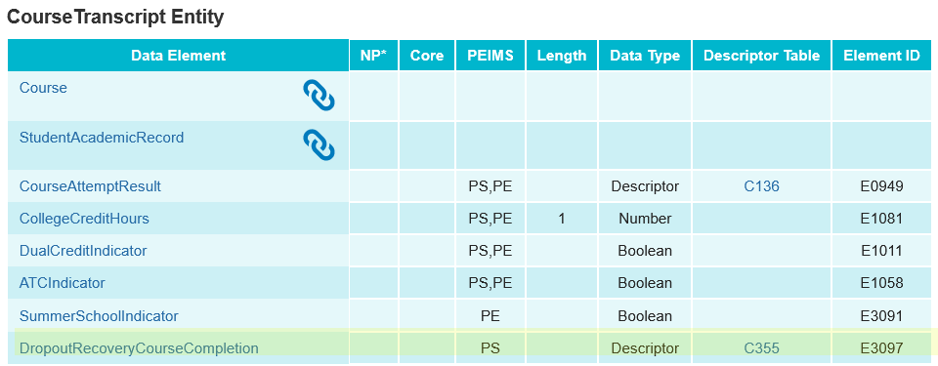
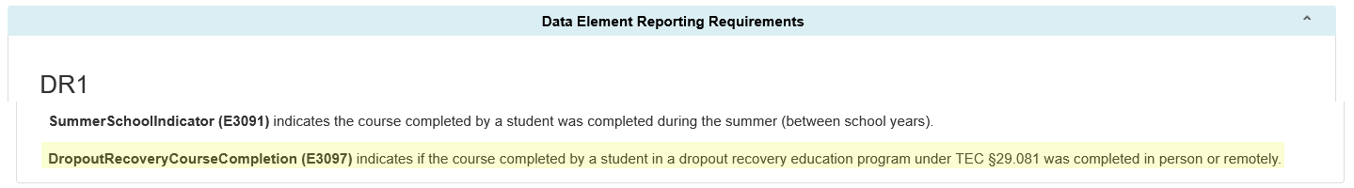
DATA ELEMENT UPDATES 92
NEW Added new data element E3097 DropoutRecoveryCourseCompletion and associated guidance to the CourseTranscript entity in the Student Academic Record Domain to be reported as optional in the PEIMS Summer Submission.

Slide 30
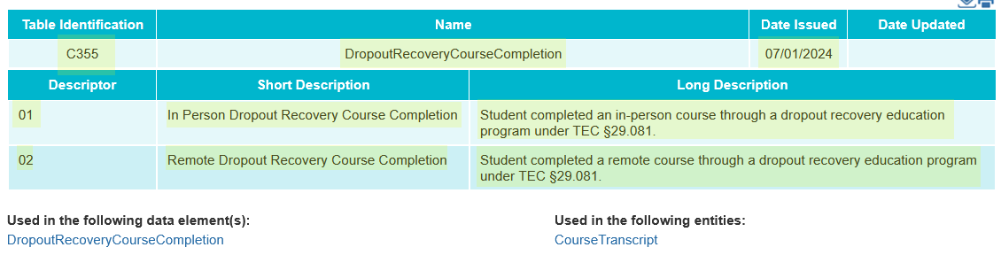
DESCRIPTOR TABLE UPDATES 33
NEW Added new descriptor table DropoutRecoveryCourseCompletion (C355).

Slide 31
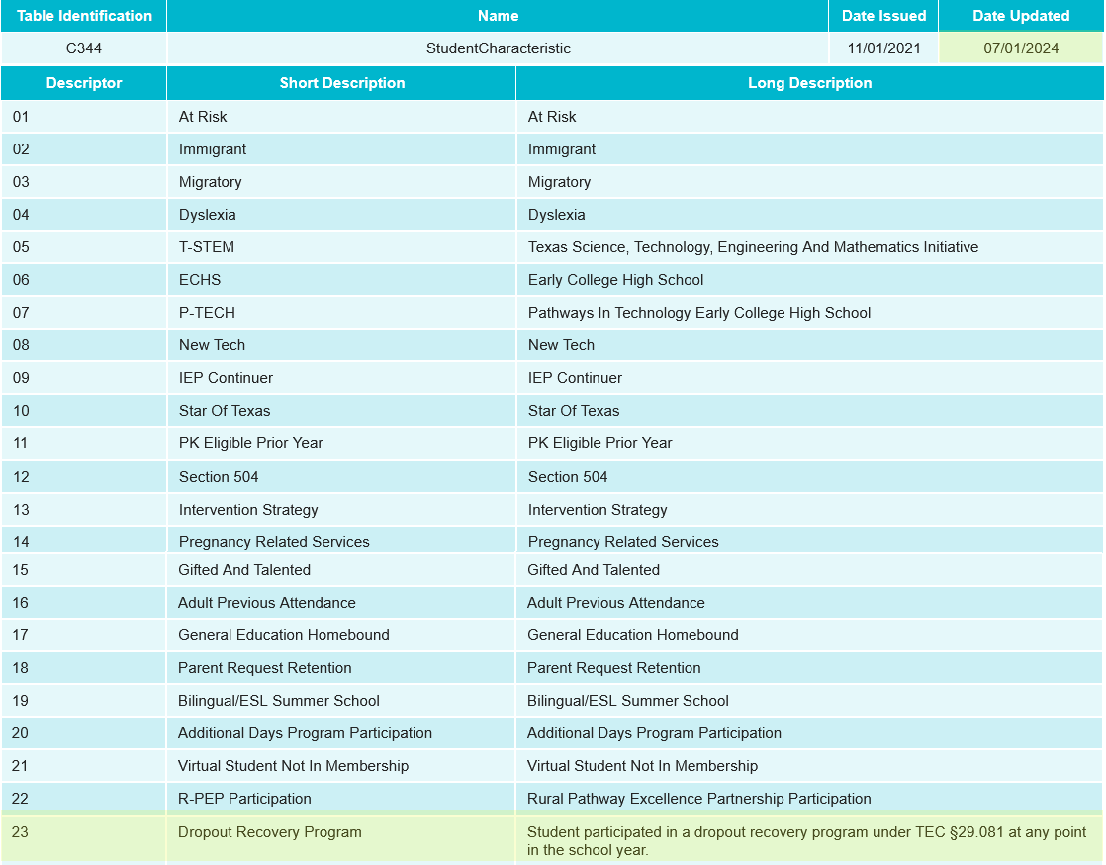
DESCRIPTOR TABLE UPDATES 34
NEW Added new descriptor to the (C344) StudentCharacteristic descriptor table.
The Dropout Recovery Program student characteristic identifies a student who participated in a dropout recovery program under TEC §29.081 at any point in the school year.

Slide 32
REPORT UPDATES 265
NEW PEIMS Summer reports will be analyzed to determine changes needed for the 2024-2025 school year for the new DropoutRecoveryCourseCompletion data element as well as the Dropout Recovery Program student characteristic.

Slide 33
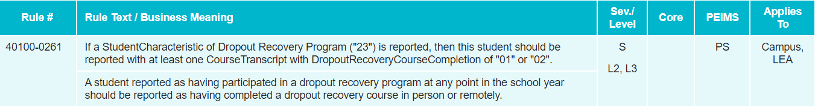
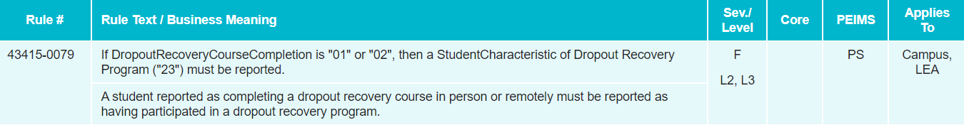
BUSINESS RULE UPDATES 126
NEW New Business rules:

Slide 34
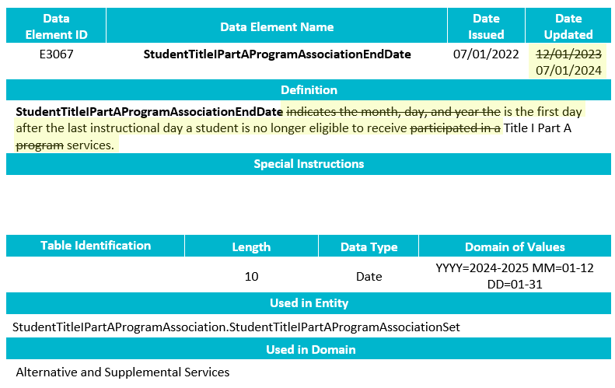
TSDS UPGRADE PROJECT UPDATES
NEW Data Element Change:
  E3067 StudentTitleIPartAProgramAssociationEndDate
    Revised the definition.

Slide 35
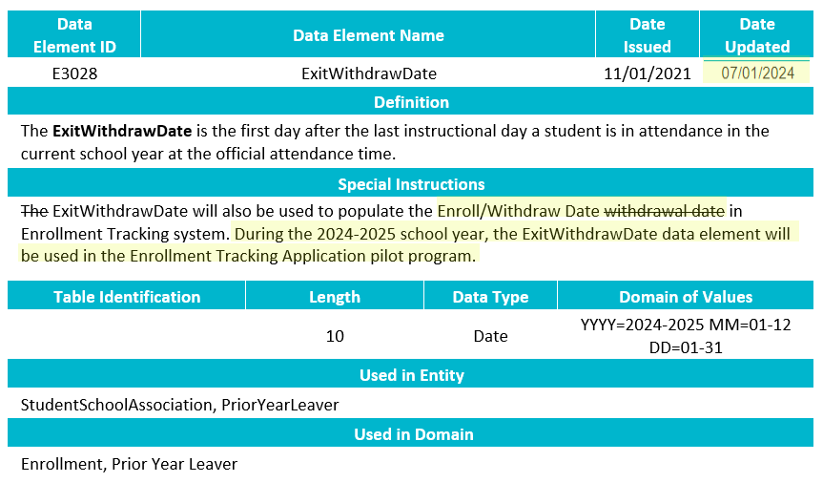
TSDS UPGRADE PROJECT UPDATES 8
NEW Data Element Change:
  E3028 ExitWithdrawDate
    Revised the special instructions.

Slide 36
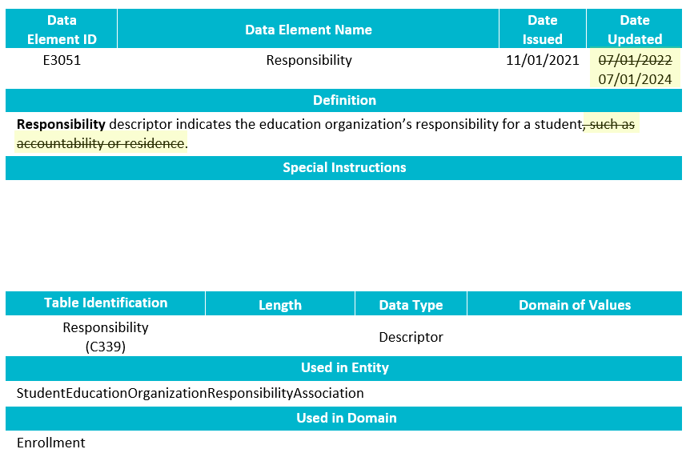
TSDS UPGRADE PROJECT UPDATES 87
NEW Data Element Change:
  E3051 Responsibility
    Revised the definition.

Slide 37
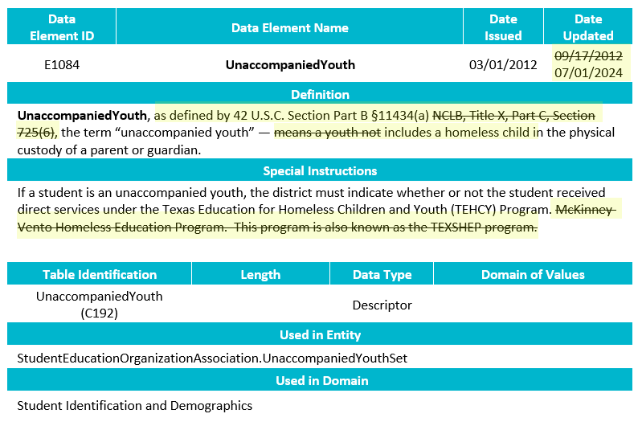
TSDS UPGRADE PROJECT UPDATES 88
NEW Data Element Change:
  E1084 UnaccompaniedYouth
    Revised the definition and special instructions.

Slide 38
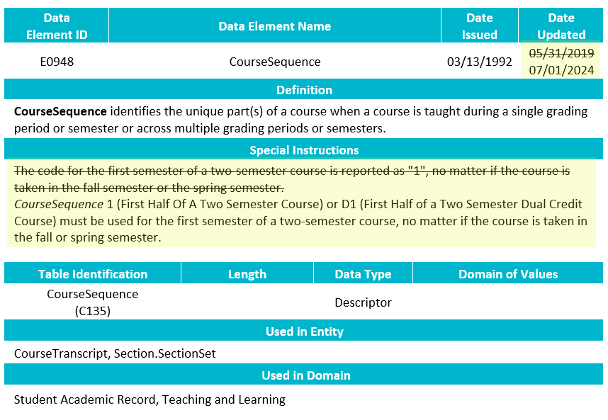
TSDS UPGRADE PROJECT UPDATES 89
NEW Data Element Change:
  E0948 CourseSequence
    Revised the special instructions.

Slide 39
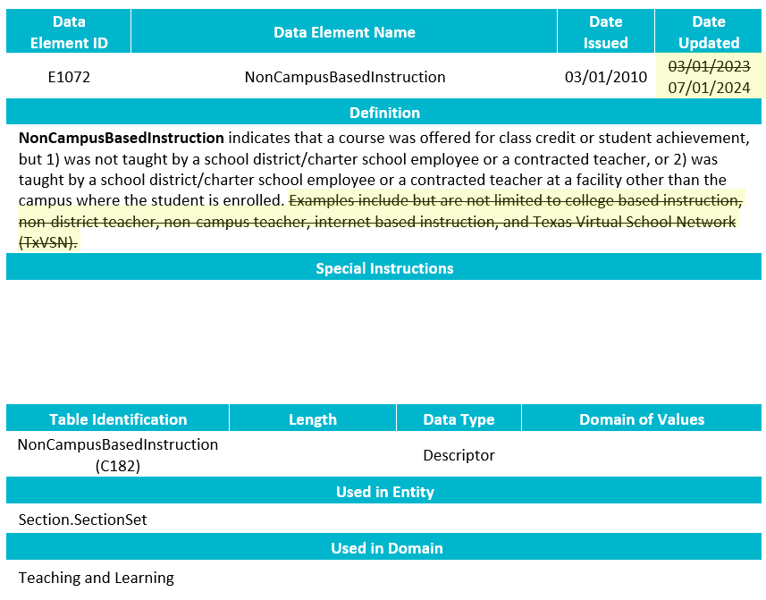
TSDS UPGRADE PROJECT UPDATES 810
NEW Data Element Change:
  E1072 NonCampusBasedInstruction
    Revised the definition.

Slide 40
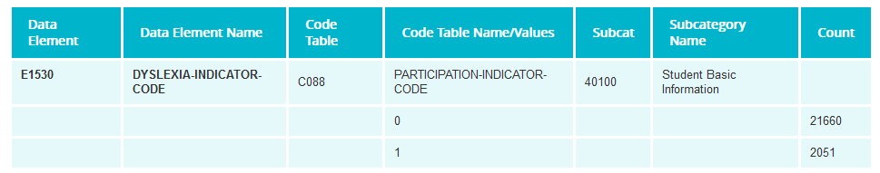
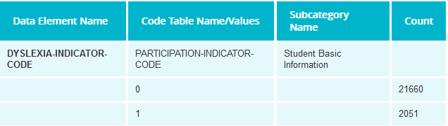
TSDS UPGRADE PROJECT UPDATES 12
Data Element Summary (PEIMS application function)
  Removing the column Data Element.
  Removing the column Code Table.
  Removing the column Subcat.
Before
After

Slide 41
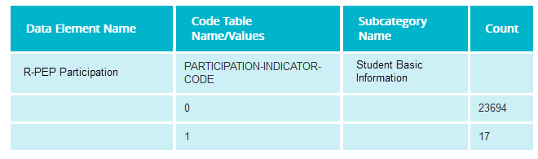
TSDS UPGRADE PROJECT UPDATES 1
Data Element Summary (PEIMS application function)
  New Data Elements & Descriptors will use new format
    Ex: New StudentCharacteristic – 22 (R-PEP Participation)

Slide 42
TSDS UPGRADE PROJECT UPDATES 2
Data Element Length Changes:
  CalendarCode
    Length changed from 2 to 60 characters.
  SectionIdentifier
    Length changed from 14 to 255 characters.
  IncidentIdentifier
    Length changed from 6 to 20 characters.
  NEW DisciplineActionIdentifier
    Length changed from 3 to 20 characters.
  NEW RestraintEventIdentifier
    Length changed from 6 to 20 characters.

Slide 43
TSDS UPGRADE PROJECT UPDATES 4
Data Element ID | XML Data Element Name | Upgrade Data Element Name
E1006 | DISCIPLINARY-ACTION-REASON-CODE | Behavior
E0975 | INSTRUCTIONAL-TRACK-INDICATOR-CODE | CalendarCode
E1582 | SCHOOL-DAY-EVENT-CODE | CalendarEvent
E1600 | INSTRUCTIONAL-PROGRAM-TYPE | CalendarType
E0949 | PASS/FAIL-CREDIT-INDICATOR-CODE | CourseAttemptResult
E3012 (was E1039) | OUT-OF-WORKFORCE-INDIVIDUAL | CTEProgramService
E3012 (was E0917) | TRANSPORTATION-CTE-SUPPORT-SERVICE | CTEProgramService
E3012 (was E0829) | SGL-PARENT-SGL-PREG-WOMAN-CODE | CTEProgramService
E1168 | CALENDAR-DATE | Date
E3015 (was E0041) | PRIMARY-DISABILITY-CODE | Disability
E1016 | DISCIPLINE-INCIDENT-NUMBER | IncidentIdentifier
E1083 | BEHAVIOR-LOCATION-CODE | IncidentLocation
E0173 | INSTRUCTIONAL-SETTING-CODE | InstructionalSetting
E1056 | CLASS-ID-NUMBER | SectionIdentifier
E3010 | N/A | BeginDate
E3020 | N/A | EndDate

Slide 44
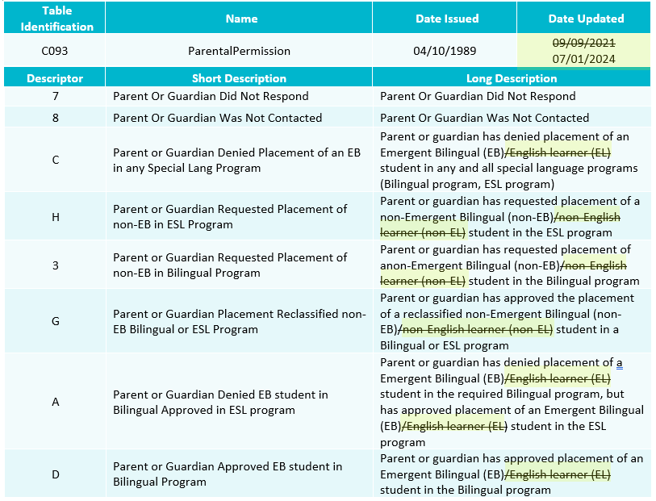
TSDS UPGRADE PROJECT UPDATES 813
NEW Descriptor Change:
  C093 ParentalPermission
    Revised

Slide 45
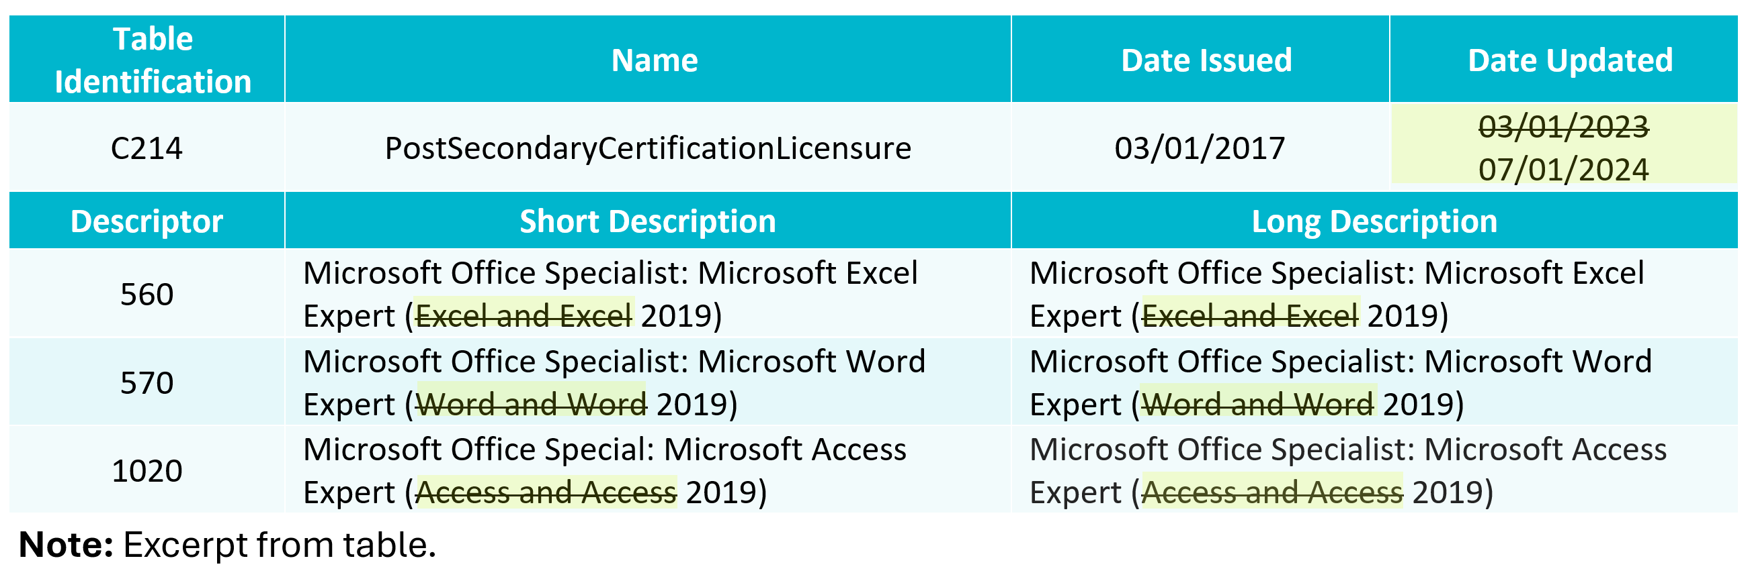
TSDS UPGRADE PROJECT UPDATES 814
NEW Descriptor Change:
  C214 PostSecondaryCertificationLicensure
    Revised

Slide 46
TSDS UPGRADE PROJECT UPDATES 3
Descriptor Table Changes:
  ‘0’ values being removed from descriptor tables
    ChildCountFunding
    Disability
    EmergentBilingualIndicator
    FosterCareType
    HomelessStatus
    MilitaryConnectedStudent
    PKProgramType
    TitleIPartAParticipant
    UnschooledAsyleeRefugee
    StudentAttribution
    PPCDServiceLocation
    CTEProgramService

Slide 47
TSDS UPGRADE PROJECT UPDATES 6
Report Updates:
  All applicable reports will be updated for the following changes below:
    Descriptor values of ‘0’ removed.
    CalendarCode
      Length changed from 2 to 60 characters.
    SectionIdentifier
      Length changed from 14 to 255 characters.
    IncidentIdentifier
      Length changed from 6 to 20 characters.
    NEW DisciplineActionIdentifier
      Length changed from 3 to 20 characters.
    NEW RestraintEventIdentifier
      Length changed from 6 to 20 characters.

Slide 48
TSDS UPGRADE PROJECT UPDATES 615
Report Updates (cont.):
  TEA is actively working to update impacted reports by the start of the 2024-2025 school year.

Slide 49
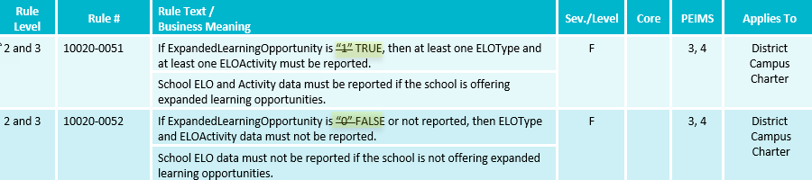
TSDS UPGRADE PROJECT UPDATES 25
Updated Business Rules:

Slide 50
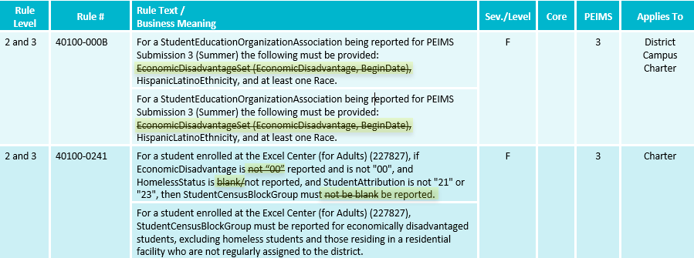
TSDS UPGRADE PROJECT UPDATES 24
Updated Business Rules:

Slide 51
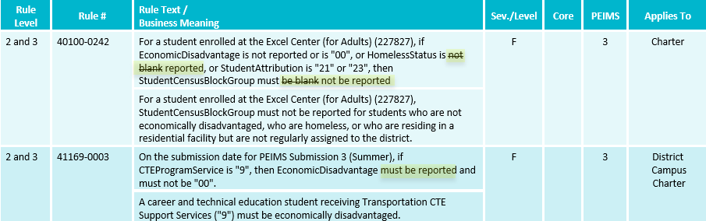
TSDS UPGRADE PROJECT UPDATES 23
Updated Business Rules:

Slide 52
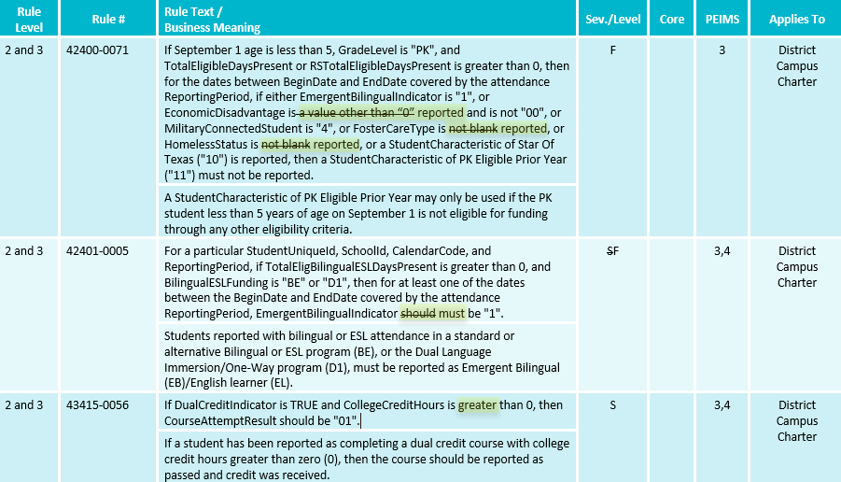
TSDS UPGRADE PROJECT UPDATES 22
Updated Business Rules:

Slide 53
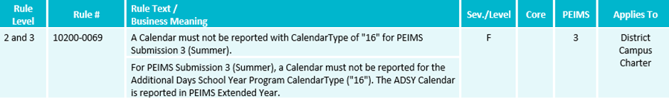
TSDS UPGRADE PROJECT UPDATES 21
New Business Rules:

Slide 54
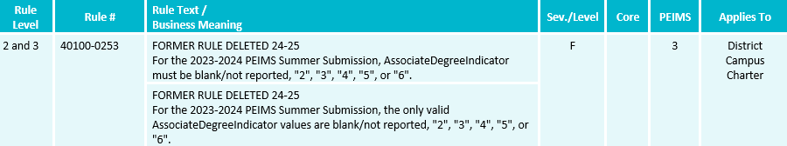
TSDS UPGRADE PROJECT UPDATES 20
Deleted Business Rules:

Slide 55
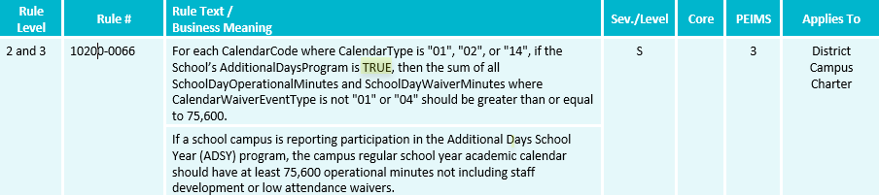
TSDS UPGRADE PROJECT UPDATES 7
Business Rule Changes:
  AdditionalDaysProgram must be ‘TRUE’ (Boolean).
    Boolean true or false versus a code of 1 or 0

Slide 56
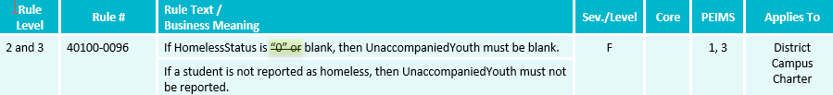
TSDS UPGRADE PROJECT UPDATES 816
Business Rule Changes:
  No longer using ‘0’ codes for HomelessStatus or UnaccompaniedYouth

Slide 57
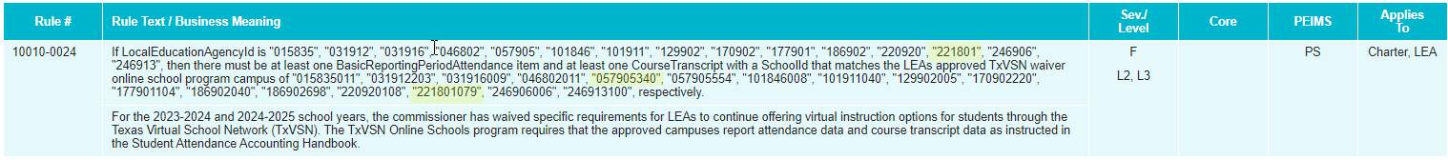
TSDS UPGRADE PROJECT UPDATES 817
NEW Business Rule Changes:

Slide 58
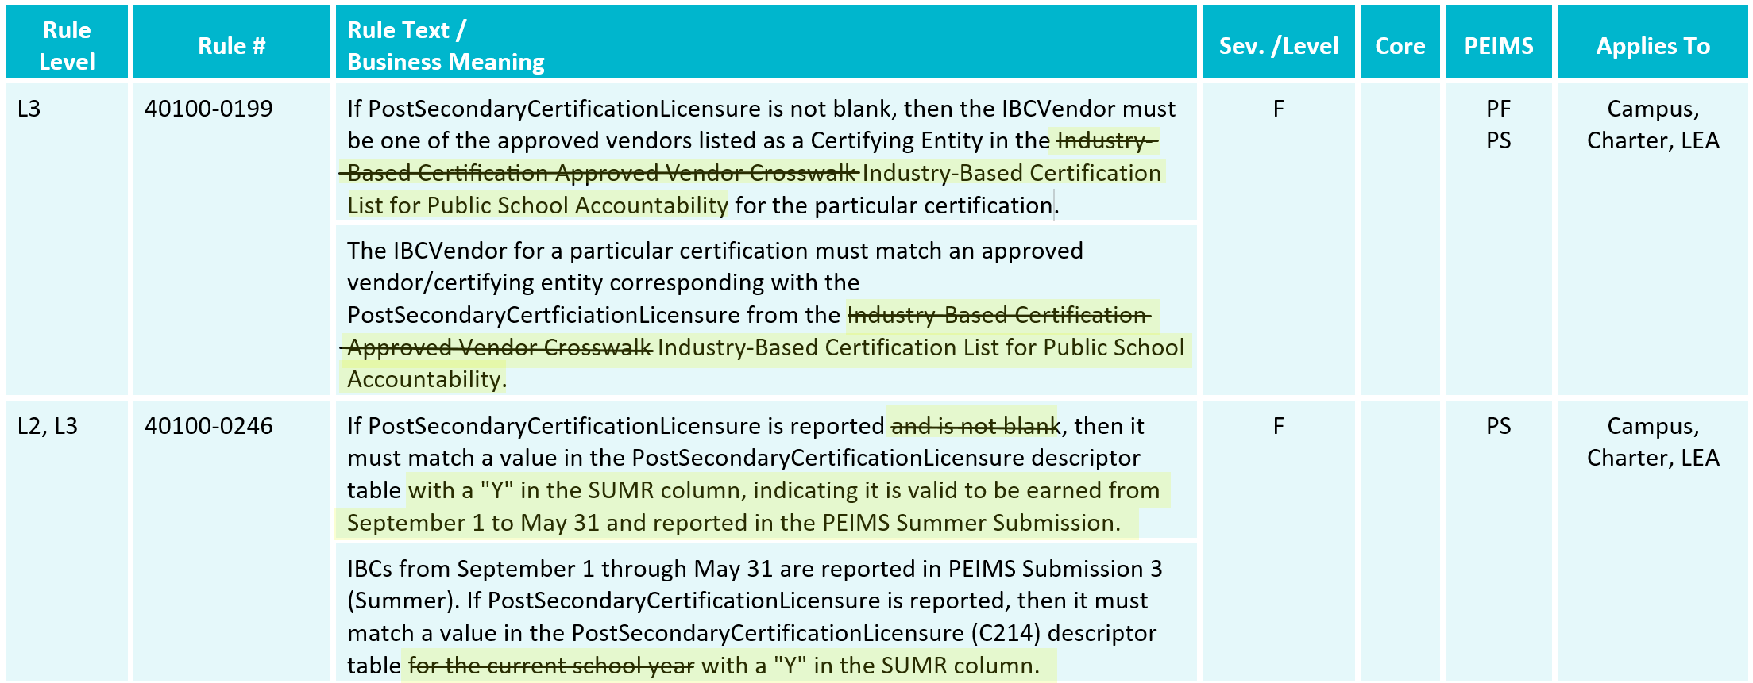
TSDS UPGRADE PROJECT UPDATES 818
NEW Business Rule Changes:

Slide 59
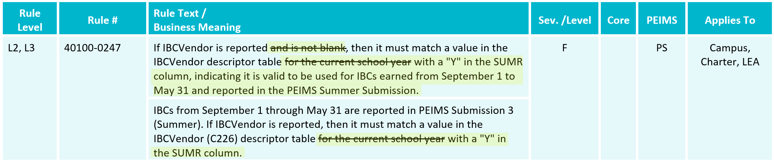
TSDS UPGRADE PROJECT UPDATES 819
NEW Business Rule Changes:

Slide 60
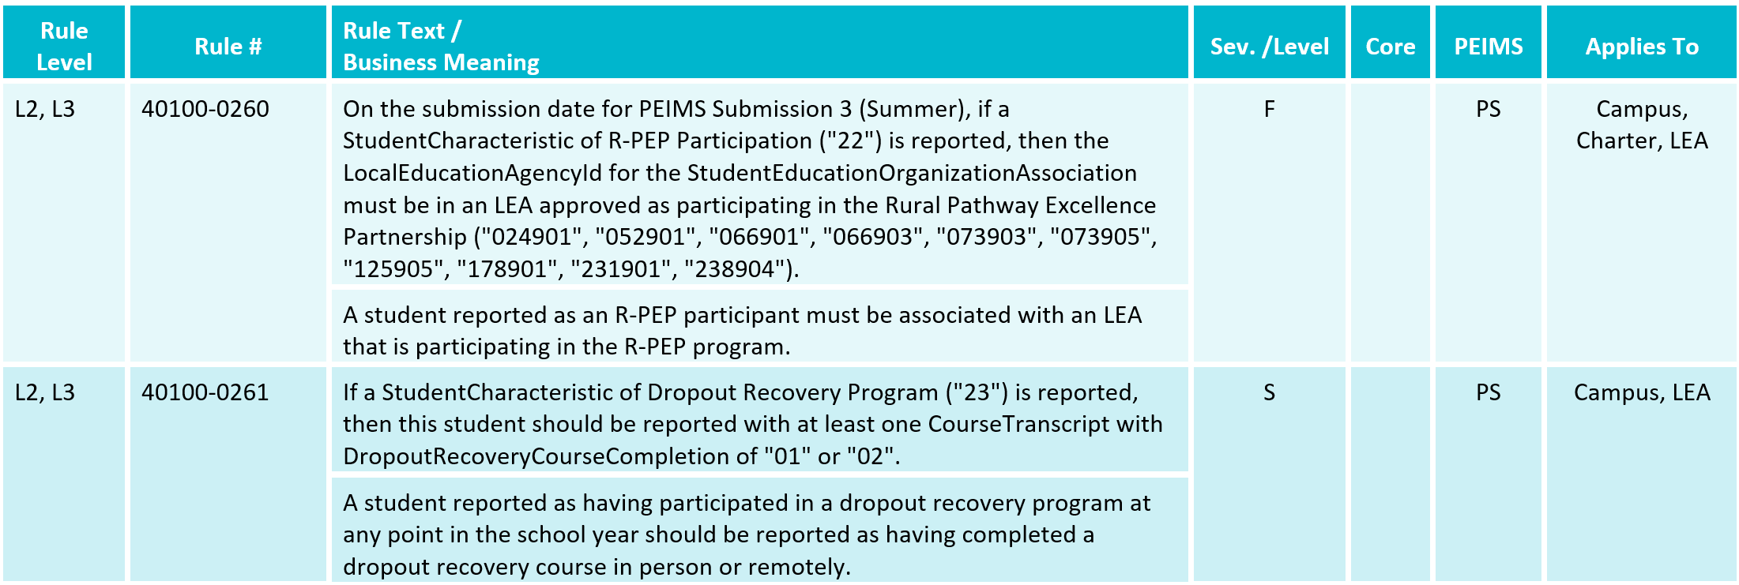
TSDS UPGRADE PROJECT UPDATES 821
NEW Business Rule Changes:
  New Rules

Slide 61
TSDS UPGRADE PROJECT UPDATES 822
NEW Business Rule Changes:
  New Rule

Slide 62
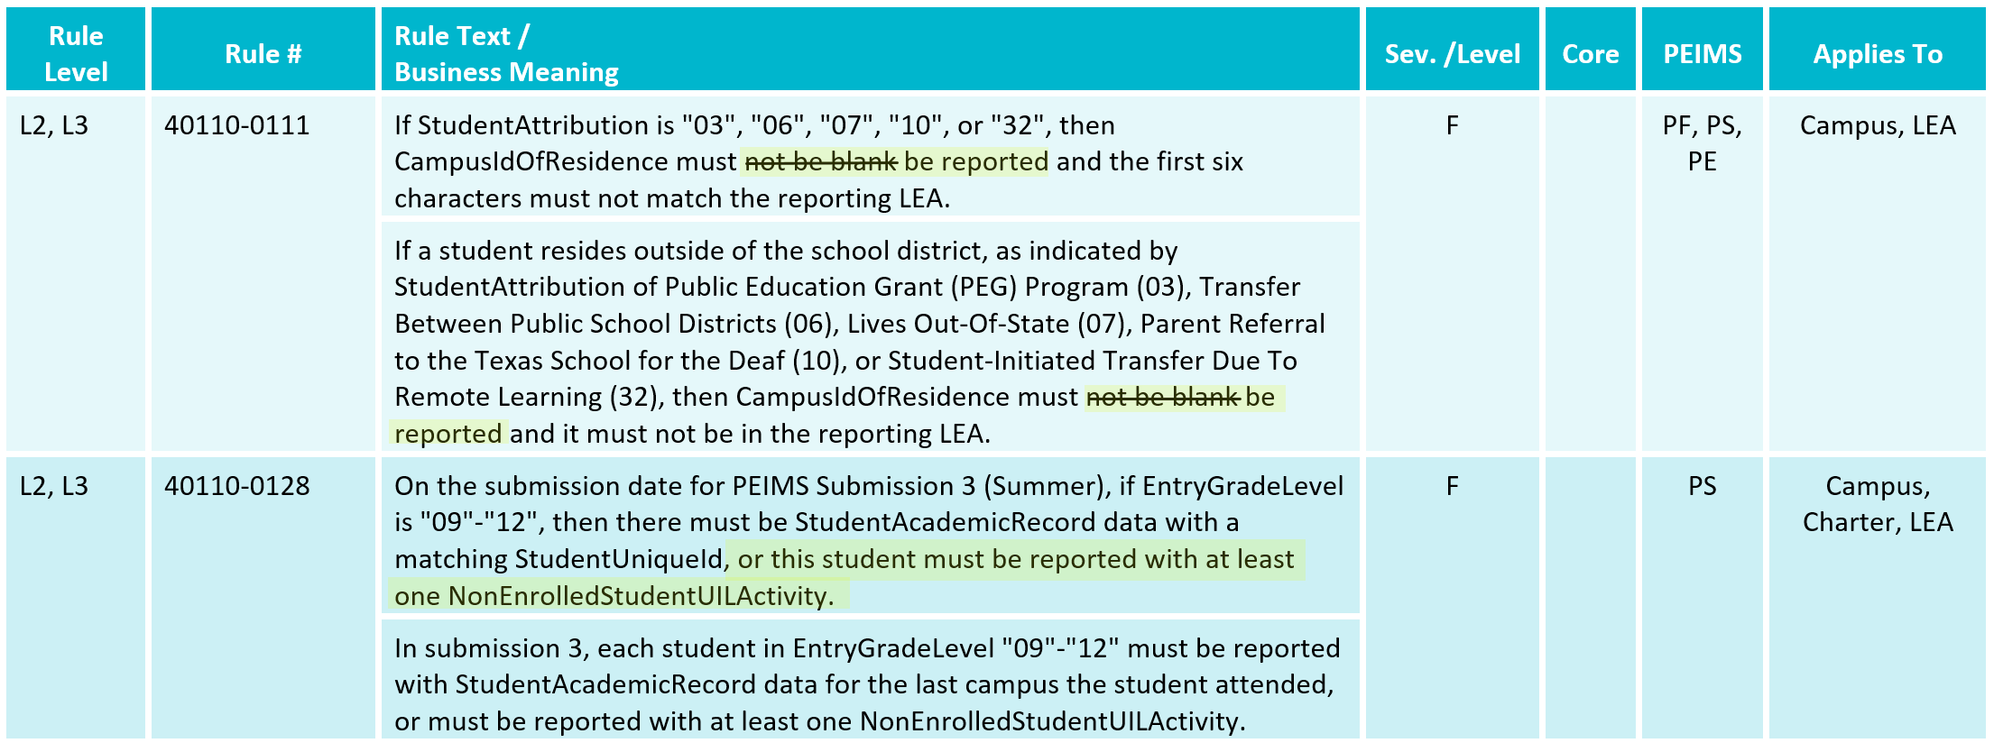
TSDS UPGRADE PROJECT UPDATES 823
NEW Business Rule Changes:

Slide 63
TSDS UPGRADE PROJECT UPDATES 824
NEW Business Rule Changes:

Slide 64
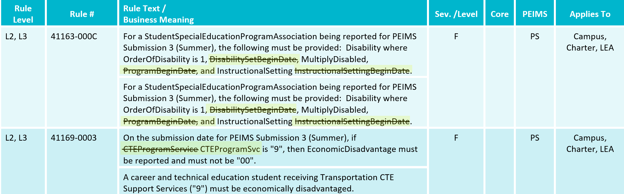
TSDS UPGRADE PROJECT UPDATES 825
NEW Business Rule Changes:

Slide 65

TSDS UPGRADE PROJECT UPDATES 826
NEW Business Rule Changes:
  Deleted Rule

Slide 66
TSDS UPGRADE PROJECT UPDATES 827
NEW Business Rule Changes:

Slide 67

TSDS UPGRADE PROJECT UPDATES 828
NEW Business Rule Changes:

Slide 68

TSDS UPGRADE PROJECT UPDATES 829
NEW Business Rule Changes:

Slide 69

TSDS UPGRADE PROJECT UPDATES 830
NEW Business Rule Changes:

Slide 70
TSDS UPGRADE PROJECT UPDATES 831
NEW Business Rule Changes:

Slide 71


TSDS UPGRADE PROJECT UPDATES 832
NEW Business Rule Changes:
  Deleted Rules

Slide 72

TSDS UPGRADE PROJECT UPDATES 833
NEW Business Rule Changes:

Slide 73

TSDS UPGRADE PROJECT UPDATES 834
NEW Business Rule Changes:

Slide 74

TSDS UPGRADE PROJECT UPDATES 835
NEW Business Rule Changes:
  Deleted Rules

Slide 75
TSDS UPGRADE PROJECT UPDATES 836
NEW Business Rule Changes:
  New Rules

Slide 76
TSDS UPGRADE PROJECT UPDATES 837
NEW Business Rule Changes:
  New Rule

Slide 77
TSDS UPGRADE PROJECT UPDATES 838
NEW Business Rule Changes:

Slide 78

TSDS UPGRADE PROJECT UPDATES 839
NEW Business Rule Changes:

Slide 79
TSDS UPGRADE PROJECT UPDATES 840
NEW Business Rule Changes:
  New Rule

Slide 80

TSDS UPGRADE PROJECT UPDATES 841
NEW Entity/Common Type Change:
  StudentSpecialEducationProgramAssociation.InstructionalSettingSet
    Removed may have multiple instances

Slide 81

TSDS UPGRADE PROJECT UPDATES 42
NEW Entity/Common Type Change:
  Removed LanguageInstructionProgramService common type

Slide 82

TSDS UPGRADE PROJECT UPDATES 43
NEW Entity/Common Type change:
  Removed SpecialEducationProgramService common type

Slide 83

TSDS UPGRADE PROJECT UPDATES 44
NEW Entity/Common Type Change:
  Removed CTEProgramService common type

Slide 84

TSDS UPGRADE PROJECT UPDATES 45
NEW Entity/Common Type Change:
  Added LangInstruProgramSvcSet common type.

Slide 85

TSDS UPGRADE PROJECT UPDATES 46
NEW Entity/Common Type Change:
  Added SPEDProgramSvcSet commong type.

Slide 86

TSDS UPGRADE PROJECT UPDATES 48
NEW Entity/Common Type Change:
  Added CTEProgSvcSet common type.

Slide 87
TSDS UPGRADE PROJECT UPDATES 850
NEW Entity/Common Type Change:
  CourseTranscript
    Deleted Section as a reference.

Slide 88

TSDS UPGRADE PROJECT UPDATES 851
NEW Entity/Common Type Change:
  ReportingPeriodExt
    Reference CalendarDate
      Removed may have multiple instances.

Slide 89
TSDS UPGRADE PROJECT UPDATES 9
NEW Promotion Logic Guide
  PEIMS Summer Promotion Logic
  Student > Student Basic Information Category/Subcategory
    Base Promotion Logic
    E1648 StudentCensusBlockGroup
    E0790 EmergentBilingualIndicator
    E1076 UnschooledAsyleeRefugee
    E3063 StudentCharacteristic
      17 (General Education Homebound)

Slide 90
TSDS UPGRADE PROJECT UPDATES 952
NEW Promotion Logic Guide
  PEIMS Summer Promotion Logic
  Student > Enrollment (School Association)Category/Subcategory
    Base Promotion Logic
    E3028 ExitWithdrawDate
      Last Enroll Date
    Program (reference)
      Special Ed Indicator Code

Slide 91
TSDS UPGRADE PROJECT UPDATES 953
NEW Promotion Logic Guide
  PEIMS Summer Promotion Logic
  Student > Course Completion Category/Subcategory
    Base Promotion Logic
    E1011 DualCreditIndicator
    E1517 EntryGradeLevel
  Student > Graduation Program Category/Subcategory
    Base Promotion Logic
    E3022 EndorsementPursuing
    E3021 EndorsementCompleted

Slide 92
TSDS UPGRADE PROJECT UPDATES 954
NEW Promotion Logic Guide
  PEIMS Summer Promotion Logic
  Student > Basic Attendance Category/Subcategory
    Base Promotion Logic
    E1078 PKProgramType
    E3044 PKFundingSource
  Student > Flexible Attendance Category/Subcategory
    Base Promotion Logic
    Data is promoted as reported.

Slide 93
TSDS UPGRADE PROJECT UPDATES 955
NEW Test Cases
  PEIMS Summer Test Cases
  Test Case 2 - Organization Expanded Learning Opportunities
  Test Case 5 - Student Indicator Report by Grade
  Test Case 7 - Special Education Student Data
  Test Case 9 - Student Class Schedule
  Test Case 10 - Student Disciplinary Action Detail by Reason
  Test Case 11 - Restraint Events by Grade
  Test Case 14 - Superintendent’s Report of Student Attendance
  Test Case 17 - Flex Attendance - Superintendent’s Report of Student Attendance

Slide 94
CURRENT KNOWN ISSUES 1
PEIMS Summer Attendance Promotion
  The PEIMS Summer Attendance promotion logic is promoting attendance data regardless of the value reported for the ReportingPeriod (E0934) data element. Only data for ReportingPeriods equal to '1' - '6' should be promoted for PEIMS Summer Attendance.

Slide 95
TITLE SLIDE: Closeout
CLOSEOUT
NAME OF COMPONENT (ALL CAPS)
MARCH 19-21, 2024

Slide 96
TIMELINE
PEIMS Summer Submission (Submission 3) | Date
TSDS PEIMS ready to load data to IODS | August 5, 2024
TSDS PEIMS ready for users to complete, approve, and accept submissions | May 19, 2025
Requests to retire Unique IDs due at TEA for PEIMS Summer First Submission | June 13, 2025
PEIMS Summer First Submission due date for LEAs | June 20, 2025
Requests to retire Unique IDs due at TEA for PEIMS Summer Resubmission | July 11, 2025
PEIMS Summer Resubmission due date for LEAs | July 17, 2025
LEAs registered with TEA with year-round tracks ending later than June 20, 2025, may delay PEIMS Summer Resubmission until two weeks following completion of the latest year-round track or August 21, 2025, whichever comes first.
However, the initial data delivery for Submission 3 must still be made by June 20, 2025, for all LEAs.
In no case will any Resubmission be processed after August 21, 2025. Data corrections made after August 21, 2025, will be processed by State Funding.
PEIMS Summer data available to customers | September 18, 2025

Slide 97
TECHNICAL RESOURCES
Technical Support
  TSDSCustomerSupport@tea.texas.gov
Technical Specification
  2024-2025 TSDS Web-Enabled Data Standards (TWEDS)
  Known Issues
TSDS Incident Management System (TIMS)
  TSDS Incident Management System (TIMS) Support Application
  TIMS Knowledge Base Article Repository
Additional Resources
  Student Attendance Accounting Handbook (SAAH)

Slide 98

QUESTIONS
QUESTIONS?

