Slide 1

TITLE SLIDE: ESC Vendor Training for One Component
RESIDENTIAL FACILITY TRACKER
July 30-31, 2024 and August 1, 2024

Slide 2

AGENDA – RESIDENTIAL FACILITY TRACKER
PROGRAM AREA
2024-2025 SCHOOL YEAR
  Data Governance Updates
  TSDS Upgrade Project Updates
  Current Known Issues
CLOSEOUT
  Timeline
  Technical Resources
  Questions

Slide 3
PROGRAM AREA UPDATES & GUIDANCE
  Office of Special Populations and Monitoring
    Department of Review and Support
      ReviewandSupport@tea.texas.gov

Slide 4

TITLE SLIDE: 2024-2025 School Year
2024-2025
SCHOOL YEAR
NAME OF COMPONENT (ALL CAPS)
MARCH 19-21, 2024

Slide 5
DATA GOVERNANCE UPDATES
No updates to the following since TSDS Spring training:
  Data Elements
  Descriptor Tables
  Reports
  Business Rules

Slide 6
TSDS UPGRADE PROJECT UPDATES 1
Data Element Name Changes:
Data Element ID | XML Data Element Name | Upgrade Data Element Name
E0041 | PRIMARY-DISABILITY-CODE | Disability
E0834 | SECONDARY-DISABILITY-CODE | Disability
E0835 | TERTIARY-DISABILITY-CODE | Disability

Slide 7
TSDS UPGRADE PROJECT UPDATES 2
Data Element Name Changes:
Data Element ID | XML Data Element Name | Upgrade Data Element Name
E0833 | REG-DAY-SCH-PROG-DEAF-CODE | SpecialEducationProgramService
E0838 | AUDIOLOGICAL-SERV-IND-CODE | SpecialEducationProgramService
E0840 | COUNSELING-SERVICES-IND-CODE | SpecialEducationProgramService
E0841 | MEDICAL-DIAGNOSTIC-SERV-IND-CODE | SpecialEducationProgramService
E0843 | OCCUPATIONAL-THERAPY-IND-CODE | SpecialEducationProgramService

Slide 8
TSDS UPGRADE PROJECT UPDATES 3
Data Element Name Changes:
Data Element ID | XML Data Element Name | Upgrade Data Element Name
E0844 | ORIENT-MOBILITY-TRNG-IND-CODE | SpecialEducationProgramService
E0845 | PHYSICAL-THERAPY-IND-CODE | SpecialEducationProgramService
E0846 | PSYCHOLOGICAL-SERVICES-IND-CODE | SpecialEducationProgramService
E0847 | RECREATION-IND-CODE | SpecialEducationProgramService

Slide 9
TSDS UPGRADE PROJECT UPDATES 4
Data Element Name Changes:
Data Element ID | XML Data Element Name | Upgrade Data Element Name
E0848 | SCHOOL-HEALTH-SERVICES-IND-CODE | SpecialEducationProgramService
E0849 | SOCIAL-WORK-SERVICES-IND-CODE | SpecialEducationProgramService
E0851 | TRANSPORTATION-INDICATOR-CODE | SpecialEducationProgramService
E0857 | SPEECH-THERAPY-INDICATOR-CODE | SpecialEducationProgramService

Slide 10
TSDS UPGRADE PROJECT UPDATES 5
Data Element Name Changes:
Data Element ID | XML Data Element Name | Upgrade Data Element Name
E0899 | PRESCHL-PROG-CHLDRN-WITH-DISAB-IND-CD | SpecialEducationProgramService
E0900 | EARLY-CHILDHOOD-INTERV-IND-CODE | SpecialEducationProgramService
E0997 | ASSISTIVE-TECH-INDICATOR-CODE | SpecialEducationProgramService
E1040 | INTERPRETING-SERVICES-TYPE-CODE | SpecialEducationProgramService

Slide 11
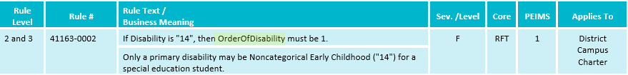
TSDS UPGRADE PROJECT UPDATES 6
Business Rule Changes:
  If Disability is "14", then OrderOfDisability must be 1.
    For 2023-2024 the disability data elements were primary, secondary, and tertiary.
    For 2024-2025, the OrderOfDisability is used, 1=primary, 2=secondary, and 3=tertiary.

Slide 12
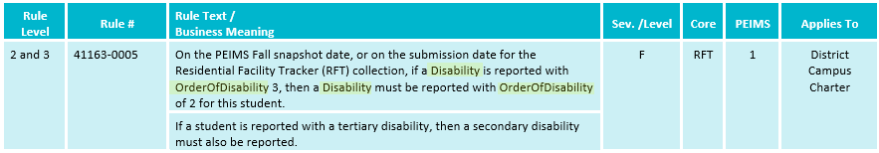
TSDS UPGRADE PROJECT UPDATES 7
Business Rule Changes:
  On the PEIMS Fall snapshot date, or on the submission date for the Residential Facility Tracker (RFT) collection, if a Disability is reported with OrderOfDisability 3, then a Disability must be reported with OrderOfDisability of 2 for this student.
    For 2023-2024 the disability data elements were primary, secondary, and tertiary.
    For 2024-2025, the OrderOfDisability is used, 1=primary, 2=secondary, and 3=tertiary.

Slide 13
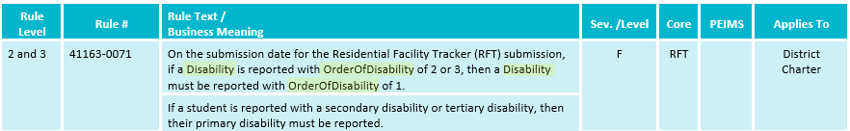
TSDS UPGRADE PROJECT UPDATES 8
Business Rule Changes:
  On the submission date for the Residential Facility Tracker (RFT) submission, if a Disability is reported with OrderOfDisability of 2 or 3, then a Disability must be reported with OrderOfDisability of 1.
    For 2023-2024 the disability data elements were primary, secondary, and tertiary.
    For 2024-2025, the OrderOfDisability is used, 1=primary, 2=secondary, and 3=tertiary.

Slide 14
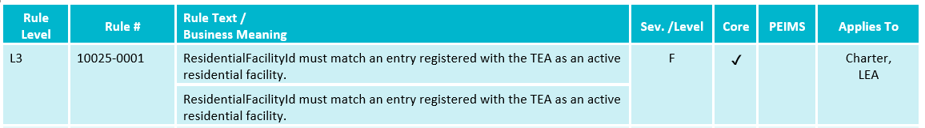
TSDS UPGRADE PROJECT UPDATES 18
NEW Business Rule Changes:
  Reinstated Data Validation Rule 10025-0001:

Slide 15
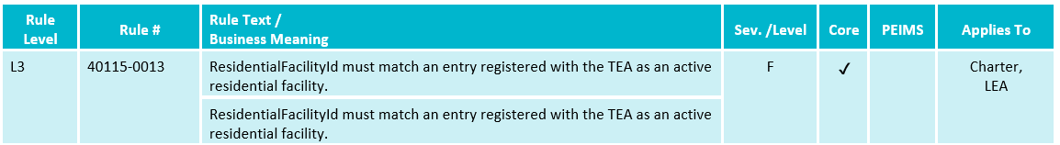
TSDS UPGRADE PROJECT UPDATES 82
NEW Business Rule Changes:
  Added Data Validation Rule 40115-0013:

Slide 16
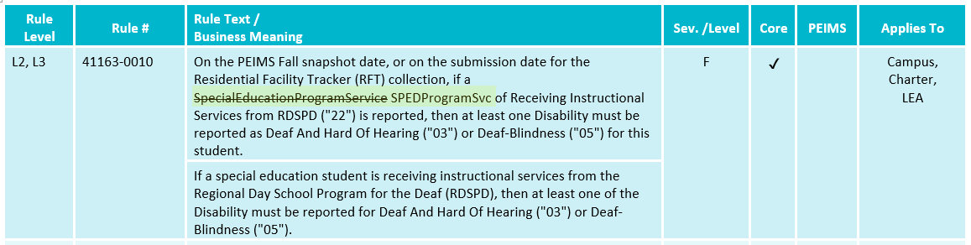
TSDS UPGRADE PROJECT UPDATES 83
NEW Business Rule Changes:
  Revised Data Validation Rule 41163-0010:

Slide 17
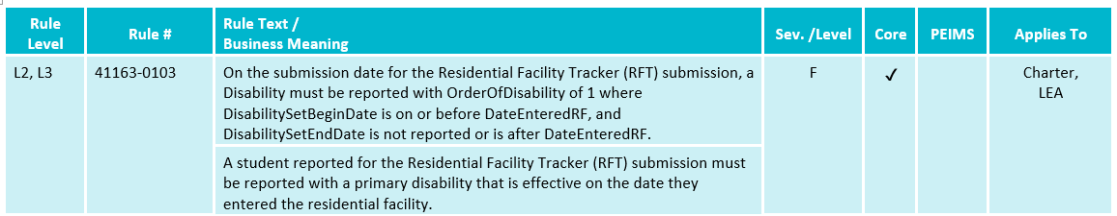
TSDS UPGRADE PROJECT UPDATES 84
NEW Business Rule Changes:
  Added Data Validation Rule 41163-0103:

Slide 18
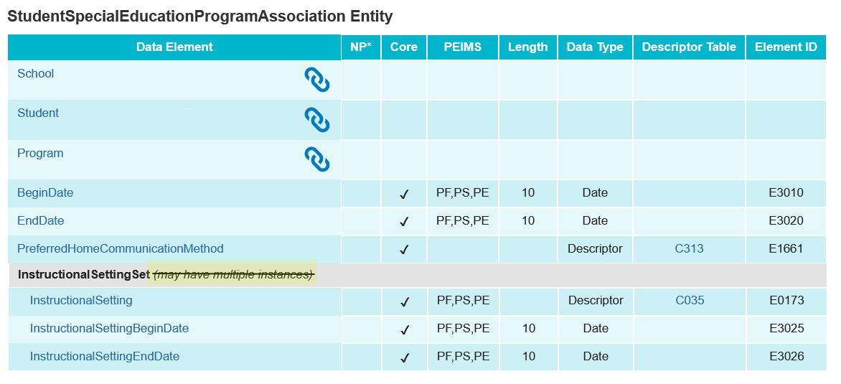
TSDS UPGRADE PROJECT UPDATES 85
NEW Entity/Common Type Change:
  StudentSpecialEducationProgramAssociation.InstructionalSettingSet
    Removed may have multiple instances

Slide 19
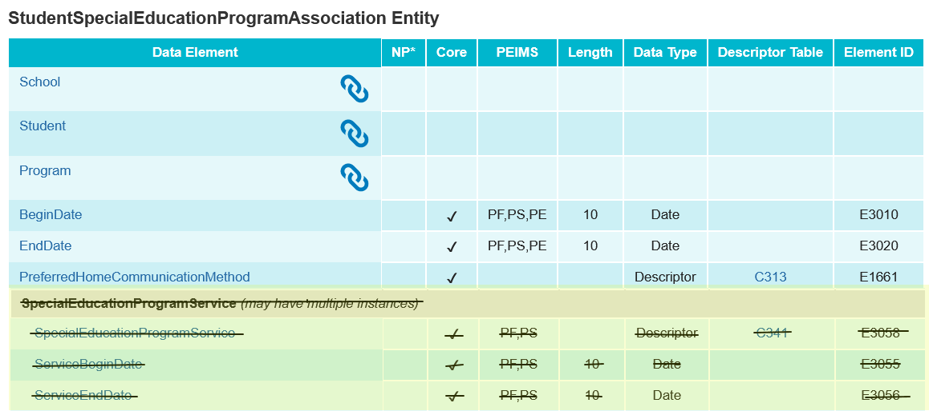
TSDS UPGRADE PROJECT UPDATES 86
NEW Entity/Common Type Change:
  Removed SpecialEducationProgramService common type

Slide 20
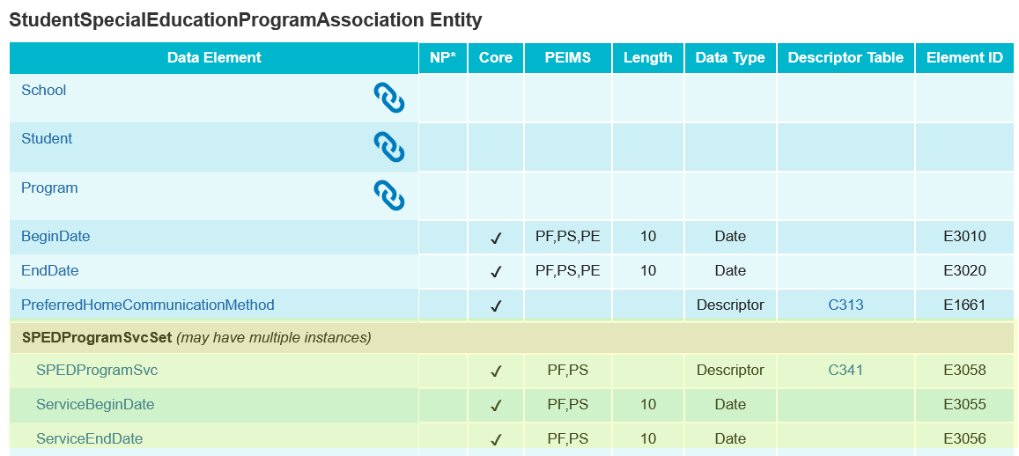
TSDS UPGRADE PROJECT UPDATES 87
NEW Entity/Common Type Change:
  StudentSpecialEducationProgramAssociation.SPEDProgramSvcSet

Slide 21
TSDS UPGRADE PROJECT UPDATES 9
Additional Changes:
Legacy Data Element | Legacy Complex Type | Upgrade Data Element | Upgrade Student Entity
CAMPUS-ID-OF-ENROLLMENT (E0782) | StudentResidentialFacilityAssociationExtension Complex Type | School | StudentSchoolAssociation
ENTRY-GRADE-LEVEL-TYPE (E1517) | StudentResidentialFacilityAssociationExtension Complex Type | EntryGradeLevel | StudentSchoolAssociation

Slide 22
TSDS UPGRADE PROJECT UPDATES 10
NEW Promotion Logic:
  RF Tracker Promotion Logic
  Education Organization > Residential Facility
    Promote from StudentResidentialFacility
    Only valid RFs, pulling data from AskTED
  Student > Student Residential Facility
    Pulling Campus ID of Enrollment and Grade Level from Student School Association
  Student > Special Education
    Special Education Program Services
    Combining same effective dates only write one record

Slide 23
TSDS UPGRADE PROJECT UPDATES 108
NEW Test Cases:
  RF Tracker Test Cases
  Test Case 3 – Student Residential Facility Data
    Student Residential Facility Enter and Exit Dates
    Student Residential Facility set data
  Test Case 4 – Student Special Education Data
    Student Special Education effective dates
      Disabilities
      Instructional Settings
      Services

Slide 24
CURRENT KNOWN ISSUES 1
RF Tracker Data Promotion Issue:
  When a student is reported in the StudentSpecialEducationProgramAssociation.SpecialEducationProgramService with (E3058) equal to ’22’ (Receiving Instructional Services from RDSPD), a value of ‘1’ is promoting to the RF Tracker data mart instead of a value of ‘3’. As a result, on the Individual Student Detail Summary (RFT0-100-004), the student will show that they are not receiving RDSPD services.
  TEA will update the RF Tracker promotion logic to promote a value of ‘3’ in this scenario. TEA will be correcting this promotion issue for the 2024-2025 school year.

Slide 25
CURRENT KNOWN ISSUES 11
RF Tracker Data Validation Error:
  The Student > Special Education Program and Student > Student Residential Facility subcategories are failing data validation.
  LEAs can use the RF Tracker Individual Student Detail Summary (RFT0-100-004) report to verify their data. TEA will be correcting the issue of the failed validations for the 2024-2025 school year.

Slide 26
TITLE SLIDE: Closeout
CLOSEOUT
NAME OF COMPONENT (ALL CAPS)
MARCH 19-21, 2024

Slide 27
TIMELINE 2
RF Tracker | Date
TSDS Ready to load data to the IODS | August 5, 2024
All RF Tracker data up to this point must be promoted, validated, and fatal free. LEA will continue to report RF Tracker data as students enter and exit residential facilities or on a monthly basis throughout the school year. | December 13, 2024
RF Tracker ready for users to complete | May 19, 2025
RF Tracker Submission due date for LEAs | July 17, 2025
RF Tracker data available to customers | July 31, 2025

Slide 28
TECHNICAL RESOURCES 1
Technical Support
  TSDSCustomerSupport@tea.Texas.gov
Technical Specifications
  2024-2025 TSDS Web-Enabled Data Standards (TWEDS)
  Known Issues
TSDS Incident Management System (TIMS)
  TSDS Incident Management System (TIMS) Support Application
  TIMS Knowledge Base Article Repository

Slide 29
TECHNICAL RESOURCES 2
Knowledge Based Articles:
  TSDSKB-586 RFT: Residential Facility Tracker (RF Tracker – FAQ)
  TSDSKB-589 RFT: Residential Facility Tracker (RF Tracker) process for adding or updating the Residential Facilities IDs
Program Area Support
  ReviewandSupport@tea.texas.gov
Residential Facility Download
  AskTED

Slide 30

QUESTIONS
QUESTIONS?

