Slide 1

TITLE SLIDE: ESC Vendor Training for One Component
SPECIAL EDUCATION LANGUAGE ACQUISITION (SELA)
MARCH 19-21, 2024

Slide 2

AGENDA – SELA
PROGRAM AREA
2023-2024 SCHOOL YEAR
  Submission Updates
  Data Element Updates
  Code Table Updates
  Business Rule Updates
  Reminders
  Timeline
  Frequently Asked Questions
2024-2025 SCHOOL YEAR
  Application Updates
  Descriptor Table Updates
  TSDS Upgrade Updates
CLOSEOUT
  Timeline
  Technical Resources
  Questions

Slide 3
PROGRAM AREA UPDATES & GUIDANCE
Special Education Programs Division​
  Emily Robinson – Director, Deaf & Hard of Hearing Program Admin. and State Director of Regional Day School Program for the Deaf
  Program-related questions can be submitted to SELA@tea.texas.gov

Slide 4

TITLE SLIDE: 2023-2024 School Year
2023-2024
SCHOOL YEAR
NAME OF COMPONENT (ALL CAPS)
MARCH 19-21, 2024

Slide 5
SUBMISSION UPDATES
No submission updates for the following:
  Reports

Slide 6
DATA ELEMENT UPDATES
The following data element length has been updated from fifteen (15) to thirty-four (34) characters:
  E1668 TOOL-OR-ASSESSMENT-USED

Slide 7
CODE TABLE UPDATES
The following data element has been revised from using code table DC162 TOOL-ASSESSMENT-CODE to DC166 TOOL-OR-ASSESSMENT-USED
  E1668 TOOL-OR-ASSESSMENT-USED

Slide 8
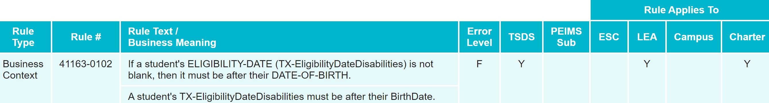
BUSINESS RULE UPDATES
The following new validation rule has been added in the Core application:
  41163-0102 – If a student's ELIGIBILITY-DATE (TX-EligibilityDateDisabilities) is not blank, then it must be after their DATE-OF-BIRTH.

Slide 9
REMINDERS
Students may only be reported with each code value once for the following data elements:
  LANG-ACQ-SERVICES-PROVIDED (E1662)
  HEARING-AMPLIFICATION-TYPE (E1666)
  TOOL-OR-ASSESSMENT-USED (E1668)
Loading multiple records for a single student with the same code value for the above data elements will result in data loading errors or one record overwriting the other.

Slide 10
TIMELINE
Special Education Language Acquisition Collection | Date
TSDS ready to load data to eDM | August 7, 2023
Special Education Language Acquisition ready for users to promote data | September 11, 2023
Special Education Language Acquisition ready for users to complete | May 20, 2024
Special Education Language Acquisition Submission due date for LEAs | June 27, 2024
Special Education Language Acquisition data available to customers | July 11, 2024

Slide 11
FREQUENTLY ASKED QUESTIONS
When a student is being reported with two DISABILITY (E1220) codes (‘Deaf And Hard Of Hearing’ and ‘Developmental Delay’), does ELIGIBILITY-DATE (E1723) need to be reported for both disabilities? What about the EFFECTIVE-DATE (E1632)??
ELIGIBILITY-DATE (E1723) shall only be reported with the ‘Deaf And Hard Of Hearing’ disability code. It does not need to be reported with ‘Developmental Delay’.
EFFECTIVE-DATE (E1632) will need to be reported for both disabilities. However, this date is not promoted to the SELA data mart for either. It is only required to load the data to the ODS.

Slide 12
TITLE SLIDE: 2024-2025 School Year
2024-2025
SCHOOL YEAR
NAME OF COMPONENT (ALL CAPS)
MARCH 19-21, 2024

Slide 13
APPLICATION UPDATES
No application updates for the following:
  Data Elements
  Descriptor Tables
  Reports
  Business Rules

Slide 14
TSDS UPGRADE PROJECT UPDATES
Data Element Name Changes:
Data Element ID | XML Data Element Name | Upgrade Data Element Name
E3010 | N/A | BeginDate
E3020 | N/A | EndDate
E3016 | N/A | DisabilitySetBeginDate
E3017 | N/A | DisabilitySetEndDate
E3025 | N/A | InstructionalSettingBeginDate
E3026 | N/A | InstructionalSettingEndDate
E0266 | CAMPUS-ID | EducationOrganization (Reference)

Slide 15
TSDS UPGRADE PROJECT UPDATES 8
Descriptor Table Name Changes:
Descriptor Table ID | XML Code Table Name | Upgrade Descriptor Table Name
C061 (was DC079) | EMERGENT-BILINGUAL-TYPE | EmergentBilingualIndicator
C318 (was DC160) | PERIOD-OF-TIME-ACCESS-CODE | HearingAmplificationAccess
C319 (was DC161) | AVERAGE-TIME-CODE | HearingAmplificationDailyUse
C303 (was DC096) | PROGRAM-TYPE | ProgramType
C053 (was DC142) | DISABILITY-TYPE | Disability
Notes:
DC096 PROGRAM-TYPE->C303 ProgramType:
C303 now only includes the following values:
04 Bilingual
05 Career and Technical Education
12 English as a Second Language (ESL)
33 Special Education
38 Title I Part A
DC142 DISABILITY TYPE->C053 Disability
C053 descriptor value updates (description reassigned to new code values)
01-Orthopedic Impairment
02-Other Health Impairment
03-Deaf And Hard Of Hearing
04-Deaf And Hard Of Hearing
05-Deaf-Blindness
06-Intellectual Disability
07-Emotional Disturbance
08-Specific Learning Disability
09-Speech or Language Impairment
10-Autism
12-Developmental Delay
13-Traumatic Brain Injury
14-Noncategorical Early Childhood

Slide 16
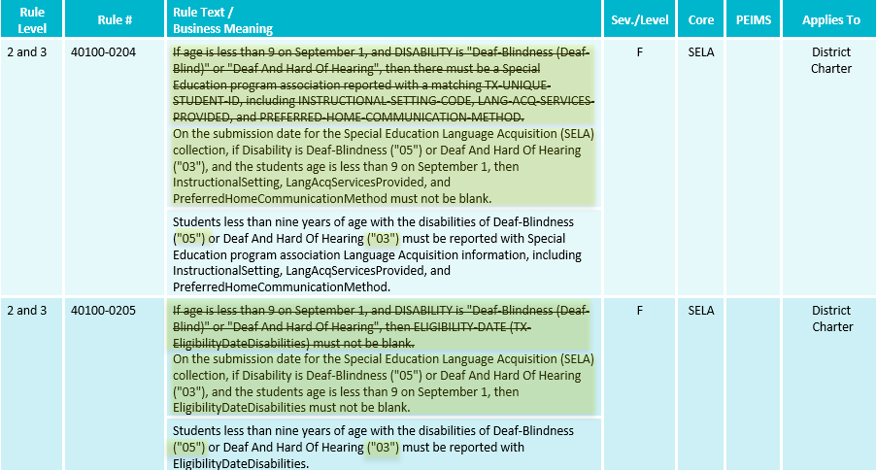
TSDS UPGRADE PROJECT UPDATES 2 1
Business Rule Changes:
  Uses Disability ’05’ and ‘03’ descriptor values replacing ‘Deaf Blindness’ and ‘Deaf And Hard of Hearing’

Slide 17
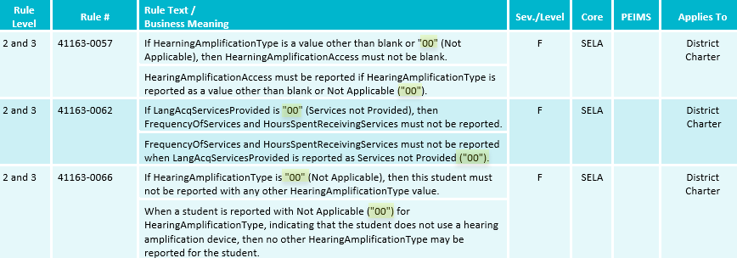
TSDS UPGRADE PROJECT UPDATES 3
Business Rule Changes:
  Example of rules that use ‘00’descriptor values instead of code value description:

Slide 18
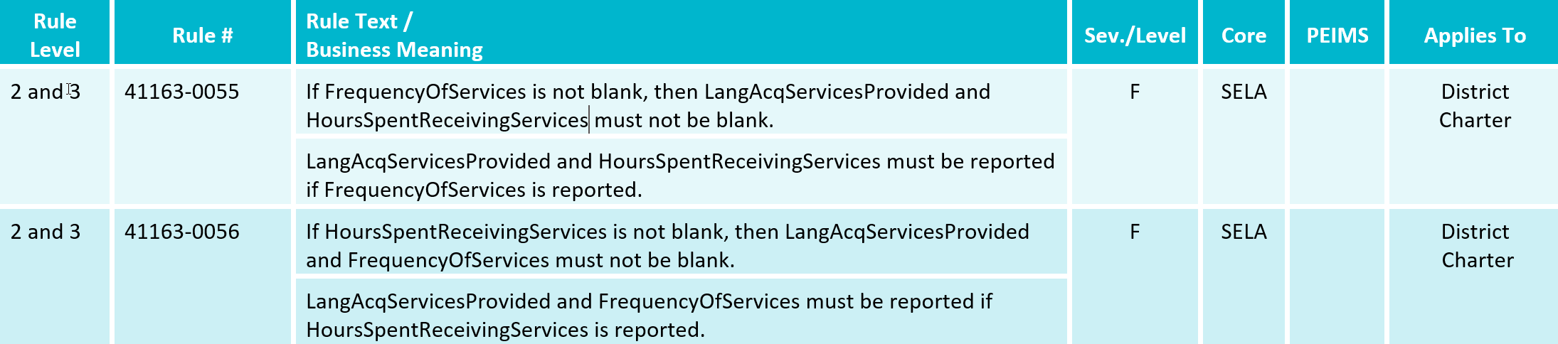
TSDS UPGRADE PROJECT UPDATES 4
Business Rule Changes:
  The following business rules have been added:

Slide 19
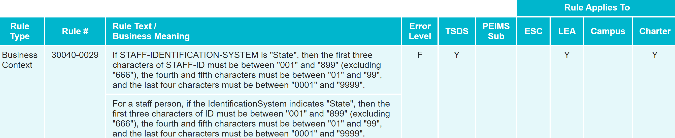
TSDS UPGRADE PROJECT UPDATES 5
Business Rule Changes:
  Deleted Data Validation Rule 30040-0029
    Uses STAFF-IDENTIFICATION-SYSTEM-TYPE which is not used in TSDS Upgrade Project.

Slide 20
TSDS UPGRADE PROJECT UPDATES 7
Promotion Logic Guide & Test Cases Coming Soon!
  More details will be provided in the TSDS Summer Training.

Slide 21
TITLE SLIDE: Closeout
CLOSEOUT
NAME OF COMPONENT (ALL CAPS)
MARCH 19-21, 2024

Slide 22
TIMELINE 2
Special Education Language Acquisition (SELA) | Date
TSDS ready to load data to IODS | August 5, 2024
Special Education Language Acquisition ready for users to complete | May 19, 2025
Special Education Language Acquisition Submission due date for LEAs | June 26, 2025
Special Education Language Acquisition data available to customers | July 10, 2025

Slide 23
TECHNICAL RESOURCES
Technical Support
  TSDSCustomerSupport@tea.texas.gov
Technical Specifications
  2024-2025 Domains​
  2024-2025 Data Element Definitions​
  2024-2025 Descriptor Tables​
  2024-2025 Data Validation Rules​
  2024-2025 Data Submission Timelines
  Known Issues
TSDS Incident Management System (TIMS)
  TSDS Incident Management System (TIMS) Support Application
  TIMS Knowledge Base Article Repository

Slide 24

QUESTIONS
QUESTIONS?

