Slide 1

TITLE SLIDE: ESC Vendor Training for One Component
SPECIAL EDUCATION LANGUAGE ACQUISITION
July 30-31, 2024 and August 1, 2024

Slide 2

AGENDA – SELA
PROGRAM AREA
2024-2025 SCHOOL YEAR
  Data Governance Updates
  TSDS Upgrade Updates
  Current Known Issues
CLOSEOUT
  Timeline
  Frequently Asked Questions
  Technical Resources
  Questions

Slide 3
PROGRAM AREA UPDATES & GUIDANCE
Special Education Programs Division​
  Emily Robinson – Director, Deaf & Hard of Hearing Program Admin. and State Director of Regional Day School Program for the Deaf
  Program-related questions can be submitted to SELA@tea.texas.gov.

Slide 4

TITLE SLIDE: 2024-2025 School Year
2024-2025
SCHOOL YEAR
NAME OF COMPONENT (ALL CAPS)
MARCH 19-21, 2024

Slide 5
DATA GOVERNANCE UPDATES
No updates to the following since TSDS Spring training:
  Data Elements
  Reports
  Business Rules

Slide 6
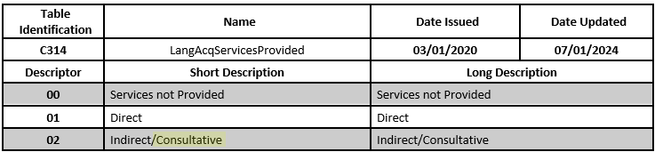
DATA GOVERNANCE UPDATES
Descriptor Table Updates:

Slide 7
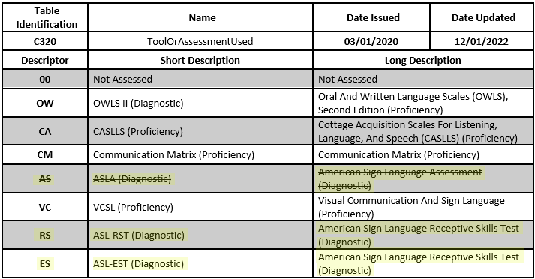
DATA GOVERNANCE UPDATES
Descriptor Table Updates:

Slide 8
TSDS UPGRADE PROJECT UPDATES
Data Element Name Changes:
Data Element ID | XML Data Element Name | Upgrade Data Element Name
E3010 | N/A | BeginDate
E3020 | N/A | EndDate
E3016 | N/A | DisabilitySetBeginDate
E3017 | N/A | DisabilitySetEndDate
E3025 | N/A | InstructionalSettingBeginDate
E3026 | N/A | InstructionalSettingEndDate
E0266 | CAMPUS-ID | EducationOrganization (Reference)

Slide 9
TSDS UPGRADE PROJECT UPDATES 8
Descriptor Table Name Changes:
Descriptor Table ID | XML Code Table Name | Upgrade Descriptor Table Name
C061 (was DC079) | EMERGENT-BILINGUAL-TYPE | EmergentBilingualIndicator
C318 (was DC160) | PERIOD-OF-TIME-ACCESS-CODE | HearingAmplificationAccess
C319 (was DC161) | AVERAGE-TIME-CODE | HearingAmplificationDailyUse
C303 (was DC096) | PROGRAM-TYPE | ProgramType
C053 (was DC142) | DISABILITY-TYPE | Disability

Slide 10
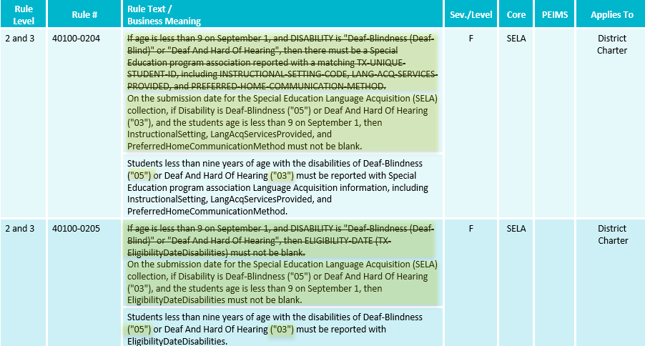
TSDS UPGRADE PROJECT UPDATES 2 1
Business Rule Changes:
  Uses Disability ’05’ and ‘03’ descriptor values replacing ‘Deaf Blindness’ and ‘Deaf And Hard of Hearing’

Slide 11
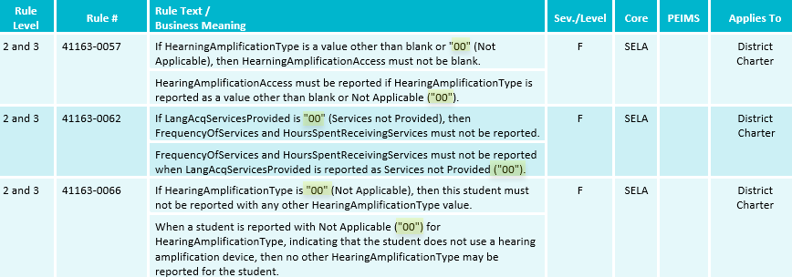
TSDS UPGRADE PROJECT UPDATES 3
Business Rule Changes:
  Example of rules that use ‘00’ descriptor values instead of code value description:

Slide 12
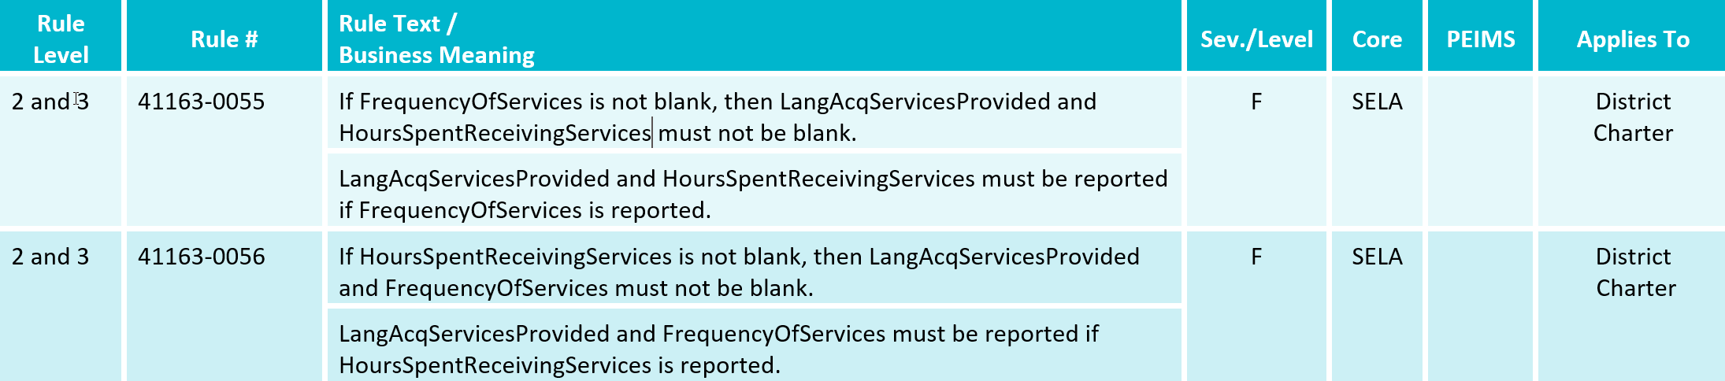
TSDS UPGRADE PROJECT UPDATES 4
Business Rule Changes:
  The following business rules have been added:

Slide 13
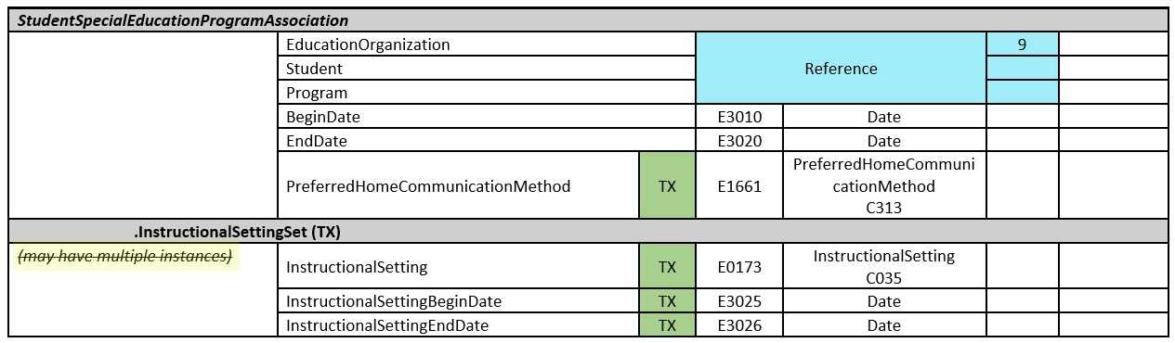
TSDS UPGRADE PROJECT UPDATES
NEW Entity/Common Type Change:

Slide 14
TSDS UPGRADE PROJECT UPDATES 7
NEW Promotion Logic:
  SELA Promotion Logic
  Student > Special Education Program Category/Subcategory:
    New promotion logic that references Begin and End Date for several data elements:
      E1723 EligibilityDateDisabilities
      E1073 InstructionalSetting
      E1661 PreferredHomeCommunicationMethod
  Student > Student Basic Information Category/Subcategory:
    New promotion logic that references Begin and End Date:
      E0790 EmergentBilingualIndicator

Slide 15
TSDS UPGRADE PROJECT UPDATES 7
NEW Test Cases:
  SELA Test Cases
  Test Case 1 – SELA Roster Report and Business Validations

Slide 16
CURRENT KNOWN ISSUES 1
SELA Data Promotion Error:
  Data element E1661 PreferredHomeCommunicationMethod:
    The SELA promotion of the Student > Special Education Program subcategory will generate a unique constraint error for LEAs that have updated the BeginDate value for their PreferredHomeCommunicationMethod.
    As a result, this is causing rule 40100-0204 to fire incorrectly.

Slide 17
CURRENT KNOWN ISSUES 1
API/MetaEd
    The InstructionalSettingSets common type does not allow for multiple instructional settings to be reported with the same InstructionalSettingBeginDate (E3025). When data is reported with the same InstructionalSettingBeginDate, a Level 1 (API) error is triggered. TEA is evaluating the data standards to determine what changes will need to be made to allow for multiple instructional settings to be reported with the same begin date.
      Workaround: The LEA should load only one InstructionalSettingSet. A student who receives speech therapy services and who also receives instructional services through another InstructionalSetting (E0173) should be reported with the primary setting (not with 00) and a SpecialEducationProgramService (E3058) 25 (Student Receives Speech Therapy Along With Service Through Another Special Education Instructional Setting).

Slide 18
TITLE SLIDE: Closeout
CLOSEOUT
NAME OF COMPONENT (ALL CAPS)
MARCH 19-21, 2024

Slide 19
TIMELINE 2
Special Education Language Acquisition (SELA) | Date
TSDS ready to load data to IODS | August 5, 2024
Special Education Language Acquisition ready for users to complete | May 19, 2025
Special Education Language Acquisition Submission due date for LEAs | June 26, 2025
Special Education Language Acquisition data available to customers | July 10, 2025

Slide 20
TECHNICAL RESOURCES
Technical Support
  TSDSCustomerSupport@tea.texas.gov
Technical Specifications
  2024-2025 TSDS Web-Enabled Data Standards (TWEDS)
  Known Issues
TSDS Incident Management System (TIMS)
  TSDS Incident Management System (TIMS) Support Application
  TIMS Knowledge Base Article Repository

Slide 21

QUESTIONS
QUESTIONS?

