Slide 1

TITLE SLIDE: ESC Vendor Training for One Component
TEXAS RECORDS EXCHANGE (TREx)
MARCH 19-21, 2024

Slide 2

AGENDA – TEXAS RECORDS EXCHANGE (TREx)
2023-2024 SCHOOL YEAR
  Data Element Updates
  Code Table Updates
  Reminders
2024-2025 School Year
  Data Element Updates
  Code Table Updates
CLOSEOUT
  Reminders
  Frequently Asked Questions
  Technical Resources
  Questions

Slide 3

TITLE SLIDE: 2023-2024 School Year
2023-2024
SCHOOL YEAR
NAME OF COMPONENT (ALL CAPS)
MARCH 19-21, 2024

Slide 4
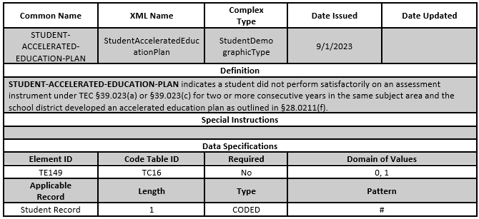
DATA ELEMENT UPDATES 1
Added a new data element TE149 STUDENT-ACCELERATED-EDUCATION-PLAN (HB 1416, 88th Legislative Session)

Slide 5
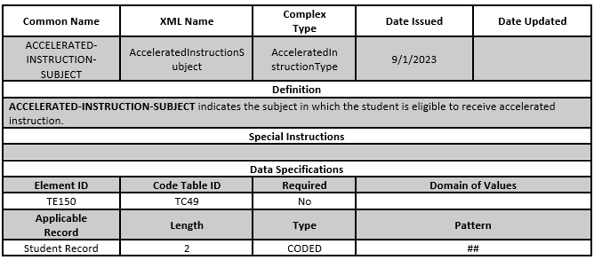
DATA ELEMENT UPDATES 2
Added a new data element TE150 ACCELERATED-INSTRUCTION-SUBJECT (HB 1416, 88th Legislative Session)

Slide 6
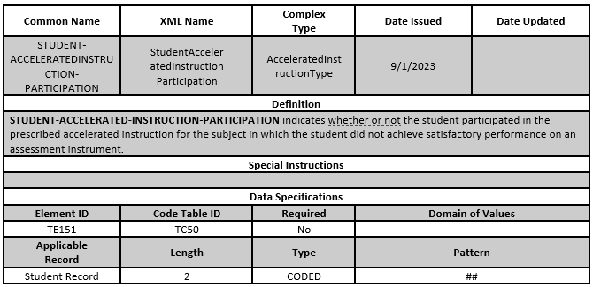
DATA ELEMENT UPDATES 3
Added a new data element TE151 STUDENT-ACCELERATED-INSTRUCTION-PARTICIPATION (HB 1416, 88th Legislative Session)

Slide 7
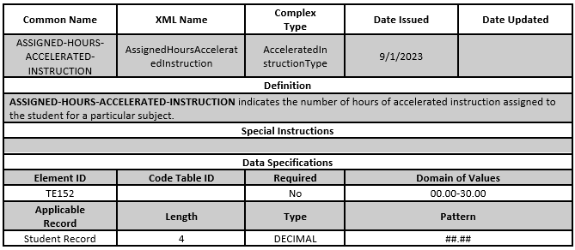
DATA ELEMENT UPDATES 4
Added a new data element TE152 ASSIGNED-HOURS-ACCELERATED-INSTRUCTION (HB 1416, 88th Legislative Session)

Slide 8
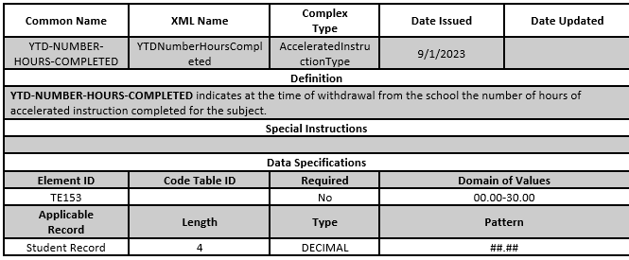
DATA ELEMENT UPDATES 5
Added a new data element TE153 YTD-NUMBER-HOURS-COMPLETED (HB 1416, 88th Legislative Session)

Slide 9
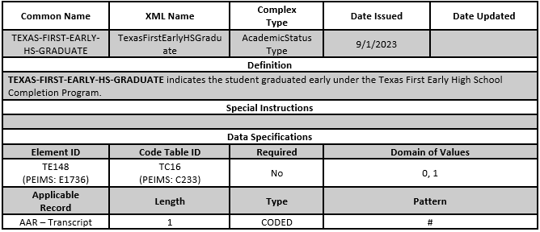
DATA ELEMENT UPDATES 6
Added a new data element TE148 TEXAS-FIRST-EARLY-HS-GRADUATE (SB 1888, 87th Legislative Session)

Slide 10
DATA ELEMENT UPDATES 7
No Deleted Data Elements

Slide 11
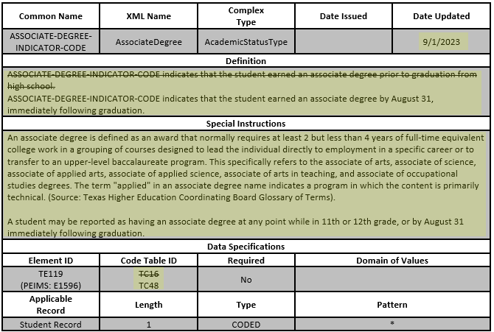
DATA ELEMENT UPDATES 8
REVISED the data element TE119 ASSOCIATE-DEGREE-INDICATOR-CODE (HB 8, 88th Legislative Session)

Slide 12
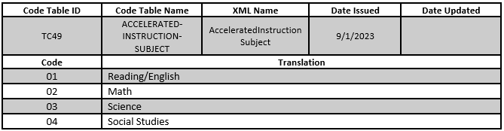
CODE TABLE UPDATES 1
Added a new code table TC49 ACCELERATED-INSTRUCTION-SUBJECT (HB 1416, 88th Legislative Session)

Slide 13
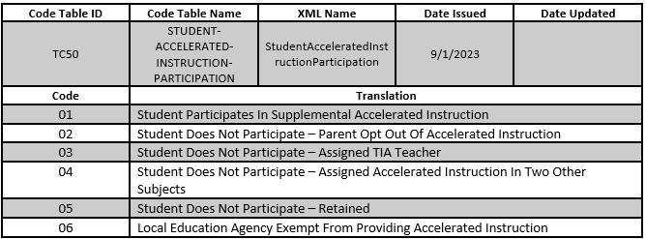
CODE TABLE UPDATES 2
Added a new code table TC50 STUDENT-ACCELERATED-INSTRUCTION-PARTICIPATION (HB 1416, 88th Legislative Session)

Slide 14
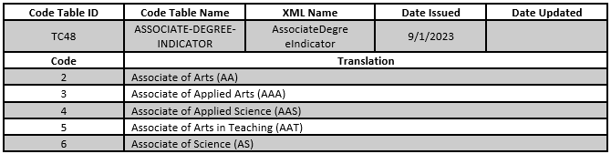
CODE TABLE UPDATES 3
Added a new code table TC48 ASSOCIATE-DEGREE-INDICATOR (HB 8, 88th Legislative Session)

Slide 15
CODE TABLE UPDATES 4
No Deleted Code Tables

Slide 16
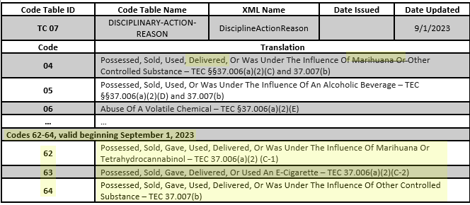
CODE TABLE UPDATES 5
Revised the code table TC07 DISCIPLINARY-ACTION-REASON (HB 114, 88th Legislative Session)

Slide 17
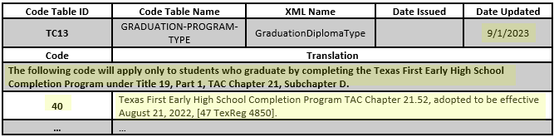
CODE TABLE UPDATES 6
Revised the code table TC13 GRADUATION-PROGRAM-TYPE (SB 1888, 87th Legislative Session)

Slide 18
REMINDERS 1
Legislative Updates (HB 3, 88th Legislative Session):
HB 3 amends TEC §25.002(a) to include in the documents required to be transferred when a student moves from one school to a new school a copy of the child’s disciplinary record and any threat assessment involving the child’s behavior under §37.115.
TEA has developed a method in TREx to transfer five prior years of student discipline records using the PEIMS Summer discipline records. LEAs also need to send threat assessment information and current year discipline records from one LEA to a new LEA at the time of a student’s transfer. TEA has added 11 new, revised three existing and deleted one data element. TEA has also added two new code tables.

Slide 19
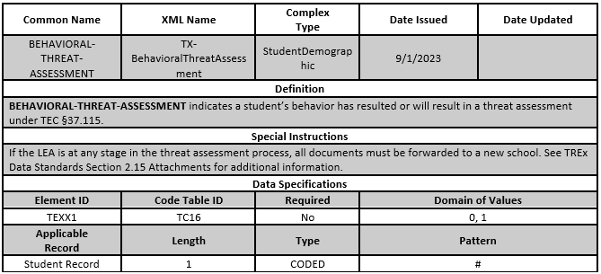
REMINDERS 2
Added a new data element TE154 BEHAVIORAL-THREAT-ASSESSMENT:
  To indicate the behavior of a student resulted in a review by the Safe and Supportive School Team.

Slide 20
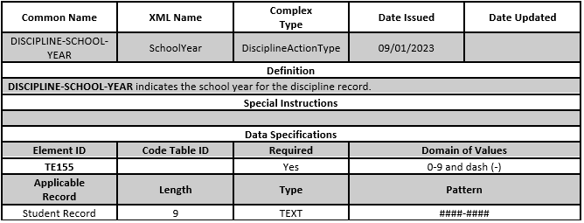
REMINDERS 3
Added a new data element TE155 DISCIPLINE-SCHOOL-YEAR:
  To the TREx DisciplineAction complex type to allow an LEA to transmit discipline actions for a student.

Slide 21
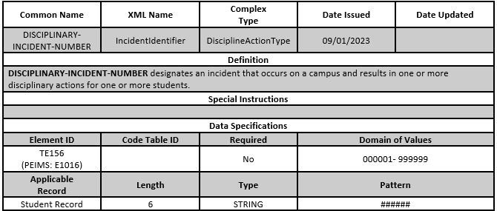
REMINDERS 4
Added a new data element TE156 DISCIPLINARY-INCIDENT-NUMBER:
  To the TREx DisciplineAction complex type to allow an LEA to transmit discipline actions for a student.

Slide 22
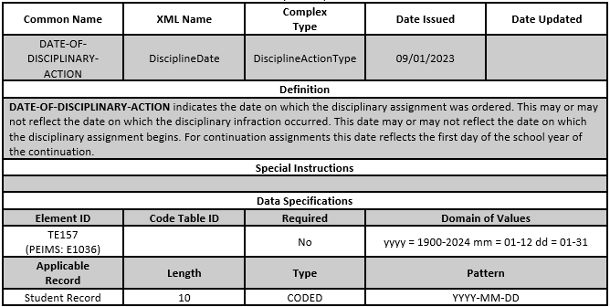
REMINDERS 5
Added a new data element TE157 DATE-OF-DISCIPLINARY-ACTION:
  To the TREx DisciplineAction complex type to allow an LEA to transmit discipline actions for a student.

Slide 23
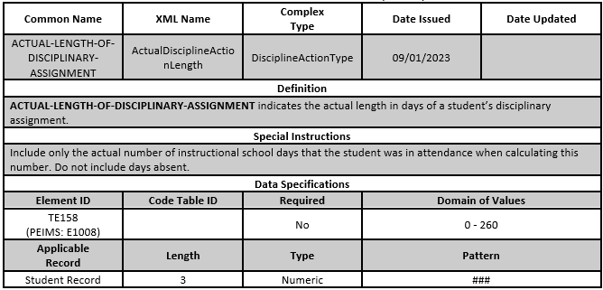
REMINDERS 6
Added a new data element TE158 ACTUAL-LENGTH-OF-DISCIPLINARY-ASSIGNMENT:
  To the TREx DisciplineAction complex type to allow an LEA to transmit discipline actions for a student.

Slide 24
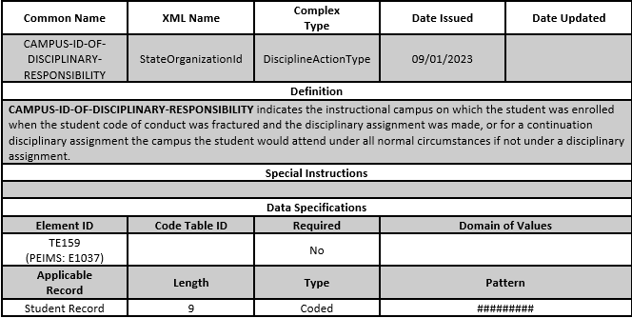
REMINDERS 7
Added a new data element TE159 CAMPUS-ID-OF-DISCIPLINARY-RESPONSIBILITY:
  To the TREx DisciplineAction complex type to allow an LEA to transmit discipline actions for a student.

Slide 25
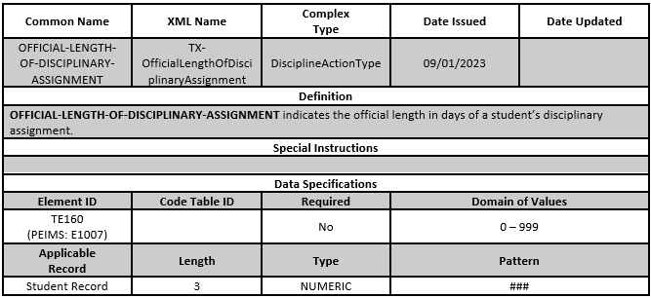
REMINDERS 8
Added a new data element TE160 OFFICIAL-LENGTH-OF-DISCIPLINARY-ASSIGNMENT:
  To the TREx DisciplineAction complex type to allow an LEA to transmit discipline actions for a student.

Slide 26
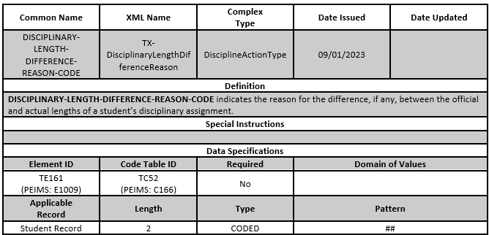
REMINDERS 9
Added a new data element TE161 DISCIPLINARY-LENGTH-DIFFERENCE-REASON-CODE:
  To the TREx DisciplineAction complex type to allow an LEA to transmit discipline actions for a student.

Slide 27
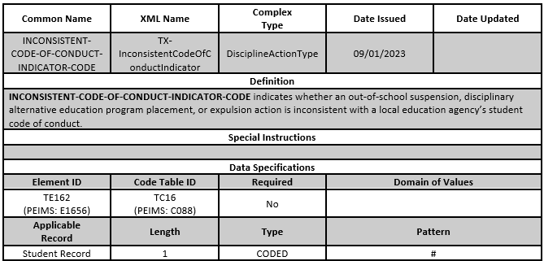
REMINDERS 10
Added a new data element TE162 INCONSISTENT-CODE-OF-CONDUCT-INDICATOR-CODE:
  To the TREx DisciplineAction complex type to allow an LEA to transmit discipline actions for a student.

Slide 28
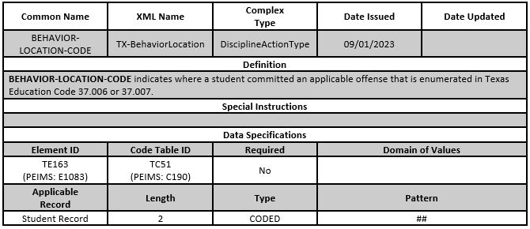
REMINDERS 11
Added a new data element TE163 BEHAVIOR-LOCATION-CODE:
  To the TREx DisciplineAction complex type to allow an LEA to transmit discipline actions for a student.

Slide 29
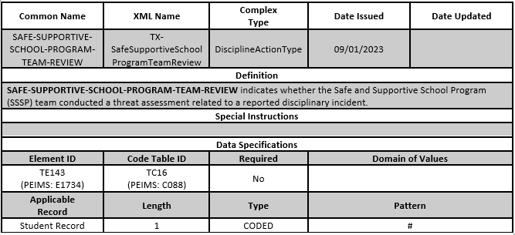
REMINDERS 12
Added a new data element TE143 SAFE-SUPPORTIVE-SCHOOL-PROGRAM-TEAM-REVIEW:
  To the TREx DisciplineAction complex type to allow an LEA to transmit discipline actions for a student.

Slide 30
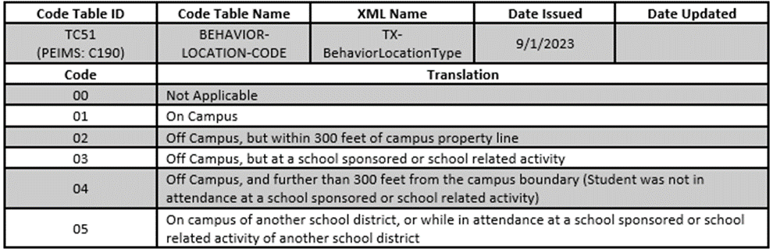
REMINDERS 13
Added a new code table TC51 BEHAVIOR-LOCATION-CODE:
  To the TREx DisciplineAction complex type to allow an LEA to transmit discipline actions for a student.

Slide 31
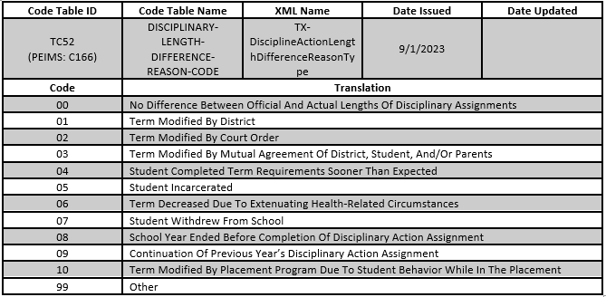
REMINDERS 14
Added a new code table TC52 DISCIPLINARY-LENGTH-DIFFERENCE-REASON-CODE:
  To the TREx DisciplineAction complex type to allow an LEA to transmit discipline actions for a student.

Slide 32
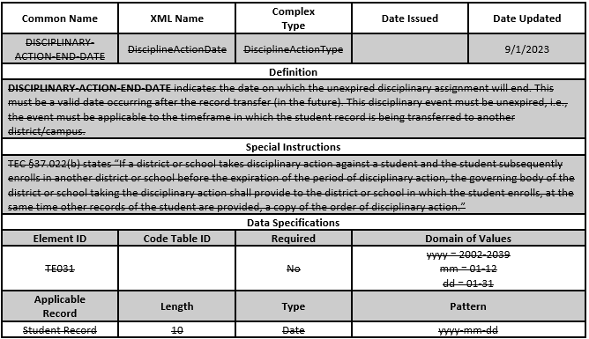
REMINDERS 15
Removed a data element TE031 DISCIPLINARY-ACTION-END-DATE:
  From the TREx DisciplineAction complex type.

Slide 33
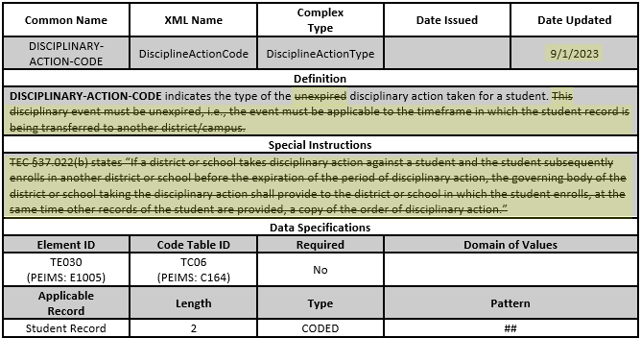
REMINDERS 16
Revised the data element TE030 DISCIPLINARY-ACTION-CODE

Slide 34
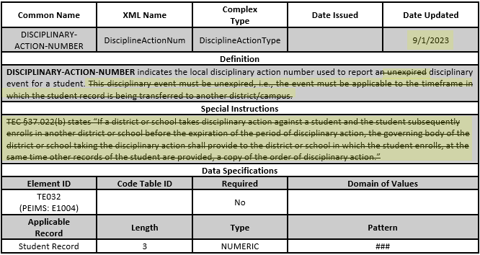
REMINDERS 17
Revised the data element TE032 DISCIPLINARY-ACTION-NUMBER

Slide 35
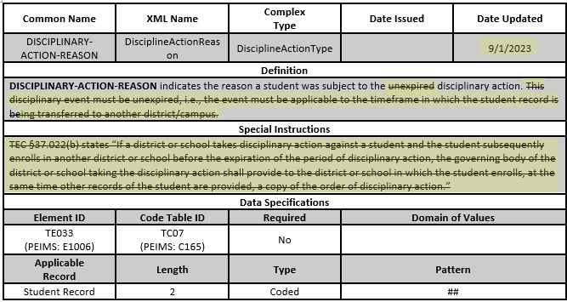
REMINDERS 18
Revised the data element TE033 DISCIPLINARY-ACTION-REASON

Slide 36
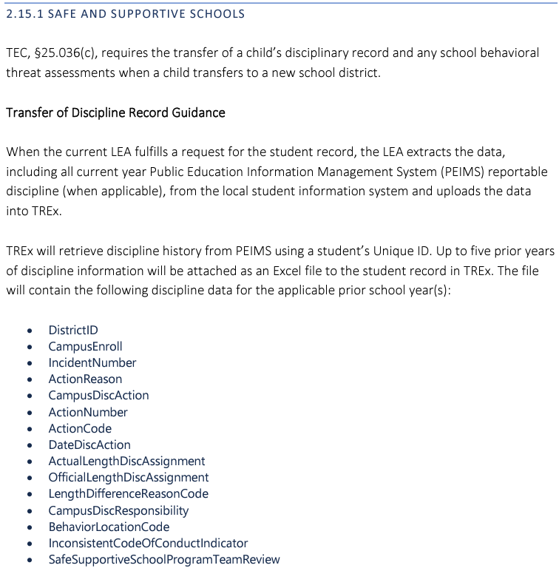
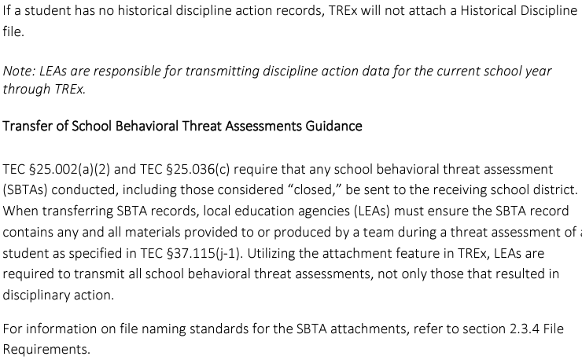
REMINDERS 19
New Subsection (v5.5 January 2024)
  2.15.1 Safe and Supportive School
    Transfer of Discipline Record Guidance
    Transfer of School Behavioral Threat Assessment Guidance

Slide 37
TITLE SLIDE: 2024-2025 School Year
2024-2025
SCHOOL YEAR
NAME OF COMPONENT (ALL CAPS)
MARCH 19-21, 2024

Slide 38
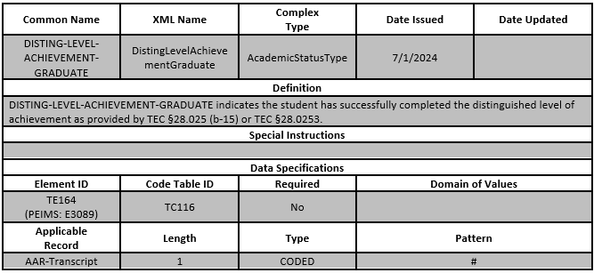
DATA ELEMENT UPDATES 9
Added a new data element TE164 DISTING-LEVEL-ACHIEVEMENT-GRADUATE

Slide 39
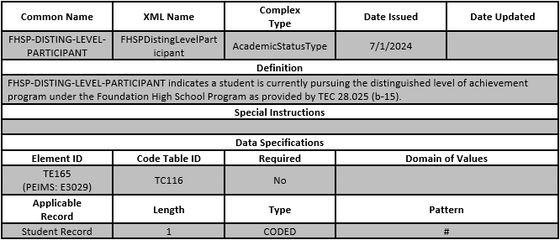
DATA ELEMENT UPDATES 10
Added a new data element TE165 FHSP-DISTING-LEVEL-PARTICIPANT

Slide 40
DATA ELEMENT UPDATES 112
Beginning with the 2023-2024 school year graduates, the data element TE104 FHSP-DISTING-LEVEL-ACHIEVE-INDICATOR-CODE is no longer used in TREx. The data element will remain in TREx for the transfer of records and transcripts of graduates prior to the 2023-2024 school year. Graduates from the 2023-2024 school year will use the following data elements:
    TE164 DISTING-LEVEL-ACHIEVEMENT-GRADUATE to indicate a student has earned a designation of distinguished level of achievement under the Texas First Early High School Completion Program and,
    TE165 FHSP-DISTING-LEVEL-PARTICIPANT to indicate the student is pursuing the distinguished level of achievement under Foundation High School Program (FHSP).

Slide 41
DATA ELEMENT UPDATES 12
No Updated Data Elements

Slide 42
TITLE SLIDE: Closeout
CLOSEOUT
NAME OF COMPONENT (ALL CAPS)
MARCH 19-21, 2024

Slide 43
REMINDERS 20
HB1, Sec 25.002 (a-1) requires each district to transfer student records within 10 working days of receipt of a request by the receiving district.

Slide 44
REMINDERS 21
TREx Notifications and Purges are PAUSED over breaks in the school year, such as annual breaks for Winter, Spring, and Summer to allow users additional time to fulfill requests and download records.
For Spring, retention windows and email notifications in TREx were paused on March 15, 2024, to prevent records and requests from being deleted by the system.
  TREx will be returning to normal operations on March 29, 2024. TREx users are urged to fulfill and/or download all records on or before that date.
  Starting on March 29, 2024, all records and requests older than 14 calendar days will be purged from the system and paused email notifications will resume their normal schedule.

Slide 45
FREQUENTLY ASKED QUESTIONS
When are the TREx Data Standards published?
The TREx Data Standards are published twice a year. In June/July, TEA publishes for the upcoming school year. In December/January TEA publishes updates for the current school year.
  For example, the initial standards for the 2023-2024 school year were published in August 2023. Due to the 88th Legislative Session, a subsequent version of the standards for the 2023-2024 school year were published in September 2023. Updates for the 2023-2024 school year were published in January 2024. For the 2024-2025 school year, initial standards will be published in June/July 2024.
Additional publications are provided on an ad-hoc basis, depending on legislative changes.

Slide 46

TECHNICAL RESOURCES
TIMS tickets can be created by clicking on the “ ” icon in the TREx application.
Questions can be sent via email to trex@tea.texas.gov.
To view the TREx Data Standards, visit the TEA webpage at Texas Records Exchange (TREx)

Slide 47
TECHNICAL RESOURCES 1
Additional information on record transfers can be found in the
  Student Attendance Accounting Handbook (SAAH) sections:
    Section 3.4.4 Information and Record of Transfer
    Section 4.3.3.1 Transfer of Records
  Texas Records Exchange (TREx) version 5.5 sections:
    Section 2.9 Student Records
    Section 2.15.1 Safe and Supportive School
  Texas Records Exchange (TREx) Training Materials section:
    Transfer of Disciplinary Record / Behavior Threat Assessment: Tutorial Video

Slide 48

QUESTIONS
QUESTIONS?

