Slide 1

TITLE SLIDE: ESC Vendor Training for One Component
TEXAS RECORDS EXCHANGE (TREx)
July 30-31, 2024, and August 1, 2024

Slide 2

AGENDA – TEXAS RECORDS EXCHANGE (TREx)
2024-2025 School Year
  Data Element Updates
  Code Table Updates
CLOSEOUT
  Reminders
  Frequently Asked Questions
  Technical Resources
  Questions

Slide 3

TITLE SLIDE: 2024-2025 School Year
2024-2025
SCHOOL YEAR
NAME OF COMPONENT (ALL CAPS)
MARCH 19-21, 2024

Slide 4
DATA ELEMENT UPDATES 112
NEW Beginning with the 2024-2025 school year, the data element TE104 FHSP-DISTING-LEVEL-ACHIEVE-INDICATOR-CODE is being replaced by two new data elements. TE104 will remain in TREx for the transfer of records and transcripts.
    TE164 DISTING-LEVEL-ACHIEVEMENT-GRADUATE indicates the student has successfully completed the distinguished level of achievement as provided by TEC §28.025 (b-15) or TEC §28.0253.
    TE165 FHSP-DISTING-LEVEL-PARTICIPANT indicates the student is currently pursuing the distinguished level of achievement under the Foundation High School Program as provided by TEC §28.025 (b-15).

Slide 5
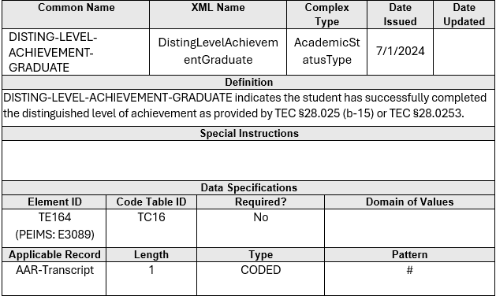
DATA ELEMENT UPDATES 9
Added a new data element TE164 DISTING-LEVEL-ACHIEVEMENT-GRADUATE

Slide 6
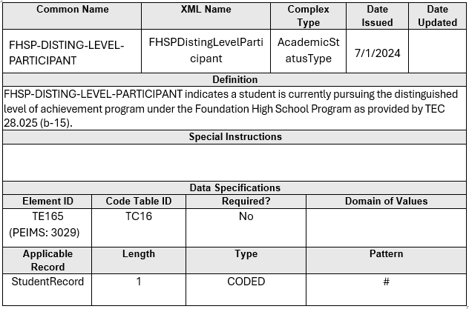
DATA ELEMENT UPDATES 10
Added a new data element TE165 FHSP-DISTING-LEVEL-PARTICIPANT

Slide 7
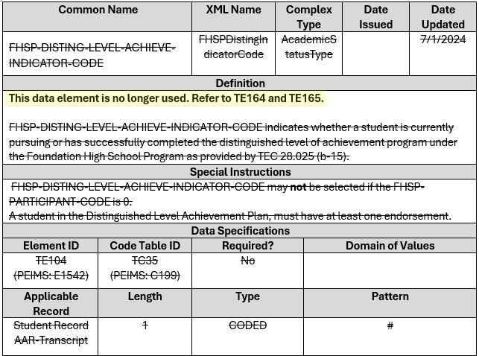
DATA ELEMENT UPDATES 110
NEW Revised data element TE104 FHSP-DISTING-LEVEL-ACHIEVE-INDICATOR-CODE

Slide 8
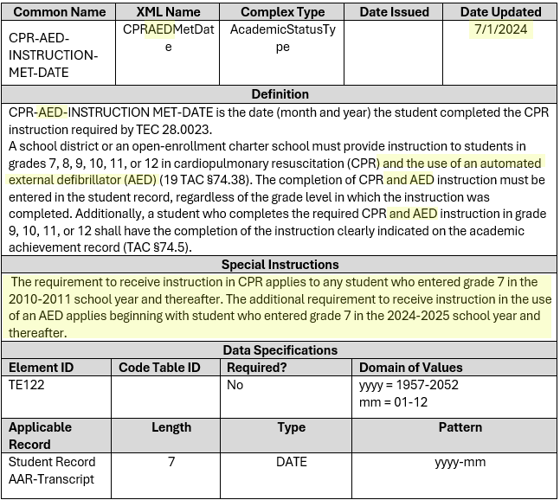
DATA ELEMENT UPDATES 12
NEW Revised both the data element and XML name for TE122 CPR-INSTRUCTION-MET-DATE

Slide 9
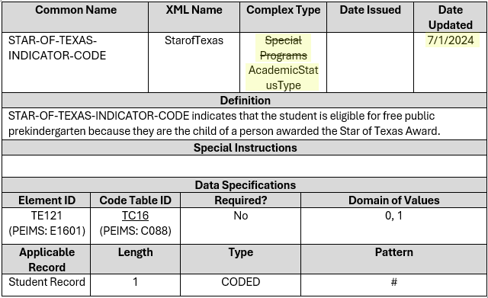
DATA ELEMENT UPDATES 122
NEW Revised the complex type for TE121 STAR-OF-TEXAS-INDICATOR-CODE

Slide 10
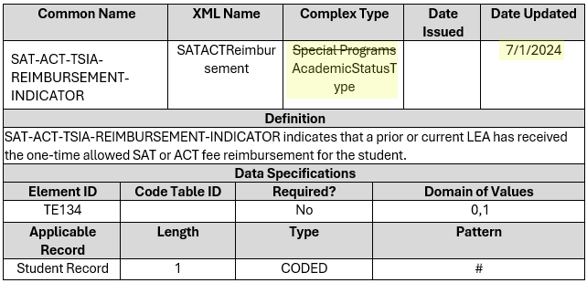
DATA ELEMENT UPDATES 123
NEW Revised the complex type for TE134 SAT-ACT-TSIA-REIMBURSEMENT-INDICATOR

Slide 11
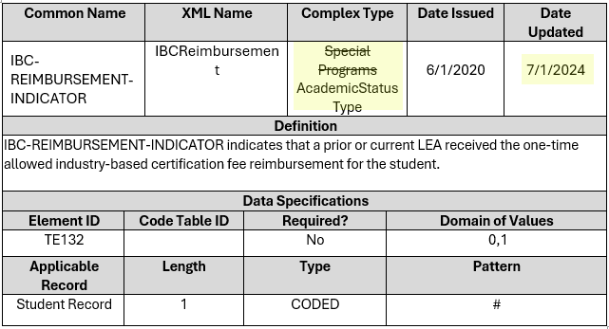
DATA ELEMENT UPDATES 124
NEW Revised the complex type for TE132 IBC-REIMBURSEMENT-INDICATOR

Slide 12
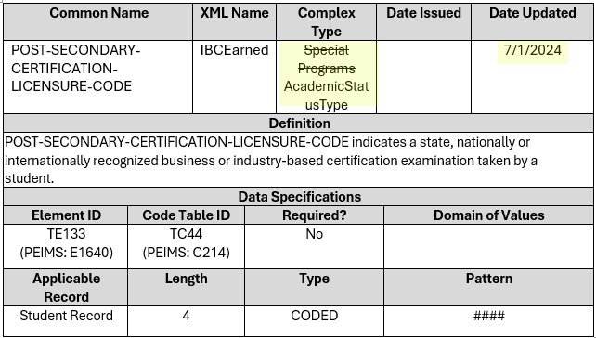
DATA ELEMENT UPDATES 125
NEW Revised the complex type for TE133 POST-SECONDARY-CERTIFICATION-LICENSURE-CODE

Slide 13
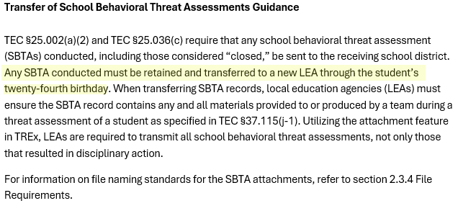
REMINDERS 19
NEW Revised 2.15.1 Safe and Supportive School
  Transfer of School Behavioral Threat Assessment Guidance

Slide 14
TITLE SLIDE: Closeout
CLOSEOUT
NAME OF COMPONENT (ALL CAPS)
MARCH 19-21, 2024

Slide 15
REMINDERS 20
HB1, Sec 25.002 (a-1) requires each district to transfer student records within 10 working days of receipt of a request by the receiving district.

Slide 16
REMINDERS 21
TREx Notifications and Purges are PAUSED over breaks in the school year, such as annual breaks for Winter, Spring, and Summer to allow users additional time to fulfill requests and download records.
For Summer, retention windows and email notifications in TREx were paused on Friday, June 7, 2024, to prevent records and requests from being deleted by the system.
  TREx will be returning to normal operations on Friday, September 13, 2024. TREx users are urged to fulfill and/or download all records on or before that date.
  Starting on Friday, September 13, 2024, all records and requests older than 14 calendar days will be purged from the system and paused email notifications will resume their normal schedule.
Revised for Summer Training

Slide 17
FREQUENTLY ASKED QUESTIONS
When are the TREx Data Standards published?
The TREx Data Standards are published twice a year. In June/July, TEA publishes for the upcoming school year. In December/January TEA publishes updates for the current school year.
  For example, the initial standards for the 2023-2024 school year were published in August 2023. Due to the 88th Legislative Session, a subsequent version of the standards for the 2023-2024 school year were published in September 2023. Updates for the 2023-2024 school year were published in January 2024.
For the 2024-2025 school year, initial standards were published in July 2024.
Additional publications are provided on an ad-hoc basis, depending on legislative changes.

Slide 18

TECHNICAL RESOURCES
TIMS tickets can be created by clicking on the “ ” icon in the TREx application.
Questions can be sent via email to trex@tea.texas.gov.
To view the TREx Data Standards, visit the TEA webpage at Texas Records Exchange (TREx) .

Slide 19
TECHNICAL RESOURCES 1
Additional information on record transfers can be found in the
  Student Attendance Accounting Handbook (SAAH) sections:
    Section 3.4.4 Information and Record of Transfer
    Section 4.3.3.1 Transfer of Records
  Texas Records Exchange (TREx) version 5.5 sections:
    Section 2.9 Student Records
    Section 2.15.1 Safe and Supportive School
  Texas Records Exchange (TREx) Training Materials section:
    Transfer of Disciplinary Record / Behavior Threat Assessment: Tutorial Video

Slide 20

QUESTIONS
QUESTIONS?

