Slide 1

TITLE SLIDE: ESC Vendor Training for One Component
<NAME OF COMPONENT> (ALL CAPS)
MARCH 19-21, 2024
CHANGES TO REPORTING LEAVERS AND GRADUATES
April 1, 2025

Slide 2

Agenda – Changes to Reporting Leavers and Graduates
Overview
Timeline
Data Collection Changes
  PEIMS Summer Submission
  PEIMS Extended Year Submission
Scenarios
Business Validations
Questions

Slide 3

TITLE SLIDE: Overview
OVERVIEW
NAME OF COMPONENT (ALL CAPS)
MARCH 19-21, 2024

Slide 4
Background
The U.S. Department of Education (ED) expects state data submissions to be timely, complete, and accurate on the due date. The Texas Education Agency (TEA) has never been in compliance with meeting federal reporting deadlines for certain EDFacts and Perkins files. TEA is unable to come into compliance because the data are not available for use until after the federal deadlines have passed.
For the second year in a row, ED has placed a condition on TEA’s Title I and Perkins funds, required corrective action on the Perkins grant, excluded Texas data from publicly available graduation rate reports, and excluded Texas from nationwide, public directory of districts and campuses.

Slide 5
Discussions
TEA had discussions regarding the current issues TEA is facing with federal reporting deadlines and the consequence of late reporting with internal TEA leadership, program area stakeholders, data governance committees (Information Task Force, Policy Committee on Public Education Information, and Data Governance), and formed a focus group consisting of district, charter, and ESC PEIMS Coordinators.
TEA has determined that the 2026-2027 school year is the first TEA could submit data on time due to the implementation of the Ed-Fi upgrade in 2024-2025.
The Research and Analysis Division met with the ED to provide a proposal to be on time with federal reporting by January 2027.

Slide 6
Resulting Changes
The Leavers and Graduates from the 2024-2025 school year will be reported in the 2025-2026 PEIMS Fall Submission.
The Leavers and Graduates from the 2025-2026 school year will be reported in the 2025-2026 PEIMS Summer and Extended Year Submissions.
The Leavers and Graduates from the 2026-2027 school year will be reported in the PEIMS Summer and Extended Year Submissions.

Slide 7
TITLE SLIDE: Timeline
TIMELINE
NAME OF COMPONENT (ALL CAPS)
MARCH 19-21, 2024

Slide 8
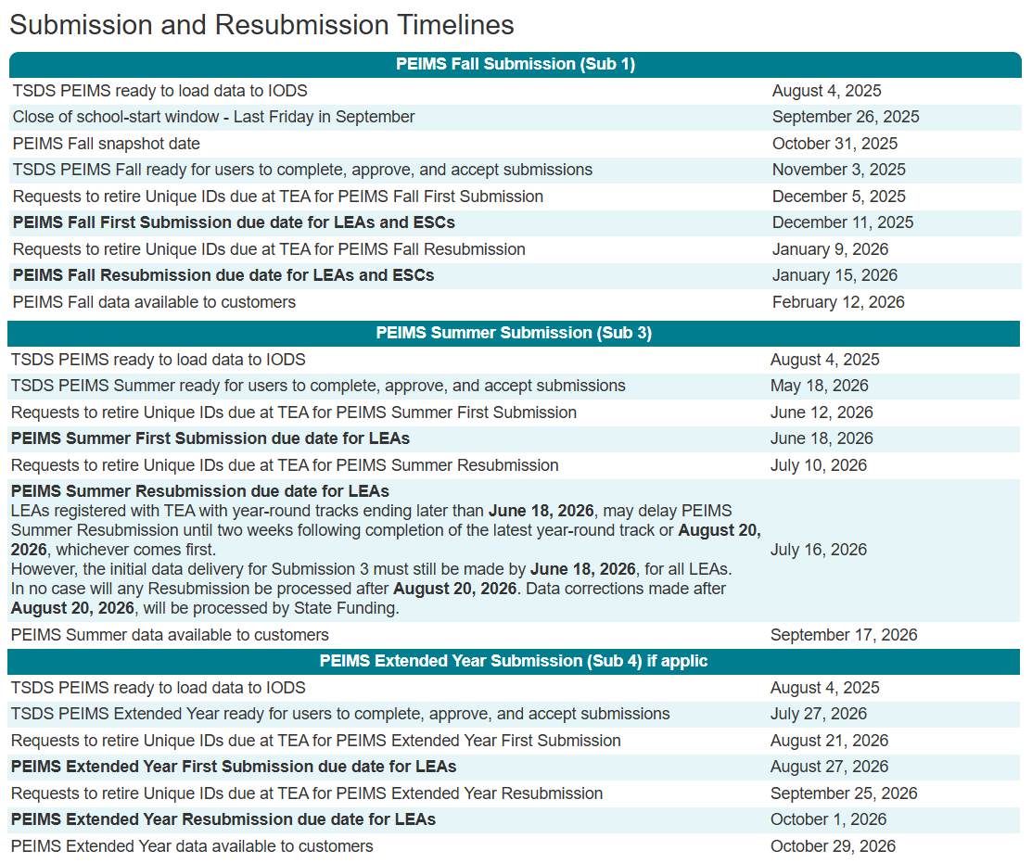
Timeline
2025-2026 School Year (Transition Year)
2024-2025 school year Leavers and Graduates reported in the 2025-2026 PEIMS Fall Submission.
2025-2026 school year Leavers and Graduates reported in the 2025-2026 PEIMS Summer and Extended Year Submissions.

Slide 9
TITLE SLIDE: Data Collection Changes
DATA COLLECTION CHANGES
NAME OF COMPONENT (ALL CAPS)
MARCH 19-21, 2024

Slide 10

TITLE SLIDE: PEIMS Summer
PEIMS SUMMER
NAME OF COMPONENT (ALL CAPS)
MARCH 19-21, 2024

Slide 11
PEIMS Summer Submission
2025-2026 School Year Leavers and Graduates
  PEIMS Summer First Submission and Resubmission students in grades 7 through 12:
    Who were enrolled at some time during the year but not on the final day of the school year (AsOfStatusLastDayEnrollment (C323) “I”).
    Who were enrolled on the final day of the school year (AsOfStatusLastDayEnrollment (C323) “H”), and the LEA now has documentation that the student has since entered a new educational setting. (Atypical situation).
    Who graduated between the first and last day of school.

Slide 12
Important Summer Information
Between the PEIMS Summer First Submission and Resubmission, TEA will reconcile any school-year movers and provide a preliminary list of underreported students.
Once the LEA meets the documentation standard that supports the exit withdraw type used, the LEA can but is not required to obtain additional leaver information for the student.

Slide 13
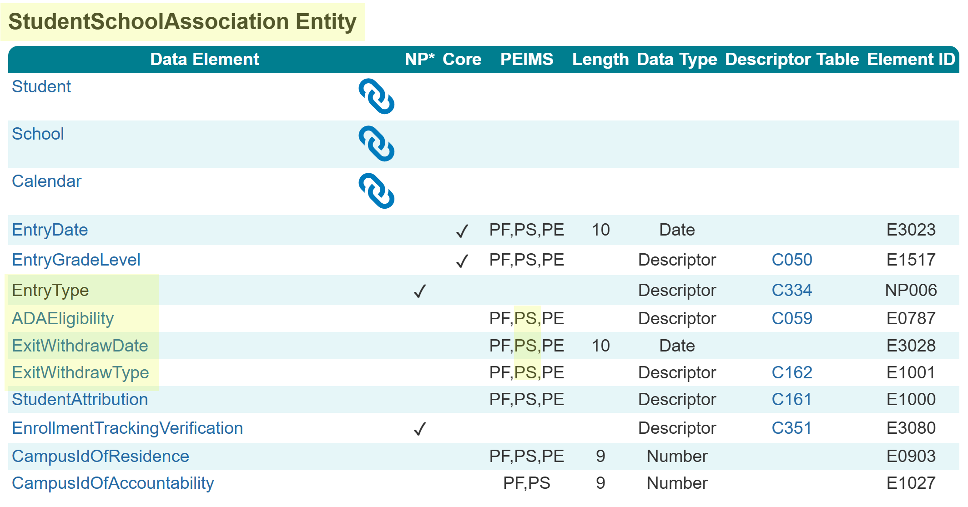
StudentSchoolAssociation Entity Summer
The following is added to the PEIMS Summer Submission:
  Data Elements:
    EntryType (NP006)
    ADAEligibility (E0787)
    ExitWithdrawDate (E3028)
    ExitWithdrawType (E1001)

Slide 14
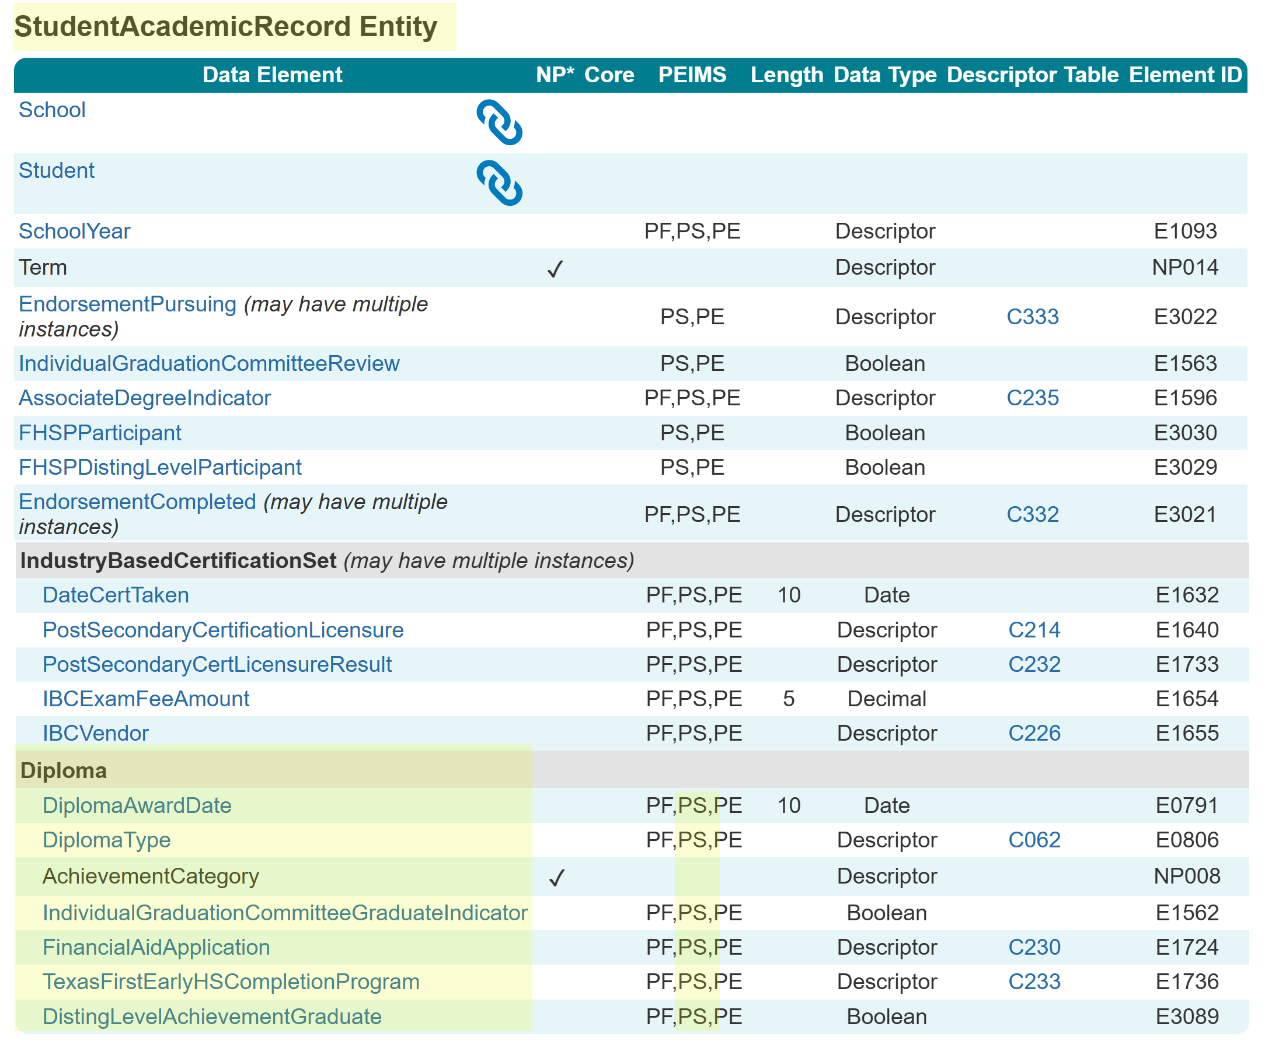
StudentAcademicRecord Entity Summer
The following is added to the PEIMS Summer Submission:
  Common Type:
    Diploma
  Data Elements:
    DiplomaAwardDate (E0791)
    DiplomaType (E0806)
    AchievementCategory (NP008)
    IndividualGraduationCommitteeGraduateIndicator (E1562)
    FinancialAidApplication (E1724)
    TexasFirstEarlyHSCompletionProgram (E1736)
    DistingLevelAchievementGraduate (E3089)

Slide 15
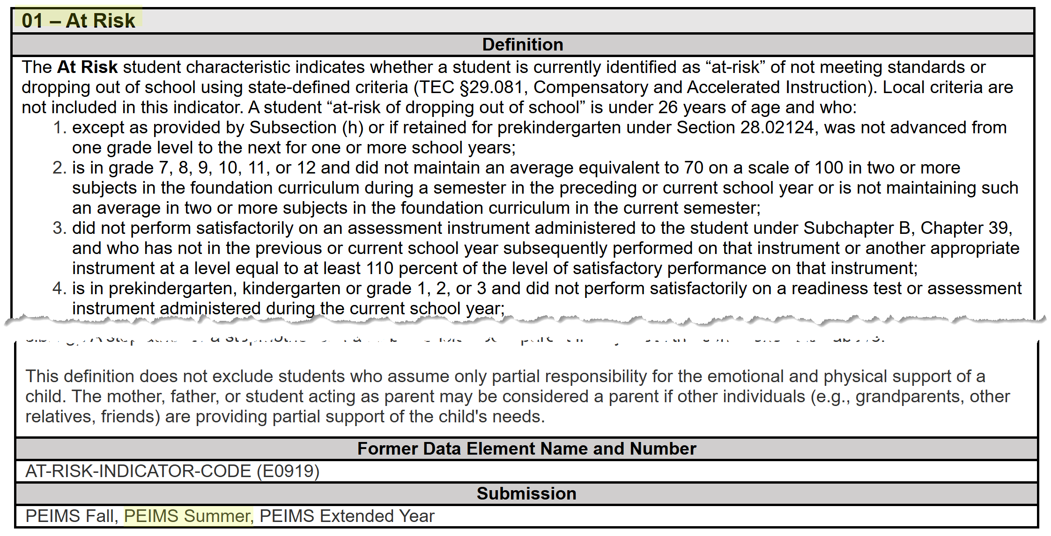
StudentCharacteristic – At Risk Summer
The StudentCharacteristic (C344) “01” At Risk will be added to the PEIMS Summer Submission:

Slide 16
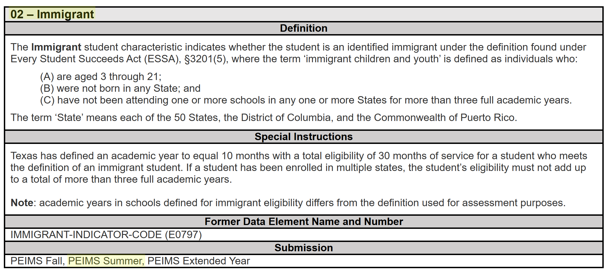
StudentCharacteristic – Immigrant Summer
The StudentCharacteristic (C344) “02” Immigrant will be added to the PEIMS Summer Submission:

Slide 17
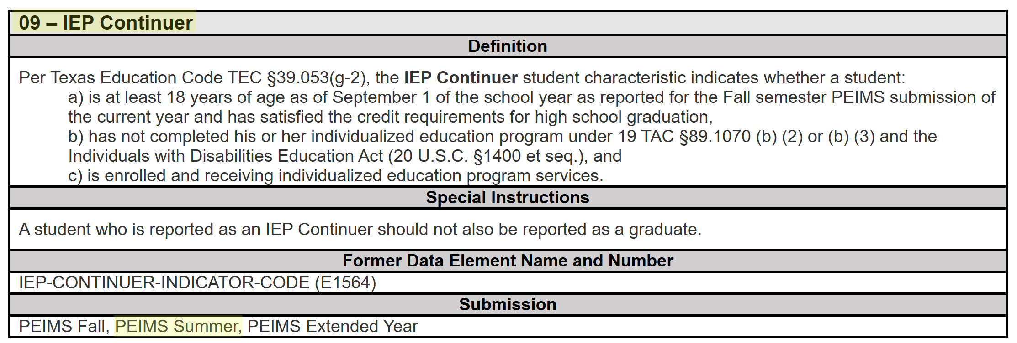
StudentCharacteristic – IEP Continuer Sum
The StudentCharacteristic (C344) “09” IEP Continuer will be added to the PEIMS Summer Submission:

Slide 18
TITLE SLIDE: PEIMS Extended Year
PEIMS EXTENDED YEAR
NAME OF COMPONENT (ALL CAPS)
MARCH 19-21, 2024

Slide 19
PEIMS Extended Year Submission
2025-2026 School Year Leavers and Graduates
  PEIMS Extended Year First Submission and Resubmission students in grades 7 through 12:
    Who were enrolled on the final day of the school year (AsOfStatusLastDayEnrollment (C323) “H”) and did not return during the school-start window.
    Who graduated during the summer months (Until August 31).
    For which additional leaver documentation was received, resulting in more accurate leaver information. When additional information is received, local policy will determine if a student's existing ExitWithdrawType (C162) is updated.

Slide 20
Important Extended Year Information
Between the PEIMS Extended Year First Submission and Resubmission, TEA will reconcile any movers and provide a preliminary list of underreported students.
If leaver or graduate information is reported in both the PEIMS Summer and Extended Year Submissions for a student, TEA will use the information provided in the PEIMS Extended Year Submission for state and federal reporting purposes.

Slide 21
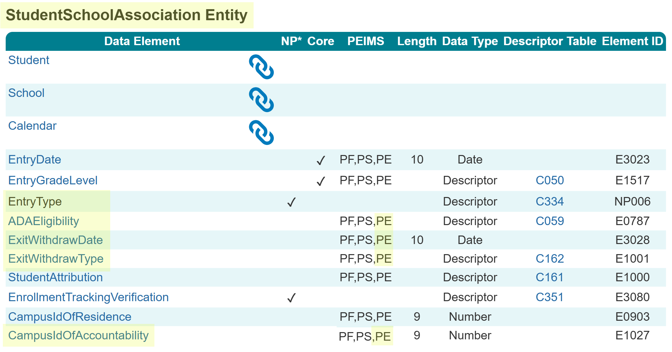
StudentSchoolAssociation Entity Extended
The following is added to the PEIMS Extended Year Submission:
  Data Elements:
    EntryType (NP006)
    ADAEligibility (E0787)
    ExitWithdrawDate (E3028)
    ExitWithdrawType (E1001)
    CampusIdOfAccountability (E1027)

Slide 22
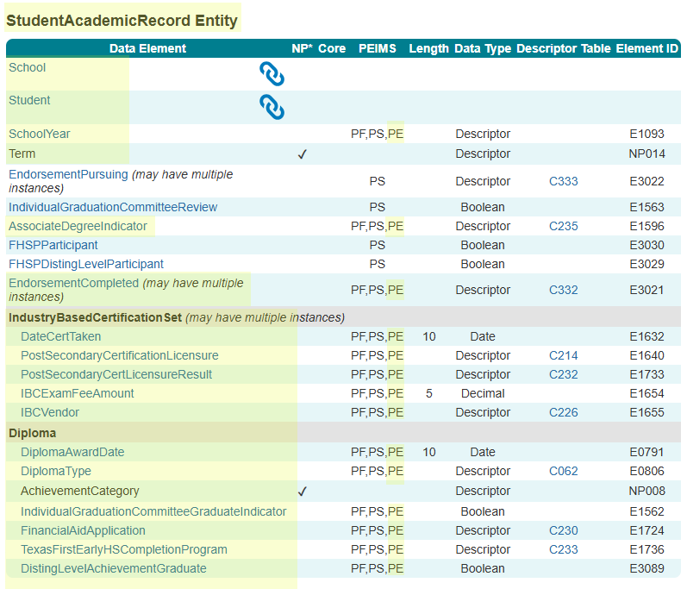
StudentAcademicRecord Entity Extended
The following is added to the PEIMS Extended Year Submission:
  Common Types:
    IndustryBasedCertificationSet
    Diploma
  Data Elements:
    AssociateDegreeIndicator (E1596)
    EndorsementCompleted (E3021)
    DateCertTaken (E1632)
    PostSecondaryCertificationLicensure (E1640)
    PostSecondaryCertLicensureResult (E1733)
    IBCExamFeeAmount (E1654)
    IBCVendor (E1655)

Slide 23
StudentAcademicRecord Entity Continued
  Data Elements Continued:
    DiplomaAwardDate (E0791)
    DiplomaType (E0806)
    AchievementCategory (NP008)
    IndividualGraduationCommitteeGraduateIndicator (E1562)
    FinancialAidApplication (E1724)
    TexasFirstEarlyHSCompletionProgram (E1736)
    DistingLevelAchievementGraduate (E3089)

Slide 24
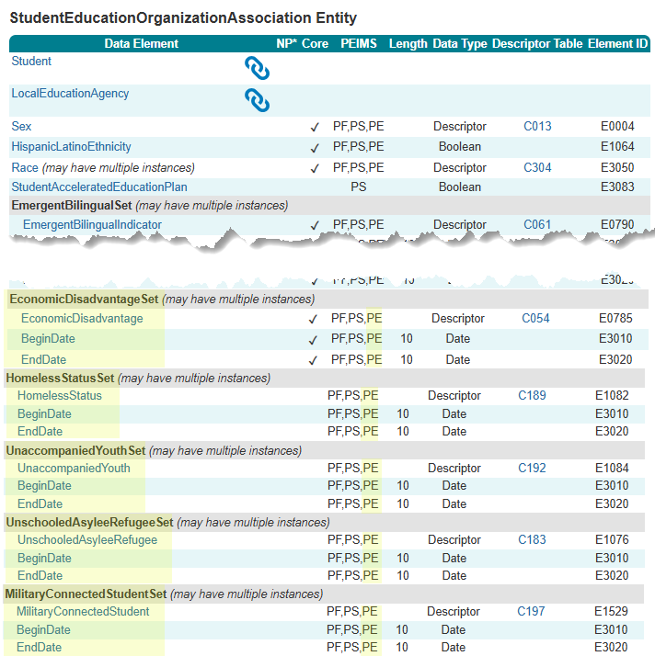
StudentEducationOrganizationAssociation Entity
The following is added to the PEIMS Extended Year Submission:
  Common Types:
    EconomicDisadvantageSet
    HomelessStatusSet
    UnaccompaniedYouthSet
    UnschooledAsyleeRefugeeSet
    MilitaryConnectedStudentSet
  Data Elements:
    EconomicDisadvantage (E0785)
    HomelessStatus (E1082)
    UnaccompaniedYouth (E1084)
    UnschooledAsyleeRefugee (E1076)
    MilitaryConnectedStudent (E1529)

Slide 25
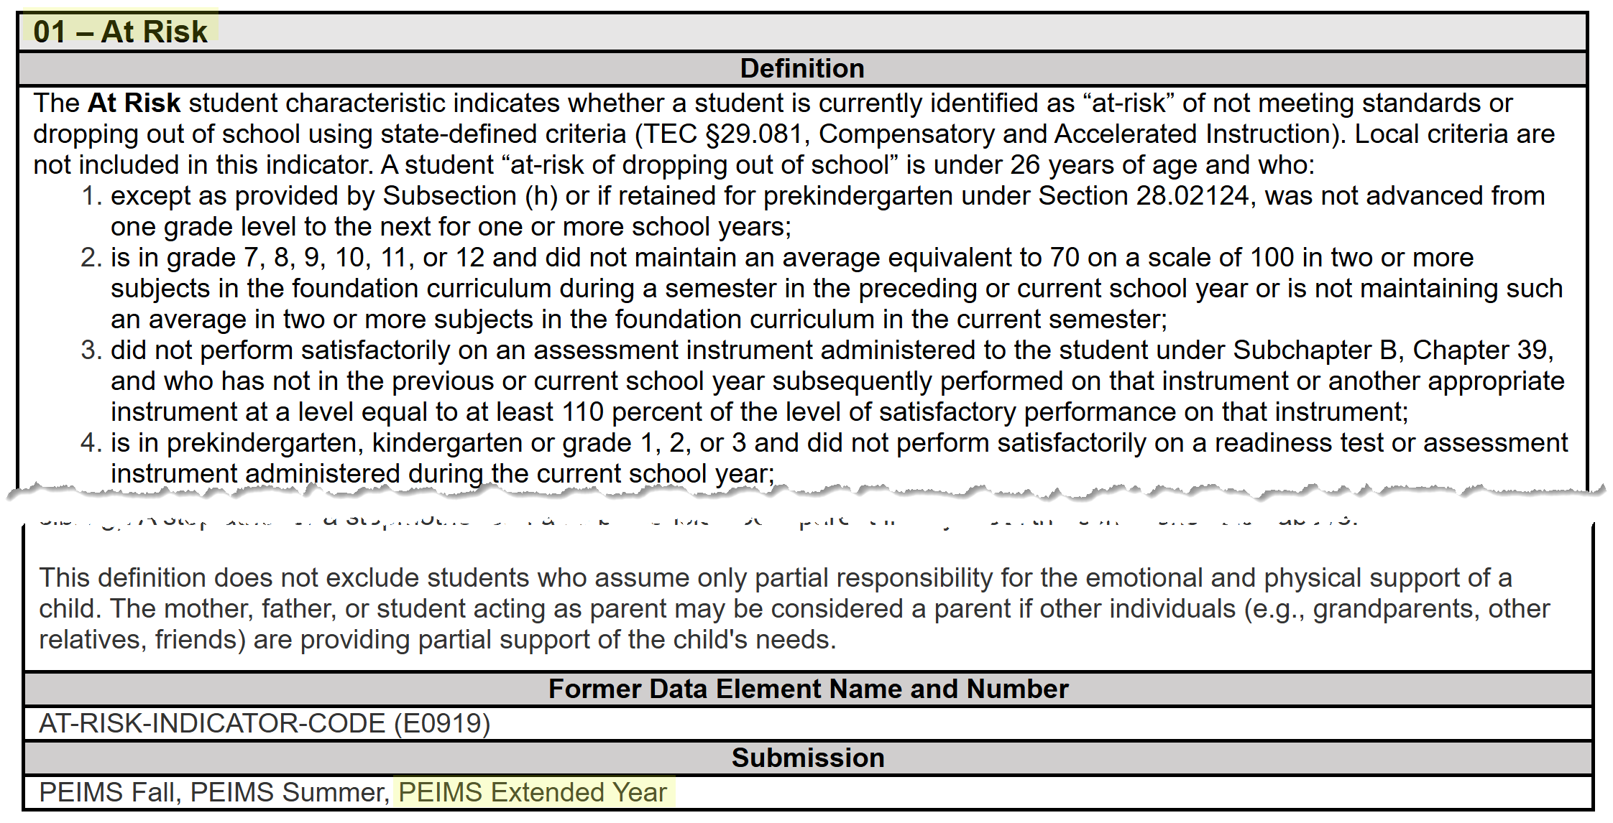
StudentCharacteristic – At Risk Extended
The StudentCharacteristic (C344) “01” At Risk will be added to the PEIMS Extended Year Submission:

Slide 26
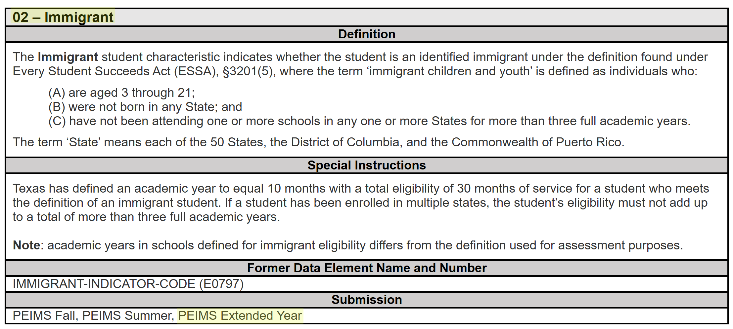
StudentCharacteristic – Immigrant Extended
The StudentCharacteristic (C344) “02” Immigrant will be added to the PEIMS Extended Year Submission:

Slide 27
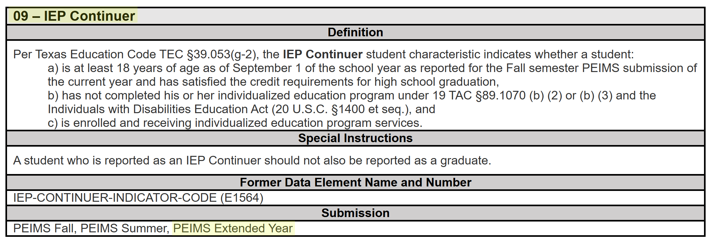
StudentCharacteristic – IEP Continuer Ext
The StudentCharacteristic (C344) “09” IEP Continuer will be added to the PEIMS Extended Year Submission:

Slide 28
TITLE SLIDE: Scenarios
SCENARIOS
NAME OF COMPONENT (ALL CAPS)
MARCH 19-21, 2024

Slide 29
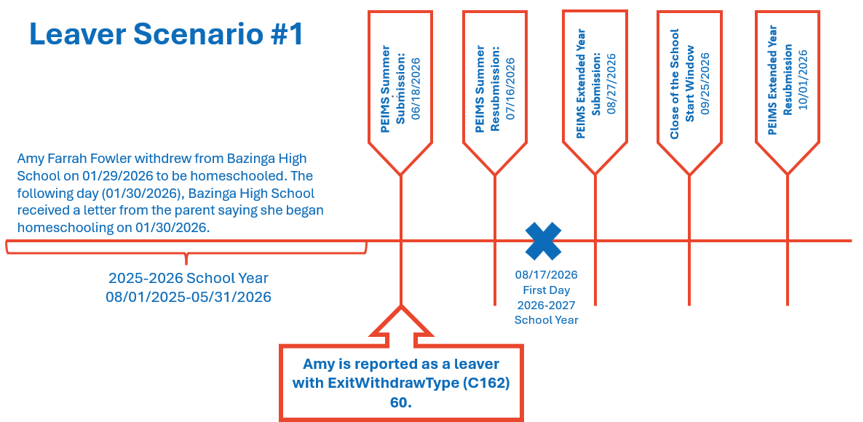
Leaver Scenario #1

Slide 30
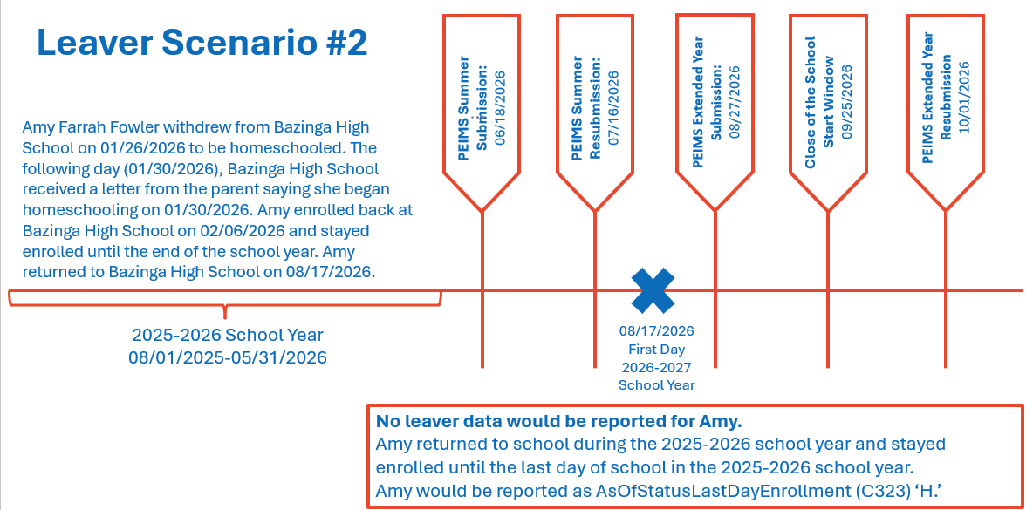
Leaver Scenario #2

Slide 31
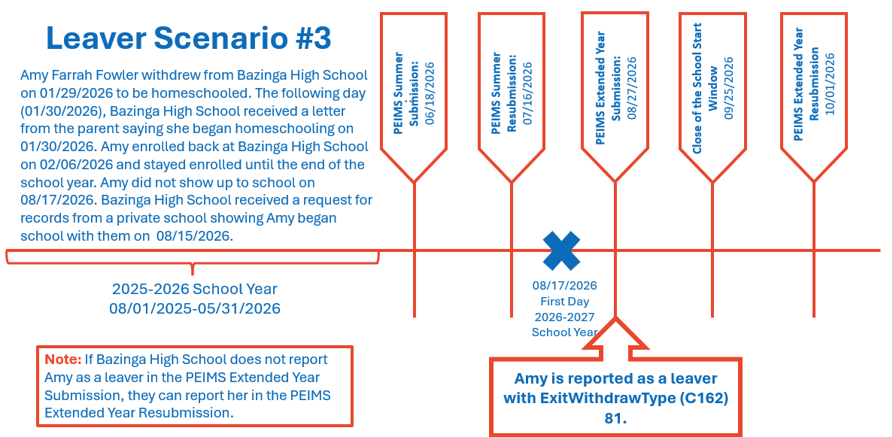
Leaver Scenario #3

Slide 32
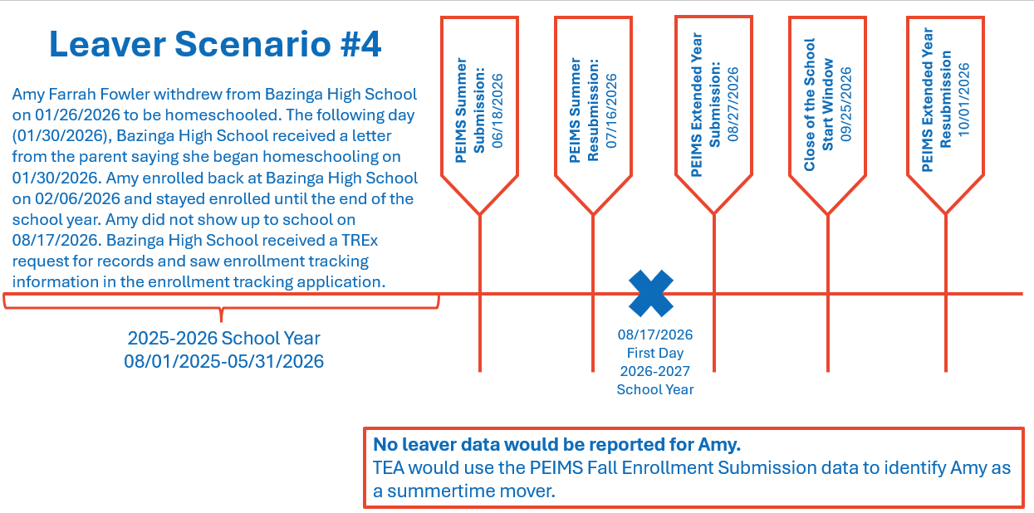
Leaver Scenario #4

Slide 33
TITLE SLIDE: Business Validations
BUSINESS VALIDATIONS
NAME OF COMPONENT (ALL CAPS)
MARCH 19-21, 2024

Slide 34
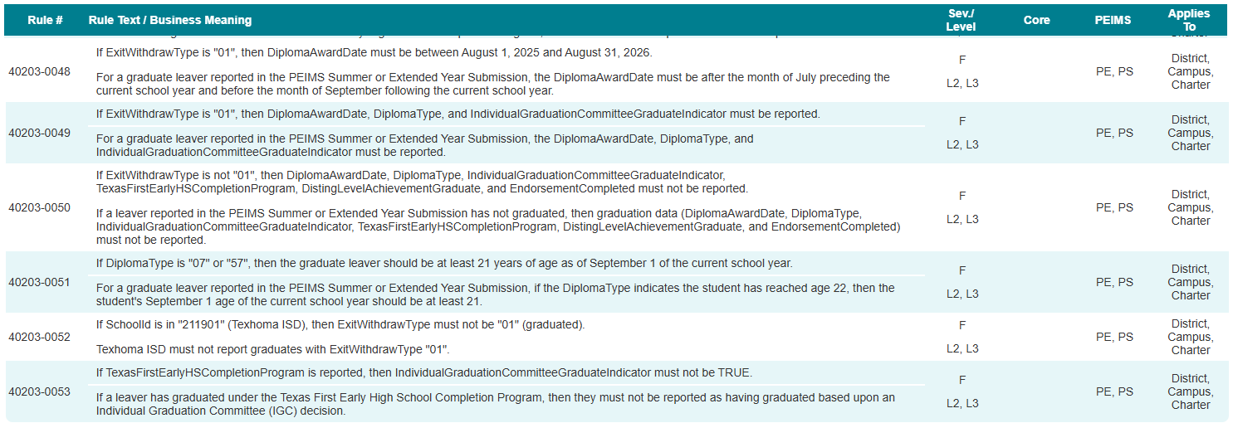
School Leaver Category
New rules added to the PEIMS Summer and Extended Year Submissions:

Slide 35
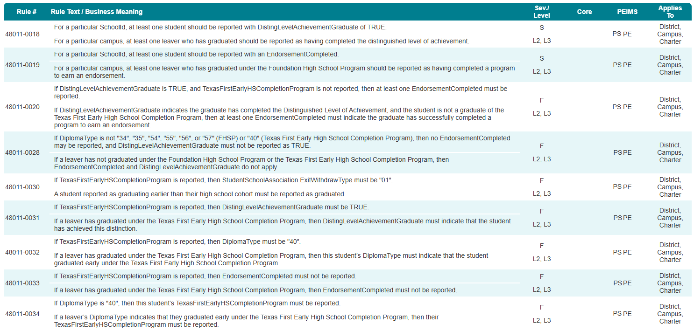
Student Graduation Program Category
PEIMS Fall Submission rules added to the PEIMS Summer and Extended Year Submissions:

Slide 36
Rule Summary
Rules added to the PEIMS Summer and Extended Year Submissions:
40203-0048 (New)
40203-0049 (New)
40203-0050 (New)
40203-0051 (New)
40203-0052 (New)
40203-0053 (New)
48011-0018 (PEIMS Fall)
48011-0019 (PEIMS Fall)
48011-0020 (PEIMS Fall)
48011-0026 (PEIMS Fall)
48011-0030 (PEIMS Fall)
48011-0031 (PEIMS Fall)
48011-0032 (PEIMS Fall)
48011-0033 (PEIMS Fall)
48011-0034 (PEIMS Fall)

Slide 37

QUESTIONS
QUESTIONS?

