Slide 1
OPEN PEIMS SUBMISSIONS
2024-2025
REACHING THE FINISH LINE

Slide 2
SESSION AGENDA
PEIMS Summer
PEIMS Extended Year

Slide 3
PEIMS Summer

Slide 4
PEIMS Summer New Reporting Requirements
SUMMER TRAINING 2024 Data Reporting:
Rural Pathway Excellence Partnership (RPEP)
NumberOfHoursInRPEP (E3090)
New descriptor as part of the Student Characteristics descriptor table (344)
Two new reports
PDM3-120-027 Roster of Students Participating in R-PEP
PDM3-130-021 Superintendent's Report of Rural Pathway Excellence Partnership (R-PEP) Hours & FTEs
Three new business rules
42400-0096
42400-0097
42400-0098

Slide 5
PEIMS Summer New Reporting Requirements 2
SUMMER TRAINING 2024 Data Reporting:
Accelerated Instruction
StudentAcceleratedEducationPlan (E3083)
New common type AcceleratedInstructionSet
E3084 AcceleratedInstructionSubject
E3085 StudentAcceleratedInstructionParticipation
E3086 AssignedHoursAcceleratedInstruction
E3087 CompletedHoursAcceleratedInstruction
E3088 DifferenceReasonHoursAcceleratedInstruction
New descriptor tables
StudentAcceleratedInstructionParticipation (C353)
DifferenceReasonHoursAceleratedInstruction (C354)
Two new reports
PDM3-120-025 Student Accelerated Instruction Roster
PDM3-120-026 Accelerated Instruction Summary Report
New business rules
40100-0254
40100-0255
40100-0256
40100-0257
40100-0258
40100-0259

Slide 6
PEIMS Summer New Reporting Requirements
SUMMER TRAINING 2024 Data Reporting:
Dropout Recovery Education Program
DropoutRecoveryCourseCompletion (E3097)
DropoutRecoveryCourseCompletion (C355)
New descriptor as part of the Student Characteristics descriptor table (344)
New Report
PDM3-133-003 Students Participating in Dropout Recovery Program
Two new business rules
40100-0261
43415-0079

Slide 7
PEIMS Summer Promotion Logic
PEIMS Summer Promotion Logic Highlights:
Student Basic Information
Base Promotion Logic
Census Block Group
Emergent Bilingual
Early Reading Indicator
Student Enrollment (Programs)
Base Promotion Logic
LEP Indicator
StudentCharacteristics
Course Completion
Base Promotion Logic
Student Section Association
Course Transcript
Data Collection Documentation

Slide 8
PEIMS Extended Year

Slide 9
PEIMS Extended Year Additional Days School Year
Reminders – Student
Grades PK - 5
Attendance tracked daily
Total days reported in PEIMS EXYR
Reported in ReportingPeriodExt entity
Uses Reporting Period 9
Reminders – Staff
AdditionalDaysProgramTeacher (E1673)
Reports in StaffSectionAssociation
Reminders – Calendar
ADSY CalendarType (E1600) ‘16’
180 days minimum submitted in PEIMS Summer
Up to 30 days submitted in PEIMS Extended Year
½ day funding

Slide 10
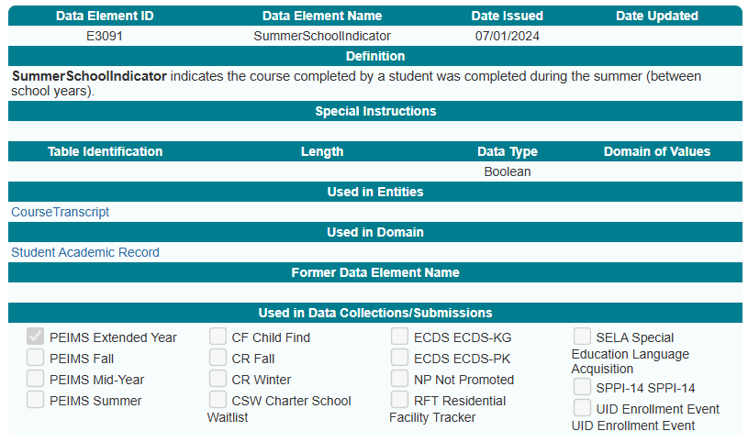
PEIMS Extended Year New Data Element
SummerSchoolIndicator (E3091)
The CourseTranscript Entity is reported for completed courses. (CourseCompletionIndicator is 'true') during the summer (between school years) for:
Career and Technical Education (CTE) courses,
Dual credit courses,
College Preparatory Course English Language Arts (CP110100), or
College Preparatory Course Mathematics (CP111200).

Slide 11
QUESTIONS

Slide 12
OPEN CORE SUBMISSIONS
2024-2025
REACHING THE FINISH LINE

Slide 13
CORE COLLECTION AGENDA
ECDS PK
SELA
RF TRACKER
CHILD FIND

Slide 14
Early Childhood Data System Prekindergarten

Slide 15
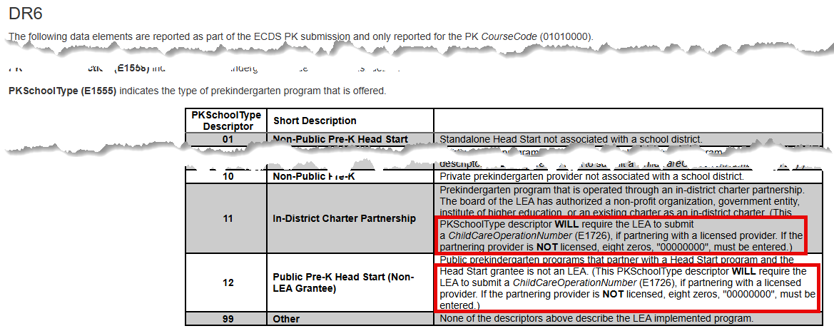
ECDS PK – Guidance Update
Guidance found in DR6 of Section Entity has been updated for the PKSchoolType (E1555) concerning descriptor codes ‘11’ and ‘12’.
This school type descriptor WILL require the LEA to submit a Child Care Operation Number, if partnering with a licensed provider. If the partnering provider is NOT licensed, eight zeros, "00000000", must be entered.)
Section Entity - DR6

Slide 16
ECDS PK – Descriptor Table Updates
TitleOfAssessment
C312
Changes to the TitleOfAssessment descriptor table
PKTeacherRequirement
C207
Two new descriptors added to the PKTeacherRequirement descriptor table
98 – PK teacher in a school district no additional HQPK Qualification
99 – Emp PK teacher in LEA no additional HQPK Qualification
Rules impacted by the change
30040-0049
30040-0057

Slide 17
Special Education Language Acquisition

Slide 18
SELA Descriptor Updates
ToolOrAssessmentUsed
C320
Updates to the descriptor table
Descriptor Table Name Changes
C318 (was DC160) – HearingAmplificationAccess
Two new descriptors “RS” and “ES”
One descriptor deleted “AS”
C319 (was DC161) - HearingAmplificationDailyUse

Slide 19
Current Known Issues - SELA 1
No current known issues as of March 20, 2025.
Notes:
CTE AUTO-CALCULATION UPDATES

Slide 20
Residential Facility Tracker

Slide 21
RF Tracker Mid-year Checkpoint2
Original mid-year checkpoint – December 13, 2024
Statewide extension – January 17, 2025
With a few additional extensions, 189 LEAs completed the checkpoint by January 21, 2025.

Slide 22
RF Tracker Rules Update 2
Reinstated rule: 10025-0001
ResidentialFacilityId must match an entry registered with the TEA as an active residential facility.
Added new rule: 40115-0013
ResidentialFacilityId must match an entry registered with TEA as an active residential facility.
Reasoning:
Ensures that the Residential Facility ID is active, and a valid number assigned by the Special Education Division. If there are no students reported residing in a residential facility during a school year, the residential facility will be inactivated for the next school year.

Slide 23
Current Known Issues – RF Tracker21
No current known issues as of March 20, 2025.

Slide 24
CHILD FIND

Slide 25
Child Find CHANGE to Compliance Timeline
Change to SPPI-11 compliance calculation for holdover students.
The standard SPPI-11 Eligibility Determination compliance timeline for students evaluated less than 30 calendar days before the end of the prior school year has been updated.
OLD: EligibilityDeterminationDate had to be completed no later than the 1st instructional day of the next school year.
NEW: EligibilityDeterminationDate must be completed no later than the 15th instructional day of the next school year.

Slide 26
Child Find CHANGE to Compliance Timeline 2
This change was made in the February 28, 2025 software release.
LEAs that promoted data to Child Find prior to this date should re-promote their submission data to re-calculate the compliance in this scenario.
The Child Find compliance flowcharts have been updated to reflect this change:
TSDSKB-620: SPPI-11 Compliance Flowchart
TSDSKB-650: Child Find Interactive Flowchart

Slide 27
Reminder - OriginalECIServicesDate
OriginalECIServicesDate (E1737)
Only reported for children receiving early childhood intervention (ECI) services.
Date must come before the child’s 3rd birthday.​
Children reported with a date less than 90 days before their 3rd birthday will have their compliance calculated through the SPPI-11 timeline.​
CHF0-100-002 SPPI-12 Student Compliance Report
Review the ‘Calc Days Til 3rd Bday Count’ column on this report.​
These children will show up on both the:
SPPI-11 reports CHF0-100-001, CHF0-100-003 and CHF0-100-005.
and be counted in both the SPPI-12 reports CHF0-100-002 and CHF0-100-004.

Slide 28
Current Known Issues – Child Find5 1
CalendarCode (E0975) promotion logic issue when a student's latest enrollment campus does not match their evaluation campus.
CHF0-100-003 TSDS SPPI-11 Aggregate Report
Row (a) is counting the total number of students reported in all of Child Find and should only be counting those being reported for SPPI-11.
Notes:
CTE AUTO-CALCULATION UPDATES

Slide 29
NEXT STEPS
Ensure your product is ready for all remaining open submissions.
Share product release schedule and roadmap of upcoming updates.
Provide any appropriate training and guidance on updated changes or features.
Establish effective support channels and opportunities for triaged support.

Slide 30
THANK YOU

