Slide 1

TITLE SLIDE: ESC Vendor Training for One Component
NEW PEIMS FALL ENROLLMENT SUBMISSION
April 1, 2025
<NAME OF COMPONENT> (ALL CAPS)
MARCH 19-21, 2024

Slide 2

Agenda – New PEIMS Fall Enrollment Submission
Overview
Timeline
New PEIMS Fall Enrollment Submission
PEIMS Fall Submission Impact
Business Validations
Questions

Slide 3

TITLE SLIDE: Overview
OVERVIEW
NAME OF COMPONENT (ALL CAPS)
MARCH 19-21, 2024

Slide 4
Background
The U.S. Department of Education (ED) expects state data submissions to be timely, complete, and accurate on the due date. The Texas Education Agency (TEA) has never been in compliance with meeting federal reporting deadlines for certain EDFacts and Perkins files. TEA is unable to come into compliance because the data are not available for use until after the federal deadlines have passed.
For the second year in a row, ED has placed a condition on TEA’s Title I and Perkins funds, required corrective action on the Perkins grant, excluded Texas data from publicly available graduation rate reports, and excluded Texas from nationwide, public directory of districts and campuses.

Slide 5
Discussions
TEA had discussions regarding the current issues TEA is facing with federal reporting deadlines and the consequence of late reporting with internal TEA leadership, program area stakeholders, data governance committees (Information Task Force, Policy Committee on Public Education Information, and Data Governance), and formed a focus group consisting of district, charter, and ESC PEIMS Coordinators.
TEA has determined that the 2026-2027 school year is the first TEA could submit data on time due to the implementation of the Ed-Fi upgrade in 2024-2025.
The Research and Analysis Division met with the ED to provide a proposal to be on time with federal reporting by January 2027.

Slide 6
Resulting Changes
The Leavers and Graduates from the 2025-2026 school year will be reported in the 2025-2026 PEIMS Summer and Extended Year Submissions.
The Leavers and Graduates from the 2026-2027 school year will be reported in the PEIMS Summer and Extended Year Submissions.
TEA will add a new submission to PEIMS. The PEIMS Fall Enrollment Submission.

Slide 7
TITLE SLIDE: Timeline
TIMELINE
NAME OF COMPONENT (ALL CAPS)
MARCH 19-21, 2024

Slide 8
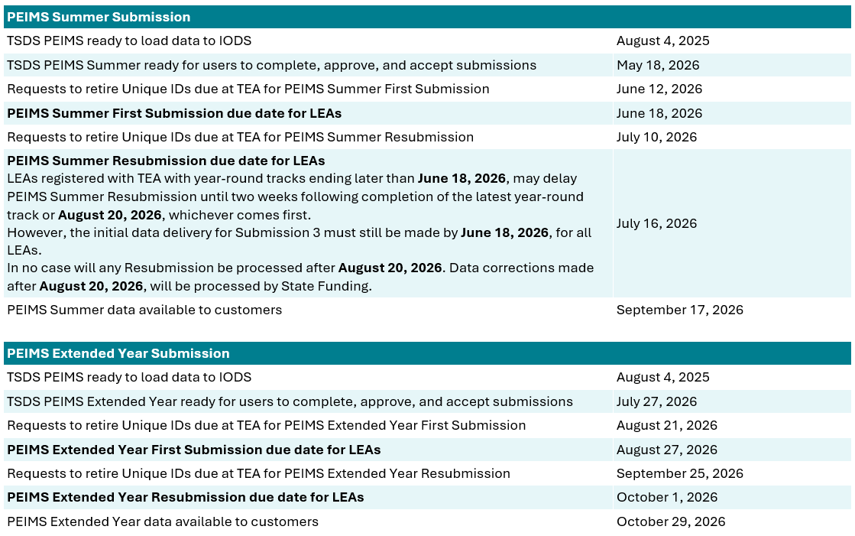
2025-2026 Timeline
2025-2026 School Year
2025-2026 school year Leavers and Graduates reported in the 2025-2026 PEIMS Summer and Extended Year Submissions.

Slide 9
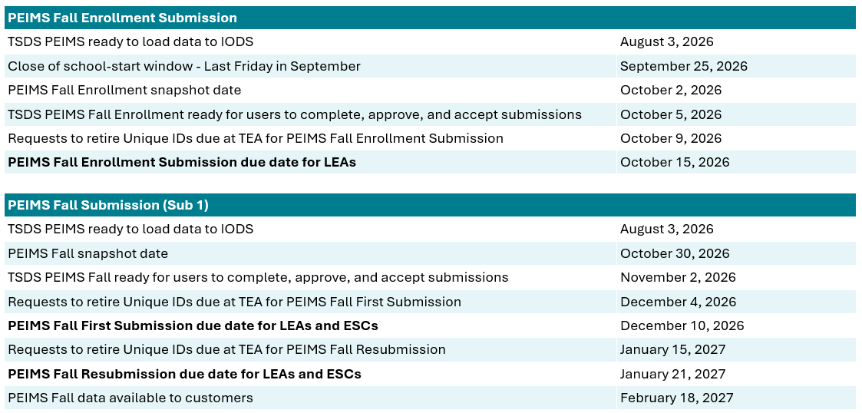
2026-2027 Timeline
2026-2027 School Year
New PEIMS Fall Enrollment Submission.
PEIMS Fall Submission excludes leavers and graduates.

Slide 10
TITLE SLIDE: New PEIMS Fall Enrollment Submission
NEW PEIMS FALL ENROLLMENT SUBMISSION
NAME OF COMPONENT (ALL CAPS)
MARCH 19-21, 2024

Slide 11
NEW PEIMS Fall Enrollment Submission
The PEIMS Fall Enrollment Submission will consist of:
  All students enrolled on the first Friday in October with their Special Education program determination and
  Students in grades 7-12 enrolled at any point during the school start window (first day of school through the last Friday in September).

Slide 12
Entities
The PEIMS Fall Enrollment Submission will consist of the following entities:
  LocalEducationAgency
  School
  StudentSchoolAssociation
  Student
  StudentEducationOrganizationAssociation
  Program
  StudentSpecialEducationProgramAssociation

Slide 13
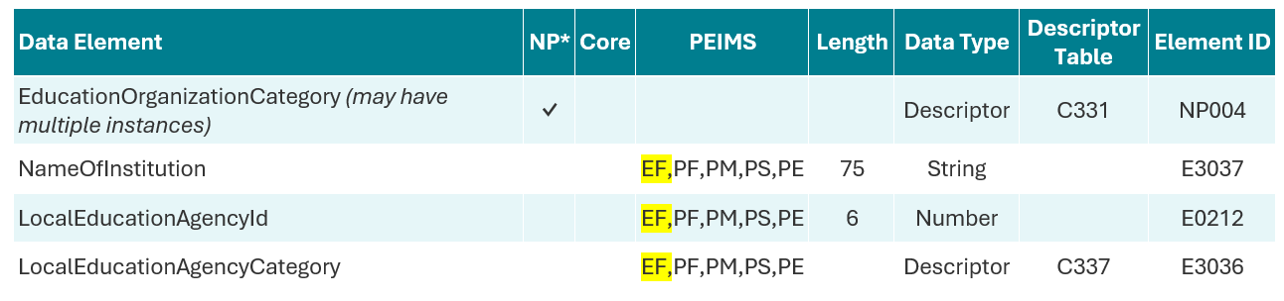
LocalEducationAgency Entity Summer
The following is added to the PEIMS Fall Enrollment Submission:
  Data Elements:
    EducationOrganizationCategory (NP004)
    NameOfInstitution (E3037)
    LocalEducationAgencyId (E0212)
    LocalEducationAgencyCategory (E3036)

Slide 14
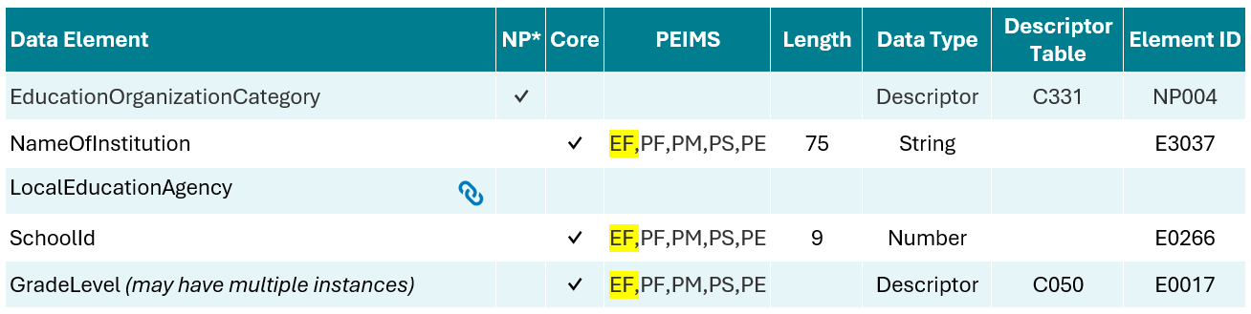
School Entity Summer
The following is added to the PEIMS Fall Enrollment Submission:
  Data Elements:
    EducationOrganizationCategory (NP004)
    NameOfInstitution (E3037)
    LocalEducationAgency (Reference)
    SchoolId (E0266)
    GradeLevel (E0017)

Slide 15
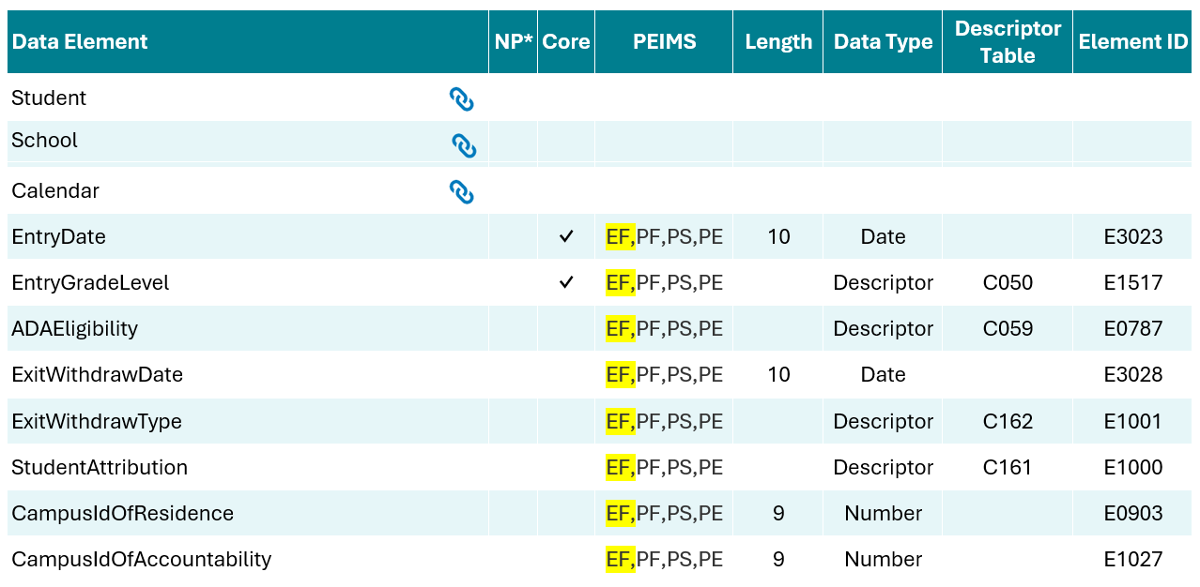
StudentSchoolAssociation Entity
The following is added to the PEIMS Fall Enrollment Submission:
  Data Elements:
    Student (Reference)
    School (Reference)
    Calendar (Reference)
    EntryDate (E3023)
    EntryGradeLevel (E1517)
    ADAEligibility (E0787)
    ExitWithdrawDate (E3028)
    ExitWithdrawType (E1001)
    StudentAttribution (E1000)
    CampusIdOfResidence (E0903)
    CampusIdOfAccountability (E1027)

Slide 16
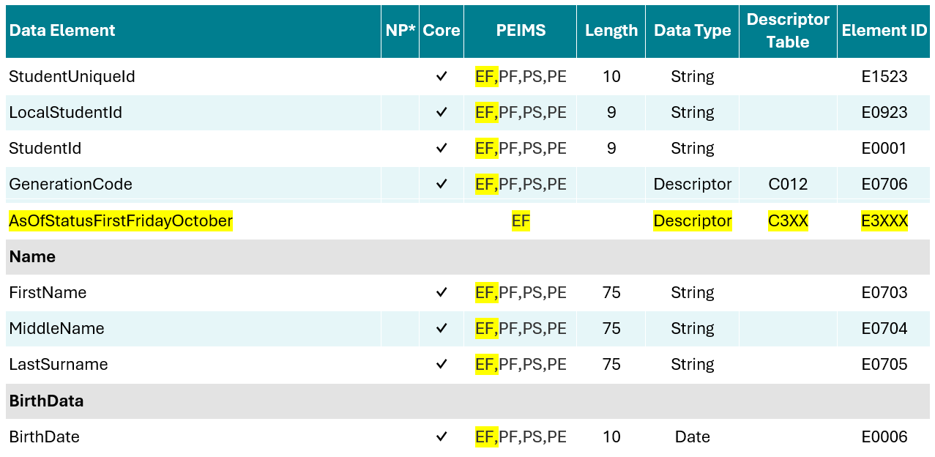
Student Entity
The following is added to the PEIMS Fall Enrollment Submission:
  Common Types:
    Name
    BirthData
  Data Elements:
    StudentUniqueId (E1523)
    LocalStudentId (E0923)
    StudentId (E0001)
    GenerationCode (E0706)
    AsOfStatusFirstFridayOctober (New)
    FirstName (E0703)
    MiddleName (E0704)
    LastSurname (E0705)
    BirthDate (E0006)

Slide 17
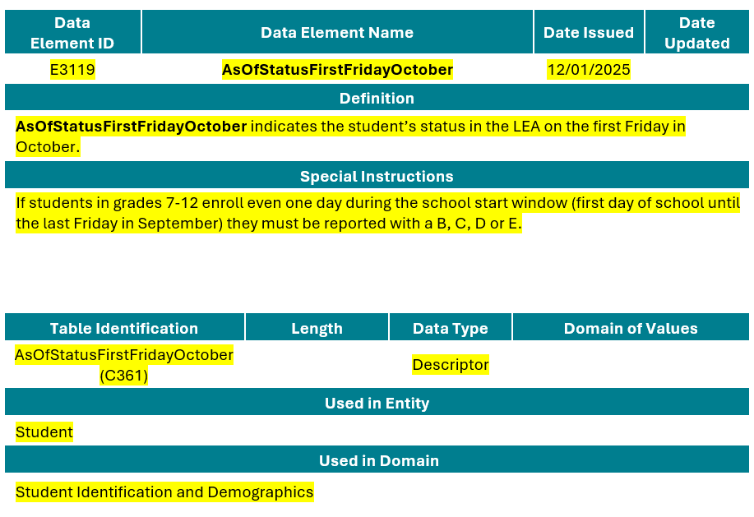
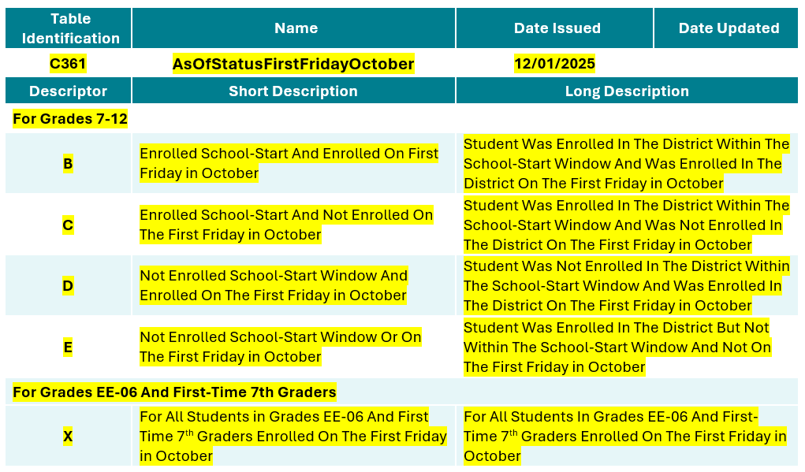
AsOfStatusFirstFridayOctober (New)

Slide 18
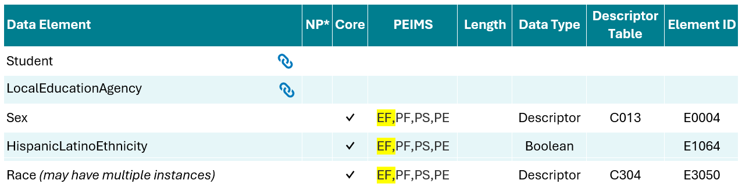
StudentEducationOrganizationAssociation Entity
The following is added to the PEIMS Fall Enrollment Submission:
  Data Elements:
    Student (Reference)
    LocalEducationAgency (Reference)
    Sex (E0004)
    HispanicLatinoEthnicity (E1064)
    Race (E3050)

Slide 19
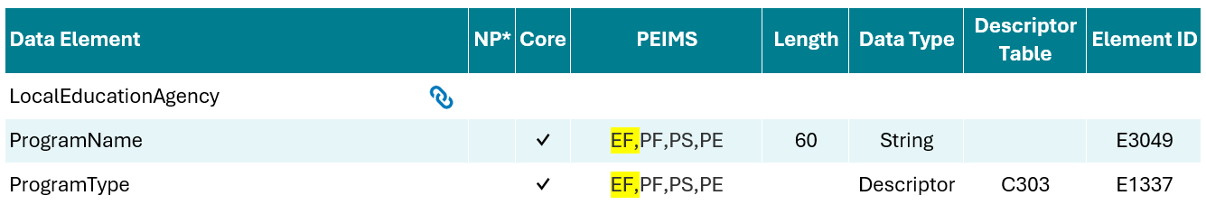
Program Entity
The following is added to the PEIMS Fall Enrollment Submission:
  Data Elements:
    Local Education Agency (Reference)
    ProgramName (E3049)
    ProgramType (E1337)

Slide 20
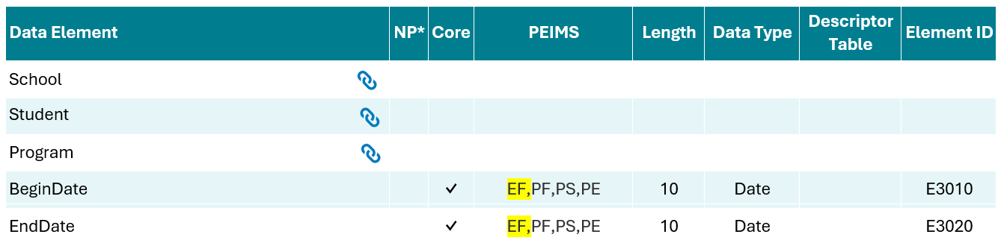
StudentSpecialEducationProgramAssociation Entity
The following is added to the PEIMS Fall Enrollment Submission:
  Data Elements:
    School (Reference)
    Student (Reference)
    Program (Reference)
    BeginDate (E3010)
    EndDate (E3020)

Slide 21
TITLE SLIDE: PEIMS Fall Submission Impact
PEIMS FALL SUBMISSION IMPACT
NAME OF COMPONENT (ALL CAPS)
MARCH 19-21, 2024

Slide 22
PEIMS Fall Submission Impact
The PEIMS Fall Submission will consist of:
  ONLY students enrolled on the last Friday in October,
  LEA budget, and
  Staff employed on the last Friday in October.

Slide 23
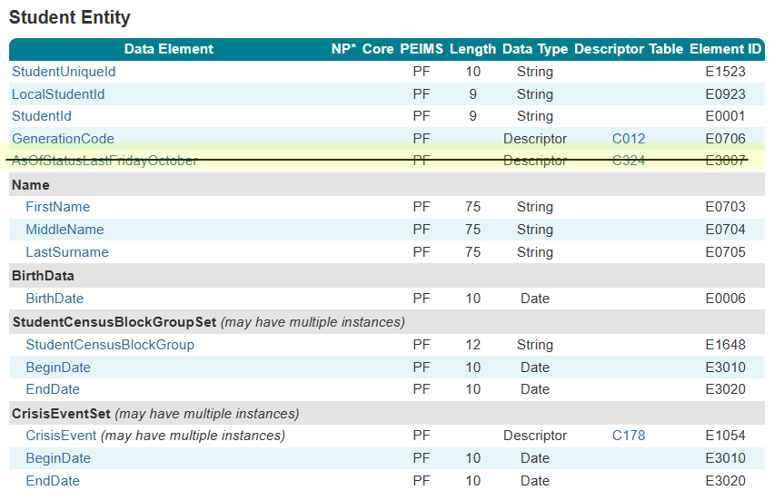
AsOfStatusLastFridayOctober (Removed)
The AsOfStatusLastFridayOctober will be removed from the Student Entity reported in the PEIMS Fall Submission.

Slide 24
Business Validation Impact
The following rules will be removed from the PEIMS Fall Submission:
10010-0099
10020-0036
40100-0002
40100-0004
40100-0006
40100-000G
40100-0040
40100-0043
40100-0044
40100-0051
40100-0052
40100-0055
40100-0074
40100-0095
40100-0110
40100-0113
40100-0114
40100-0119

Slide 25
Business Validation Impact, Cont.
The following rules will be removed from the PEIMS Fall Submission:
40100-0125
40100-0129
40100-0139
40100-0141
40100-0146
40100-0154
40100-0190
40100-0191
40100-0239
40100-0240
40110-0024
40110-0026
40110-0027
40110-0060
40110-0098
40110-0101
40110-0191
41461-0004

Slide 26
TITLE SLIDE: Business Validations
BUSINESS VALIDATIONS
NAME OF COMPONENT (ALL CAPS)
MARCH 19-21, 2024

Slide 27
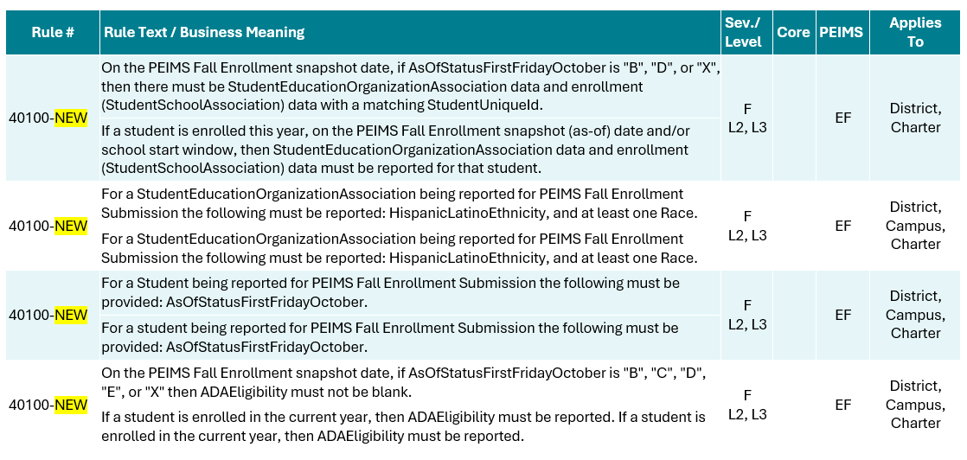
New Business Validations New1
New rules will be added to the PEIMS Fall Enrollment Submission such as:

Slide 28
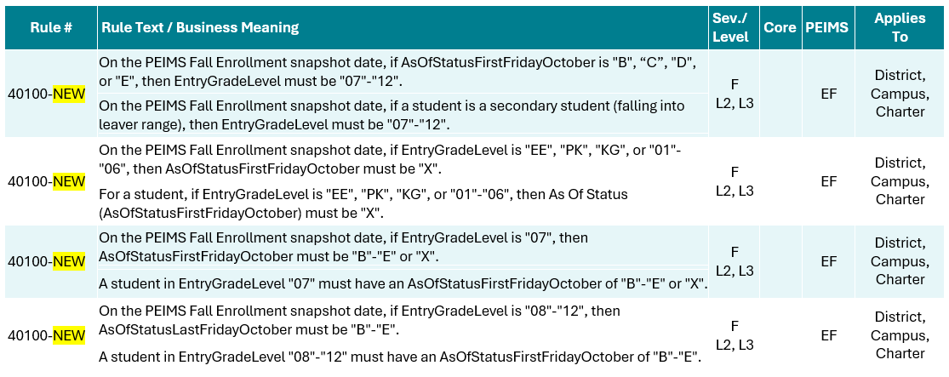
New Business Validations New 2
New rules will be added to the PEIMS Fall Enrollment Submission such as:

Slide 29
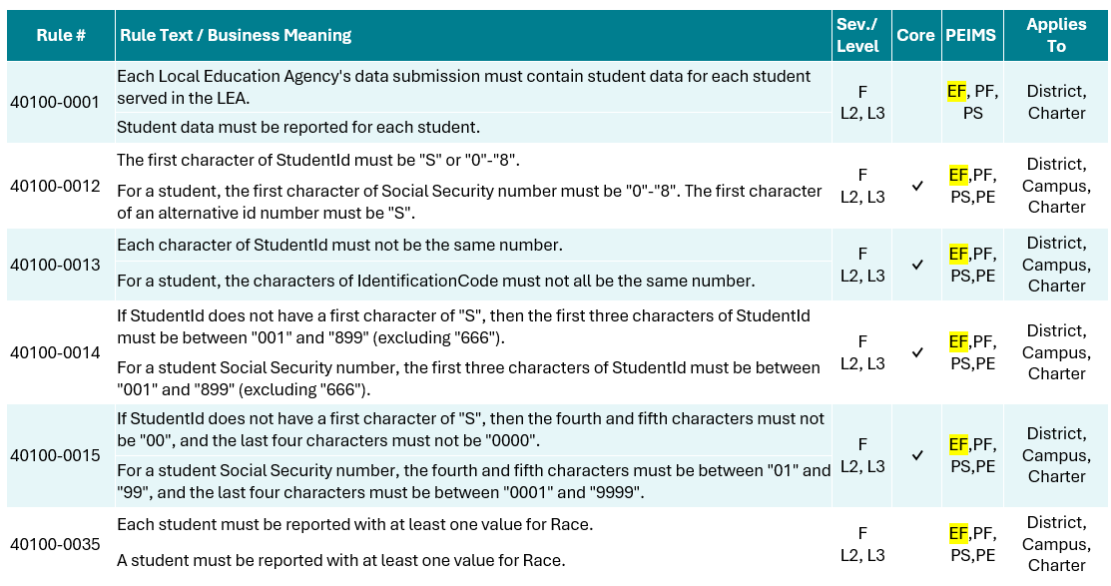
Revised Business Validations 1
Existing rules will be added to the PEIMS Fall Enrollment Submission, such as:

Slide 30
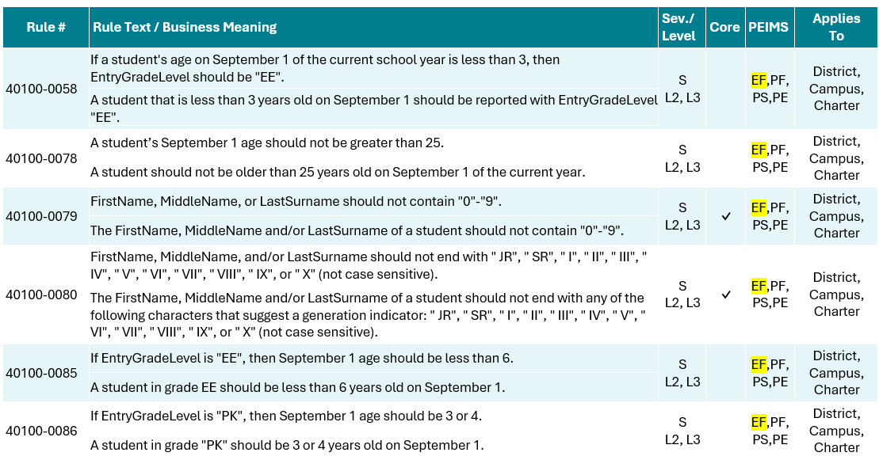
Revised Business Validations 2
Existing rules will be added to the PEIMS Fall Enrollment Submission, such as:

Slide 31
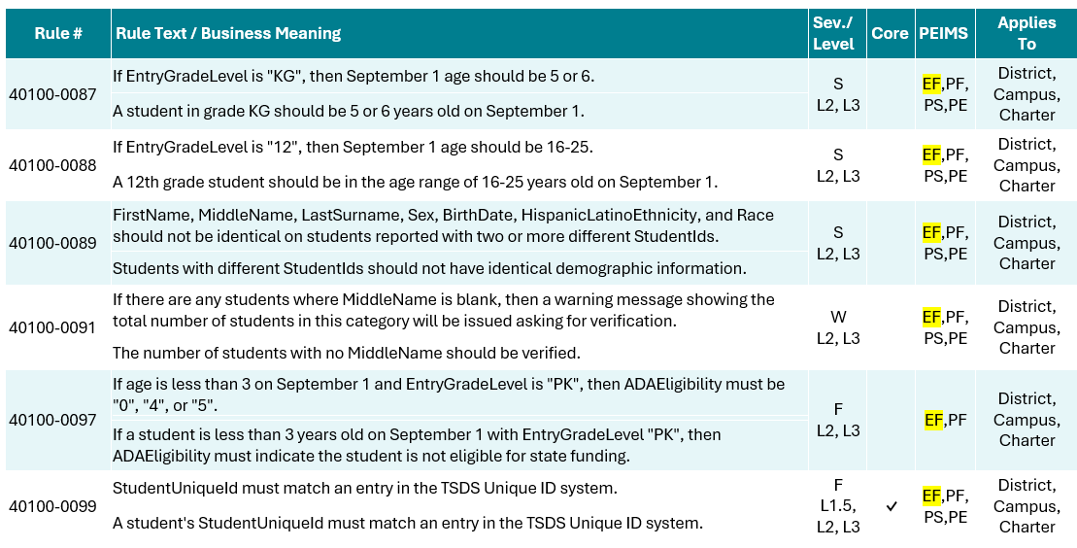
Revised Business Validations 3
Existing rules will be added to the PEIMS Fall Enrollment Submission, such as:

Slide 32
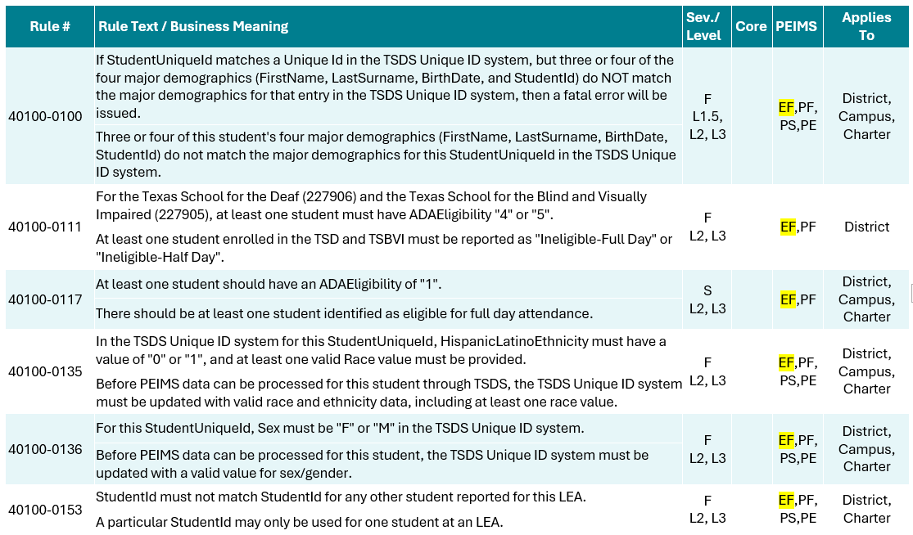
Revised Business Validations 4
Existing rules will be added to the PEIMS Fall Enrollment Submission, such as:

Slide 33

QUESTIONS
QUESTIONS?

