Slide 1

TITLE SLIDE: ESC Vendor Training for One Component January
<NAME OF COMPONENT> (ALL CAPS)
MARCH 19-21, 2024
SPECIAL EDUCATION DATA SYSTEM
SUMMER SUBMISSION
April 1, 2025

Slide 2

AGENDA – SPECIAL EDUCATION DATA SYSTEM
Background
Timeline
Data Collection
Business Validations
Questions
Additional Resources

Slide 3

TITLE SLIDE: BACKGROUND
BACKGROUND
NAME OF COMPONENT (ALL CAPS)
MARCH 19-21, 2024

Slide 4
BACKGROUND
The Special Education Data System Summer Submission will combine the following:
  Child Find Collection
  SPPI-7 – Preschool Outcomes
  SPPI-13 – Secondary Transition

Slide 5
BACKGROUND – CHILD FIND
Child Find (SPPI-11 and 12)
  SPPI-11 – Timely Initial Evaluation
    Refers to compliance with state-established timeframes (19 TAC §89.1011) for evaluating children, ages 3-21, for special education under Part B of the Individuals with Disabilities Education Act (IDEA).
  SPPI-12 – Early Childhood Transition
    Refers to compliance for children referred from Part C of IDEA before age three, found eligible for Part B, and have an individualized education program (IEP) developed and implemented by their third birthday to receive early childhood special education (ECSE) services.

Slide 6
BACKGROUND – SPPI-7
SPPI-7 – Preschool Outcomes
  Measures the demonstrated improvement for preschool children aged three through five with IEPs in the following areas:
    Positive social-emotional skills (including social relationships);
    Acquisition and use of knowledge and skills (including early language/communication and early literacy); and
    Use of appropriate behaviors to meet their needs.
  Local Education Agencies (LEA) utilize the Childhood Outcomes Summary Process to document children’s progress in the three outcomes. LEAs report these outcomes using a specific rating category on a seven-point scale at entry and exit for all students aged three through five (not in kindergarten) who receive early childhood special education (ECSE) services for six months or more during the school year.

Slide 7
BACKGROUND – SPPI-13
SPPI-13 – Secondary Transition
  Measures the percentage of youth with IEPs aged 16 up to age 21 with an IEP that includes:
    Appropriate measurable postsecondary goals that are annually updated and based upon an age-appropriate transition assessment;
    Transition services, including courses of study, that will reasonably enable the student to meet those postsecondary goals; and
    Annual IEP goals related to the student’s transition service needs.
  There must be documented evidence that the student was invited to the admission, review, and dismissal (ARD) committee meeting where transition services are to be discussed and evidence that, if appropriate, a representative of any participating agency that is likely to be responsible for providing or paying for transition services be invited to the ARD meeting with prior consent of the parent or student who has reached the age of majority.

Slide 8
BACKGROUND – CURRENT COLLECTION
SPPI-7 data are collected through the SPP 7 Early Childhood Outcomes application in TEAL.
SPPI-13 data are collected through the SPP 13 Secondary Transition application in TEAL. SPPI-13 is currently collected on only a select number of students. Once moved into TSDS, the data will be collected on all students aged 16 through 21 during the data collection year, which runs from July 1 to June 30.
Child Find (combination of SPPI-11 and 12) is currently collected in TSDS through the Child Find Collection.

Slide 9
TITLE SLIDE: TIMELINE
TIMELINE
NAME OF COMPONENT (ALL CAPS)
MARCH 19-21, 2024

Slide 10
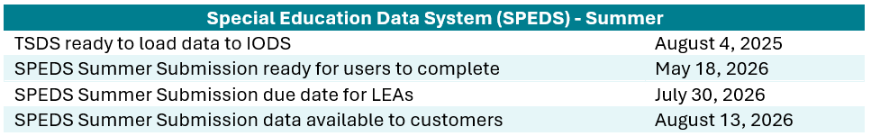
TIMELINE – 2025-2026 SCHOOL YEAR

Slide 11
TITLE SLIDE: DATA COLLECTION
DATA
NAME OF COMPONENT (ALL CAPS)
MARCH 19-21, 2024
COLLECTION

Slide 12
DATA COLLECTION - OVERVIEW
The following students will be collected in the new SPEDS Summer Submission:
  Child Find: children aged 3-21 evaluated for special education services, and students with an IEP developed and implemented by their third birthday.
  SPPI-7: children aged 3-5 (not in kindergarten) who receive ECSE services for six months or more during the school year. Collected at entry to and exit from ECSE services.
  SPPI-13: all children with an IEP aged 16 up to age 21.
The annual data collection period occurs from July 1 to June 30.

Slide 13
DATA COLLECTION - DOMAINS
Domains:
  Education Organization
  School Calendar
  Enrollment
  Student Identification and Demographics
  Alternative and Supplemental Services
  Student Special Education Program Eligibility Association

Slide 14

EDUCATION ORGANIZATION DOMAIN
EDUCATION ORGANIZATION DOMAIN
NAME OF COMPONENT (ALL CAPS)
MARCH 19-21, 2024

Slide 15
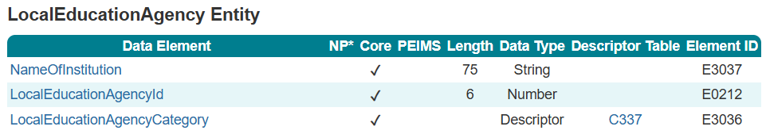
LocalEducationAgency

Slide 16
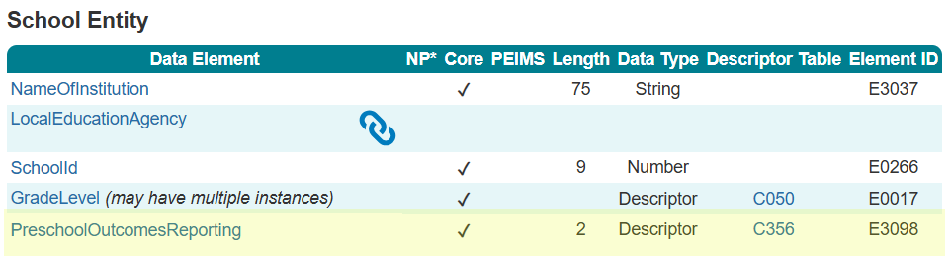
School

Slide 17
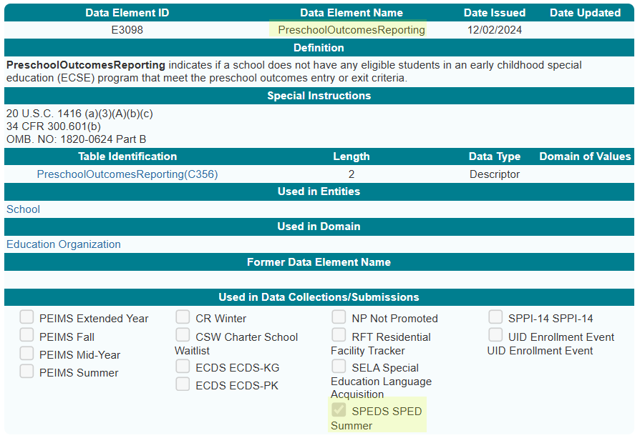
PreschoolOutcomesReporting

Slide 18
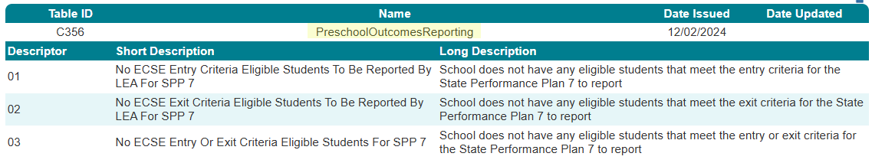
PreschoolOutcomesReporting `

Slide 19
SCHOOL CALENDAR DOMAIN
SCHOOL CALENDAR DOMAIN
NAME OF COMPONENT (ALL CAPS)
MARCH 19-21, 2024

Slide 20
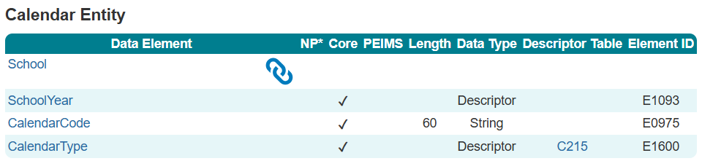
Calendar

Slide 21
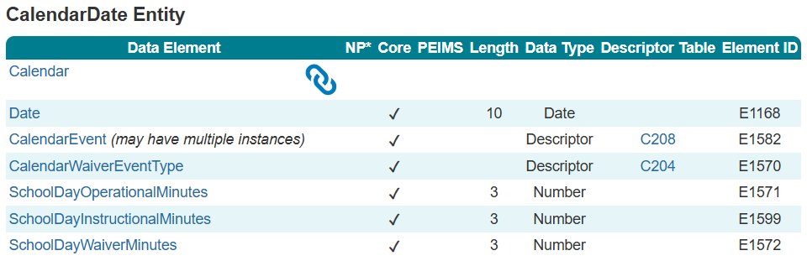
CalendarDate

Slide 22
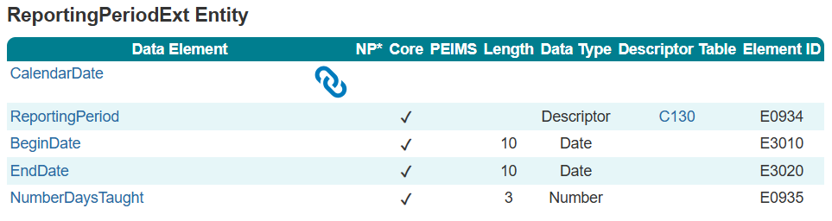
ReportingPeriodExt

Slide 23
ENROLLMENT DOMAIN
ENROLLMENT DOMAIN
NAME OF COMPONENT (ALL CAPS)
MARCH 19-21, 2024

Slide 24
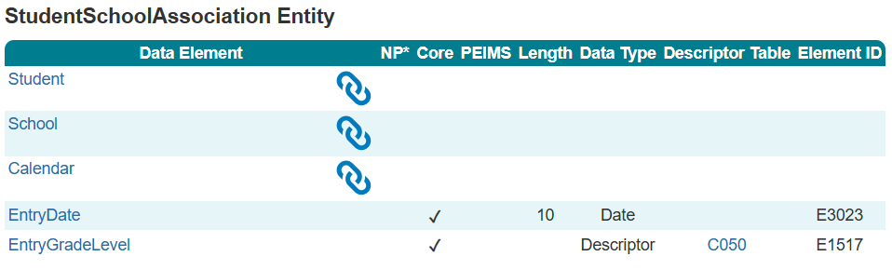
StudentSchoolAssociation

Slide 25
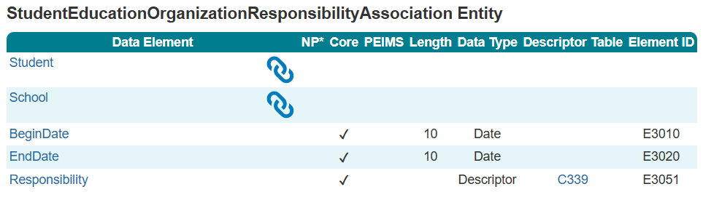
StudentEducationOrganizationResponsibility
Association

Slide 26
STUDENT IDENTIFICATION AND DEMOGRAPHICS DOMAIN
STUDENT IDENTIFICATION AND DEMOGRAPHICS DOMAIN
NAME OF COMPONENT (ALL CAPS)
MARCH 19-21, 2024

Slide 27
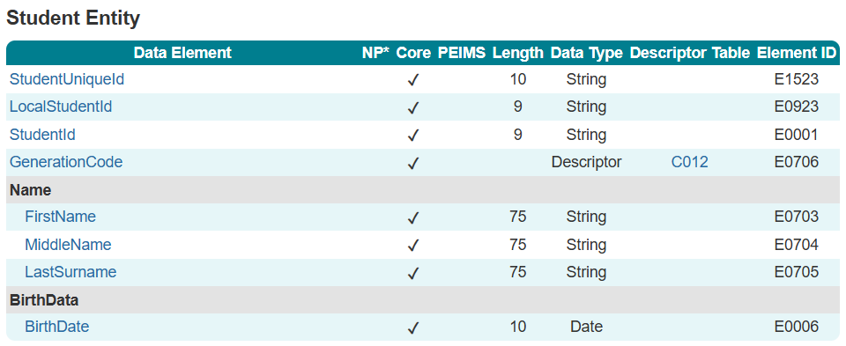
Student

Slide 28
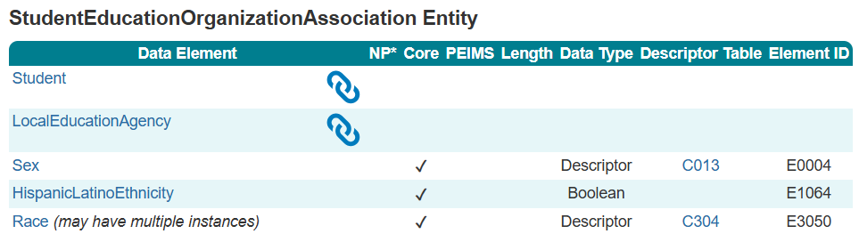
StudentEducationOrganizationAssociation

Slide 29
ALTERNATIVE AND SUPPLEMENTAL SERVICES DOMAIN
ALTERNATIVE AND SUPPLEMENTAL SERVICES DOMAIN
NAME OF COMPONENT (ALL CAPS)
MARCH 19-21, 2024

Slide 30
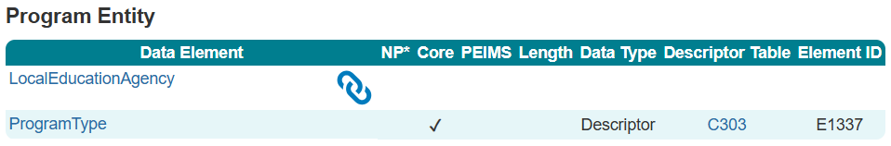
Program

Slide 31
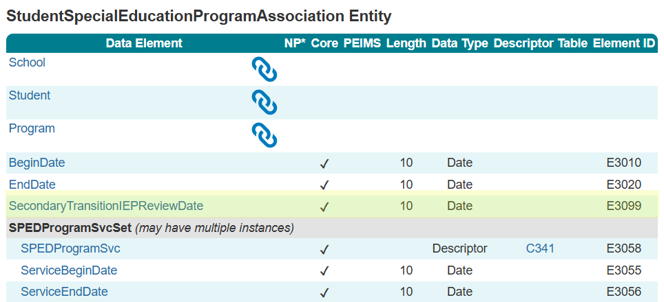
StudentSpecialEducationProgram
Association

Slide 32
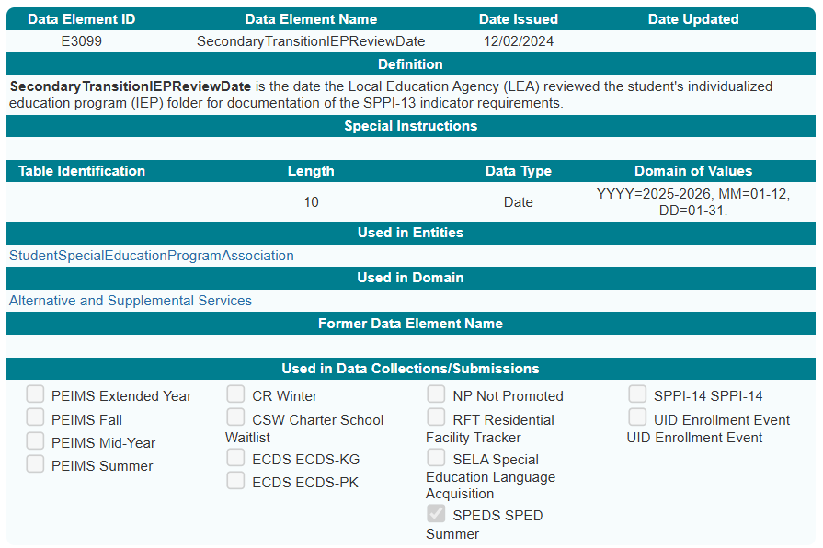
SecondaryTransitionIEPReviewDate

Slide 33
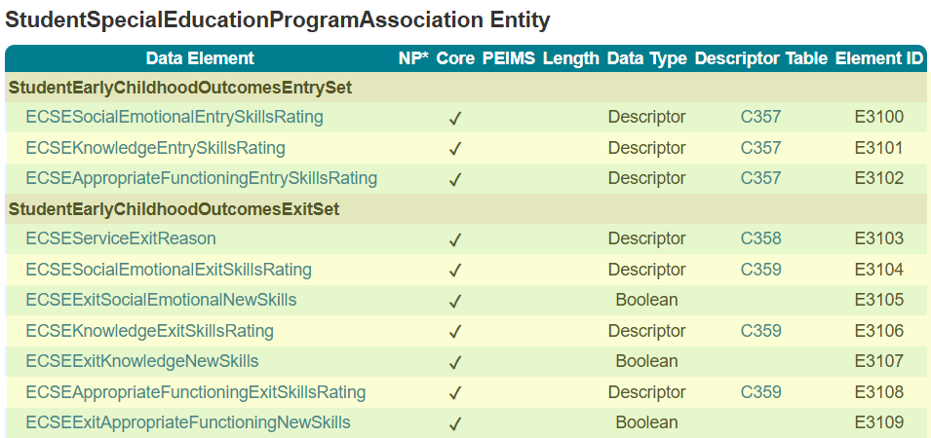
StudentSpecialEducationProgram
Association

Slide 34
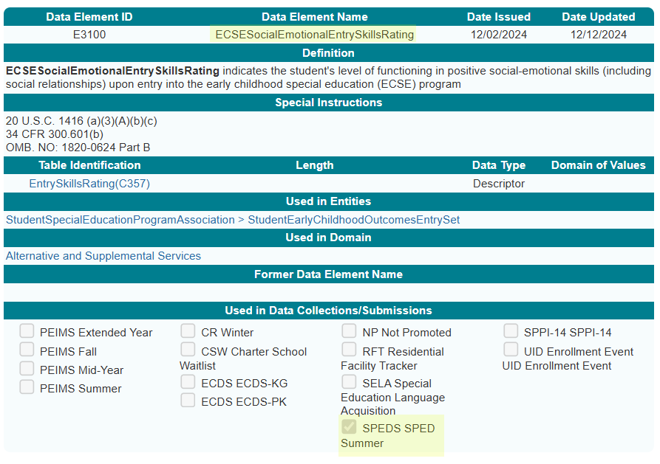
ECSESocialEmotionalEntrySkillsRating

Slide 35
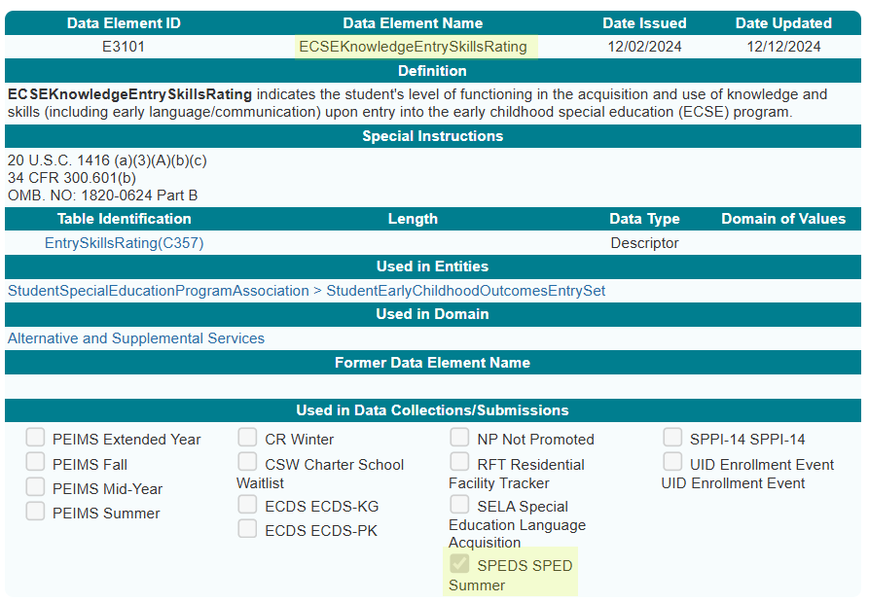
ECSEKnowledgeEntrySkillsRating

Slide 36
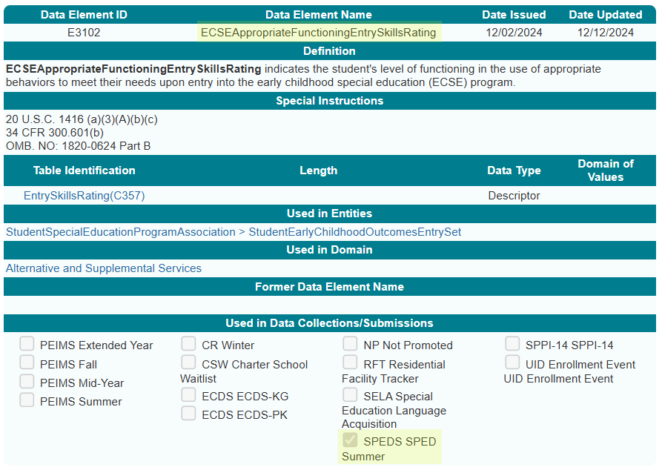
ECSEAppropriateFunctioningEntrySkillsRating

Slide 37
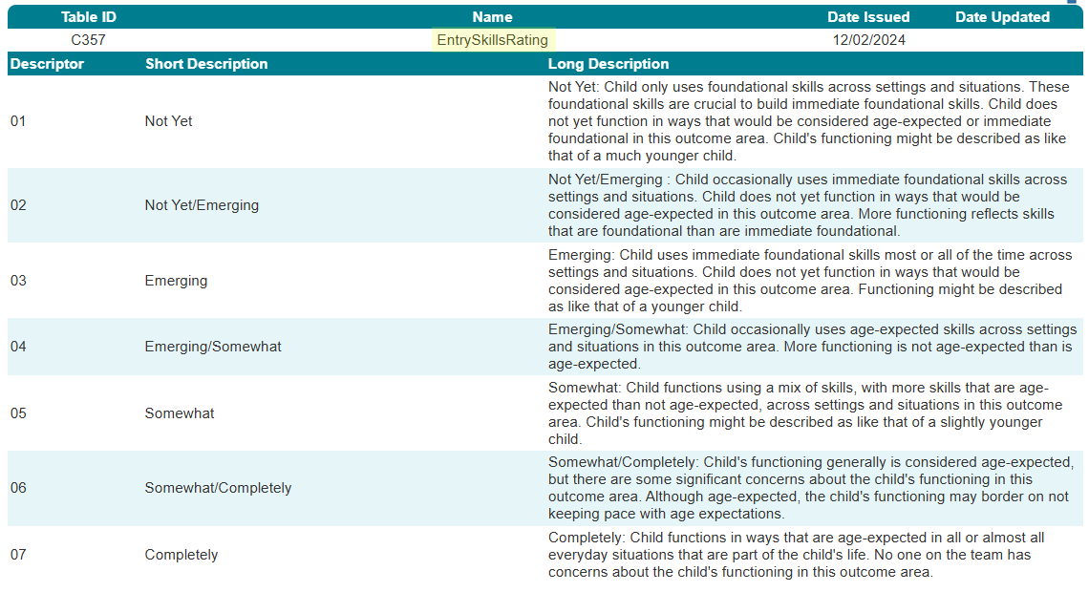
EntrySkillsRating Descriptor Table

Slide 38
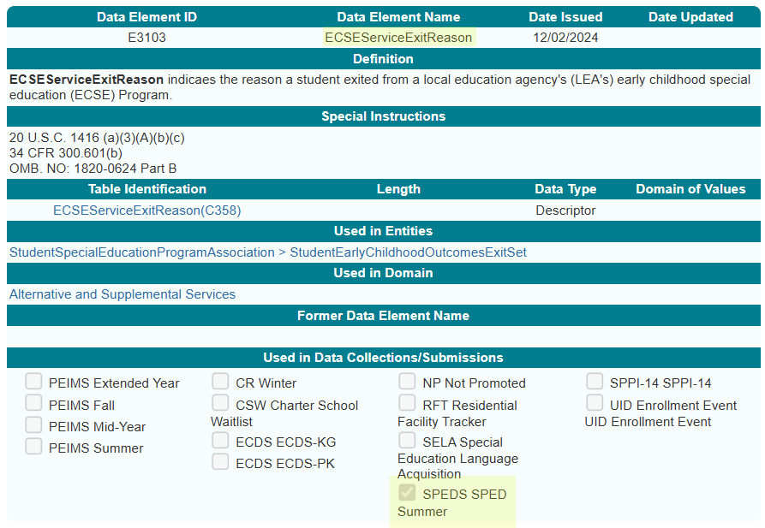
ECSEServiceExitReason

Slide 39
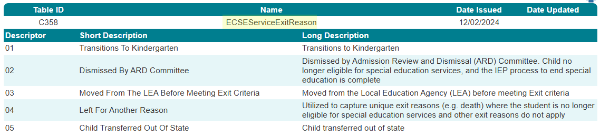
ECSEServiceExitReason Descriptor Table

Slide 40
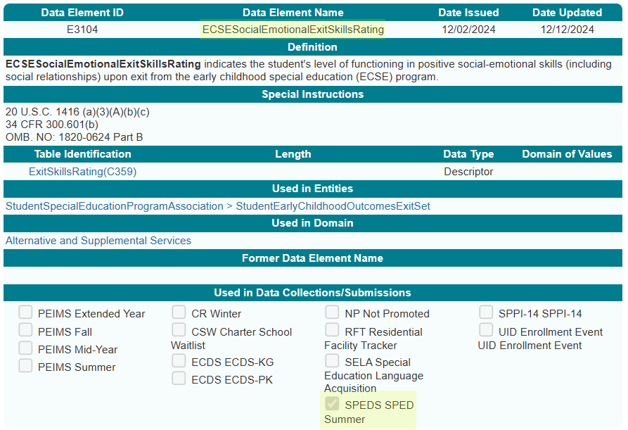
ECSESocialEmotionalExitSkillsRating

Slide 41
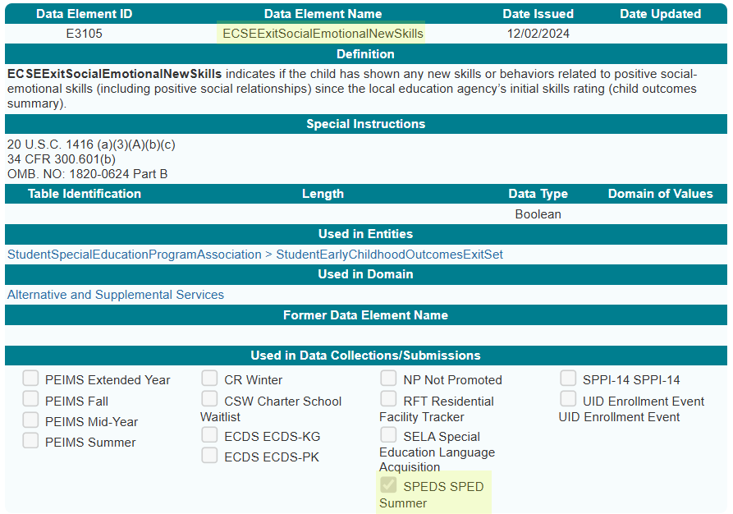
ECSEExitSocialEmotionalNewSkills

Slide 42
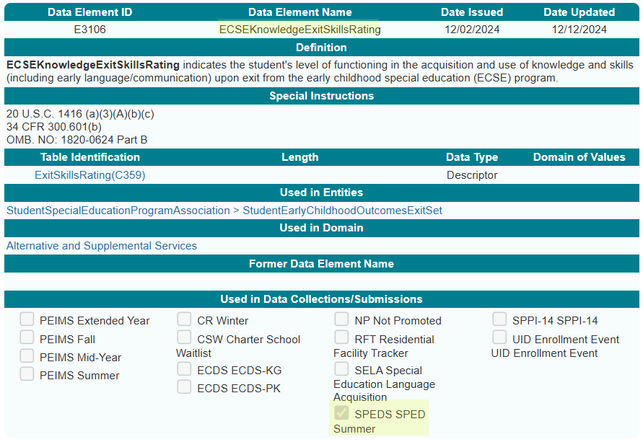
ECSEKnowledgeExitSkillsRating

Slide 43
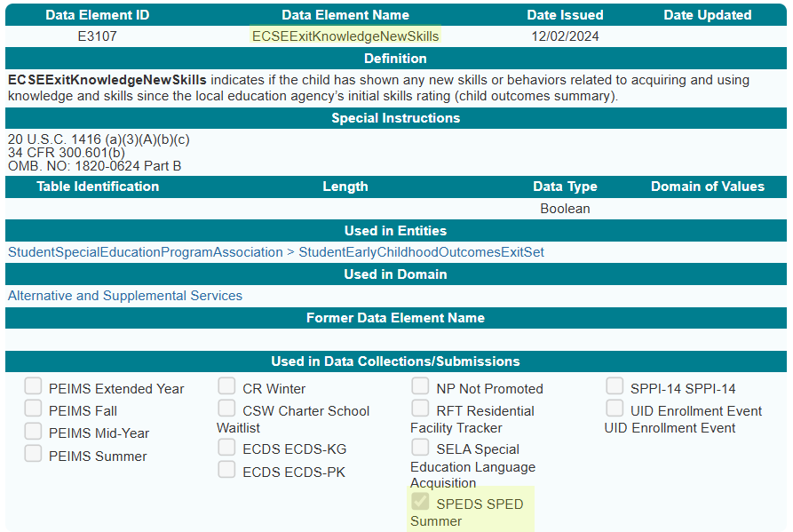
ECSEExitKnowledgeNewSkills

Slide 44
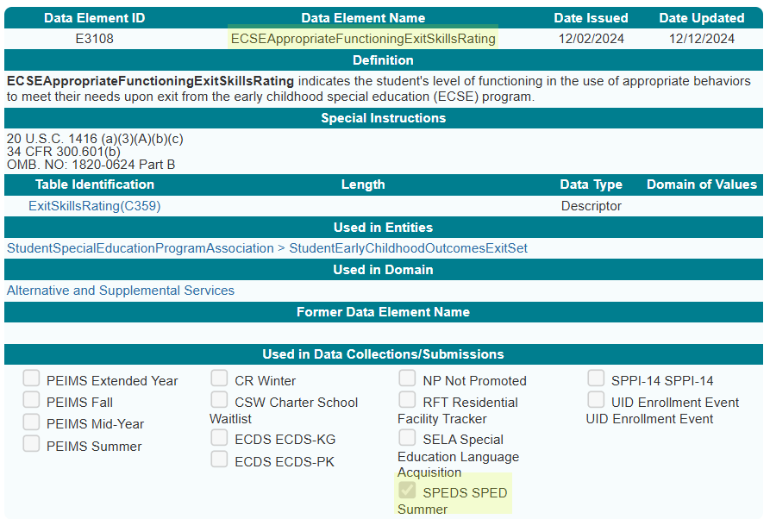
ECSEAppropriateFunctioningExitSkillsRating

Slide 45
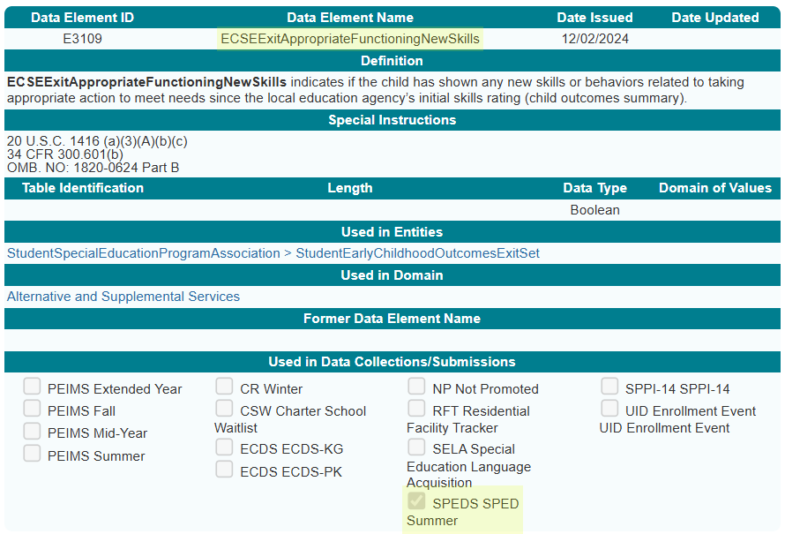
ECSEExitAppropriateFunctioningNewSkills

Slide 46
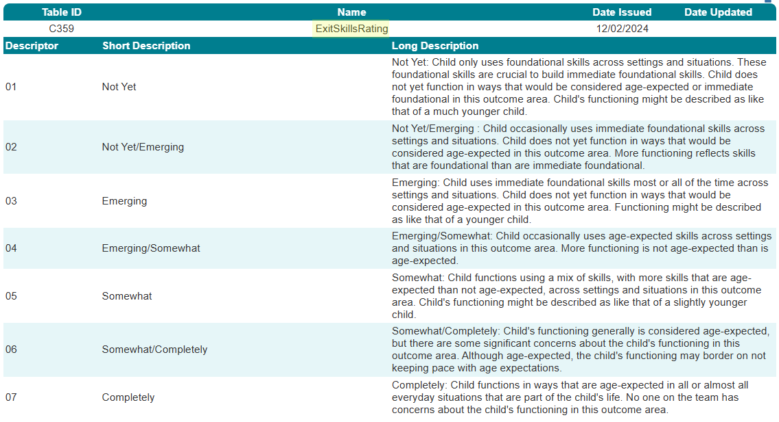
ExitSkillsRating Descriptor Table

Slide 47
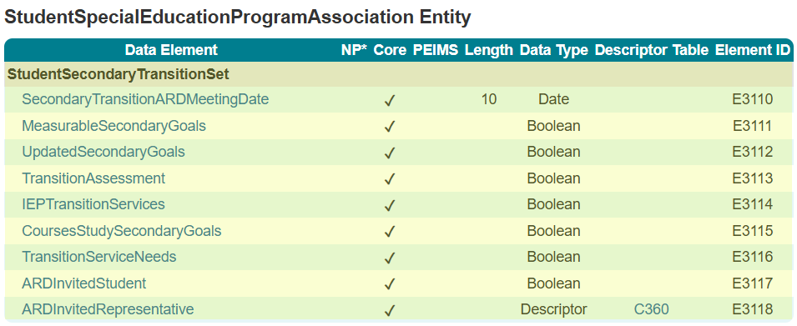
StudentSpecialEducationProgram
Association 1

Slide 48
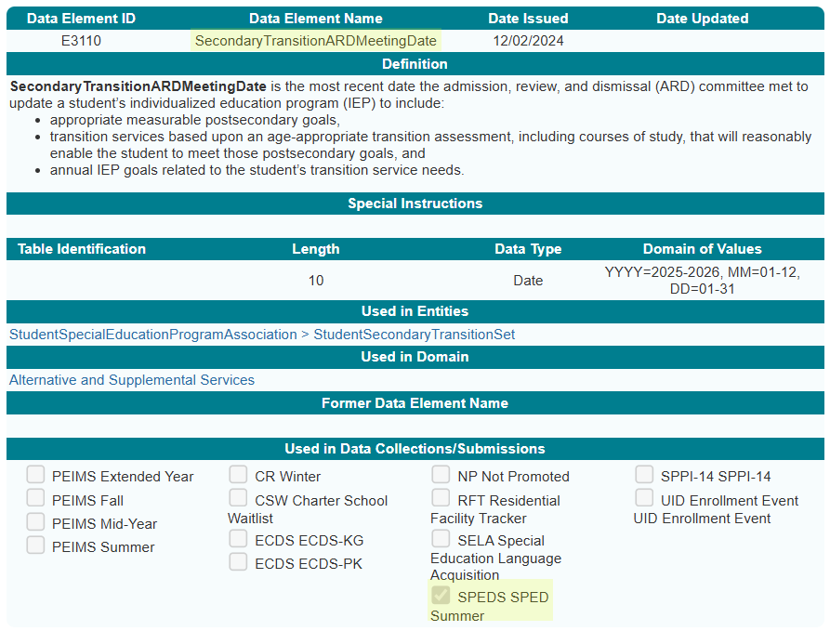
SecondaryTransitionARDMeetingDate

Slide 49
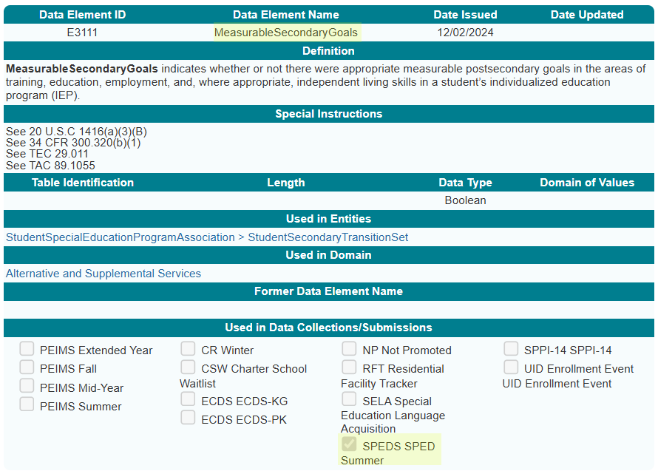
MeasurableSecondaryGoals

Slide 50
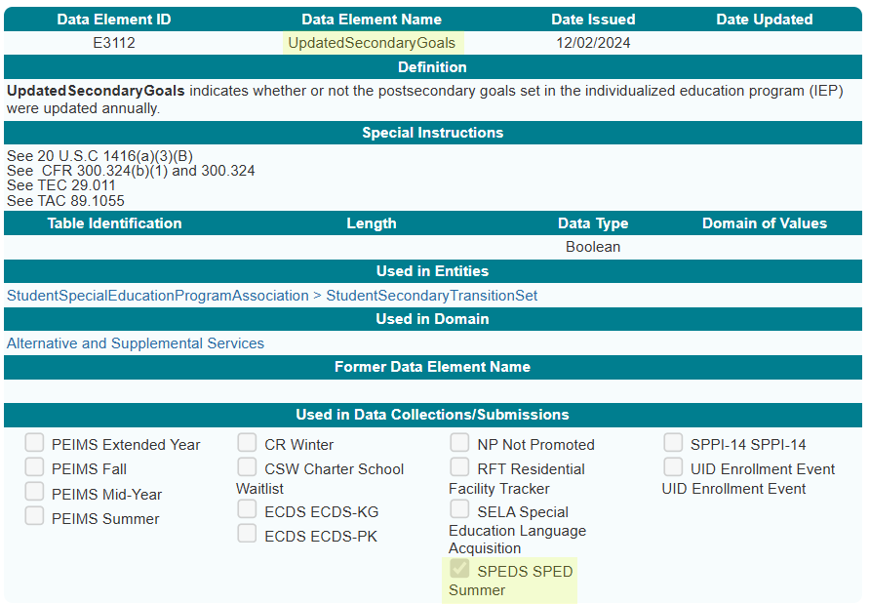
UpdatedSecondaryGoals

Slide 51
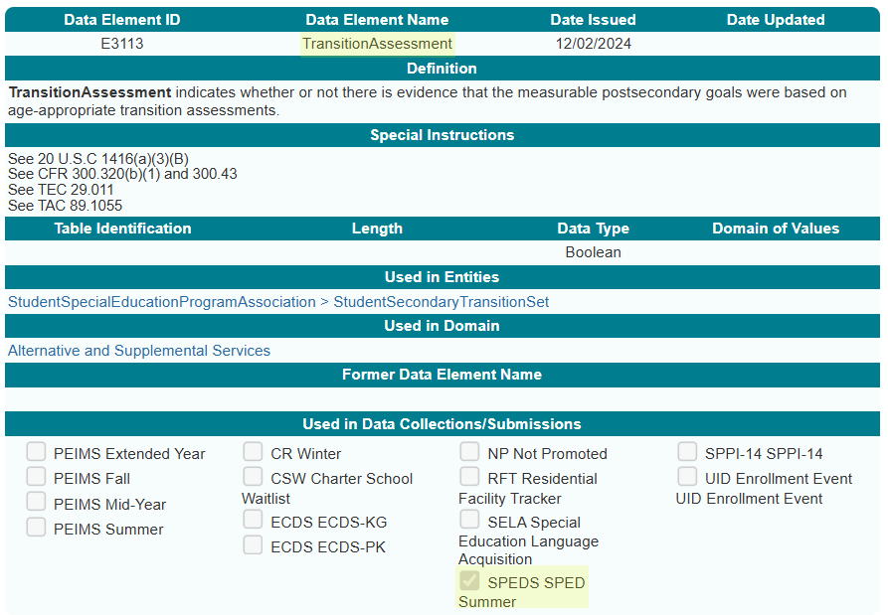
TransitionAssessment

Slide 52
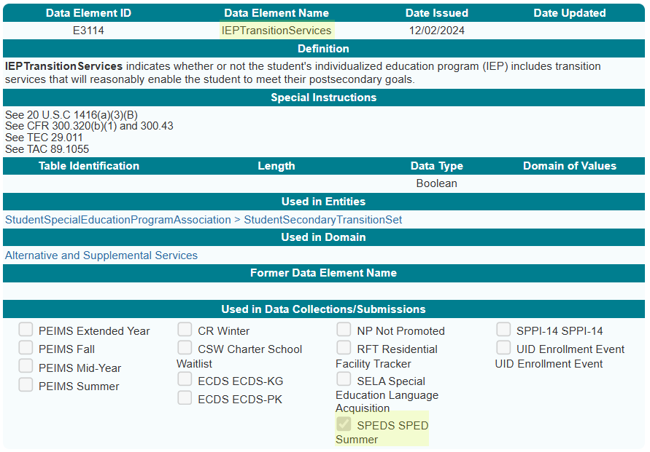
IEPTransitionServices

Slide 53
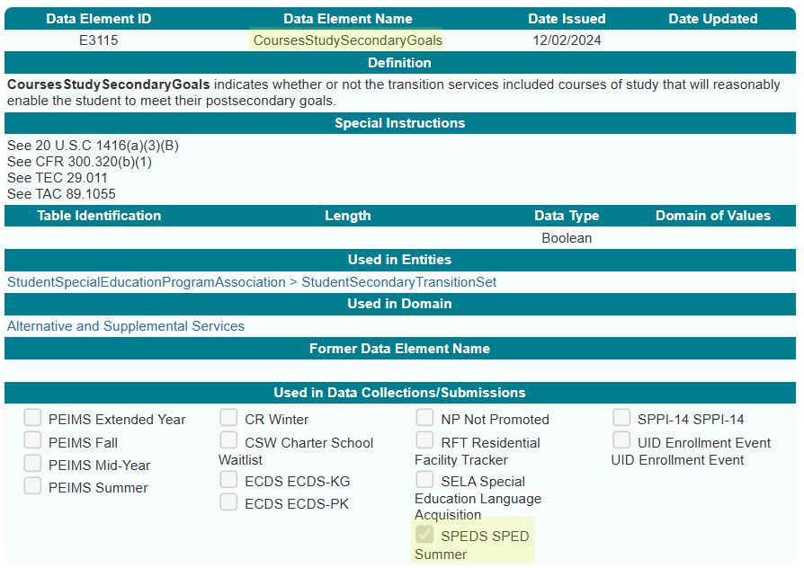
CoursesStudySecondaryGoals

Slide 54
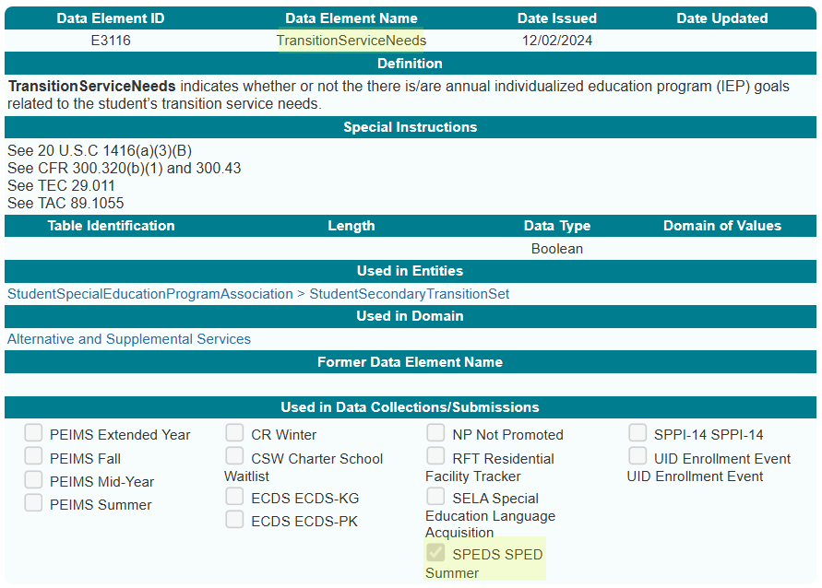
TransitionServiceNeeds

Slide 55
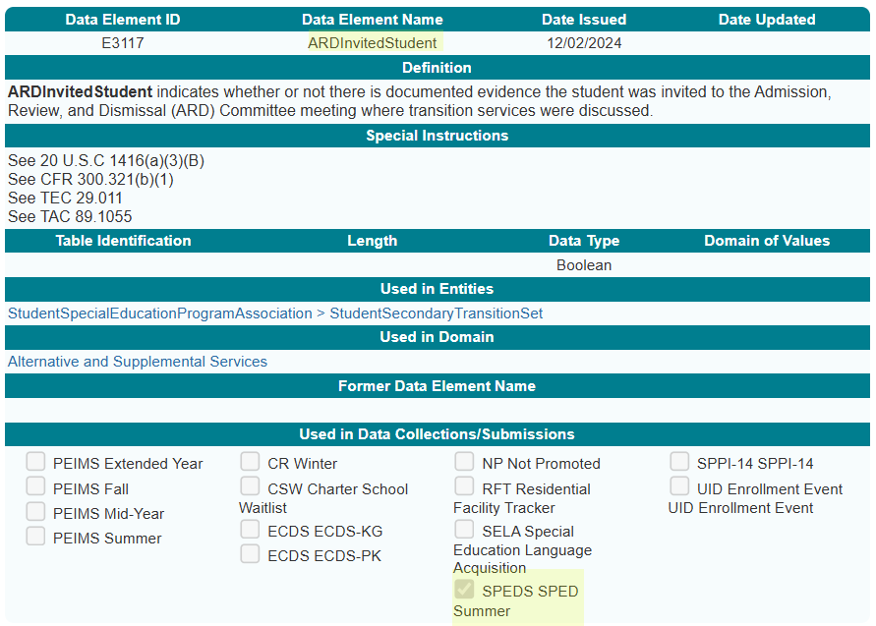
ARDInvitedStudent

Slide 56
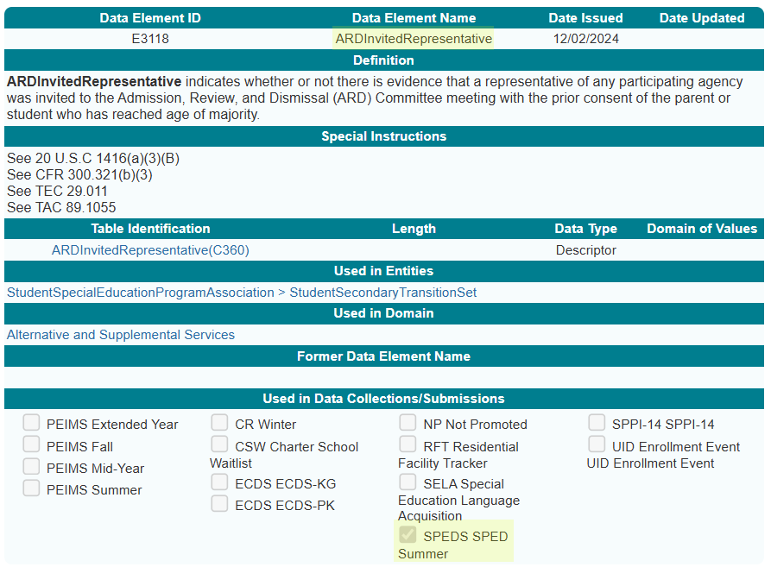
ARDInvitedRepresentative

Slide 57
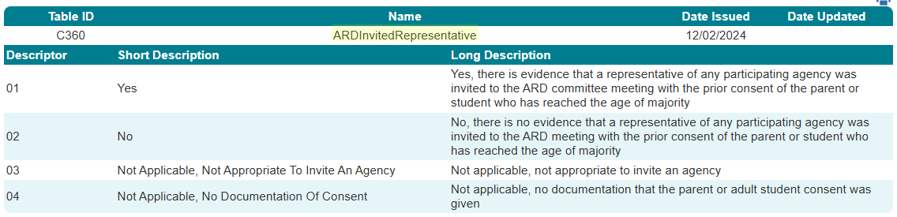
ARDInvitedRepresentative Descriptor Table

Slide 58
STUDENT SPECIAL EDDUCATION PROGRAM ELIGIBILITY ASSOCIATION DOMAIN
STUDENT SPECIAL EDUCATION PROGRAM ELIGIBILITY ASSOCIATION DOMAIN
NAME OF COMPONENT (ALL CAPS)
MARCH 19-21, 2024

Slide 59
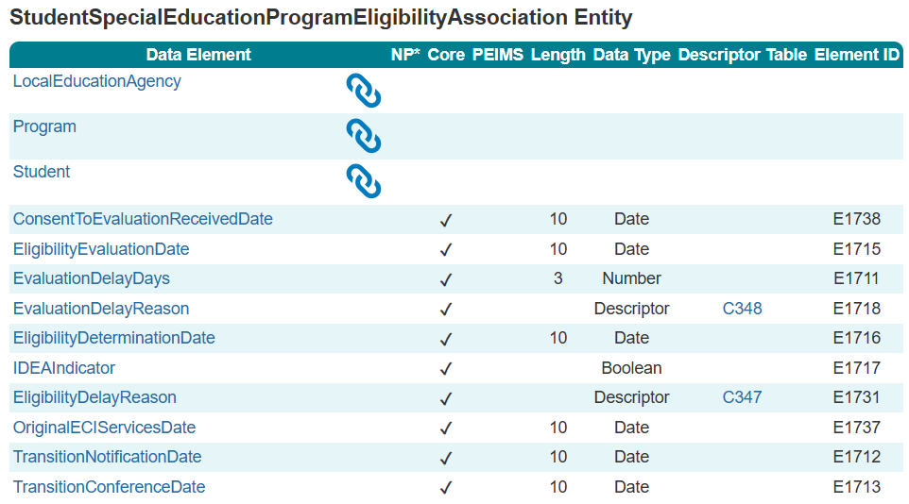
StudentSpecialEducationProgramEligibility
Association

Slide 60
TITLE SLIDE: BUSINESS VALIDATIONS
BUSINESS
NAME OF COMPONENT (ALL CAPS)
MARCH 19-21, 2024
VALIDATIONS

Slide 61
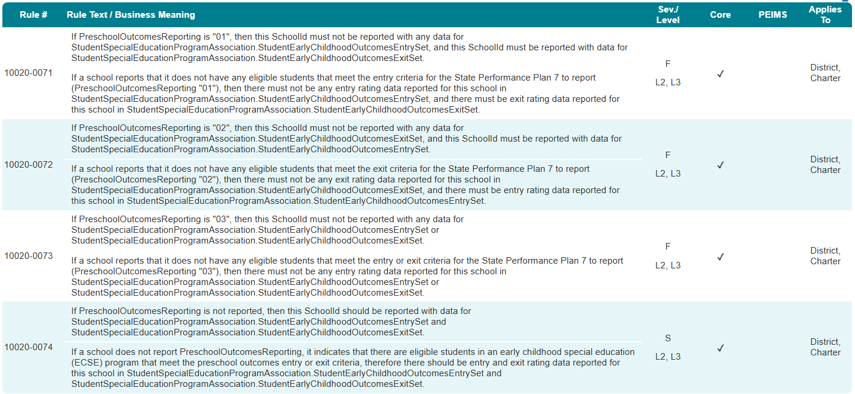
CAMPUS CATEGORY

Slide 62
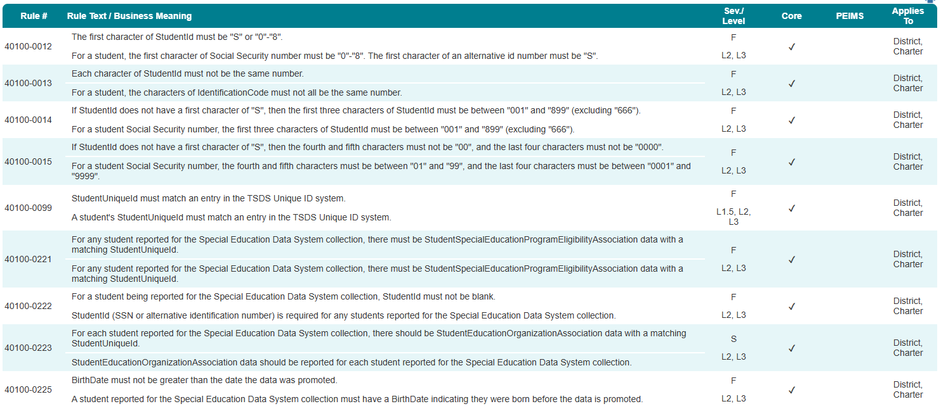
STUDENT BASIC CATEGORY

Slide 63
ENROLLMENT CATEGORY

Slide 64
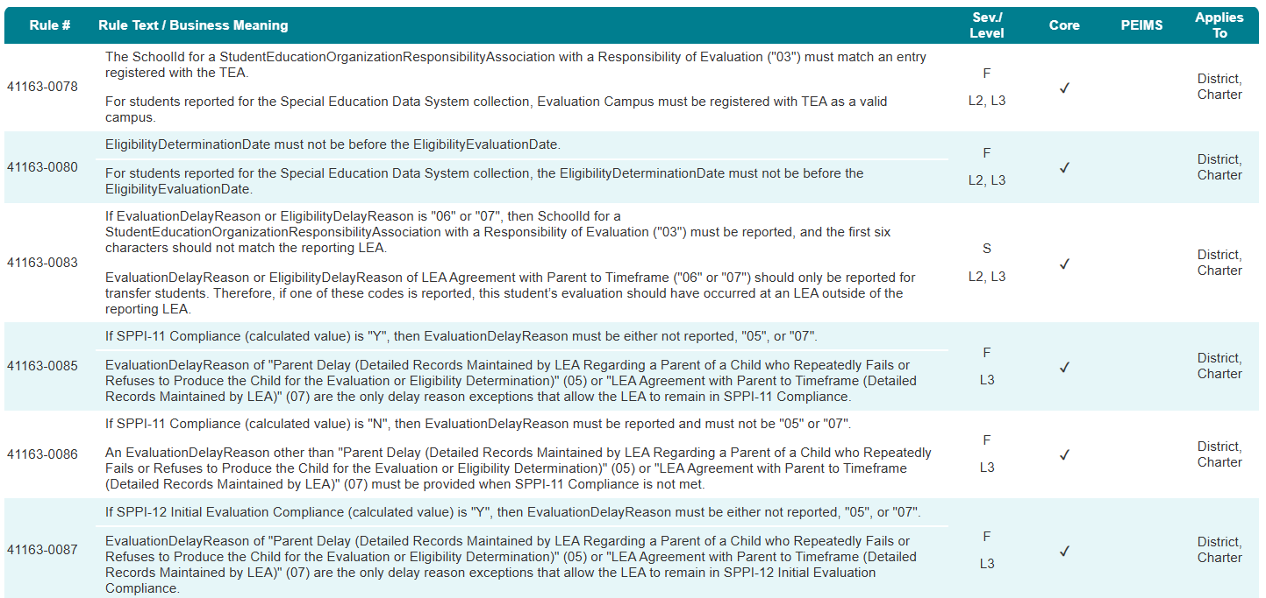
SPECIAL EDUCATION PROGRAM CATEGORY 1

Slide 65
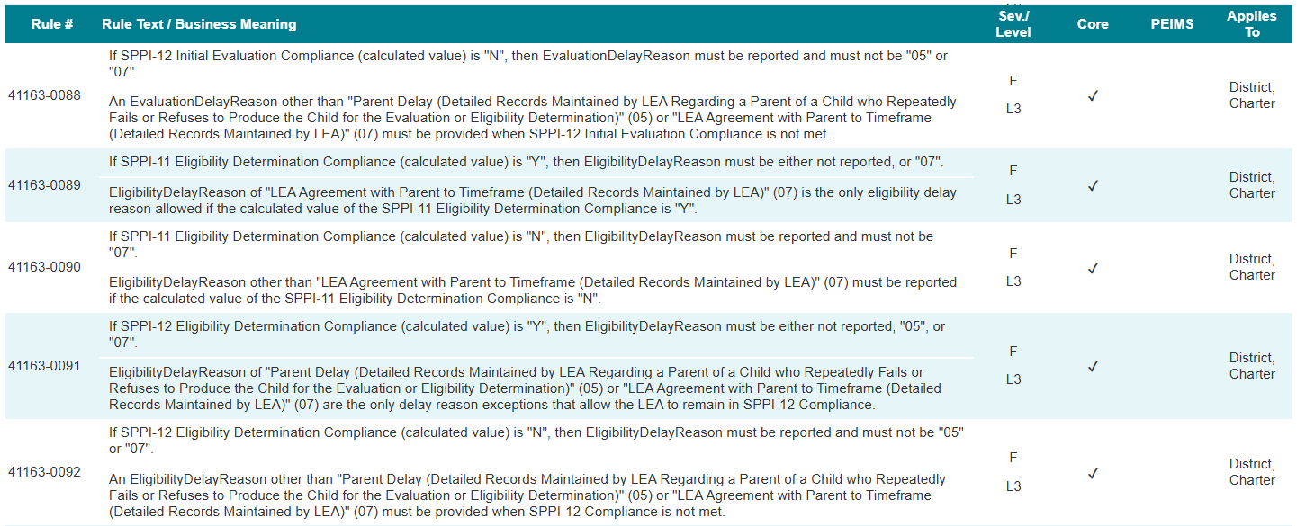
SPECIAL EDUCATION PROGRAM CATEGORY 2

Slide 66
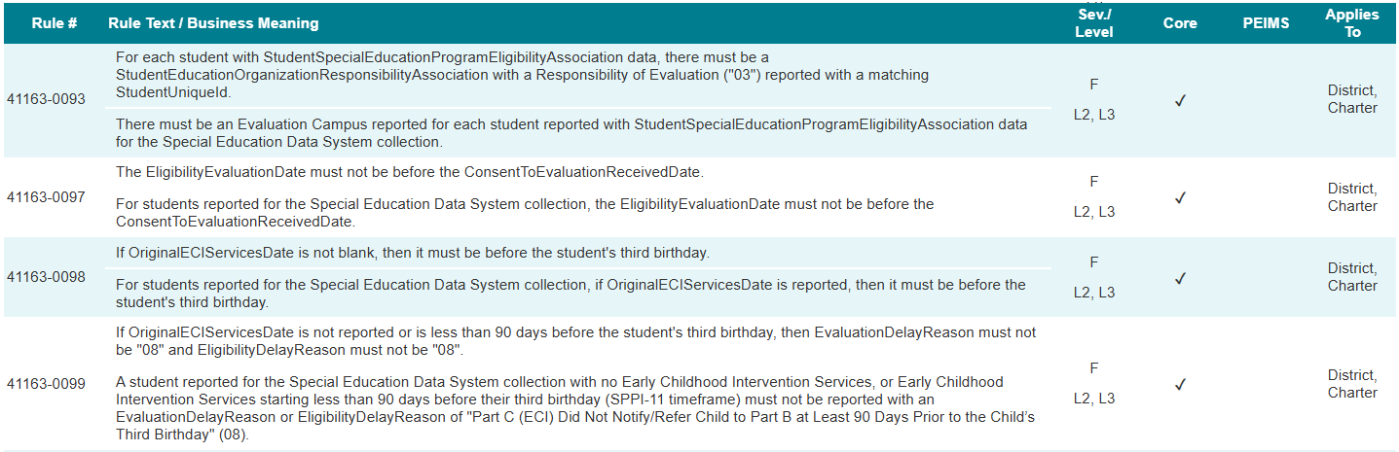
SPECIAL EDUCATION PROGRAM CATEGORY 3

Slide 67
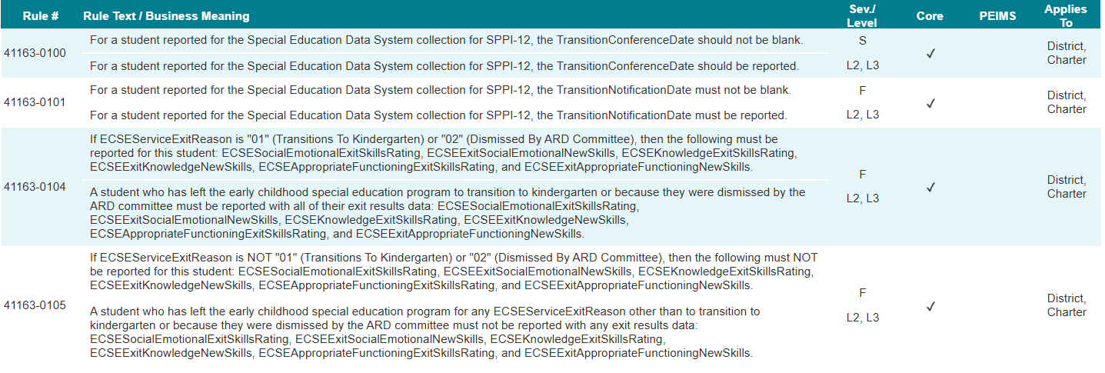
SPECIAL EDUCATION PROGRAM CATEGORY 4

Slide 68

QUESTIONS
QUESTIONS?

Slide 69

ADDITIONAL RESOURCES
ADDITIONAL RESOURCES

Slide 70
DATA ELEMENTS IN SUBMISSION 1
Data Element Names | Data Element Names
ARDInvitedRepresentative (E3118) | ARDInvitedStudent (E3117)
BeginDate (E3010) | BirthDate (E0006)
CalendarCode (E0975) | CalendarEvent (E1582)
CalendarType (E1600) | CalendarWaiverEventType (E1570)
ConsentToEvaluationReceivedDate (E1738) | CoursesStudySecondaryGoals (E3115)
Date (E1168) | ECSEAppropriateFunctioningEntrySkillsRating (E3102)
ECSESocialEmotionalEntrySkillsRating (E3100) | ECSEKnowledgeEntrySkillsRating (E3101)
ECSEExitKnowledgeNewSkills (E3107) | ECSEAppropriateFunctioningEntrySkillsRating (E3102)
ECSEExitSocialEmotionalNewSkills (E3105) | ECSEExitAppropriateFunctioningNewSkills (E3109)
ECSEKnowledgeEntrySkillsRating (E3101) | ECSEAppropriateFunctioningExitSkillsRating (E3108)
New data elements are in green.

Slide 71
DATA ELEMENTS IN SUBMISSION 2
Data Element Names | Data Element Names
ECSEServiceExitReason (E3103) | ECSEKnowledgeExitSkillsRating (E3106)
ECSESocialEmotionalExitSkillsRating (E3104) | EndDate (E3020)
EligibilityEvaluationDate (E1715) | EntryGradeLevel (E1517)
EntryDate (E3023) | EvaluationDelayReason (E1718)
EvaluationDelayDays (E1711) | GenerationCode (E0706)
FirstName (E0703) | HispanicLatinoEthnicity (E1064)
GradeLevel (E0017) | IEPTransitionServices (E3114)
IDEAIndicator (E1717) | LocalEducationAgencyCategory (E3036)
LastSurname (E0705) | LocalStudentId (E0923)
LocalEducationAgencyId (E0212) | MeasurableSecondaryGoals (E3111)
New data elements are in green.

Slide 72
DATA ELEMENTS IN SUBMISSION 3
Data Element Names | Data Element Names
NameOfInstitution (E3037) | MiddleName (E0704)
OriginalECIServicesDate (E1737) | NumberDaysTaught (E0935)
ProgramType (E1337) | PreschoolOutcomesReporting (E3098)
ReportingPeriod (E0934) | Race (E3050)
SchoolDayInstructionalMinutes (E1599) | Responsibility (E3051)
SchoolDayWaiverMinutes (E1572) | SchoolDayOperationalMinutes (E1571)
SchoolYear (E1093) | SchoolId (E0266)
SecondaryTransitionIEPReviewDate (E3099) | SecondaryTransitionARDMeetingDate (E3110)
New data elements are in green.

Slide 73
DATA ELEMENTS IN SUBMISSION 4
Data Element Names | Data Element Names
ServiceBeginDate (E3055) | Sex (E0004)
ServiceEndDate (E3056) | StudentId (E0001)
SPEDProgramSvc (E3058) | TransitionAssessment (E3113)
StudentUniqueId (E1523) | TransitionNotificationDate (E1712)
TransitionConferenceDate (E1713) | UpdatedSecondaryGoals (E3112)
TransitionServiceNeeds (E3116)
New data elements are in green.

Slide 74
DESCRIPTOR TABLES IN SUBMISSION
Descriptor Table Names | Descriptor Table Names
ARDInvitedRepresentative (C360) | CalendarEvent (C208)
CalendarType (C215) | CalendarWaiverEventType (C204)
ECSEServiceExitReason (C358) | EligibilityDelayReason (C347)
EntrySkillsRating (C357) | EvaluationDelayReason (C348)
ExitSkillsRating (C359) | GenerationCode (C012)
GradeLevel (C050) | ProgramType (C303)
ReportingPeriod (C130) | LocalEducationAgencyCategory (C337)
Race (C304) | Sex (C013)
PreschoolOutcomesReporting (C356) | SPEDProgramSvc (C341)
Responsibility (C339)
New data elements are in green.

