Slide 1

TITLE SLIDE: ESC Vendor Training for One Component
NEW TWEDS
MARCH 20, 2024

Slide 2

AGENDA – TWEDS
CURRENT STANDARDS
NEW TWEDS
CLOSEOUT
  QUESTIONS

Slide 3

TITLE SLIDE: 2023-2024 School Year
CURRENT
STANDARDS
NAME OF COMPONENT (ALL CAPS)
MARCH 19-21, 2024

Slide 4
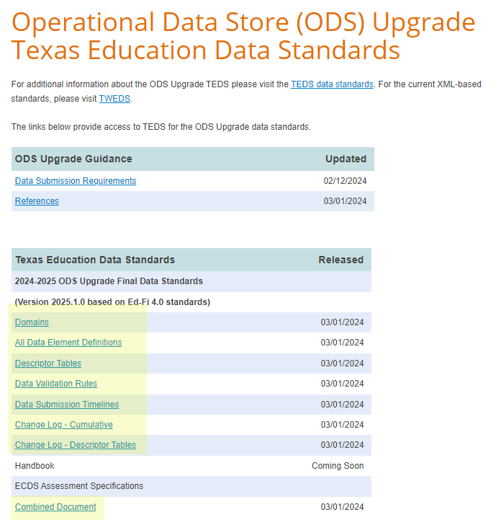

CURRENT STANDARDS
ODS Upgrade Data Standards

Slide 5
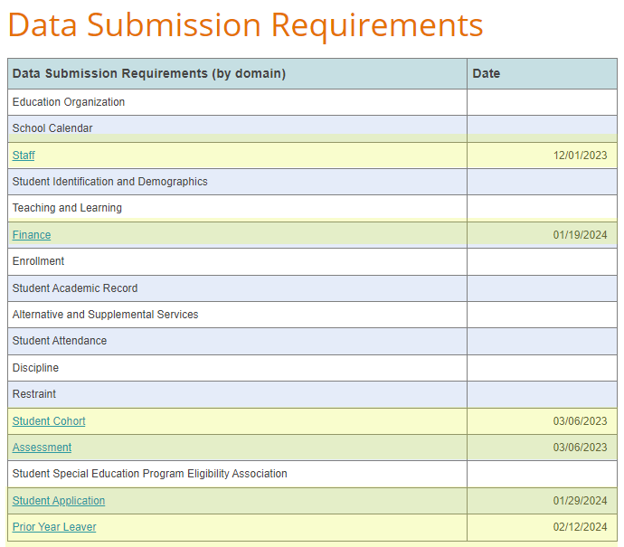
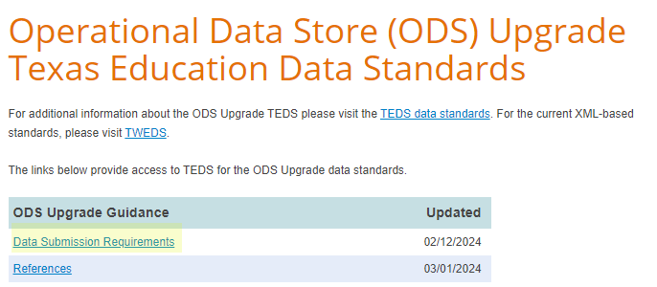
CURRENT STANDARDS 1

Slide 6
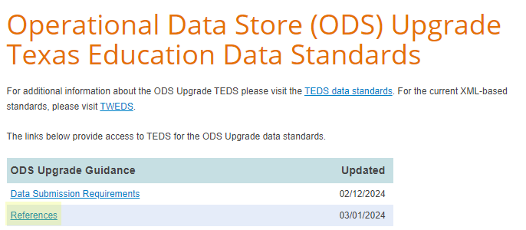
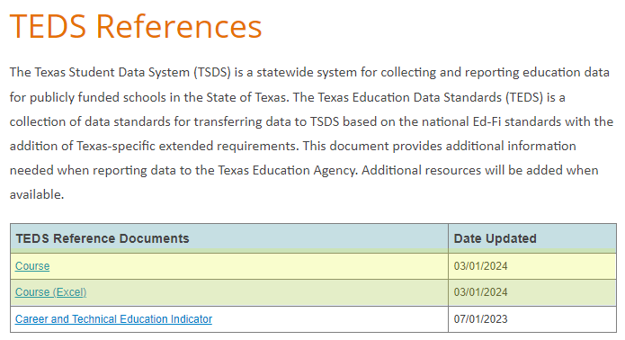
CURRENT STANDARDS 2

Slide 7
TITLE SLIDE: 2024-2025 School Year
NEW
TWEDS
NAME OF COMPONENT (ALL CAPS)
MARCH 19-21, 2024

Slide 8
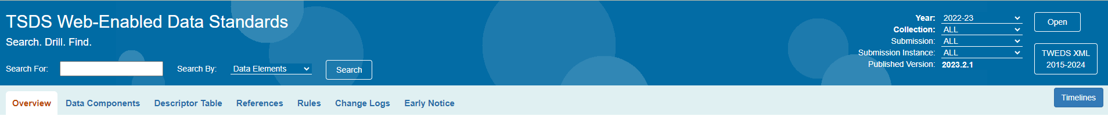

NEW TSDS WEB-ENABLED DATA STANDARDS
The new TSDS Web-Enabled Data Standards (TWEDS) are under construction.
The July 1, 2024, publication will be completed in new TWEDS.

Slide 9
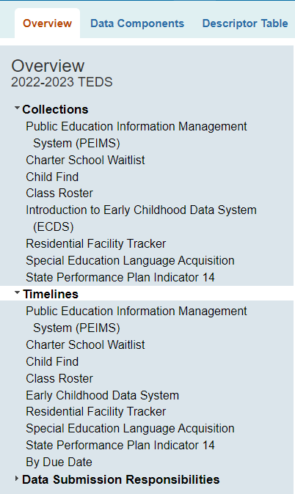
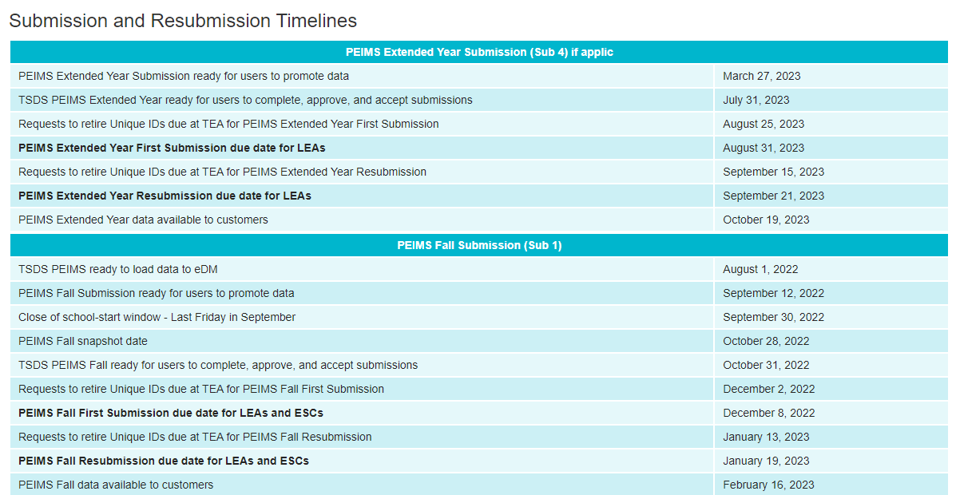
NEW TWEDS

Slide 10
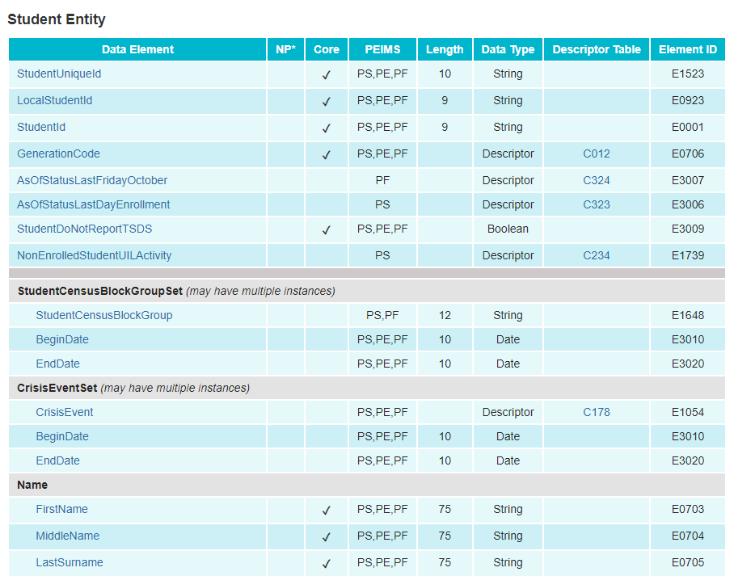
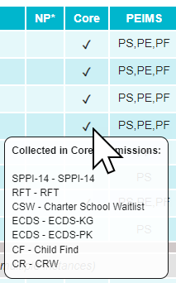
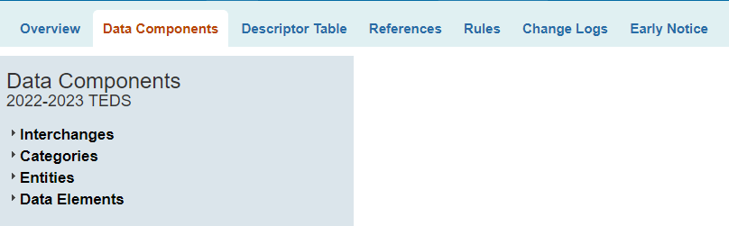
NEW TWEDS 1
Data Components
  Entities
  Data Elements

Slide 11
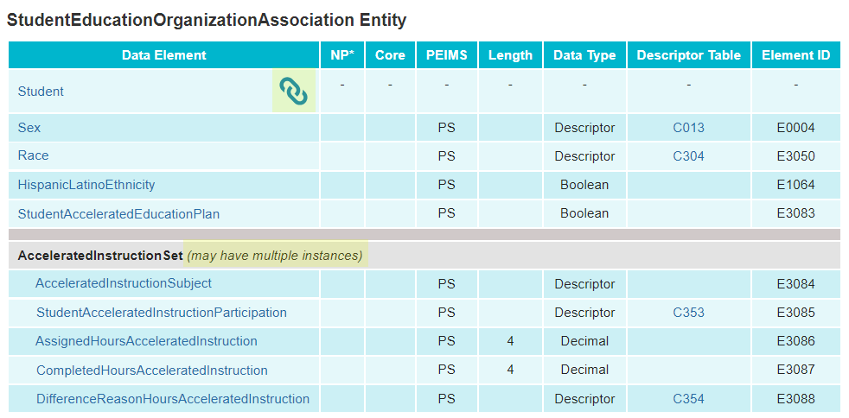
NEW TWEDS 2
Data Components
  Entities
  Data Elements

Slide 12
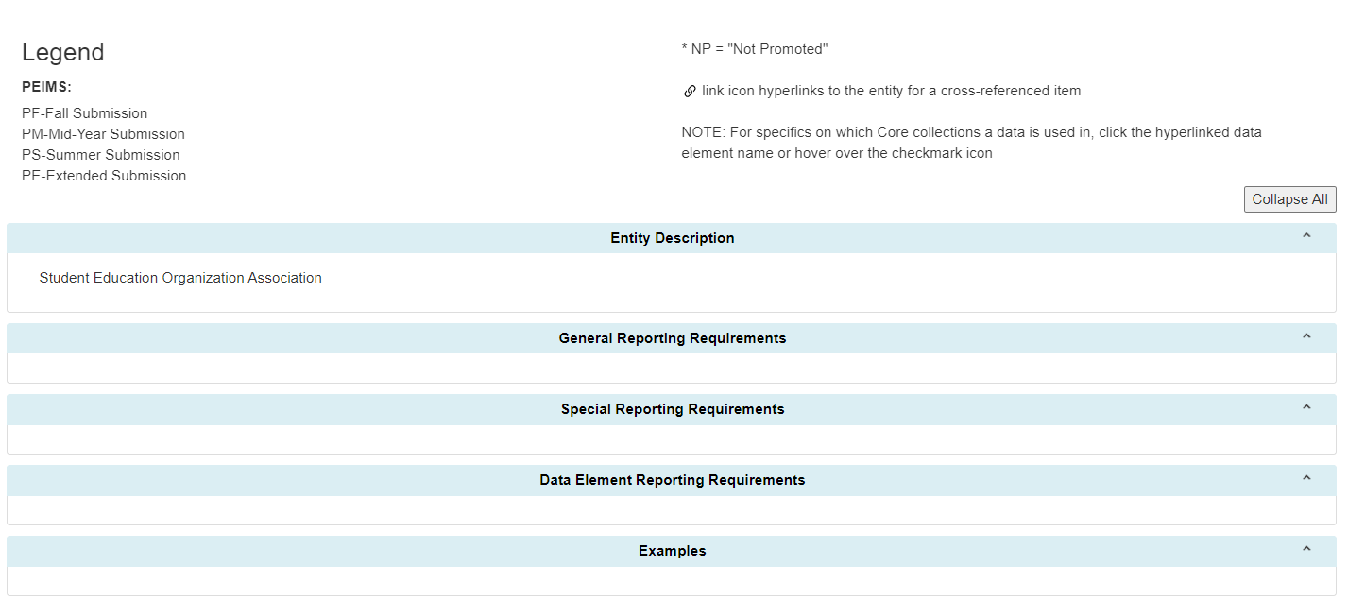
NEW TWEDS 3
Data Components
  Entities
  Data Elements

Slide 13
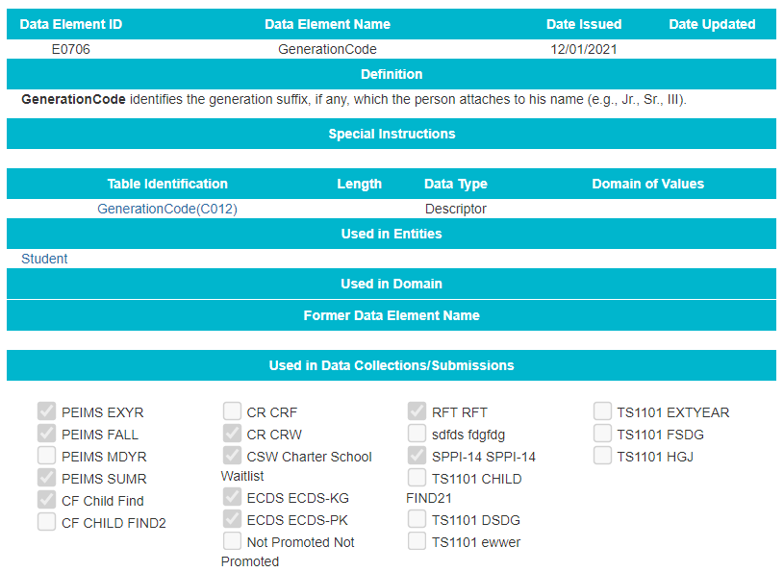
NEW TWEDS 4
Data Components
  Entities
  Data Elements

Slide 14
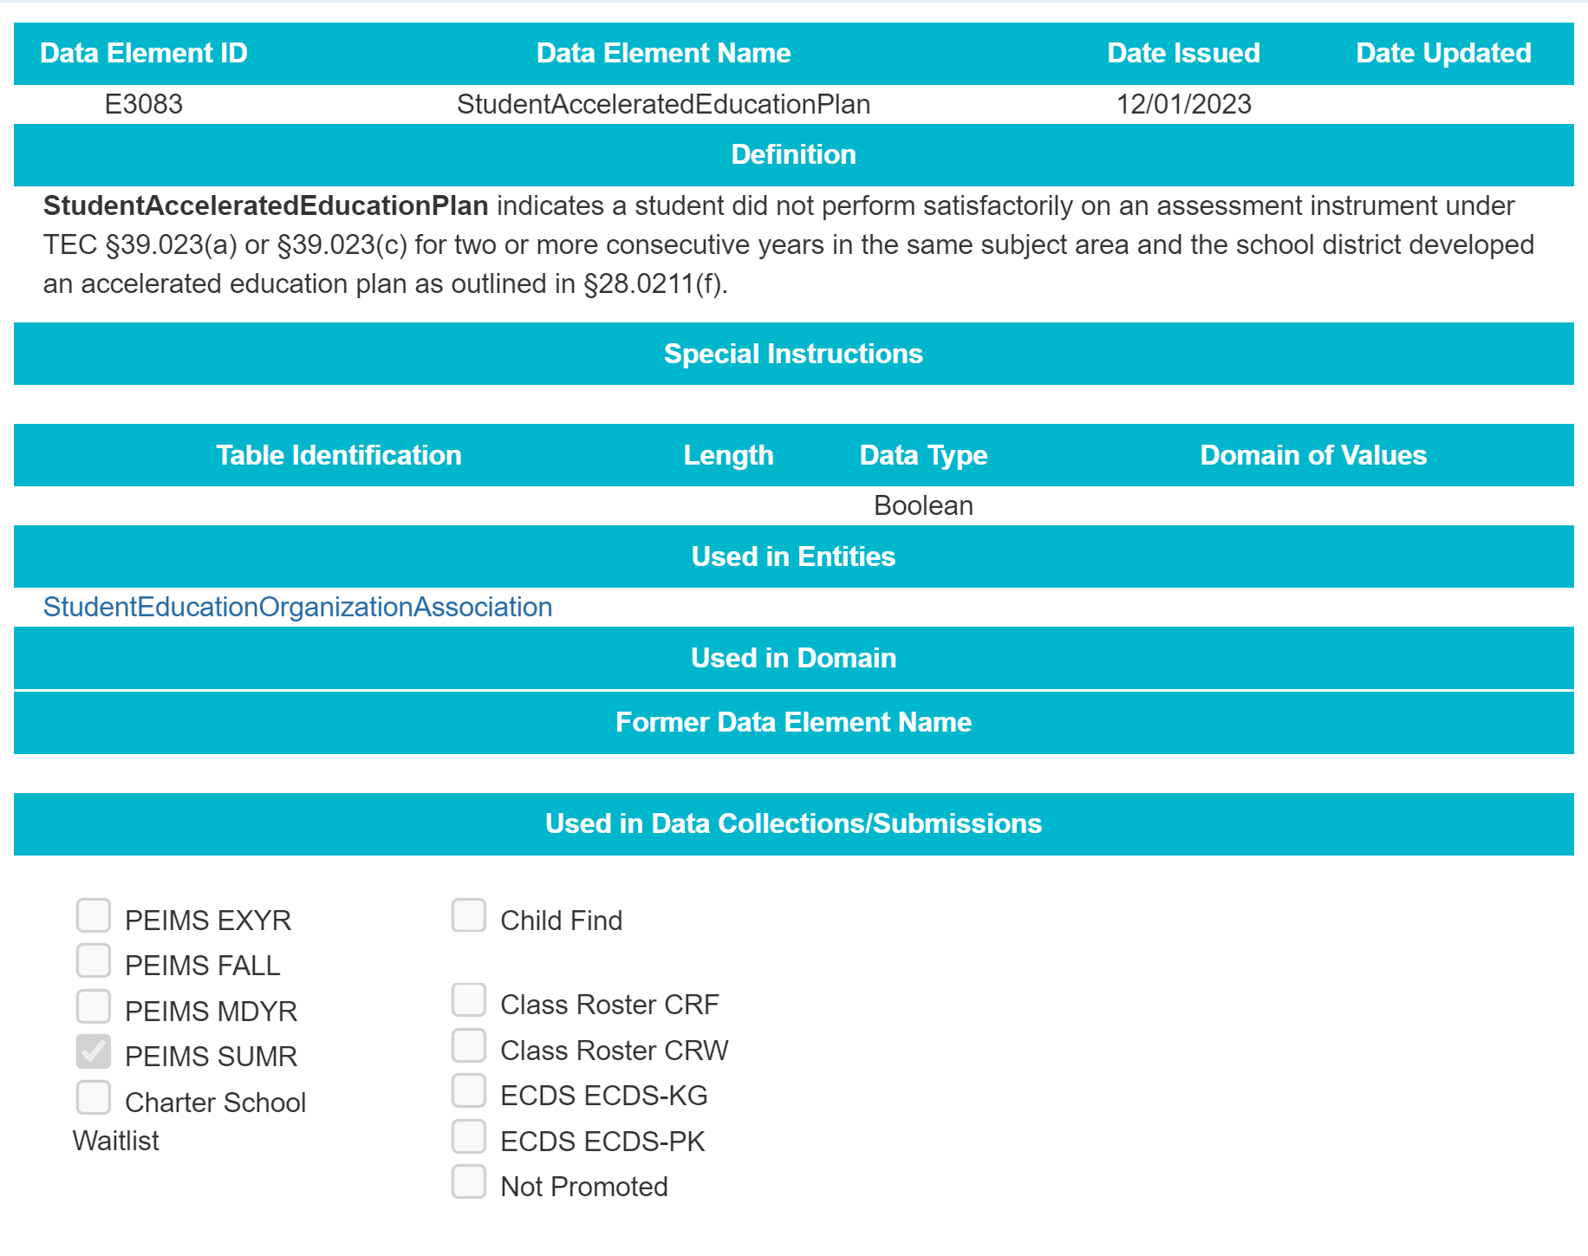
NEW TWEDS 5
Data Components
  Entities
  Data Elements

Slide 15
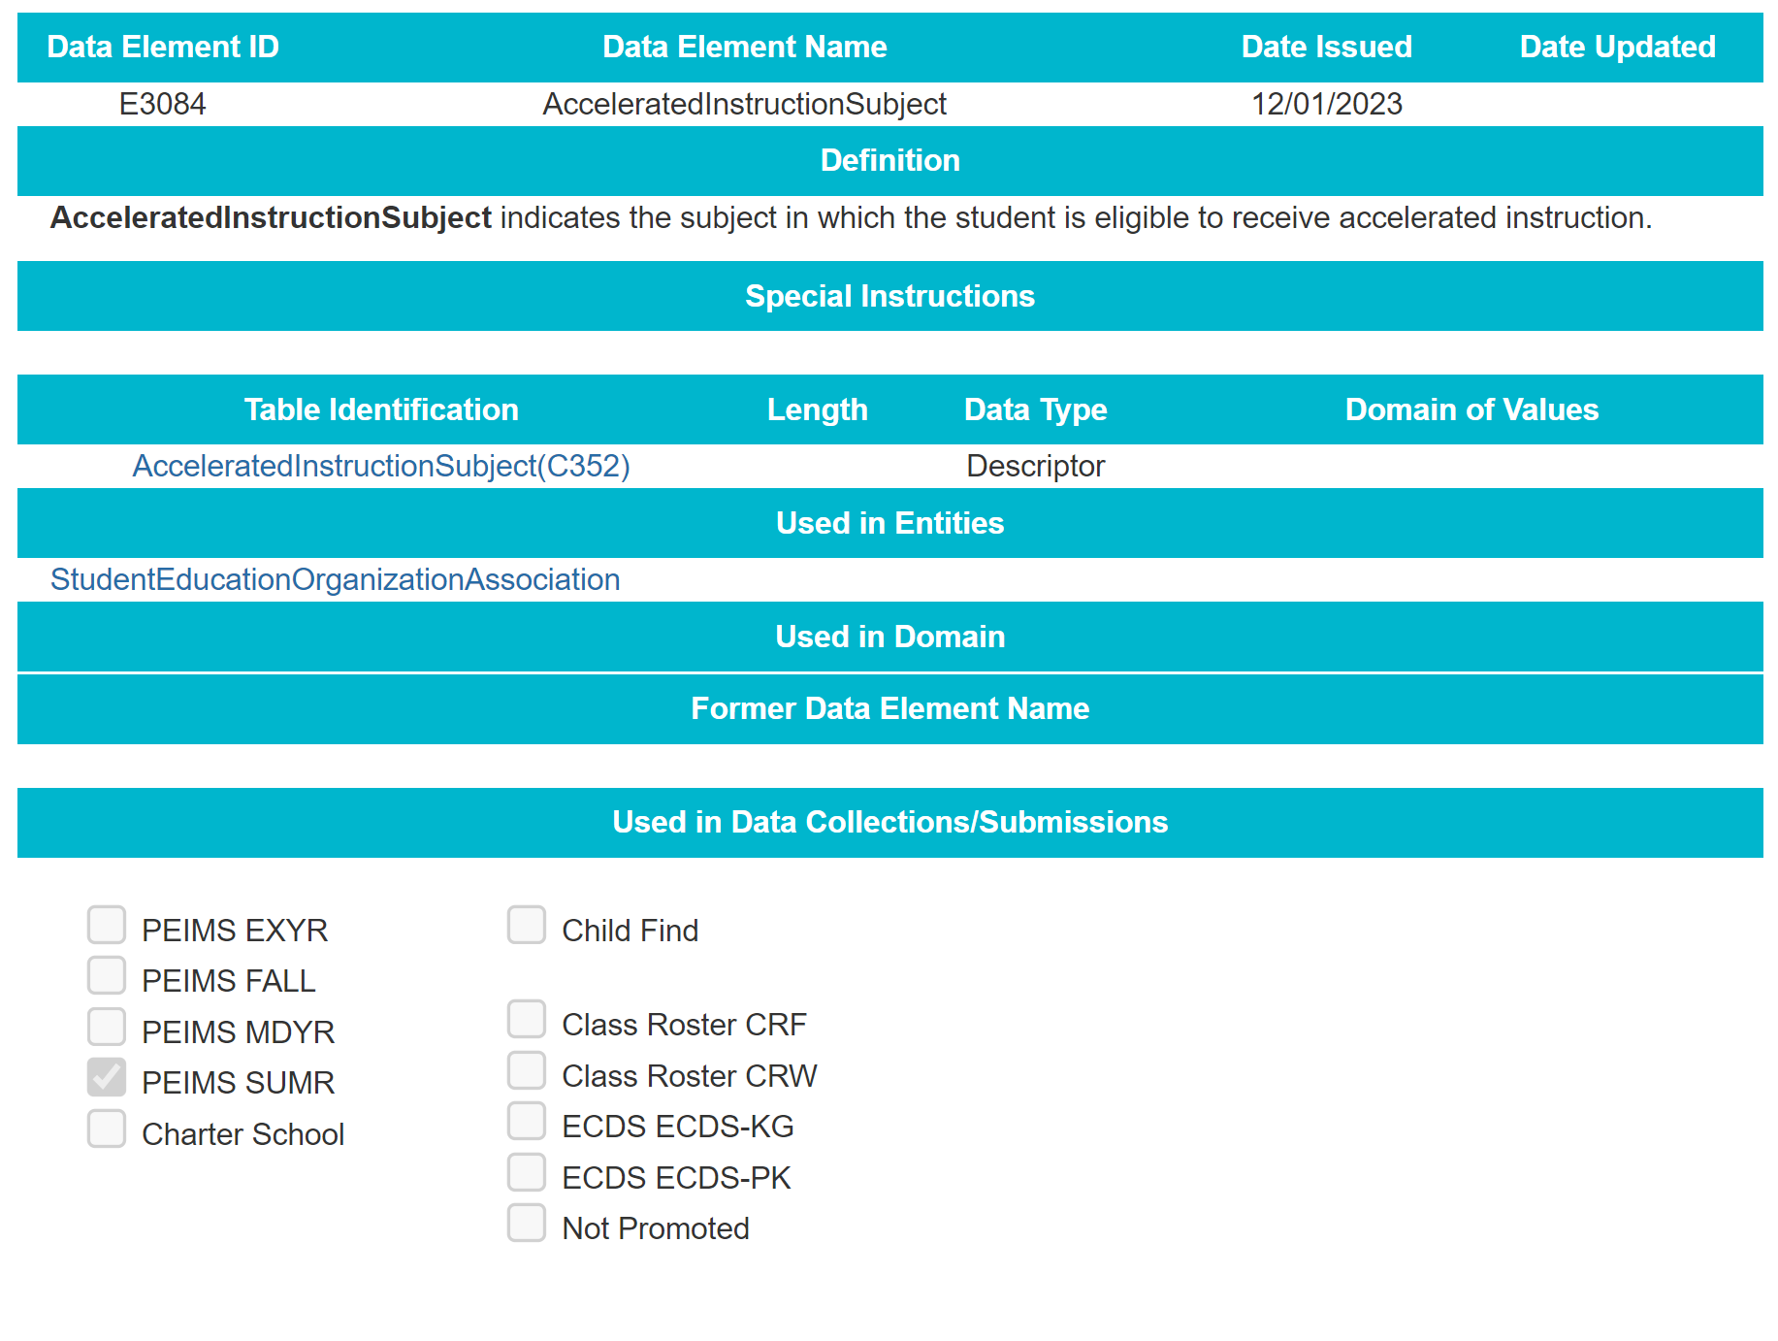
NEW TWEDS 6
Data Components
  Entities
  Data Elements

Slide 16
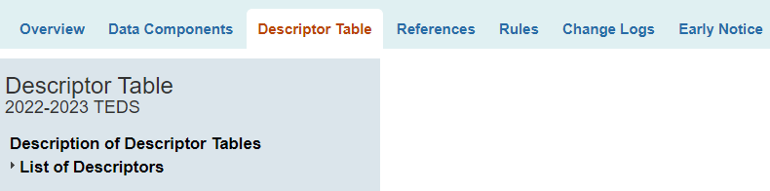
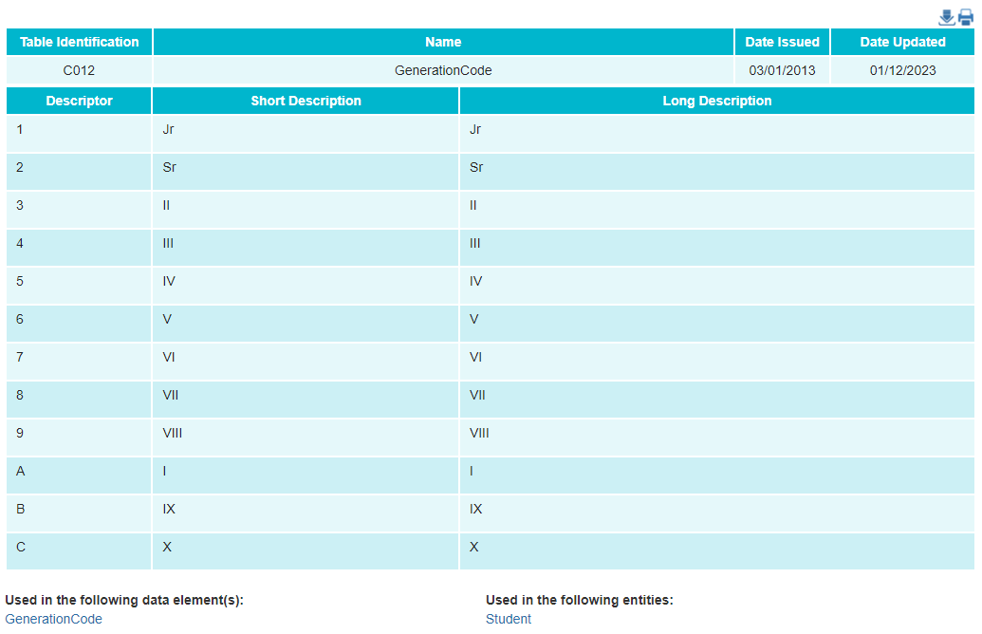
NEW TWEDS 7
Descriptor Table
  List of Descriptors

Slide 17
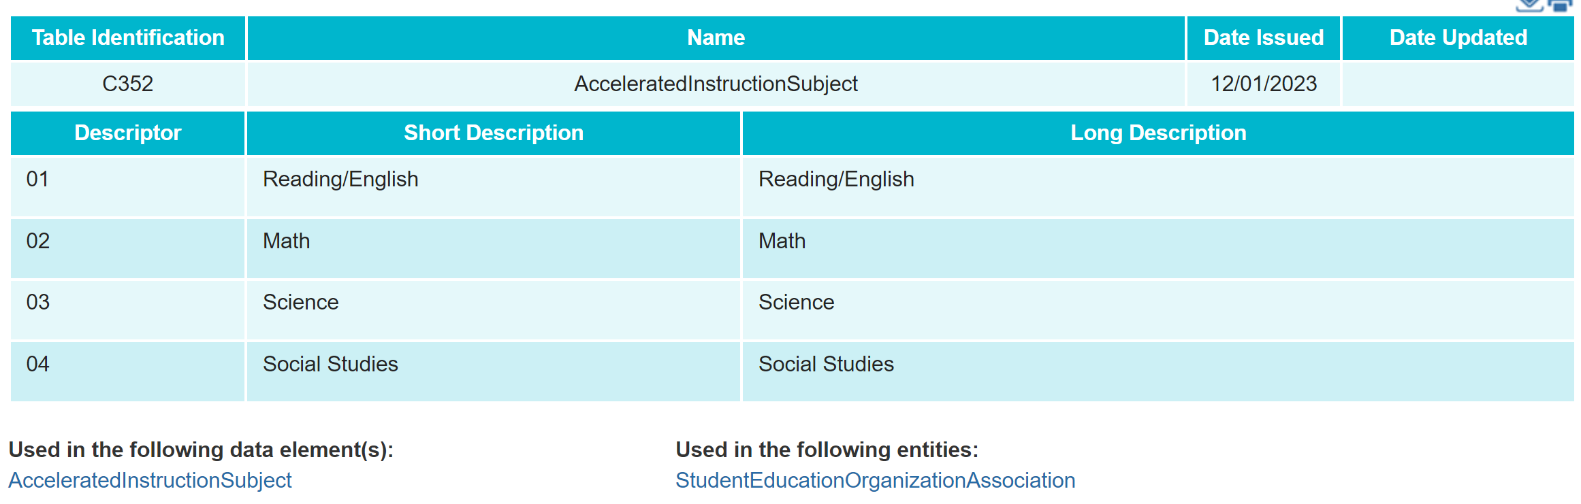
NEW TWEDS 8
Descriptor Table
  List of Descriptors

Slide 18
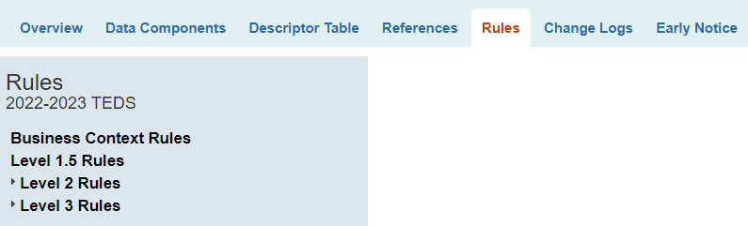
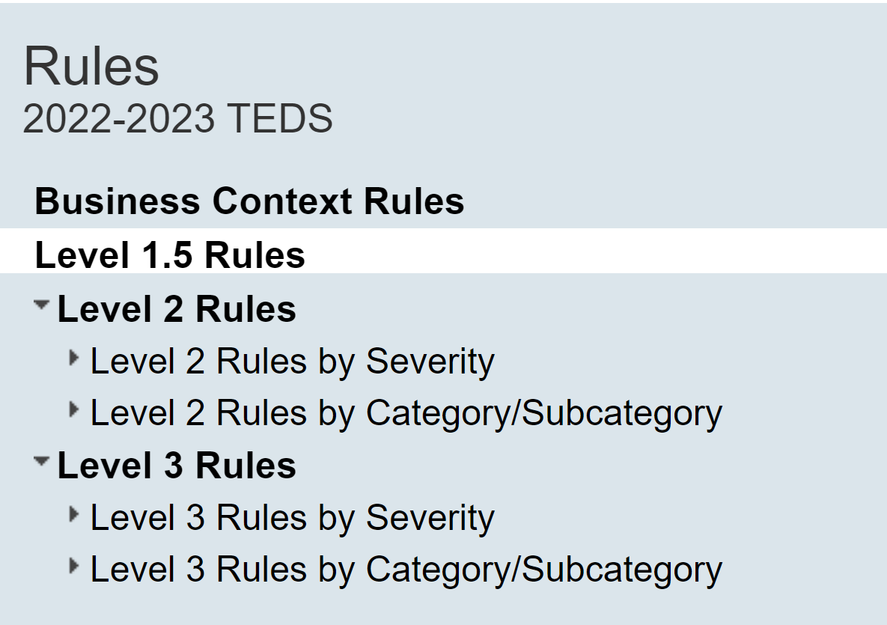
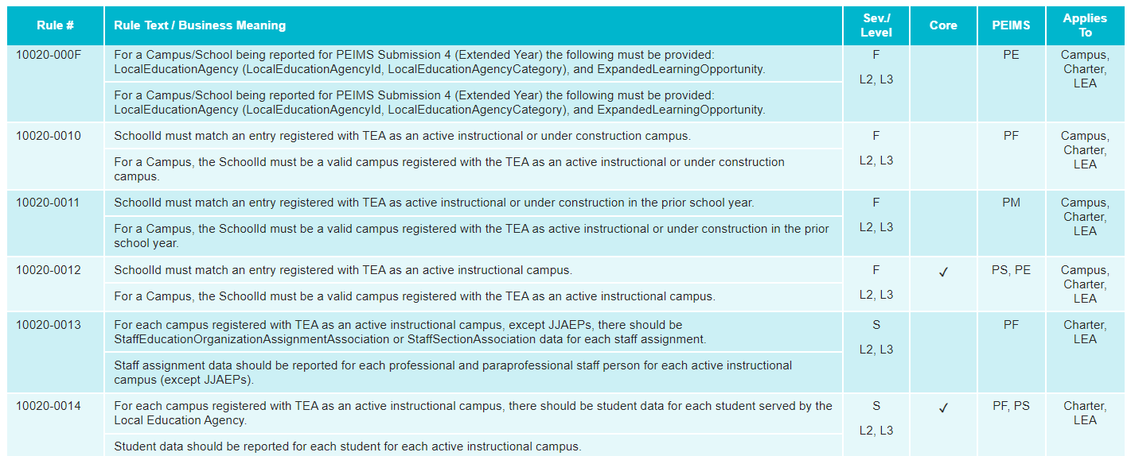
NEW TWEDS 9

Slide 19
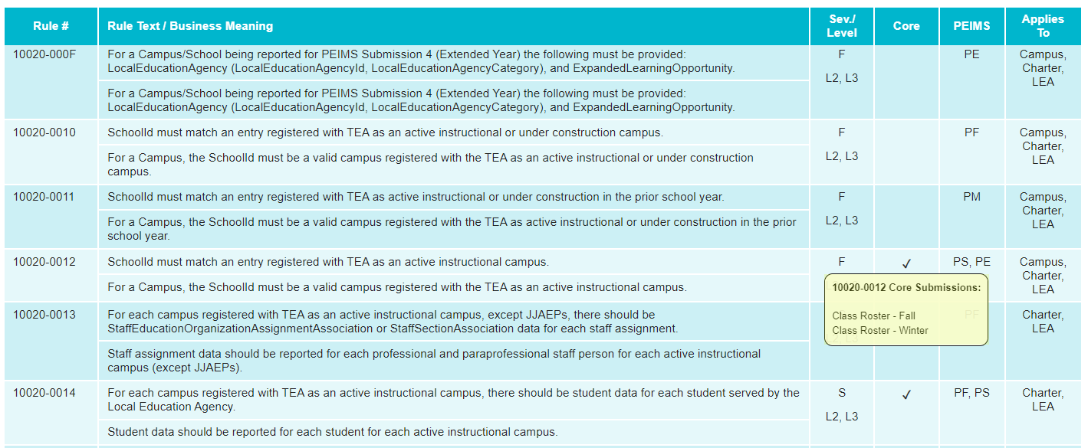
NEW TWEDS 10

Slide 20

NEW TWEDS 11
References: replaces the Technical Resources available in the current TWEDS.
Change Logs: link to documents showing the cumulative changes.
Early Notice: available when TEA has a notice for future data collections.

Slide 21
TITLE SLIDE: Closeout
CLOSEOUT
NAME OF COMPONENT (ALL CAPS)
MARCH 19-21, 2024

Slide 22

QUESTIONS
QUESTIONS?

