Slide 1

TITLE SLIDE: Data Standards Changes
2025-2026 DATA STANDARDS CHANGES
July 29, 2025
<NAME OF COMPONENT> (ALL CAPS)
MARCH 19-21, 2024

Slide 2

Agenda – 2025-2026 Data Standards Changes
Middle School Advanced Mathematics
Advanced Technical Credit
OnRamps Dual Enrollment Indicator
Accelerated Instruction Changes
Discipline Changes
New Classroom Position
Special Education Changes
Begin and End Date for Homeless Identification
Changes Following Year One of the TSDS Upgrade
Questions
Resources

Slide 3

TITLE SLIDE: Middle School Advanced Mathematics
Middle School Advanced Mathematics
NAME OF COMPONENT (ALL CAPS)
MARCH 19-21, 2024

Slide 4
Middle School Advanced Mathematics
During the 88th legislative session, SB 2124 was passed, which added that each school district and open-enrollment charter school should develop an advanced mathematics program for middle school students that is designed to enable those students to enroll in Algebra I in eighth grade. (Texas Administrative Code (TAC) §74.2101)
One new descriptor will be added to the StudentCharacteristic (C344) descriptor table to collect in the PEIMS Fall Submission if a student is enrolled in an advanced mathematics program.
A student should remain coded with the StudentCharacteristic “24” until they are no longer enrolled in a Middle School Advanced Mathematics course and upon enrolling in the ninth grade.
Resources

Slide 5
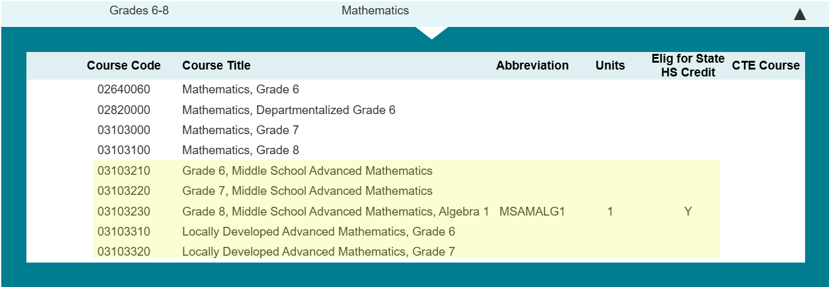
MS Advanced Math CourseCodes
The following CourseCodes have been added for a student participating in the Middle School Advanced Math program:
Resources

Slide 6
TITLE SLIDE: Advanced Technical Credit
Advanced Technical Credit
NAME OF COMPONENT (ALL CAPS)
MARCH 19-21, 2024

Slide 7
Sunset – Advanced Technical Credit
The Career and Technical Education program area has requested that the Texas Education Agency (TEA) sunset the ATCIndicator (E1058). Perkins V removed funding for the Advanced Technical Credit (ATC) program. The last ATC course was offered during the 2018-2019 school year. The ATCIndicator was collected in the PEIMS Summer and Extended Year Submissions.
Resources

Slide 8
TITLE SLIDE: OnRamps Dual Enrollment Indicator
OnRamps Dual Enrollment Indicator
NAME OF COMPONENT (ALL CAPS)
MARCH 19-21, 2024

Slide 9
OnRamps Dual Enrollment Background
The TEA Performance Reporting Division receives student-level information about OnRamps college course completion, course credit, and credit hours directly from the University of Texas at Austin. TEA cannot determine the secondary course credit given to a student by the local education agency (LEA).
One new data element, OnRampsDualEnrollmentIndicator (E3120), will be added to the CourseTranscriptExt Entity and collected in the PEIMS Summer and Extended Year Submissions for TEA to determine which secondary courses align with specific OnRamps courses.
Resources

Slide 10
Frequently Asked Questions (OnRamps):
Should LEAs report college credit hours for a dual enrollment course?
Yes, LEAs should report the college credit hours earned by a student for a dual enrollment course, including an OnRamps course.
Resources

Slide 11
Frequently Asked Questions (OnRamps):
Will TEA continue to use the OnRamps college credit hours received from the University of Texas at Austin (UT) for the dual credit college hours indicator for the College, Career, and Military Readiness (CCMR) indicator?
Yes, TEA will continue to use the college credit hours received from UT for the CCMR indicator. The new OnRampsDualEnrollmentIndicator (E3120) was added since TEA cannot determine which secondary course credit is given to a student by the LEA based on the data received from UT. The TEA Performance Reporting Division needs to know the secondary course credits awarded and the college credit hours earned through the OnRampus dual enrollment course.
Resources

Slide 12
TITLE SLIDE: Accelerated Instruction Changes
Accelerated Instruction Changes
NAME OF COMPONENT (ALL CAPS)
MARCH 19-21, 2024

Slide 13
Accelerated Instruction
In the 2024-2025 PEIMS Summer Submission, TEA began collecting data to identify the accelerated instruction provided by an LEA to a particular student.
Texas Administrative Code, Section 104.1001, was adopted, which approved Ratio Waiver List (RWL) products. These products use automated, computerized, or other augmented methods of instruction, which LEAs can use in place of some or all of the required individual or group instruction.
The Texas Tutoring Supports Division has determined that it is necessary to know which students use a product from the RWL for their accelerated instruction.
One new data element, RatioWaiverListProductUsed (E3121), will be added to the AcceleratedInstructionSet common type in the StudentEducationOrganizationAssociation Entity and collected beginning in the 2025-2026 PEIMS Summer Submission.
Resources

Slide 14
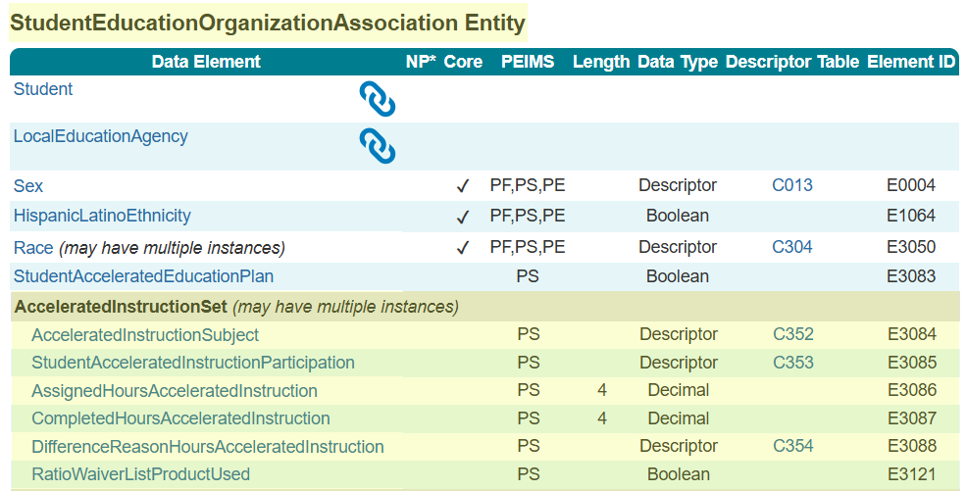
AcceleratedInstructionSet Common Type Reminder
AcceleratedInstructionSet common type is reported for each Subject where a student did not meet standard on the assessment. A student with an AcceleratedInstructionSet reported does NOT automatically mean a student is reported with a StudentAcceleratedEducationPlan (E3083).
Resources

Slide 15
Accel Instruction Data Element Updates
AssignedHoursAcceleratedInstruction (E3086): revised the domain of values from 00.00-60.00 to 00.00-90.00.
CompletedHoursAcceleratedInstruction (E3087): revised the domain of values from 00.00-60.00 to 00.00-90.00.
RatioWaiverListProductUsed (E3121): revised from required to optional.
Resources

Slide 16
Accelerated Instruction Resources
Accelerated Instruction Website
Support Resources
Contact Texas Tutoring Supports
Resources

Slide 17
Frequently Asked Questions (Accel Instruction):
Can you provide an example of when an LEA would report a student with true for the RatioWaiverListProductUsed (E3121)?
Student A is assigned 30 hours of accelerated instruction and completes 24 hours using a product on the ratio waiver list. Student A completed 80% (24 of 30 hours) of their accelerated instruction using a product on the ratio waiver list and would be reported with true for this indicator.
Student B is assigned 30 hours of accelerated instruction and completes 18 hours using a product on the ratio waiver list. Student B completed 60% (18 of 30 hours) of their accelerated instruction using a product on the ratio waiver list and would be reported with true for this indicator.
Student C is assigned 30 hours of accelerated instruction and completes 12 hours using a product on the ratio waiver list. Student C completed 40% (12 of 30 hours) of their accelerated instruction using a product on the ratio waiver list and would be reported with false for this indicator.
Student D is assigned 30 hours of accelerated instruction and completes 15 hours using a product on the ratio waiver list. Student D completes 50% (15 of 30 hours) of their accelerated instruction using a product on the ratio waiver list and would be reported with true for this indicator.
Resources

Slide 18
Frequently Asked Questions (Accel Instruction):
If a student moves to another Texas public school, do both schools report the accelerated instruction information for the student?
When a student moves to another Texas public school, the school where the student ended the school year is responsible for reporting all accelerated instruction provided to the student. The original LEA should transmit through the Texas Records Exchange (TREx) any accelerated instruction provided to the student while enrolled. However, TEA will not prevent both LEAs from reporting the accelerated instruction provided to the student. TEA will use existing data to determine where a student ended the school year.
Resources

Slide 19
TITLE SLIDE: Discipline Changes
Discipline Changes
NAME OF COMPONENT (ALL CAPS)
MARCH 19-21, 2024

Slide 20
Discipline Changes
The Student Discipline Program Specialist audited all discipline-related data components and guidance in the Texas Education Data Standards (TEDS) and the Texas Records Exchange (TREx) Data Standards for accuracy and alignment with Chapter 37 of the Texas Education Code.
The changes reviewed during the Spring training are the results of this audit.
Additional changes may occur as a result of House Bill 6 from the 89th Regular Legislative Session. TEA will provide those changes in the September 2, 2025, post-addendum publication of the Texas Education Data Standards.
Resources

Slide 21
TITLE SLIDE: New Classroom Position
New ClassroomPosition
NAME OF COMPONENT (ALL CAPS)
MARCH 19-21, 2024

Slide 22
New Classroom Position
TEA developed the Teacher Residency initiative to address the scale of, access to, and sustainability of high-quality teacher preparation through incentives and support to LEAs and Education Preparation Program (EPP) Partnerships to implement paid teacher residency programs.
The Educator Quality Department has requested that a new ClassroomPosition (C309) descriptor be added to help identify individuals serving as teacher residents. ClassroomPosition (E1454) is reported in the PEIMS Fall Submission, Class Roster Winter Submission, and the Early Childhood Data System Prekindergarten and Kindergarten Submissions.
Resources

Slide 23
Frequently Asked Questions (ClassroomPosition):
Can an LEA begin using the ClassroomPosition (C309) 06 (Teacher Resident) at the start of the 2025-2026 school year?
Yes, the new ClassroomPosition (C309) is available for LEAs to use beginning in the 2025-2026 school year.
Resources

Slide 24
Frequently Asked Questions (ClassroomPosition):
Does a section reported with the new ClassroomPosition (C309) 06 (Teacher Resident) also need to be reported with a 01 (Teacher of Record)?
A section does not need to be reported with a Teacher Resident and a Teacher of Record unless there are different staff members who provide services for each role for the section. Any staff who provides a service in a particular section should be reported with the corresponding ClassroomPosition reflecting their role.
Resources

Slide 25
TITLE SLIDE: Special Education Changes
Special Education Changes
NAME OF COMPONENT (ALL CAPS)
MARCH 19-21, 2024

Slide 26
Special Education (SPED) Changes
The Special Population Policy, Integration, and Technical Assistance Department audited all special education-related data components in the Texas Education Data Standards (TEDS) and the Texas Records Exchange (TREx) Data Standards for accuracy and alignment with TAC §89.1040 adopted on July 26, 2024. and TAC §89.1070 adopted on November 1, 2024.
As a result of this audit, the program area requested the following language changes:
  Preschool Program for Children with Disabilities (PPCD) to Early Childhood Special Education (ECSE)
  Special Education Students to Students Receiving Special Education Services
  Individualized Education Plan to Individualized Education Program
  Reference to aged 3 through 5 changed to aged 3 through 5 (not in kindergarten)
Resources

Slide 27
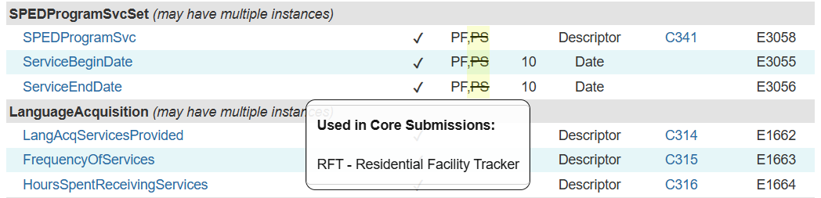
SPEDProgramSvc (E3083)
In XML, LEAs reported the SPEDProgramSvc (E3083) in the PEIMS Summer Submission files. The SPEDProgramSvc was not promoted to the PEIMS Summer Submission but was promoted for RF Tracker. When the upgrade data standard was developed, SPEDProgramSvc still showed that the data element was promoted to the PEIMS Summer Submission. This has been changed.
Resources

Slide 28
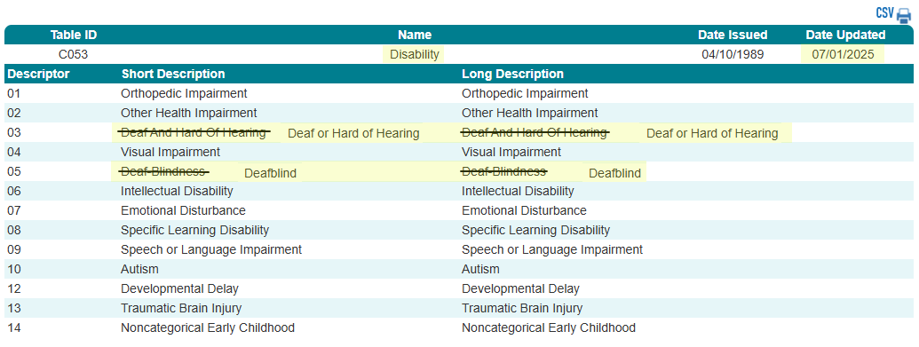
Disability (C053)
Resources

Slide 29
TITLE SLIDE: Homeless Identification
Begin and End Date for Homeless Identification
NAME OF COMPONENT (ALL CAPS)
MARCH 19-21, 2024

Slide 30
Begin and End Date for Homeless Identification
TEA’s Self-Reported Data Unit (SRDU) conducts compliance reviews related to potential discrepancies in data reported to TEA by school systems, including reviews of school system compliance requirements related to the identification of and disciplinary decisions for students experiencing homelessness.
Per Texas Education Code (TEC), Section 37.001, student disciplinary decisions must consider “(4)(F) a student’s status as a student who is homeless” as a factor, “regardless of whether the decision concerns a mandatory or discretionary action” and whether it is “concerning suspension, removal to Disciplinary Alternative Education Program (DAEP), expulsion or placement in Juvenile Justice Alternative Education Program (JJAEP).”
Beginning in the 2025-2026 PEIMS Summer Submission, TEA will promote the BeginDate (E3010) and EndDate (E3020) for the HomelessStatus (E1082).

Slide 31
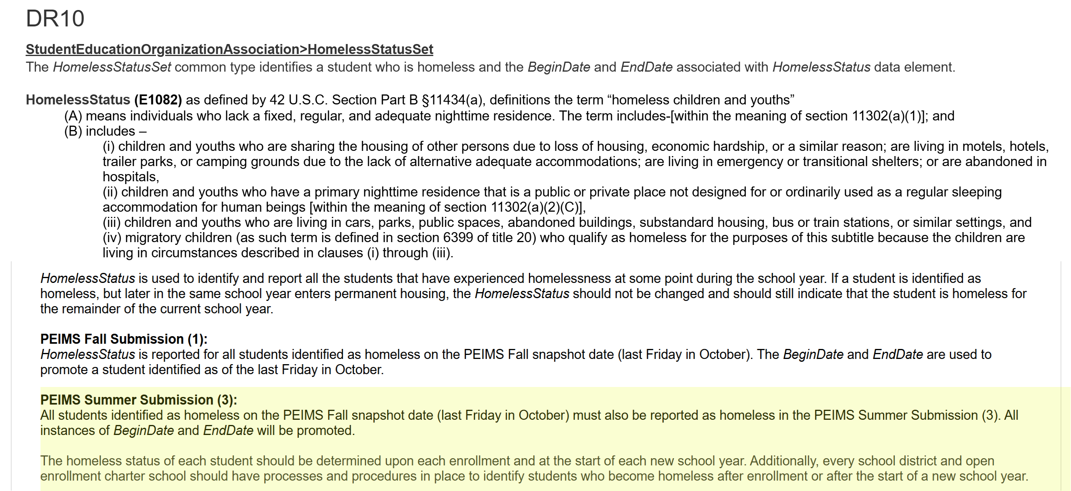
Homeless Indicator in PEIMS Summer Submission

Slide 32

QUESTIONS
QUESTIONS?

Slide 33

Agenda – 2025-2026 TEDS Changes Following Year One TSDS Upgrade
Shared Service Arrangements
CourseTranscriptExt Entity
StudentAcademicRecord Entity
Adult Previous Attendance
SSSP Team Review
PriorYearLeaver Entity
EmploymentPeriod Guidance Update
PayrollExt Entity
Staff Entity
Questions

Slide 34

TITLE SLIDE: Middle School Advanced Mathematics
Shared Service Arrangements
NAME OF COMPONENT (ALL CAPS)
MARCH 19-21, 2024

Slide 35
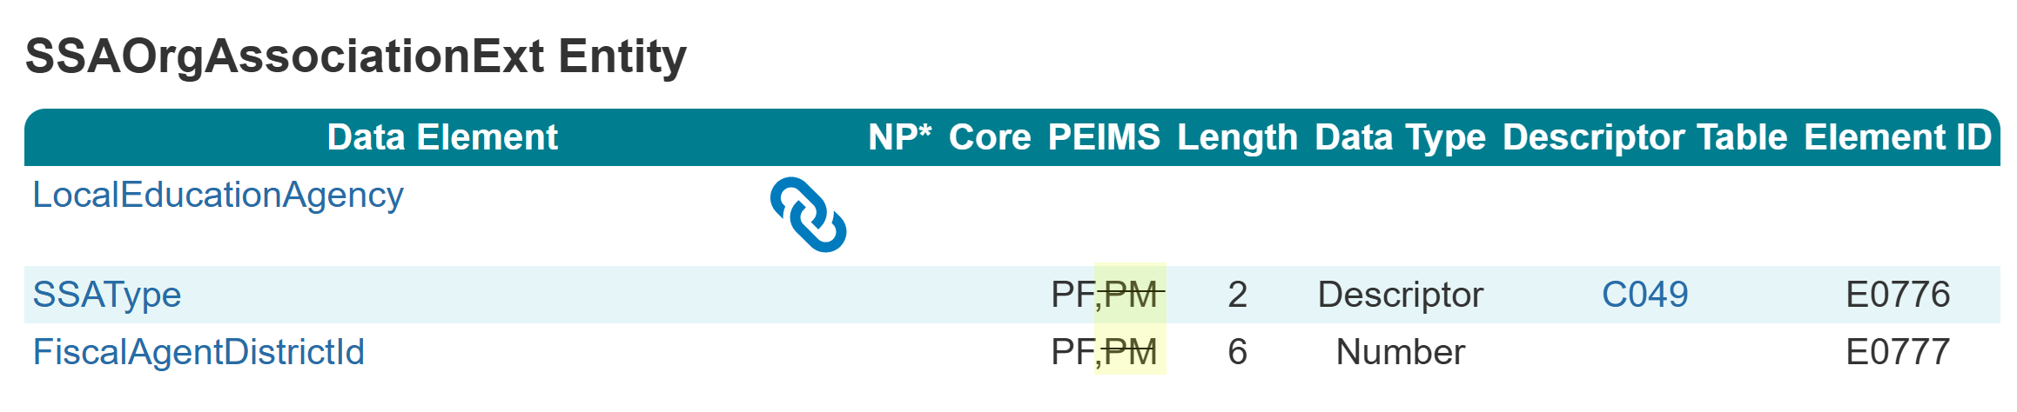
SSAOrgAssociationExt Entity
During the 2024-2025 PEIMS Fall Submission, it was determined that the shared service arrangement type could differ for the PEIMS Fall or PEIMS Mid-Year Submissions in certain circumstances.
For the 2025-2026 school year, the SSAOrgAssociationExt Entity will be used for the PEIMS Fall Submission only.

Slide 36
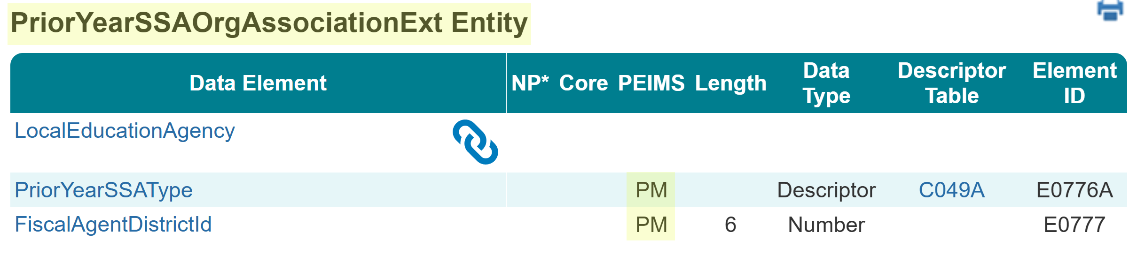
PriorYearSSAOrgAssociationExt Entity
For the 2025-2026 school year, the PriorYearSSAOrgAssociationExt Entity will be used for the PEIMS Mid-Year Submission.

Slide 37
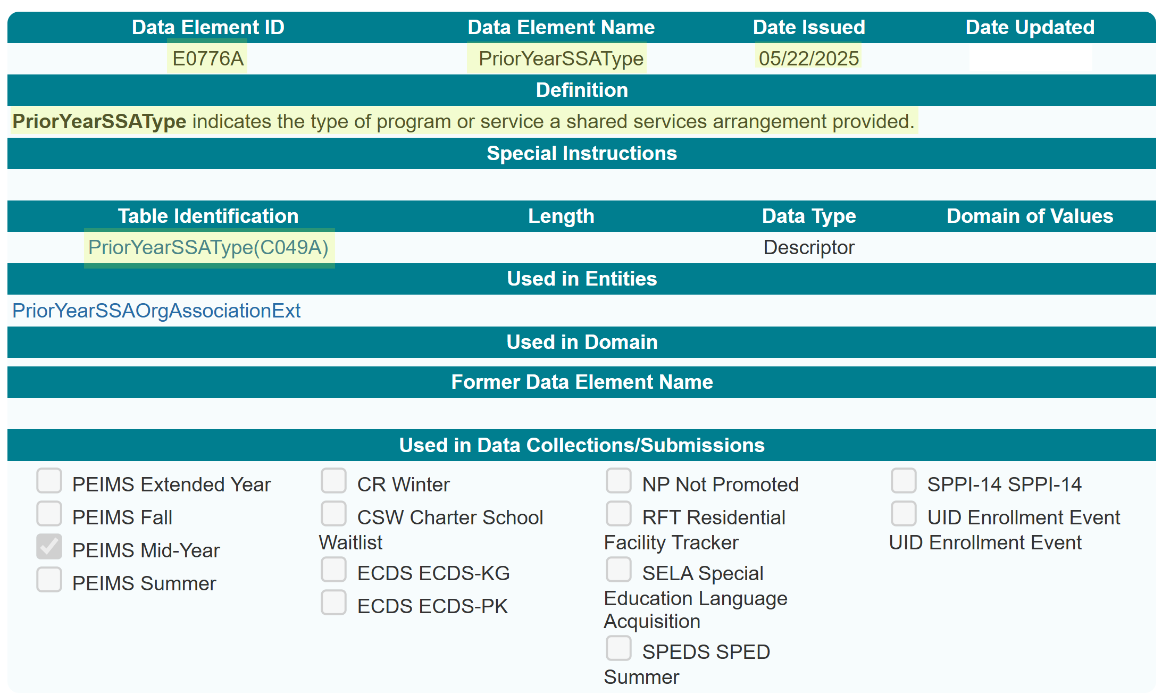
PriorYearSSAType (E0776A)
New PriorYearSSAType (E0776A) data element:

Slide 38
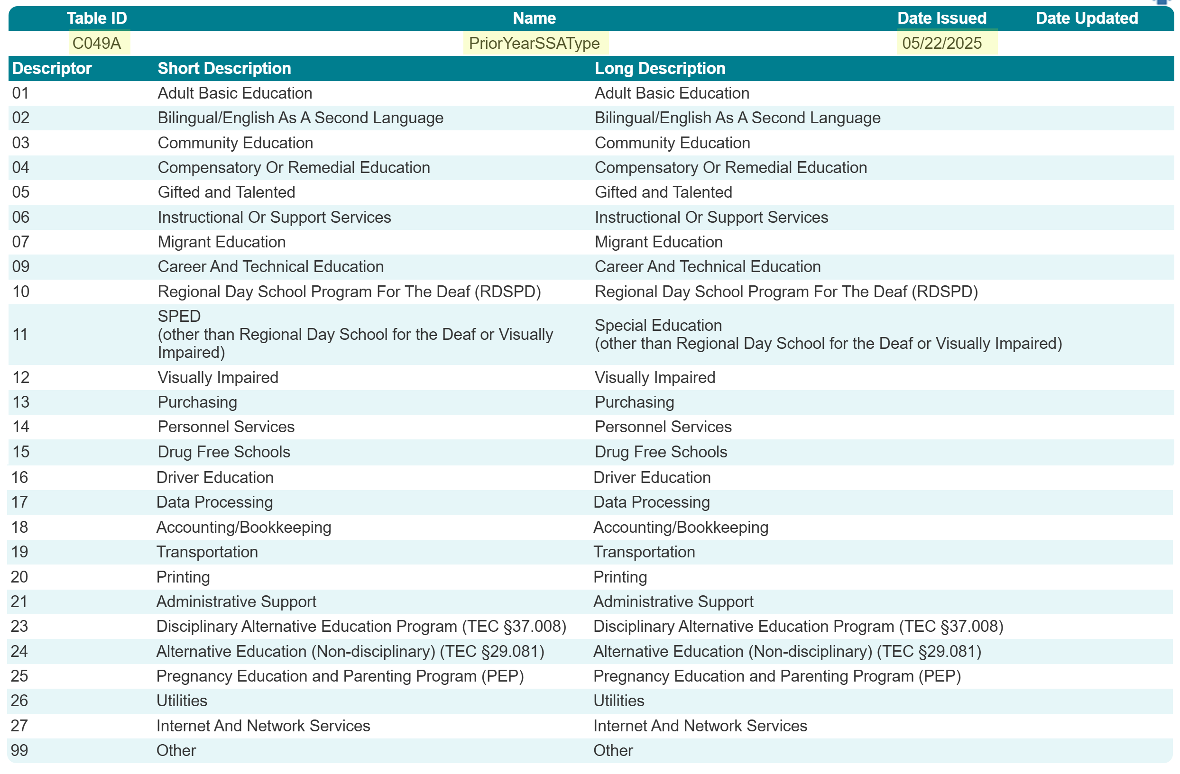
PriorYearSSAType (C049A)
New PriorYearSSAType (C049A) descriptor table:

Slide 39
TSDS PEIMS Mid-Year Reports
Three reports reflect data collected through the new PriorYearSSAType Entity:
  PDM2-100-015
  PDM2-100-017
  PDM2-100-018
Promotion logic will pull from the new entity for the EdOrg > SSA Organization Association subcategory.
No updates to reports will be needed.

Slide 40
TITLE SLIDE: Middle School Advanced Mathematics
CourseTranscriptExt
Entity
NAME OF COMPONENT (ALL CAPS)
MARCH 19-21, 2024

Slide 41
CourseTranscriptExt Entity
The Ed-Fi CourseTranscript Entity has the following as the key:
  CourseAttemptResult
  Course
  StudentAcademicRecord
Using the Ed-Fi CourseTranscript Entity would not allow TEA to accurately promote the completed courses.
On Friday, May 16, 2025, the CourseTranscriptExt Entity was released for the 2025.2.2 version of TEDS. The CourseTranscriptExt Entity was also added to the 2026.1.1 version of TEDS.

Slide 42
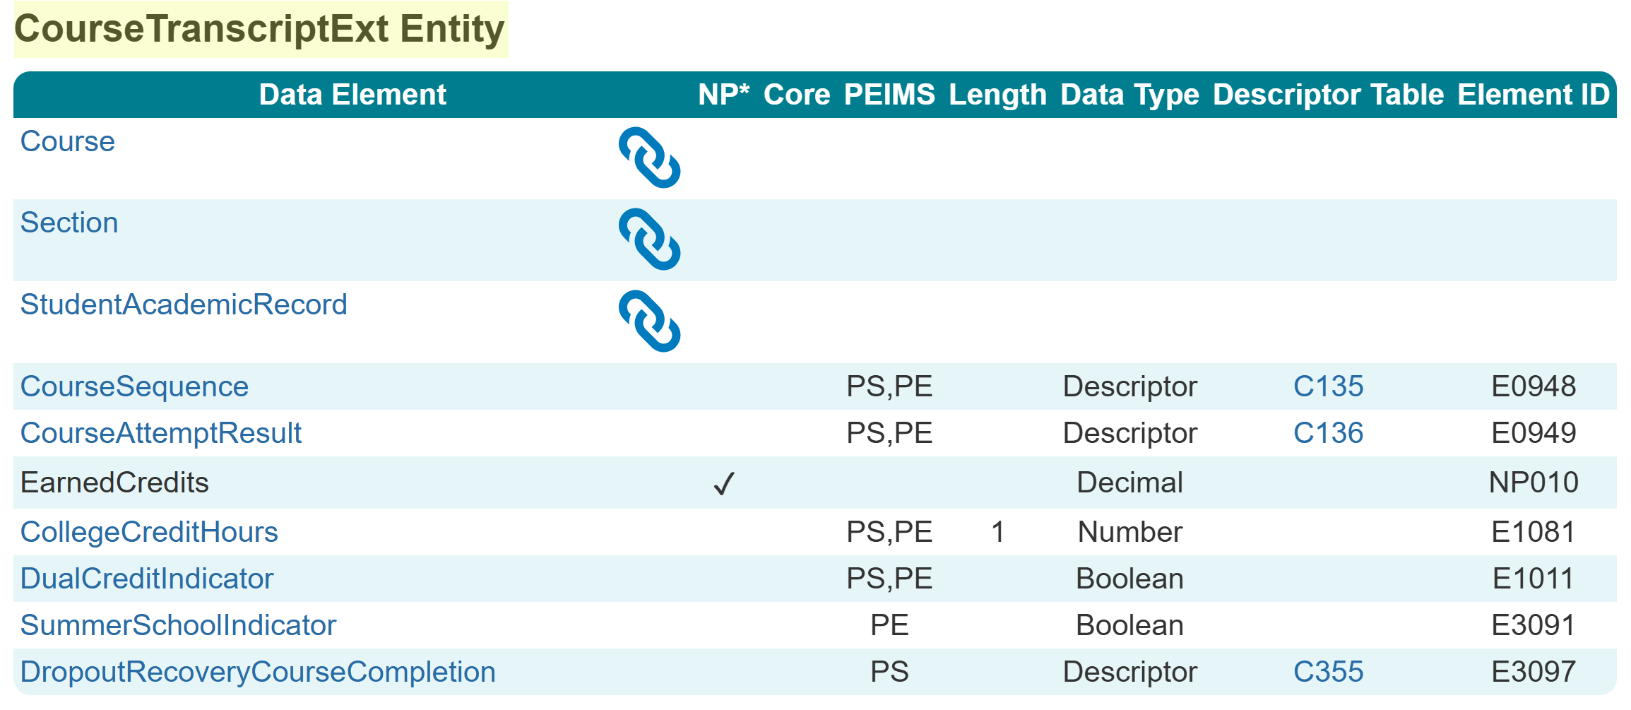
CourseTranscriptExt Entity
The new CourseTranscriptExt Entity has the following as the key:
  CourseAttemptResult
  Course
  StudentAcademicRecord
  Section
  CourseSequence

Slide 43
Course Completion Promotions
Course Completion records for students will be promoted when…
  The CourseTranscriptExt Entity record published has a UID matching …
  A StudentAcademicRecord Entity record published matching School Year/Term…
  To a published Session Entity record.
  Additionally,
  The CourseTranscriptExt Entity record published has a matching CourseSequence…
  To a published Section Entity record with matching SectionSet > CourseSequence.
  Finally,
  The CourseTranscriptExt Entity record published has a matching SectionIdentifier…
  To a StudentSectionAssociation Entity record published with CourseCompletionIndicator “True” that matches 1-to-1 a…
  Published Section Entity record.

Slide 44
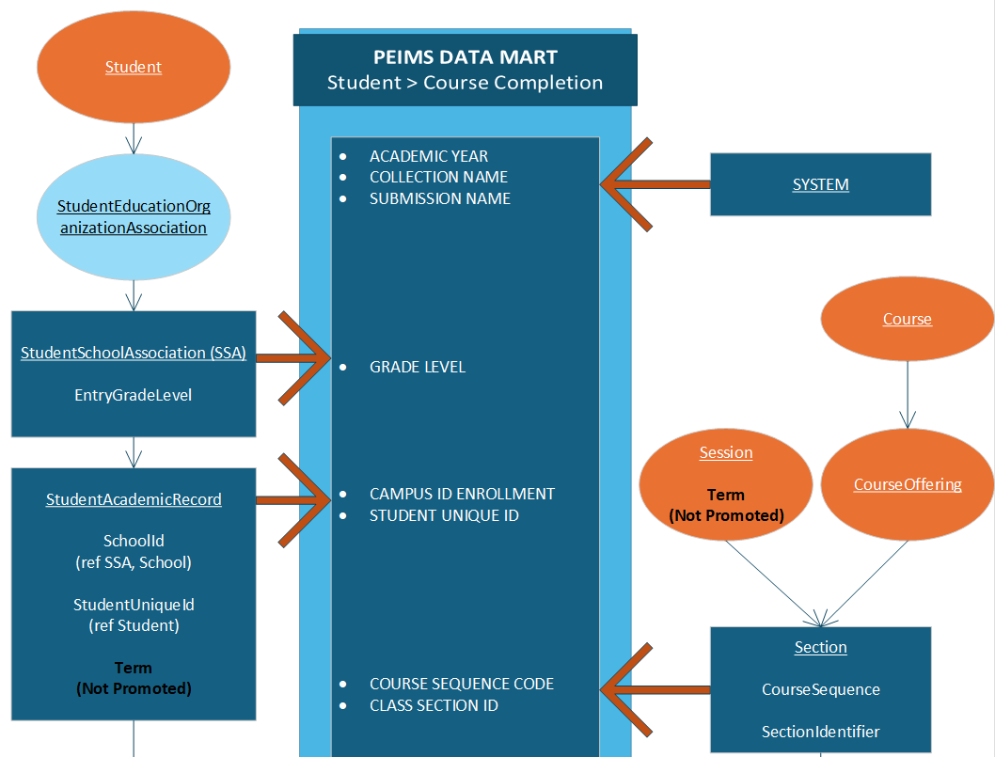
Course Completion Promotions

Slide 45
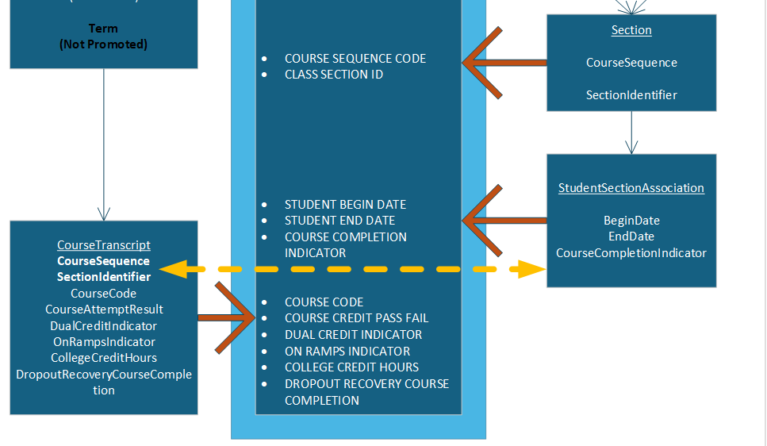
Course Completion Promotions

Slide 46
TITLE SLIDE: Middle School Advanced Mathematics
StudentAcademicRecord Entity
NAME OF COMPONENT (ALL CAPS)
MARCH 19-21, 2024

Slide 47
StudentAcademicRecord (SAR) Entity
The StudentAcademicRecord Entity has TEA extended data elements:
  EndorsementPursuing (E3022)
  IndividualGraduationCommitteeReview (E1563)
  AssociateDegreeIndicator (E1596)
  FHSPParticipant (E3030)
  FHSPDistingLevelParticipant (E3029)
  EndorsementCompleted (E3021)
The data element Term is part of the key, so vendors sent multiple StudentAcademicRecord entities with different Terms for an individual student, and TEA had to determine which StudentAcademicRecord set of data to promote.

Slide 48
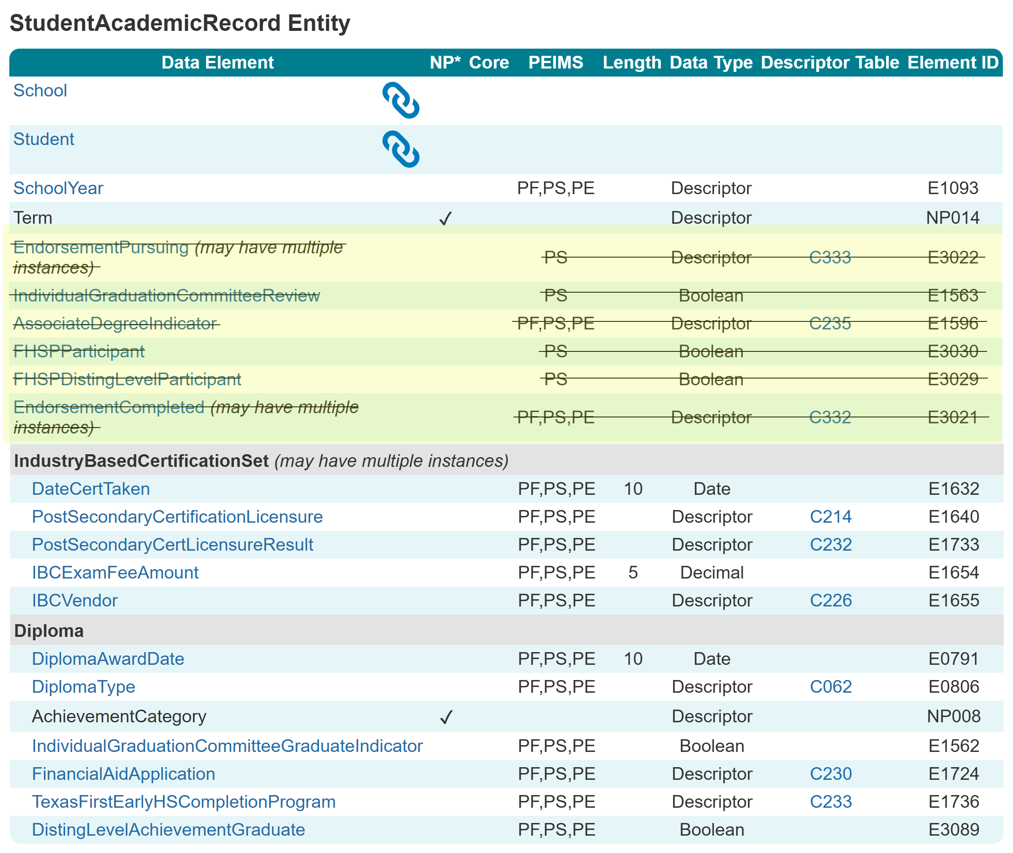
StudentAcademicRecord (SAR) Entity
The following data elements were moved to separate common types in the StudentAcademicRecord Entity:
EndorsementPursuing
IndividualGraduationCommitteeReview
AssociateDegreeIndicator
FHSPParticipant
FHSPDistingLevelParticipant
EndorsementCompleted

Slide 49
SAR Entity
New dates within the new Common Types are used for promotion logic purposes; they will not promote into the data mart.
Students should only have current-year SAR Entity records in the current-year IODS.
Students may have more than one SAR Entity record published:
  Term (NP014) is part of the primary key to publish and reflects the LEA’s course scheduling setup.
  If the LEA is publishing multiple SARs for a student, the data within the JSON should promote into the data mart correctly with these new common types.

Slide 50
SAR New Common Types
Four new common types were added to the StudentAcademicRecord Entity:
  GraduationProgramParticipationSet
  IndividualGraduationCommitteeReviewSet
  AssociateDegreeIndicatorSet
  EndorsementCompletedSet

Slide 51
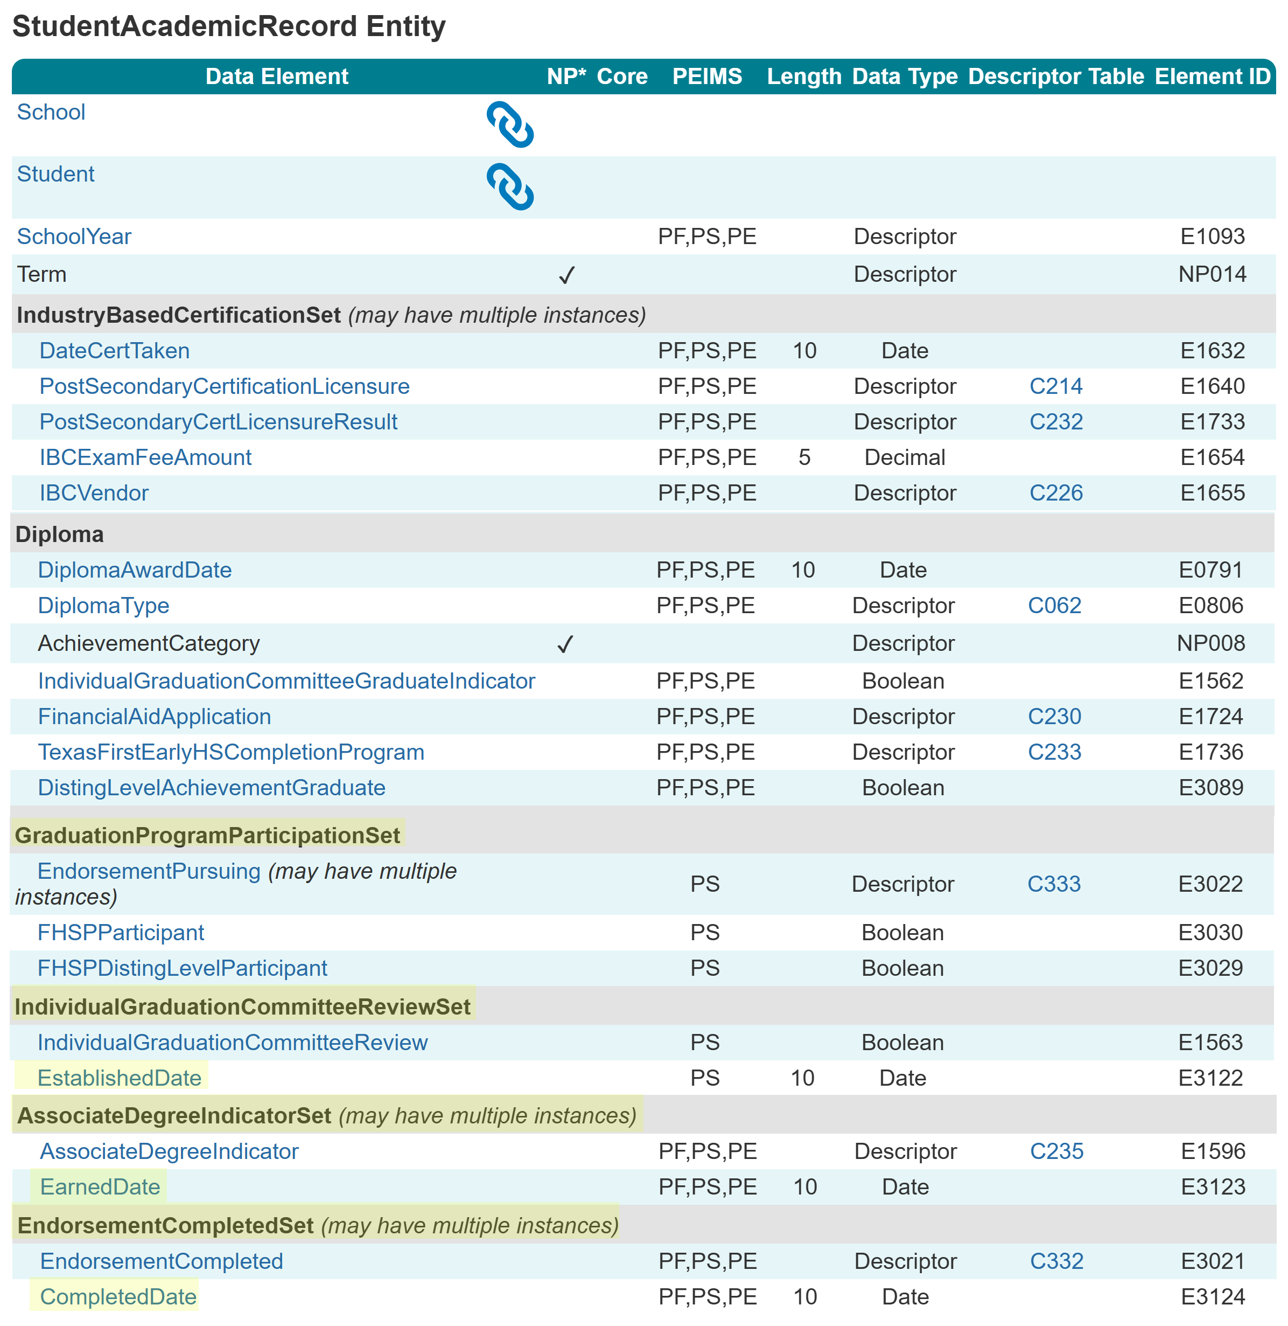
SAR New Common Types

Slide 52
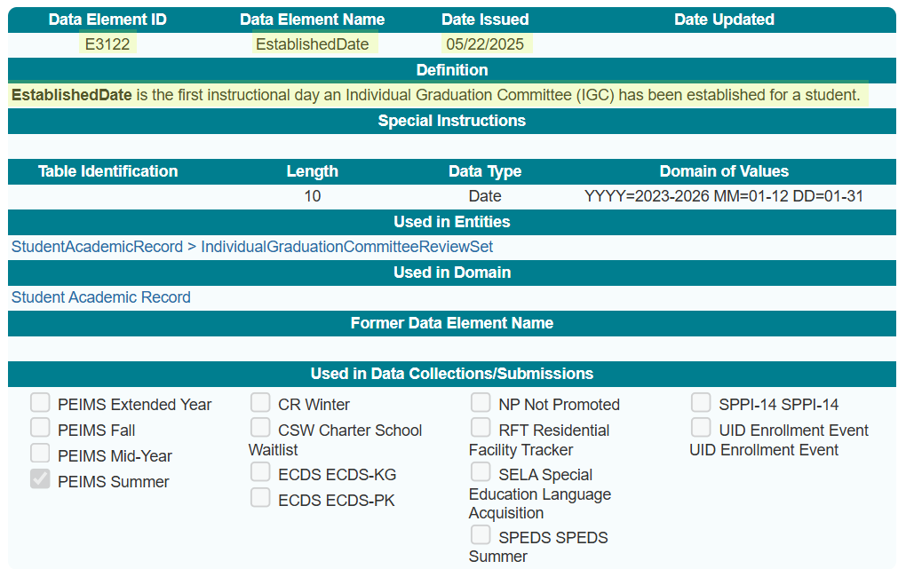
EstablishedDate (E3122)

Slide 53
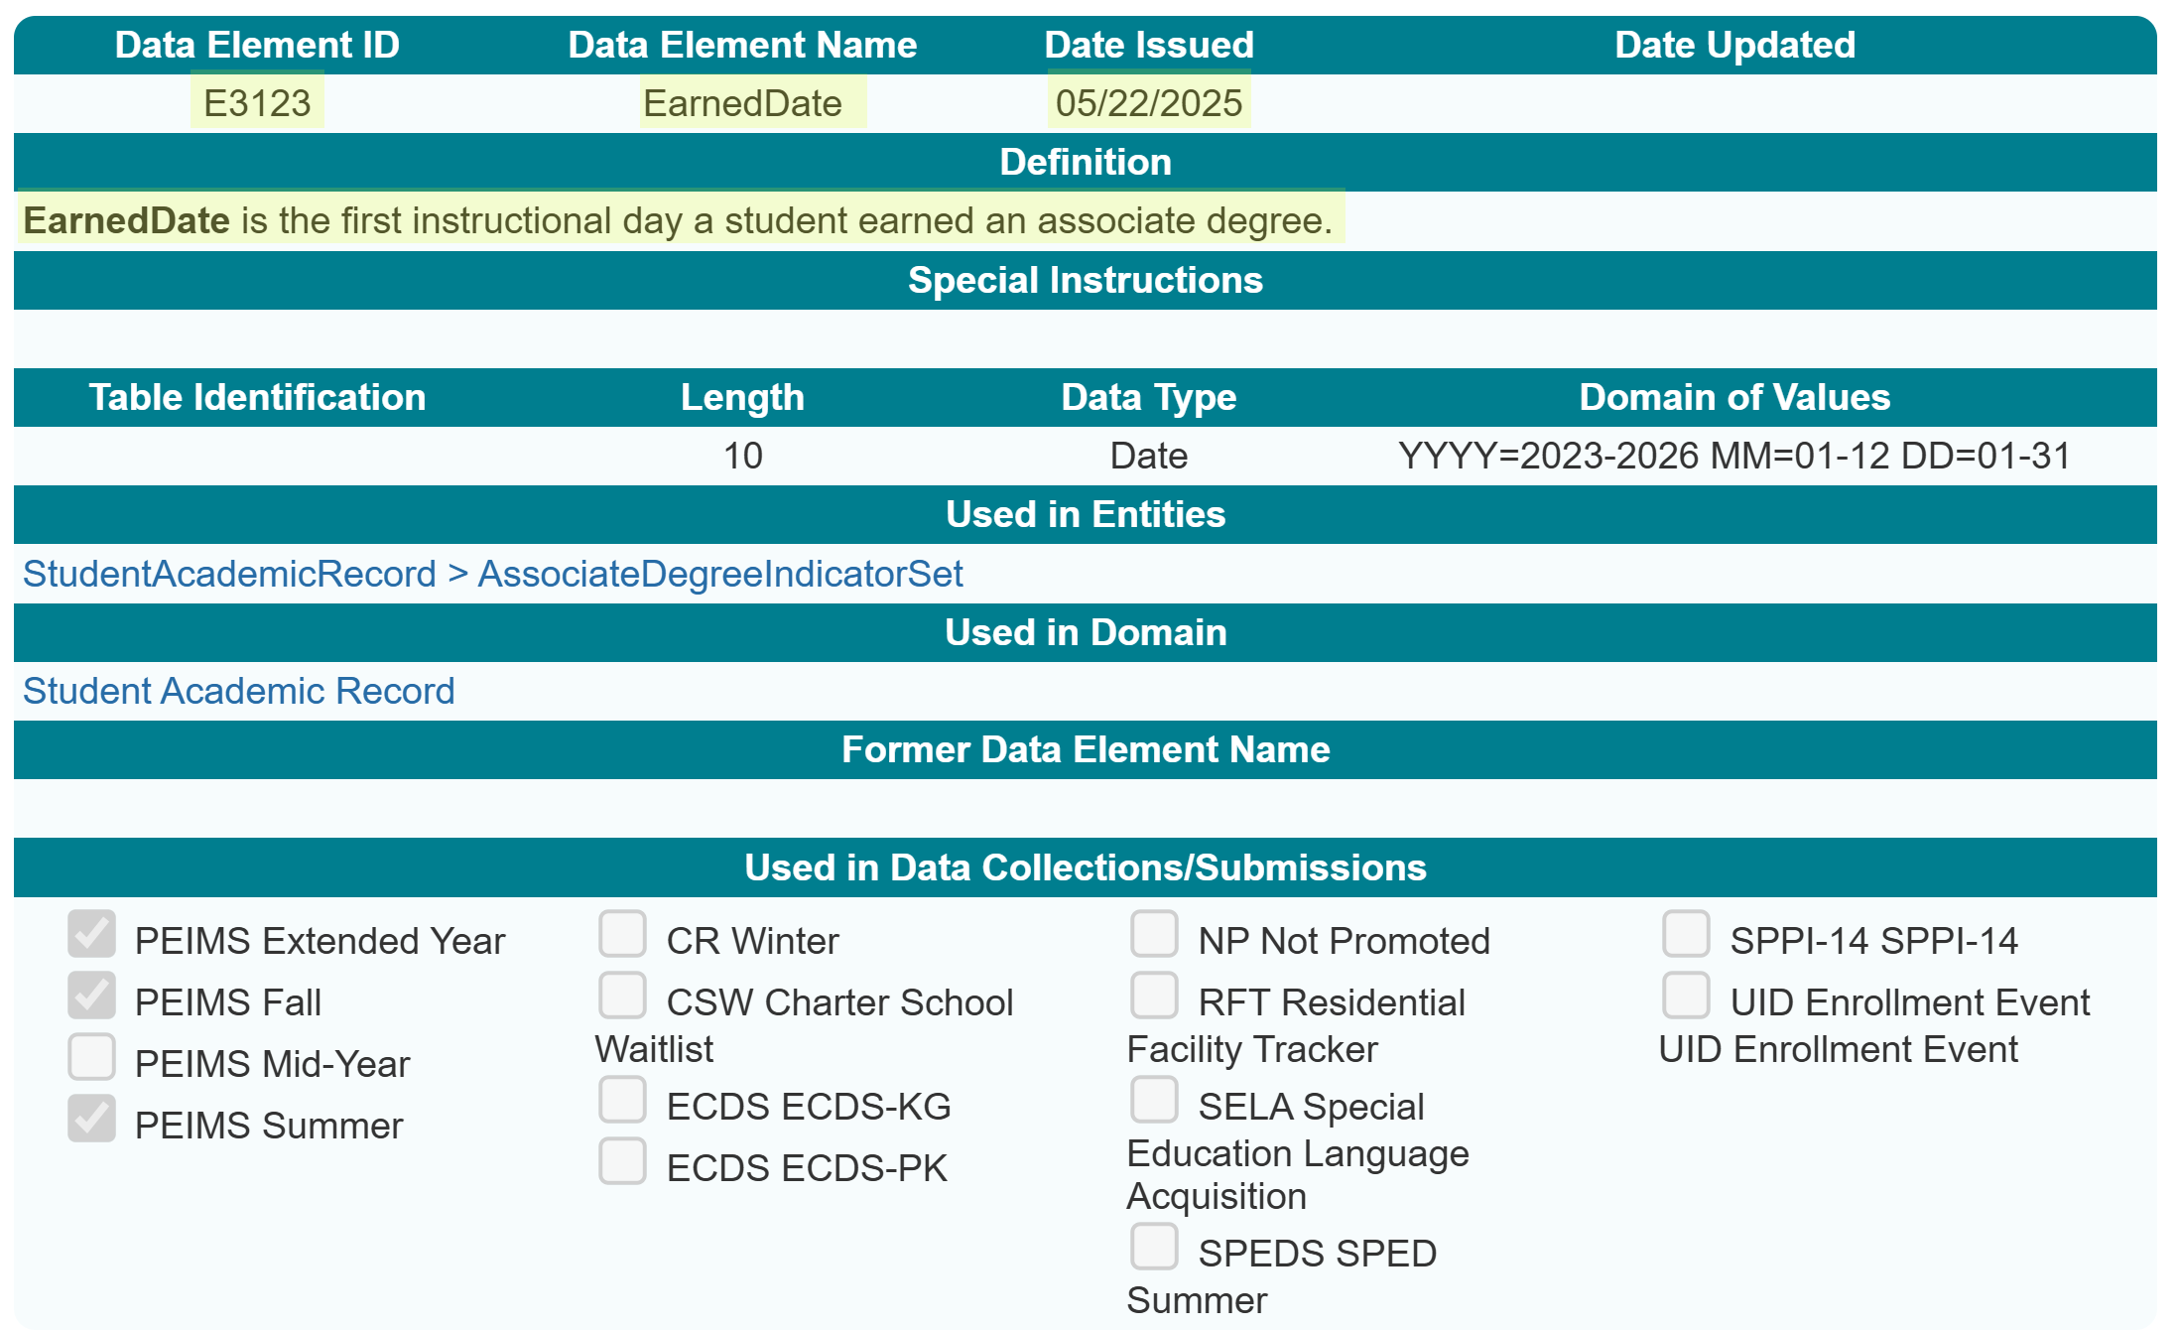
EarnedDate (E3123)

Slide 54
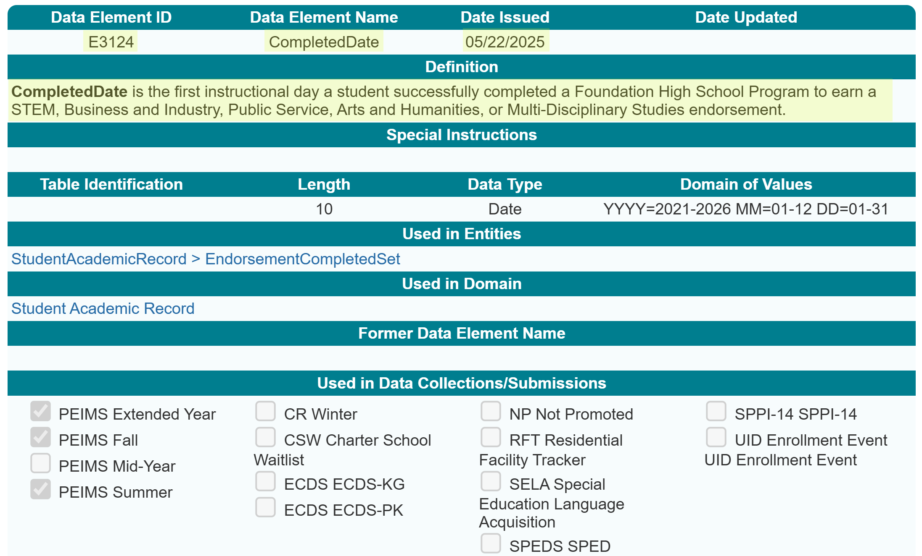
CompletedDate (E3124)

Slide 55
TITLE SLIDE: Middle School Advanced Mathematics
Adult Previous Attendance
NAME OF COMPONENT (ALL CAPS)
MARCH 19-21, 2024

Slide 56
2023-2024 Adult Previous Attendance
In the 2023-2024 school year, the ADULT-PREVIOUS-ATTENDANCE-INDICATOR-CODE (E1660) was used to report an adult student (age 18-25) who is currently in a high school equivalency program, dropout recovery school, or other adult education program, has or has not attended school in the previous nine months prior to enrolling.
ADULT-PREVIOUS-ATTENDANCE-INDICATOR-CODE = “1” meant the student attended school in the previous nine months.
ADULT-PREVIOUS-ATTENDANCE-INDICATOR-CODE = “0” meant the student had NOT attended school in the previous nine months.

Slide 57
2024-2025 Adult Previous Attendance
In the 2024-2025 school year, Adult Previous Attendance was reported in the PEIMS Fall and PEIMS Summer Submissions using a StudentCharacteristic (C344).
There was no way for an LEA to report that a student did not attend school in the previous nine months before enrolling using a “0.”
For the 2025-2026 school year, the StudentCharacteristic “16” will be removed and replaced with a new common type to collect the information.

Slide 58
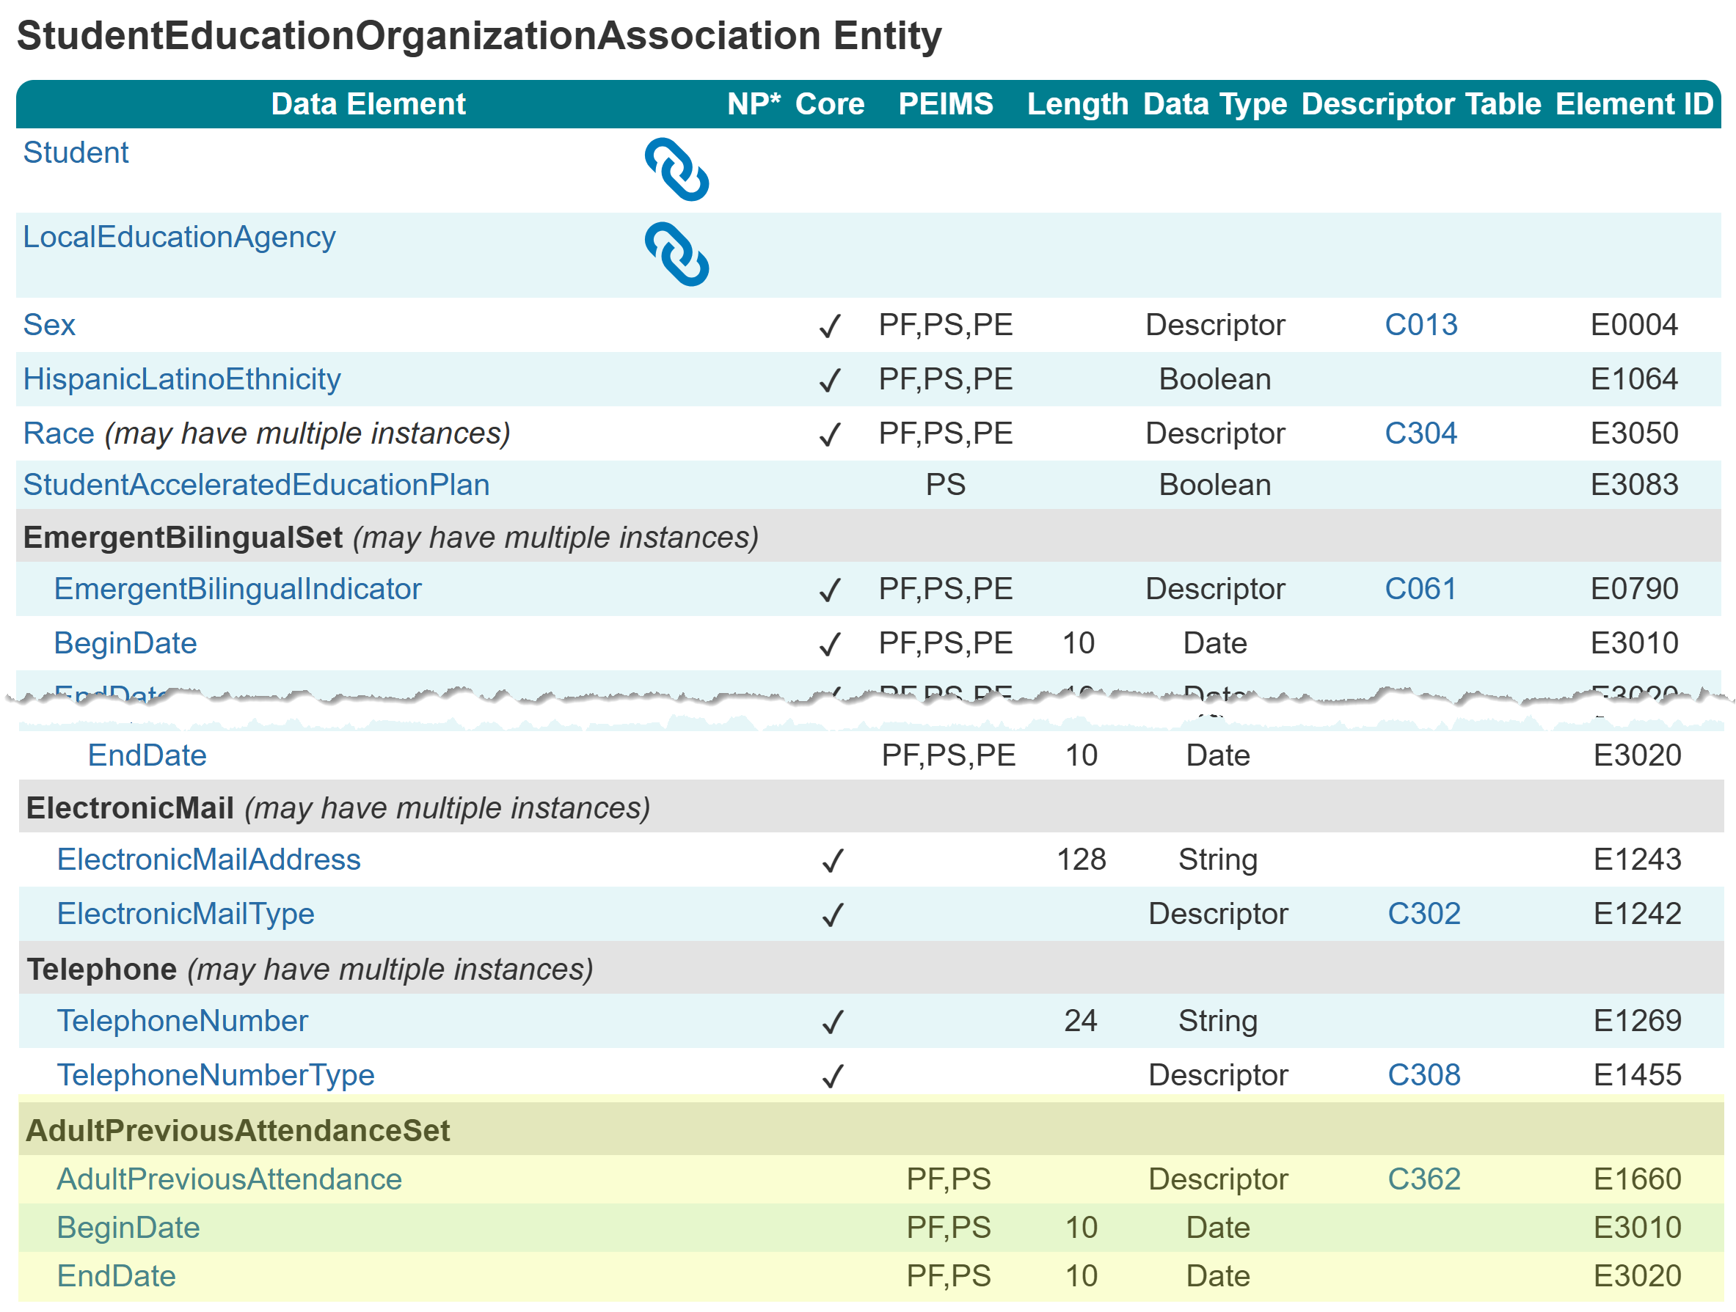
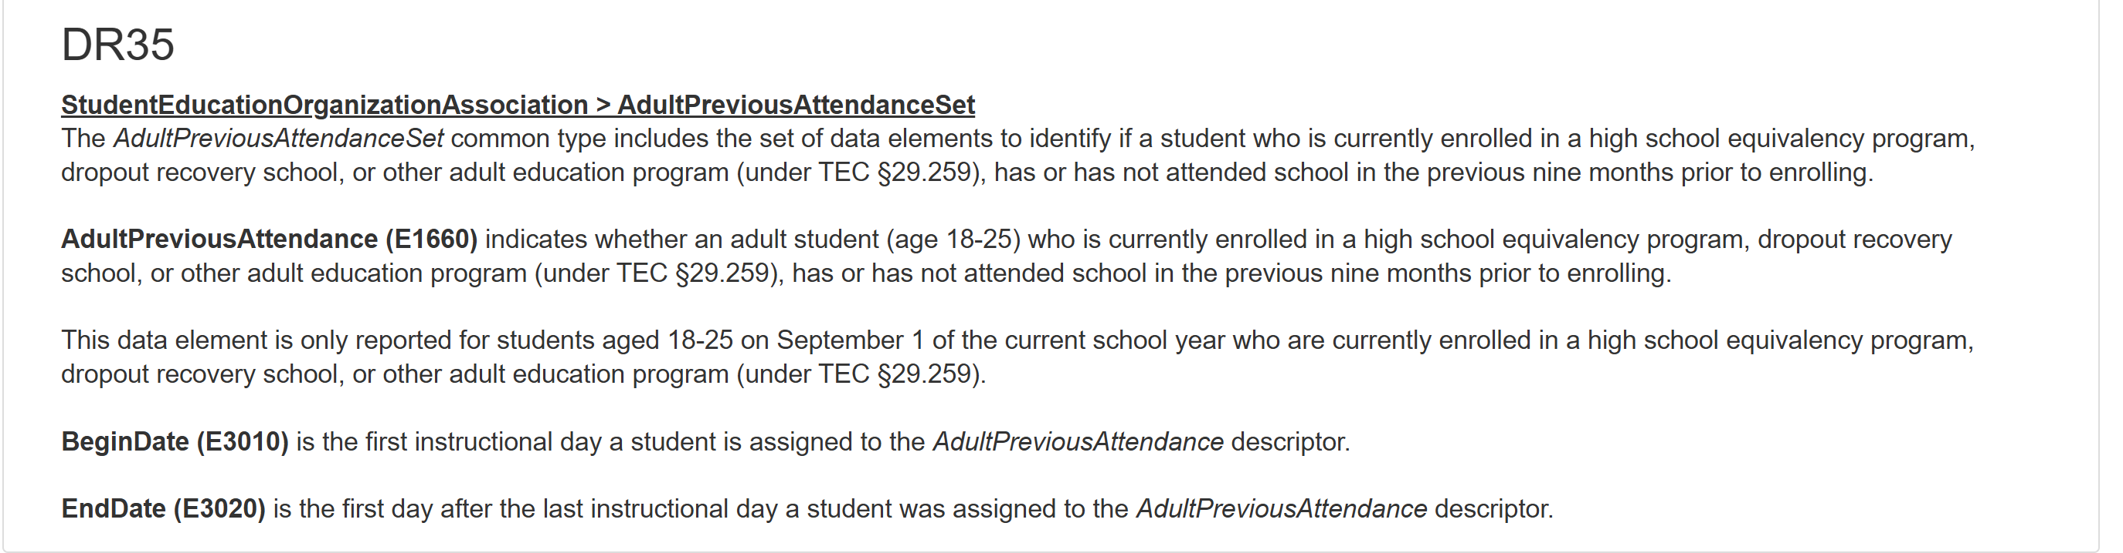
AdultPreviousAttendanceSet

Slide 59
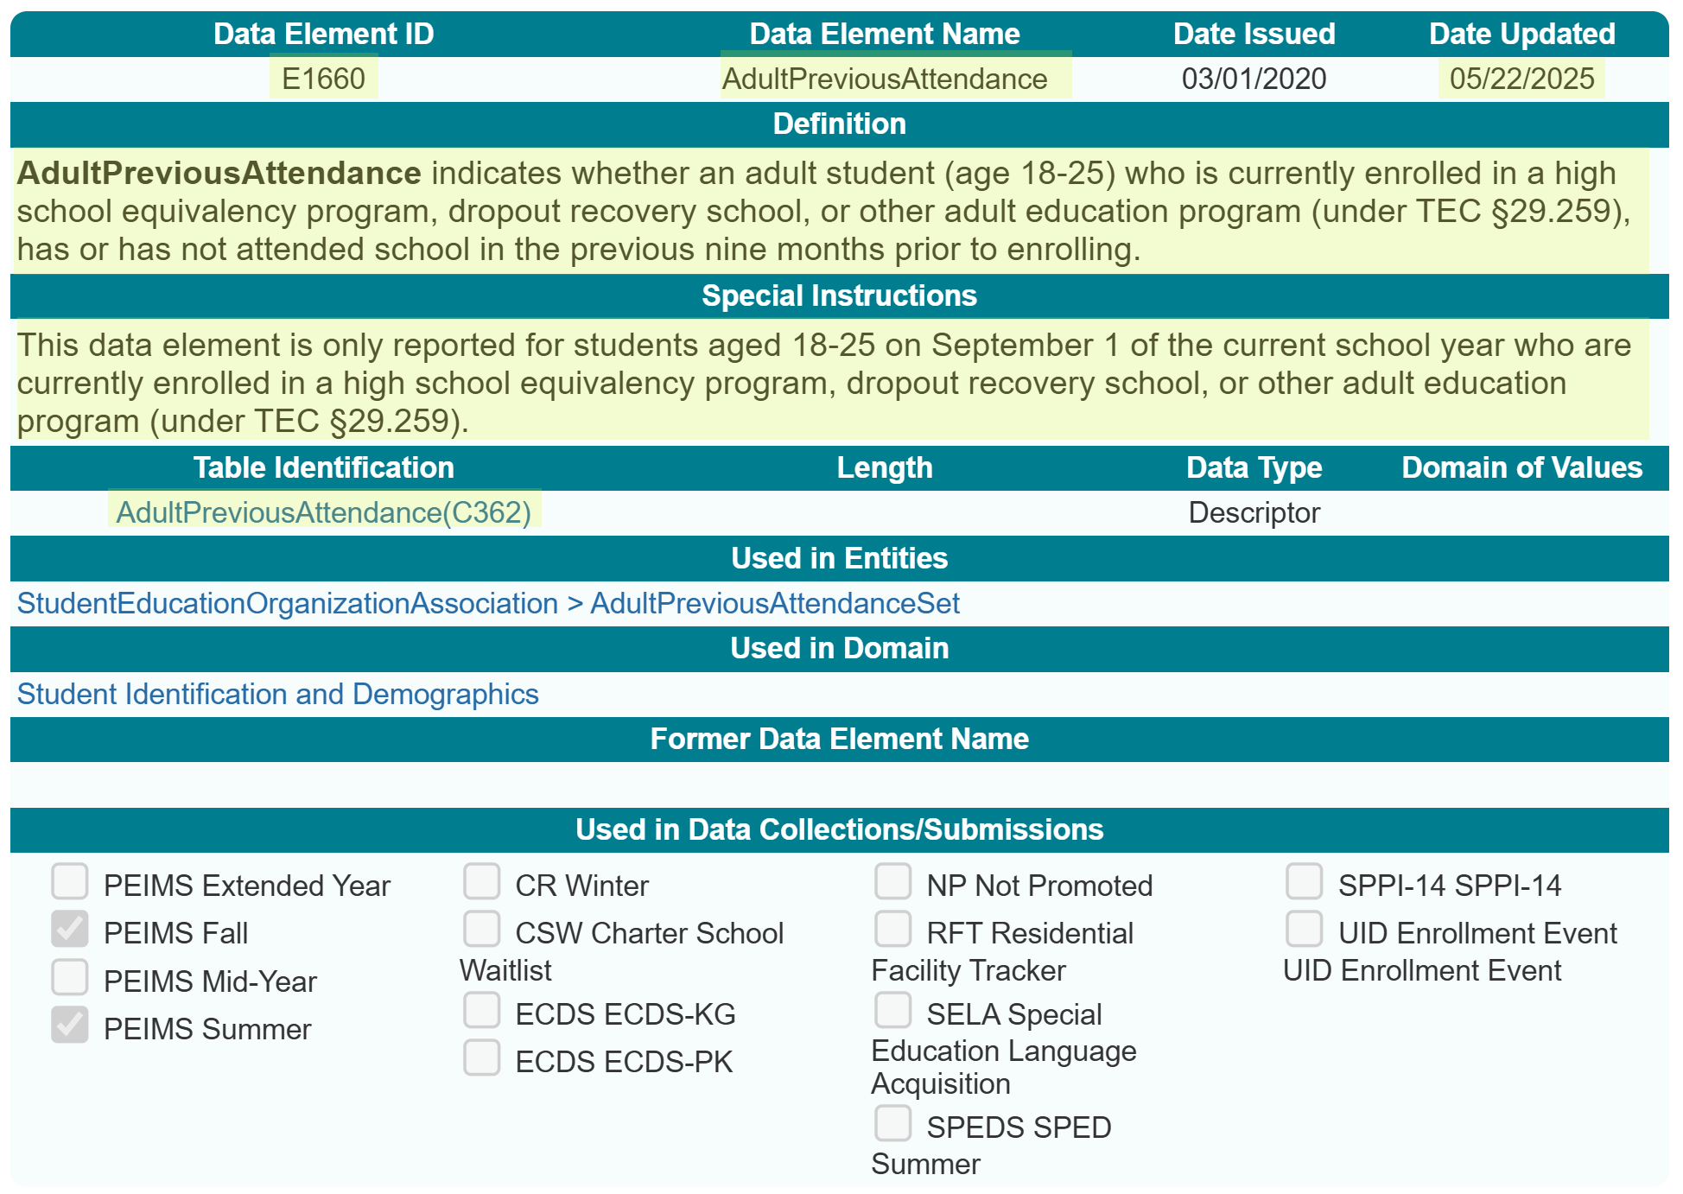
AdultPreviousAttendance (E1660)

Slide 60
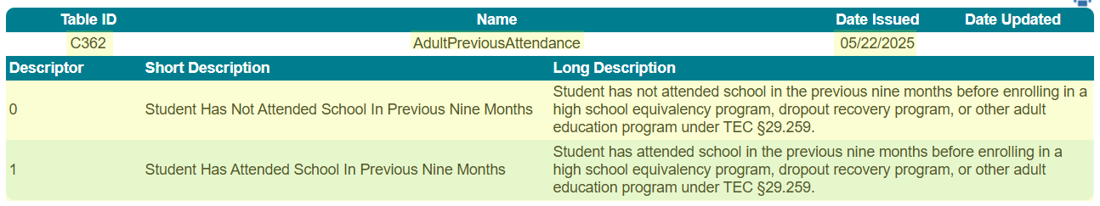
AdultPreviousAttendance (C362)

Slide 61
TITLE SLIDE: Middle School Advanced Mathematics
SSSP Team Review
NAME OF COMPONENT (ALL CAPS)
MARCH 19-21, 2024

Slide 62
SafeSupportiveSchoolProgramTeamReview (E1734)
In the 2023-2024 school year, the SAFE-SUPPORTIVE-SCHOOL-PROGRAM-TEAM-REVIEW (E1734) was reported in the StudentDisciplineIncidentAssociationExtension complex type.
In the 2024-2025 school year, the SafeSupportiveSchoolProgramTeamReview (E1734) was reported in the DisciplineIncident Entity. This meant that any student associated with a discipline incident would be reported as showing that the SSSP team reviewed the student incident.
It was determined that the data should be associated with the individual student and not the incident.

Slide 63
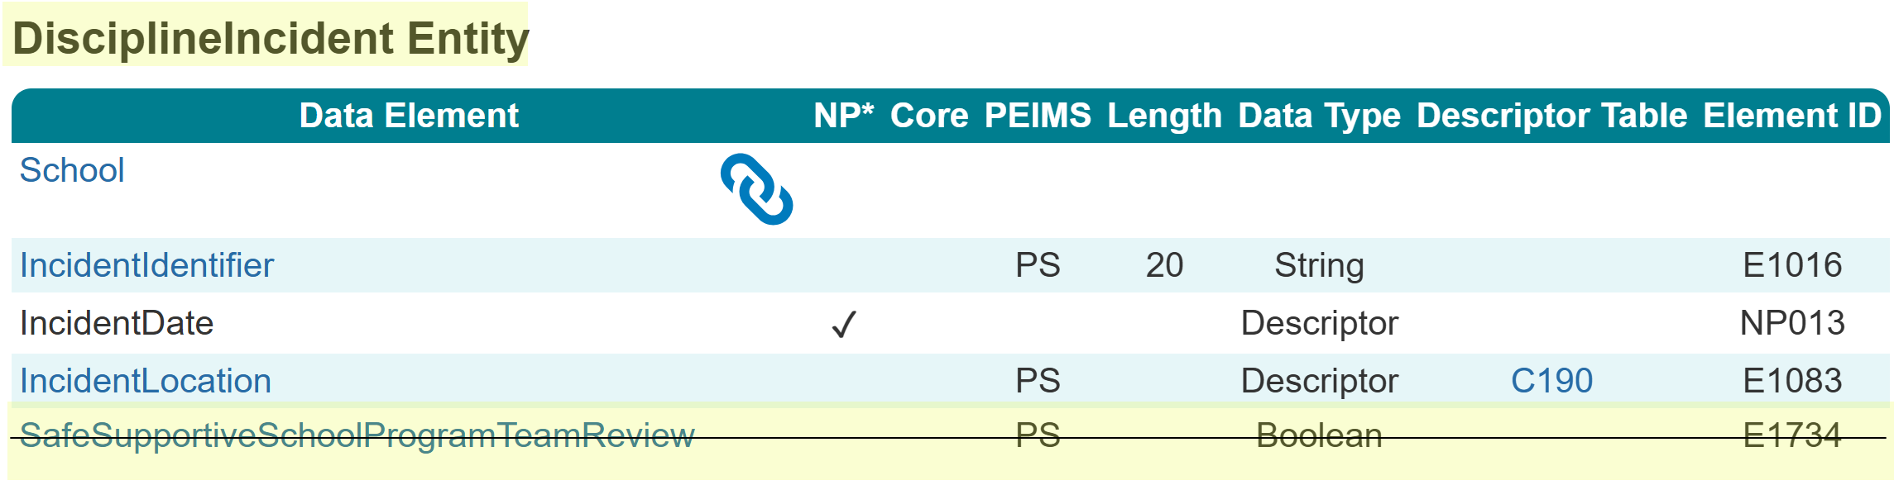
SafeSupportiveSchoolProgramTeamReview (E1734)
The SafeSupportiveSchoolProgramTeamReview (E1734) data element was removed from the DisciplineIncident Entity.
Resources

Slide 64
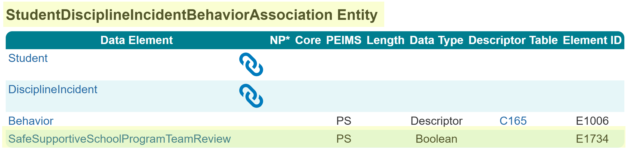
SafeSupportiveSchoolProgramTeamReview (E1734)
The SafeSupportiveSchoolProgramTeamReview (E1734) data element was added to the StudentDisciplineIncidentBehaviorAssociation Entity.
Resources

Slide 65
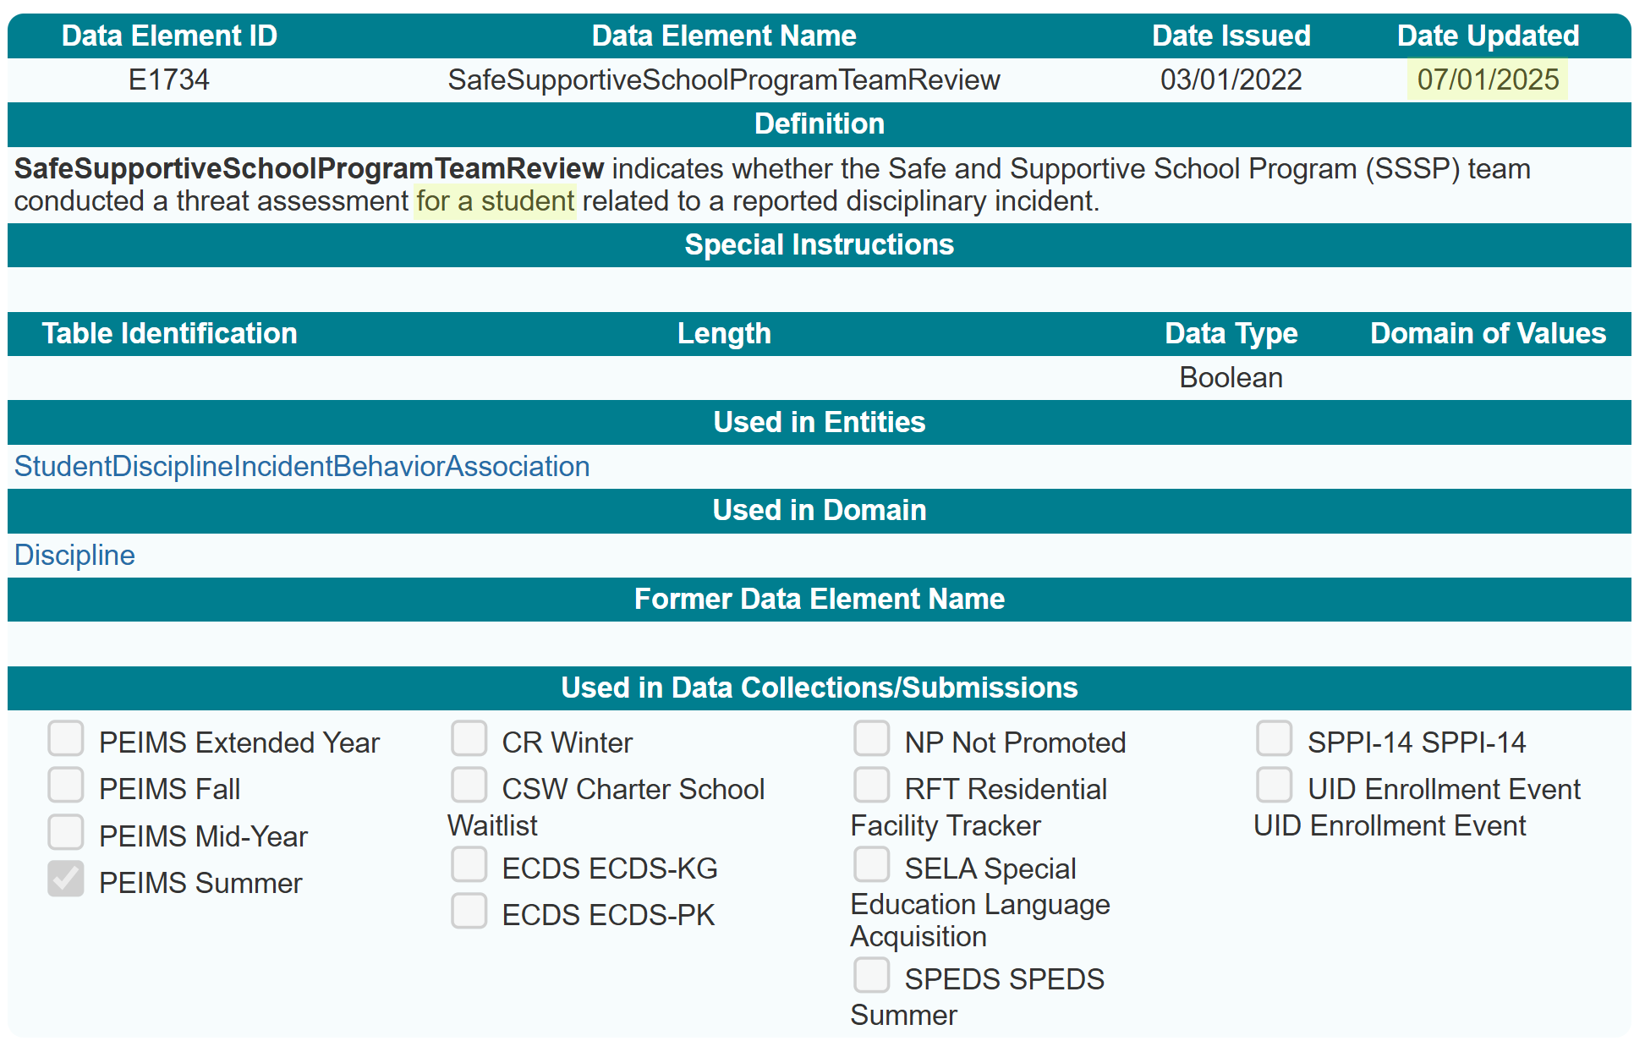
Data Element Definition Update

Slide 66
TITLE SLIDE: Middle School Advanced Mathematics
PriorYearLeaver Entity
NAME OF COMPONENT (ALL CAPS)
MARCH 19-21, 2024

Slide 67
PriorYearLeaver Entity Data Element Removed
During the 2024-2025 school year, TEA began using the PriorYearLeaver Entity to collect data on all students they served in grades 7-12 during the prior school year. The program information reported reflects the information for the student as of the last day of the prior school year or the last day of the student’s enrollment in that year. It was determined that TEA uses the data reported in the prior year’s PEIMS Fall and Summer Submission for the information reported in the TEA Completion, Graduation, and Dropout Reports.
https://tea.texas.gov/reports-and-data/school-performance/accountability-research/completion-graduation-and-dropout/completion-graduation-and-dropout-reports

Slide 68
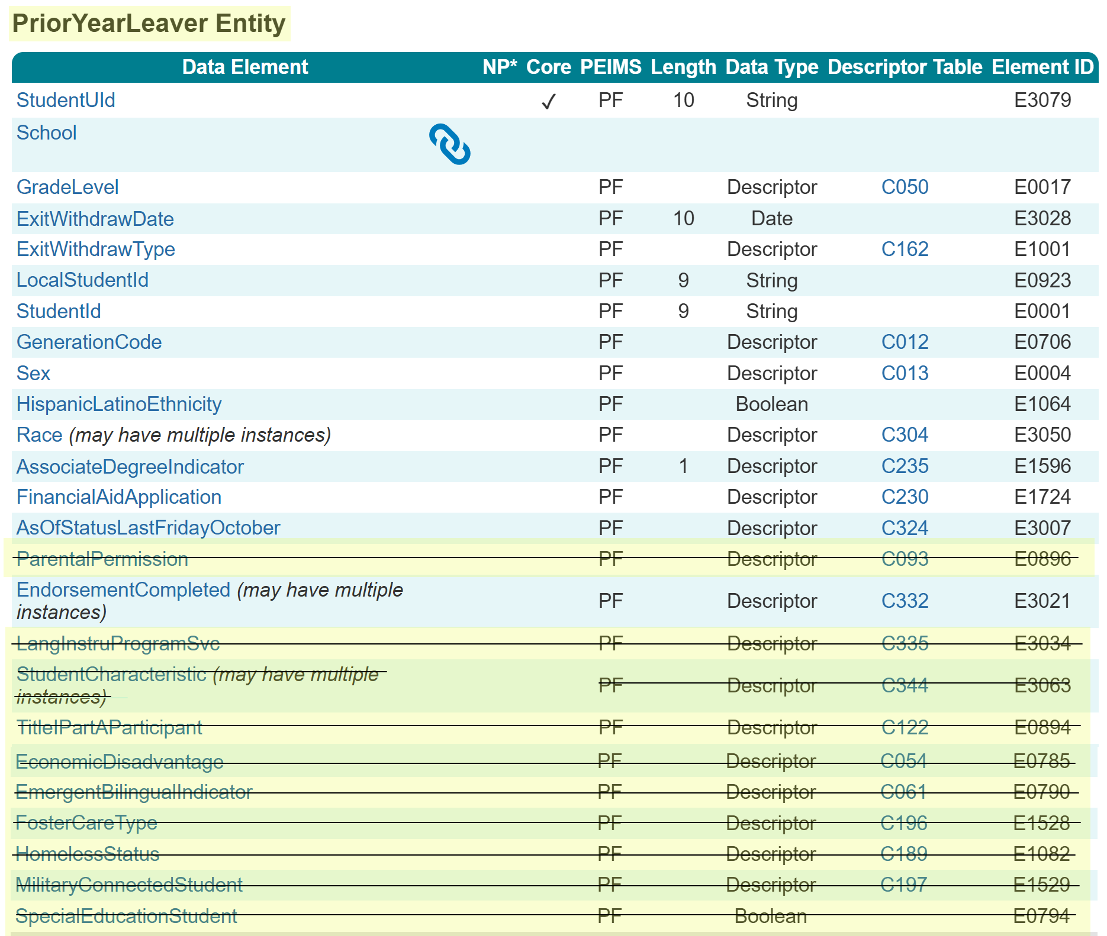
PriorYearLeaver Entity Data Element Removed
The following data elements were removed from the PriorYearLeaver Entity:
ParentalPermission (E0896)
LangInstruProgramSvc (E3034)
StudentCharacteristic (E3063)
TitleIPartAParticipant (E0894)
EconomicDisadvantage (E0785)
EmergentBilingualIndicator (E0790)
FosterCareType (E1528)
HomelessStatus (E1082)
MilitaryConnectedStudent (E1529)
SpecialEducationStudent (E0794)
In the 2025-2026 PEIMS Fall Submission, TEA will use the data reported in the 2024-2025 PEIMS Fall and Summer Submission for these data elements.

Slide 69
PriorYearLeaver Entity PEIMS Fall 2025-2026
Program Area uses data from…
ParentalPermission
Program Area uses data from…
EconomicDisadvantage
LangInstruProgSvc
StudentCharacteristics:
At Risk (01)
Immigrant (02)
EmergentBilingualIndicator
FosterCareType
HomelessStatus
MilitaryConnectedStudent
SpecialEducationStudent
TitleIPartAParticipant
StudentCharacteristics:
Migrant (03)
Section 504 (12)
Gifted & Talented (15)
Dyslexia (04)

Slide 70
TITLE SLIDE: Middle School Advanced Mathematics
EmploymentPeriod Guidance Update
NAME OF COMPONENT (ALL CAPS)
MARCH 19-21, 2024

Slide 71
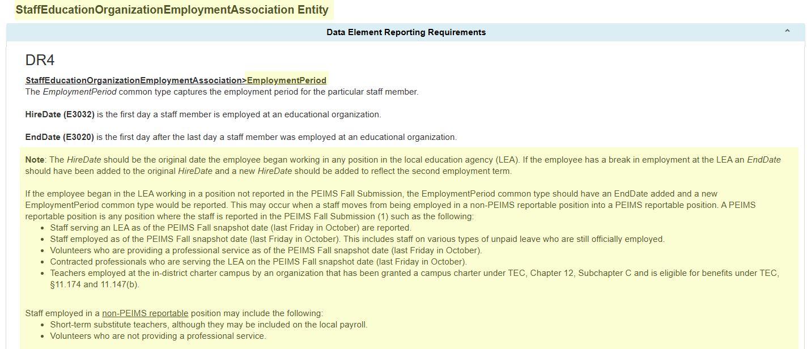
EmploymentPeriod Common Type Guidance
During the 2024-2025 school year, TEA received questions about reporting the HireDate.

Slide 72
TITLE SLIDE: Middle School Advanced Mathematics
PayrollExt Entity
NAME OF COMPONENT (ALL CAPS)
MARCH 19-21, 2024

Slide 73
PayrollExt Entity
During the 2024-2025 school year, TEA received questions about reporting payroll information for staff on paid and unpaid leave.
Additionally, questions were received about what the BeginDate in the PayrollExt Entity should be when a staff member is hired or changes positions close to the PEIMS Fall Snapshot date and has not yet received a payroll record reflecting the changes.

Slide 74
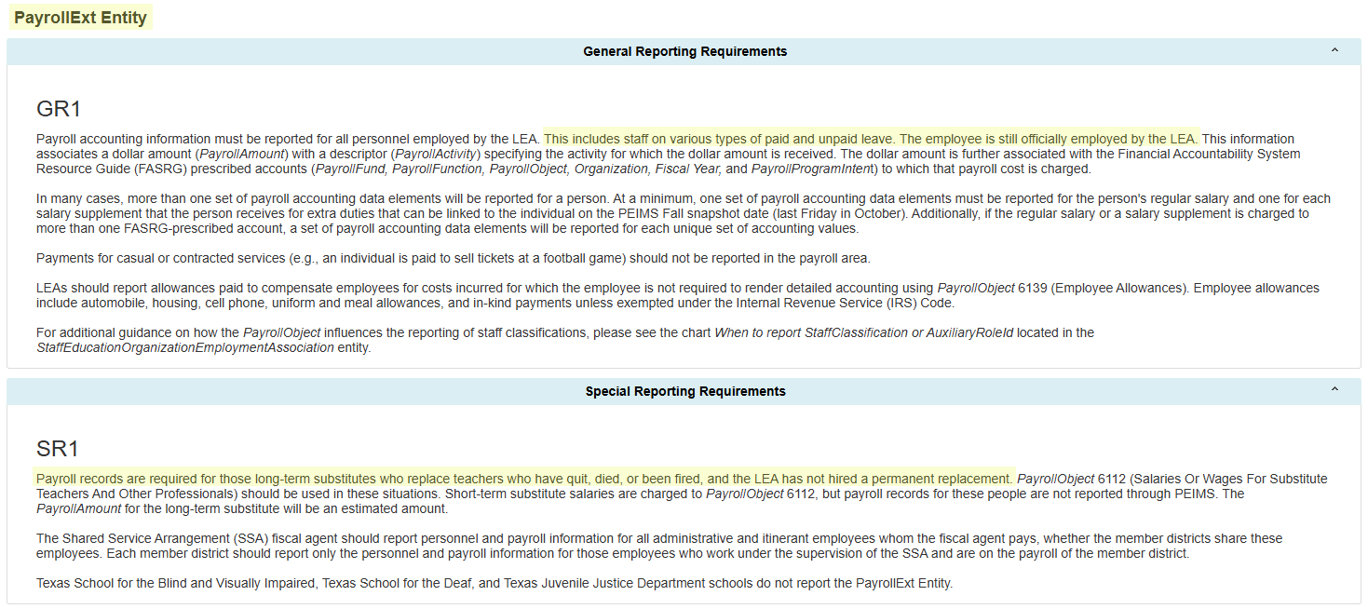
PayrollExt Entity Guidance
The General Reporting Requirements and the Special Reporting Requirements in the PayrollExt Entity have been updated to reflect that staff on paid or unpaid leave would still have the PayrollExt Entity reported. All staff still employed by the LEA should report a PayrollExt Entity.

Slide 75
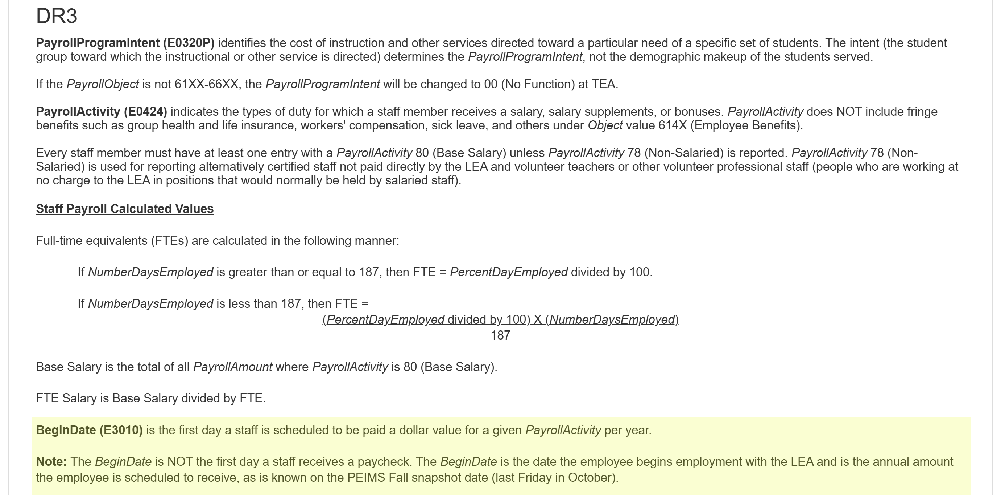
PayrollExt Entity BeginDate
The BeginDate (E3010) in the PayrollExt Entity has been updated and a note added to clarify the PayrollAmount reported.

Slide 76
TITLE SLIDE: Middle School Advanced Mathematics
Staff Entity
NAME OF COMPONENT (ALL CAPS)
MARCH 19-21, 2024

Slide 77
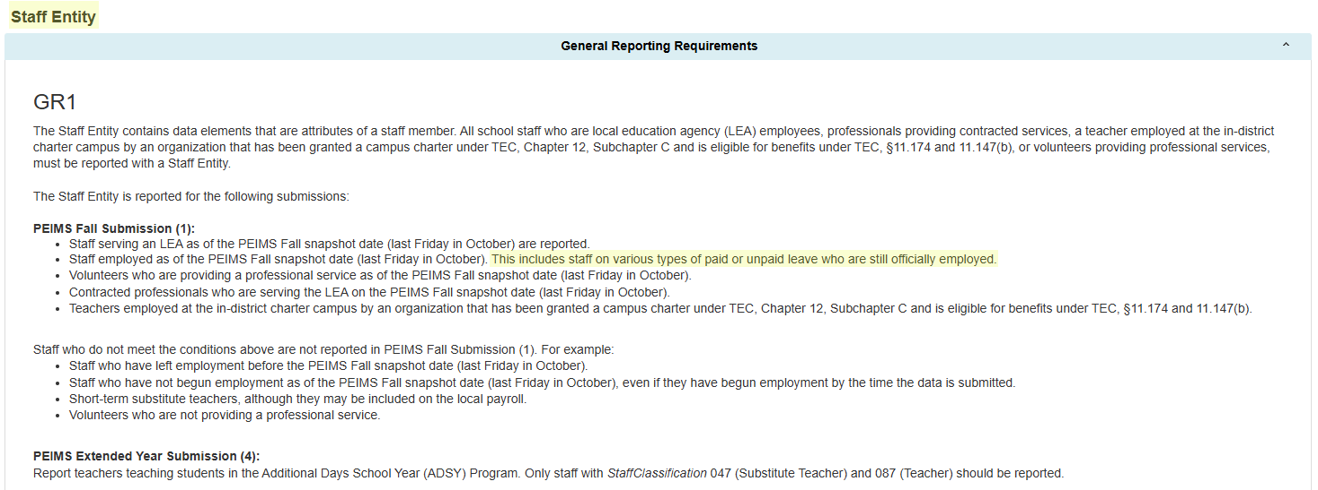
Staff Entity Changes
During the 2024-2025 school year, TEA received questions about reporting staff information for staff on paid and unpaid leave. General Reporting Requirements were updated to show that these staff are reported in the PEIMS Fall Submission.

Slide 78

TITLE SLIDE: Resources
QUESTIONS?
NAME OF COMPONENT (ALL CAPS)
MARCH 19-21, 2024

Slide 79
TITLE SLIDE: Resources
Resources
NAME OF COMPONENT (ALL CAPS)
MARCH 19-21, 2024

Slide 80

TITLE SLIDE: Middle School Advanced Mathematics Resources
The following slides were presented during the 2025 Spring TSDS ESC Coordinators Training for Middle School Advanced Mathematics:
NAME OF COMPONENT (ALL CAPS)
MARCH 19-21, 2024

Slide 81
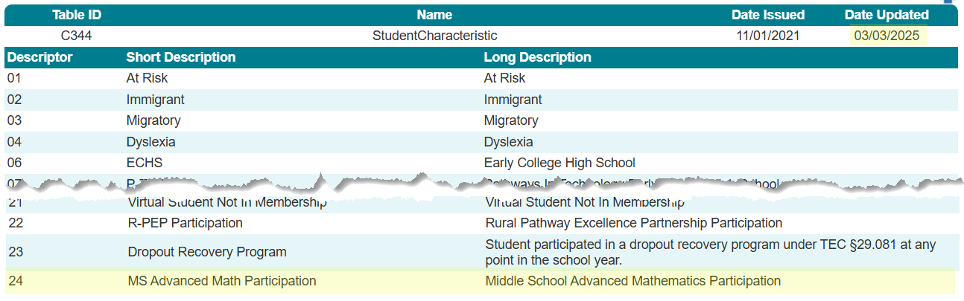
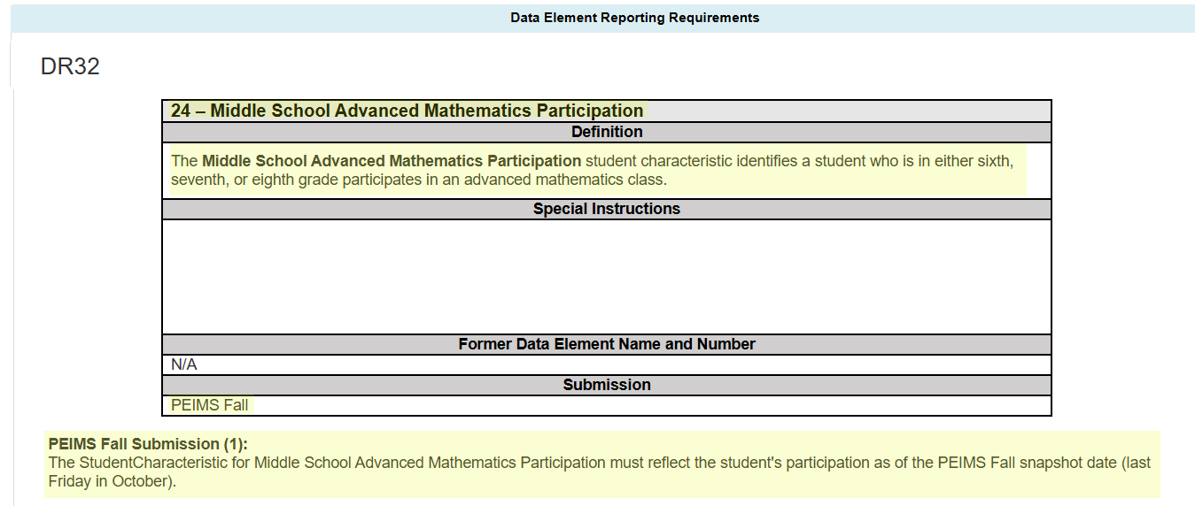
StudentCharacteristic (C344)

Slide 82
MS Advanced Math Data Validation
The following data validation will be added to the PEIMS Fall Submission to only allow the new StudentCharacteristic to be reported for a student in grades sixth, seventh, or eighth:

Slide 83
MS Advanced Math Reports
The following PEIMS Fall Submission reports will be updated to include the new StudentCharacteristic:
PDM1-120-003 – Student Program Roster
This report provides a listing of enrolled students, arranged alphabetically by last name, and indicates participation in special programs.
PDM1-120-005 – Student Data Review
This report summarizes student counts by grade, ethnicity, graduates, dropouts, economically disadvantaged, emergent bilingual (EB), and special programs.

Slide 84
MS Advanced Math Reports Cont.
PDM1-120-009 – Disaggregation of PEIMS Student Data
This report provides student enrollment counts and percentages from the Fall submission.
PDM1-120-003 – Student Indicator Report by Grade
This report lists students within various demographics and program enrollment information.
PDM1-230-001 –Data Element Summary Report
This report summarizes all data reported for TSDS PEIMS.

Slide 85
TITLE SLIDE: Advanced Technical Credit Resources
The following slides were presented during the 2025 Spring TSDS ESC Coordinators Training for Advanced Technical Credit:
NAME OF COMPONENT (ALL CAPS)
MARCH 19-21, 2024

Slide 86
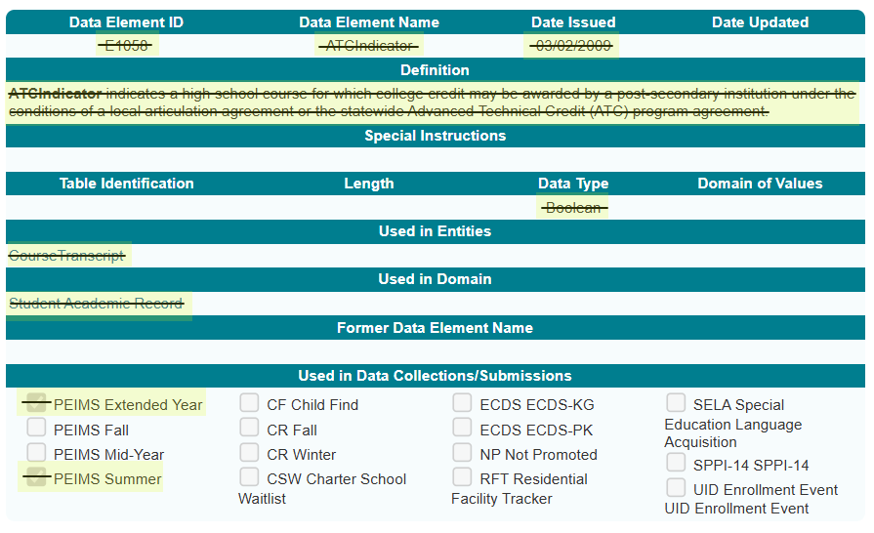
Sunset – Advanced Technical Credit

Slide 87
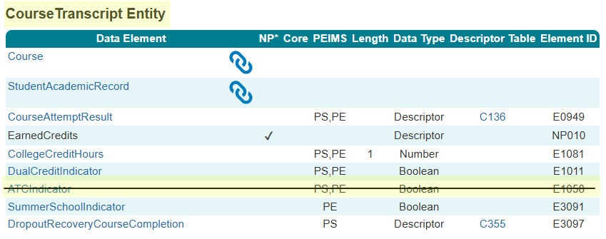
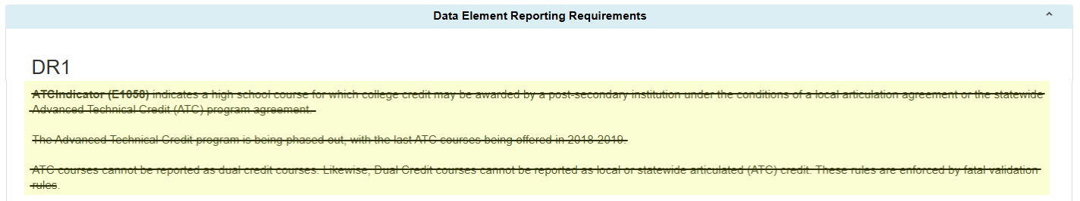
ATC Data Element

Slide 88
ATC Data Validations
The following data validations will be removed from the PEIMS Summer and Extended Year Submissions:

Slide 89
ATC Reports – Summer Submission
The ATCIndicator will be removed from the following PEIMS Summer Submission report:
PDM3-133-002 – Students Completing Courses with Advanced/Dual Credit/Enrollment
This report summarizes the count of students completing courses that were eligible for dual credit or advanced technical credit.
PDM3-230-001 – Data Element Summary Report
This report summarizes all data reported for TSDS PEIMS.

Slide 90
ATC Report – Extended Year Submission
The ATCIndicator will be removed from the following PEIMS Extended Year Submission report:
PDM4-230-001 – Data Element Summary Report
This report summarizes all data reported for TSDS PEIMS.

Slide 91
TITLE SLIDE: OnRamps Dual Enrollment Indicator Resources
The following slides were presented during the 2025 Spring TSDS ESC Coordinators Training for OnRamps Dual Enrollment Indicator:
NAME OF COMPONENT (ALL CAPS)
MARCH 19-21, 2024

Slide 92
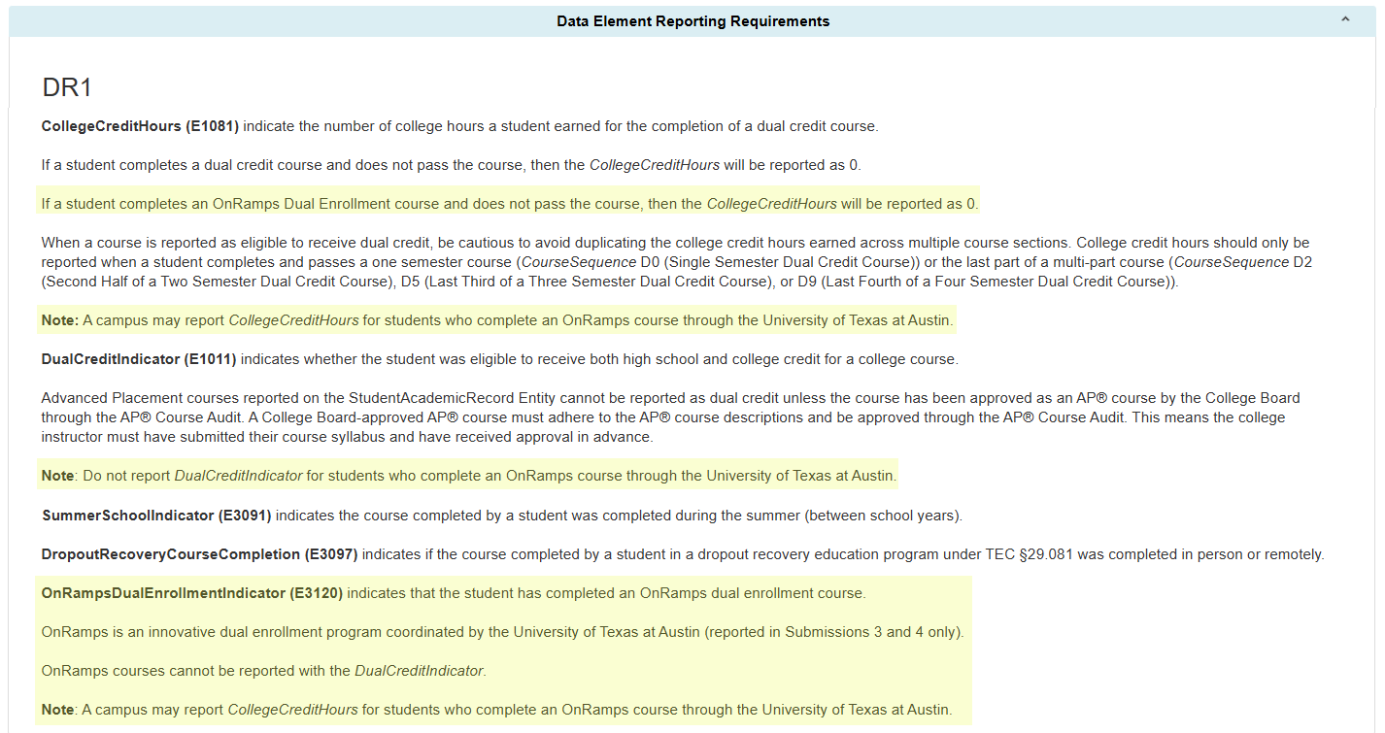
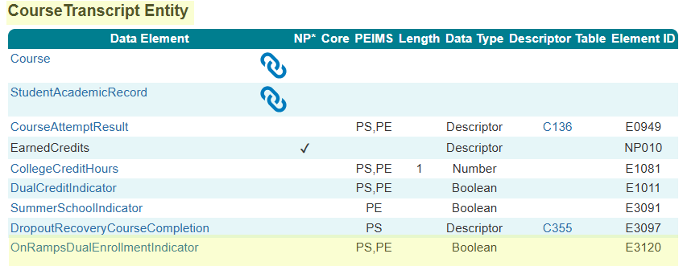
OnRampsDualEnrollmentIndicator

Slide 93
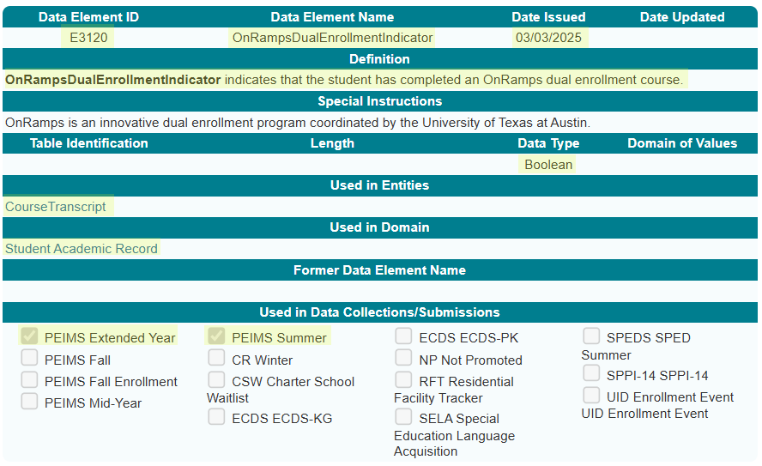
OnRampsDualEnrollmentIndicator Data Element

Slide 94
OnRamps Data Validation
The following data validations will be revised in the PEIMS Summer and Extended Year Submissions:
43415-0037
43415-0050
43415-0051
43415-0052
43415-0057

Slide 95
OnRamps Data Validation 1
The following data validations will be added to the PEIMS Summer and Extended Year Submissions:

Slide 96
OnRamps Reports – Summer Submission
The OnRampsDualEnrollmentIndicator will be added to the following PEIMS Summer Submission report:
PDM3-133-002 – Students Completing Courses with Advanced/Dual Credit/Enrollment
This report summarizes the count of students completing courses that were eligible for dual credit or advanced technical credit.
PDM3-230-001 – Data Element Summary Report
This report summarizes all data reported for TSDS PEIMS.

Slide 97
OnRamps Reports – Extended Year Submission
The OnRampsDualEnrollmentIndicator will be added to the following PEIMS Extended Year Submission reports:
PDM4-133-002 – Students Completing Courses with Dual Credit
This report summarizes the count of students completing courses that were eligible for dual credit.
PDM4-230-001 – Data Element Summary Report
This report summarizes all data reported for TSDS PEIMS.

Slide 98
TITLE SLIDE: Accelerated Instruction Changes Resources
The following slides were presented during the 2025 Spring TSDS ESC Coordinators Training for Accelerated Instruction Changes:
NAME OF COMPONENT (ALL CAPS)
MARCH 19-21, 2024

Slide 99
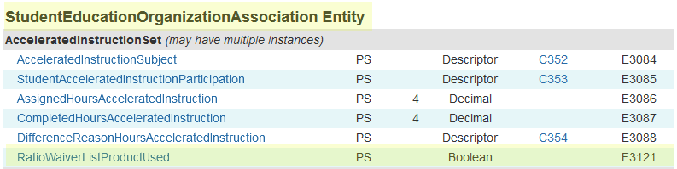
AcceleratedInstructionSet Common Type
One new data element, RatioWaiverListProductUsed (E3121), will be added to the AcceleratedInstructionSet common type in the StudentEducationOrganizationAssociation Entity and collected beginning in the 2025-2026 PEIMS Summer Submission.

Slide 100
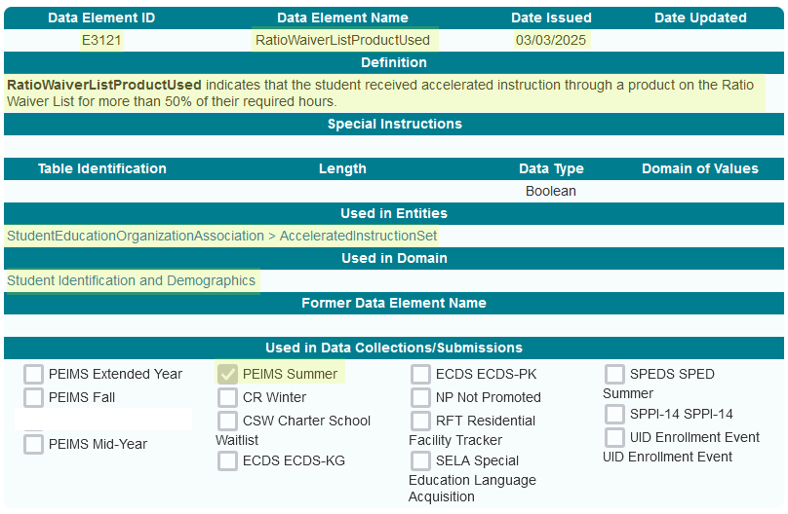
RatioWaiverListProductUsed Data Element

Slide 101
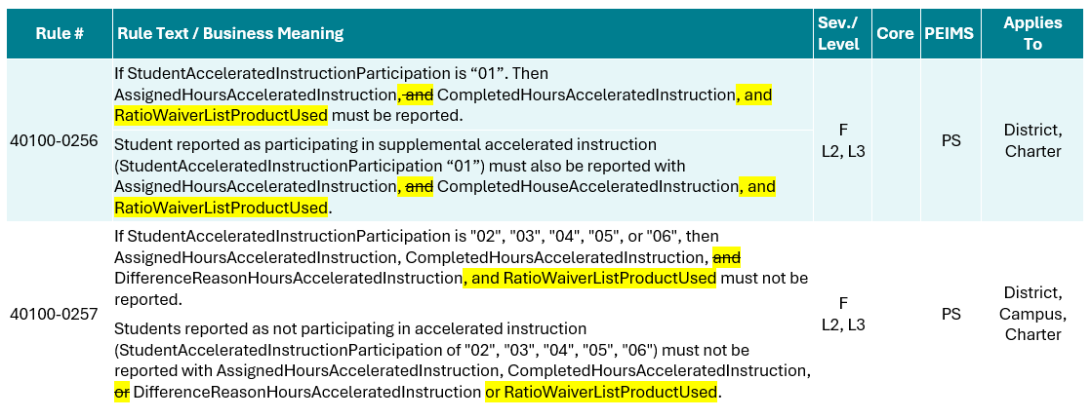
RatioWaiverListProductUsed Data Validation
The following PEIMS Summer Submission data validations will be revised:

Slide 102
Accelerated Instruction Report
The RatioWaiverListProductUsed data element will be added to the following PEIMS Summer Submission reports:
PDM3-120-025 – Accelerated Instruction Student Roster
This report will include students who have a student accelerated education plan and shall display the accelerated instruction subject, accelerated participation, assigned hours, completed hours, and difference reason hours for each subject submitted.
PDM3-120-026 – Accelerated Instruction Summary Report
This report summarizes the accelerated instruction totals by subject, participation, difference hours reason and grade.
PDM3-230-001 – Data Element Summary Report
This report summarizes all data reported for TSDS PEIMS.

Slide 103
TITLE SLIDE: Discipline Changes Resources
The following slides were presented during the 2025 Spring TSDS ESC Coordinators Training for Discipline Changes:
NAME OF COMPONENT (ALL CAPS)
MARCH 19-21, 2024

Slide 104
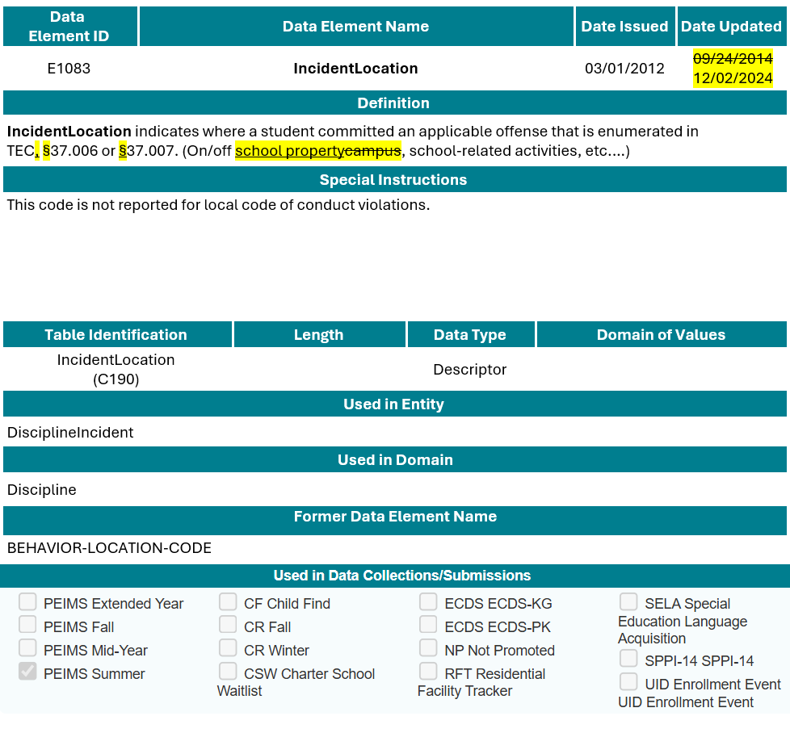
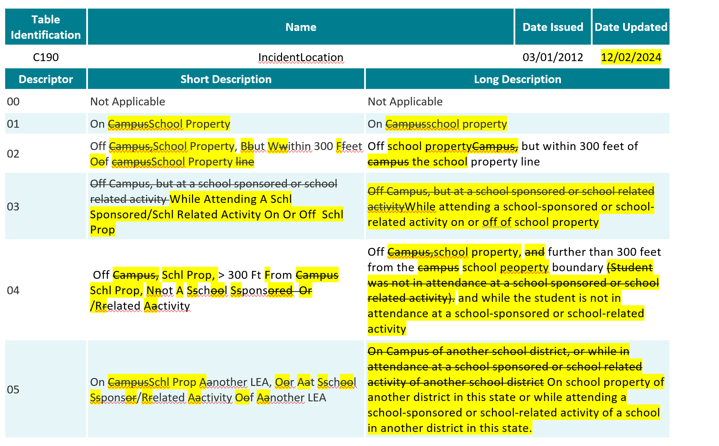
IncidentLocation (E1083)

Slide 105
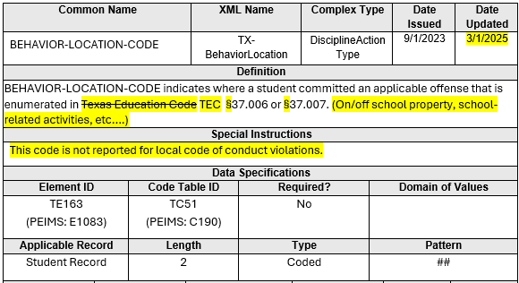
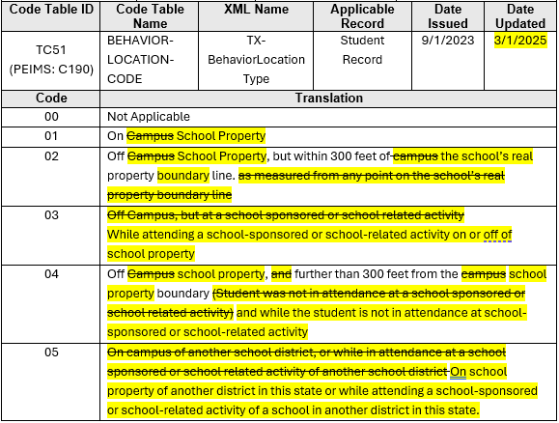
BEHAVIOR-LOCATION-CODE (TE163)

Slide 106
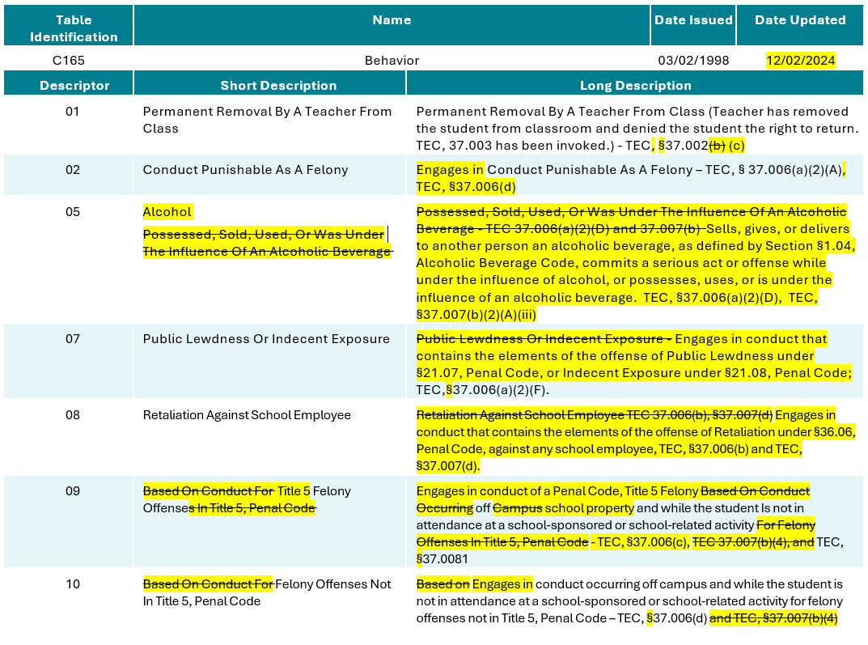
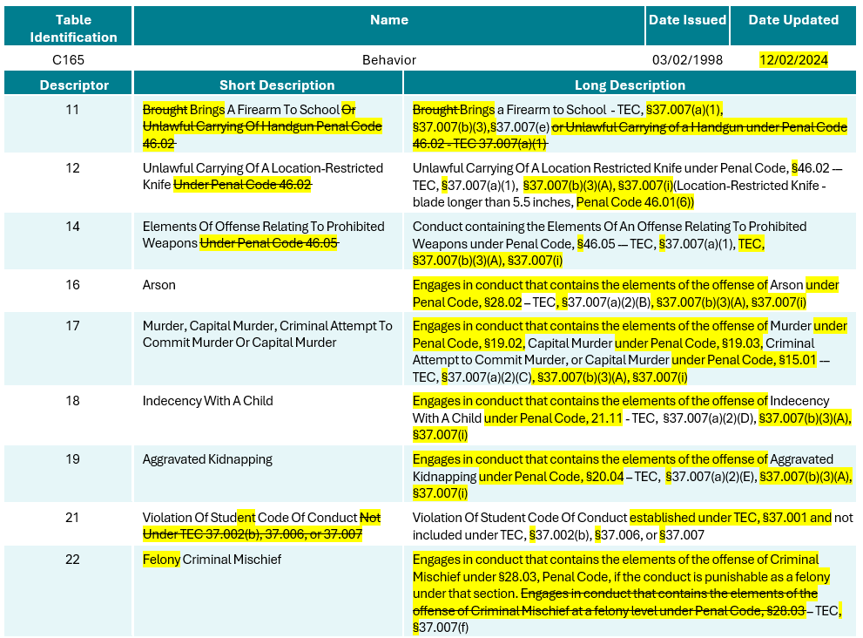
Behavior (C165)

Slide 107
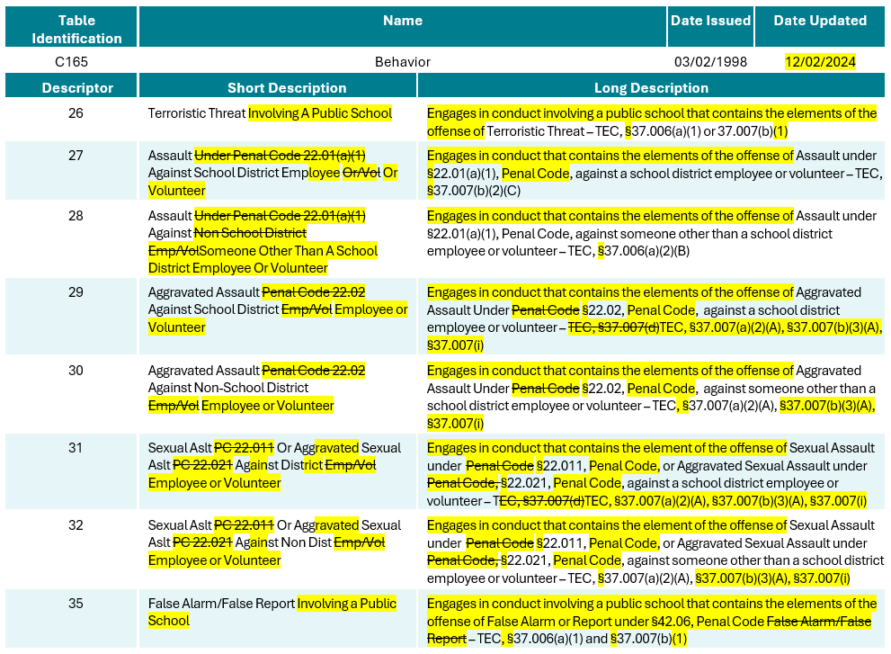
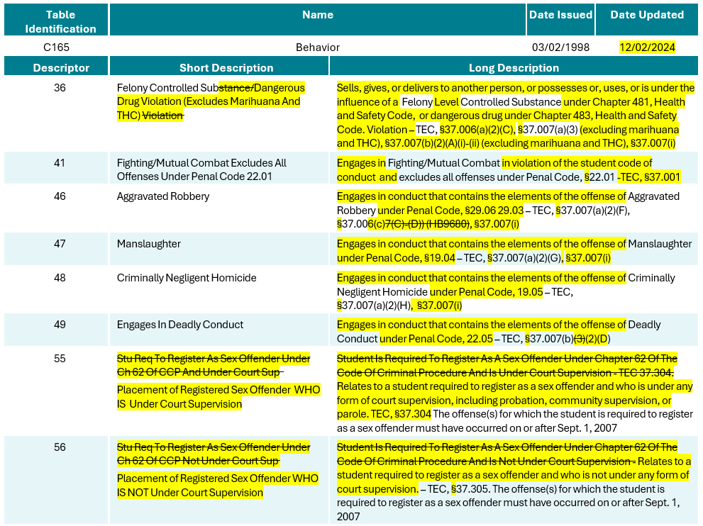
Behavior (C165) 1

Slide 108
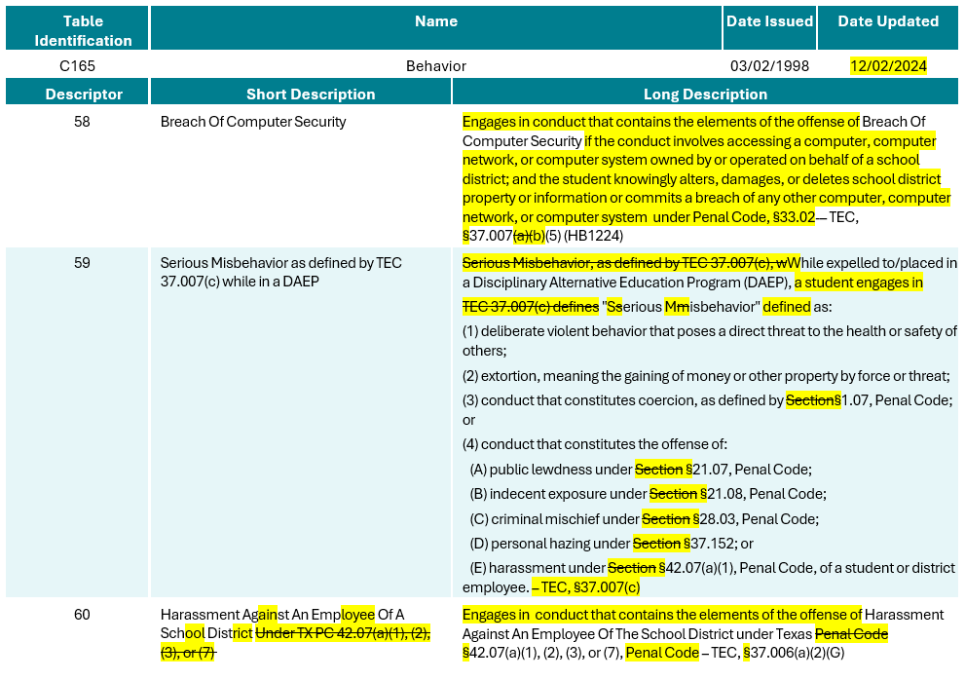
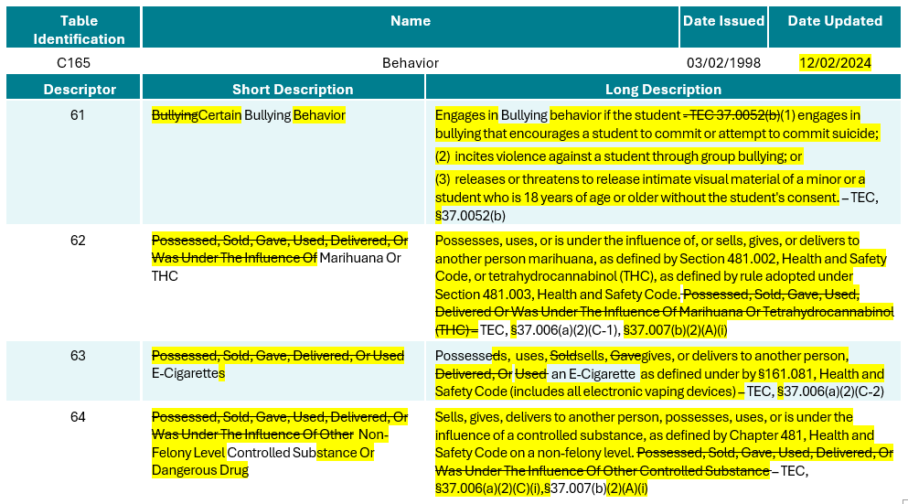
Behavior (C165) 2

Slide 109


DISCIPLINARY-ACTION-REASON (TC07)

Slide 110


DISCIPLINARY-ACTION-REASON (TC07) 1

Slide 111

DISCIPLINARY-ACTION-REASON (TC07) 2

Slide 112

StudentDisciplineIncidentBehaviorAssociation Entity

Slide 113
Discipline Data Validation Changes
The business meanings in the following data validations will be revised in the PEIMS Summer Submission:
44425-0030
44425-0051
44425-0056
44425-0057
44425-0058
44425-0059
44425-0060
44425-0079

Slide 114
Discipline Report Changes
The following PEIMS Summer Submission reports will be revised to reflect the discipline changes made:
PDM3-132-003 – Student Disciplinary Action Summary
PDM3-132-006 – Student Disciplinary Action Incident Counts by Reason Code

Slide 115
TITLE SLIDE: Classroom Position Resources
The following slides were presented during the 2025 Spring TSDS ESC Coordinators Training for New ClassroomPosition:
NAME OF COMPONENT (ALL CAPS)
MARCH 19-21, 2024

Slide 116

ClassroomPosition Data Element

Slide 117

ClassroomPosition Descriptor Table

Slide 118

StaffSectionAssociation PEIMS Fall Reporting

Slide 119

ClassroomPosition vs. Course Matrix

Slide 120
ClassroomPosition Data Validations
The following data validations will be revised in the PEIMS Fall and Class Roster Winter Submissions:
30090-0007
30090-0052
30090-0086
30090-0122
40110-0052
40110-0067
TEA may need to add additional rules to the Early Childhood Data System for the new ClassroomPosition.

Slide 121
ClassroomPosition Reports
The following Class Roster Winter Submission reports will be updated to include the new ClassroomPosition 06 (Teacher Resident):
CLS2-100-001 – Student Class Roster – Winter Submission
This report provides a Class Roster Winter Submission listing of each course, including basic information about each class and a roster of the students in that class.
CLS2-100-003 – Staff Class Assignment Report – Winter Submission
This report provides a Class Roster Winter Submission listing of staff, arranged alphabetically by staff name then class course code, along with classroom attributes.
CLS2-100-004 – Student Class Roster – Winter Submission
This report provides a Class Roster Winter Submission listing and summarizes teacher and class information, including student counts for grades 1-12.
CLS2-100-006 – Submission Summary Report – Winter Submission
This report displays the row count for the Class Roster Winter Submission by category and subcategory.

Slide 122
ClassroomPosition Reports Cont.
The following Early Childhood Data System Prekindergarten and Kindergarten Submissions reports will be updated to include the new ClassroomPosition 06 (Teacher Resident):
ECD0-000-003 – Early Childhood Assessment PK Sources
This statewide report identifies the prekindergarten (PK) programs associated with kindergarten students and their kindergarten ready or not kindergarten ready status.
ECD0-000-001 – TSDS Early Childhood Assessment Completion
This report provides the overall status of the current ECDS collection for all kindergarten programs.
ECD0-000-002 – TSDS Early Childhood KG Assessment Summary
This report summarizes the results of kindergarten assessment, showing the number and percentage of students who are kindergarten ready or who are not kindergarten ready.
ECD0-000-004 – TSDS Early Childhood KG Data Submission
This report provides a detailed breakdown of data submissions for the kindergarten data collection.

Slide 123
TITLE SLIDE: Special Education Changes Resources
The following slides were presented during the 2025 Spring TSDS ESC Coordinators Training for Special Education Changes:
NAME OF COMPONENT (ALL CAPS)
MARCH 19-21, 2024

Slide 124
SPED Data Element Changes
PPCDServiceLocation (E1077)
  Data Element Name (ECSEServiceLocation)
  Definition
SPEDStudentAgeRange (E3059)
  Definition
EligibilityDeterminationDate (E1716)
  Definition
ResidentialFacilityStudentSchoolDayLength (E1637)
  Definition

Slide 125
SPED Descriptor Table Changes
SPEDProgramSvc (C341)
  Short and Long Description – 23-25
PPCDServiceLocation (C184)
  Descriptor Table Name (ECSEServiceLocation)
  Short and Long Description – 1, 3-8
DiplomaType (C062)
  Short and Long Description – 35
PopulationServed (C030)
  Short and Long Description – 06
SPEDStudentAgeRange (C342)
  Short and Long Description – 00, 01, 02

Slide 126
SPED Reporting Requirement Changes
In addition to the specific changes made to the data elements and descriptors, changes were made to the TEDS General Reporting Requirements (GR) and Data Element Reporting Requirements (DR).
StudentSpecialEducationProgramAssociation Entity
  GR1, DR2, DR4, DR7, DR12
StudentSpecialEducationProgramEligibilityAssociation Entity
  DR3
Section Entity
  DR3

Slide 127
SPED Reporting Requirement Changes, Cont.
StudentAcademicRecord
  DR7, DR8, DR9
StaffEducationOrganizationAssignmentAssociation Entity
  DR2
StudentEducationOrganizationAssociation Entity
  DR28

Slide 128
SPED Data Validation Changes
The following data validations will be revised:
30090-0022
30090-0047
30090-0052
30090-0060
30090-0083
30090-0120
30090-0121
40100-0151
40110-0006
40110-0176
41163-0029
41163-0036
42401-0010
42400-0021
45435-0003
45435-0005
50300-0012

Slide 129
SPED Report Changes
The following PEIMS Fall Submission reports will be updated to include the special education changes:
PDM1-121-006 – Special Education Roster by Grade
This report lists special education students, their disabilities, and their services by last name and grade.
PDM1-121-008 – Preschool Program for Children w/ Disabilities by Grade and Service Location*
This report summarizes special education students participating in the Preschool Program for Children with Disabilities (PPCD), grouped by campus with counts by grade and PPCD service location.
PDM1-121-009 – Special Education Student Data
This report contains data for Special Education students from the Fall Collection.
*Note: the report name and description of report will be changed to reflect the new terminology Early Childhood Special Education.

Slide 130
SPED Report Changes Cont.
The following Residential Facility Tracker report will be updated to include the special education changes:
RFT0-100-004 – Individual Student Detail Summary
This report provides a list of all students in residential facilities for a selected LEA.

