Slide 1
Leaver Reconciliation
Division of Research and Analysis
April 3, 2025

Slide 2
Leaver Reconciliation Definition and Purpose
What is leaver reconciliation?
Leaver reconciliation is the process by which student leavers are identified and determined to have one of the following statuses: graduate, other exit leaver, high school equivalency certificate recipient, dropout, or an underreported student.
Why does leaver reconciliation matter?
The statuses determined through leaver reconciliation are used to calculate a variety of indicators including longitudinal graduation rates, annual dropout rates, and indicators using annual graduates such as CCMR.

Slide 3
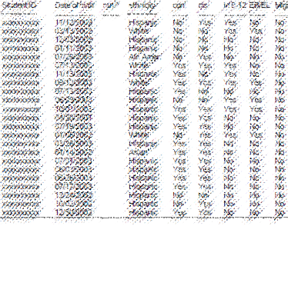
Leaver Reconciliation Process Overview
1
Create
roster
Create cumulative list of students served
in a school year
5
Finalized statuses are available
Final student statuses are used for indicators and reporting
2
TEA accounts for leavers
TEA identifies students who graduated previously, TxCHSE recipients, and movers
Student Roster
TEA adds mover, TxCHSE, previous graduate status
3
School systems account for leavers
School systems submit enrollment and leaver records
Schools submit enrollment and leaver information
4
TEA runs leaver reconciliation
All information for
a student is reconciled
TEA derives a final status for each student

Slide 4
Accounting for Students
1
Create
roster
Create cumulative list of students served
in a school year
Each student served in the district in one school year must be accounted for the next fall either through TEA or district records.
TSDS reports available in the fall provide the full roster of students expected to be accounted for by TEA or the district.
Sample Reports:
PDM1-320-001 | Interim List to Assist LEAs in Leaver Record Submission
PDM1-320-002 | Preliminary Presumed Underreported Students List
PDM1-321-001 | Presumed Underreported Students List

Slide 5
Accounting for Students by TEA
2
TEA accounts for leavers
TEA identifies students who graduated previously, TxCHSE recipients, and movers
Students accounted forª: | Source:
Texas Certificate of High School Equivalency (TxCHSE) recipients | TEA’s TxCHSE database August 31st summer after expected graduation
Previous TX public school graduates | TEA’s graduate database
Movers (or students who move from one TX public school district and enroll in another) | TSDS PEIMS submission 3 records submitted by districts in mid June (school-year movers), and TSDS PEIMS submission 1 (early December) records submitted by districts the next fall (summertime movers)
ªDistricts can use TSDS reports on TxCHSE recipients, previous graduates, and school-year movers (PDM1-320-001) in October and on presumed summertime movers (PDM1-321-001) in December.

Slide 6
Accounting for Students by School Systems
3
School systems account for leavers
School systems submit enrollment and leaver records
Students accounted for: | Source:
Returned students | Enrollment records (i.e., TSDS PEIMS submission 1 records submitted by districts the next fall)
Leavers (graduates, dropouts, and students who leave for non-dropout reasons) | Leaver records (i.e., TSDS PEIMS submission 1 records submitted by districts the next fall)

Slide 7
School Start Window
3
School systems account for leavers
School systems submit enrollment and leaver records
Students served in the prior year must return to school by the end of the school-start window to not be considered leavers.
First day of school through the last Friday in September.
For students who fail to return the following fall, leaver reasons apply on the first day of school or its approximation, the school-start window.
The district may obtain the documentation to support the leaver codeª at any time up until the PEIMS Submission 1 resubmission date.
ªDocumentation of student status through end of SSW only.

Slide 8
Determining Student Statuses
4
TEA runs leaver reconciliation
All information for a student is reconciled
TEA determines each student’s status for each school system attended.ª
For those who did not return to a school system, TEA determines whether the student is a graduate, other leaver, TxCHSE recipient, or dropout.
A dropout is a student who attends Grade 7-12 in a public school in a particular school year, does not return the following fall, is not expelled, and does not:
graduate,
receive a Texas Certificate of High School Equivalency (TxCHSE),
continue school outside the public school system,
begin college, or
die.
ªStudent can have only one status at each school system. Statuses are not always mutually exclusive, so a hierarchy exists to determine the status. Statuses may vary from school system to school system. A school system is held accountable for student’s leaver status in that school system.

Slide 9
Leaver Status Hierarchy
4
TEA runs leaver reconciliation
All information for a student is reconciled
Status: | Determined by:
Graduate | Leaver records (reason code = 01)
Previous graduate | TSDS PEIMS graduate database
Not a leaver | Enrollment records (enrolled in school-start window in fall)
Mover | Attendance and enrollment records
Other leaver | Leaver records (reason code = 03, 16, 24 through 87, 90)
TxCHSE recipient | TxCHSE database
Dropout^{b} | Leaver records (reason code = 08, 20, 88, 89, 98)
Underreported^{c} | Record required but not submitted
^{b}Student becomes a dropout in annual dropout rate and possibly in longitudinal rate. ^{c}Student becomes underreported in annual rate and possibly in longitudinal rate.

Slide 10
Underreported Students
5
Finalized statuses are available
Final student statuses are used for indicators and reporting
Underreported students are students reported in enrollment or attendance in one school year who are not accounted for through district records or TEA processing the next year.
In other words, a student will appear on a district’s Underreported Student listing if a leaver record was not submitted for a student served by the district the prior school year who did not return by the end of the school start window the following year and did not:
enroll in another Texas public school district,
previously graduate from a Texas public school, or
receive a Texas Certificate of High School Equivalency (TxCHSE) by August 31.
(cont.)

Slide 11
Underreported Students
5
Finalized statuses are available
Final student statuses are used for indicators and reporting
As a reminder, district personnel with access to the accountability application in TEAL can view the preliminary cohorts to be used for graduation rate calculations, as well as their underreported student listings, under the Research and Analysis tab.
LEAs should review the reports listed on Slide #4 during fall PEIMS submission to ensure all leavers have been reported with a leaver reason code or have been accounted for by agency processing.
Important to note that there are systems in place to ensure data integrity. The leaver data validation system includes annual data validation analyses that examine LEAs’ leaver and dropout data. Additional data analyses, including random audits, are conducted as necessary to ensure the data submitted to TEA are accurate and reliable.

Slide 12
Resources

Slide 13
Resources Supporting Leaver Reconciliation
TSDS reports available in the fall provide the full roster of students expected to be accounted for by TEA or the district.
Sample Reports:
PDM1-320-001 | Interim List to Assist LEAs in Leaver Record Submission
PDM1-320-002 | Preliminary Presumed Underreported Students List
PDM1-321-001 | Presumed Underreported Students List

Slide 14
TEAL Underreported Student Listings
The underreported student listing shows all underreported students in a district, as well as the district's number and rate of underreported students.
Underreported students are students reported in enrollment or attendance in one school year who are not accounted for through district records or Texas Education Agency processing the next year.
Underreported students from 2022-23 will be available in June 2024.ª
ªAccess to information on TEAL is temporary. Districts are encouraged to save the reports provided on TEAL to a local secured location. The reports will be replaced with more current information as it becomes available.

Slide 15
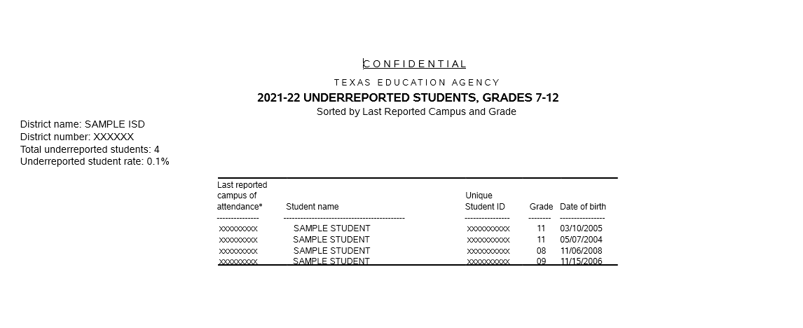
Underreported Students

Slide 16
Contacts
Division of Research and Analysis
(512) 475-3523
research@tea.texas.gov

Slide 17
Thank you!

Slide 18
Appendix

Slide 19
2023-24 TSDS PEIMS ExitWithdrawTypesª
01 – Graduated from a high school in this district.
03 – Died.
16 – Returned to home country or emigrated to another country.
24 – Entered college and is working towards a degree.
60 – Is home schooled. This code may be used only for a student whose parent/guardian confirms that the student is pursuing, under direct supervision of the parent/guardian, a curriculum designed to meet basic education goals.
(continues)
ªThe agency requires that districts have documentation to support the leaver reason code assigned to each leaver. See the TEDS (Texas Education Data Standards) for documentation requirements.

Slide 20
2023-24 TSDS PEIMS ExitWithdrawTypes
66 – Removed by Child Protective Services.
78 – Expelled for criminal behavior under the provisions of Texas Education Code (TEC) §37.007 and cannot return. This code should only be used for a student who met the following two conditions:
a) was expelled for an offense included in TEC §37.007, and
b) was expelled from a district located in a county that does not have a JJAEPª.
81 – Enrolled in a private school in TX.
(continues)
ªJuvenile Justice Alternative Education Program

Slide 21
2023-24 TSDS PEIMS ExitWithdrawTypes
82 – Enrolled in a public or private school outside of TX.
83 – Was attending and was withdrawn by the district when the district discovered the student was not entitled to enrollment in the district because the student:
a) was not a resident of the district;
b) was not entitled under other provisions of TEC §25.001 or as a transfer student; or
c) was not entitled to public school enrollment under TEC §38.001 or a corresponding rule of the TX Dept. of State Health Services because the student was not immunized.
This code is not for a student who stops attending because he/she has moved.
(continues)

Slide 22
2023-24 TSDS PEIMS ExitWithdrawTypes
85 – Graduated outside TX before entering a TX public school, entered a TX public school, and left again.
86 – Received high school equivalency certificate outside TX.
87ª – Enrolled in SBOEª-authorized Texas Tech Univ. High School Diploma program or UT-Austin High School Diploma program.
90 – Graduated from another state under provisions of the Interstate Compact on Educational Opportunity for Military Children.
(continues)
ªState Board of Education

Slide 23
2023-24 TSDS PEIMS ExitWithdrawTypes
08 – Student (female or male) withdrew from/left school because of pregnancy.
20 – Student has suffered a condition, injury, or illness that requires substantial medical care and leaves the student unable to attend school and assigned to a medical or residential treatment facility.
88 – Ordered by a court to attend a high school equivalency program and has not earned a TxCHSE.
89 – Incarcerated in a state jail or federal penitentiary as an adult or as a person certified to stand trial as an adult.
98 – Other.
Dropouts with a leaver reason code of 08 and 98 are included in rates calculated for state accountability purposes.
Dropouts with a leaver reason code of 08, 20, 88, 89, or 98 are included in rates calculated for federal accountability purposes.

